Slide 1




“If you LIKE this, you will LOVE that!”
2026

Slide 2
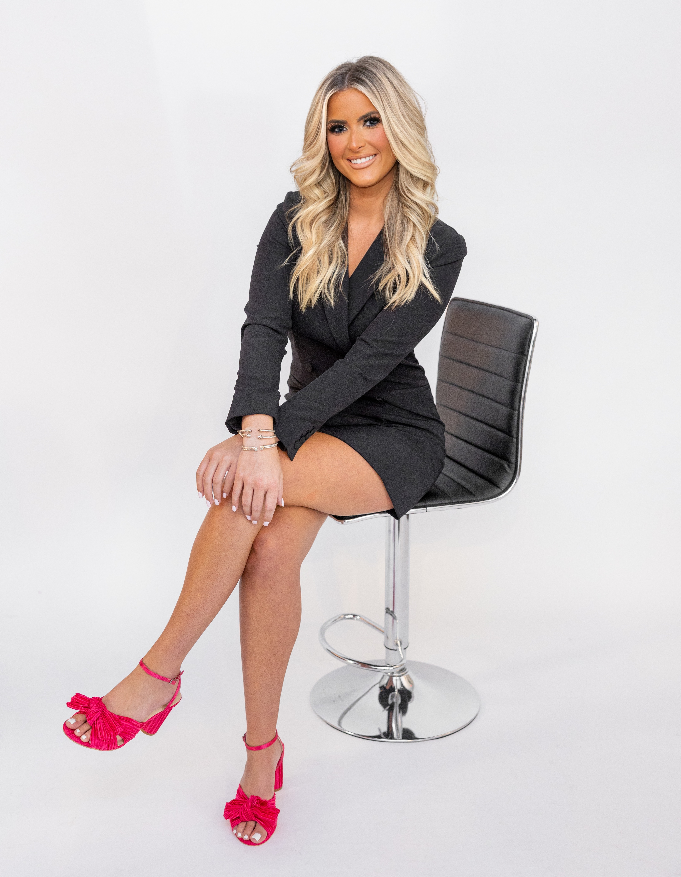
Makayla Thomas
International Sales Trainer

Slide 3

Why we do this…?
It acknowledges the change
Changing lineups can be a lot, and we want to help!
Keeps the customer inside the DC Family
The customer already loves DC, now they will love a newer product within the same family of brands!
Frames “discontinued” as “upgraded”
Some products get discontinued so that we can UPGRADE formulas for more updated skincare and trends!
Staff can feel confident while selling new product
They will have an easier understanding the newer product as an “upgrade” of an older product rather than completing learning something new!

Slide 4
Giveaway Alert!!!
Stay logged on until the very end for a fun giveaway!

Slide 5
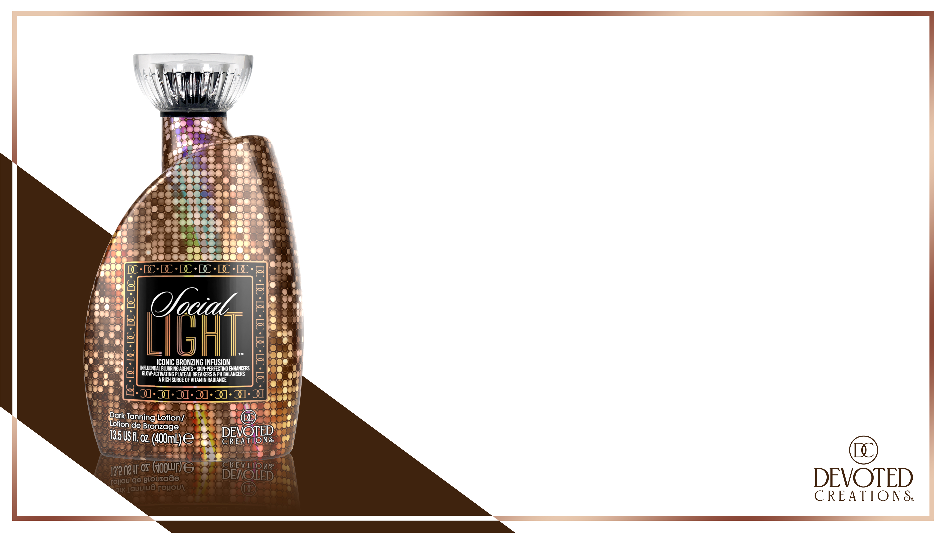
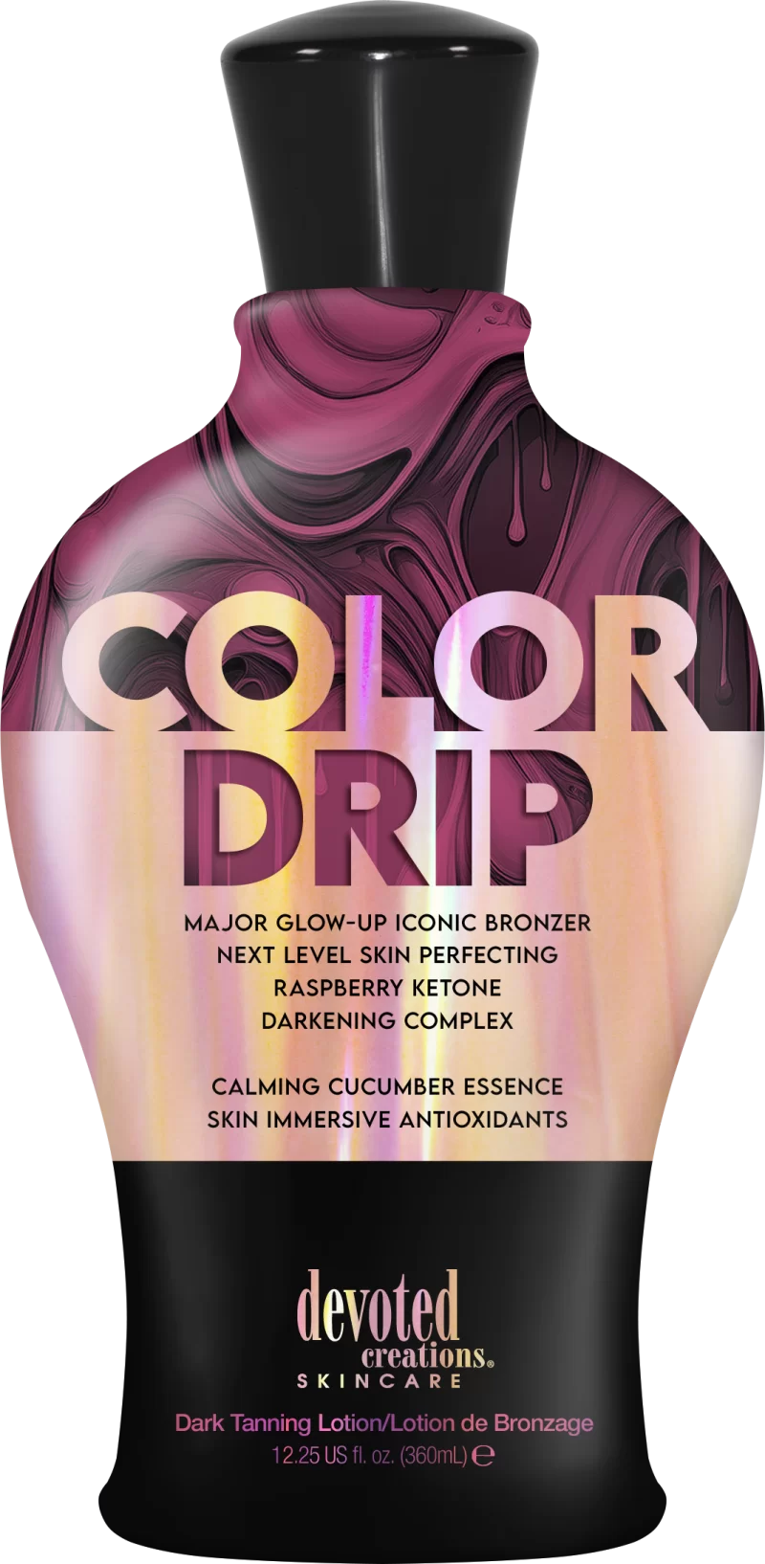
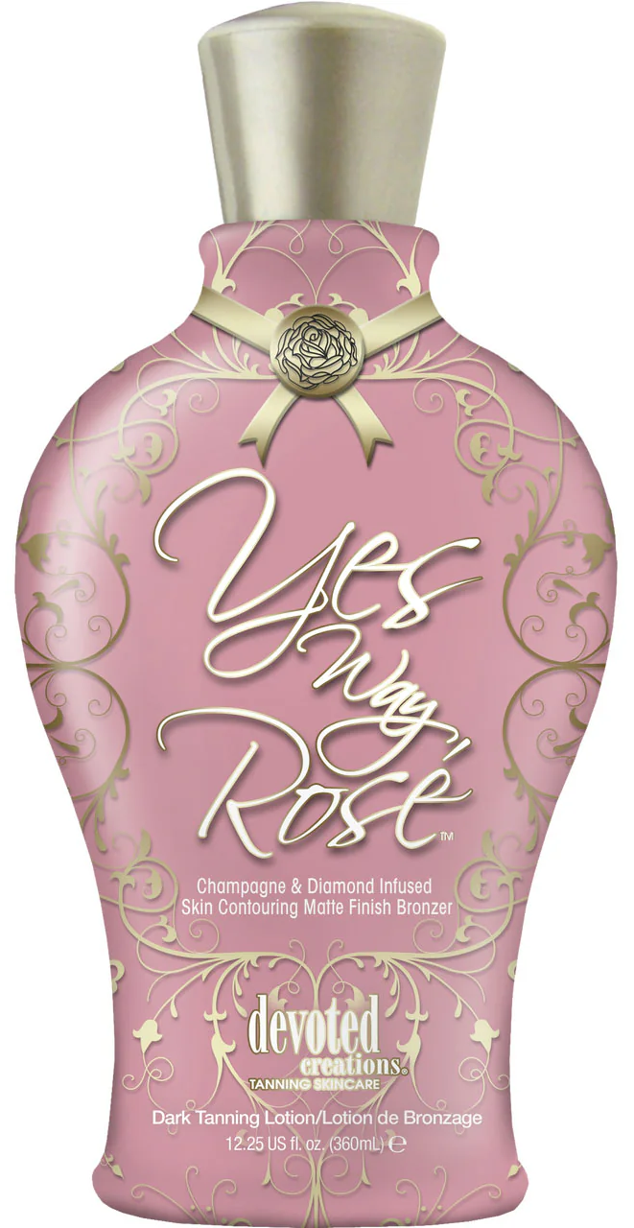
If you like Color Drip…You’ll LOVE Social Light…
Upgrade from: Color Drip/Yes Way Rose
Mid–Level DHA Bronzer
Both have Raspberry Ketones, Snow Mushroom and a Collagen Banking Complex
Social Light’s upgraded skincare packed formula is ALSO formulated FOR all light use as well as spray tan customers!
Great way to increase higher sales from Classic to Color Rush

Slide 6
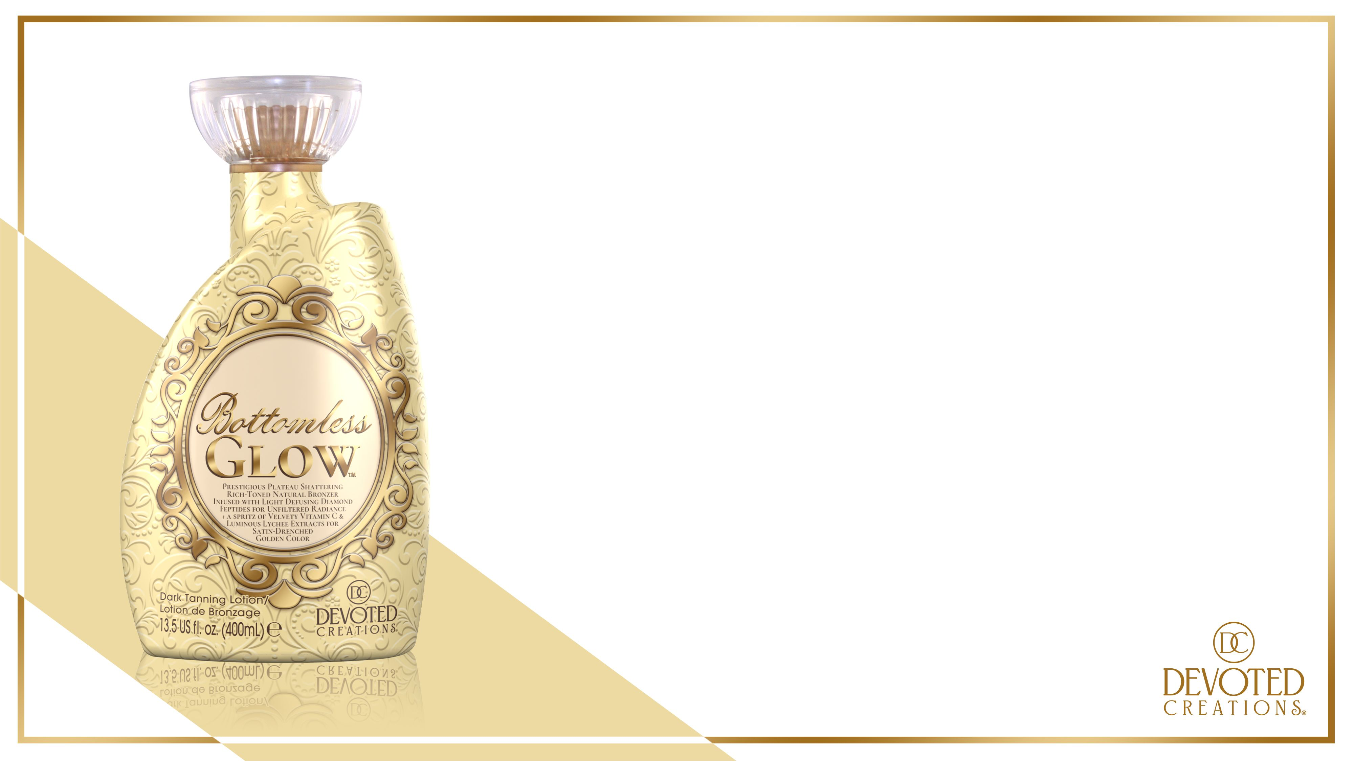
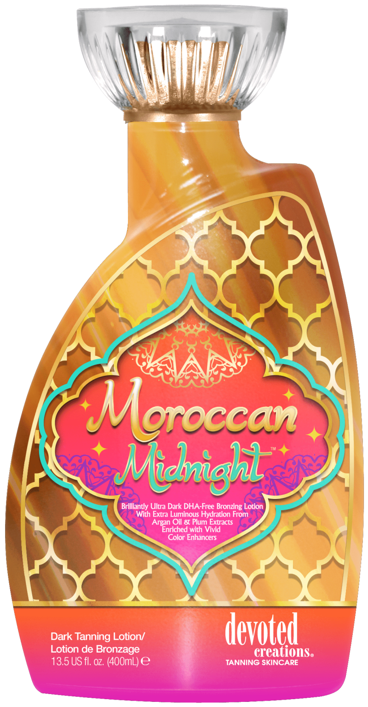
If you like Moroccan Midnight…You’ll LOVE Bottomless Glow…
Upgrade from: Moroccan Midnight
Natural Bronzer
Leaves the skin flawless minimizing imperfections
High in Vitamin C to brighten the skin, great for that customer who is seeking skin brightening results
Great way to increase higher sales from Classic to Color Rush

Slide 7
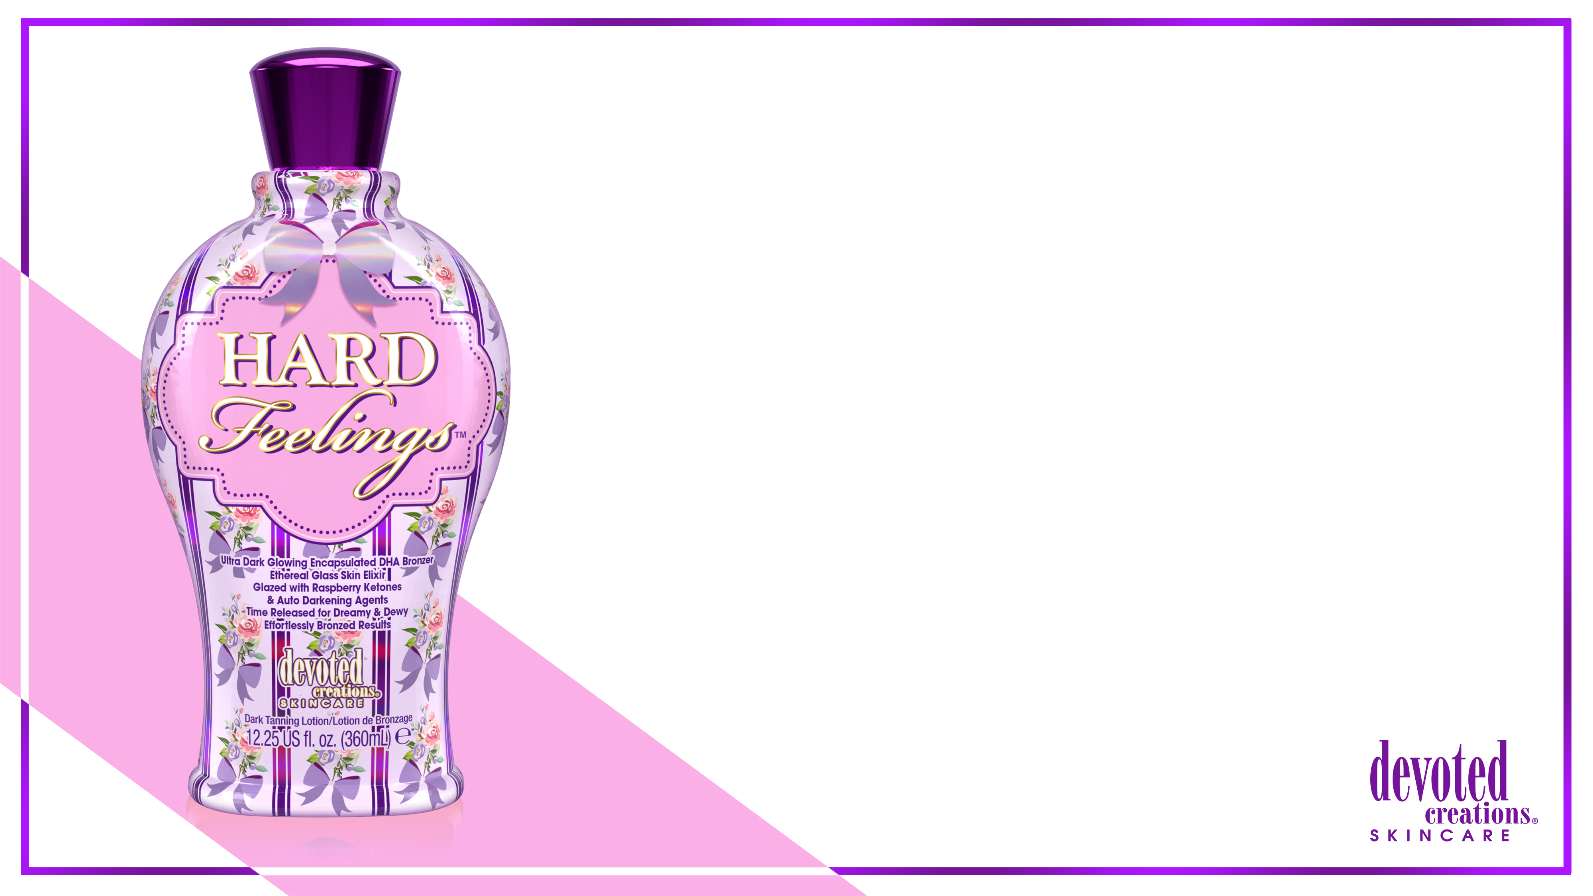
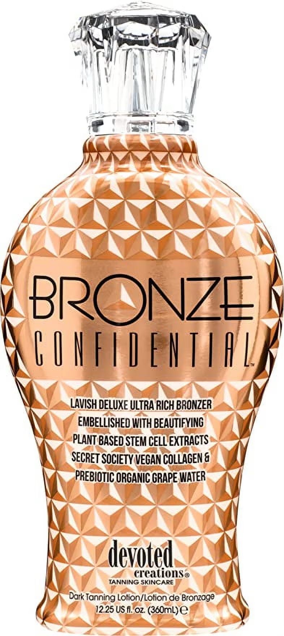
If you like Bronze Confidential…You’ll LOVE Hard Feelings…
Upgrade from: Bronze Confidential
ULTRA Dark DHA Bronzer
Similar feel to Vault, but more dew like on the skin
Needed a new girly dark DHA bronzer in the Classic Collection to fill the gap

Slide 8
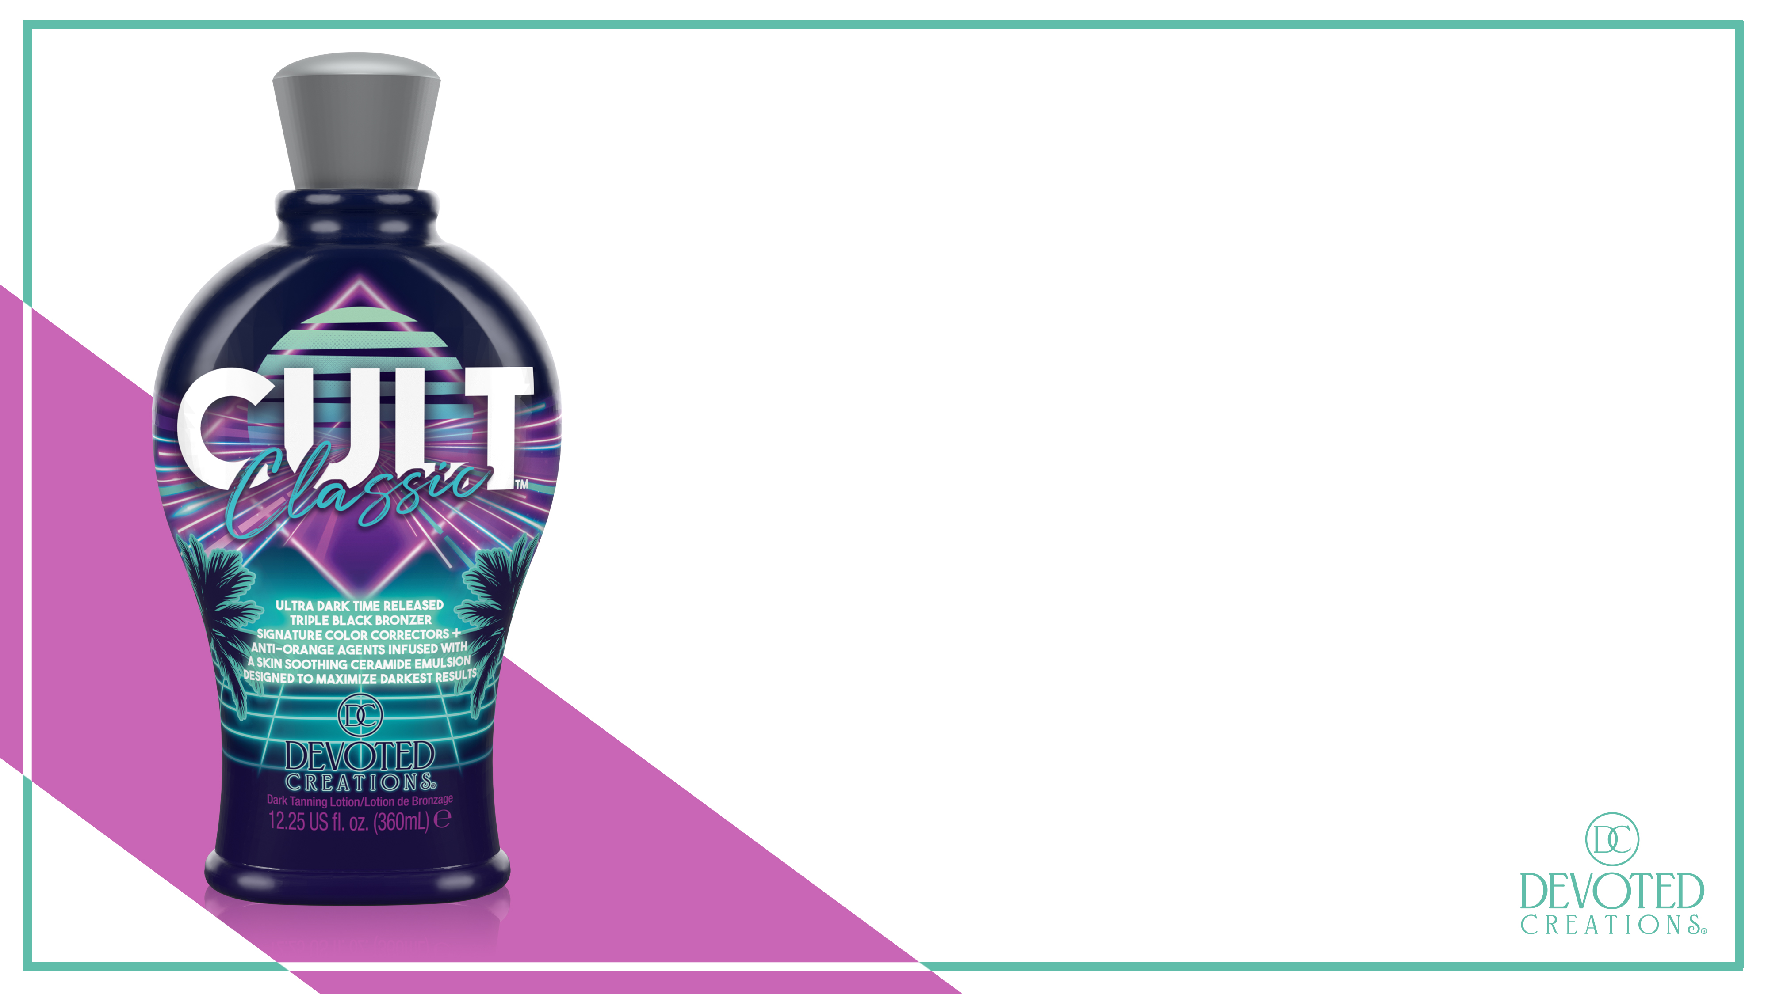
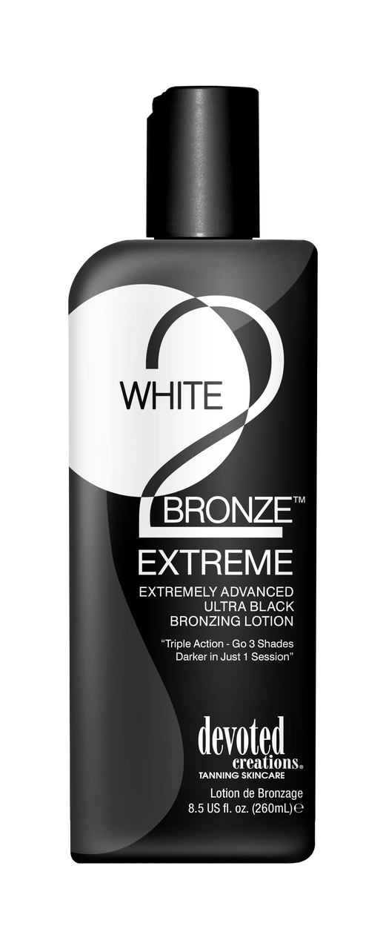
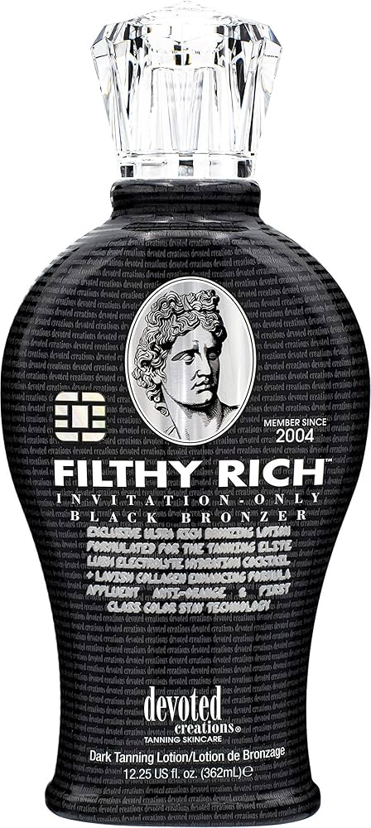
If you like Filthy Rich…You’ll LOVE Cult Classic…
Upgrade from: Filthy Rich/W2B Extreme
Dark DHA Bronzer
Great for someone who wants to use DHA but ALSO would like to use color correcting properties
Needed a new unisex DHA bronzer in the Classic Collection to fill the gap

Slide 9
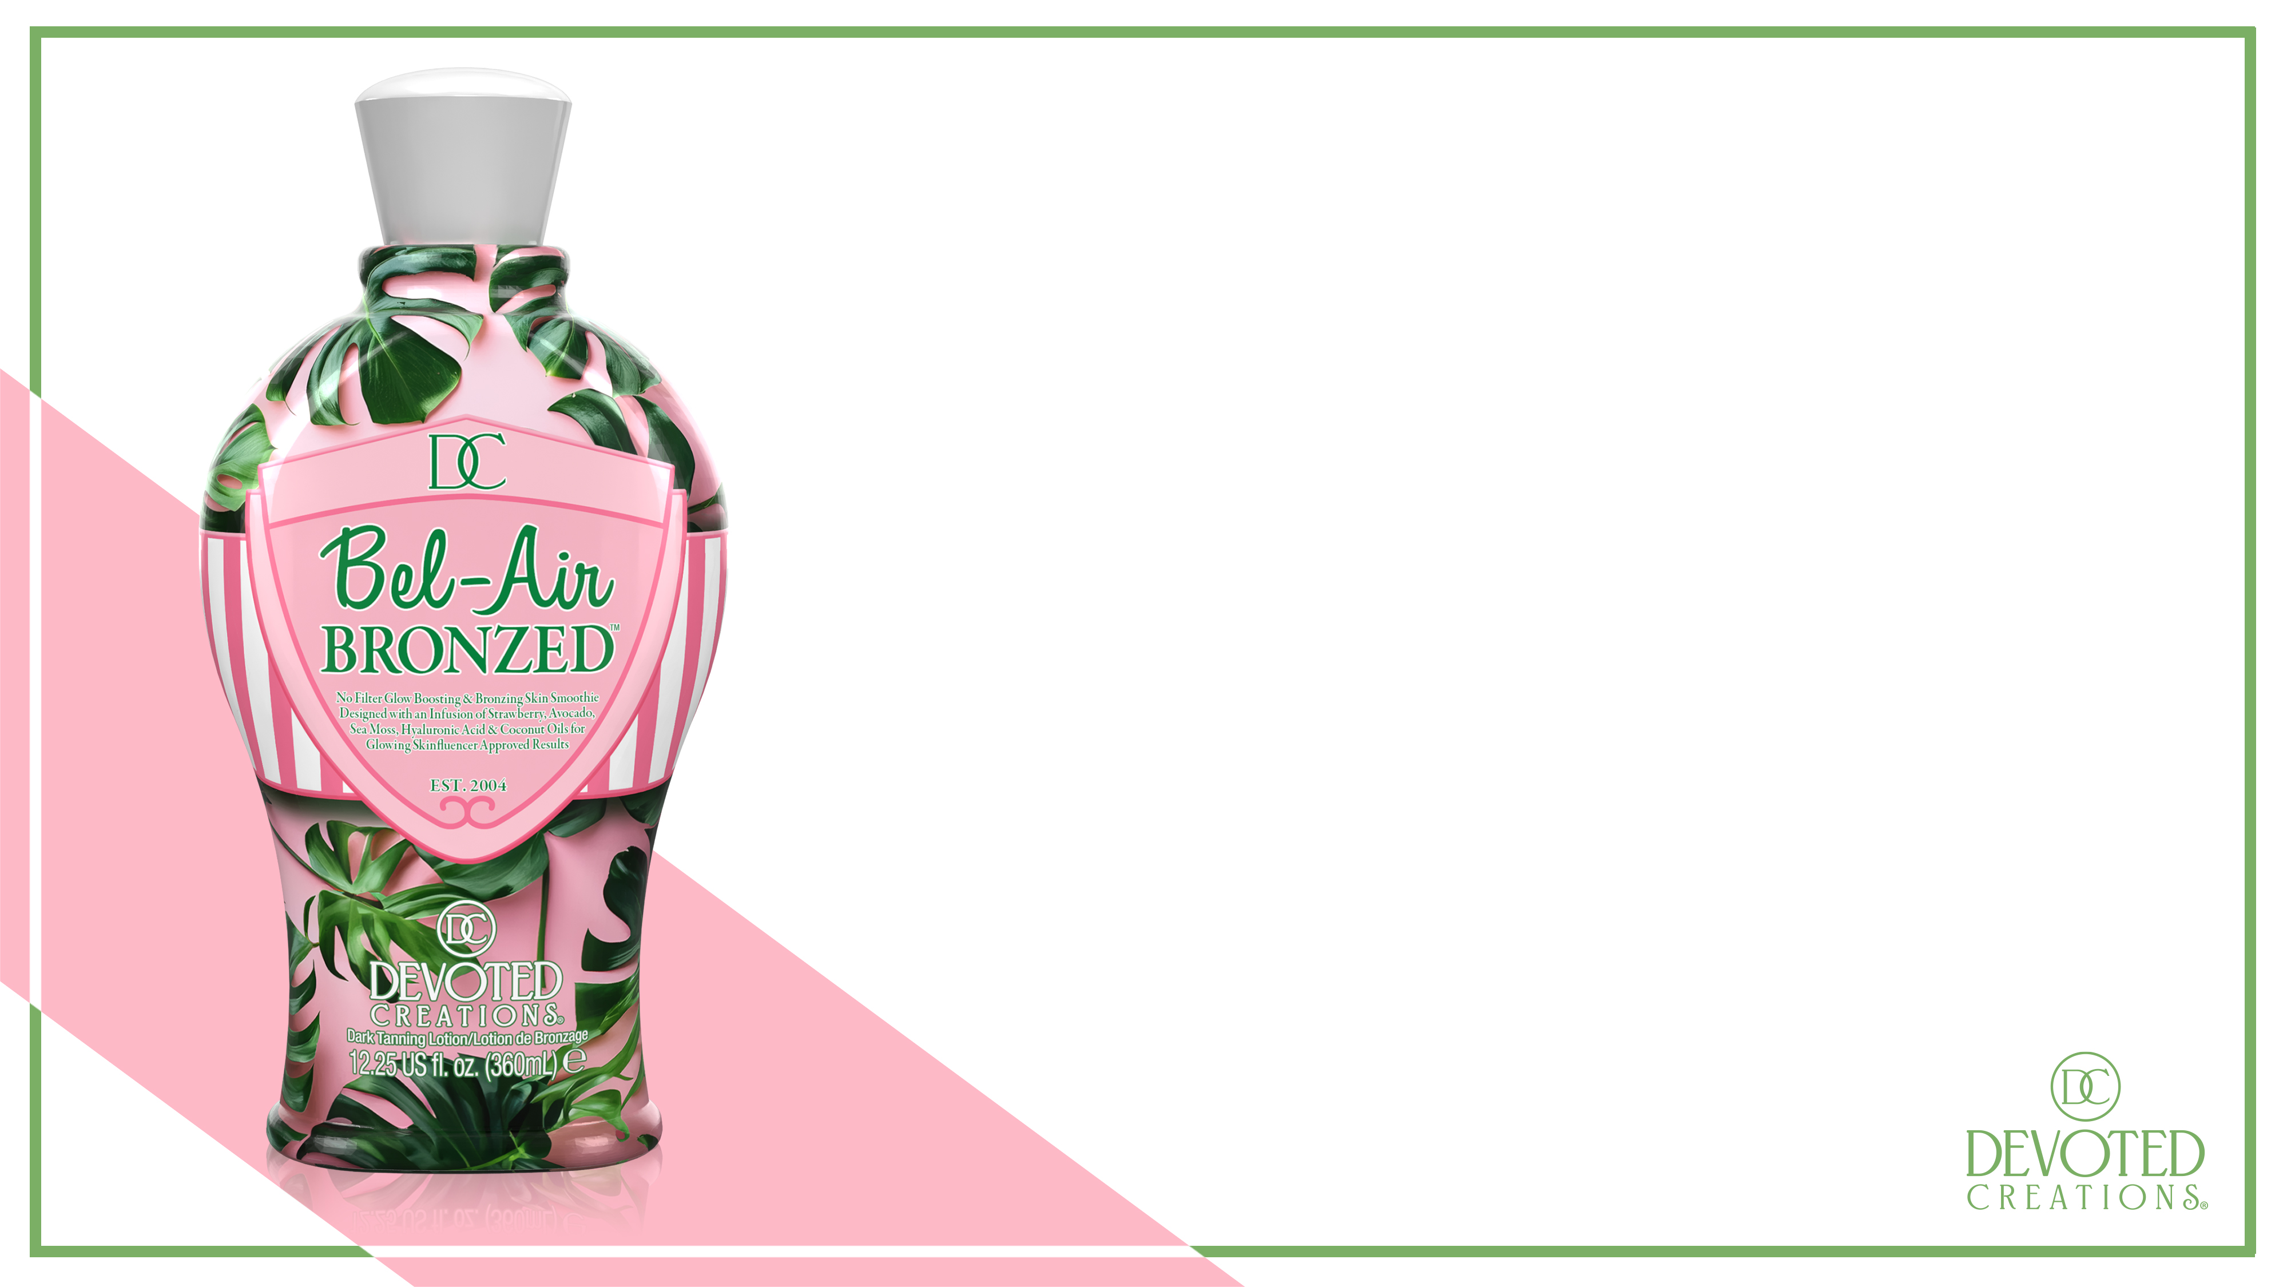
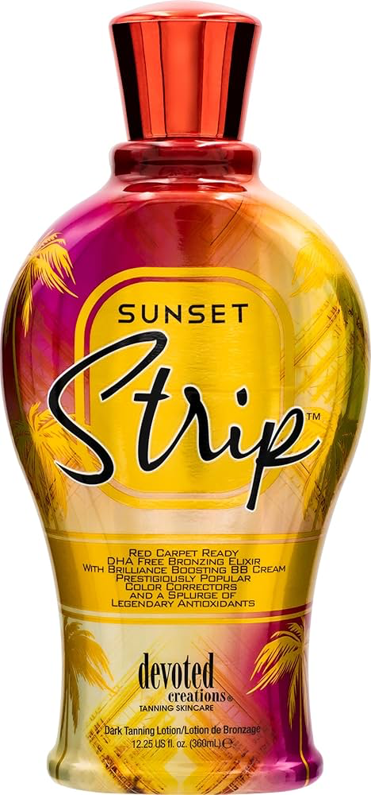
If you like Sunset Strip…You’ll LOVE Bel-Air Bronzed…
Upgrade from: Sunset Strip
Natural Bronzer
BB Cream like formula for a flawless finish to the skin
High in antioxidants to brighten the skin naturally
Needed a new girly natural bronzer to fill the place of Sunset Strip

Slide 10
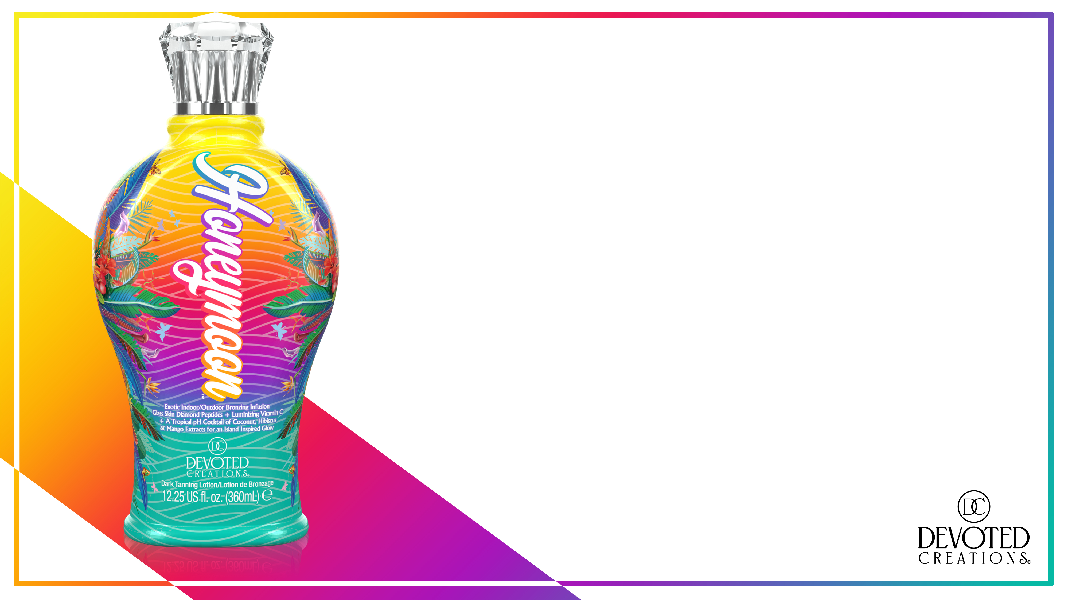
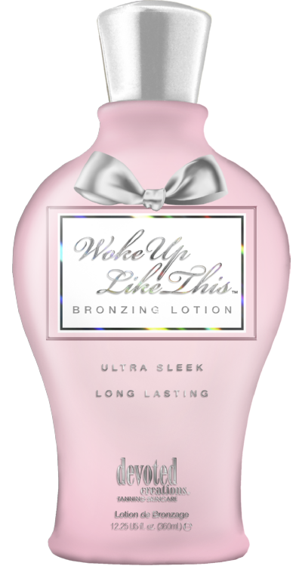
If you like Woke up like This…You’ll LOVE Honeymoon…
Upgrade from: Woke up like This
DHA Bronzer
Lightweight hydration like formula
High in antioxidants to brighten the skin naturally
Great for those customers who are wanting to be introduced to DHA

Slide 11
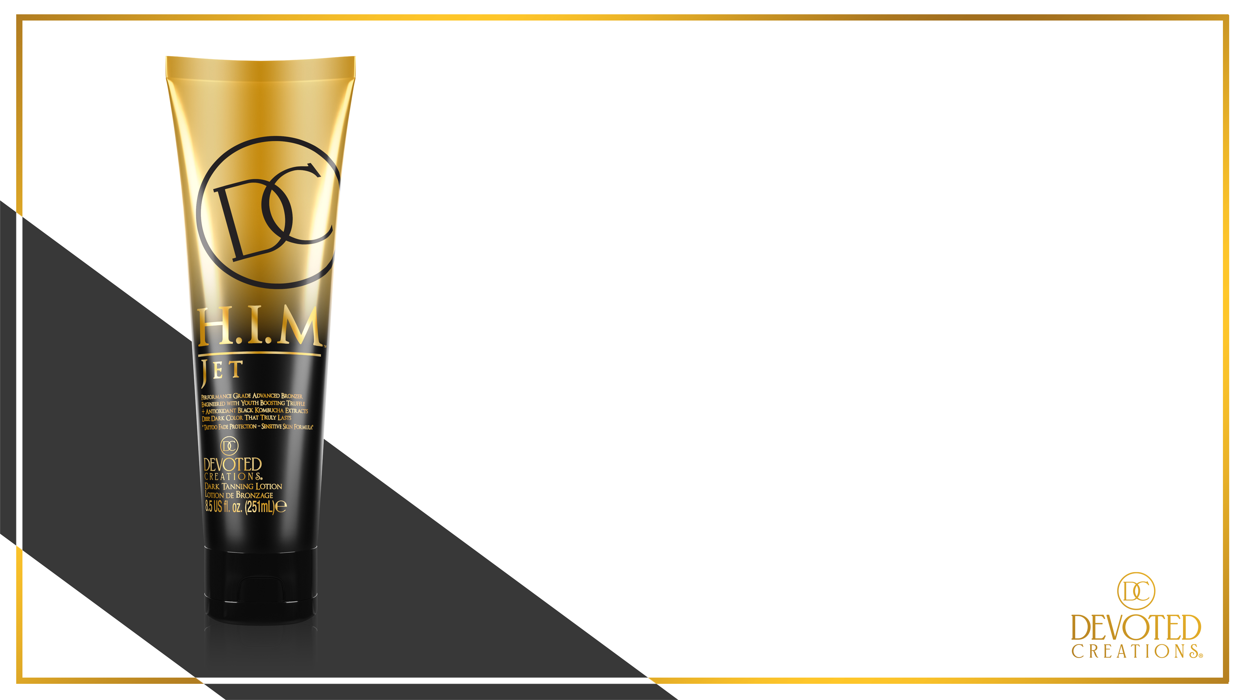
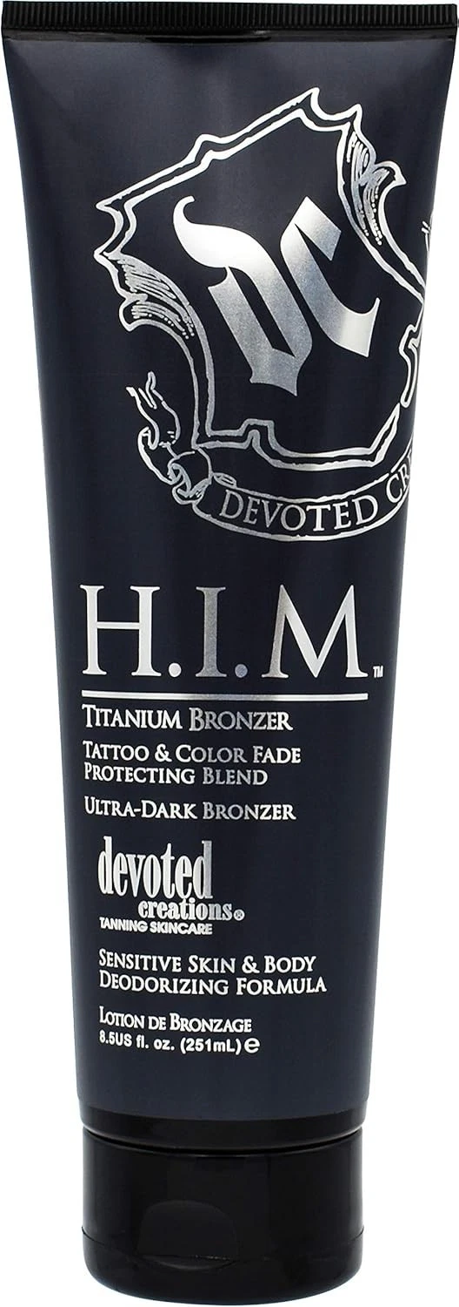
If you like H.I.M. Titanium…You’ll LOVE H.I.M. Jet…
Upgrade from: H.I.M. Titanium
Dark DHA Bronzer
Lightweight hydration like formula
High in antioxidants to brighten the skin naturally
Great for those male customers who want to seek instantly dark results!
Very unisex fragrance

Slide 12
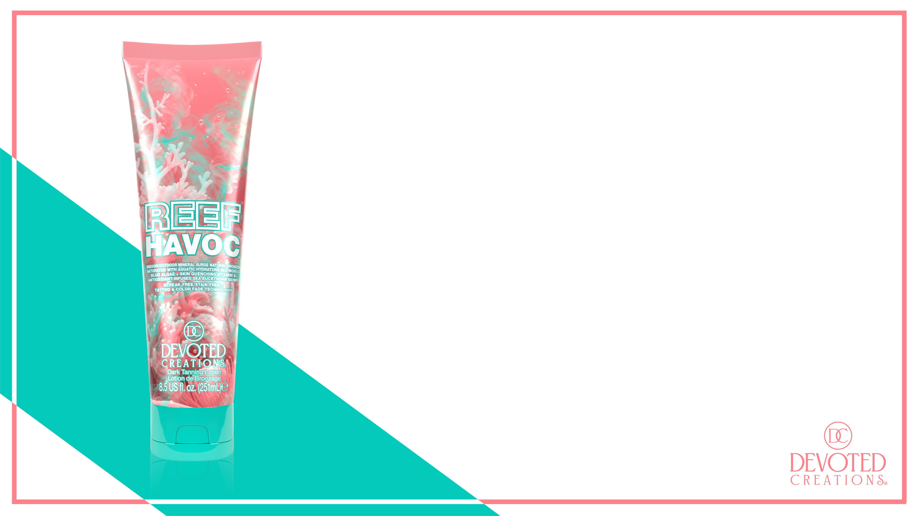
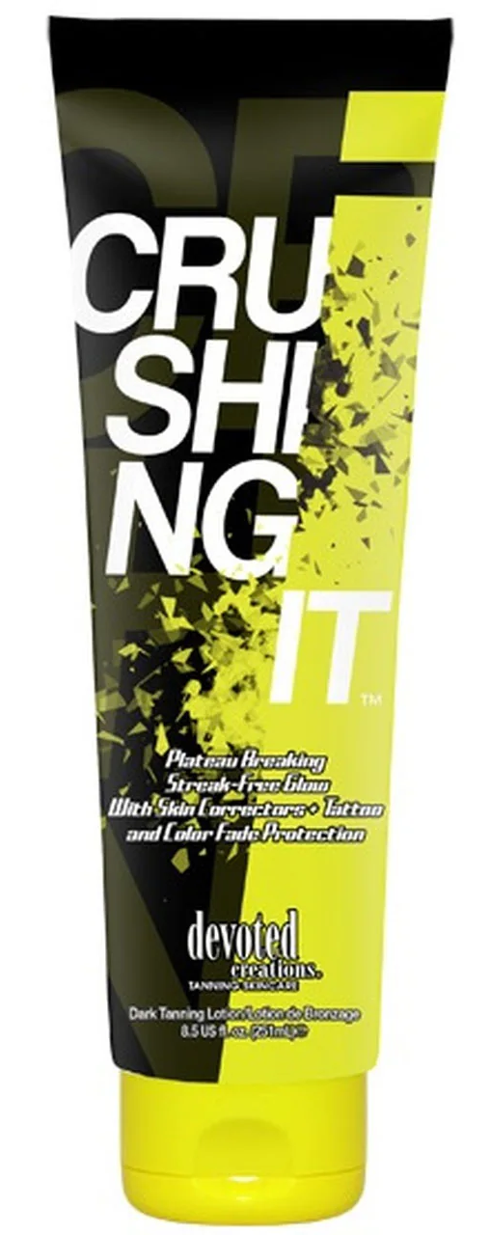
If you like Crushing It…You’ll LOVE Reef Havoc…
Upgrade from: Crushing It
Natural Bronzer
Needed a new natural bronzer in this collection to go along with the theme we have had since “Vacay Vibes”

Slide 13
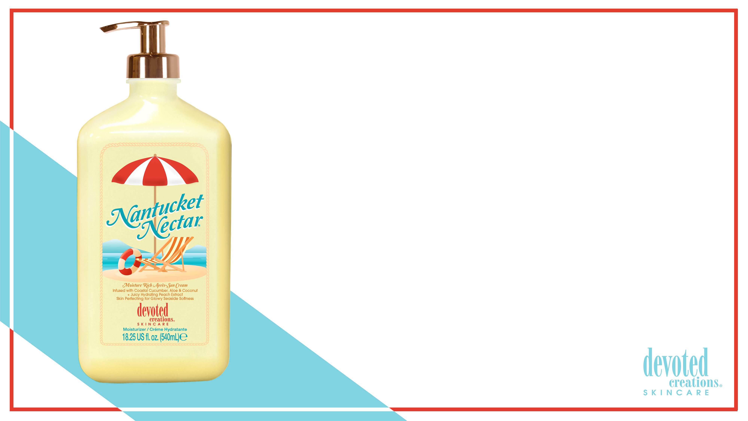
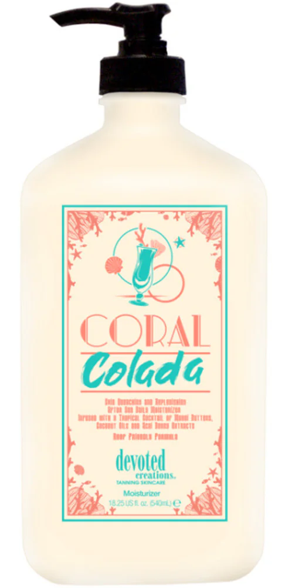
If you like Coral Colada…You’ll LOVE Nantucket Nectar…
Upgrade from: Coral Colada
Tan Extender
Very Beachy like fragrance
Lightweight tan extender with long-lasting hydration
Both filled with Coconut Extracts
HIGH in Vitamin C

Slide 14
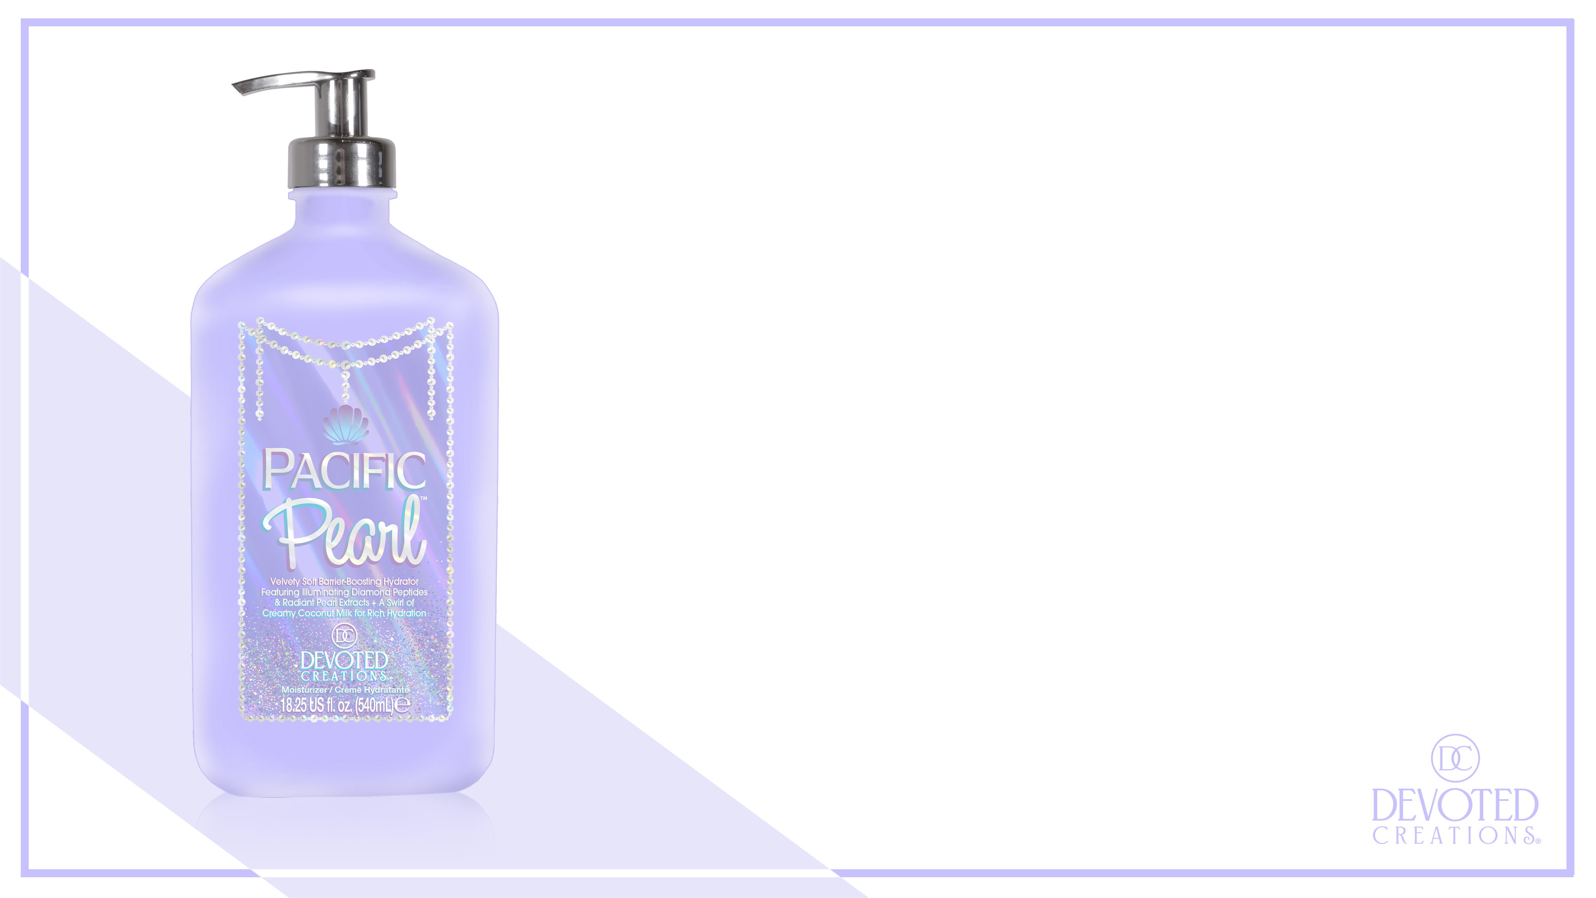
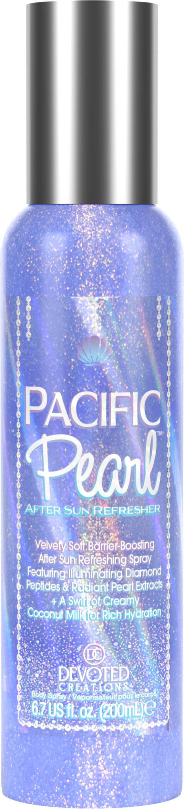
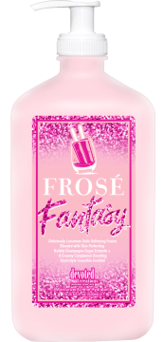
If you like Frose Fantasy…You’ll LOVE Pacific Pearl…
Upgrade from: Frose Fantasy
Tan Extender
Very high notes of sweet/sugar like fragrance
Rich in collagen & antioxidants
Those seeking hydrating results with a brightened glow to their skin

Slide 15
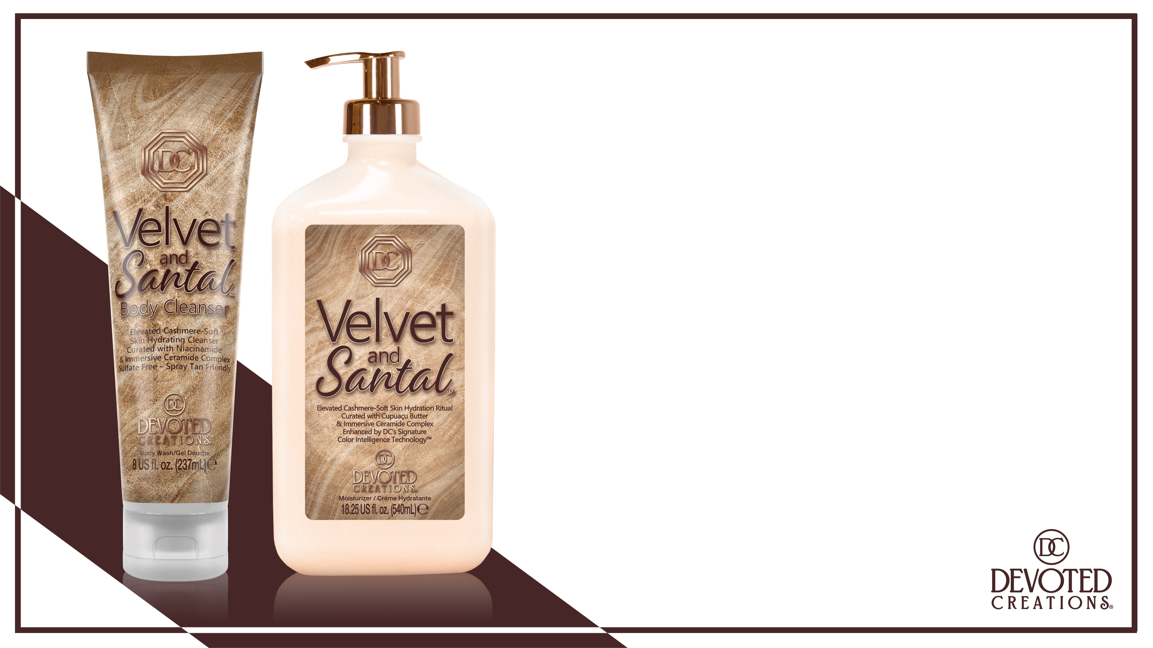
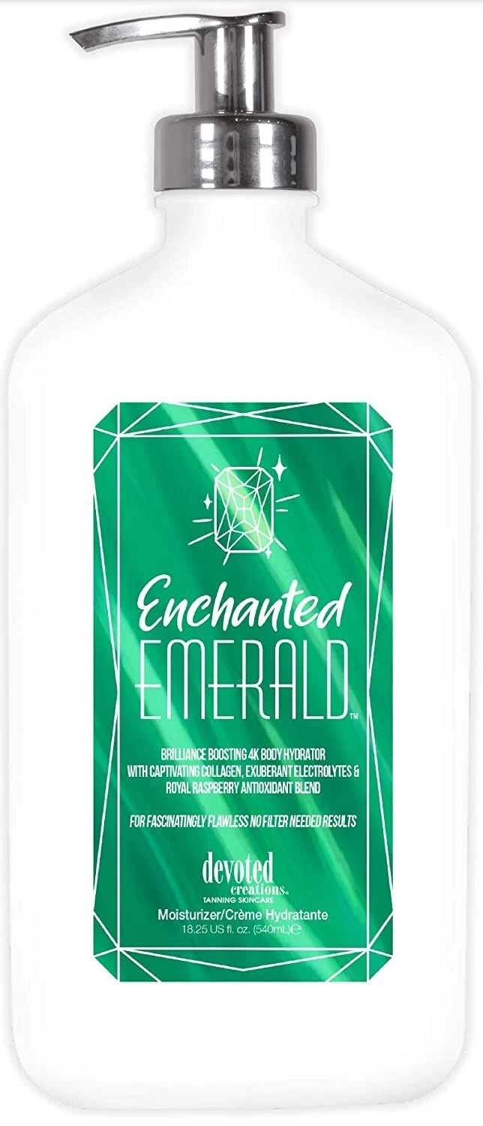
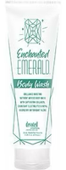
If you like Enchanted Emerald…You’ll LOVE Velvet & Santal…
Upgrade from: Enchanted Emerald
Tan Extender
NEW Color Intelligence Technology to continue to boost melanin stimulation beyond UV exposure
NEW body wash
Unisex fragrance

Slide 16
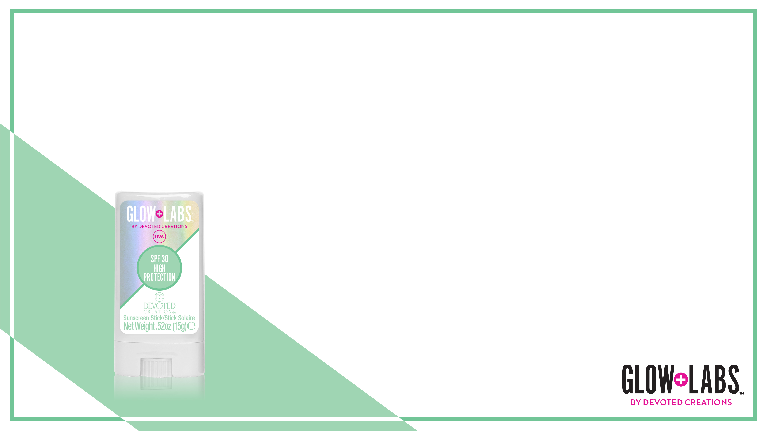
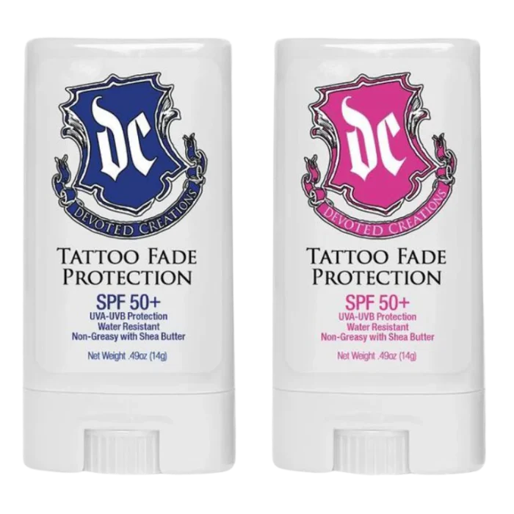
If you like Blue & Pink Tattoo Sticks…You’ll LOVE Glow Labs Tattoo Stick…
Formula: Blue & Pink Tattoo Stick
SPF Tattoo Stick
Those who have tattoos that seek extra protection to keep the color of their ink lasting longer!

Slide 17
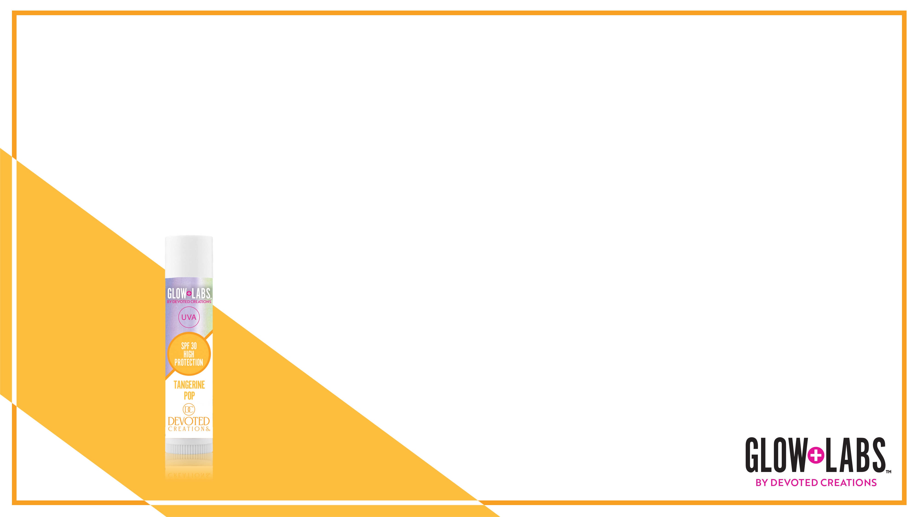
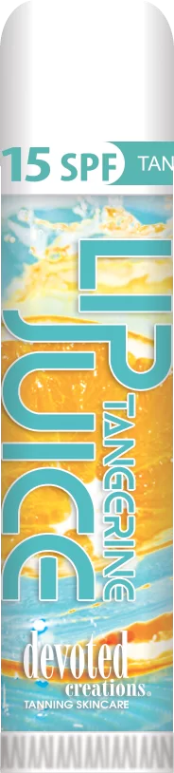
If you like Tangerine Lip Juice…You’ll LOVE Glow Labs Tangerine Pop Lip Balm…
Formula: Tangerine Lip Juice
Lip Balm
Those who want to protect their lips
SPF 30

Slide 18
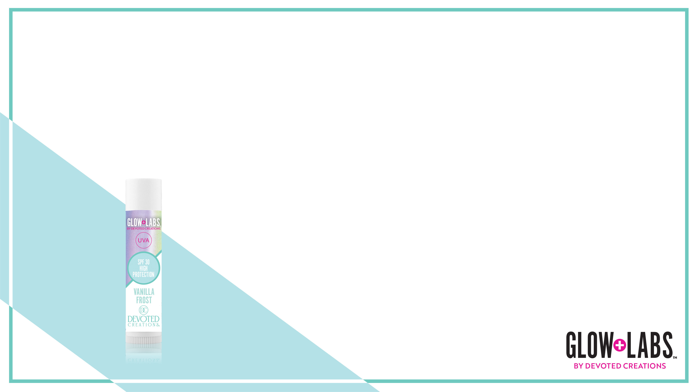
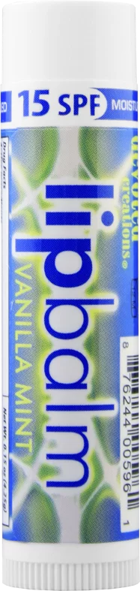
If you like Vanilla Mint Lip Balm…You’ll LOVE Glow Labs Vanilla Frost Lip Balm…
Formula: Vanilla Mint Lip Balm
Lip Balm
Those who want to protect their lips
SPF 30

Slide 19
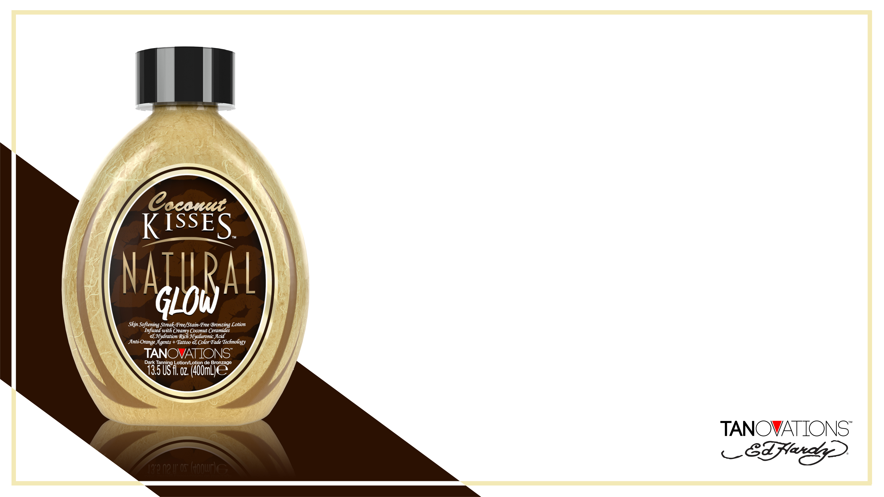
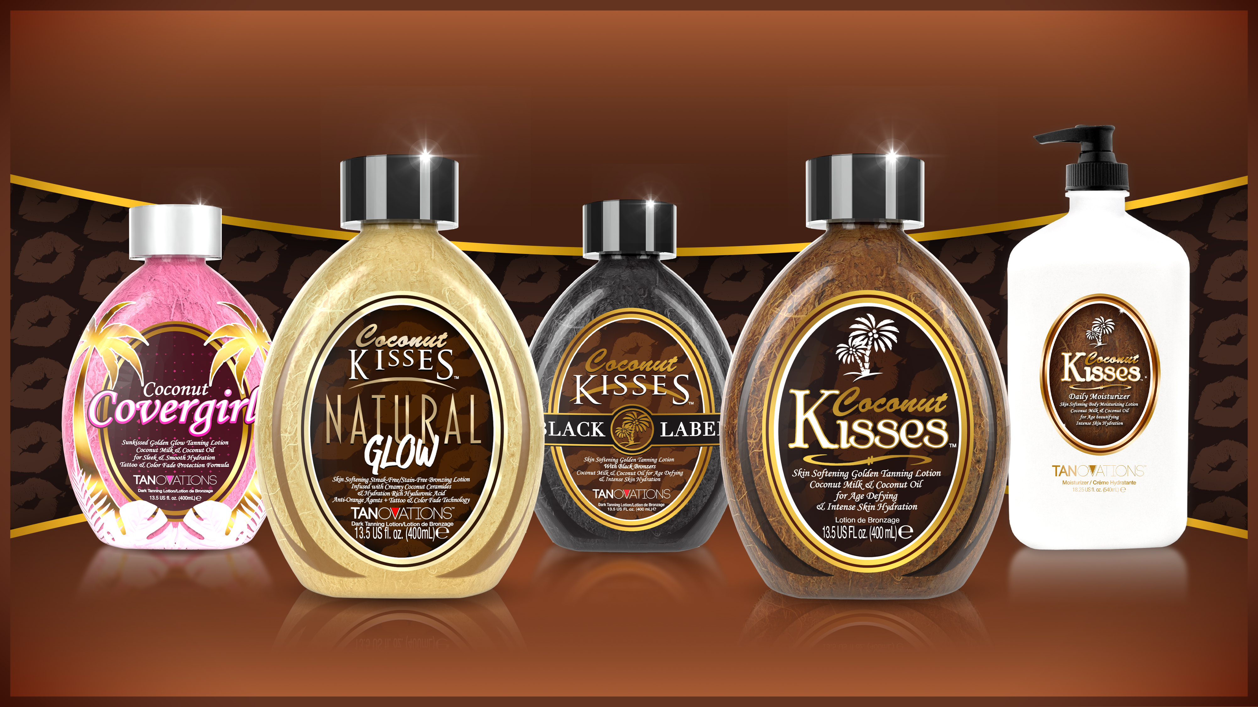
If you like the entire Coconut Kisses collection…You’ll LOVE Natural Glow…
Upgrade from: Coconut Covergirl
Natural Bronzer
High in antioxidants to brighten the skin naturally
Great for those customers who are wanting that OG coconut fragrance without any DHA

Slide 20
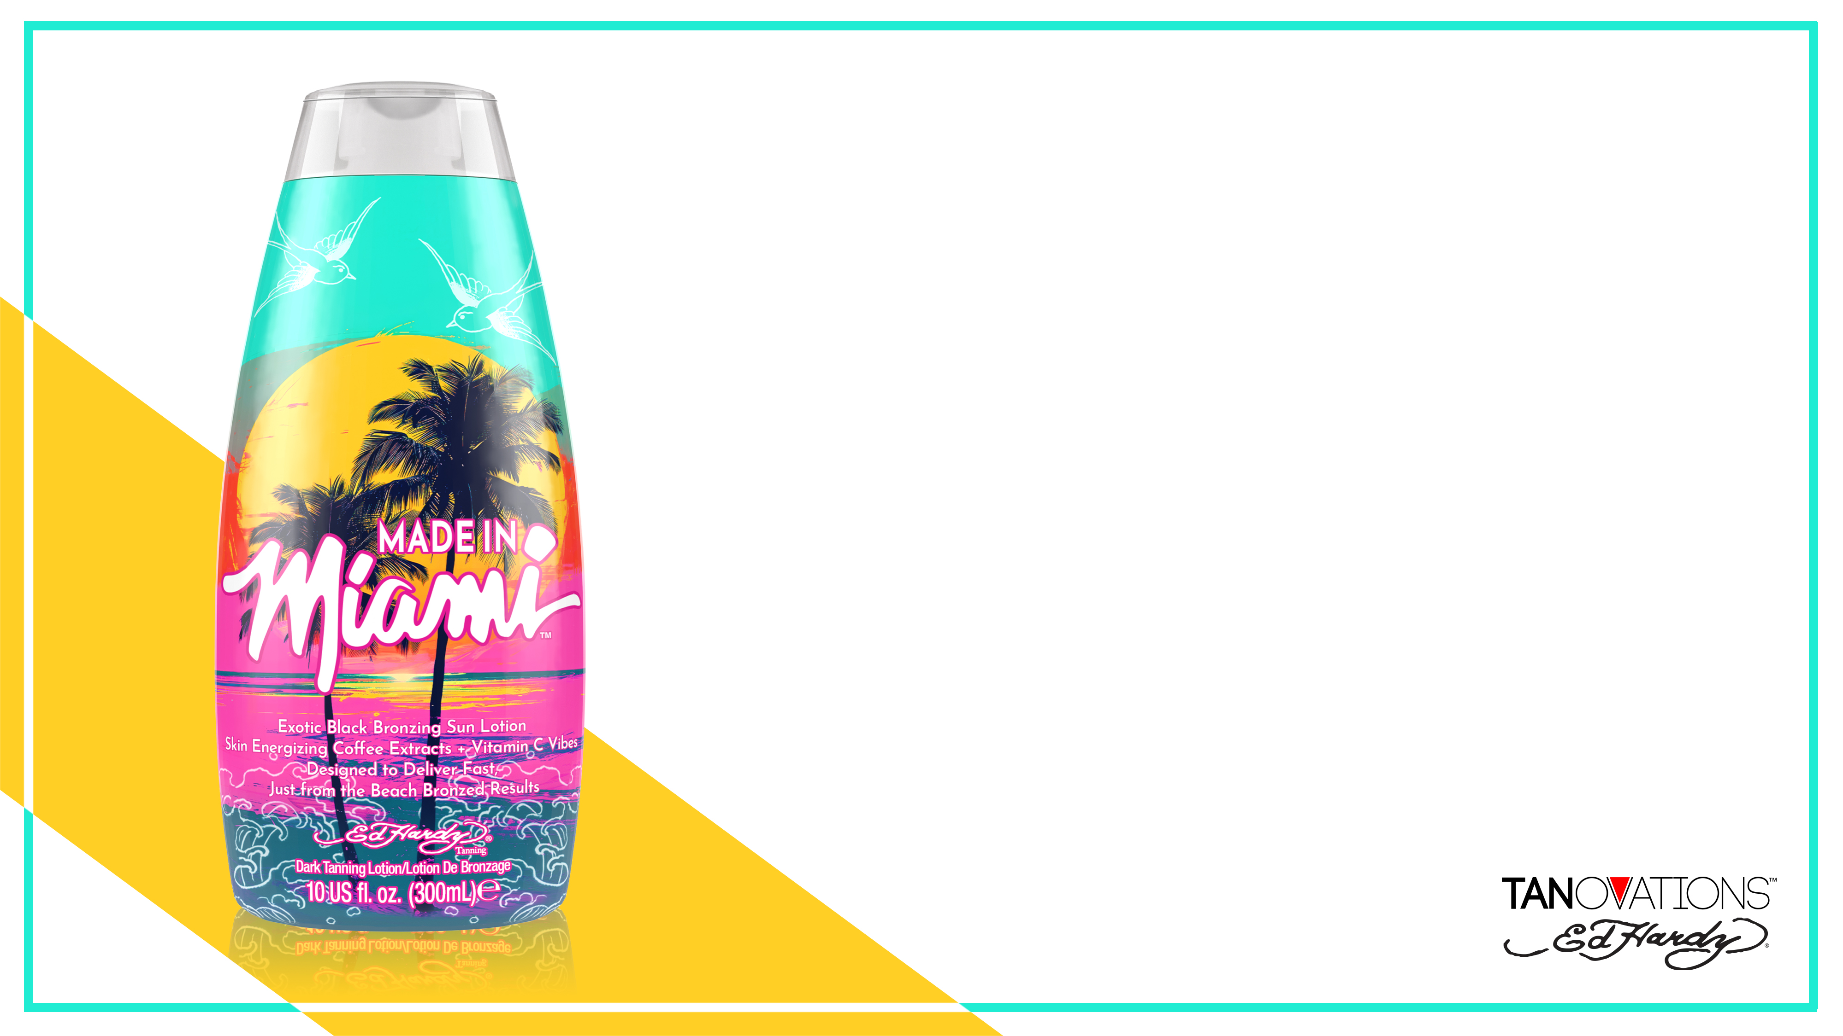
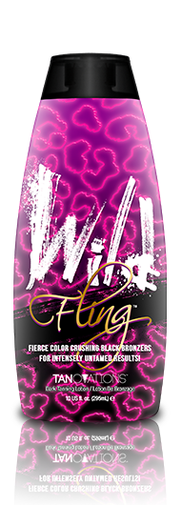
If you like Wild Fling…You’ll LOVE Made in Miami…
Upgrade from: Wild Fling
Ultra DHA Bronzer
Lightweight hydration like formula
High in antioxidants to brighten the skin naturally
Great for those customers who are wanting immediate, ultra DARK color

Slide 21
Giveaway Alert!!!
What is the other GIRLY natural bronzer in the Classic Collection BEFORE Sunset Strip?

Slide 22
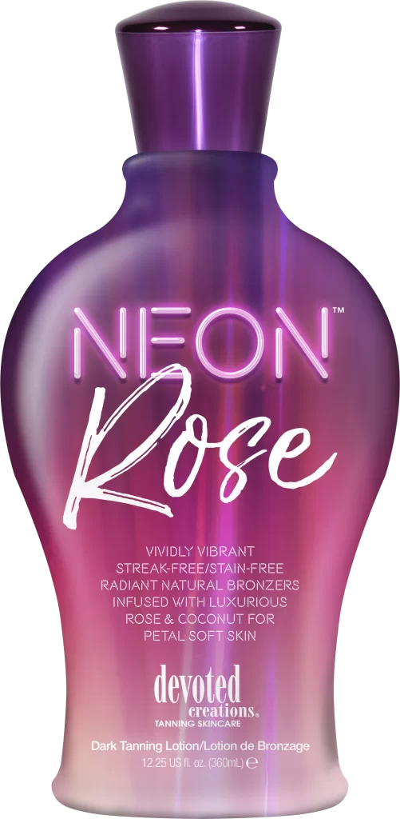
Winner will receive:
1 Bel-Air Bronzed
1 Velvet & Santal
1 Velvet & Santal Body Wash

Slide 23

Makayla Thomas
International Sales Trainer
(727) 297-8730
makayla@devotedcreations.com

