Slide 1
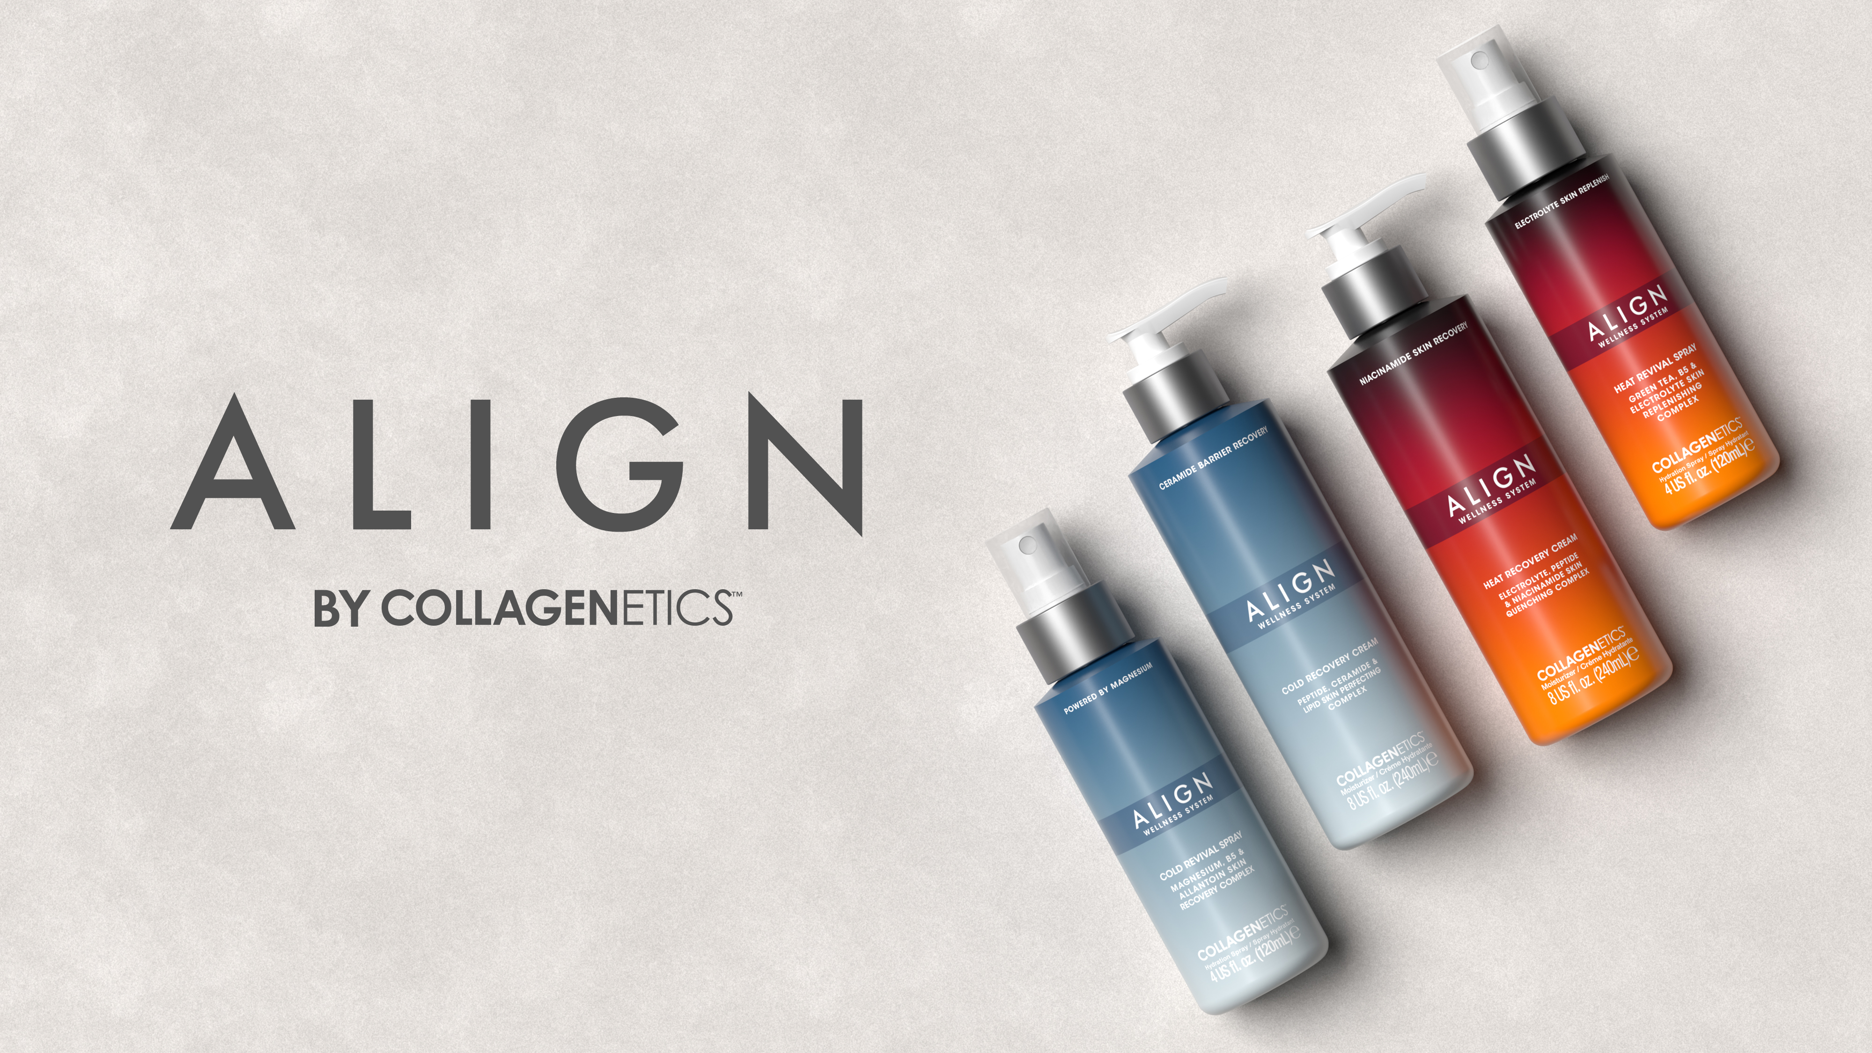

Slide 2

Why Align…
More salons are bringing in different pieces of wellness equipment
These pieces are designed to replenish the skin after a wellness visit
As a manufacturer, we need to have product so that salons have the ability to make money with their new equipment
As equipment and salons evolve…so are WE!

Slide 3
Heat Therapy…
Increases circulation
Promotes collagen production
Boosts hydration levels in the skin
Creates a more firm, youthful appearance to the skin
Reduces muscle tension
Promotes better sleep
Detoxifies the skin
Mood & Mental Wellness

Slide 4
Cold Therapy…
Increases recovery after a workout
Reduces swelling and inflammation
Boosts circulation
Elevates Mood
Can help reduce skin conditions to improve skin texture
Stimulates calories burning
Shrinks the appearance of pores for a more youthful complexion

Slide 5
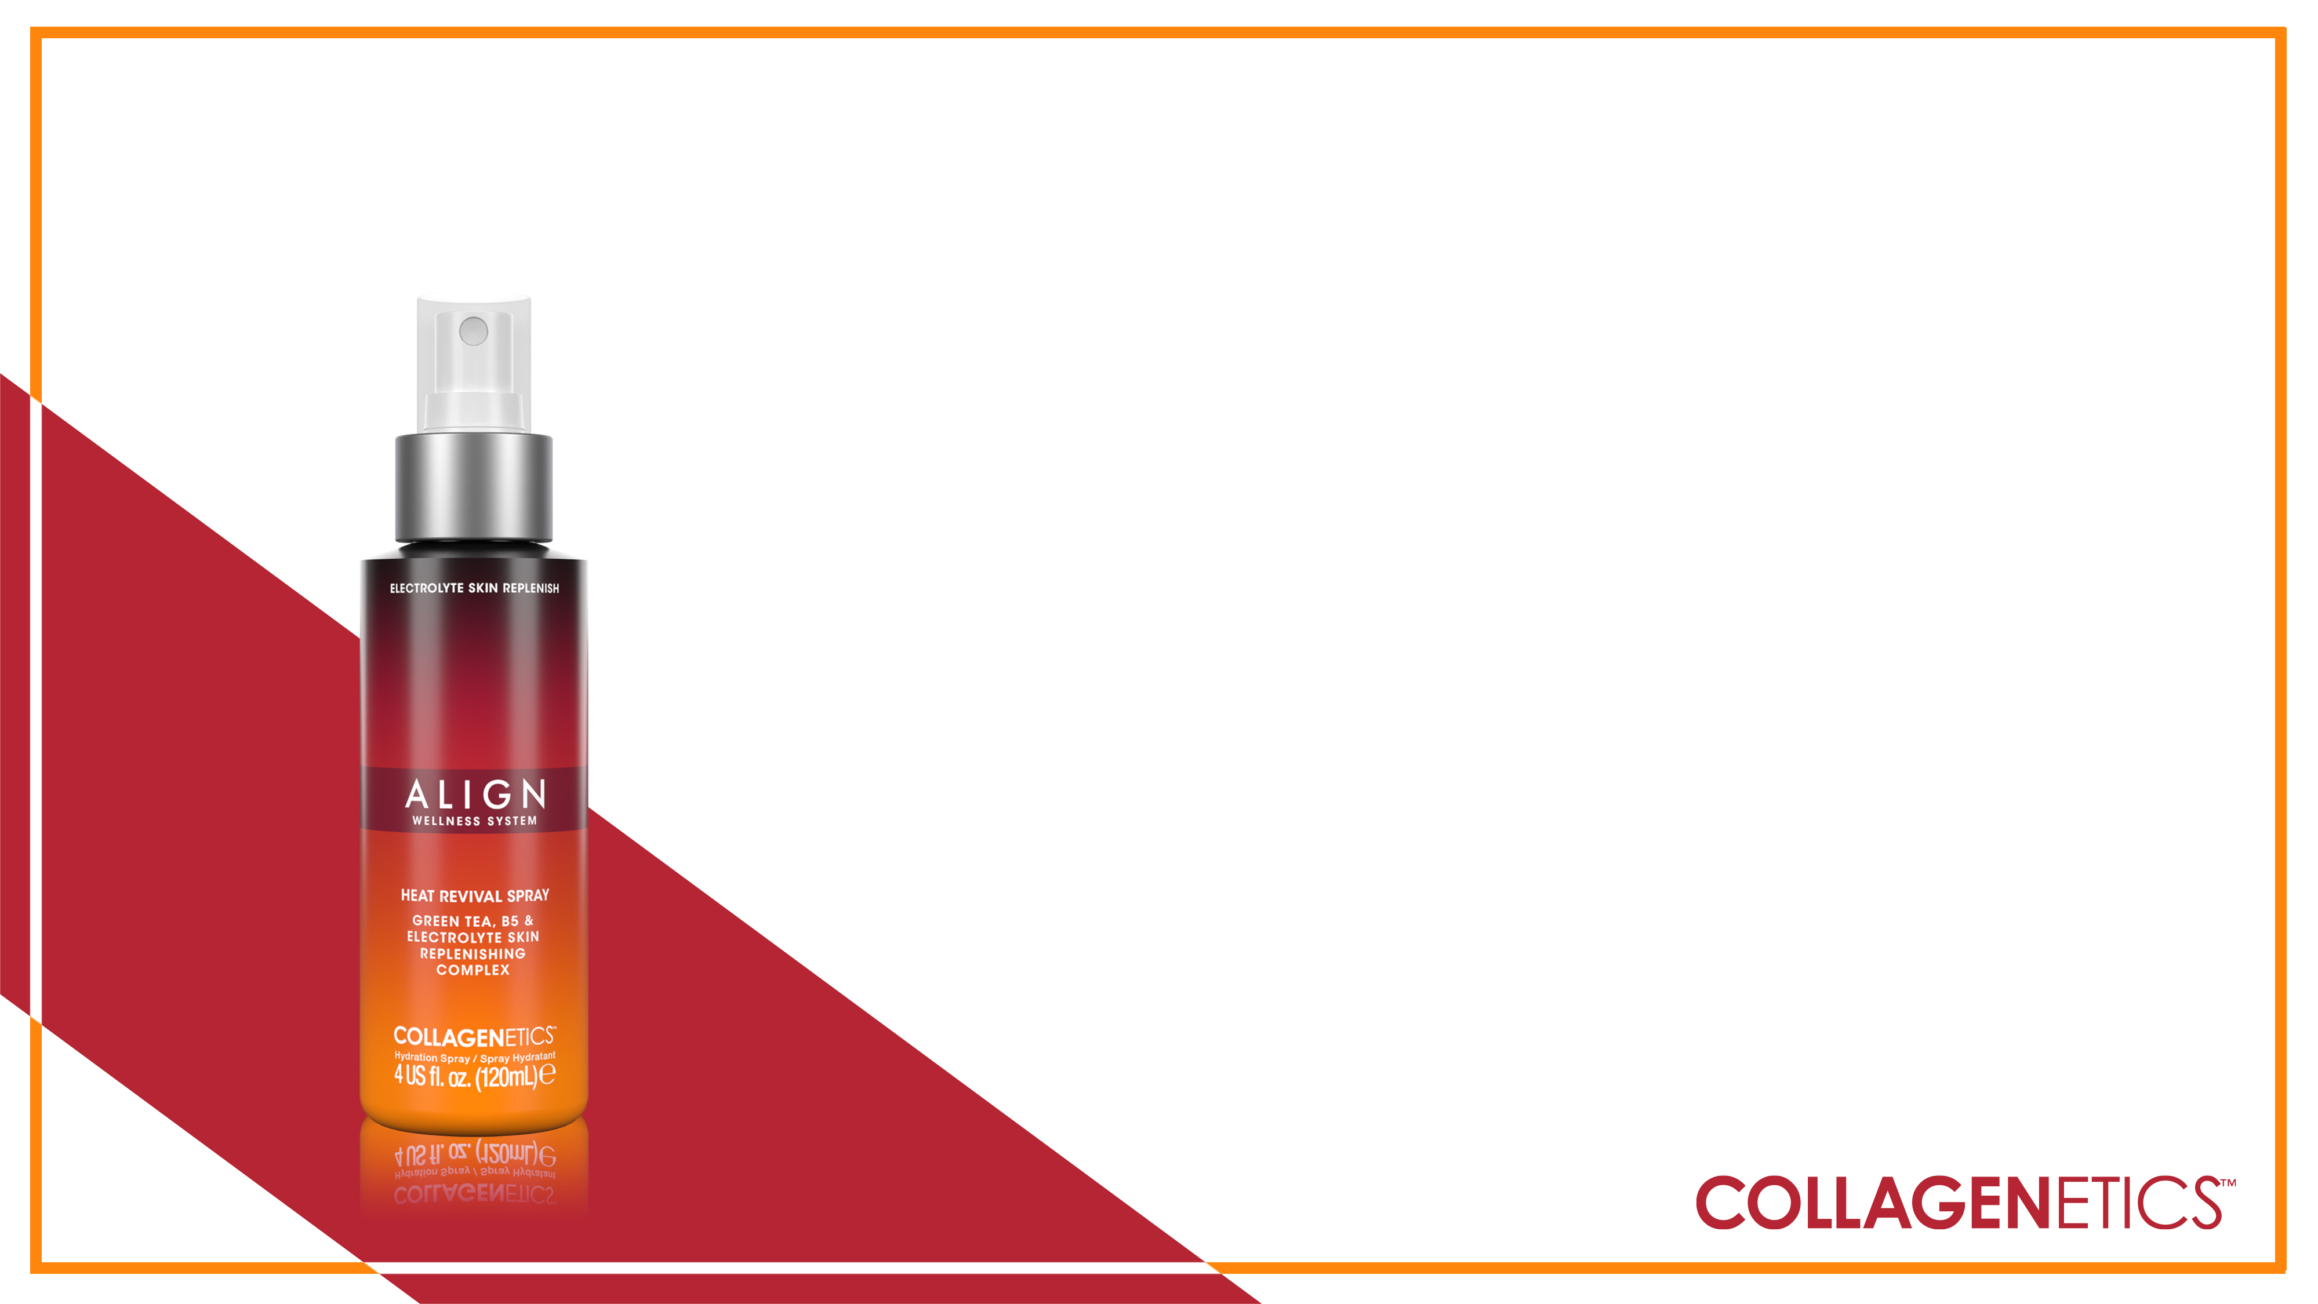
$29.00 Retail
Heat Revival Spray™
Post Heat Therapy Spray
Niacinamide™ works to fight breakouts, improve the skins’ elasticity while evening out the tone and complexion
Matrixyl works to produce new collagen and works to help anti-aging by eliminating fine lines and wrinkles
Electrolytes support bringing back lost nutrients back into the skin after sweating
Added Green Tea works to add antioxidants back into the skin while calming and comforting the skin after thermal exposure
Infused with Vitamin B5(Panthenol) to aid in skin repair while hydrating the skin
To add moisture and retain hydration levels in the skin Hyaluronic Acid supports the skins barrier
Fragrance: Pomberry Breeze

Slide 6
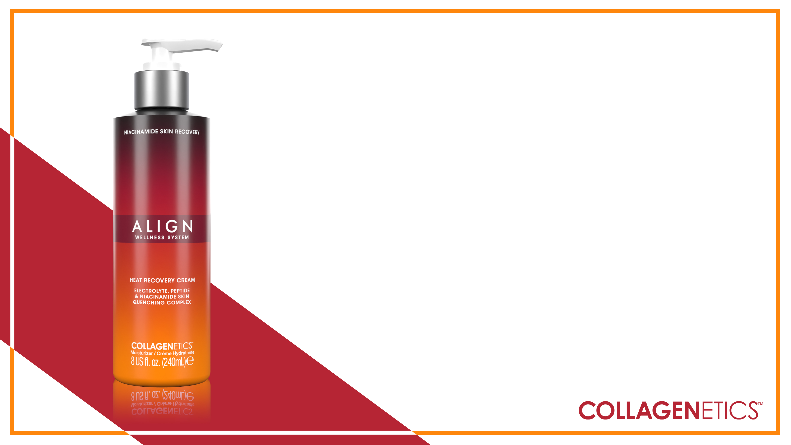
Heat Recovery Cream™
Post Heat Hydrator
Niacinamide™ works to fight breakouts, improve the skins’ elasticity while evening out the tone and complexion
Matrixyl works to produce new collagen and works to help anti-aging by eliminating fine lines and wrinkles
Electrolytes support bringing back lost nutrients back into the skin after sweating
To add moisture and retain hydration levels in the skin Hyaluronic Acid supports the skins barrier
Added Peptides work to reinforce the skins moisture barrier and natural recovery process
A natural cooling agent, Cucumber Water is added to give the skin that weightless hydration feel while calming the skin after heat exposure
Infused with Colloidal Oat Extracts to soothe the skin after heat exposure
Fragrance: Pomberry Breeze
$34.00 Retail

Slide 7
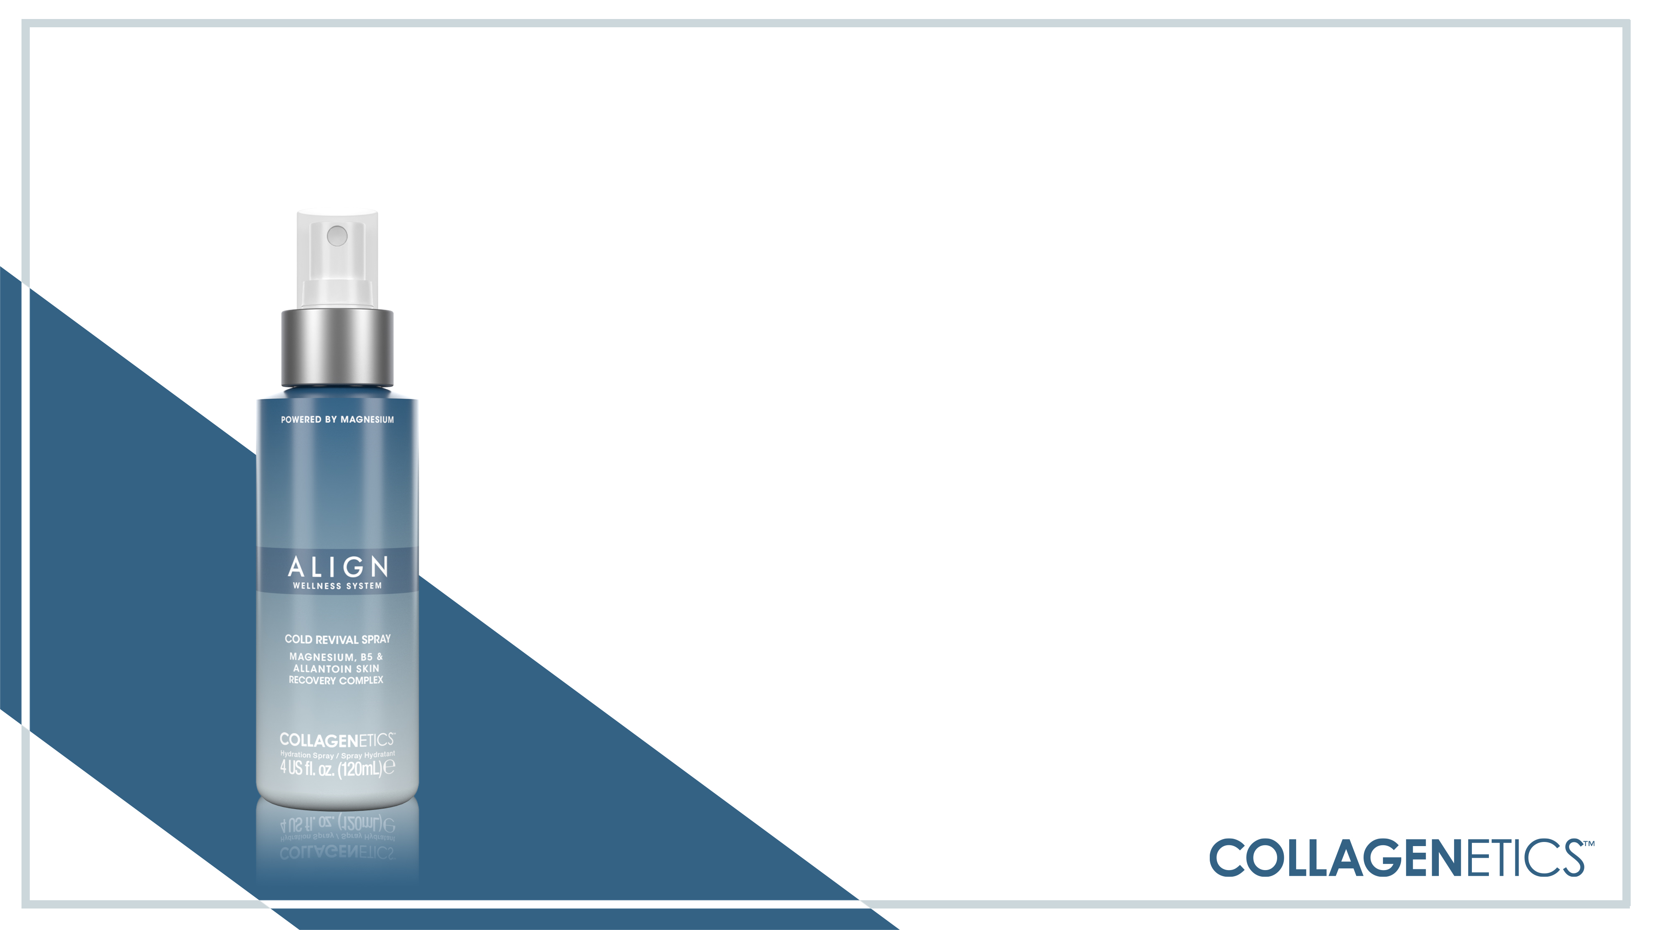
Cold Revival Spray™
Post Cold Renewal Spray
Infused with Vitamin B5(Panthenol) to aid in skin repair while hydrating the skin
Matrixyl works to produce new collagen and works to help anti-aging by eliminating fine lines and wrinkles
Added Allantoin helps to calm irritated skin and support recovery
Magnesium works to create a more balanced, soothed skin state after cold therapy
Infused with Chamomile to reduce visible signs of stress for a more balanced complexion after cryotherapy
Sodium PCA works to maintain hydration levels in the skin
Fragrance: Blue Cascade
$29.00 Retail

Slide 8
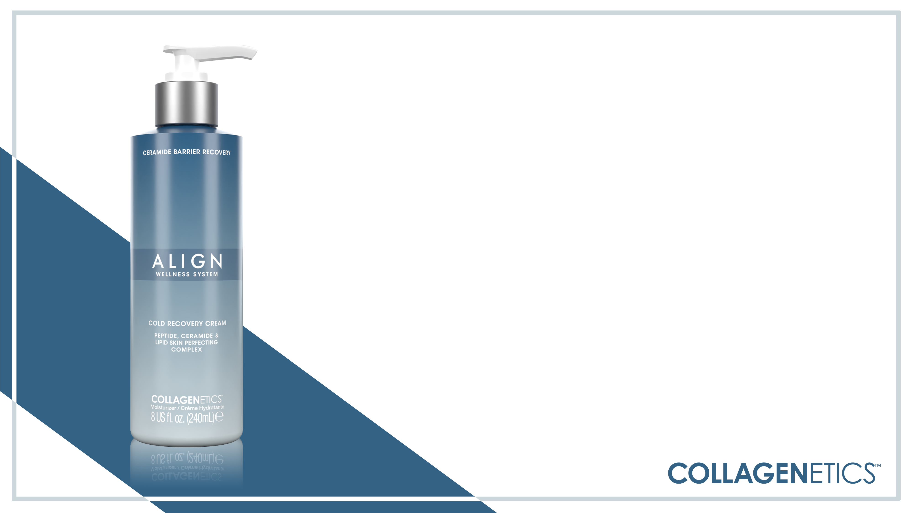
Cold Recovery Cream™
Cold Recovery Cream
Infused with Ceramides to aid in skin repair while hydrating the skin to protect the skins natural moisture barrier
Matrixyl works to produce new collagen and works to help anti-aging by eliminating fine lines and wrinkles
Added Allantoin helps to calm irritated skin and support recovery
Fatty Acids work to replenish lost lipids supporting the skins hydration levels after cryotherapy
Infused with Cholesterol to improve moisture retention
Squalane works to to leave the skin with weightless hydration and supports the skins lipid barrier
Fragrance: Blue Cascade
$34.00 Retail

Slide 9
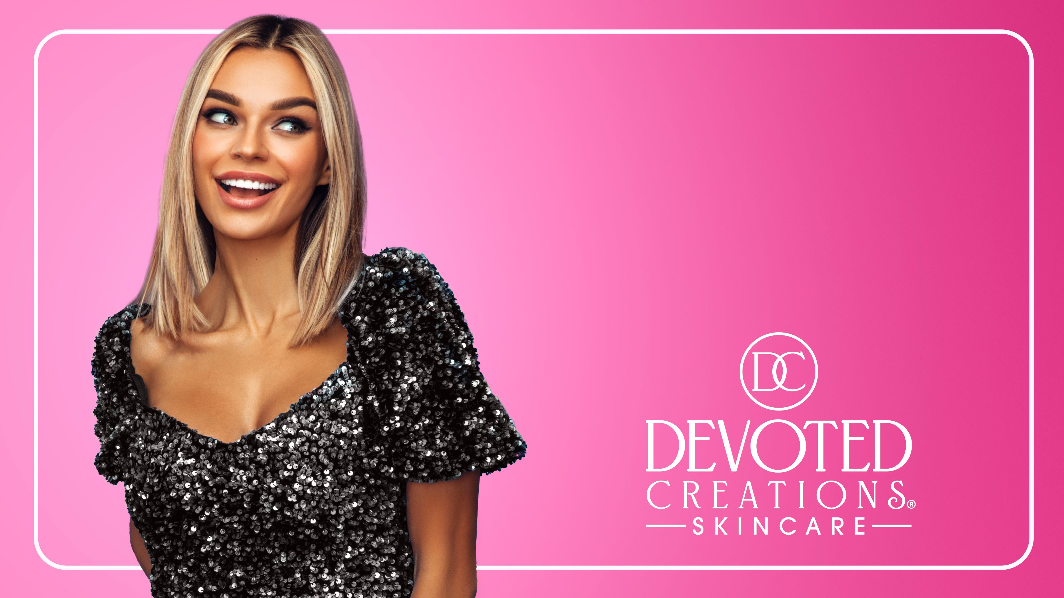
Makayla Thomas
International Sales Trainer
Gracie Cale
Key Accounts Executive

