Slide 1
Prep & Maintain

Slide 2
Prepping the Skin
Clients are coming to the salon to prep their skin
Building their initial base tan, teeth whitening, etc
What products are they using?
Tanning lotion, facial products, tan extender/moisturizer
Educating them on the proper steps of prepping their skin for any type of tan (exfoliating, shaving)
It will optimize their results and last longer

Slide 3
Why they need to prep with a good tanning lotion!
Saves them time and money
Increases their results every time they come in to tan because of tyrosine
Keeps their skin hydrated during and after the tanning process to extend the life of their tan and absorb more UV light

Slide 4
Why they need to have a good tan extender for maintenance!
Drugstore vs Professional Salon Grade Tan Extender
Mineral Oil free – wont clog their pores
Made specifically for tanners to help extend the life of their tan and keep their skin hydrated
But great for everyday client usage!
Doesn’t dry out the skin and keeps your skin cells hydrated and keeps their life cycle lasting longer

Slide 5
The best add on products for Vacation Tanners!
Facial products are not just for tanning
Tan extenders help to not only extend the life of your tan, but also give 24-hour hydration to your skin
Body Washes are non-alkaline, paraben & sulfate free
Tan extenders have minis so they can travel with them!

Slide 6
Things to think about…
Add incentives to the bundles that would have them come back to the salon after their vacation
Extra sessions at no charge
Buy a bottle of tanning lotion & facial lotion, get the tan extender for free
Buy a lotion, get a month of tanning at a discounted rate plus #x of tans in April
Buy a lotion, get a month of tanning at a discounted rate with free enrollment for EFT upon return

Slide 7
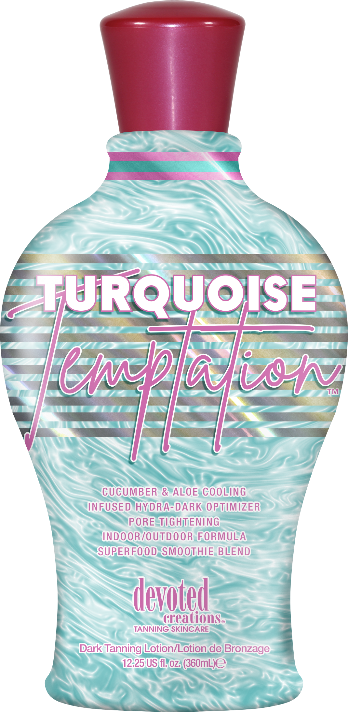
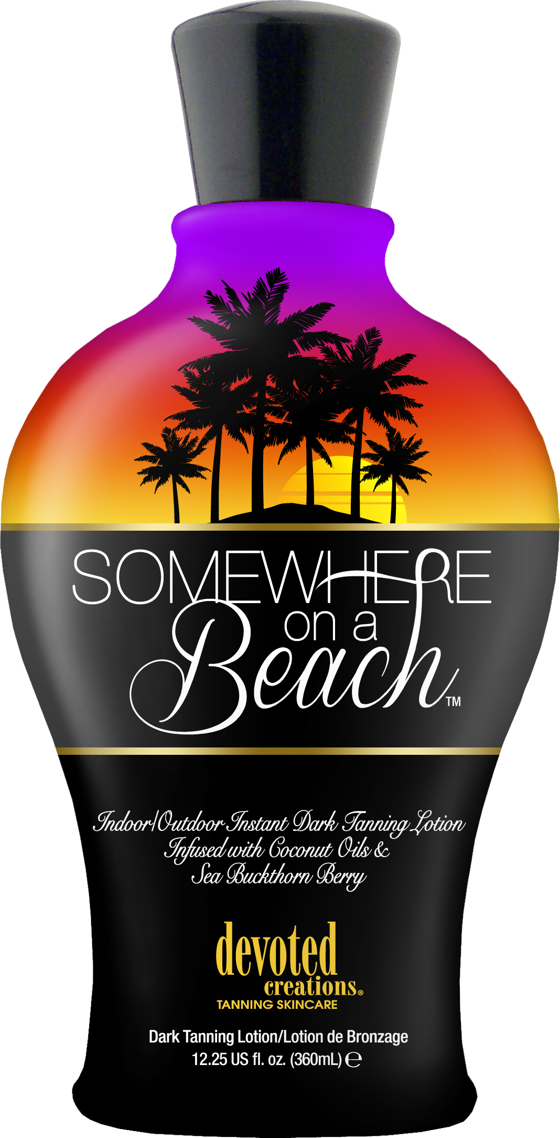
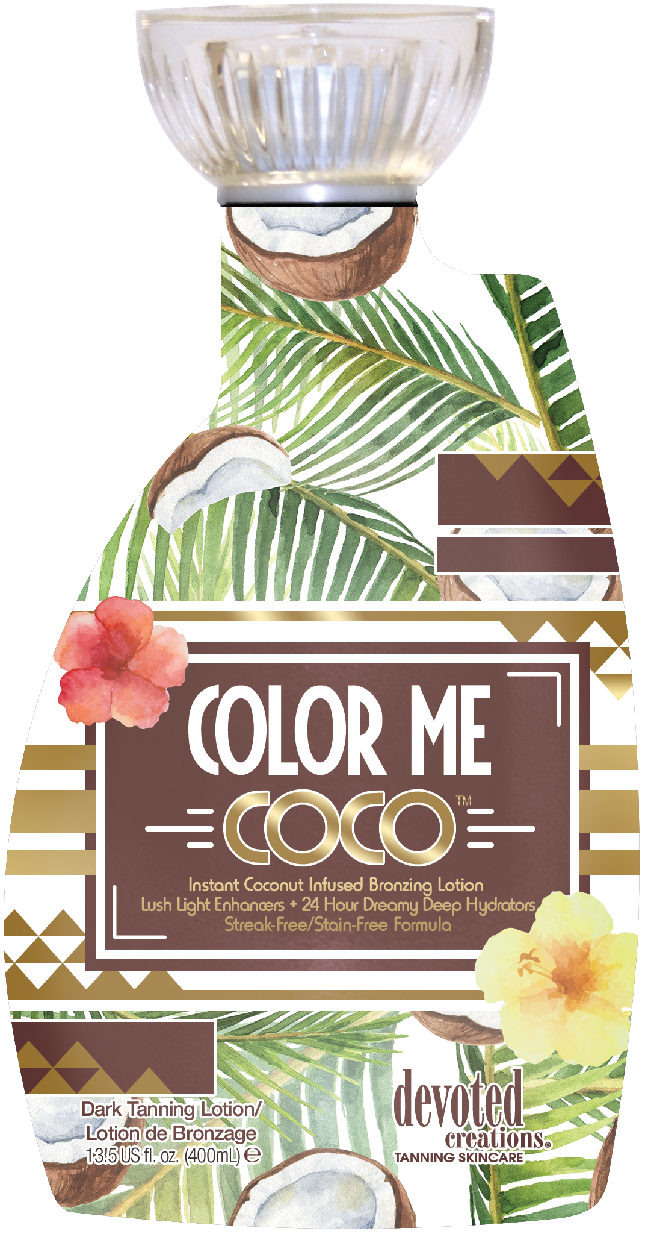
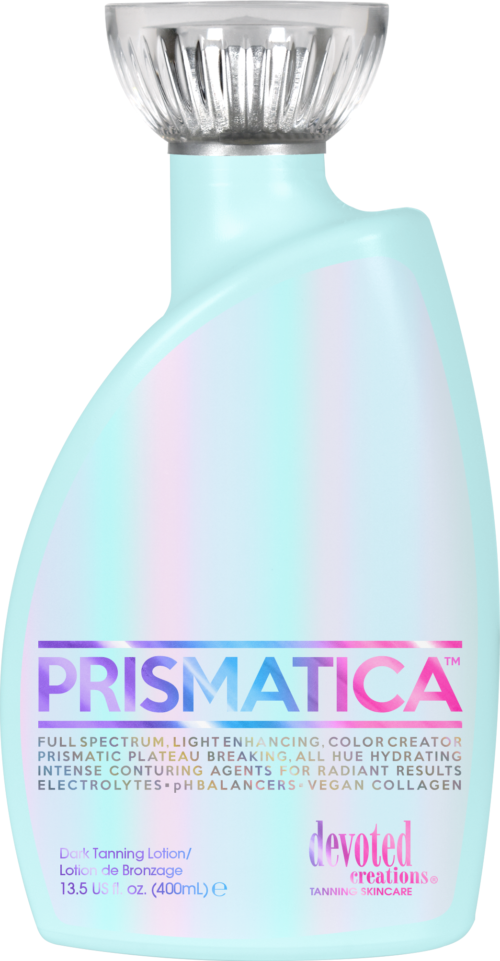
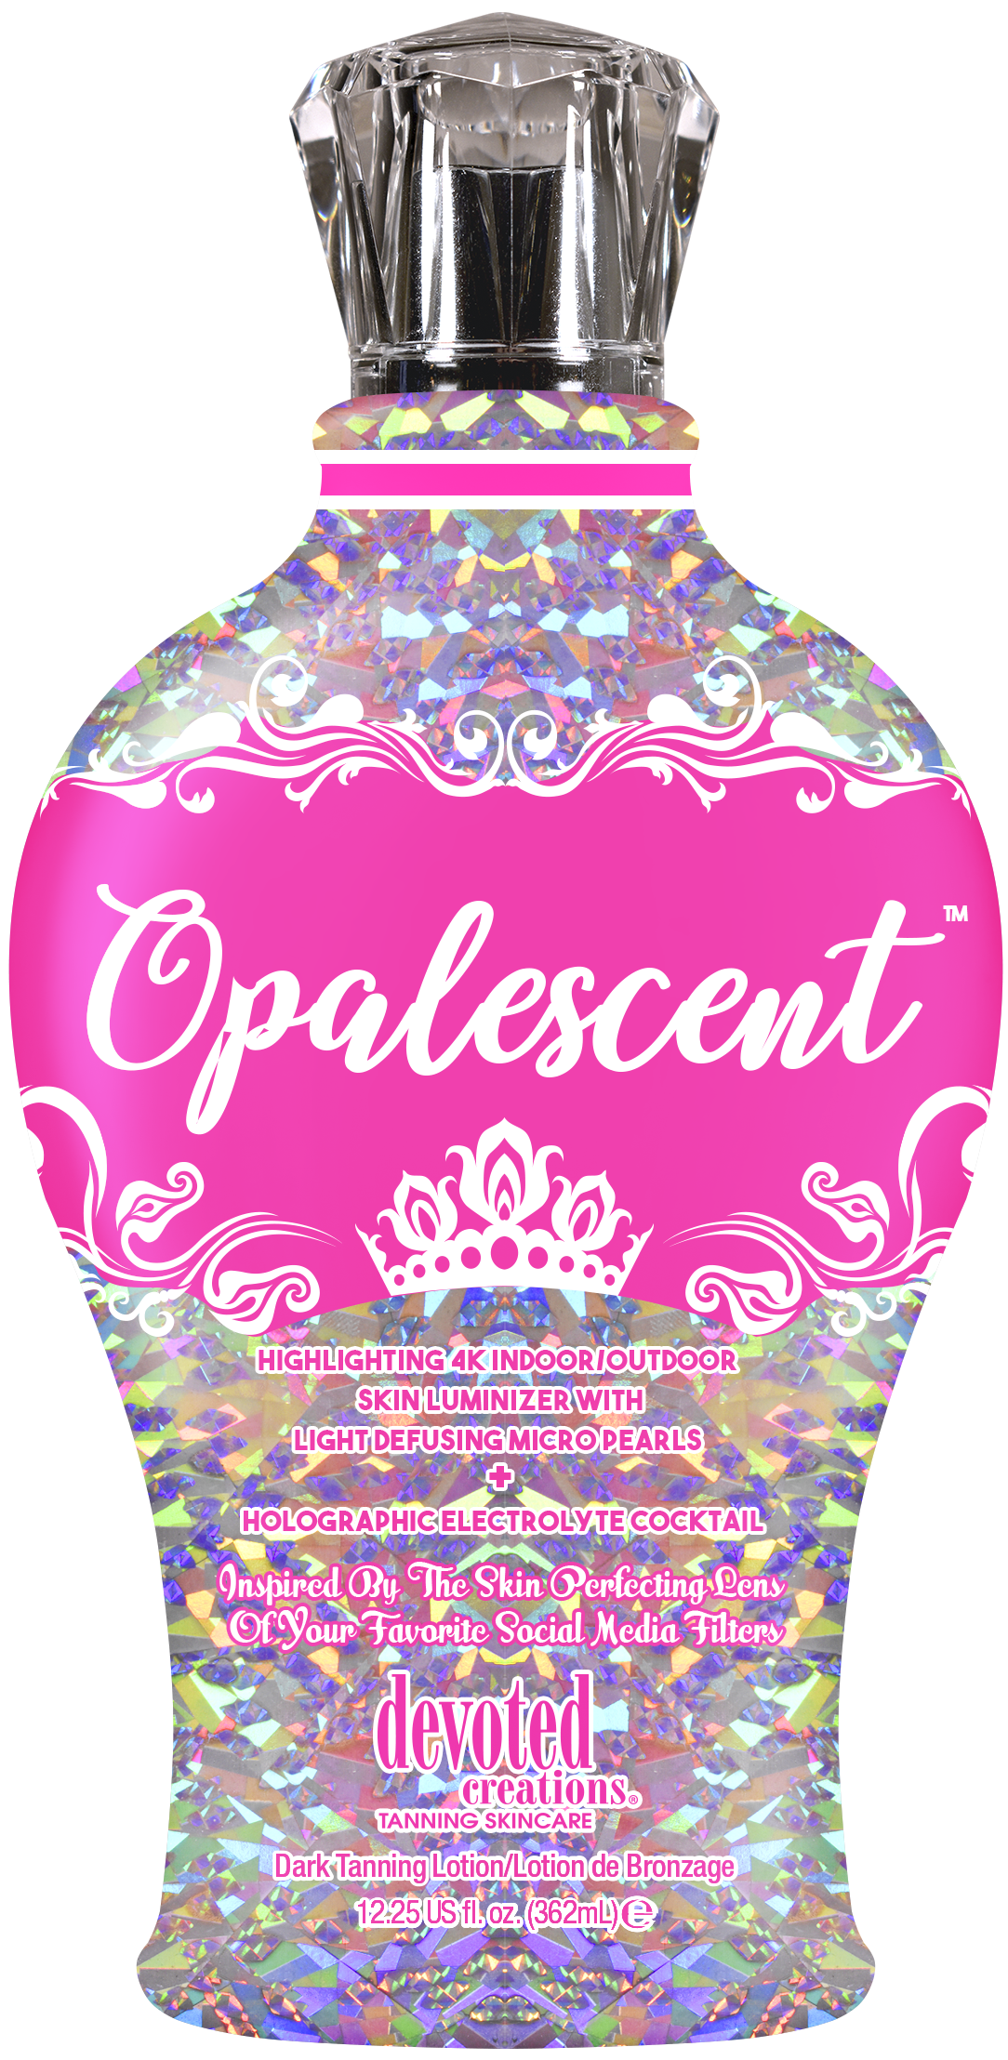
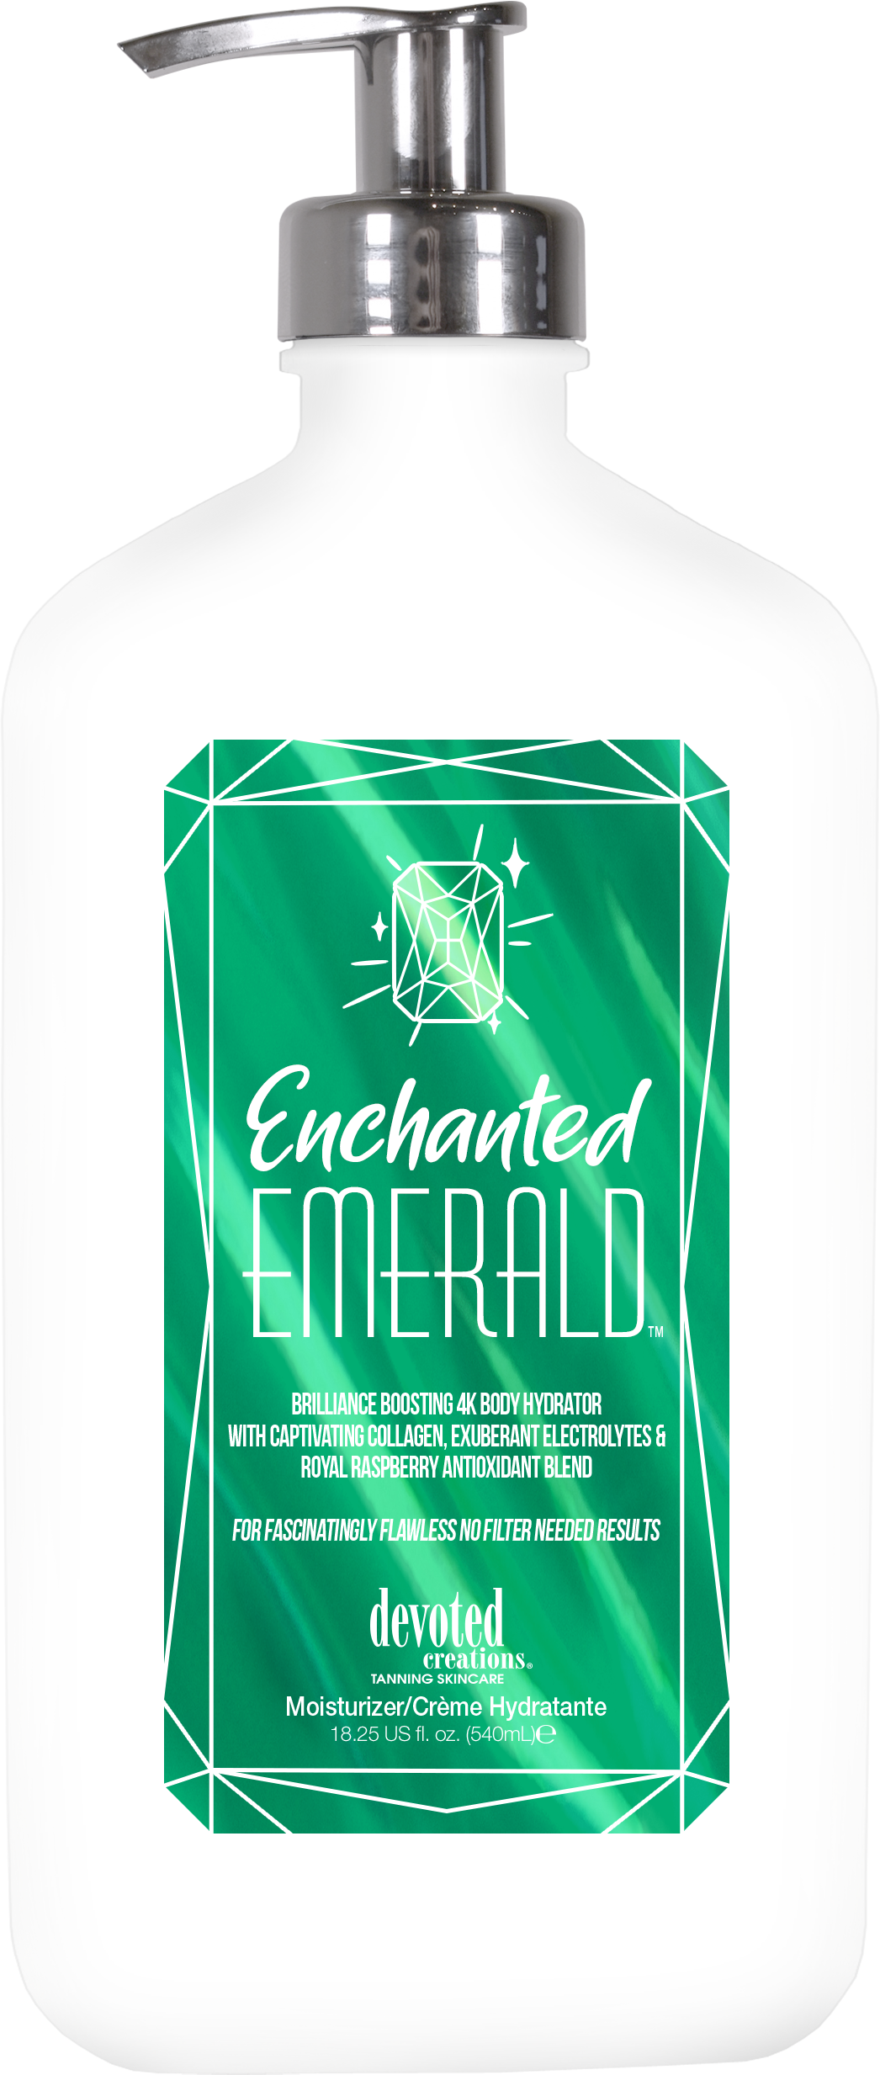
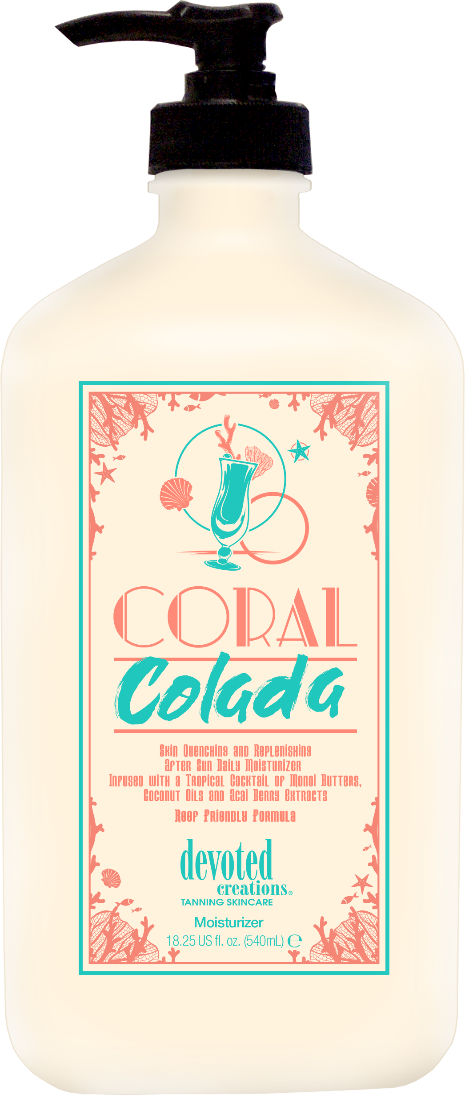
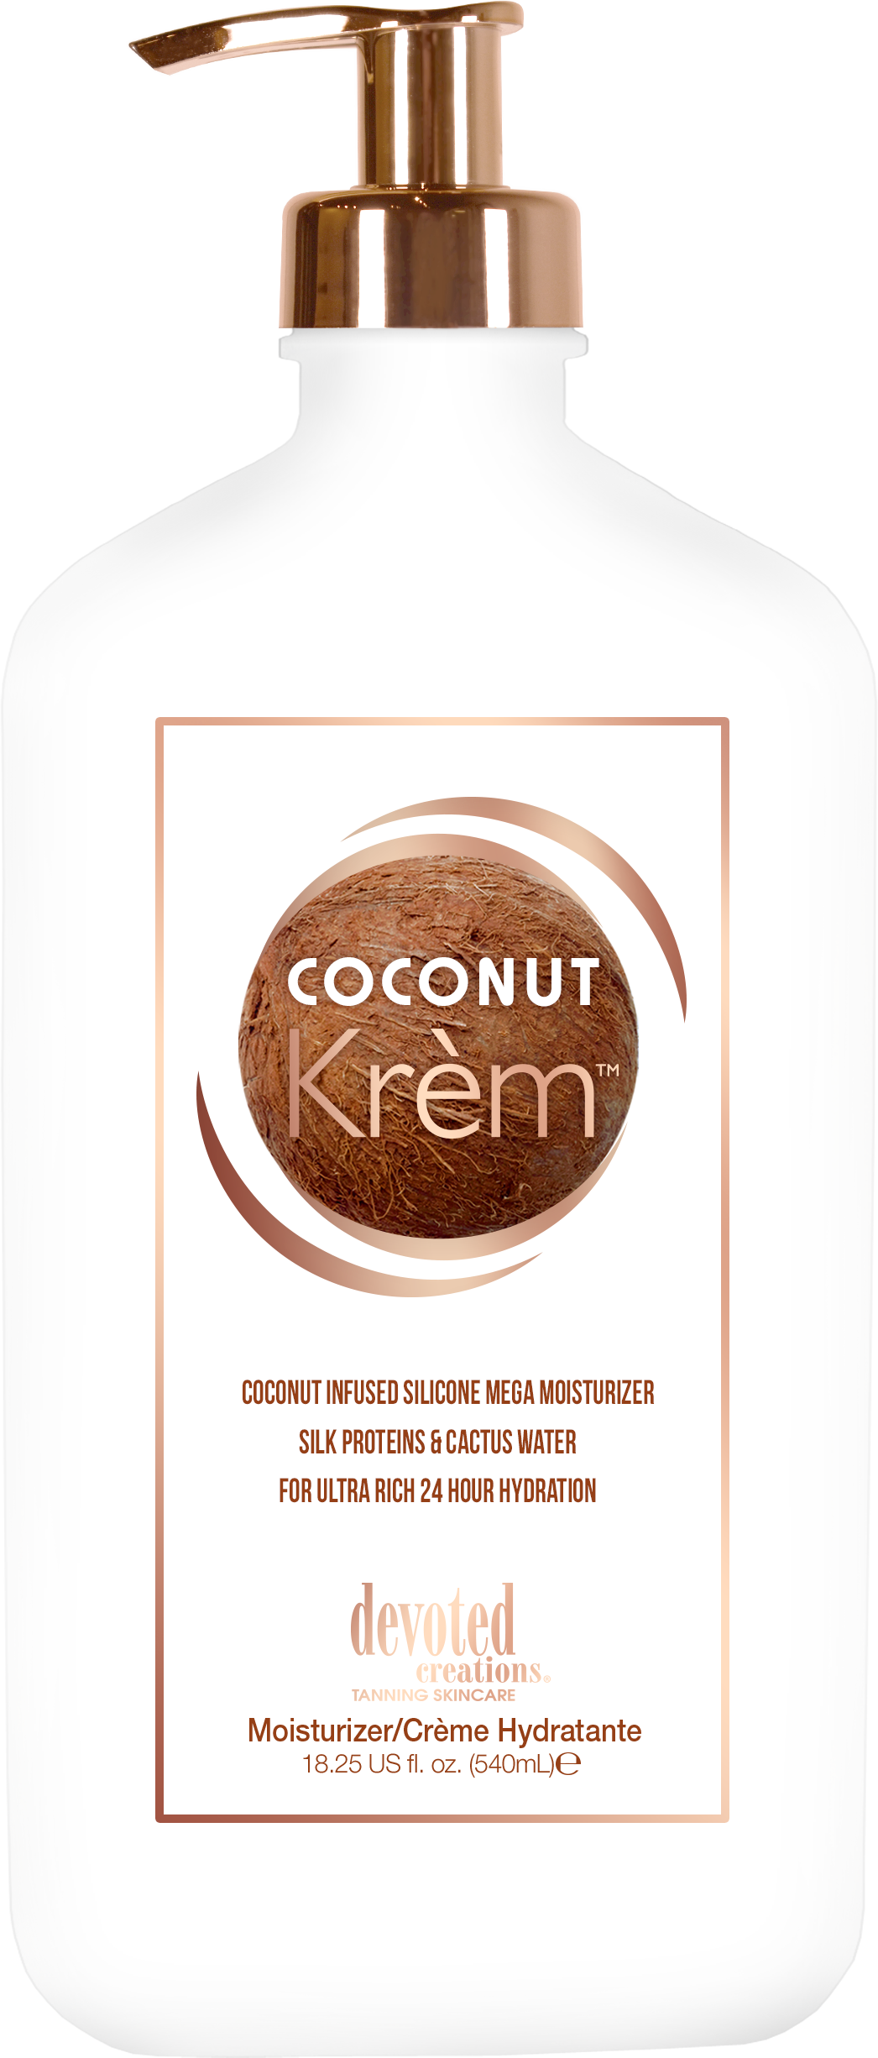
Spring Break Bundle Combinations

Slide 8
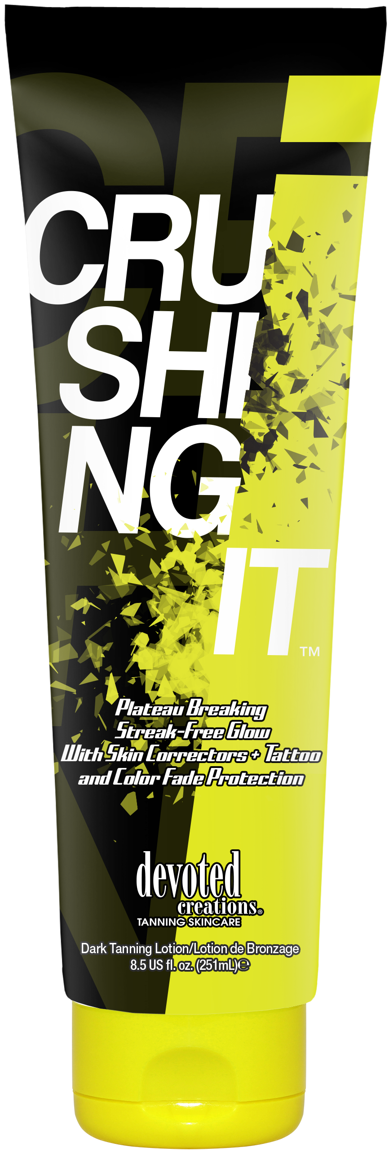
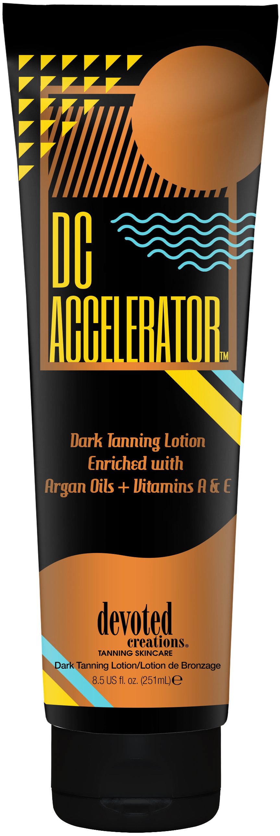
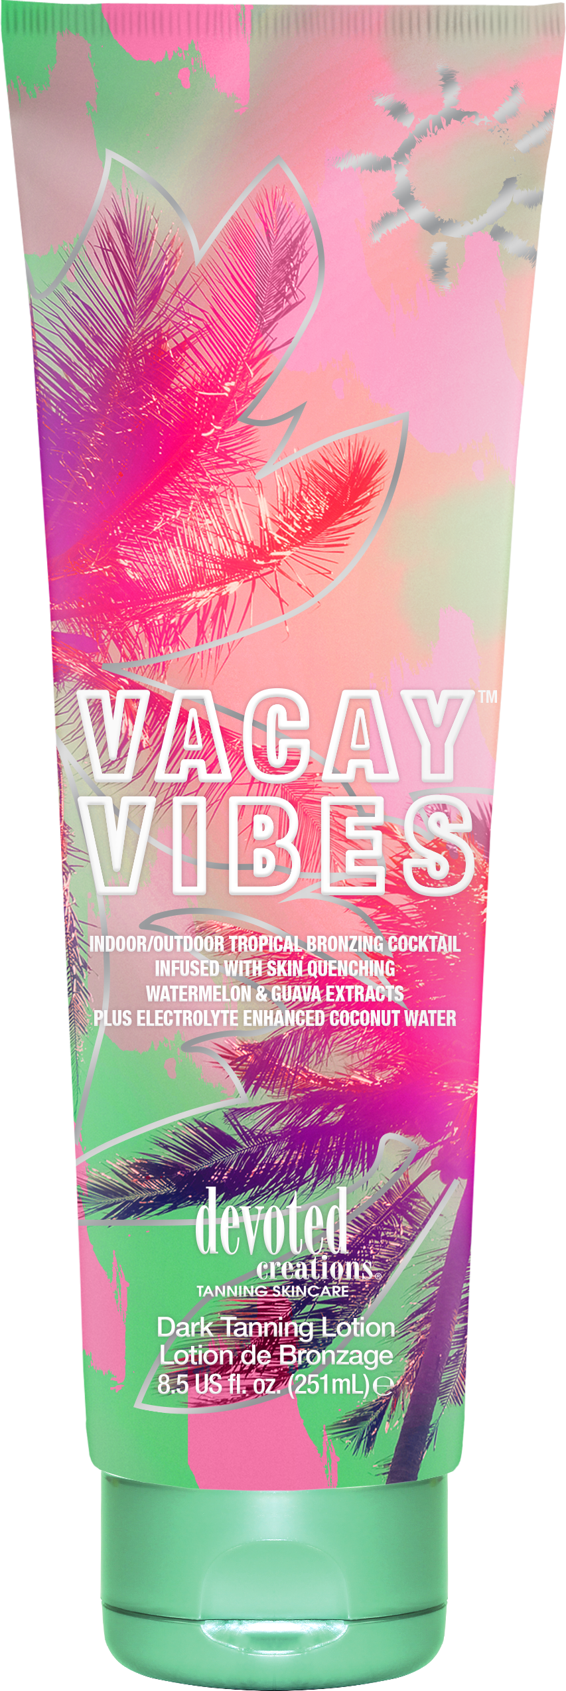
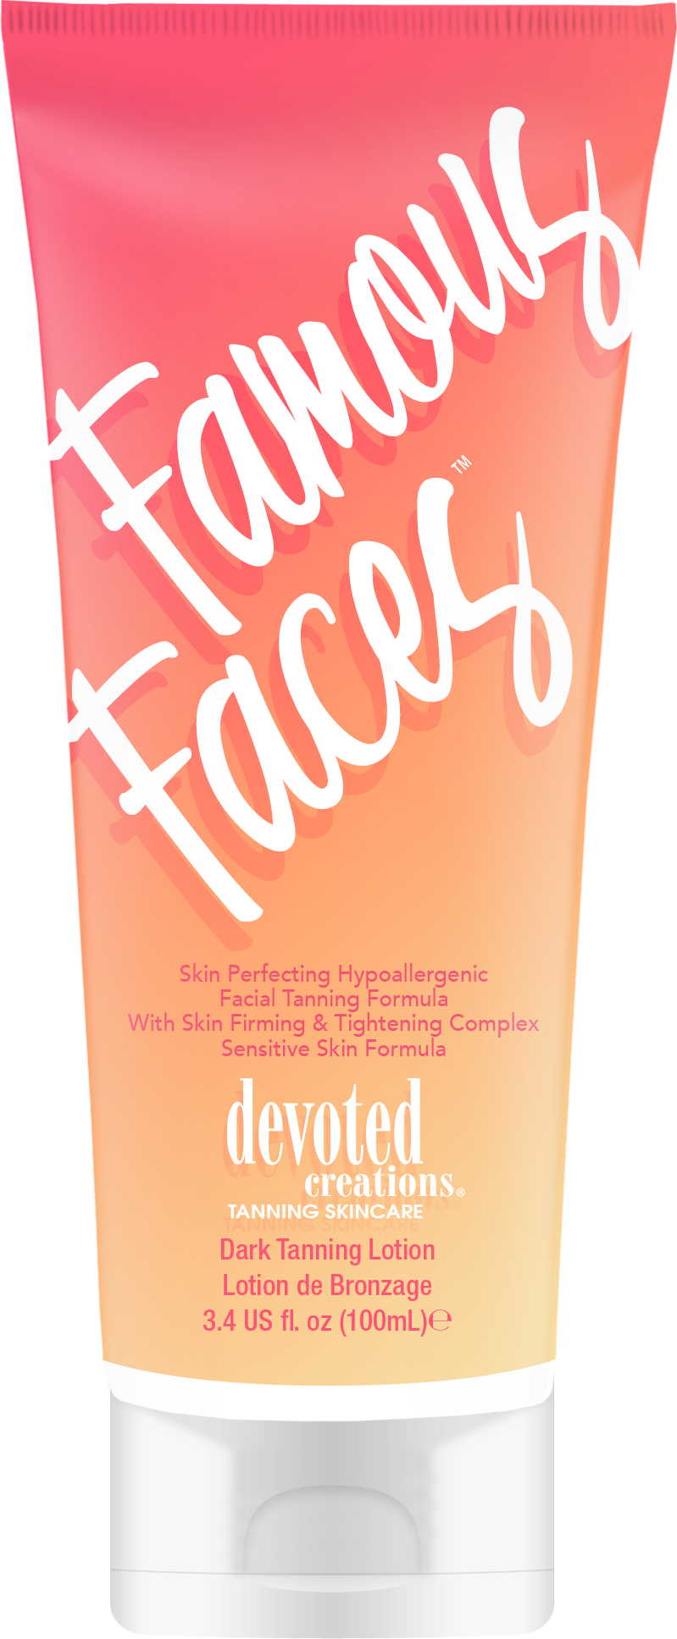
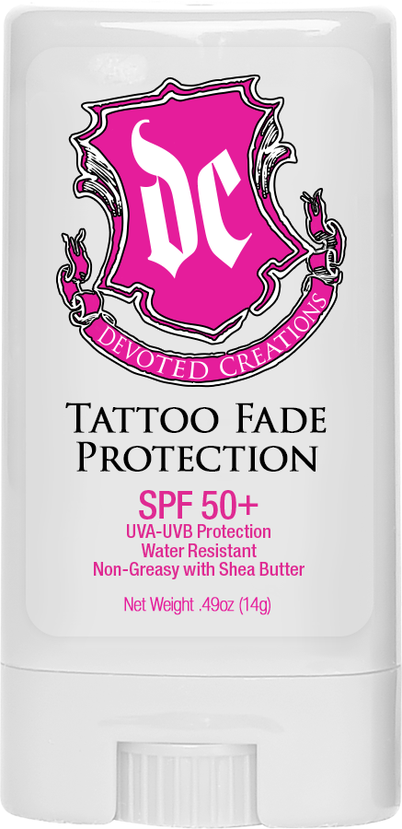

Slide 9
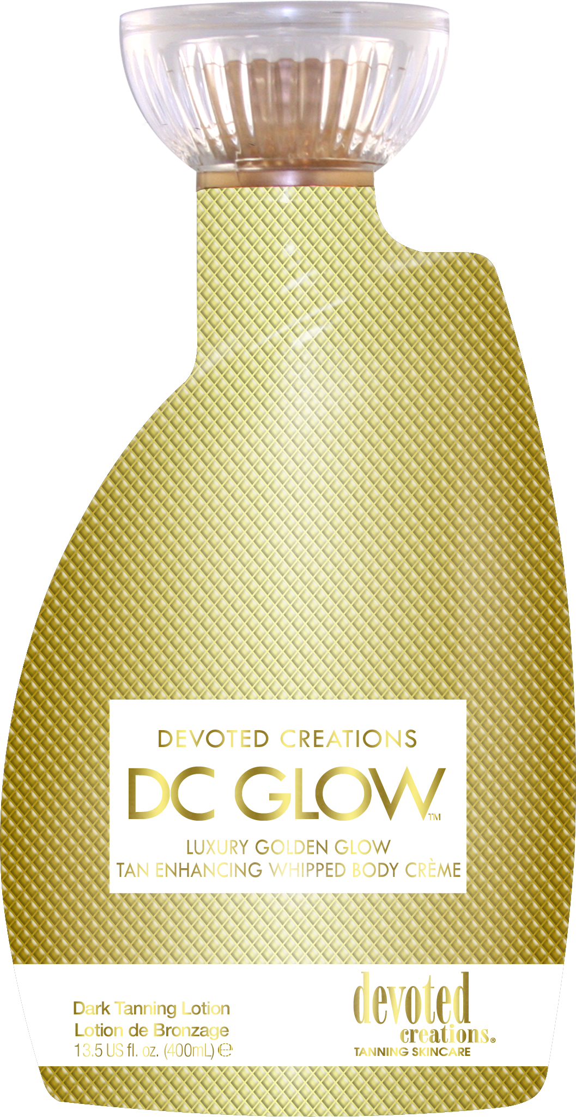
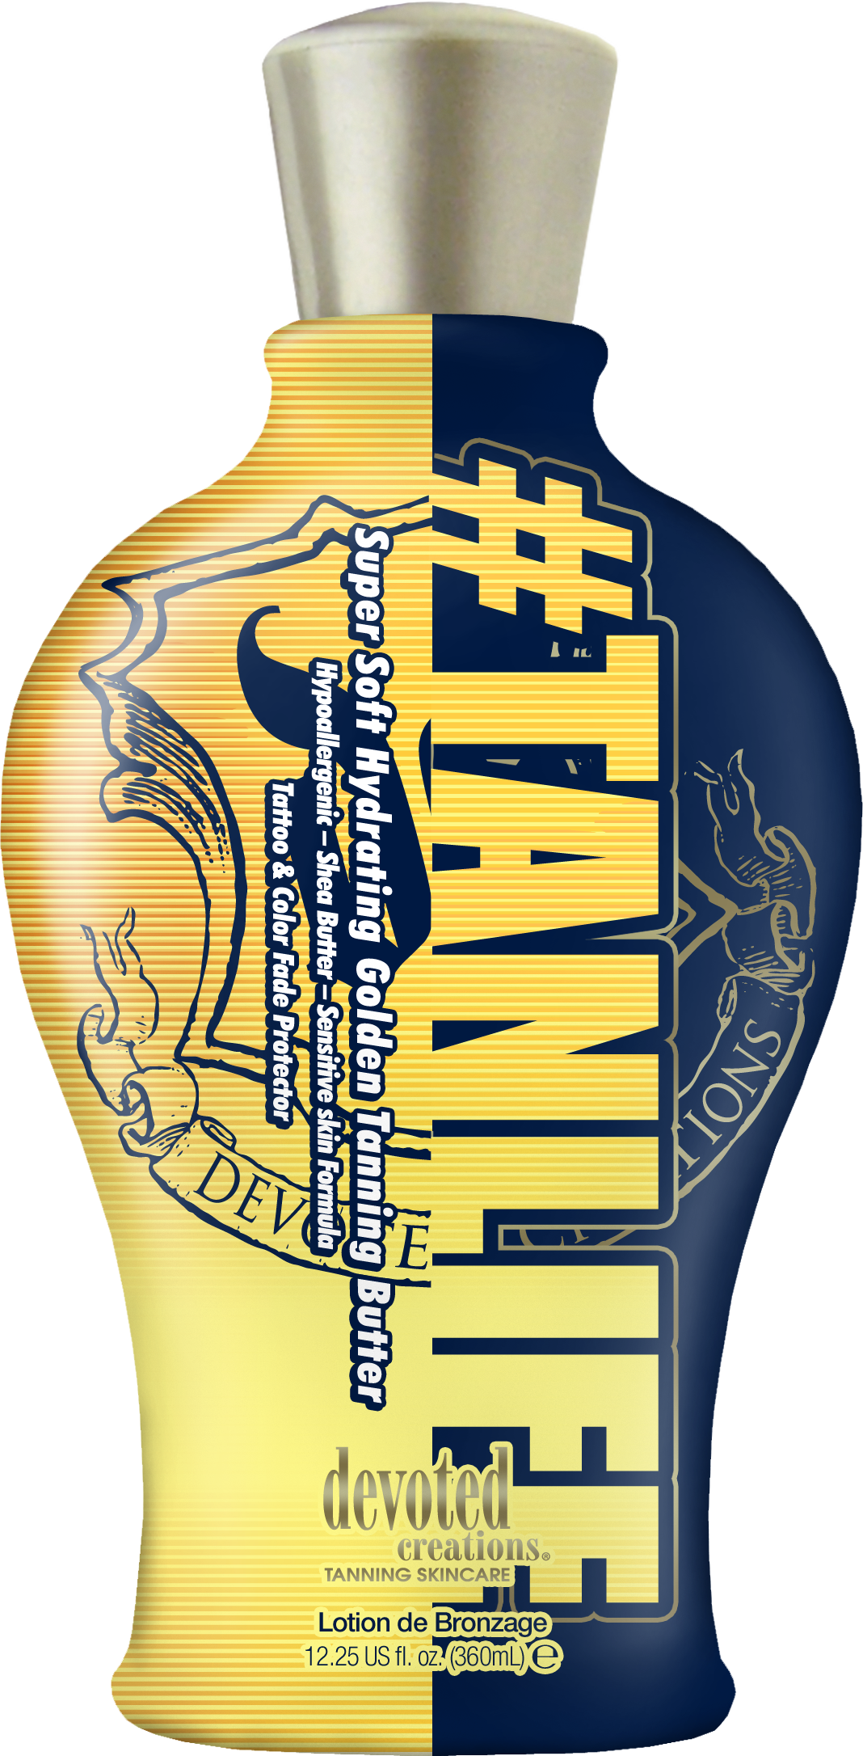
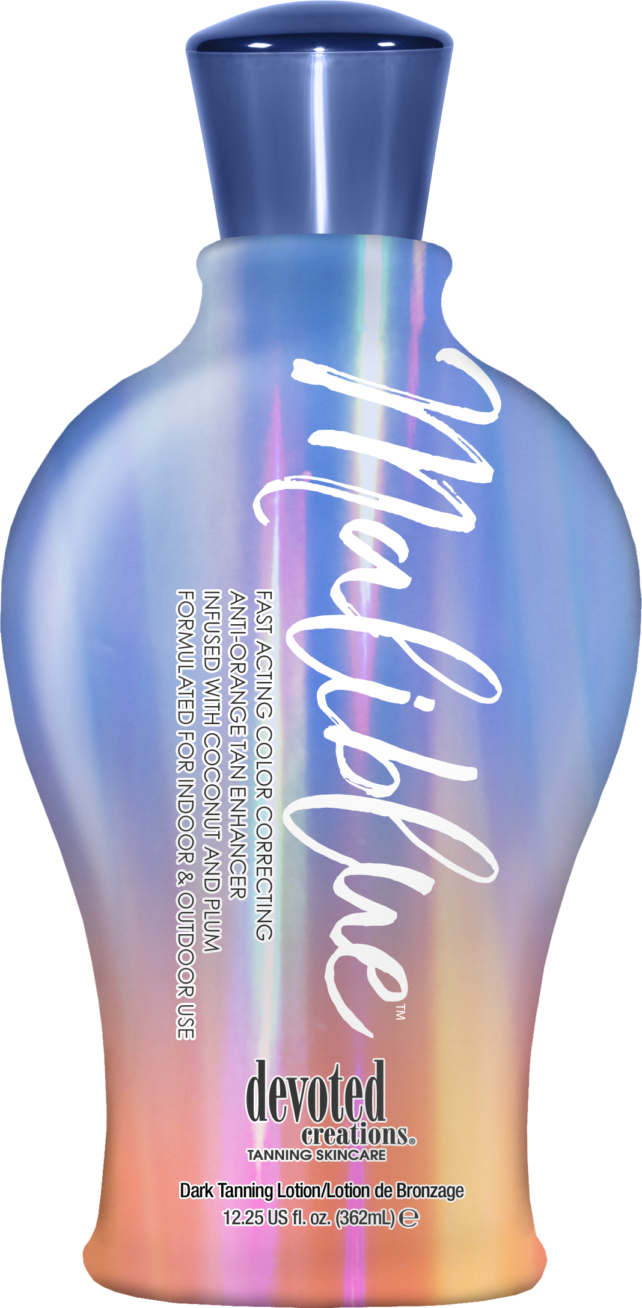

Slide 10
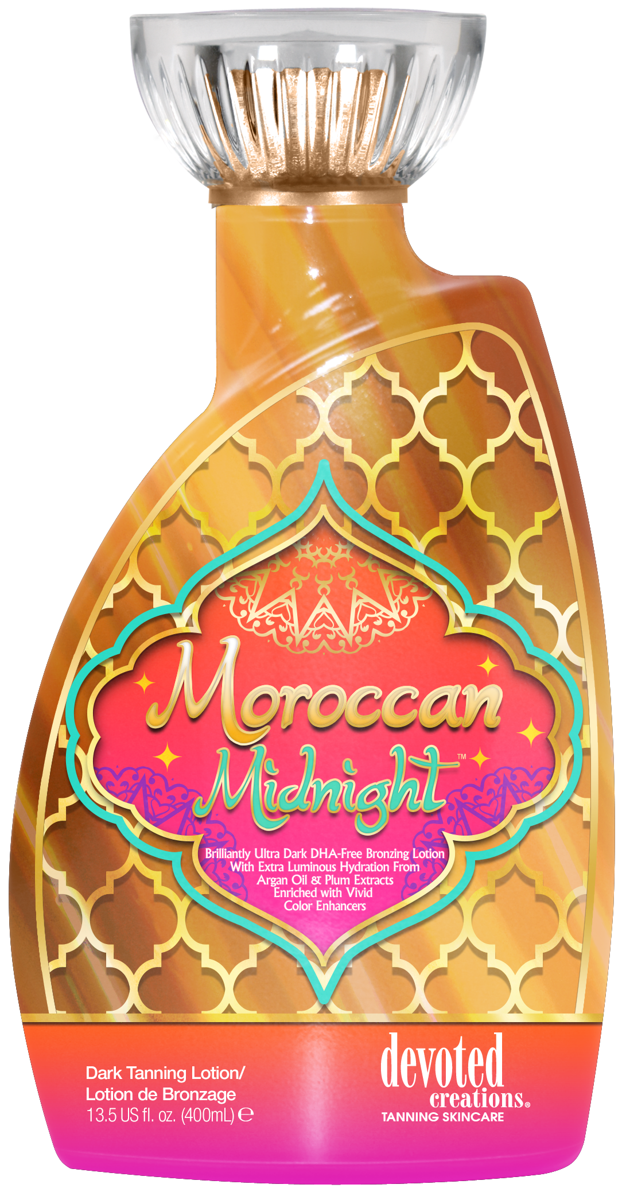
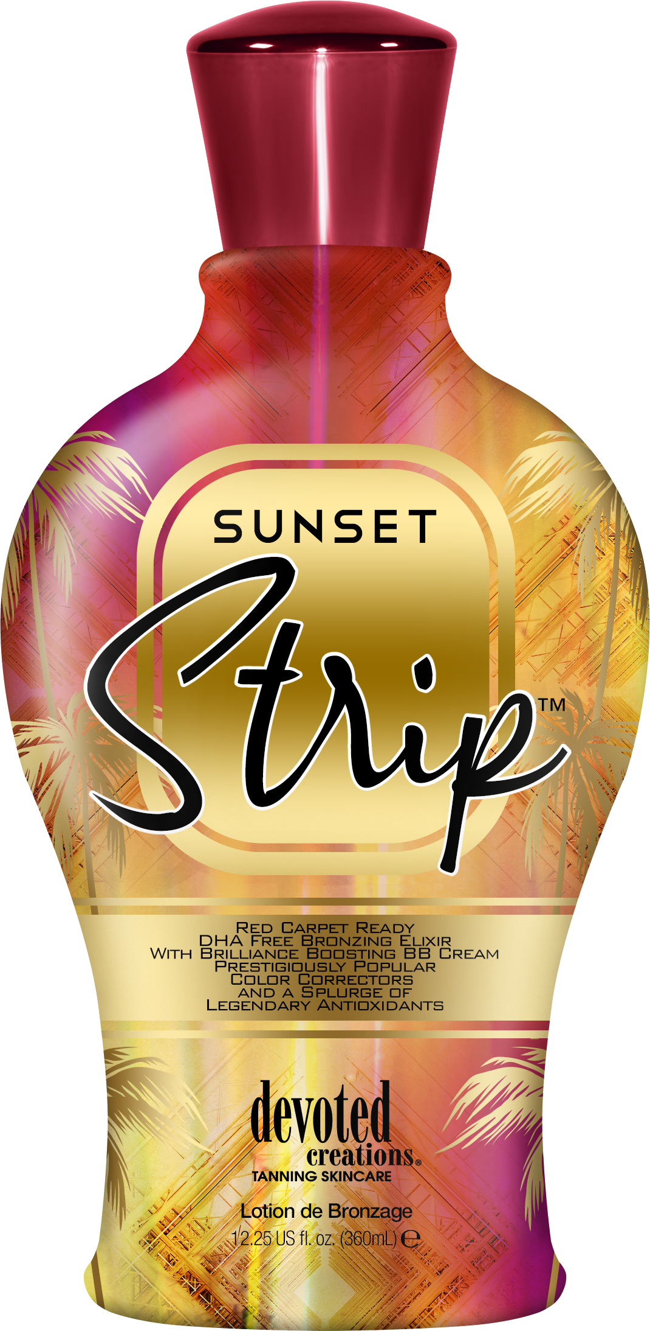
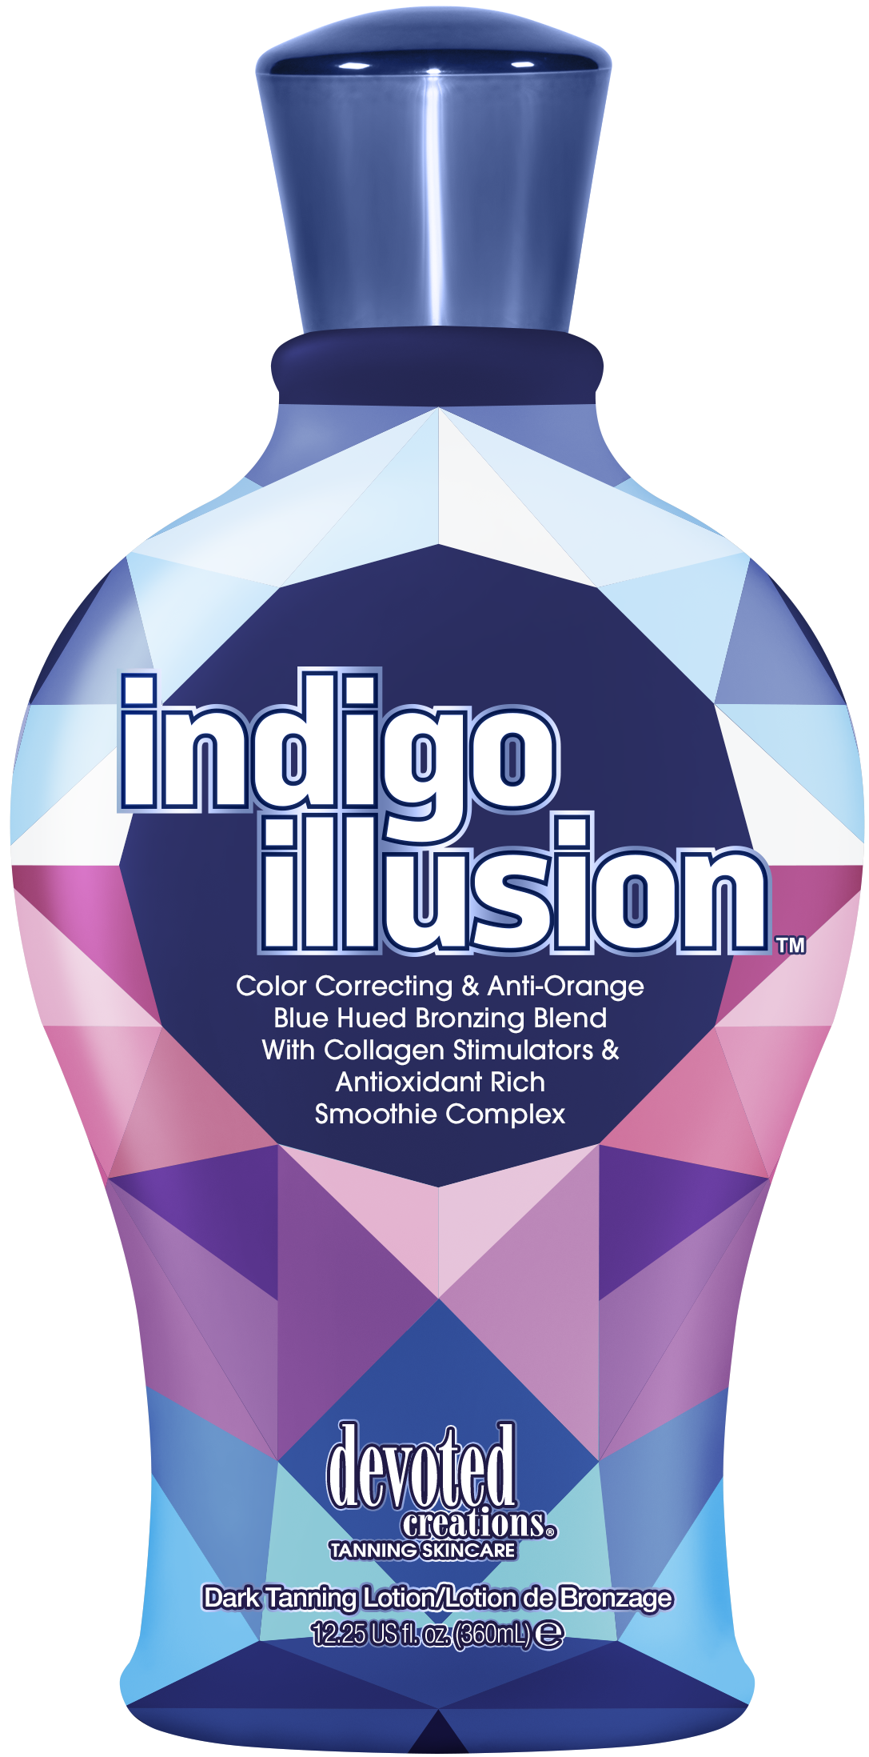

Slide 11
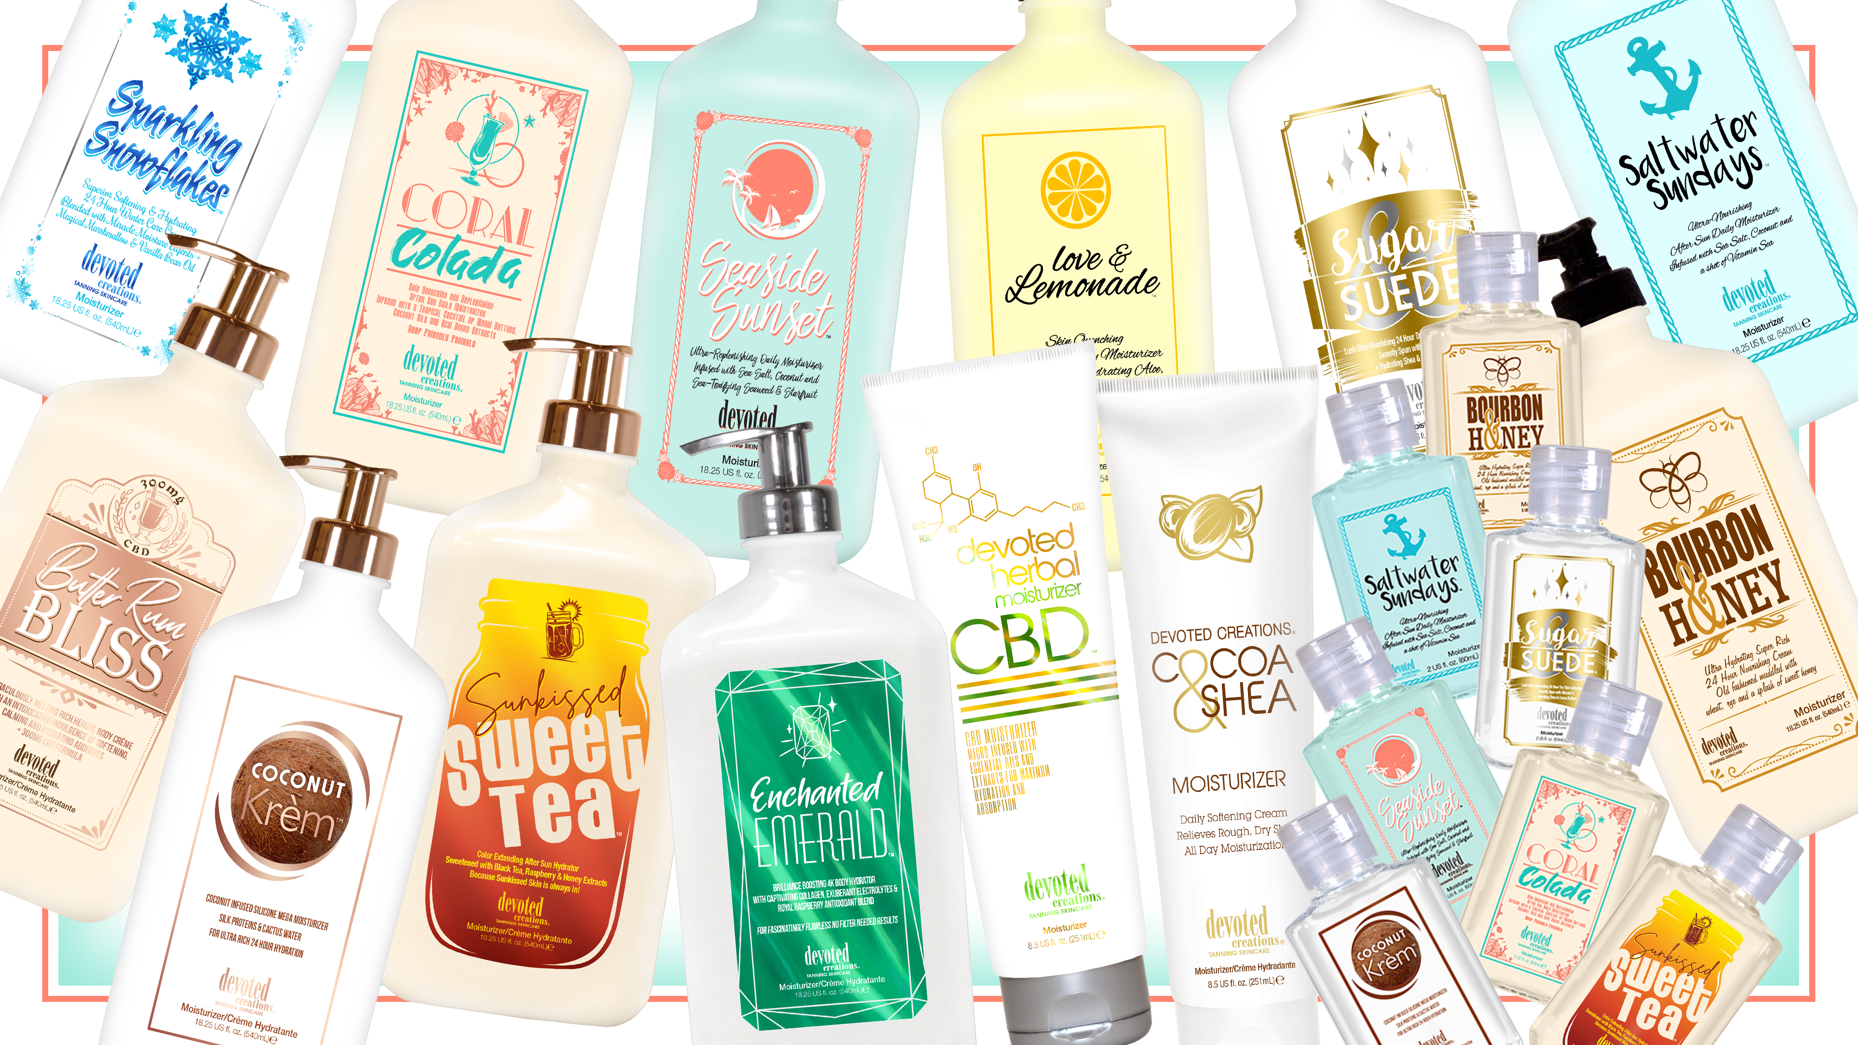

Slide 12
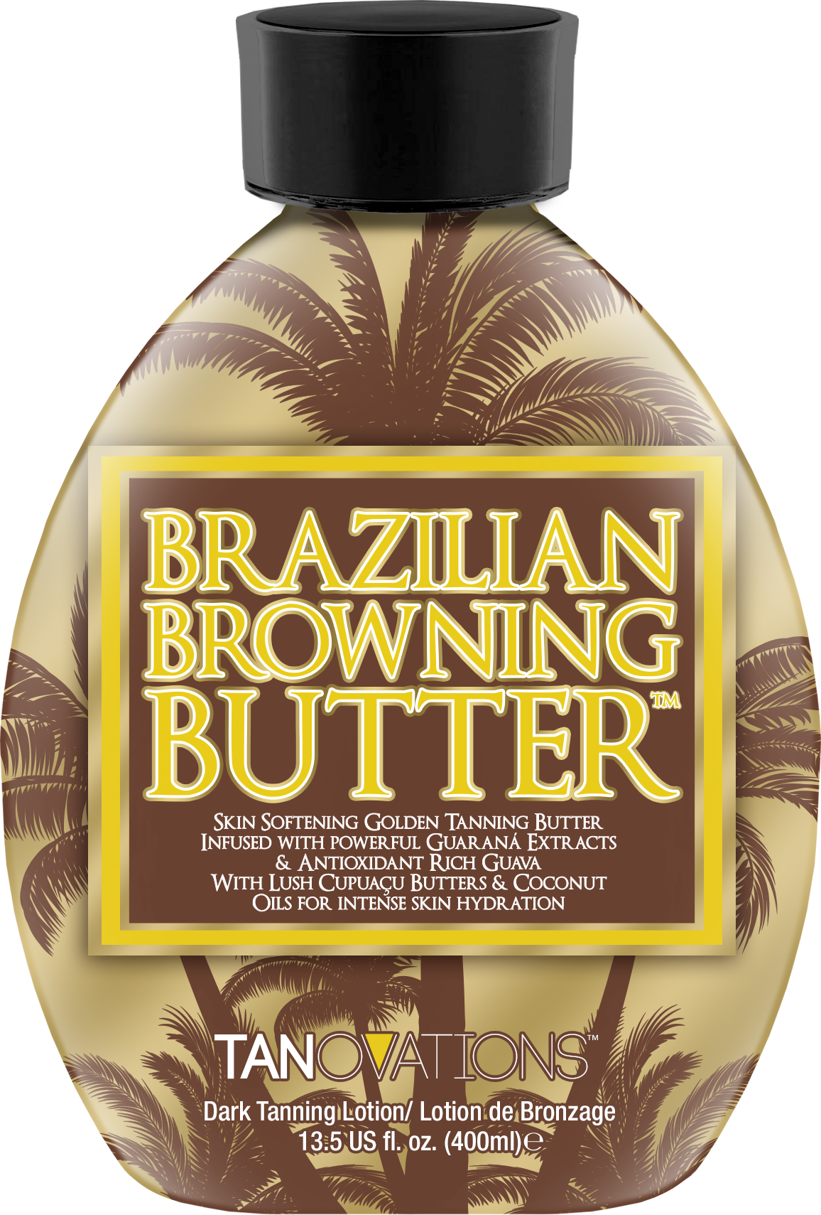
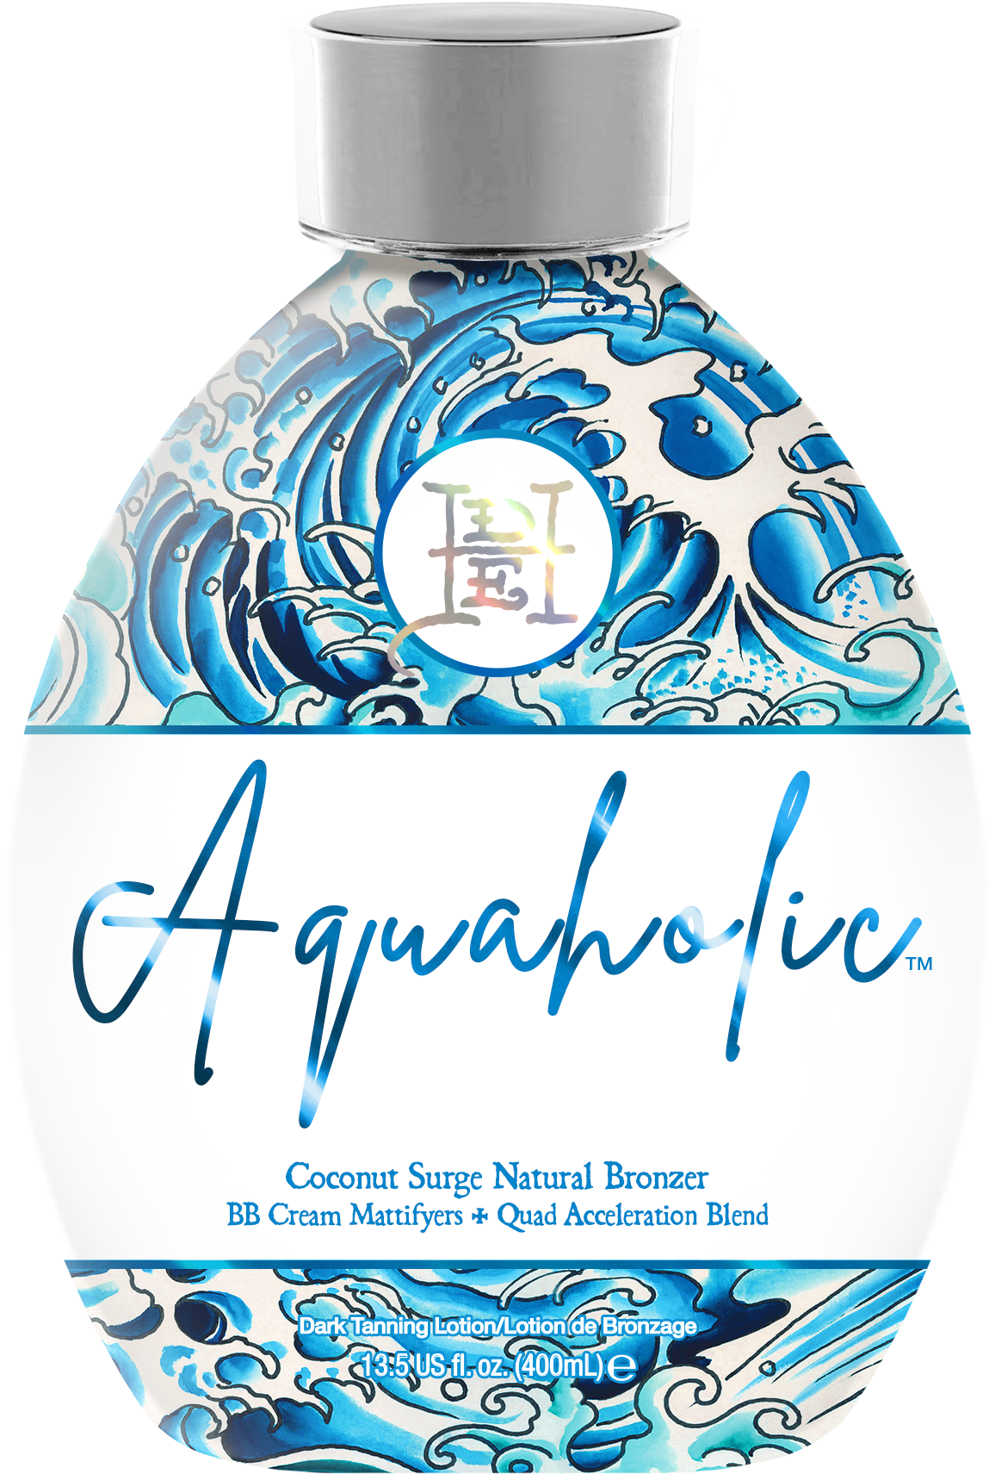
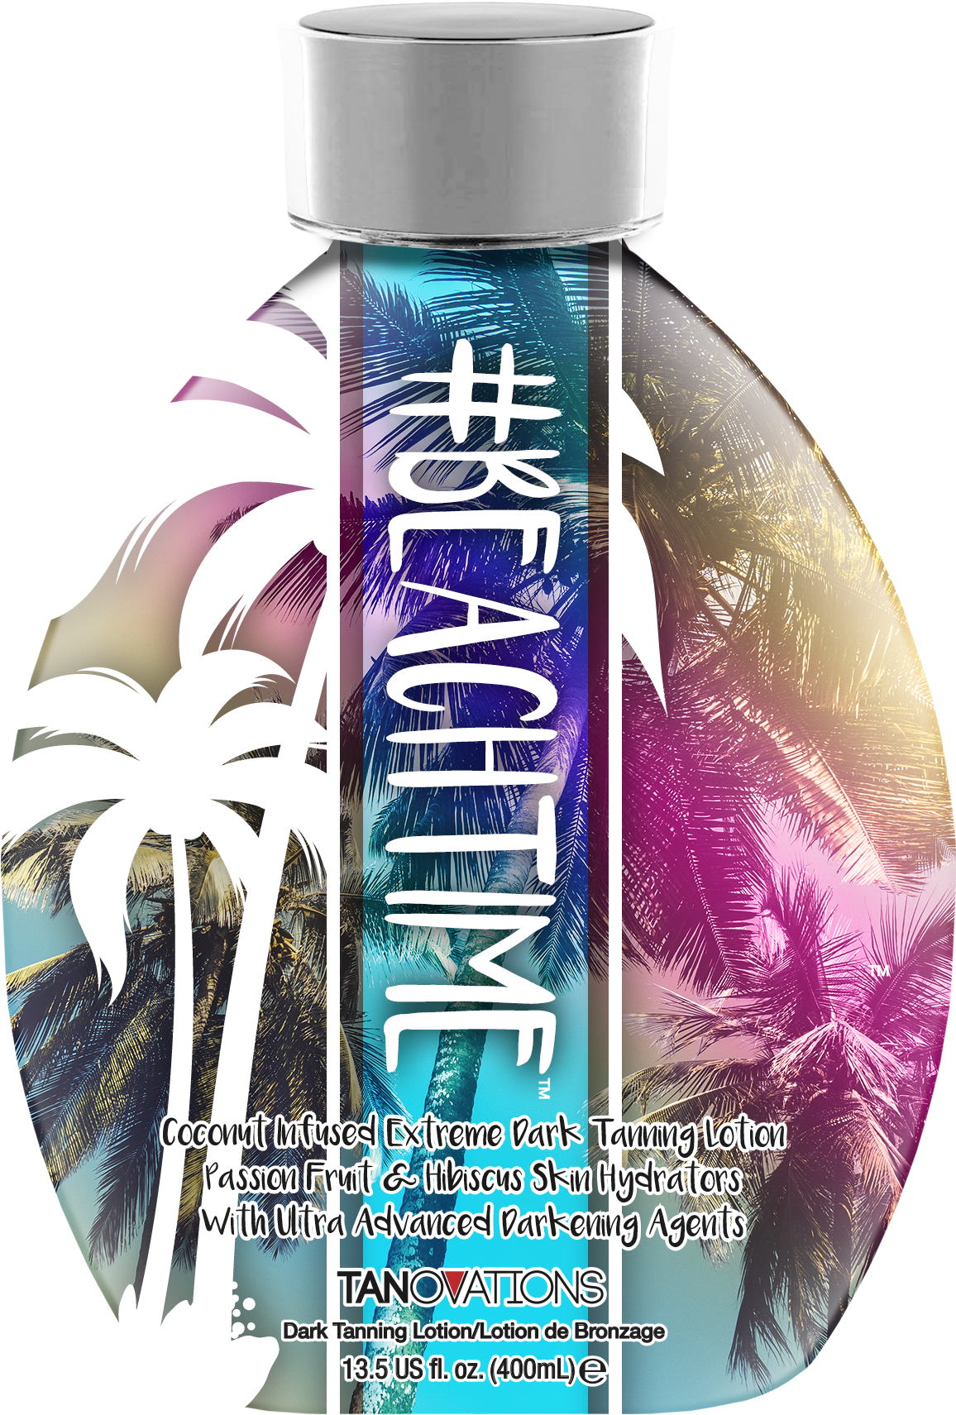

Slide 13
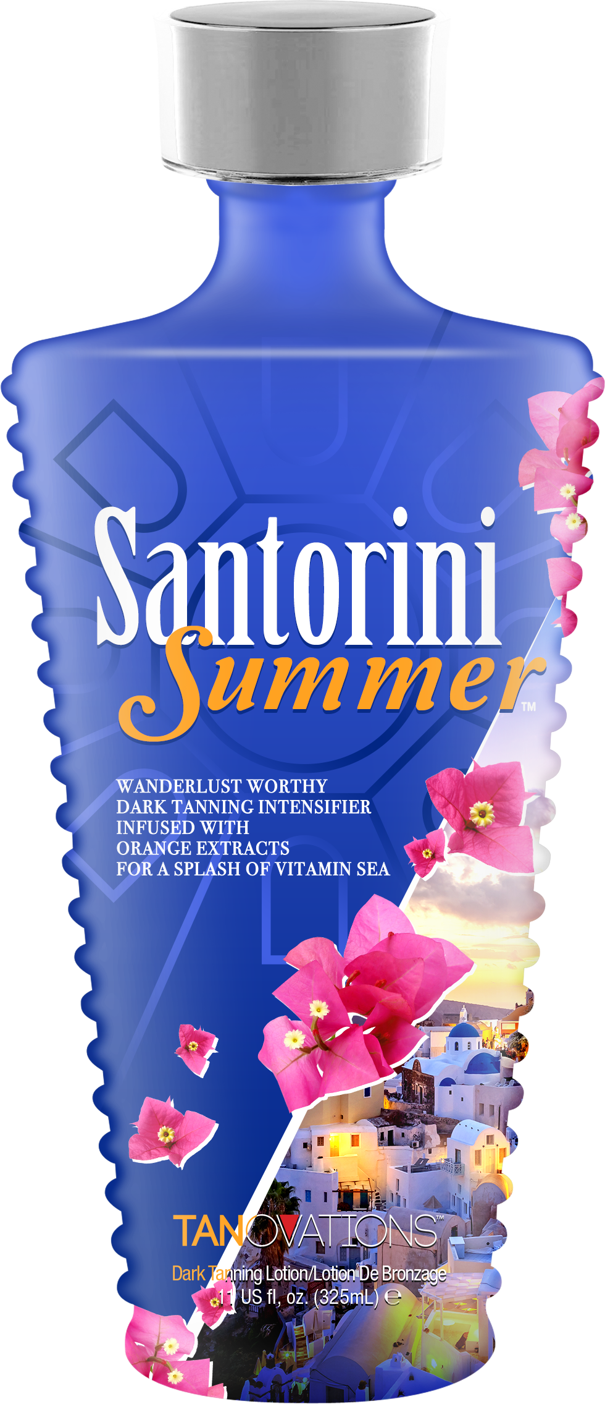
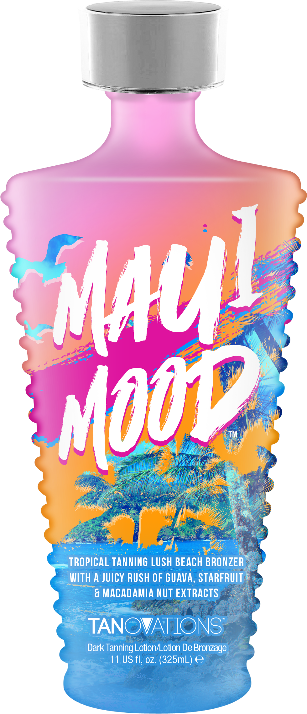
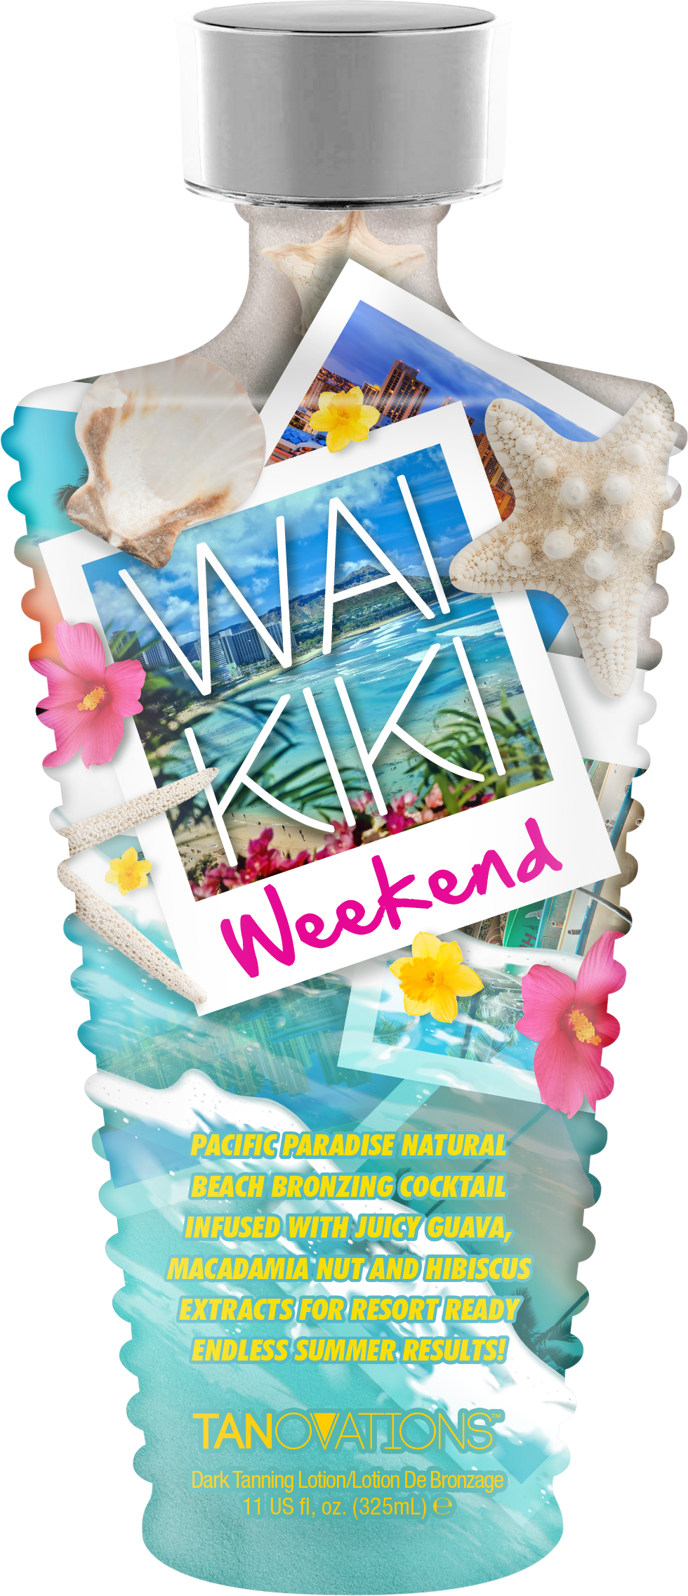
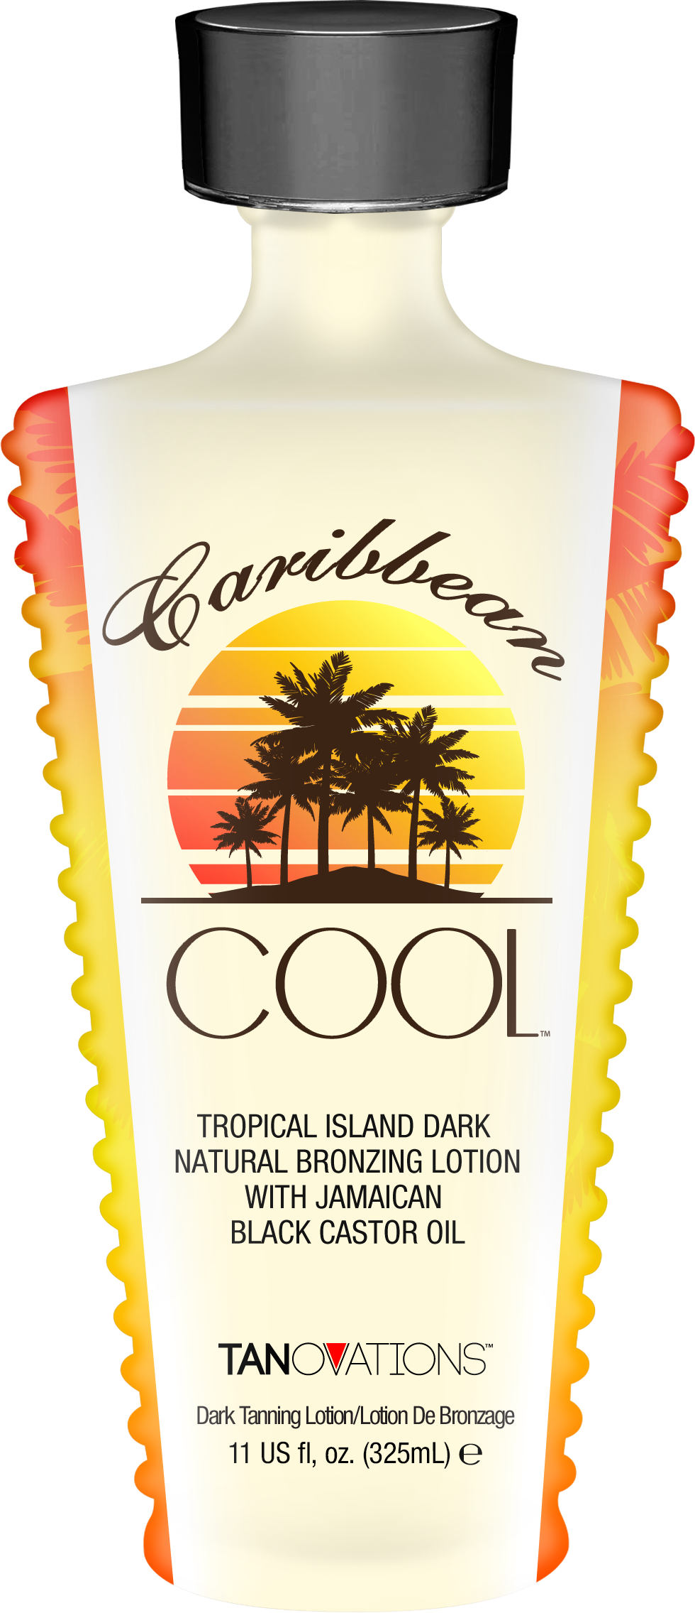

Slide 14
Megan Racine
National Sales Trainer
megan@devotedcreations.com
813.361.1866

