Slide 1
How To Make Your Retail Space POP!

Slide 2
Memorable first impressions
New products or sales need to be seen first, colors and textures matter
Research indicates that customers look from left to right
Have signage /advertisements with information that helps clients find what they want/need, place at eye level
Shelving heights, layout designs, rule of 3 tells customers which featured items to focus on
Sometimes shoppers prefer environments without sharp edges - open display shelves or rounded display tables encourage touch and holding items

Slide 3
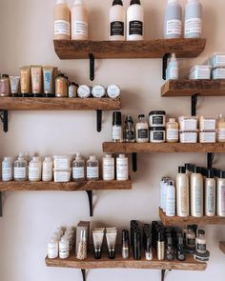
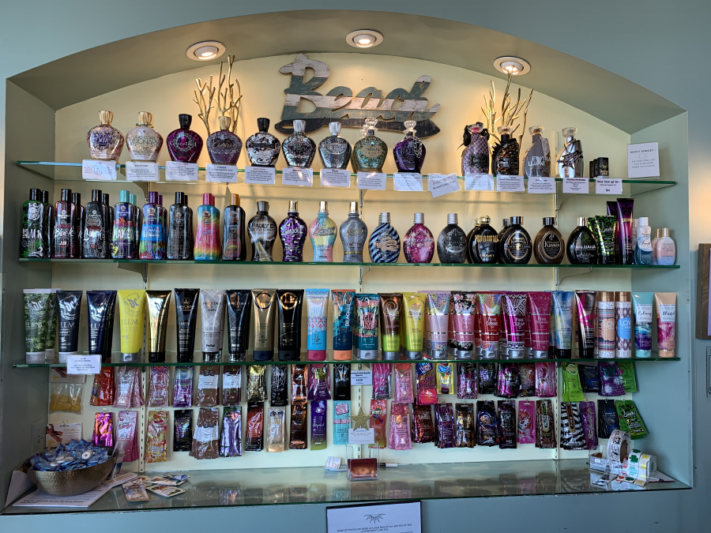
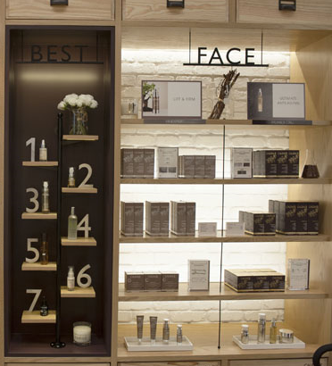
Shelf displays
Staggered
You are creating a design
Many SKUs = inconsistency
Too little SKUs = sold out and what is left is what “doesn’t work”
Creating a top shelf experience
Nevers ❌
Put lotion in a glass case
Put a price tag straight on the bottle
Never have too much/too little
18-21 SKUs
3-6 of each product

Slide 4
SWITCH IT UP
Go away green – grey green
Our eyes grow accustomed to an arrangement
Our eyes naturally look from top to bottom
Refresh and rearrange your displays weekly/monthly to always keep the customer looking
Yellow is the first color our eyes see
Color meanings and preferences can persuade a customer when purchasing an item

Slide 5
Red
Creates a sense of urgency
Physically stimulates the body raising heart rate
Associated with movement, excitement and passion
Red is all about emotion and passion which is what McDonald’s wants you to feel when eating their food
Target’s logo grabs attention, creates and idea of excitement for shopping

Slide 6
Orange & Yellow
Cheerful and promote optimism
Have to be careful when used for marketing purposes
Yellow can make babies cry and orange insights caution
Excitement and adventure
Happiness, excitement and creativity – towards the younger target, inspires thought and curiosity

Slide 7
Can be associated with health, tranquility, wealth and nature
Used to relax customers
Starbucks promotes a sense of relaxation
Whole foods is associated with healthy eating, organic foods, relaxing

Slide 8
Blue
Peace, water, tranquility and reliability
Sense of security and promotes productivity
Can be used to promote trust in a brand
Blue is used in social media logos more than any other color. Blue is tested as the color of intelligence, communication and trust

Slide 9
Purple
Royalty, wisdom and respect
Can stimulate problem solving and creativity
Can be found promoting anti-aging and beauty products

Slide 10
Black
More of a hue than a color
Authority, power, stability, confidence, strength

Slide 11
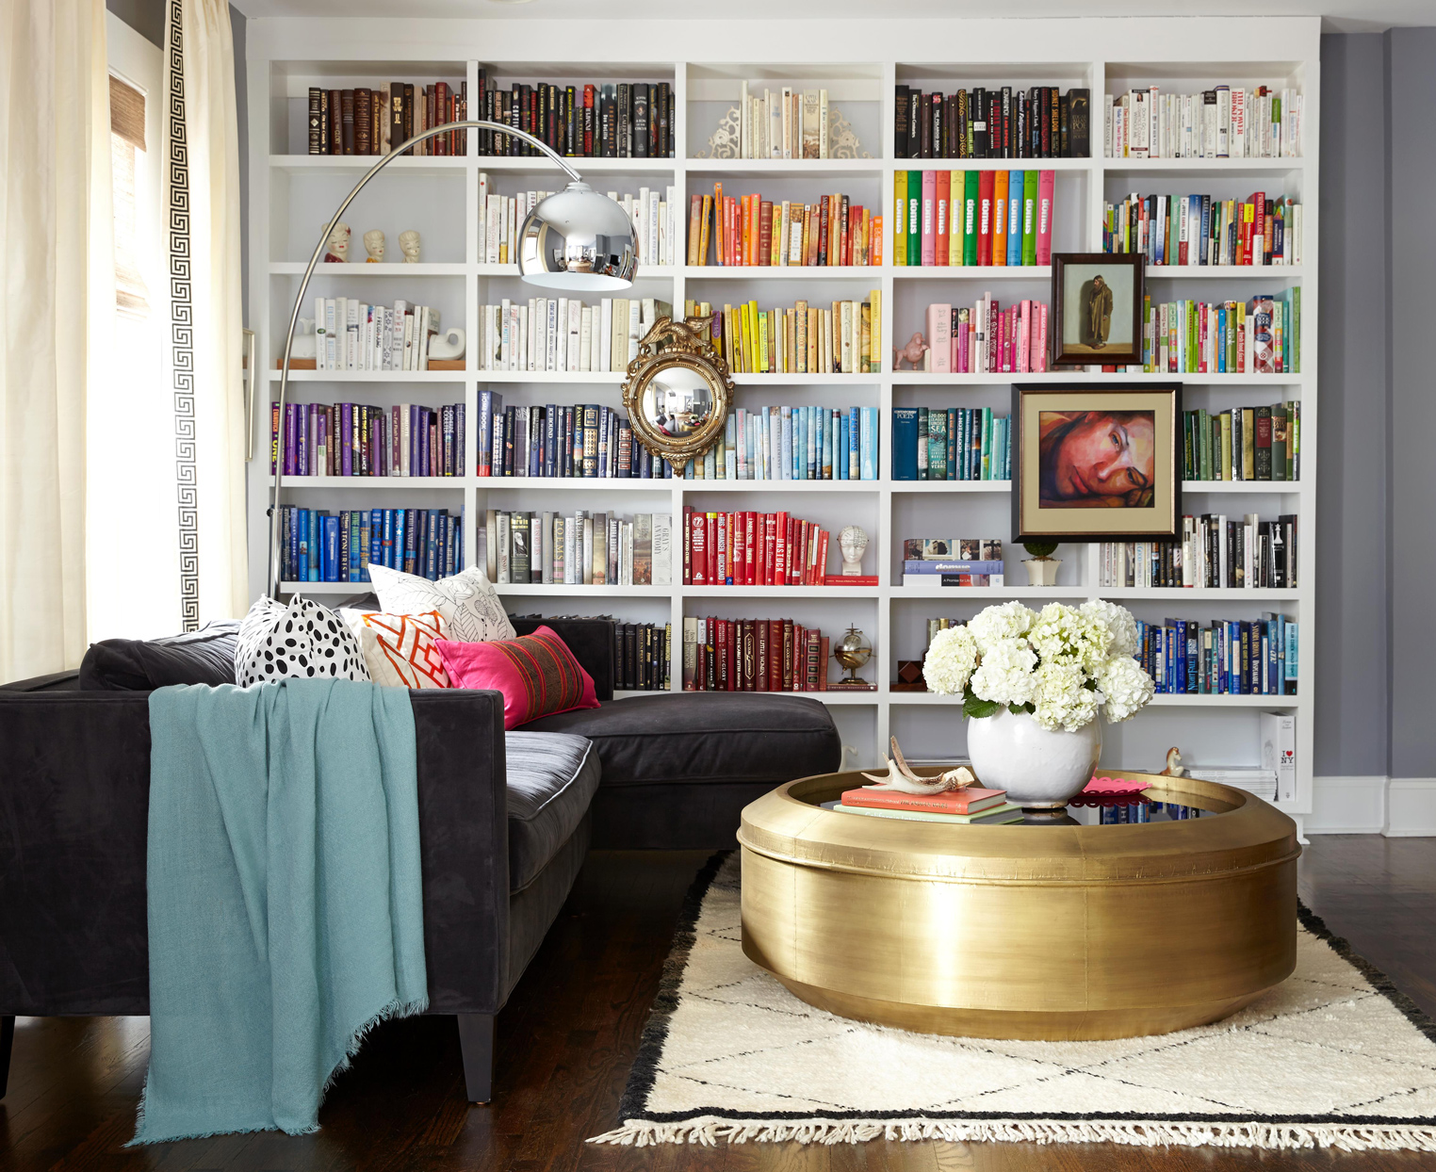
White
Cleanliness, purity and safety
Can be used in the absence of color or neutrality
White space helps start the creative mind

Slide 12
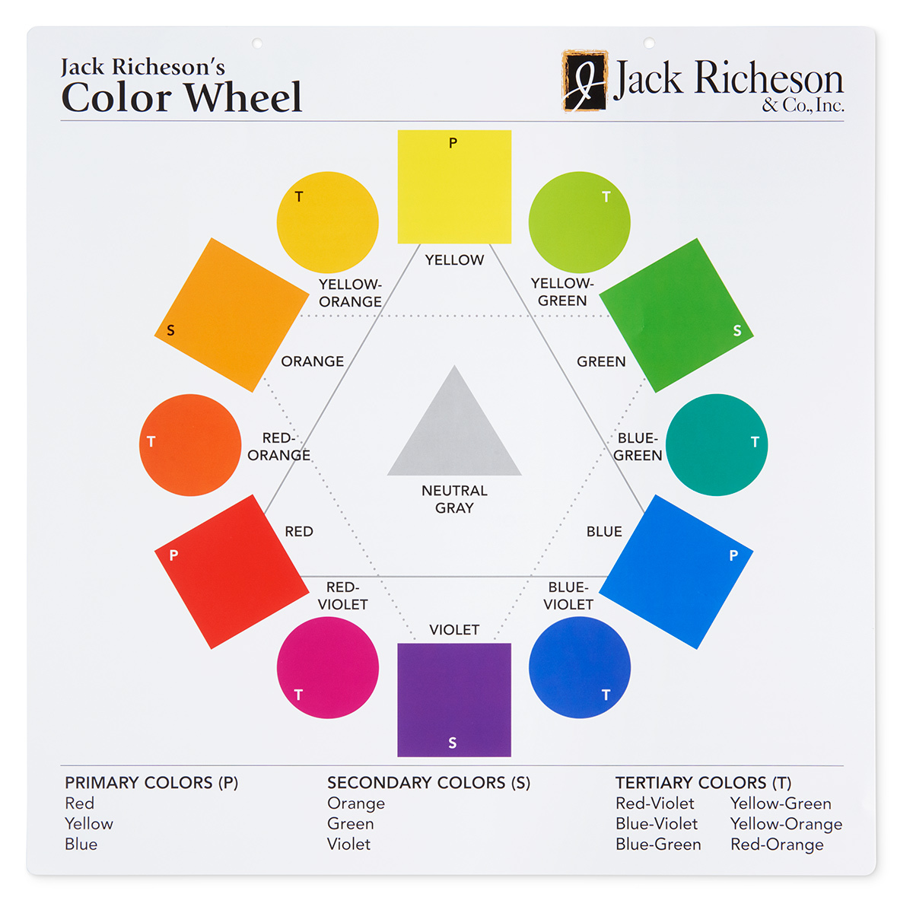
Colors for business
Color reflects the personality of your brand
Decide on what colors best represent YOU
Pick 2 main colors
Easier to remember 2 colors rather than 4-5
Use colors that stand out when promoting or drawing attention

Slide 13
In room advertising
Studies show that 84% of clients pay attention to in-room advertising more than others
Can highlight promos, feature new products/services, tanning tips
Clients spend more time in the room than standing at the front counter

Slide 14
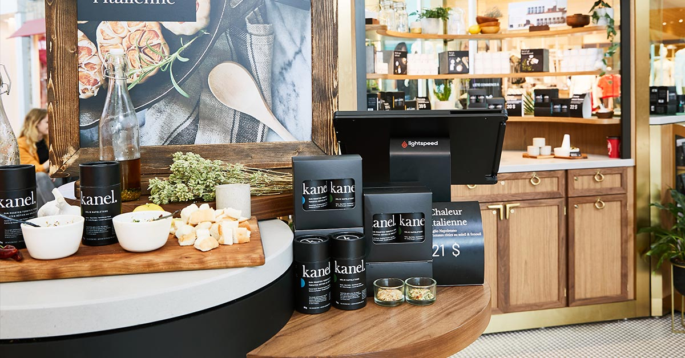
Counter displays (Impulse Buys)
Acrylic box that features products
Lip Balm fishbowls
Tattoo Sticks/SPF
Hand Sanitizer
Mini Moisturizers/Tan Extenders
Testers
Bundles
Product Call Outs
Bottle Displays

Slide 15
Visual Merchandising Tips
Product grouping - Complementary items or something that makes a customer look twice
Rule of 3 creates balance and symmetry
Activating all senses
Hearing - What music is playing in the salon
Sight – Lighting, color schemes
Touch – How soft an item feels, visualizing it in their possession
Smell – The sense of smell can connect customers to the product on an emotional level
Taste

Slide 16
Signage – In room advertising, counter displays, product call outs, promos, etc
Creating hierarchy – Giving your shelves/counters depth and dimension grabs the interest of a customer
Pyramid principle
Staying current – Refresh the items/theme throughout the year
Displaying colors – Display them in an energetic and complimentary way that appeal to customers. Minds automatically will draw towards the color that appeals to them
Color schemes - monochromatic, analogous, complementary
Color is an accent, don’t let it overshadow the product, choose bright colors
Separate by type of product – UV, sunless, body care

Slide 17
Promotions with cross merchandising
Make life easy for customers and cross merchandise things they’d likely need to use together.
Mix in products that customers might otherwise forget about.
See it as an opportunity to introduce a new product.
Approximately 2/3 of consumers buy products at the point of purchase – so use eye-catching product displays and testers to your advantage!

Slide 18
Rule of Three
Displaying in sets of 3 captures customers’ attention
Stagger at different heights
Elements need to be organized and make sense
Cross-selling & Up-selling
Gives customers a visual of options that can go together

Slide 19
Megan Racine
National Sales Trainer
megan@devotedcreations.com
(813) 361-1866

