Slide 1
Are You Ready for Spring?

Slide 3
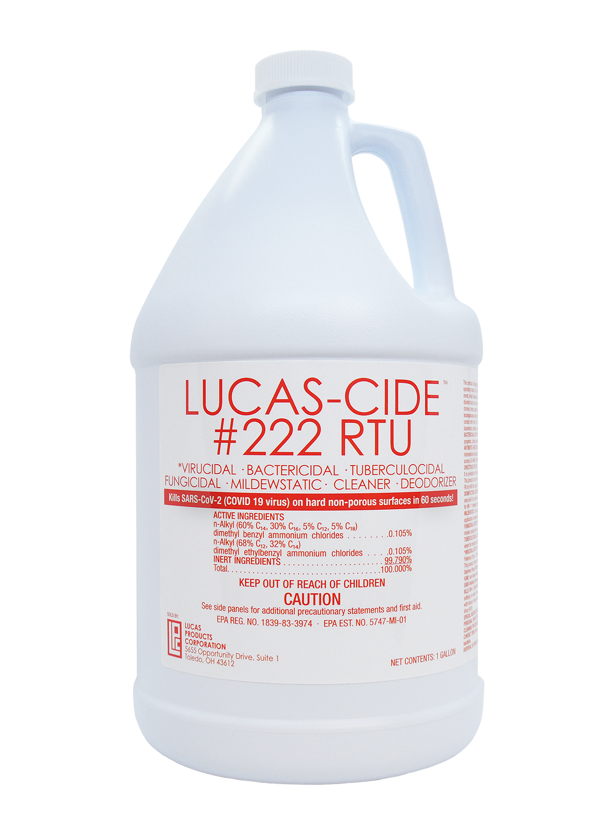
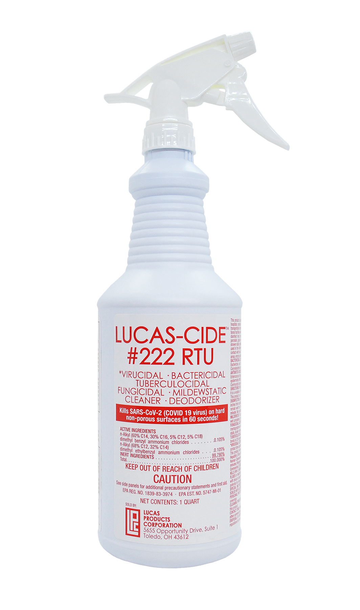
LUCAS-CIDE™ #222 RTU
Lucas-Cide #222 RTU kills 99.9% of germs and requires no mixing
Ready-to-use all purpose disinfectant, deodorizer & cleaner
Effective in kills SARS-CoV2 on non-porous surfaces in 60 seconds
Strong. Fast. Made in the USA
Recommended for an all purpose use of touch points in salon

Slide 4
Disinfection Matters because…
Failure to properly disinfect surfaces leaves you and your clients at risk of being exposed
Failure to properly disinfect is a danger for clients who have compromised immune systems
i.e. Cancer, Asthma, or Diabetes
If a client has an open cut or compromised immune system and lays in a bed that wasn’t properly cleaned, they could contract anything
Perception is everything
Common areas that should be disinfected often – door knobs, in room accessories, bathroom sink, countertops, keyboard, mouse, etc

Slide 5
LUCAS-CIDE™ vs competitors
More effective!
Destroys over 75 different pathogens including HIV-A, MRSA, SARS, Hepatitis B and Hepatitis C.
Barbicide only kills 12
OPI Spa Complete only kills 25
2. Faster results!
60 seconds destroys 99.99% of bacteria, viruses, pathogens and fungus
10 minutes destroys 100%
3. Economically Crafted
This ultra-concentrated formula packs a punch! 1/2 ounce of solution per gallon of water is all you need for effective disinfection.
Barbicide requires 8 ounces of solution per gallon.
4. Certified by the EPA (Environmental Protection Agency)
The EPA certifies disinfectants by site usage.
Hospital-grade LUCAS-CIDE is not only approved by the EPA for use in medical facilities, it is also approved for use in salons and spas.

Slide 6
Moisturizing = Happy Skin

Slide 7
Why Moisturizing is Important
Daily moisturizing is vital for healthy skin, yet some think of it as an aesthetically-inclined habit. The human skin is the body’s largest organ and requires regular attention to stay young, blemish-free and healthy
This is important for tanners because to maintain and get a long-lasting beautiful tan you NEED moisture
Dry skin reflects UV light so keeping skin moisturized is essential for the tanning process

Slide 8
Moisturizing reduces the chances of skin problems. Using the right kind of moisturizer for your skin can help maintain its balance. When skin is too dry or too oily, many common skin problems like acne start to pop up.
Moisturizing can reduce the appearance of other blemishes. Freshly moisturized skin has a healthy sheen, which can even out any existing blemishes.
Moisturizing helps your skin stay young. The most sensitive areas of your skin - the face, ears, neck, and chest - replace themselves more often than any other area on your skin. This daily loss of skin cells leaves these areas vulnerable to the dryness and the elements
Moisturizing fights wrinkles. That plump, firm feeling in your face after moisturizing isn’t an illusion.
It’s the perfect end to a hot shower. Let’s face it - a hot shower feels great and invigorating, but it strips the moisture and natural oils right out of your skin. Taking just a minute to put on some moisturizer will make sure your skin isn’t only clean, but protected from the stresses of the day and feeling great. *Most important time to moisturize*

Slide 9
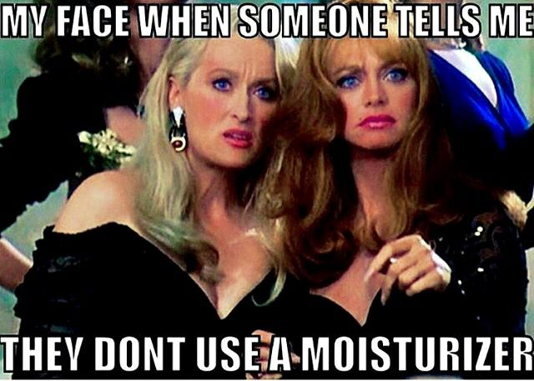
Your tanner that *doesn’t moisturize*
Creates a moisture barrier so the UV rays are pulling moisture from the product and not your skin
The reason we would recommend moisturization is because dry or dehydrated skin, or unhealthy skin, will fade a sunless tan faster or UV tan and more unevenly, then moist skin.
If you find your tan is not fading as well as you would like, then moisturization is an option to consider adding to your routine.

Slide 10
Your tanner that uses *drugstore moisturizers*
These lotions contain minerals and alcohol
Alcohol is very dehydrating and will cause you to fade faster.
Minerals also fade tans and put a SPF of 15 on your skin and take up to 48 hours to wash off.
NONE of our moisturizers have these ingredients. Our moisturizers are formulated for TANNERS to keep the longevity of your tan.
Conditioner to your shampoo
Top coat to your nail polish

Slide 11
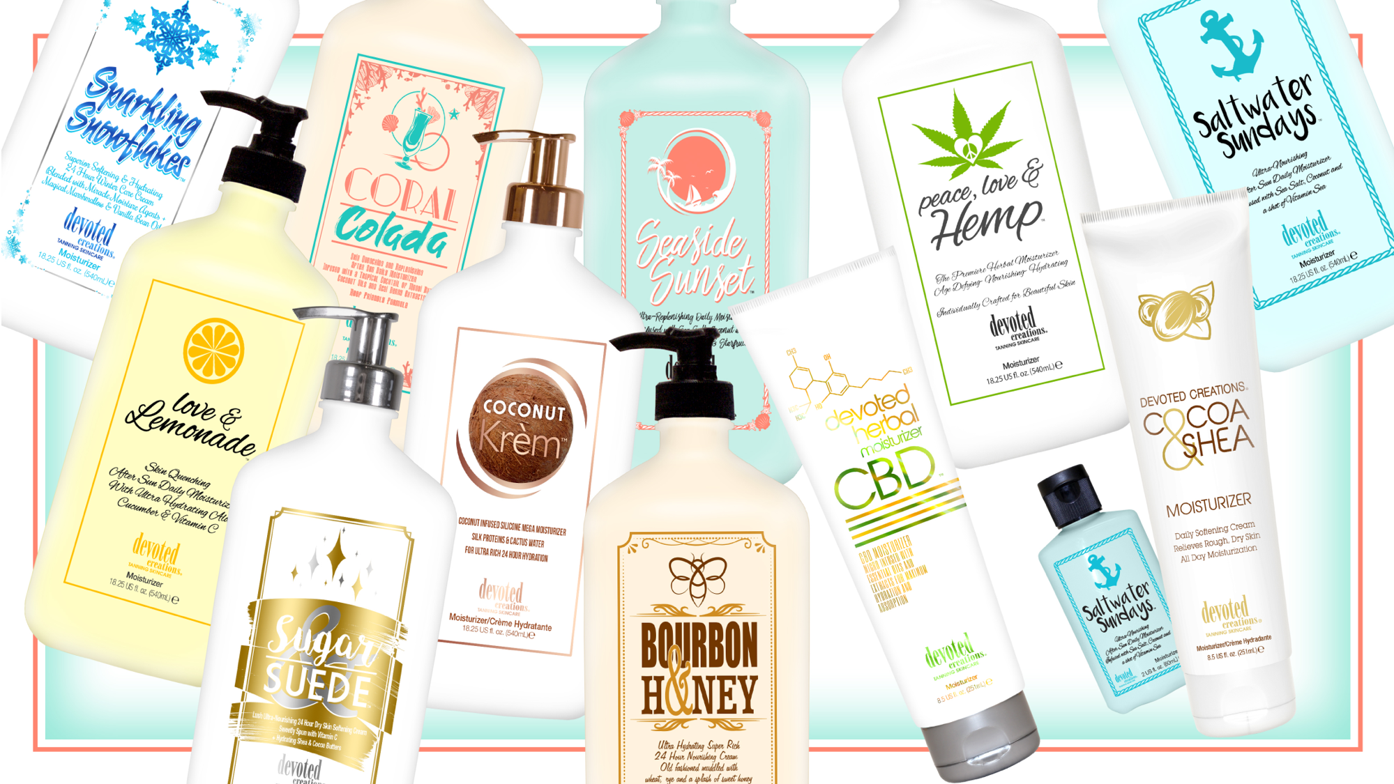

Slide 12
Enchanted Emerald™ Brilliance Boosting 4K Body Hydrator
With Captivating Collagen, Exuberant Electrolytes & Royal Raspberry Blend
For Fascinatingly Flawless No Filter Needed Results
Sugarcane Squalane – Helps to provide weightless hydration, balance excess oil, soothe and promote a plump, firm appearance to the facial skin, non-comedogenic and good for all skin types
Revolutionary 4K Blend – Allows for deeper hydration and longer lasting tanning results as well as better penetration of the high end skincare ingredients, while also working to blur imperfections and allow for a crystal clear complexion
Vegan Collagen – Helps to strengthen and condition the skin to visibly improve texture and suppleness while also helping to restore skin’s natural bounce and resilience, diminishing the look of fine lines and wrinkles
White Birch – Anti-aging and skin firming benefits
Cotton & Rice Extract – Soothe and soften the skin without irritation
Cocoa & Shea Butter – Provides deep, long lasting hydration
Royal Raspberry Extracts – High in Vitamin C, raspberry extract can help to reduce the signs of aging as well as target dark spots and wrinkle formations in the skin
Prestigious Probiotics – Helps to restore and renew the skin’s moisture balance and barrier
Cactus Water – High in antioxidants, vitamins and electrolytes to keep skin hydrated while protecting against sun damage, aging and collagen loss
Paraben, Gluten & Sulfate Free Sensitive Skin Formula
Fragrance: Enchanted Emerald

Slide 13
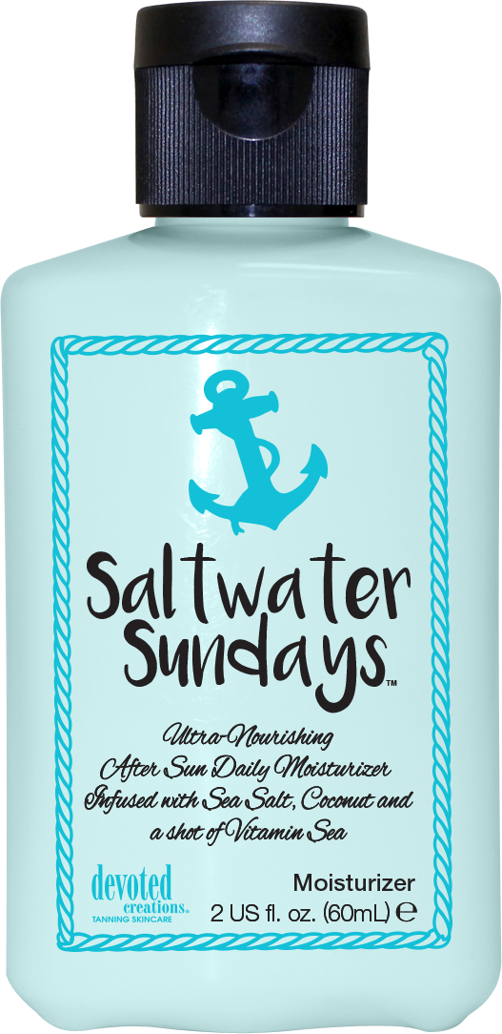
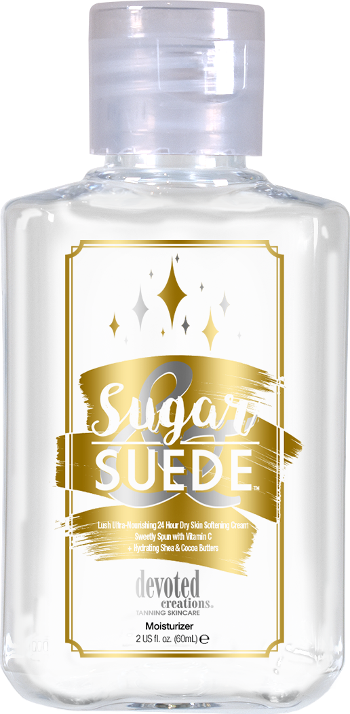
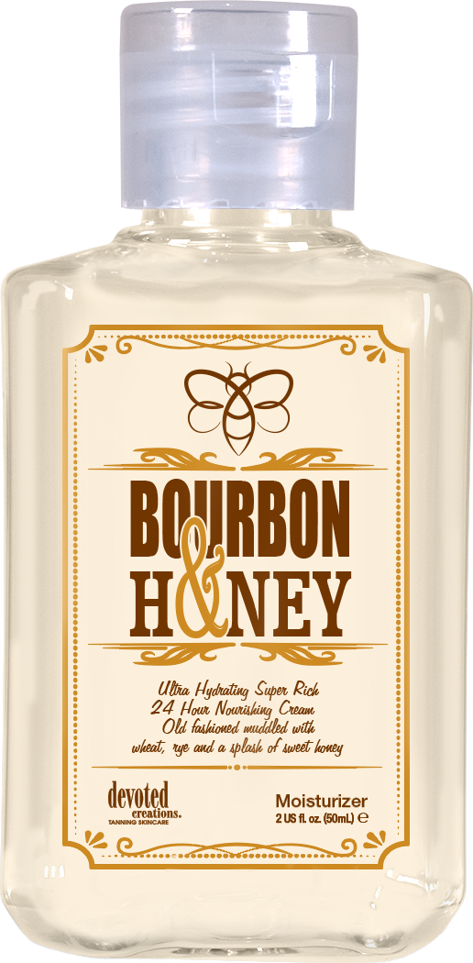
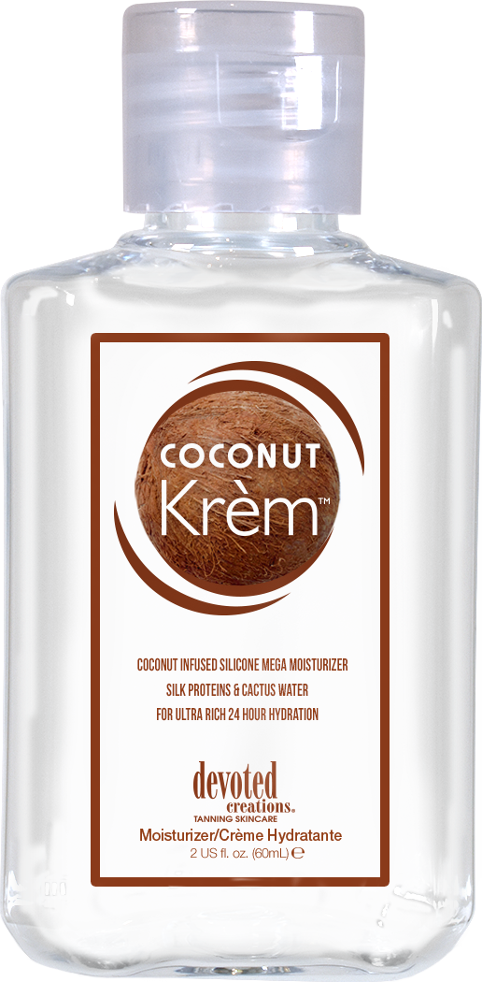
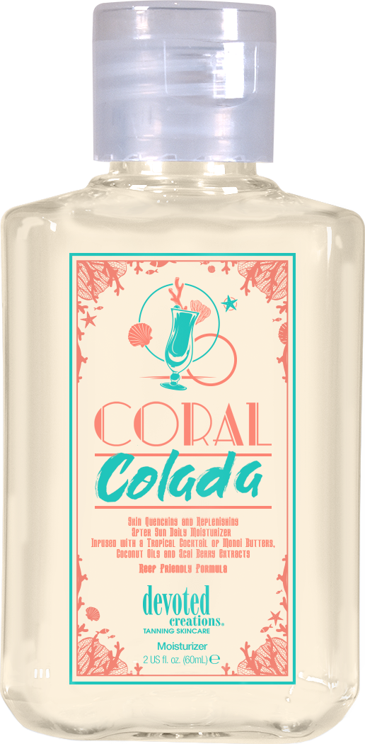
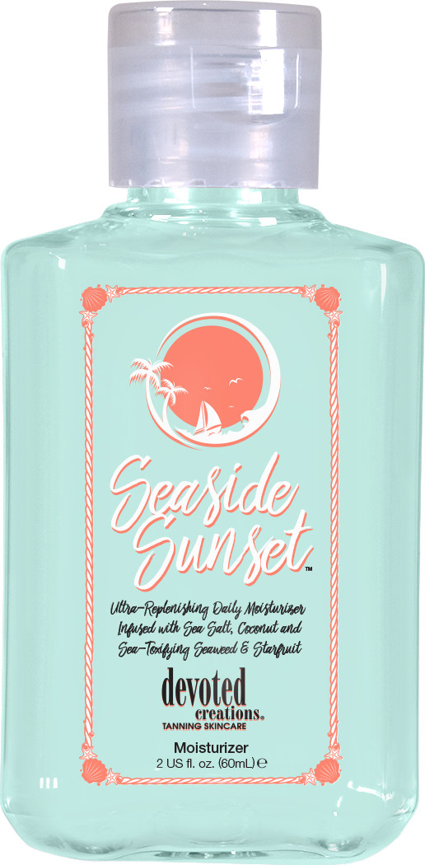

Slide 14
Coconut Krèm™ Coconut Infused Silicone Mega Moisturizer
Silk Proteins & Cactus Water for Ultra Rich 24 Hour Hydration
Silicone Blend – Visibly reduce the look of pores and imperfections while offering non-greasy hydration
Silk Proteins – Acts as a protective shield of hydration, holding in essential moisture and strengthening the skin’s barrier function without weighing it down or clogging pores
Coconut Oil – Deeply softens and nourishes, continual use can improve skin’s texture, has soothing and calming properties that can calm any temporary redness in the skin
Matrixyl Synthe 6™ – Targets and fills in fine lines and wrinkle, restores moisture in the skin and minimizes discolorations
Cactus Water – High in antioxidants, vitamins and electrolytes to keep skin hydrated, prevents moisture loss, and has antibacterial and calming properties to protect the skin from sun damage, aging and collagen loss
Fragrance: Creamy Coconut

Slide 15
Sugar & Suede™ Lush Ultra-Nourishing 24 Hour Dry Skin Softening Cream Sweetly Spun with Vitamin C + Hydrating Shea & Cocoa Butters
Daily rich body cream that will keep skin hydrated for up to 24 hours
Cocoa & Shea Butters – Helps to repair dry, damaged and scaly skin
Marshmallow Extract – Antioxidant rich, free radical fighting and complexion boosting natural extract
Vitamin C & Sparkling Plum Antioxidants- Repair skin, fight free radical damage & boost collagen production
White Birch – Anti-aging and skin firming benefits
Cotton & Rice Extract – Soothe and softens the skin without irritation
Vanilla & Sugar Extracts – Natural antibacterial packed with high levels of skin soothing antioxidants that fight breakouts and reduce the signs of aging
Paraben, Nut, Gluten & Sulfate Free Sensitive Skin Formula
Fragrance: Sugar & Suede
Notes:
15

Slide 16
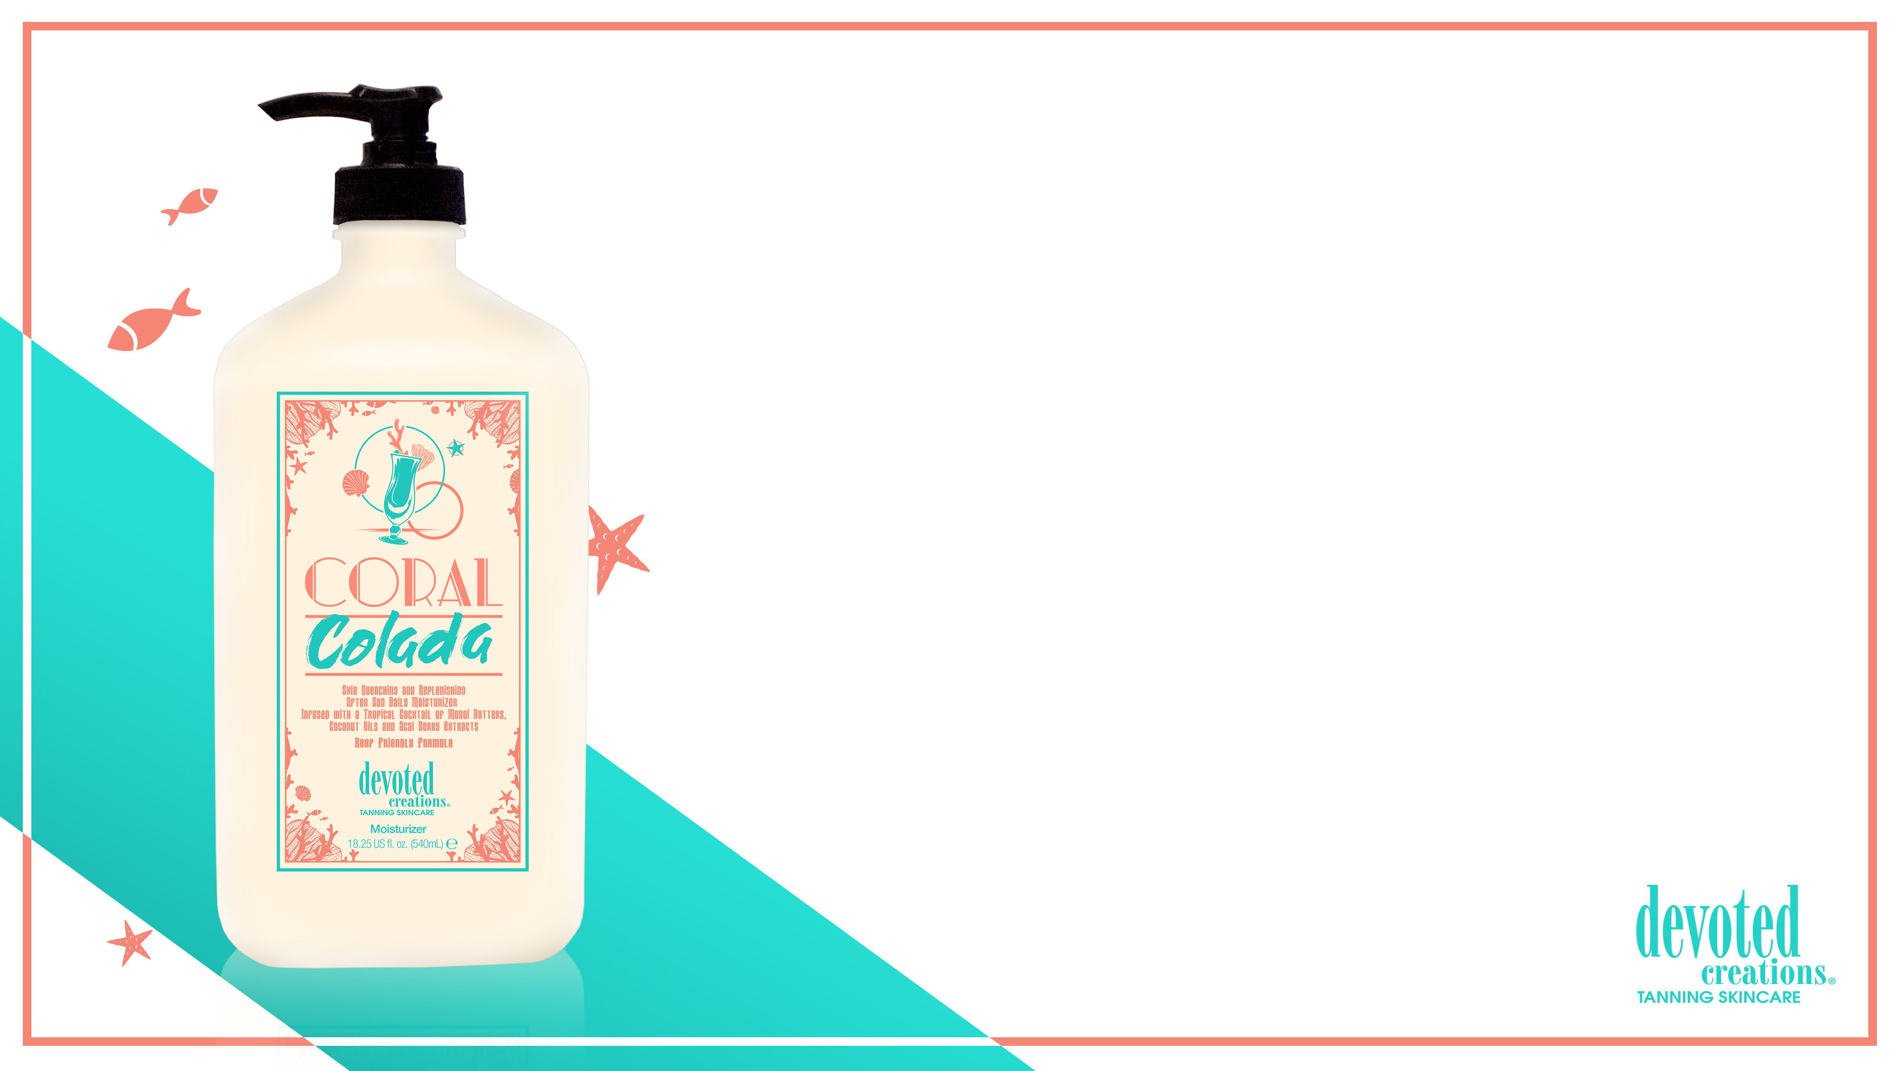
Coral Colada™ Skin Quenching & Replenishing After Sun Daily Moisturizer Infused with a Tropical Cocktail of Monoi Butters, Coconut Oils and Acai Berry Extracts Reef Friendly Formula
Moisture replenishing body lotion that will keep skin hydrated for up to 24 hours without any greasy after feel
Acai Berry – Antioxidant rich skin softening agent
Monoi Butters – Helps to repair skins moisture barrier
Vitamin C - Repair skin, fight free radical damage & boost collagen production
Green Tea & Sea Salt detoxify and help pull impurities from the skin
Cotton & Rice Extract – Soothe and soften the skin without irritation
Sensitive Skin & Reef Friendly Formula
Fragrance: Coral Colada

Slide 17
Seaside Sunset™ Ultra Replenishing After Sun Daily Moisturizer
Infused with Sea Salt, Coconut and Sea-Toxifying Seaweed & Starfruit
Daily detoxifying moisturizer that doubles as an after-sun skin hydrator
Seaweed – Provides superior hydration as well as anti-aging and anti-inflammatory benefits
Starfruit – Detoxifies while toning, tightening and reducing the appearance of fine lines and wrinkles
Vitamin C - Repair skin, fight free radical damage & boost collagen production
Lotus Flower – Age Defying, hydrating and radiance boosting
Sea Salt & Coconut – For pore tightening and extra hydration
Cotton & Rice Extract – Soothe and soften the skin without irritation
Cucumber Extracts – Helps to naturally nourish, hydrate, comfort, soothe, calm and de-puff the appearance of skin
Sensitive Skin & Reef Friendly Formula
Fragrance: Beachside Breeze

Slide 18
Bourbon & Honey™ Ultra-Hydrating Super Rich 24 Hour Nourishing Cream
Old Fashioned Muddled with Wheat & Rye, and a Splash of Honey
Daily rich body cream that will keep skin hydrated for up to 24 hours
Tamanu Oil – Helps to repair dry, damaged and scaly skin
Marshmallow Extract – Antioxidant rich, free radical fighting and complexion boosting natural extract
Vitamin C – Repair skin, fight free radical damage and boost collagen production
Rye & Wheat Extract – Anti – aging and skin firming benefits
Cotton & Rice Extract – Soothe and soften the skin without irritation
Honey Extract – Natural antibacterial packed with high levels of skin soothing antioxidants that fight breakouts and reduce signs of aging
Sensitive Skin Formula
Fragrance: Bourbon & Honey

Slide 19
Saltwater Sundays™ Ultra-Nourishing After Sun Daily Moisturizer
Infused with Sea Salt, Coconut and a Shot of Vitamin Sea
Daily body moisturizer that doubles as an after sun skin hydrator
Peppermint Extract – Provide skin soothing and healing properties while fighting skin inflammation and red tones
Aloe Vera Crème Gel – Skin protector that contains minerals and nutrients to reduce inflammation and keep skin hydrated
Vitamin C – Repair skin, fight free radical damage and boost collagen production
Sea Salt & Coconut – Pore tightening and added hydration
Cotton & Rice Extract – Soothe and soften the skin without irritation
Cucumber Extracts – Helps to naturally nourish, hydrate, comfort, soothe, calm and de-puff the appearance of skin
Hypoallergenic, Nut free, Vitamin E free, Wheat free, Vegan Formula
Fragrance: Sea Salt Breeze

Slide 20
Devoted Creations Cocoa & Shea™ Daily Softening Cream Relieves Rough, Dry Skin All Day Moisturization
Daily body moisturizer that doubles as an after-sun skin hydrator
Cocoa and Shea Butters – Penetrates through dry layers of skin for softer results
Vitamin E – Reduces appearance of fine lines and wrinkles and helping to slow down the aging process
Fragrance: Cocoa & Shea

Slide 21
Aqua Rush™ Moisture Surge 48 Hour Skin Hydrator
Cutting Edge formula designed to Rehydrate, Strengthen & Improve
Skin’s Overall Texture
Myramaze – Potent antioxidant which effectively moisturizes dry skin while toning, revitalizing and soothing
Acquacell ™ – Rapid fine line & wrinkle reducer
Coconut Water – Intense skin hydrator
Advanced Matrixyl Synthe 6 ™ – Targets and fills in fine lines and wrinkles
Renovage ™ – Firms, hydrates and plumps the skin
Body Fit ™ – Reduces the appearance of cellulite and restores firmness
Dead Sea Mineral Complex – Repairs skin damage, improves tone & texture, increases elasticity and works to reverse the signs of aging
Argan & Hemp Seed Oil – Ads hydration and protects premature aging of the skin
SunXtend ™ – Helps prevent color fading and prolongs the life of your tan
Fragrance: Aqua Rush

Slide 22
Glow On Gorgeous™ Rose Lust Worthy Gold Gradual Bronzing -
Color Contouring – Pore Refining & Imperfection Blurring Glow & Go Crème
High-end DHA enhanced, transfer resistant, tan extending moisturizer to help build, keep and maintain flawless bronzed results
Rose Gold Elixir – Japanese Rose ™, Rose Bouquet Blend ™ and added DHA repair, regenerate and rejuvenate for flawless, glowing skin
Electric Daisy ™ - Flower derived to promote skin firmness, perfect skin contour, shrink pore size and combat the signs of aging
Advanced Matrixyl Synthe 6 ™ – Targets and fills in fine lines and wrinkles
Renovage ™ – Firms, hydrates and plumps the skin
Body Fit ™ – Reduces the appearance of cellulite and restores firmness
SunXtend ™ – Helps prevent color fading and prolongs the life of your tan
Fragrance: Gorgeous Glow
Notes:
22

Slide 23
So Naughty Nude Head to Glow™ In-Shower Tan Extending Lotion & Shave Cream
24 Hour Moisture Lock System
Perfect Solution for the Girl On The Go!
In-shower 24 hour body moisturizing shave crème with tan extending benefits
Cashmere Blend – Cashmere extracts work with the skin’s natural moisture to increase levels of hydration
Cocoa Butter – Hydrating butter that adds superior moisture the even the driest skin
Almond Oil – Repairs and soothes the skin
Vitamin E – Keeps your skin smooth, prevents dryness and cracking, but also blocks free radicals to keep your skin looking youthful
Provides immediate and long-term moisturizing benefits
Fragrance: Gorgeous Glow

Slide 24
Spring Break Bundling
Don’t forget your aftercare
They need something to keep their tan and protect their skin
2. Don’t forget the SPF
Always recommend pairing our lotions with an SPF to protect your skin in more ways
3. Recommend that perfect lotion they can take with them
Indoor/Outdoor lotions
4. Lip Balm
Our lips need to be protected too!
There is no melanin in our lips and they can get sunburnt

Slide 25
If you are named WINNER, send me an email with:
Name
Salon Name
Shipping Address
Megan Racine
National Sales Trainer
Megan@devotedcreations.com
813-361-1866
Notes:
25

