Slide 1
Product Spotlight: Summer Edition

Slide 2
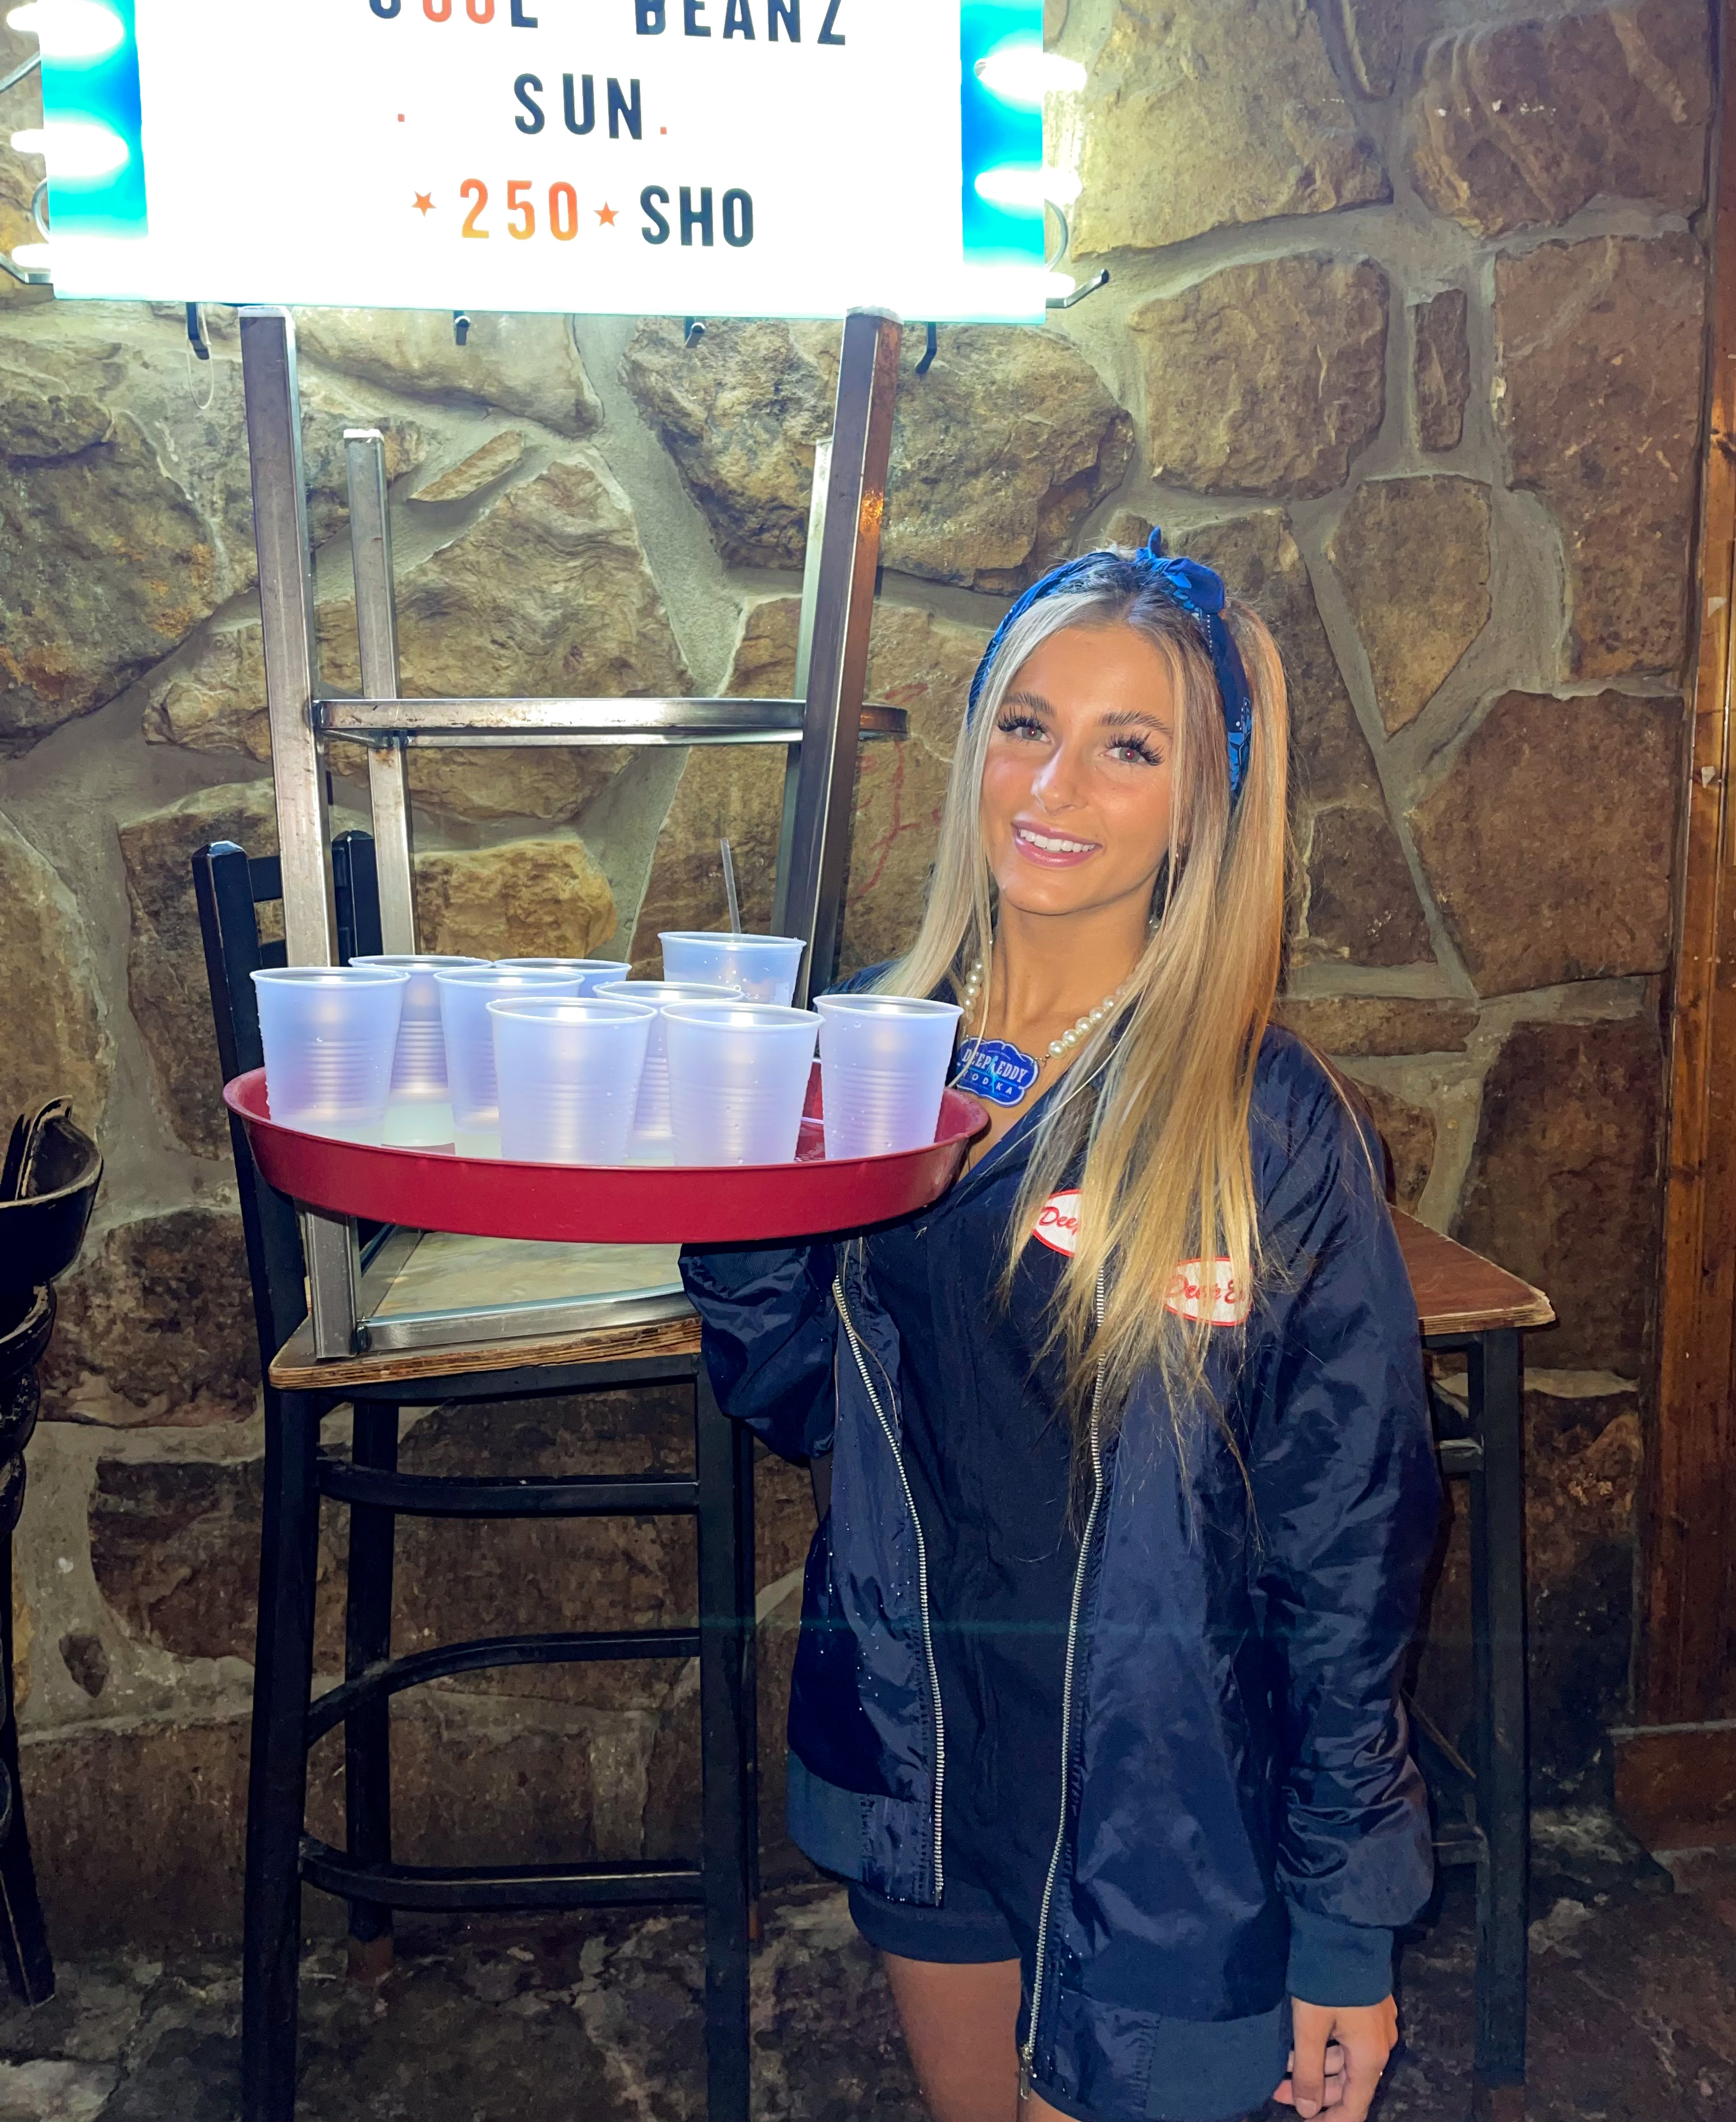
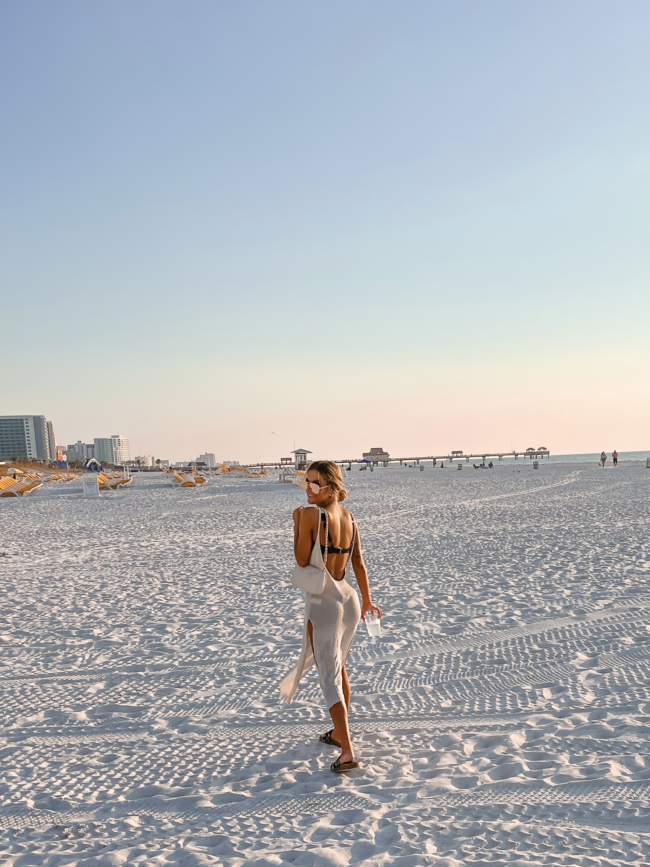
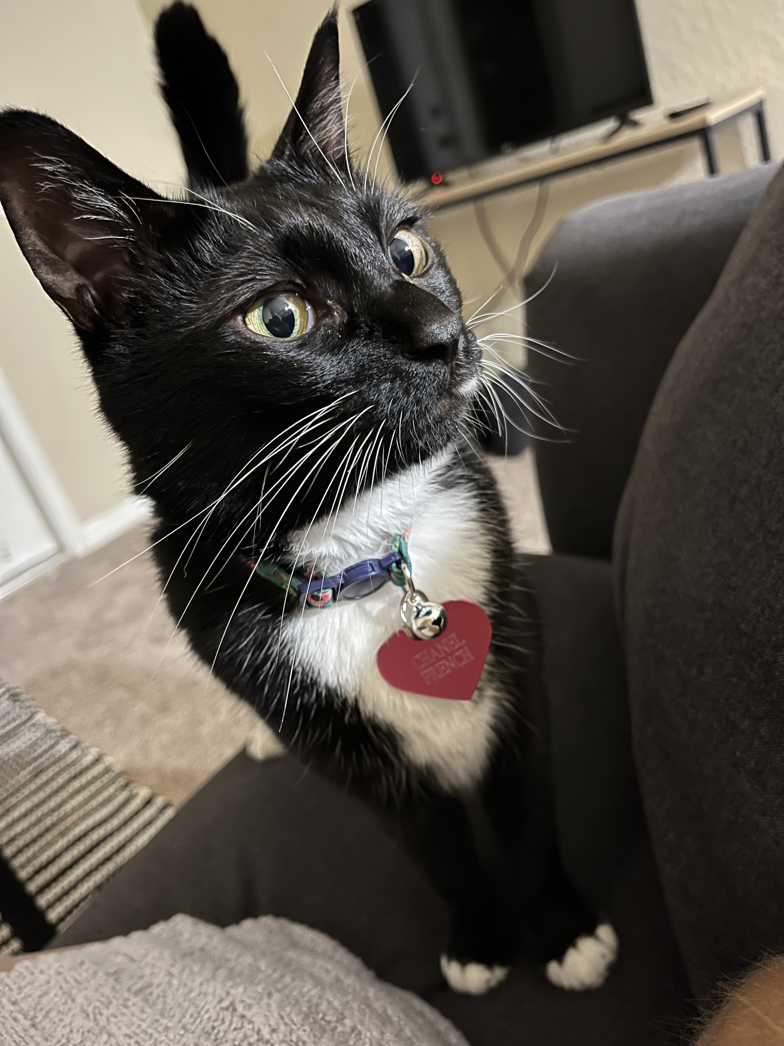

Slide 3
Devoted Difference
True manufacturer for over 25 years
Everything done in house and based in Tampa, FL
Own the company that makes our bottles and packet materials
Distribute to 70+ countries worldwide
Focus on skincare
1st ingredient used in 95% of products is aloe vera
Use highly sought fragrances

Slide 4
What are Summer Products
Indoor/Outdoor Products!!
Accelerators, Natural Bronzers, Low DHA Bronzers
Facial Tanning Products
Professional Tan Extenders
The key to keeping our tan vibrant and our skin moisturized to avoid dryness or peeling from the sun

Slide 5
Indoor/Outdoor
A product that can be used both Indoors AND outdoors!
A product being Indoor/Outdoor is an added selling point!! Especially during the summer! Think lake days, pool days, beach days, vacations, etc
Tyrosine!! Tanning ingredient that helps speed up the tanning process found in professional tanning lotions! This ingredient sets you apart from tanning oils or lotions from Walmart

Slide 6
Facial Tanning Products
Perfect for indoor or outdoor tanning!
Protect delicate facial skin- formulated for delicate and sensitive skin: Not going to clog pores or irritate skin
Will continuously hydrate your skin while in the sun even if you’re not purposely tanning your face
Contain tyrosine if you are tanning your face

Slide 7
Tan Extenders
Whether tanning indoors or outdoors, tan extenders allow you to prolong your results and keep your tan
Hydration and skincare = Longer lasting tans
Dry skin does not maintain a tan or create a tan

Slide 8
Solar Saturation™
Electrolyte infused orange hue accelerator- Orange hue comes from orange extracts which provide vitamin C
Jade Extract- Mineral that helps detoxify, moisturize & combat inflammation
-Most infrared devices are made with jade stones
Red Tourmaline- Colored crystal containing natural energy made with iron and magnesium that will replenish the skin of lost nutrients
Fragrance: Tropical Sunfruit

Slide 9
Color Me Coco™
Streak Free, Stain Free Natural Bronzer
CoQ10– Penetrates deeply to provide antioxidants and help create collagen and elastin
Coconut Milk – Works to keep skin at ample moisture levels
Coconut Oil – Helps to penetrate through dry layers of skin for the deeps level of hydration
Fragrance: Coastal Coconut

Slide 10
Moroccan Midnight™
Streak Free Stain Free Natural Bronzer
Rich Caramel Extracts – Provide dark, longer lasting color
Added Argon Oil delivers a velvety smooth feeling to the skin while locking in moisture for the entire day
Plum Oil- a rich oil that offers a non-greasy and silky skin feel that moisturizes skin
Liquid Glass works as a primer to mask tiny imperfections in the skin
Fragrance: Midnight Moroccan Orchid
Notes:
10

Slide 11
Cactus Cabana™
Indoor/Outdoor Low DHA Bronzer
Formulated with a special BB cream base for a satin soft, silky finish
Cactus Water- High in nutrients, vitamins and electrolytes, help hydrate the skin and help the skin retain moisture
Tiger Grass™- Color correcting, anti-reddening ingredient
Mel[O]stem™- Plant derived active ingredient that targets sun spots
Agave Extracts- Helps plump the skin and calm irritation
Fragrance: Kiwi & Cactus Water

Slide 12
Sunshine Superstar™
Influential Glow Boost Dark Tanning Accelerator
Plant Based Silicone – Silicone alternative that creates a silky soft finish, while improving moisture levels, softness and smoothness of the skin while being spray tan friendly
Electrolyte Cocktail – Improves skin moisture barrier, calms redness, and maintains hydration levels of the skin
Hyaluronic Acid – Hydrates through the layers of the skin to promote a bouncy, plump look
Fragrance: Sweet Summer Escape

Slide 13
Turquoise Temptation™
Cucumber and Aloe Cooling Dark Tanning Accelerator
Bakuchiol – Stimulates collagen production and diminishes wrinkles, skin laxity and overall photo damage
Superfood Smoothie Blend­ – Strawberry, Acai, Dragon fruit, Blueberry & Pomegranate, load the skin with essential antioxidants
Cucumber & Aloe Cooling Agents- Helps to calm and soothe skin
Charcoal Extracts help to detoxify and pull impurities from the skin
Fragrance: Sugared Sorbet

Slide 14
Somewhere On A Beach™
Streak Free Stain Free Natural Bronzer
Sea Buckthorn Berry – Utilizes high levels of Vitamin C and Omega Fatty Acids to help protect the skin against free radical damage
Coconut & Walnut Oils - Intense skin softeners and hydrators help to keep your tanning results lasting longer, while improving the overall appearance of the skin
Black Tea – Strong antioxidant with astringent properties that work to reduce blemishes
Fragrance: Tropical Tantini

Slide 15
White 2 Bronze Summer™
Tropical Electrolyte Infused Natural Bronzer
Cactus Water – High in antioxidants, vitamins and electrolytes to keep skin hydrated
Coconut Oil – Deeply softens and nourishes the skin for long lasting hydration
Acai Berry Extracts – Rich in antioxidants, Acai berry helps to protect the skin from free radical damage
White Birch – Contains anti-aging and skin firming benefits
Fragrance: Beach Berry

Slide 16
White 2 Bronze Coastal™
Blue Hued Dark Tanning Optimizer
Maracujá Oil – Helps to address damaged or weakened skin, while helping to support the healing process
Coconut Oils & Extracts – Deeply softens and nourish the skin for long lasting hydration
Sea-Toxifying Algae Complex – Helps to detoxify the skin while also helping to improve skins elasticity
Tiger Grass and Blue Tansy– Color-correcting ingredients so the skin tans the most natural, dark bronze
Fragrance: Aquamarine Coastal Cool

Slide 17
Vacay Vibes™
Indoor/Outdoor Low DHA Bronzer
Guava Extracts – Rich in antioxidants that help reduce the appearance of fine lines and wrinkles while providing a glowing complexion
Watermelon Extracts – Provides 24-hour hydration while improving the skins tone and deeply improving the appearance of fine lines, wrinkles and dry spots of the skin
MelanoBronze™ – Stimulates melanin activity to allow for longer lasting, darker tanning results
Fragrance: Island Escape

Slide 18
Coconut Covergirl™
Sunkissed Golden Glow Natural Bronzer
Cupuaçu Butter – Helps to lock in moisture and restore skins elasticity
Coconut Juice, Coconut Oil & Coconut Water – Helps to penetrate through dry layers of skin for the deepest level of hydration
Cocoa Butter – Hydrating butter that adds superior moisture to even the driest skin
Fragrance: Pink Coconut

Slide 19
Aquaholic™
Coconut Surge Natural Bronzer
Melactiva™ – Melanin synthesizer for darker, longer lasting results
AcquaCell™ – Rapid fine line & wrinkle reducer
Coconut Juice, Coconut Oil & Coconut Water – Helps to penetrate through dry layers of skin for the deeps level of hydration
Fragrance: Aqua Kiss

Slide 20
Santorini Summer™
Wanderlust Worthy Dark Tanning Accelerator
Macadamia Nut & Coconut Oils – Nourish, soften and replenish skin for extreme moisture
Essential Orange Oil – Increases collagen production and soothes acne prone skin
Melactiva ™ & MelanoBronze ™ – Stimulates melanin activity allowing for longer lasting, darker tanning results
Fragrance: Mad for Mandarin

Slide 21
Salty Lime Slushie ™
24 Hour After Sun Daily Moisturizer
Cactus Water is high in vitamins, nutrients and electrolytes and helps keep the skin moisturized and protected from environmental aggressors
Agave Extracts help tighten sagging skin, soothe inflammation, and hydrate the skin
Mango Butter helps with fine lines and wrinkles while providing a glowing complexion
Sea Salt is a powerful pore tightening agent
Fragrance: Salty Lime Slushie

Slide 22
Barefoot Beachwood™
24 hour Moisturizing Tan Extender
Cacay Oil- Used to help heal and hydrate the skin
Willow Bark Extract- Help calm redness and soothe irritated skin leaving a radiant, clear complexion
Coconut Milk- Deeply softens and nourishes while calming irritation
Cucumber Extract- Natural soothing agent that helps reduce puffiness and irritation
Fragrance: Barefoot Beachwood

Slide 23
Sunkissed Sweet Tea™
Color Extending and Color Building Moisturizer
Golden Glow Bronzers – Low levels of DHA to prolong the life of your tan
Raspberry & Black Tea Extracts – Loaded with Vitamin C, antioxidants and skin clearing properties to help reduce the signs of aging
Mint Extract & White Birch – Helps to soothe and calm irritated and sensitive skin, especially after sun exposure
Lemon Extracts – Help promote collagen production for a more youthful appearance
Fragrance: Sunkissed Sweet Tea

Slide 24
Glocation™
Low DHA moisturizer
Cocoa and Shea Butter- Nourish and hydrate the skin while protecting the skin from environmental stressors
Nicomenthyl™ and Solarepare MB™- Help to nourish, repair and prolong your color by aiding in the healing process of the skin
Maracuja Oil- Rich in essential nutrients and antioxidants~ helps keep your tan even and glowing
Fragrance: Coconut Sands

Slide 25
Honey Gleam Cream™
Glow boosting skin tint
Multi use formula- Can be used as a facial tan enhancer, daily glowing moisturizer or dewy makeup primer
-CT Flawless Filter
Porcelain Flower Extract- Hydrate and nourishe the skin while helping promote a crystal clear complexion
GlowPlex™- Promotes glowing skin, blurs imperfections, and helps minimize the appearance of dark spots
Electric Daisy- Gives a tightening and contouring effect and increases skin elasticity
Fragrance: Hypnotic Honey

Slide 26
Gracie French
International Sales Trainer
Digital Marketing Coordinator
gracie@devotedcreations.com

