Slide 1
The Not So Summer Slow Down

Slide 2
Things to do & think of
Take a look at your inventory
Start looking into new sales for EOY & 2024
Rearrange layout
Network/build relationships with other businesses
Spend more time with clients
Employee development
Brainstorm marketing initiatives

Slide 3
Inventory
What has been selling great
What hasn’t
What has been on put on special
Do you have excess inventory of certain items?
What new 2023 items did you not bring in?
Consider something new

Slide 4
New sales
Pink Wednesday
Back to school
Black Friday
Christmas/holidays
New year specials
Free tan weekend
Customer appreciation
Local business appreciation
What worked for this tanning season?
What can be changed?

Slide 5
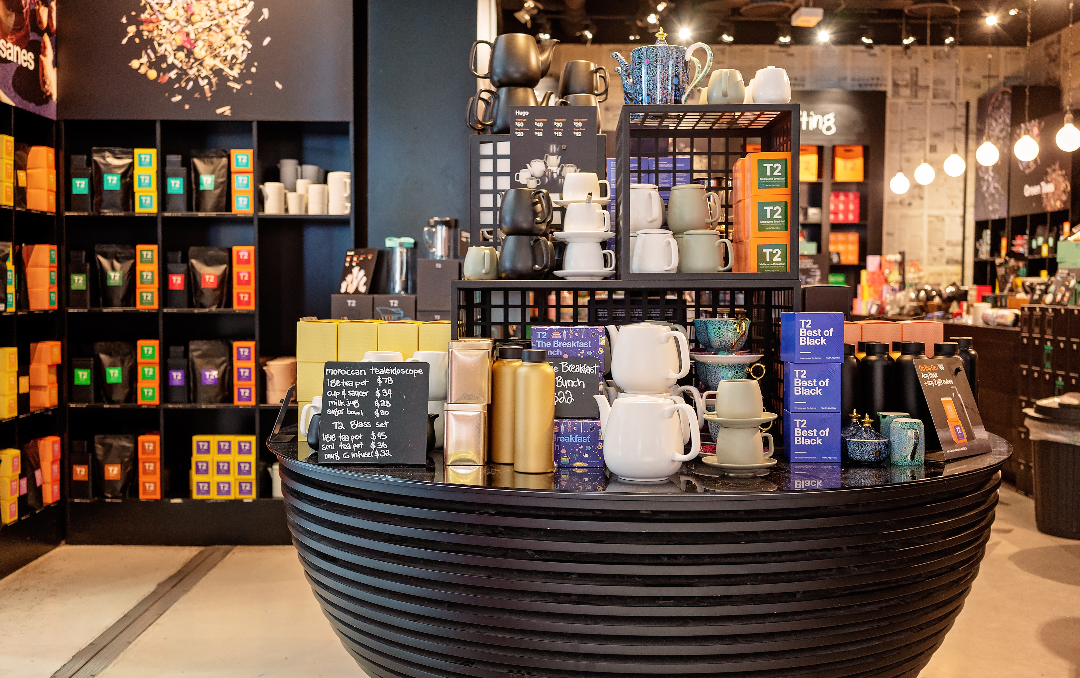
Change up your displays
Creates new surprises for clients
Something new to look at
Might look at something that has been there the whole time, just never focused on it

Slide 6
Network
Are there local businesses in your city/town?
Visit businesses where you can exchange services for clients
Is there a new business opening up that you/clients can take advantage of with helping to promote their business?
The more business owners you know, the more word of mouth recommendations go around

Slide 7
Spending more time with clients
If summer is slower, take this time to get to know your clients
Add value to their purchases
If going on a vacation – buy a bottle of lotion, get half off extender or get mini tan extender
Or add extra upgrades

Slide 8
Employee Development
Summer vacation from school doesn’t meat summer vacation from learning at work
Ongoing education, building skills, better communication, etc
Create social media content
Devoted on Demand
Monthly webinar trainings
Salon employee contests

Slide 9
Brainstorming Marketing Initiatives
Hold a social media contest!
Get your staff involved
This brings more clicks to your social pages and gets clients and potential new clients excited

Slide 10
Megan Racine
International Sales Trainer
Megan@devotedcreations.com

