Slide 1
Increase sales with key information

Slide 2
Client Focused
Take your time
Know why they came to you
Have scenarios planned out for practice
Wedding
Vacation
Event
What package would you recommend and why?
How would you start the lotion conversation?

Slide 3
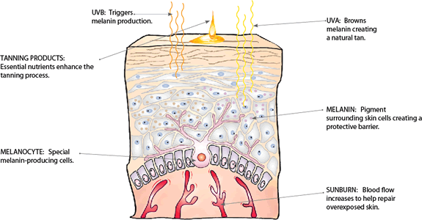
The Skin
What happens if the skin turns pink
How to explain/respond to clients
How often they can/should tan each week to reach desired results
The science of how the skin tans
The Fitzpatrick skin scale

Slide 4
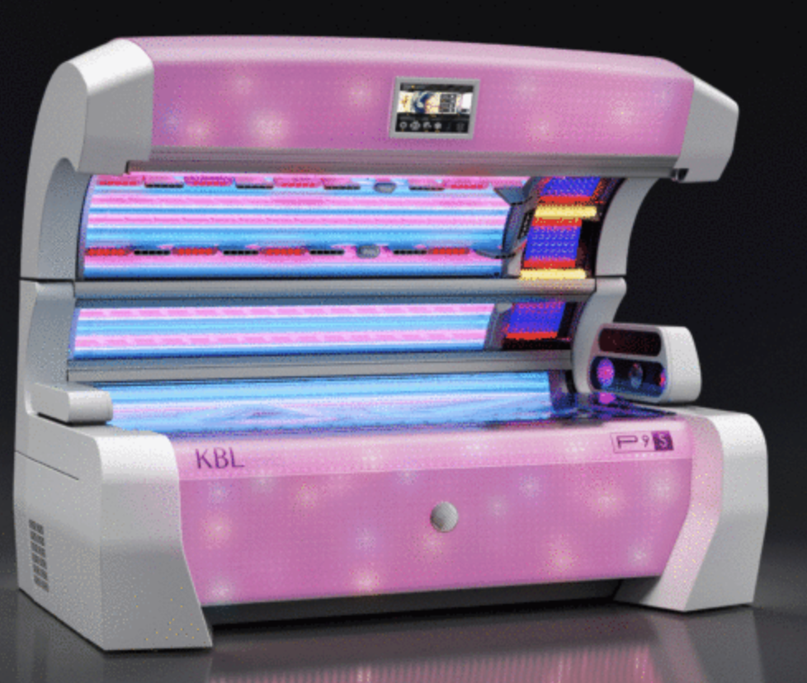
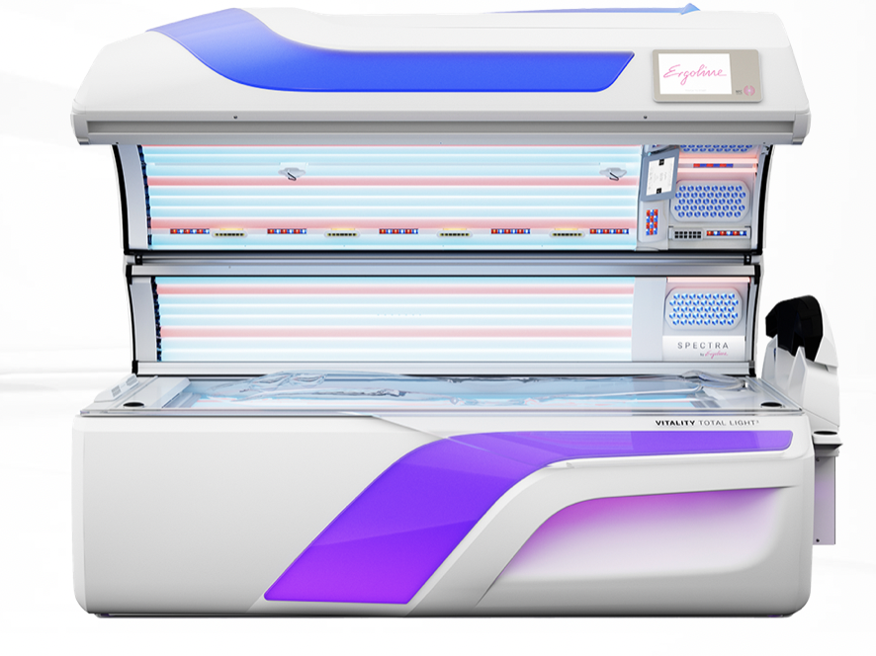
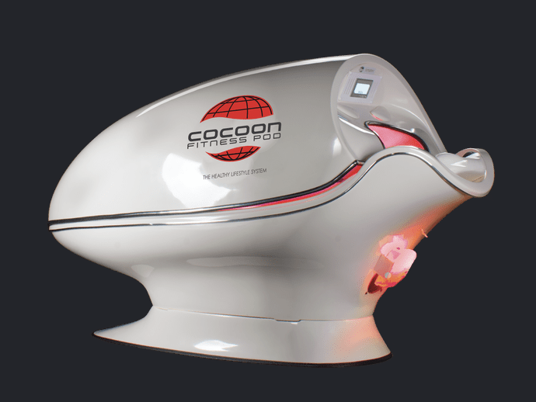
Equipment
You must know the differences in your equipment
This begins during the onboarding/training period
Features and benefits
Lay down vs stand up
The positives of mixing beds

Slide 5
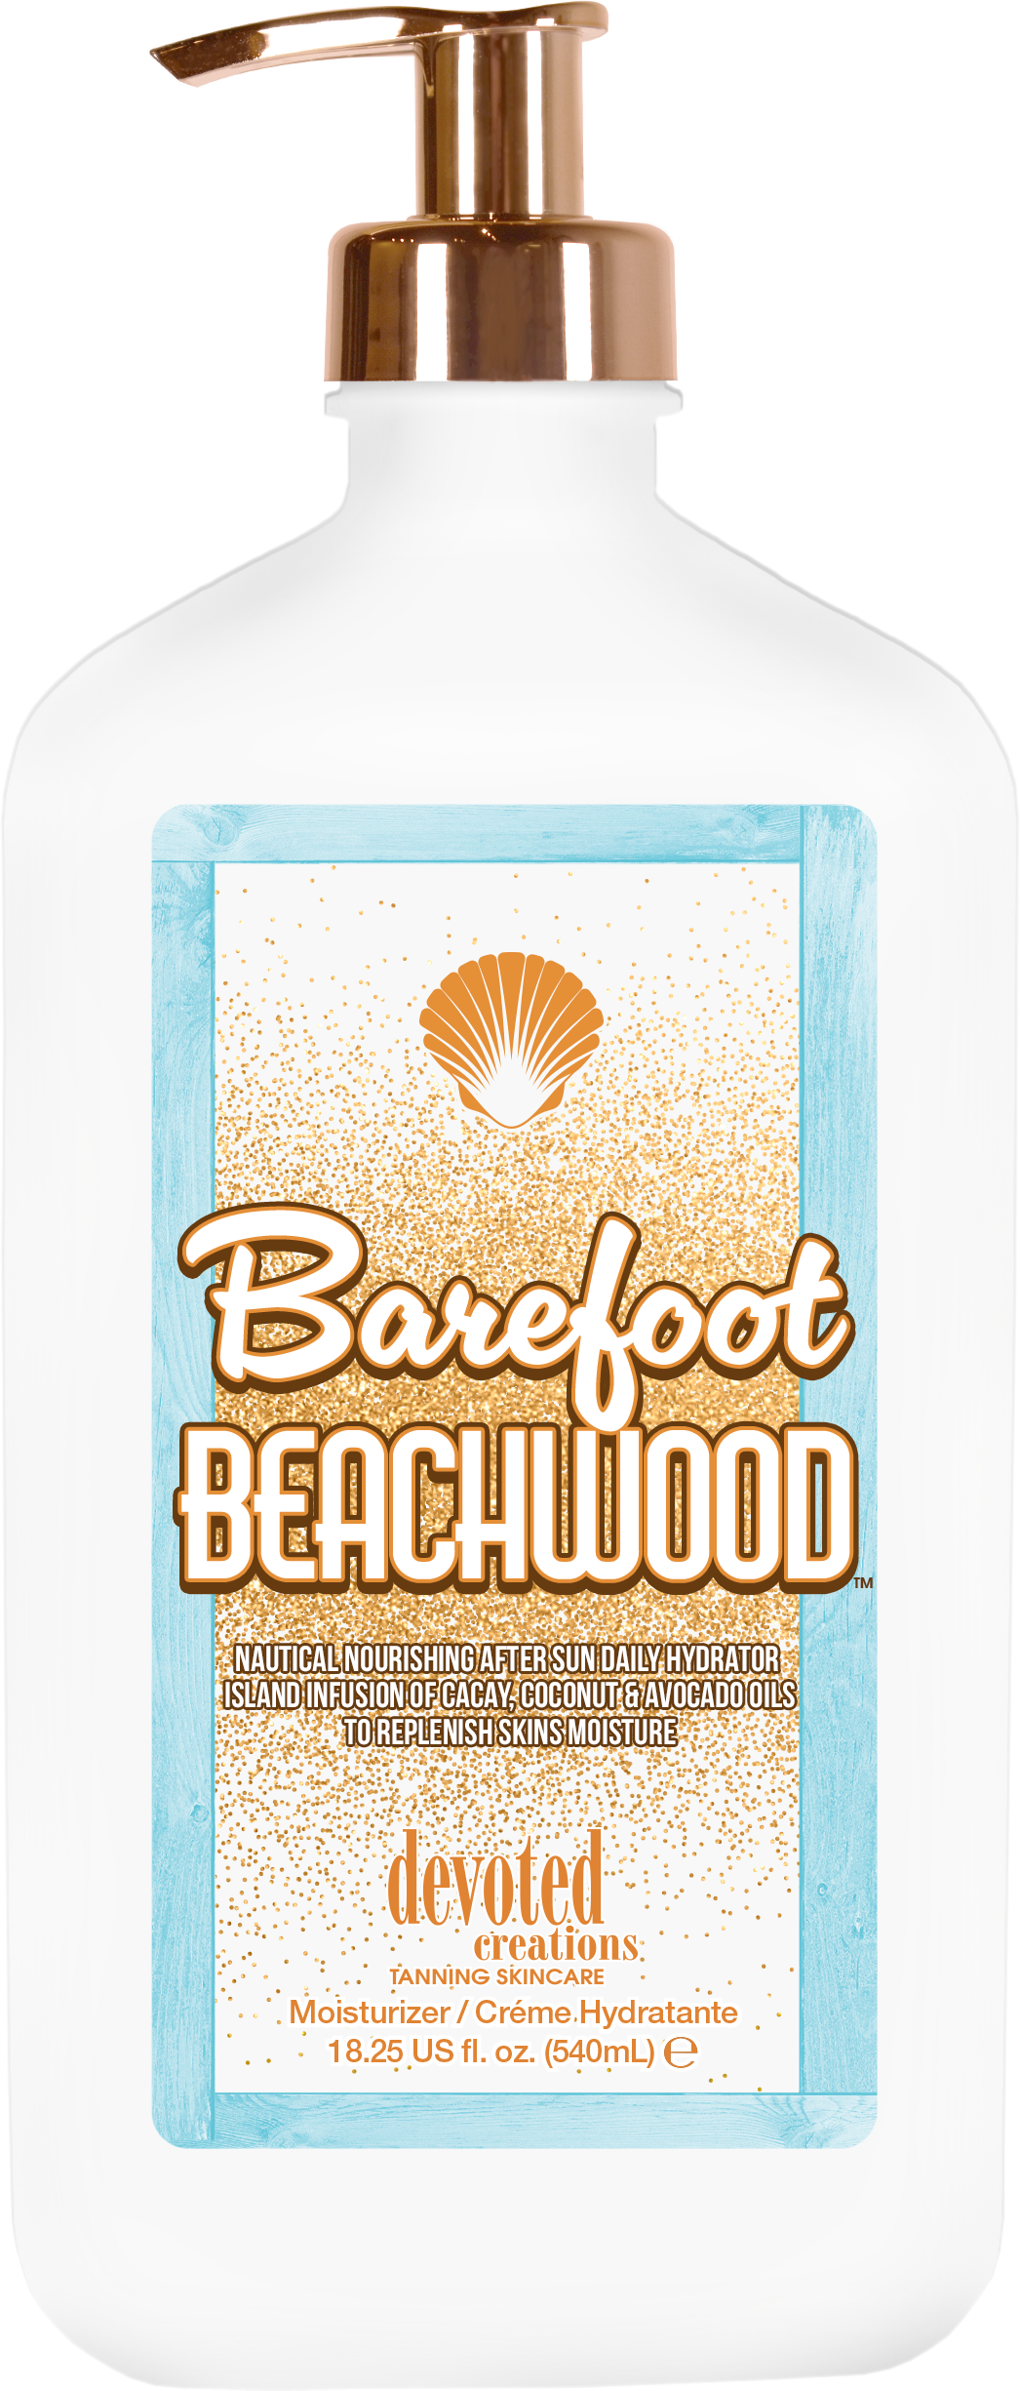
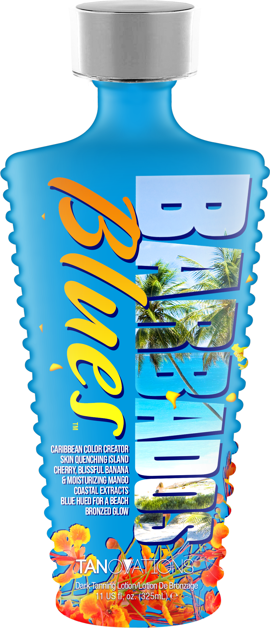
Lotion
Why professional lotion will help them
The Do’s & Don’ts of lotion
The difference between an accelerator & bronzer
Which products these apply to
Why employees should begin with Color Rush (or top collection in salon)

Slide 6
The Follow Up
Follow up with your clients on their lotion
Regardless of how much time you spent with that client (or maybe you weren’t the one who sold it to them)
Follow up on the equipment they are using
You need/want to know their feedback

Slide 7
Challenge your Employees
Have each employee pick a product that they don’t normally sell often (or lean towards)
Challenge: learn the product (what, why, what makes it special) and have them sell x# of bottles their next 2-3 shifts
If you have spa services
Challenge: have employees add a service to package/session/membership 5-8 times over their next 2-3 shifts
They must know the benefits and what type of routine the client can have when continuing using that service

Slide 8
Overall
Team meetings – team learning
Everyone should work together to help increase sales
Continuously work on scenarios with each other
Create an FAQ sheet
Know your client's tanning routine
Don’t let them choose their next bed, tell them
Don’t start with them choosing a lotion, tell them what they need based on what they have and how they’re tanning

Slide 9
Megan Racine
International Sales Trainer
Megan@devotedcreations.com
AUGUST WEB TRAININGS:
Become a Personal Tanning Stylist
August 2 @ 12:00 PM
Full 2023 Product Training
August 9 @ 12:00 PM
5 Star Diamond Program Overview
August 16 @ 12:00 PM

