Slide 1
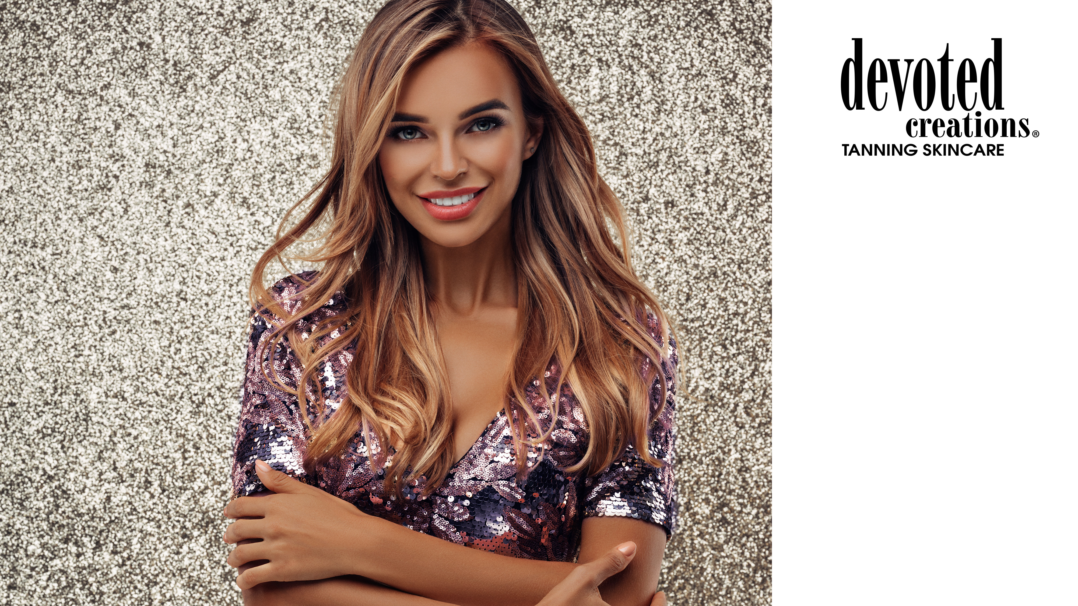





Slide 2

Quick Facts
November 1 – October 31
Unlimited event support
Customizable training options
Unlimited cash back opportunities
Can carry any brand of products that you want
We want you to take advantage of all that DC has to offer!

Slide 3
Cash Back Breakdown
6%
2%
2%
25%
All purchases from DC & EH ONLY
Social Media posts & websites
Bed Cleaner/ Sanitizer & Eyewear
Selfie Glow Sunless Retail Purchases*

Slide 4

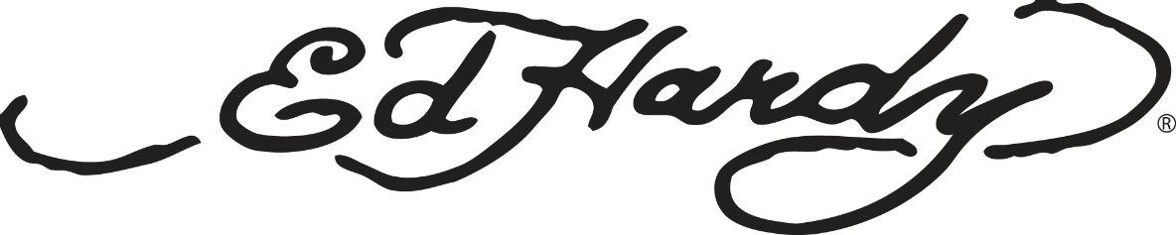
Level 1: Purchase requirements for 6% back
Purchases can only be submitted from during the rebate time period
  (November 1 – October 31)
At least 75% of all salon lotion purchases must be of Devoted Creations’ brands
  (Ed Hardy, Tanovations, Devoted Creations)
The minimum qualified rebate amount must be more than $100.

Slide 5

Level 2: Advertising requirements for 2% back
The salon must qualify under part 1 of the 5 Star Diamond Rebate Incentive Program.
All websites, email blasts and social media posts related to marketing and/or promotions must include the Devoted Creations logo exclusively to any other brands.
SOCIAL MEDIA IS FREE
Minimum 10 feed posts per rebate year (on any platform).
We LOVE stories!
38% missed this level

Slide 6
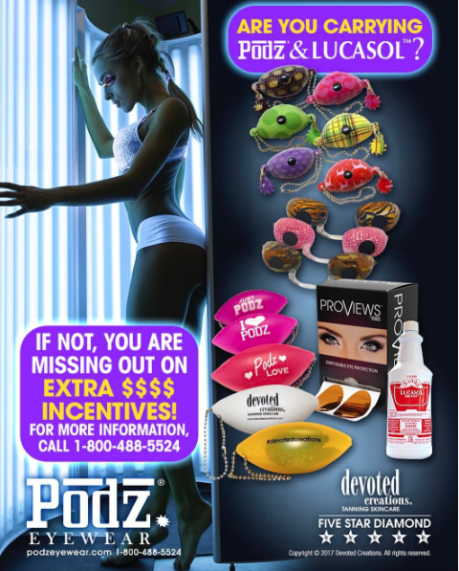

Level 3: Eyewear & Cleaner purchase requirements for 2% back
32% missed this level
The salon must qualify under part 1 of the 5 Star Diamond Rebate Incentive Program.
All eyewear and salon cleaner purchases must be exclusively Podz, Sunnies Eyewear and Lucasol brand products.

Slide 7
Level 4: Selfie Glow Sunless retail purchase requirements for 25% back
The salon must qualify under levels 1-3 of the 5 Star Diamond Rebate Incentive Program in order to qualify.
The minimum purchase amount of Selfie Glow Sunless retail products must be greater than $500.
Receive 25% back on ALL Selfie Glow Sunless retail purchases that will be added to your total rebate amount.

Slide 8
BONUS LEVEL: Bottle Spiff Incentive for
ALL SALONS!
Earn even more money back on your lotion purchases from our 4 most popular collections!
Color Rush Collection: $0.75 per bottle
DC Classic Collection: $0.40 per bottle
Pauly D Collection: $0.25 per bottle
Soho Collection: $0.20 per bottle
**Discontinued products do not qualify**

Slide 9
TRAINING OPPORTUNITIES ALL YEAR!
Client Support
Devoted on Demand
Live Webinar Trainings
In Salon Trainings
Distributor Tradeshows
Notes:
9

Slide 10
Devoted on Demand
Register for your exclusive access to our on-demand training website!
Devoted On Demand holds a library of all web-based trainings that go over products and sales, customer service, and salon informational videos. This feature is available 24 hours a day, 7 days a week, 365 days a year!
Register for trainings, re-watch, learn & download all from one site.
Client Support
The client support section on DevotedCreations.com gives you access to all things Devoted!
You will be given access to product images, product fact sheets, powerpoint presentations, online product videos, in-room advertising images, model images, logos, salon promotional materials, price guide, training books and incentive program documents.
Notes:
10

Slide 11
Live Webinar Trainings
We work with you to customize our trainings on topics that are highly requested so we can assist in the growth of your business.
Trainings can focus on products and sales, salon basics, social media, red light, customer service, etc.
Prize giveaways!
Online trainings every month
Notes:
11

Slide 12
In Salon Training
Training sessions typically last up to 2 hours and can be customized to best suit the needs of your salon.
  Trainings will typically always go over DC lotion basics, new products and sales tips unless otherwise stated.
No minimum attendance required for salons that have purchased $3000 in Devoted Creations/Tanovations products and maintain a 75% shelf presence or greater.
Custom training materials are created for your salon employees!
Notes:
12

Slide 13
Megan’s Tanning Salon
Total purchases $ spent = $9759.87
Total DC/EH lotion $ spent = $9354.56
Lucasol/Eyewear purchases = $405.31
Social Media – YES
10% cash back on $9759.87 = $975.99
Bottle spiff = $114.20
Total Rebate = $1090.19
Total purchases $ spent = $9354.56
Total DC/EH lotion $ spent = $9354.56
Lucasol/Eyewear purchases = $0
Social Media – YES
8% cash back on $9354.56 = $748.37
Bottle spiff = $114.20
Total Rebate = $862.57
Total purchases $ spent = $9354.56
Total DC/EH lotion $ spent = $9354.56
Lucasol/Eyewear purchases = $0
Social Media – NO
6% cash back on $9354.56 = $561.27
Bottle spiff = $114.20
Total Rebate = $675.47
Notes:
13

Slide 14
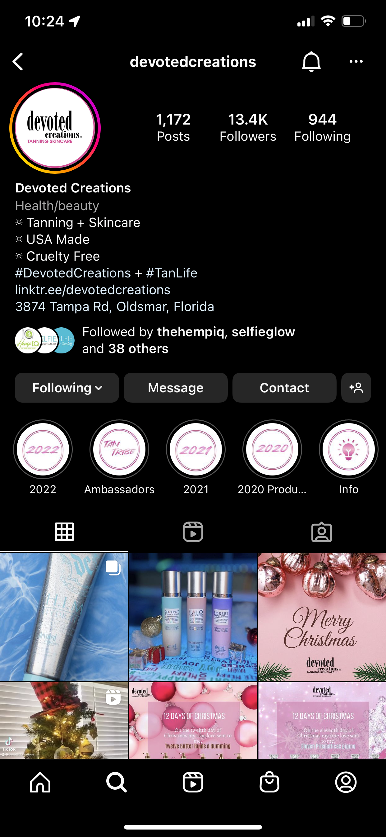
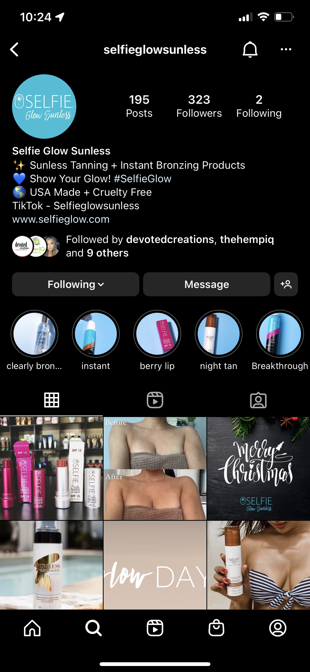
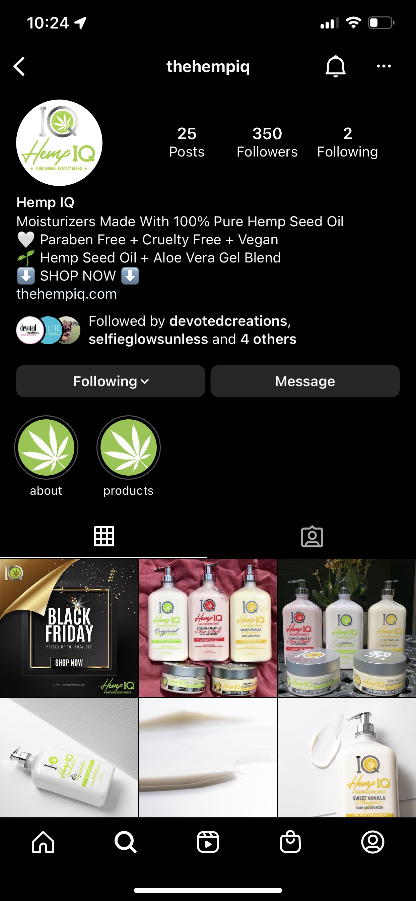
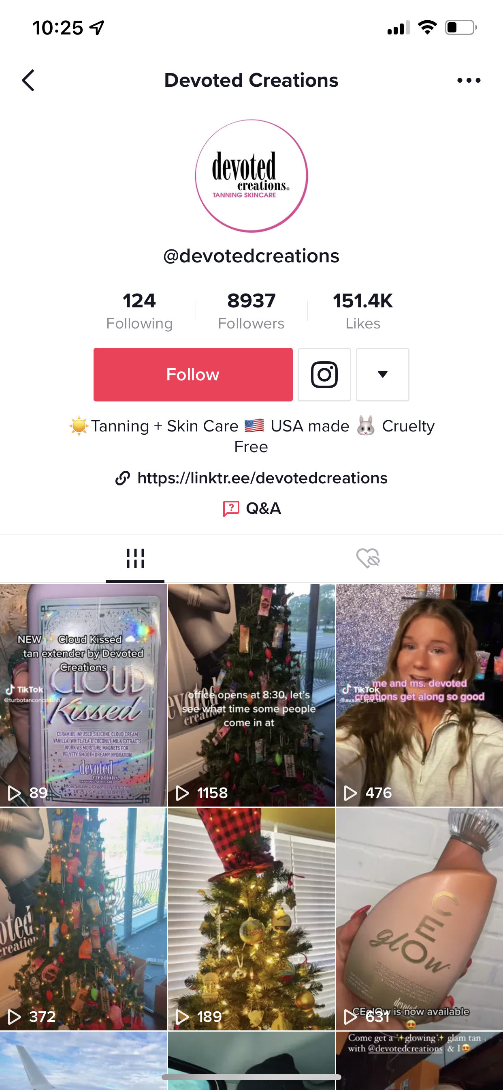
Stay Updated on all Things Devoted
Instagram & TikTok
Notes:
14

Slide 15
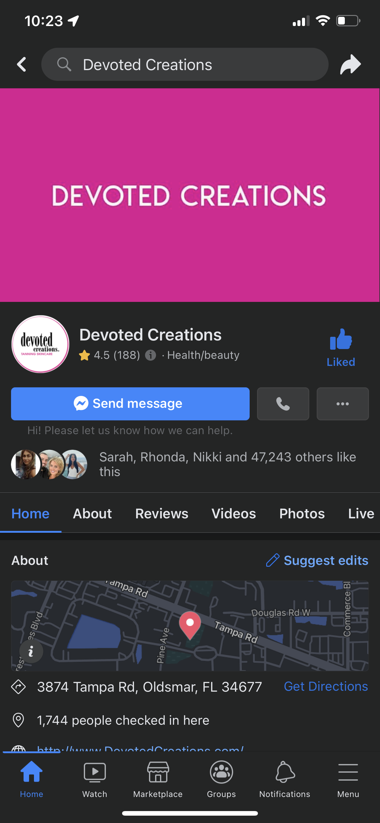
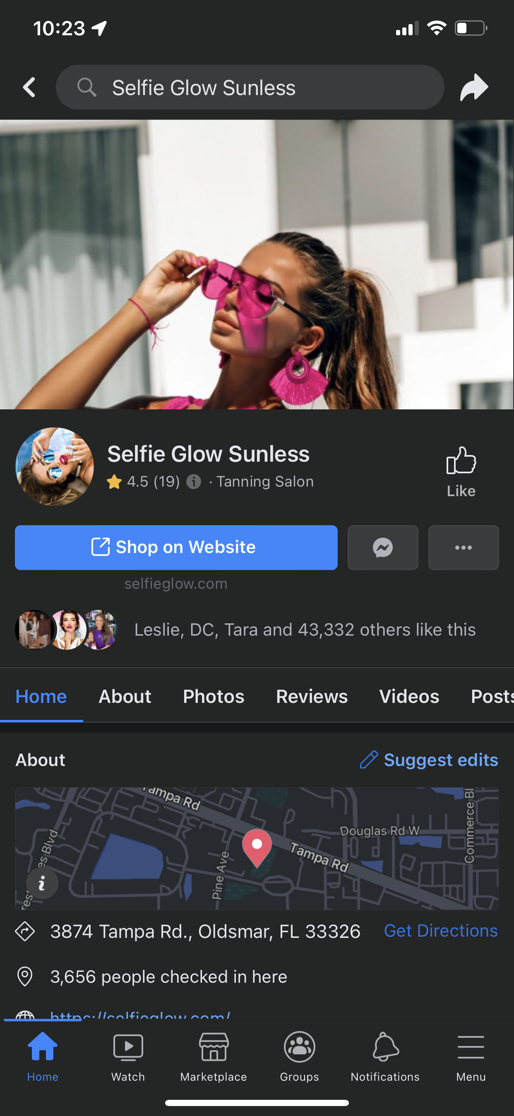
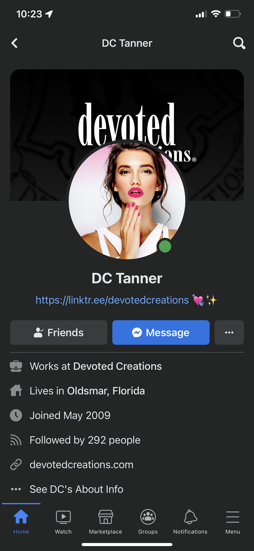
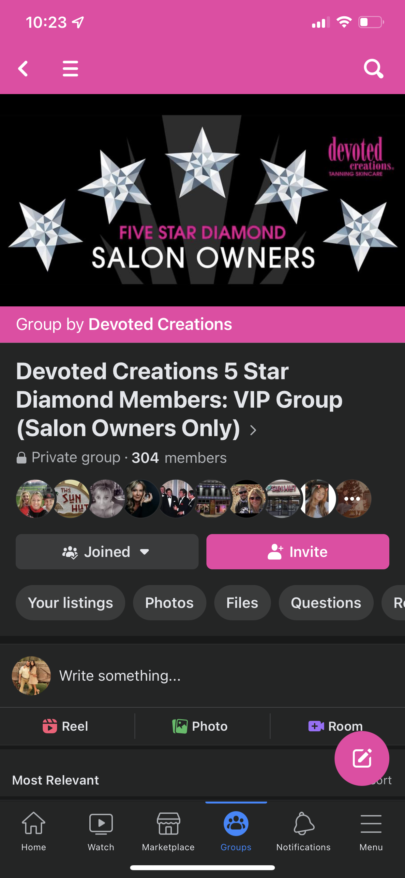
Stay Updated on all Things Devoted
Facebook
Notes:
15

Slide 16
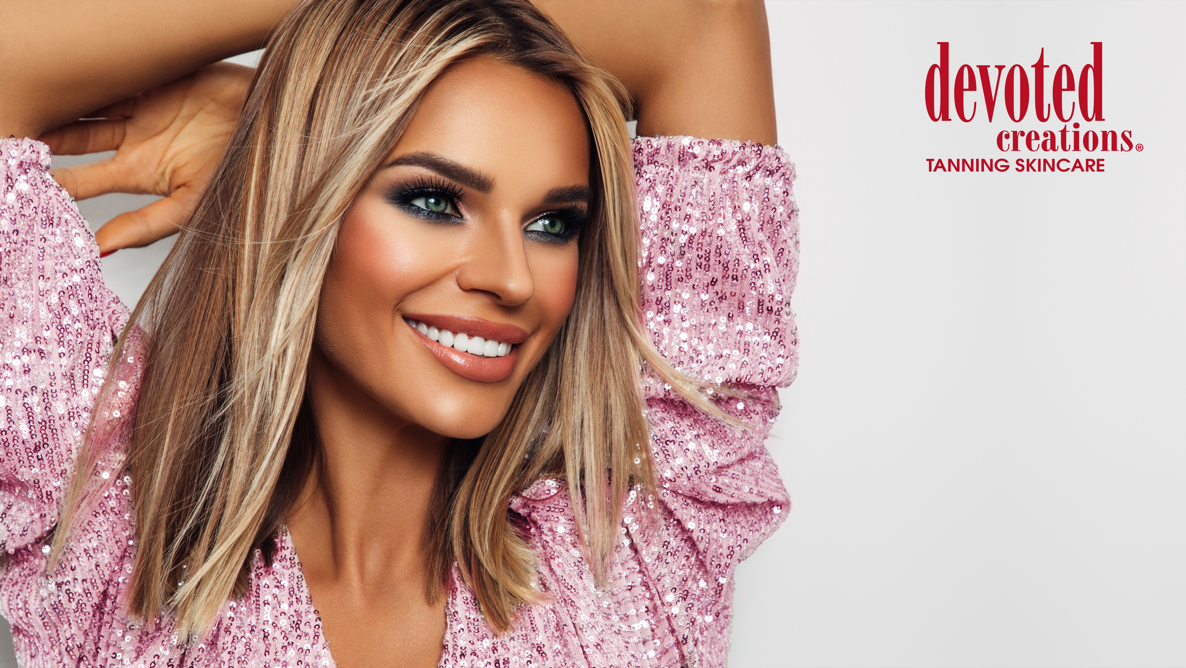
Megan Racine
International Sales Trainer
Megan@devotedcreations.com

