Slide 1
2023 Product Training

Slide 2
2023 Cutting Edge Ingredients
Fision™ GlowPlex – A multi-functional skincare active containing Niacinamide and anti-aging peptides, this complex enhances glowing skin & radiance by working to blur imperfections for a more luminous complexion. Helps to minimize the appearance of dark spots and hyperpigmentation wile supporting an even skin tone.
MossCellTec™ - A new anti-aging concept that works to constantly improve moisture levels in the skin while adapting to and protecting skin from stressful environmental changes.

Slide 3
2023 Cutting Edge Ingredients
Centella CAST – A formula created from the Centella Asciatica plant, Centella CAST restores skin’s elasticity and firmness by preserving collagen and reducing the appearance of stretch marks and skin sagging. Centella CAST works to improve the skin’s microcirculation to improve collagen production for a more youthful appearance.
Improves skin’s elasticity, density and firmness by 62%
Improves skin’s appearance by 42%
Increases skin’s microcirculation by 162%
Sagging skin and stretch marks are caused by rapid stretching of the skin or rapid shrinking of the skin and causes the collagen and elastin to rupture.
https://www.givaudan.com/fragrance-beauty/active-beauty/products/centella-cast

Slide 4
2023 Cutting Edge Ingredients
Cacay Oil – Rich in fatty acids, Cacay oil is used to help heal and hydrate the skin while also working to combat fine lines, wrinkles, dryness, dullness, uneven skin tone and discoloration.
Porcelain Flower Extract – Hydrates and nourishes the skin while helping to promote a crystal-clear complexion.
Glucohyami™ - Helps the skin to restore its natural production of hyaluronic acid to help for a more youthful and tones appearance to the skin.

Slide 5
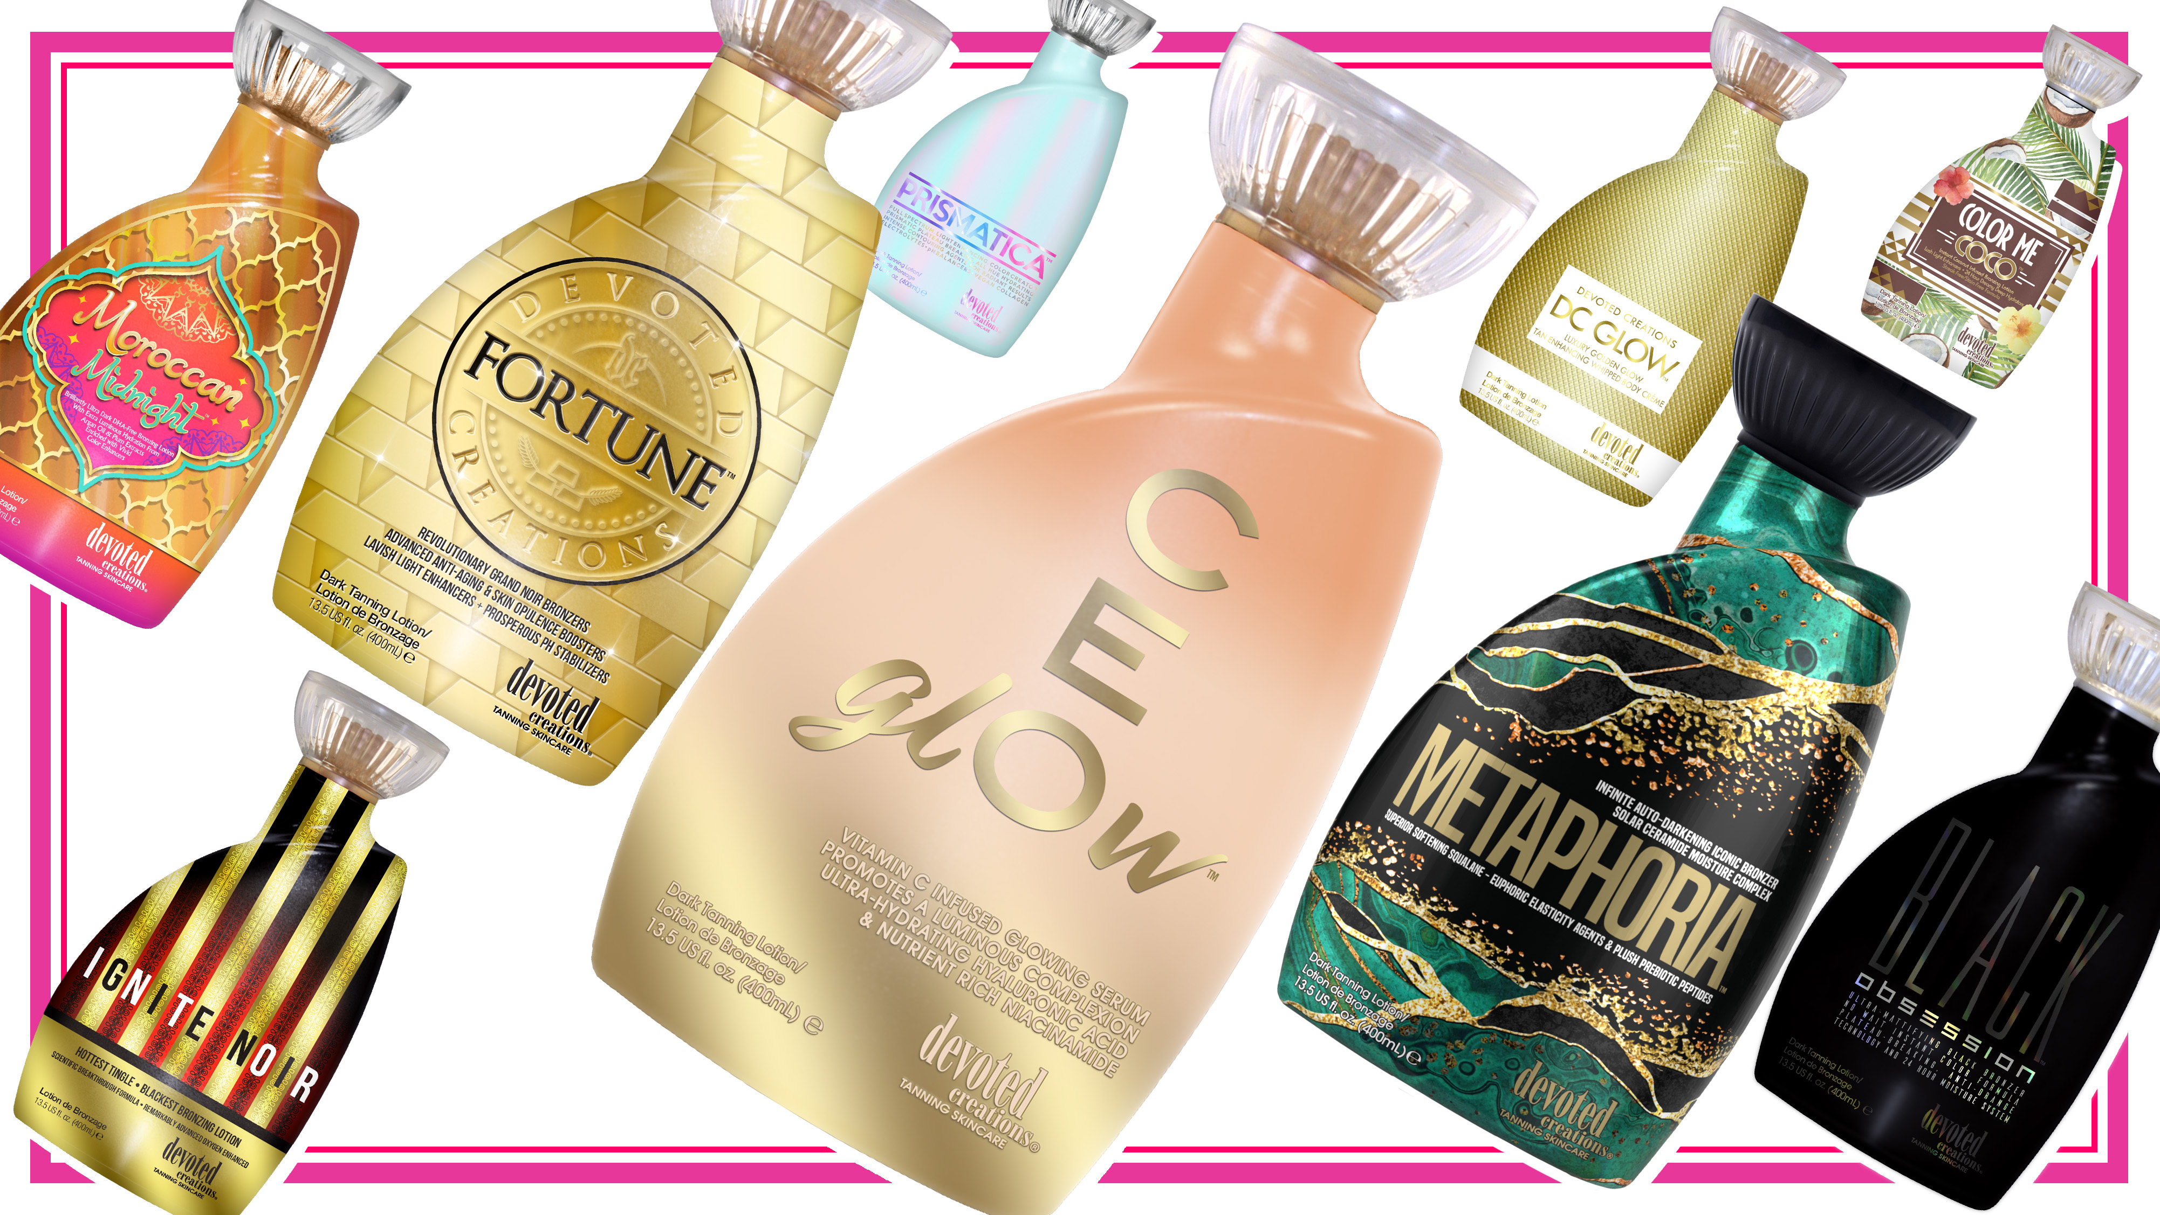
Notes:
5

Slide 6
Commonalities
Cashmere Blend
Renovage
BodyFit
FreshTek
SunXtend
Tattoo & Color Fade Protecting Formula

Slide 7
CEglOw™ Vitamin C Infused Glowing Serum | Promotes a Luminous Complexion
Ultra-Hydrating Hyaluronic Acid & Nutrient Rich Niacinamide
• Golden Glow Bronzing Serum – This revolutionary Vitamin C serum utilizes glowing levels of DHA to deeply nourish and hydrate while providing a luminous glow.
• GlowPlex™ - A multi-functional skincare active containing Niacinamide and anti-aging peptides to promote glowing skin, blur imperfections and helping to minimize the appearance of dark spots.
• X50 PhotoGlow™ - Glowing skin enhancer that turns light into cellular energy for increased luminosity and elasticity.
• Apple Cider Vinegar – Helps to absorb excess oils, unclogs blocked pores and soothe irritation. It also has the power to help restore the natural pH balance to the skin.
• Golden C – Contains Vitamin C with micro gold particles that allow the Vitamin C to penetrate deeper into the skin for enhanced complexion perfecting effects while also targeting the appearance of fine lines and pigmentation.
• Superox C™ – A specialty derived blend of Kakadu Plum known as one of the world’s richest sources of Vitamin C, Superox C is a potent antioxidant and contains micronutrient benefits that help to protect against environmental damage.
• Hyaluronic Acid – Hydrates through the layers of the skin to promote a bouncy, plump look.
• Hyalufix™ - Sustainably sourced from Thai ginger leaves, Hyalufix™ compliments the skin’s natural production of hyaluronic acid. Delivering intensive and deep down cellular hydration, Hyalufix™ significantly appears to correct deep wrinkles, improve skin density, firm and plump the skin.
• Centella CAST – Helps to restore skins elasticity and firmness while boosting collagen production, as well as helps to reduce the appearance of stretch marks and sagging skin.
Fragrance: Sweet Nectar Glow

Slide 8
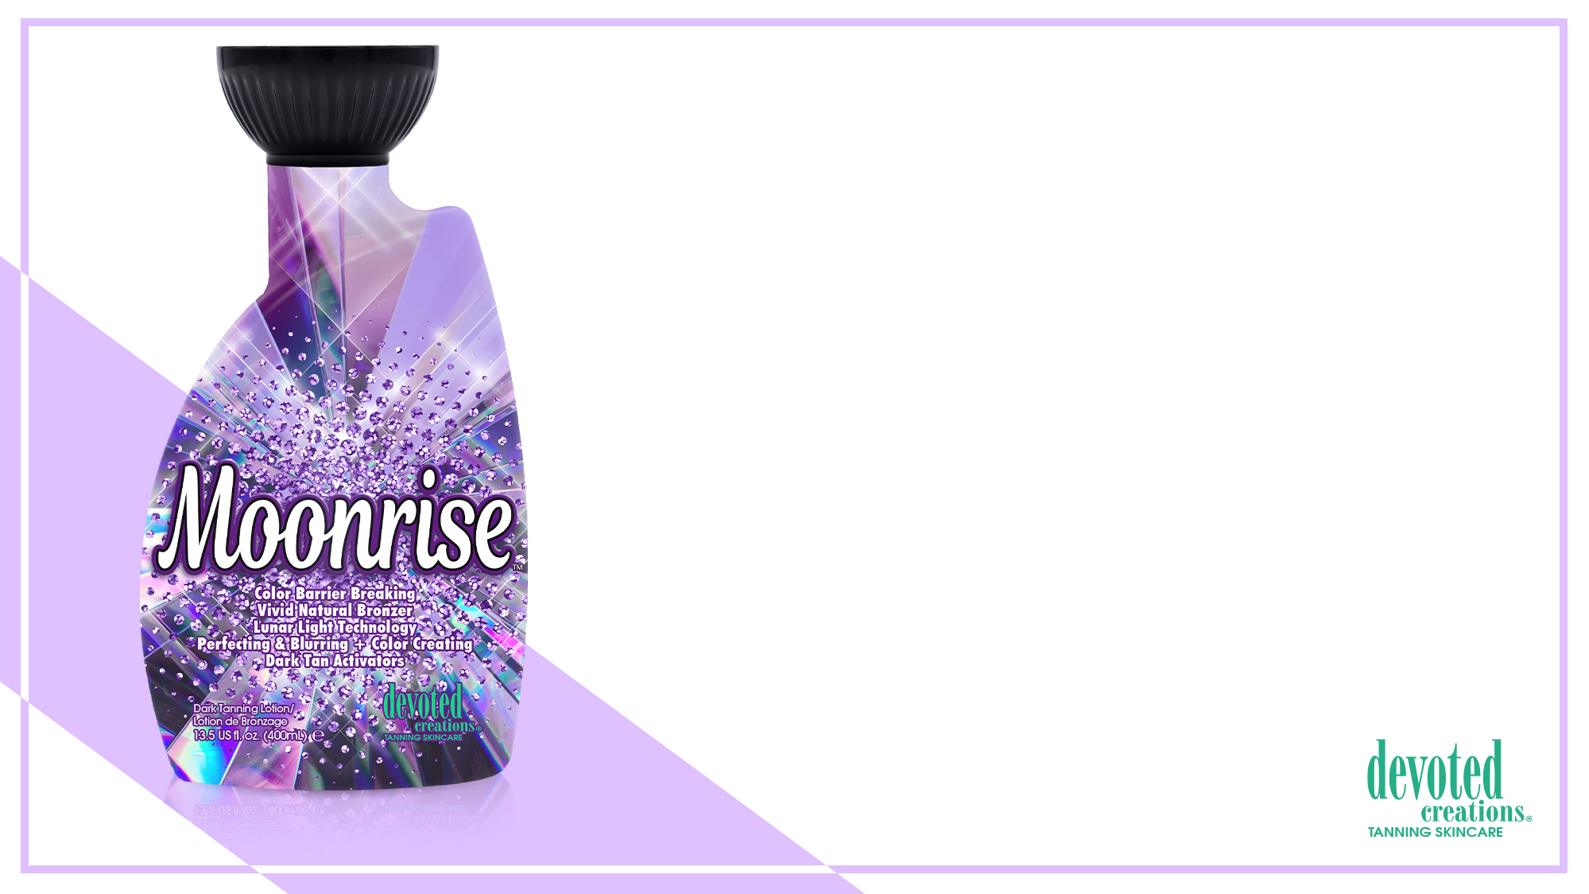
Moonrise™ Color Barrier Breaking | Vivid Natural Bronzer
Lunar Light Technology | Perfecting & Blurring + Color Creating
Dark Tan Activators
• Plateau Breaking Natural & Cosmetic bronzers for immediate deep, long lasting bronzed results without the use of self-tanning agents.
• pH Balancing & Formulated for use in all light units - Maximize your session in red light, blue light or UV light with pH balancing agents that allow for optimal light absorption.
• Light Activated Photosomes – Used with any light therapy and helps protect the skins immune system.
• X50 PhotoGlow™ - Glowing skin enhancer that turns light into cellular energy for increased luminosity and elasticity.
• GlowPlex™ - A multi-functional skincare active containing Niacinamide and anti aging peptides to promote glowing skin, blur imperfections and helping to minimize the appearance of dark spots.
• Golden C – Contains Vitamin C with micro gold particles that allow the Vitamin C to penetrate deeper into the skin for enhanced complexion perfecting effects while also targeting the appearance of fine lines and pigmentation.
• Violet Flower – Contains natural anti-inflammatory agents to calm irritated skin as well as comedolytic and bacteriostatic properties that soothe skin imperfections while helping to prevent acne and excess oil on all skin types.
• Caffeine Extracts – Firms, hydrates and tightens the skin for anti-aging and wrinkle soothing properties.
• Rose Water – Antioxidant rich to help ward off free radical damage while also targeting skin sagging and dullness.
Fragrance: Beaming Starburst

Slide 9
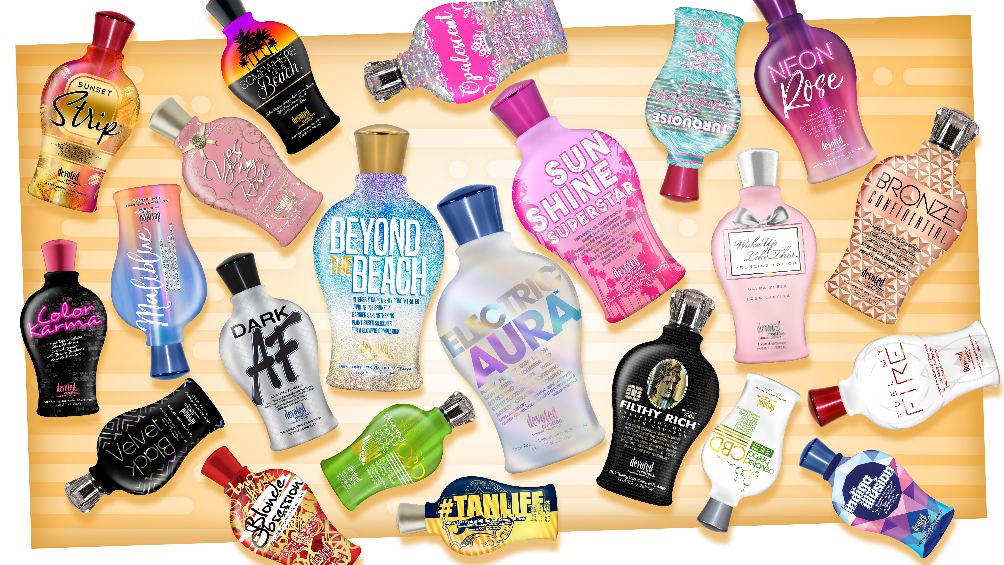
Notes:
9

Slide 10
Commonalities
BodyFit
Advanced Matrixyl Synthe 6
Antioxidants
FreshTek
Melanin Stimulators
Biggest Difference – Bases of Lotions

Slide 11
Electric Aura™ Dreamy Dark Purely Perfect Sun Lotion
Skin Calming Cucumber + Refreshing Grape Water
Super Soothing & Softening Ceramide Complex
• Ceramide Complex – Essential fatty acids that help to moisturize and strengthen the skin’s natural barrier.
• Violet Flower – Contains natural anti-inflammatory agents to calm irritated skin as well as comedolytic and bacteriostatic properties that soothe skin imperfections while helping to prevent acne and excess oil on all skin types.
• Organic Grape Water – A power packed prebiotic that can help to improve the skins microbiome to reveal fresh, healthy looking skin.
• Cucumber Extracts – Helps to naturally nourish, hydrate, comfort, soothe, calm and depuff the appearance of skin.
• White Birch Extracts – Anti-aging and skin firming benefits.
• Green Tea - Anti-aging, soothing and antioxidant rich properties.
• Cotton & Rice Extract - Soothe and soften sensitive skin without irritation.
• Sensitive Skin Hypoallergenic Formula
Fragrance: Hypoallergenic & Allergen Free Fragrance

Slide 12
Sunshine Superstar™ Influential Glow Boost Dark Tan Enhancer
Infused with Plant Based Silicones | Skin Smoothing Hyaluronic Acid
Vitamin C for Insta Fame Worthy Skin
• Revolutionary 4K Blend - Allows for deeper hydration and longer lasting tanning results as well as better penetration of the high-end skin care ingredients, while also working to blur imperfections and allow for a crystal-clear complexion
• Plant Based Silicone – Silicone alternative that creates a silky soft finish, while improving moisture levels, softness and smoothness of the skin while being spray tan friendly.
• Golden C – Contains Vitamin C with micro gold particles that allow the Vitamin C to penetrate deeper into the skin for enhanced complexion perfecting effects while also targeting the appearance of fine lines and pigmentation.
• Superox C™ – A specialty derived blend of Kakadu Plum known as one of the world’s richest sources of Vitamin C, Superox C is a potent antioxidant and contains micronutrient benefits that help to protect against environmental damage.
• Hyalufix™ - Sustainably sourced from Thai ginger leaves, Hyalufix™ compliments the skin’s natural production of hyaluronic acid. Delivering intensive and deep down cellular hydration, Hyalufix™contains antioxidant properties and significantly appears to correct deep wrinkles, improve skin density, firm and plump the skin.
• Hyaluronic Acid – Hydrates through the layers of the skin to promote a bouncy, plump look.
• Centella CAST – Helps to restore skins elasticity and firmness while boosting collagen production, as well as helps to reduce the appearance of stretch marks and sagging skin.
• Watermelon Extracts – Provides 24-hour hydration while improving the skins tone and deeply improving the appearance of fine lines, wrinkles and dry spots of the skin.
Fragrance: Sweet Summer Escape

Slide 13
Beyond the Beach™ Intensely Dark Highly Concentrated Vivid Bronzer
Barrier Strengthening Plant Based Silicones
Boosts Cellular Energy & Luminosity
• Revolutionary 4K Blend - Allows for deeper hydration and longer lasting tanning results as well as better penetration of the high-end skincare ingredients, while also working to blur imperfections and allow for a crystal-clear complexion.
• Plant Based Silicones – Silicone alternative that creates a silky soft finish, while improving moisture levels, softness and smoothness of the skin while being spray tan friendly.
• X50 PhotoGlow™ - Glowing skin enhancer that turns light into cellular energy for increased luminosity and elasticity.
• Apple Cider Vinegar – Helps to absorb excess oils, unclogs blocked pores and soothe irritation. It also has the power to help restore the natural pH balance to the skin.
• Glowplex™ - A multi-functional skincare active containing Niacinamide and anti-aging peptides to promote glowing skin, blur imperfections and helping to minimize the appearance of dark spots.
• Bakuchiol – Works by increasing cell turnover, thereby stimulating collagen production and diminishing wrinkles, skin laxity, and overall photo damage.
• Blue Tansy – Provides anti-orange agents so the skin develops the most natural, dark bronzed results.
Fragrance: Blissful Beach

Slide 14
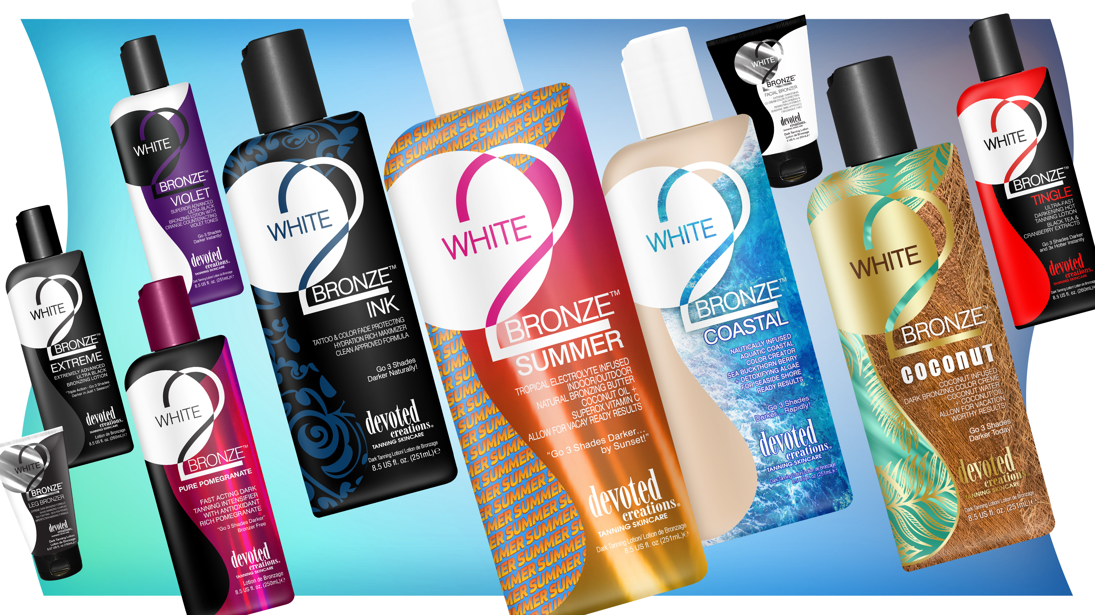

Slide 15
Commonalities
Tapioca Starch Base
ALA Technology – baby version of PhytoCellTec
Antioxidants

Slide 16
White 2 Bronze Summer™ Tropical Electrolyte Infused Sunshine or Sunbed Natural Bronzing Butter
Coconut Oil & Superox Vitamin C Allow for Vacay Ready Results!
Go 3 Shades Darker…by Sunset!
• Cactus Water – High in antioxidants, vitamins and electrolytes to keep skin hydrated.
• Coconut Oil – Deeply softens and nourishes the skin for long lasting hydration.
• Superox C™ – A specialty derived blend of Kakadu Plum known as one of the world’s richest sources of Vitamin C, Superox C is a potent antioxidant and contains micronutrient benefits that help to protect against environmental damage.
• MossCellTec™ – Potent anti-aging and moisture level preserving ingredients help to protect the skin from stressful environmental changes.
• Cupuaçu Butter – Helps to lock in moisture and restore skins elasticity.
• Acai Berry Extracts – Rich in antioxidants, Acai berry helps to protect the skin from free radical damage.
• White Birch – Contains anti-aging and skin firming benefits.
• Formulated for use indoors & outdoors
Fragrance: Beach Berry

Slide 17
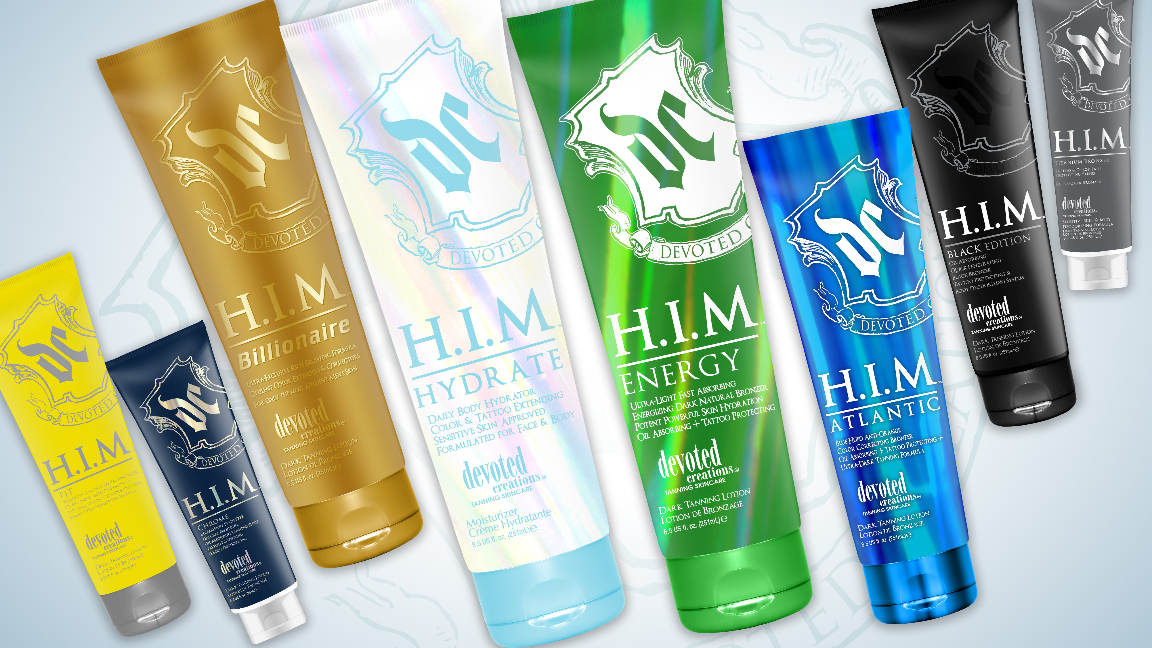
Notes:
17

Slide 18
Commonalities
Tapioca Starch Base
Advanced Matrixyl Synthe 6
FreshTek
SunXtend
Tattoo & Color Fade Protecting Formula
Avocado Extract
Vitamin C & E
Tamanu Oil

Slide 19
HIM Energy™ Ultra Light Fast Absorbing | Energizing Dark Natural Bronzer
Potent Powerful Skin Hydration
Tattoo Fade Protection – Sensitive Skin Approved
• Tamanu Oil - A powerful skin regenerator; aiding in wrinkle reducing, blemish-fighting and moisturizing dry skin. Helps to hide the appearance of scars and stretch marks.
• Caffeine, Guarana & Ginseng - Naturally energizing and skin tightening extracts that work together to firm and reduce the appearance of imperfections in the skin.
• Ginger Root - Reduces irritation and inflammation in the skin.
• Green Tea Extracts - Anti-aging, soothing and antioxidant rich properties.
• Turmeric Root Extract – Known for its antioxidant and anti-reddening properties, Turmeric helps to improve the look of the surface of your skin to create a more blemish free, even appearance.
Fragrance: Energizing Waves

Slide 20
HIM Hydrate™ Daily Body Hydrator | Tattoo & Color Extending
Sensitive Skin Approved | Formulated for the Face & Body
• Tiger Grass - Helps to improve the appearance of dull skin while reducing redness and helping to protect skin from environmental stress and blemishes.
• Lavender Oil – Helps to moisturize the skin while working to soothe inflammation and irritation.
• Rosemary Oil – Natural astringent properties that help to combat acne as well as blocked pores.
• Turmeric Root Extract – Known for its antioxidant and anti-reddening properties Turmeric helps to improve the look of the surface of your skin to create a more blemish free, even appearance.
• White Birch – Contains anti-aging and skin firming benefits.
• Matrixyl Synthe 6™ – Targets and fills in fine lines and wrinkles.
• Tamanu Oil- A powerful skin regenerator; aiding in wrinkle reducing, blemish-fighting, and moisturize dry skin. Also, helps to hide the appearance of scars and stretch marks.
• Shea Butter - Helps to soothe dry skin and improves the skin’s elasticity.
Fragrance: Ocean Waters

Slide 21
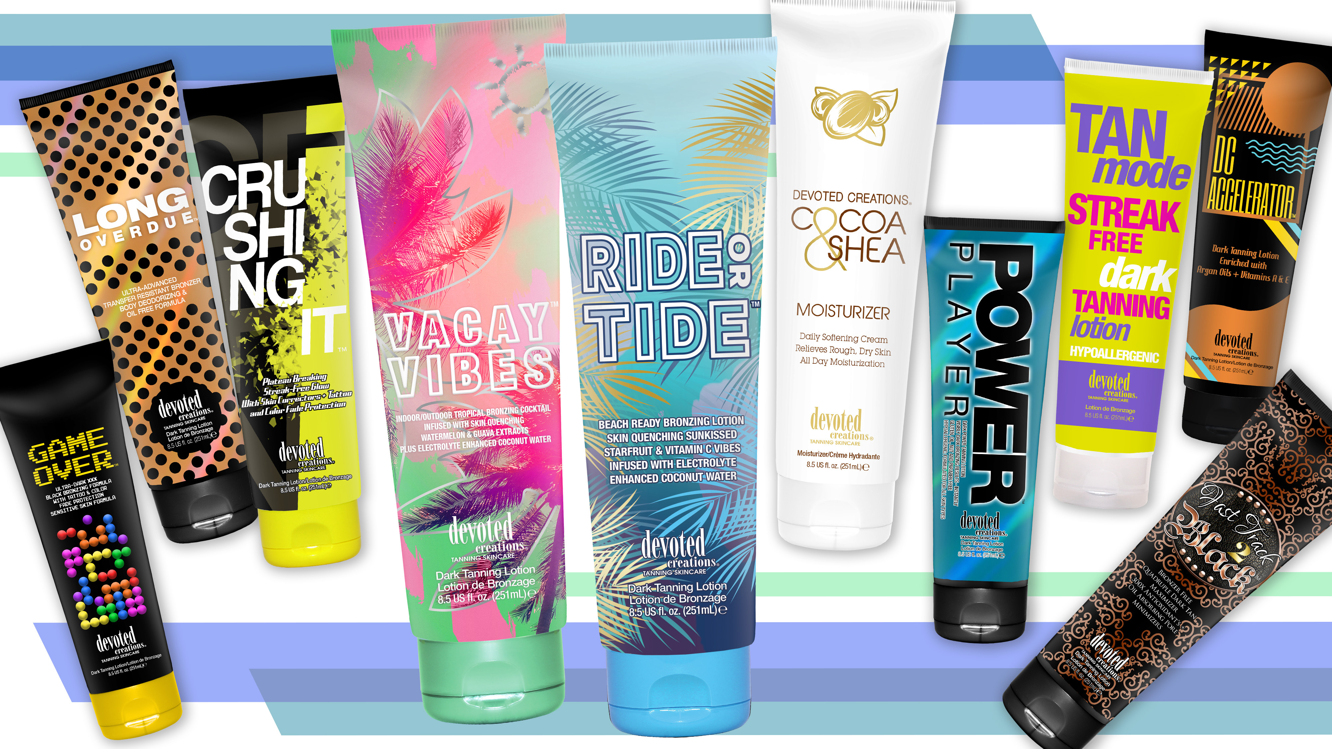

Slide 22
Ride or Tide™ Beach Ready Bronzing Cocktail
Skin Quenching Sunkissed Starfruit & Vitamin C Vibes
Infused with Electrolyte Enhanced Coconut Water
• Beach Ready Bronzing Blend – Dark levels of DHA combined with high levels of natural bronzers allow the skin to develop natural, long lasting beach bronzed results.
• Mango Butter – Non-comedogenic antioxidant that helps to reduce the appearance of fine lines and wrinkles while providing a glowing complexion and fighting acne formations.
• Starfruit Extracts – Provides pore tightening and acne combating nutrients for an anti-reddening and skin perfected effect.
• Superox C™ – A specialty derived blend of Kakadu Plum known as one of the world’s richest sources of Vitamin C, Superox C is a potent antioxidant and contains micronutrient benefits that help to protect against environmental damage.
• Coconut Water – Electrolyte rich to increase skin’s hydration and elasticity and adds a glowing effect to the skin.
• MossCellTec™ – Potent anti-aging and moisture level preserving ingredients help to protect the skin from stressful environmental changes.
• Tattoo & Color Fade Protection – Protects the color and the luster of your tan and your tattoos.
Fragrance: Moonfruit Tidal Wave

Slide 23
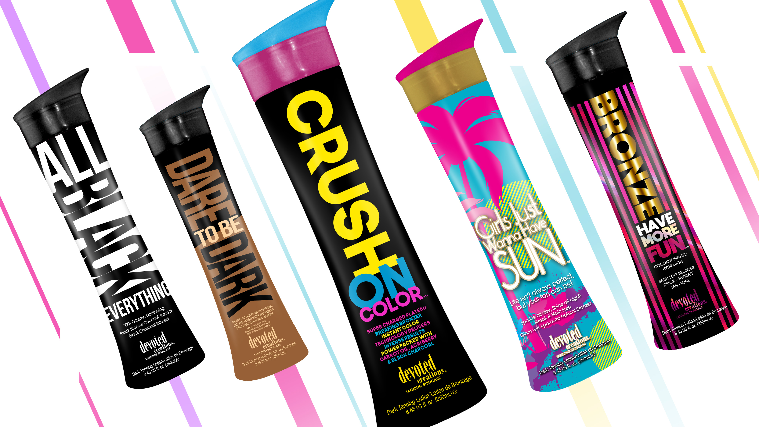

Slide 24
Crush on Color™ Super Charged Plateau Breaking Bronzer
Instant Color Technology Delivers INTENSE RESULTS
Power Packed with Carrot Oil, Acai Berry & Black Charcoal
• Chicory Extract – Provides an instant tanned appearance 60 seconds after application.
• Black Charcoal – Skin detoxifiers reduce excess oil and inflammation while aiding in improving acne prone skin.
• CC Cream Blend – Color Correctors that work to even out skin tone and mask imperfections in the skin.
• Ceramide Complex – Essential fatty acids that help to moisturize and strengthen the skin’s natural barrier.
• Carrot Oil – Contains beta-carotene to rejuvenate cells for a glowing and radiant appearance.
• Acai Berry Extracts – Rich in antioxidants, Acai berry helps to protect the skin from free radical damage.
Fragrance: Blackberry Blast

Slide 25
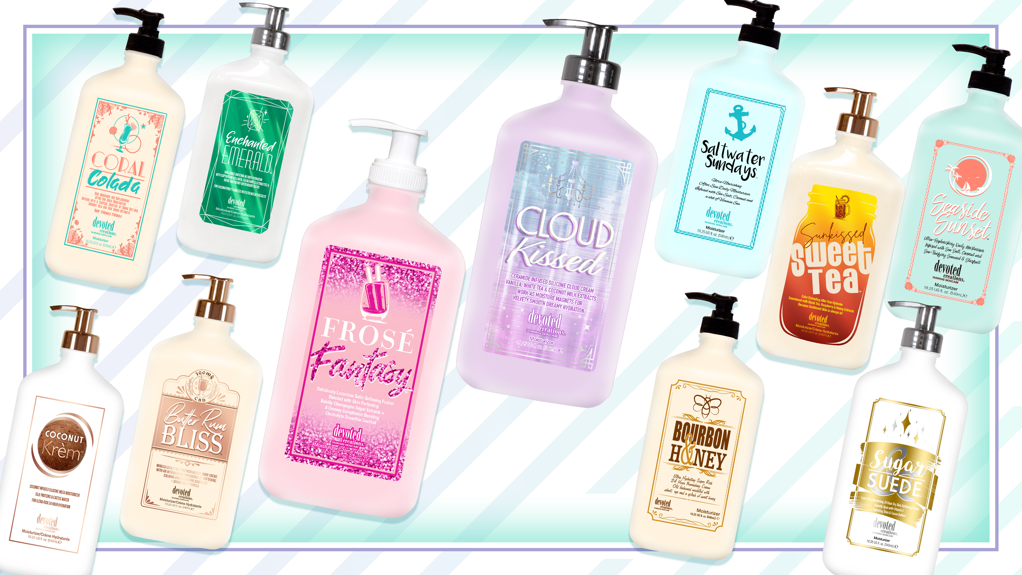

Slide 26
Cloud Kissed™ Ceramide Infused Silicone Cloud Cream
Vanilla, White Tea & Coconut Milk Extracts work as Moisture Magnets
For Velvety Smooth Dreamy Hydration
• Ceramide Complex – Essential fatty acids that help to moisturize and strengthen the skin’s natural barrier.
• Silicone Blend - Visibly reduce the look of pores and imperfections while offering non greasy hydration.
• Vanilla Extracts – Rich in antioxidants to help ward off free radical damage while also helping to combat the signs of aging.
• White Tea Extracts – Anti-inflammatory that works as a natural antioxidant to help improve the appearance of hyperpigmentation.
• Coconut Milk – Deeply softens and nourishes while calming irritation on even the most sensitive skin.
• Marshmallow Extracts – Works to counteract redness and inflammation in the skin while also helping to retain moisture.
• Vitamin C - Helps to slow the signs of aging while also working to improve the appearance of dark spots and skin imperfections.
• Tattoo & Color Prolonging Technology – Helps to lock in moisture as well as protect the color and luster of your tan and tattoos.
Fragrance: Cloud Kissed

Slide 27
Barefoot Beachwood™ Nautical Nourishing After Sun Daily Hydrator
Island Infusion of Skin Softening Cacay, Coconut & Avocado Oils
to Replenish Skin’s Moisture
• Cacay Oil – Rich is fatty acids, Cacay oil is used to help heal and hydrate the skin while also working to combat fine lines, wrinkles, dryness, dullness, uneven tone and discoloration while helping to restore luminosity.
• Willow Bark Extract – Helps to calm redness soothe irritated skin leaving a more radiant and clear complexion.
• Silicone Blend - Visibly reduce the look of pores and imperfections while offering non-greasy hydration.
• Coffeeberry Extracts – Rich in antioxidants to help ward off free radical damage while also helping to combat the signs of aging.
• White Tea Extracts – Anti-inflammatory that works as a natural antioxidant to help improve the appearance of hyperpigmentation.
• Coconut Milk – Deeply softens and nourishes while calming irritation on even the most sensitive skin.
• Cucumber Extract – A powerful natural soothing agent that also helps to reduce puffiness and decrease skin irritation.
• Avocado Extract – Helps to strengthen the skins natural moisture barrier.
Fragrance: Barefoot Beachwood

Slide 29
Commonalities
Hyaluronic Acid
Vegan Collagen
Multi-use
Formulated for delicate facial skin

Slide 30
Honey Gleam Cream™ Glow Boosting Skin Tint | Contouring Filter Effect
Iconic Airbrush Luminizer
Mega-Moisture Dewy Mineral Mask
• Airbrush Luminizing Skin Tint & Glow Enhancing Mask – This revolutionary facial tan enhancer is formulated to tan, tone and tighten facial skin while also providing a filtered luminous glow.
• Porcelain Flower Extract – Hydrates and nourishes the skin while helping to promote a crystal-clear complexion.
• GlowPlex™ - A multi-functional skincare active containing Niacinamide and anti-aging peptides to promote glowing skin, blur imperfections and helping to minimize the appearance of dark spots.
• Electric Daisy – Allows for a tightening and contouring effect to the skin while also helping to increase skin’s elasticity.
• Glucohyami™ - Helps the skin to restore its natural production of hyaluronic acid to help for a more youthful and tones appearance to the skin.
• Honey Extract – Has natural pore tightening and glow enhancing properties while helping to reduce the appearance of skin’s imperfections.
• Green Tea Extract – Power packed with antioxidants to help reduce environmental stress and damage to the skin while working to decrease puffiness.
• Hyalufix™ - Compliments the skin’s natural hyaluronic acid production by delivering deep down cellular hydration. Significantly appears to correct deep facial wrinkles, improve skin density, firm and plump the skin.
• Vegan Collagen – Helps to strengthen and condition the skin to visibly improve texture and suppleness while also helping to restore skin’s natural bounce and resilience, diminishing the look of fine lines and wrinkles.
• Multi Use – Can be used as a facial tan enhancer, daily glowing moisturizer or dewy makeup primer.
Fragrance: Hypnotic Honey

Slide 31
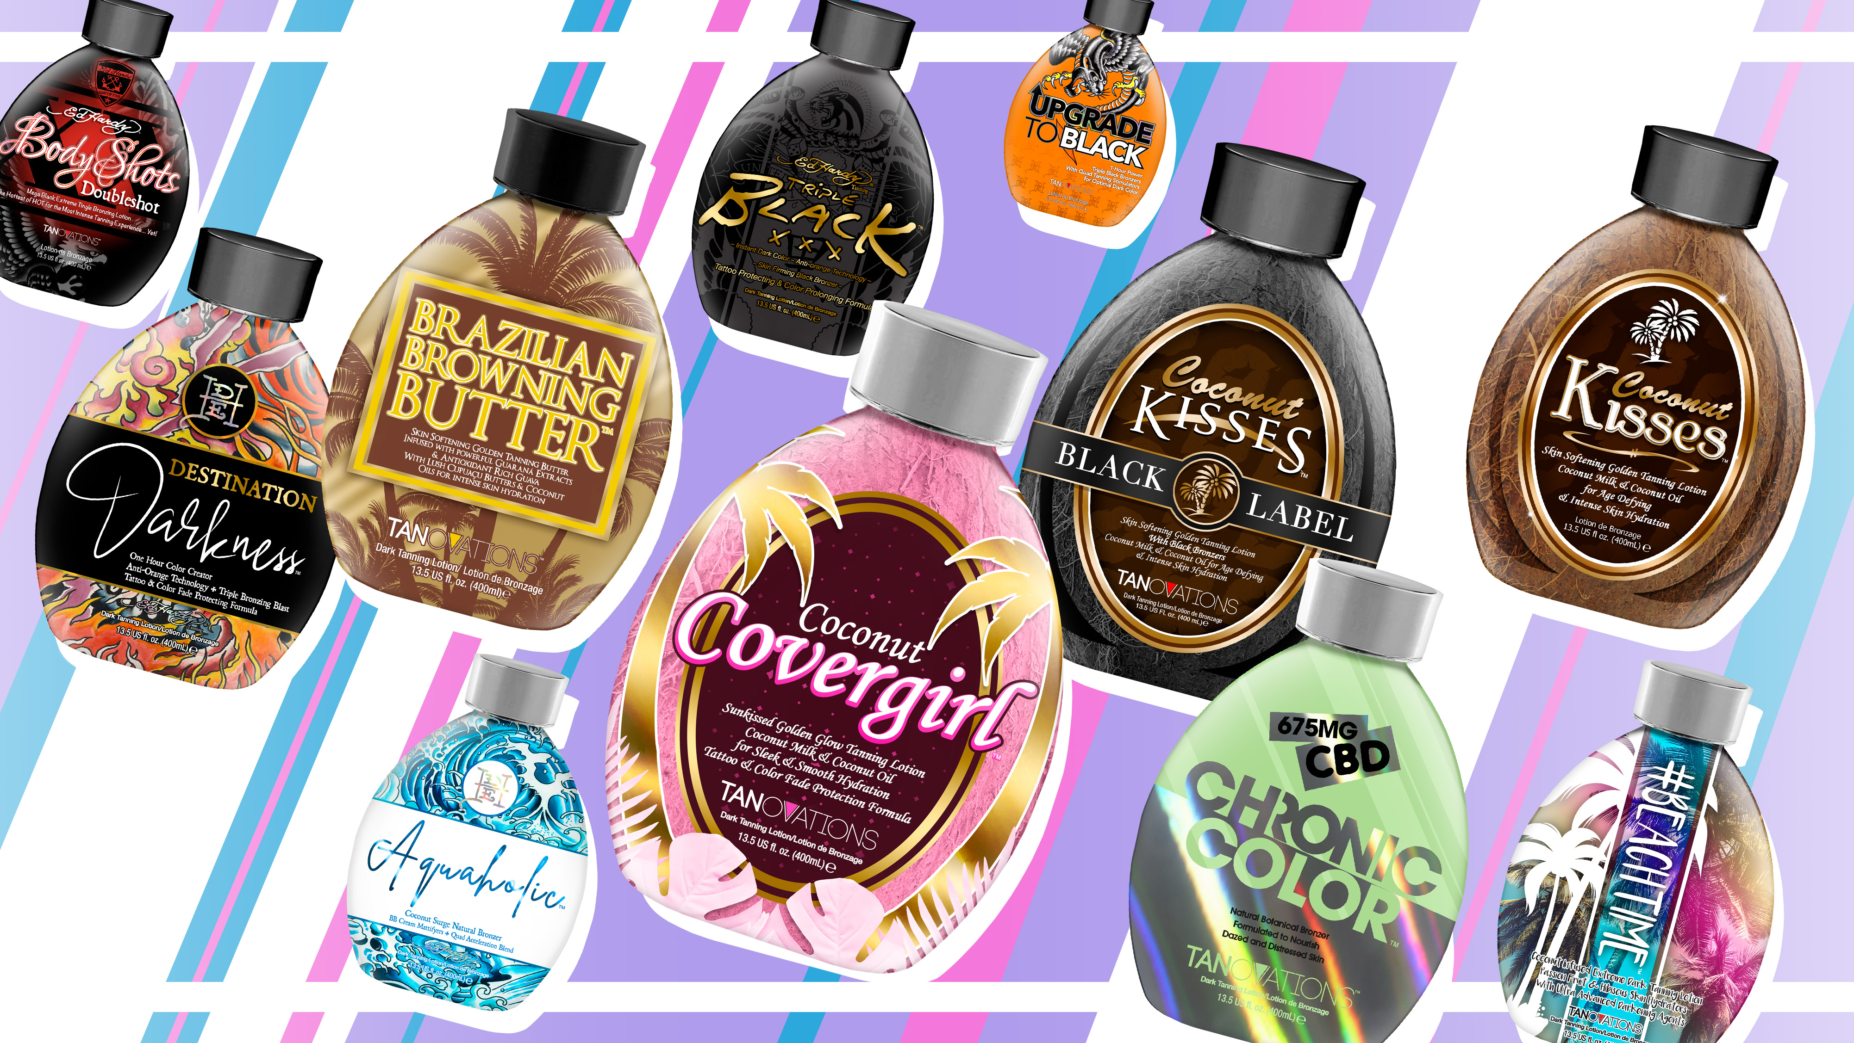

Slide 32
Coconut Covergirl™ Skin Softening Sunkissed Golden Glow Tanning Lotion
Coconut Milk & Coconut Oil for Sleek & Smooth Hydration
Tattoo & Color Fade Protection Formula
• Quad Tyrosine Blend + MelanoBronze™ - Stimulate and increase
melanin formation to accelerate the tanning process.
• Melactiva™ - Melanin synthesizer for darker, longer lasting results.
• Coffeeberry - Rich antioxidant that helps to neutralize free radical damage and
help to prevent cellular damage in the skin.
• Cupuaçu Butter – Considered as a super moisturizer, helps to lock in moisture and restore skins elasticity, while soothing dry skin.
• Centella CAST – Helps to restore skins elasticity and firmness while boosting
collagen production, as well as helps to reduce the appearance of stretch marks
and sagging skin.
• Coconut Juice, Coconut Oil & Coconut Water – Helps to penetrate through dry layers of skin for the deepest level of hydration.
• Cocoa Butter – Hydrating butter that adds superior moisture to dry skin, contains anti-inflammatory properties and works to reduce scars and stretch marks and good for tanners with skin conditions.
• Tattoo & Color Fade Protector - Prolongs the life and radiance of your tattoos and tanning results.
Fragrance: Pink Coconut

Slide 33
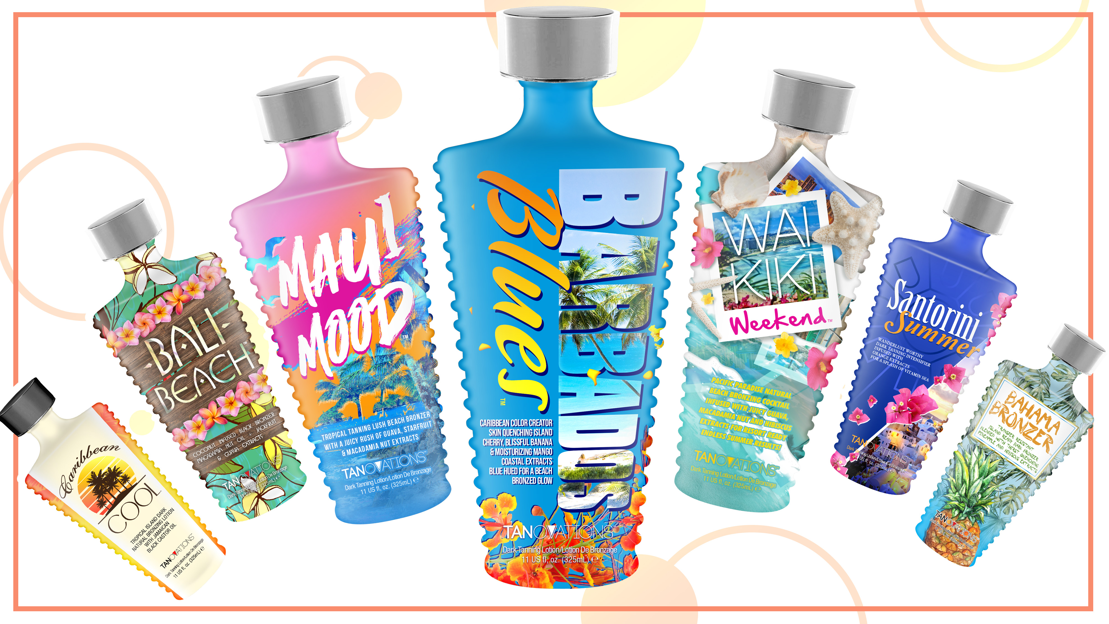

Slide 34
Barbados Blues™ Caribbean Color Creator | Skin Quenching Island Cherry, Blissful Banana &
Moisturizing Mango Coastal Extracts
Blue Hued for. Beach Bronzed Glow
• Blue Hued Dark Tanning Optimizer – Deeply intensifies tanning results for superior dark color without the use of added bronzers.
• Blue Tansy™ – Provides anti-orange agents so the skin develops the most
natural, dark bronzed result.
• Barbados Cherry Extract – Works to fight against inflammation and free
radical damage while being an antioxidant to help combat skin dullness and
hyperpigmentation, and working to seal in moisture to maintain skin’s barrier functions.
• Banana Fruit Extracts – Helps to refine the skin while being an essential source of electrolytes.
• Mango Butter – Non-comedogenic antioxidant that helps to reduce the appearance of fine lines and wrinkles while providing a glowing complexion and fighting acne formations.
• MelanoBronze™ & Melactiva™ – Stimulates melanin activity allowing for longer lasting, darker tanning results.
Fragrance: Saltwater Sea

Slide 36
FB12™ Super Workout Enhancer
Toning & Firming with Cryo-Slimming Hydration
Maximum Moisturization
• Intenslim™ - Works as a natural fat burner while also strengthening the elastin in the skin.
• Cryo-Slimming Frescolat™ - Helps to cool and refresh the skin without the use of menthol.
• Keratoline™ - An AHA alternative, Keratoline gently exfoliates to reveal youthful,
and toned skin.
• Carnitine – An oil absorbing amino acid that assists in decreasing oil production as well as helps to assist in breaking down fat accumulation
• Aquaxyl™ - Helps to quench extreme skin dehydration allowing for a softer and
more hydrated appearance.
• ISO-Slim™ - Works as a slimming and anti-cellulite agent while also assisting in the breakdown of fat cells.
• Green Tea Extracts – Rich in antioxidants to help ward off free radical damage.
• Grape Seed Extracts – Helps to boost collagen production and works to even out
skins tone and texture.
• Vitamins A & C – Power packs the skin with natural vitamins and nutrients for a more perfected appearance of the skin.
Fragrance: Fresh & Clean

Slide 37
Megan Racine
International Sales Trainer
Megan@devotedcreations.com

