Slide 1
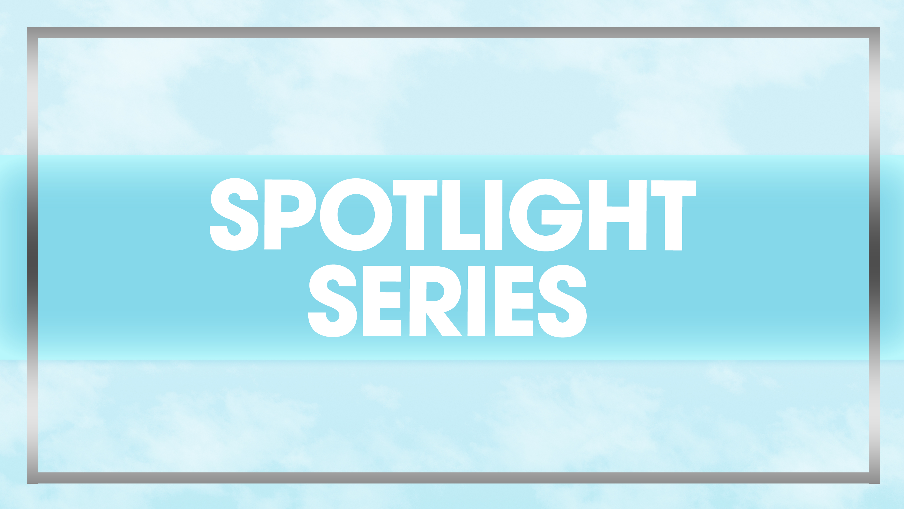
Fitburn

Slide 2
Why FB
Fitburn was created because….
Individual hot boxes for hot yoga at old tanning studio
Infrared booths for working out
Booths were called fitburn
Rise of heated workouts and infrared therapy

Slide 3
Near Infrared LED Light
Can help relax sore muscles and increase oxygen supply throughout the body.
Specific wavelengths of infrared can help increase the cell renewal process and stimulate an anti-inflammatory response form the body.
It can also be possible that it can have an anti-aging effect by stimulating collagen production.
Can penetrate deeper into the skin than Red Light at 750nm-1000nm
The wavelength is longer than red light which is why it can penetrate deeper into the skin than RL can. (i.e into the tissues and muscles)

Slide 4
What are the benefits?
Increases
Brings oxygen and nutrients to tissues to promote recovery
Breaks up fats and toxins that are trapped inside water molecules which leads to sweating and a body detox
Helps with any aches and pains by increasing blood flow
Can help boost metabolism
Boosts cell regeneration & energy
Can help with repairs of the skin with collagen production

Slide 5
Fitburn Firming Spray
Available in 2 convenient sizes, spray on technology
Flavoslim™ - Breaks up skins stored fat accumulation to fight cellulite formations.
Adiposlim™ - An AminoVector™ of Proline with a caffeine like effect to provide a slimming appearance to the skin that works on the elimination of fat storage as well as cellulite formations.
SeppiLift™ - An anti-aging active ingredient that works to moisturize the skin while providing a triple firming action for wrinkle correction on the AminoVector™ tree.
Antioxidant Formula – Works to reduce inflammation and strengthens the skin to protect against free radical damage and signs of aging.
Can be used anytime, active ingredients work with or without IR light.
*DHA & tanning*

Slide 6
What is an AminoVector™?
Amino acids are naturally found in our bodies and known as the building blocks of life, including for our skin.
We naturally lose those amino acids due to age and environmental aggressions.
AminoVector™ is a family of ingredients that delivers amino acids deeper and faster to the cellular level to achieve optimal efficiency.
This has various benefits to the skin that range from soothing, purifying, obtaining an even skin tone, fighting the effects of aging, fighting cellulite formation, etc.

Slide 7
Megan Racine | International sales trainer
megan@devotedcreations.com

