Slide 1
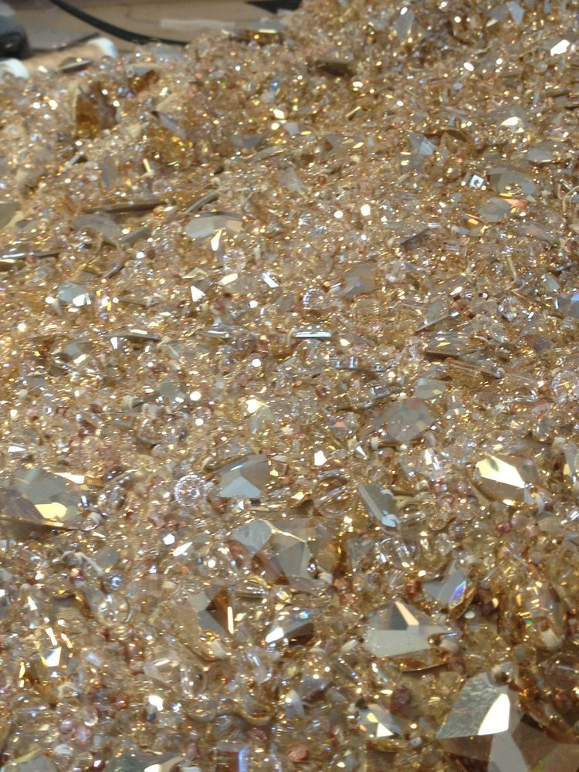
SOCIAL Light
Midseason 2025

Slide 2

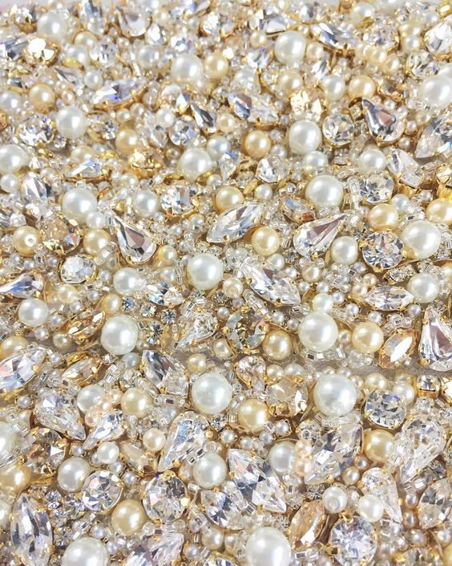

Makayla Thomas International Sales Trainer

Slide 3


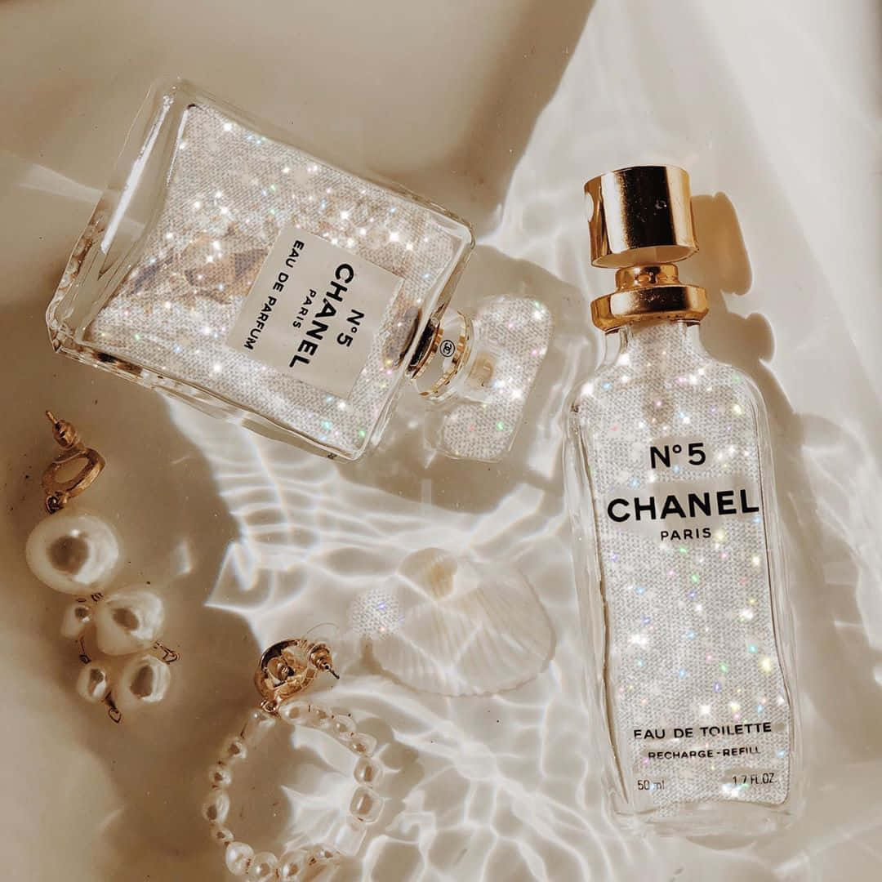

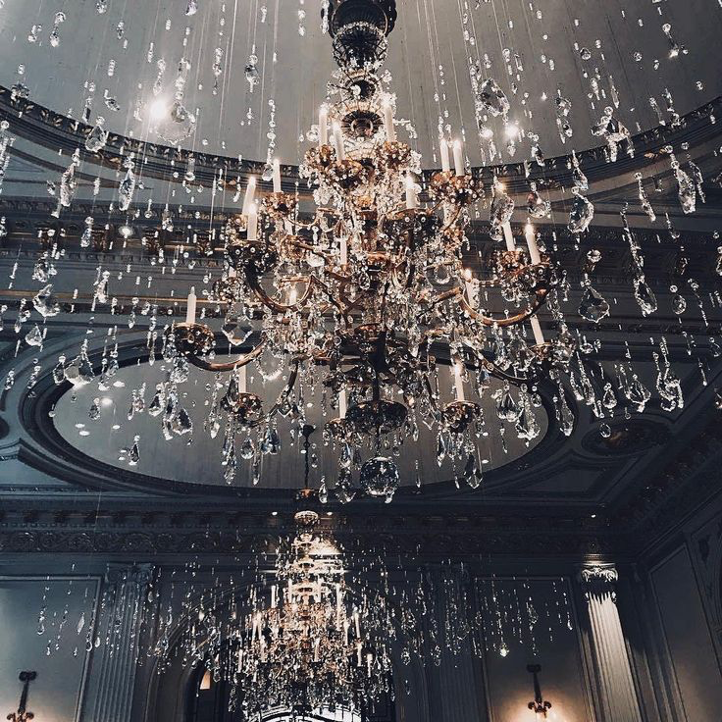

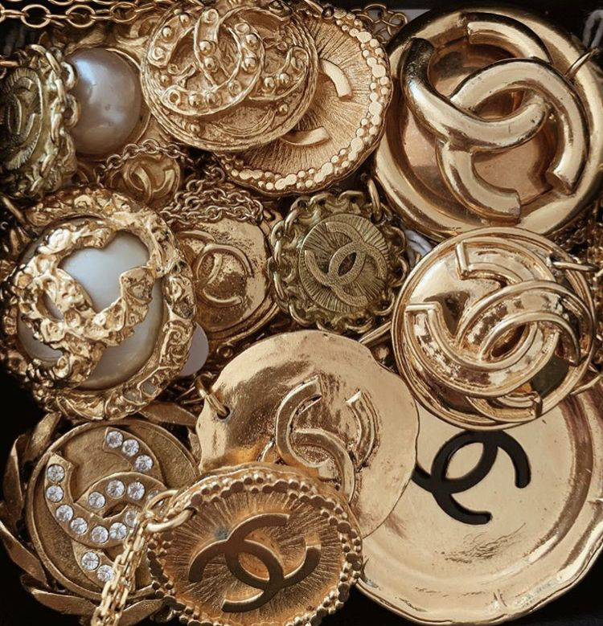

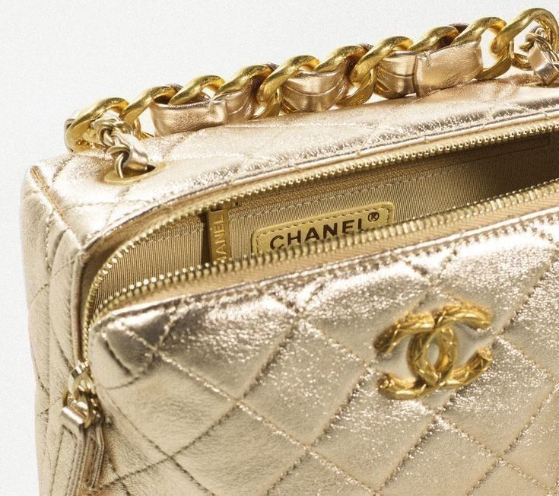

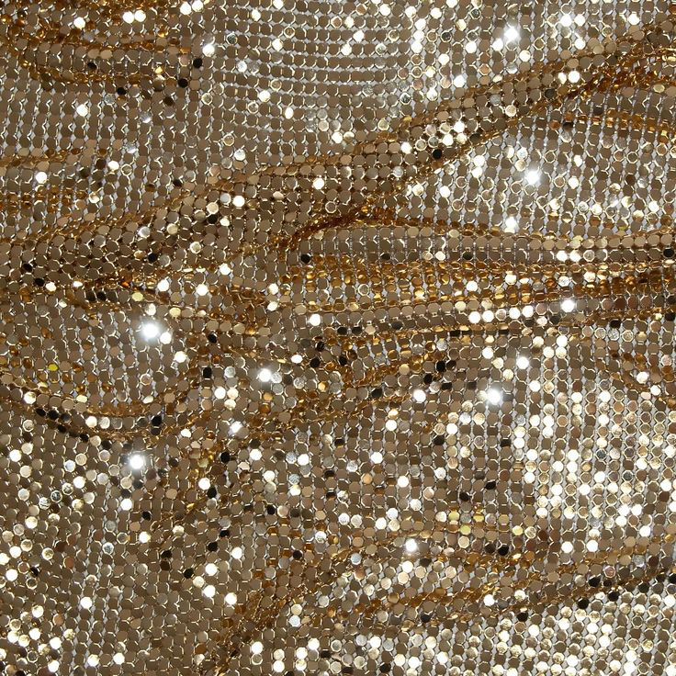

Slide 4
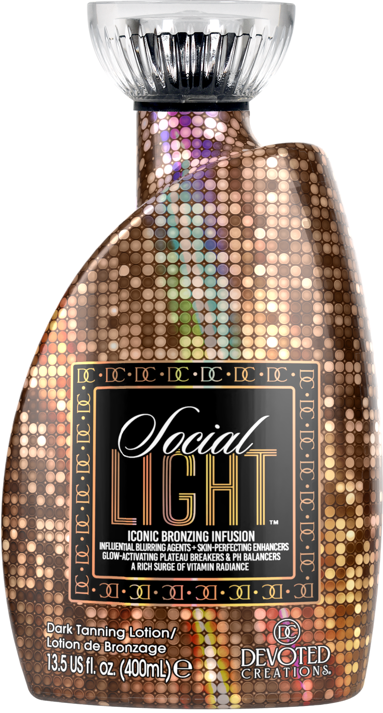

Slide 5
Why Social Light?
Needed something in that mid-level range in the Color Rush line
Mid-Level DHA
Light Cosmetic Coloring
We wanted to give that upscale, boujee, old money aesthetic
Needed an upgraded version of Color Drip
Have not done a light friendly focused product in a while
pH balancing for ALL light hues
Light Activated Photosomes
Spray-Tan Friendly
Lightwieght hydration formula
Tattoo & Color Fade Protecting
After Tan Odor Eliminators

Slide 6
Light Friendly
pH Balancers
Allows for optimal light absorption for use under all light hues
These allow this product to be spray tan friendly as well
Light Activated Photosomes
Helps protect the skins’ immune system while also allowing for light absorption

Slide 7
Ultra Hydrating
Snow Mushroom
Works to hydrate the skin and retain moisture in the skin
Creates a dewy, plump, bouncy look like a hyaluronic acid, although this is going to retain moisture in the skin 15 times MORE!
Porcelain Flower Extract
Works to hydrate and nourish the skin
High in antioxidants to promote a radiant and glowing complexion

Slide 8
Youthful & Skin Perfecting
Exosomes
These restore and rejuvenate healthy skin cells
Collagen Banking Complex
Works to preserve the life of collagen levels in the skin while also replenishing collagen levels
ISO-Slim™
Firms and smooths the skins appearance for a visibly, more youthful looking complexion
Allows for skin to appear more sculpted and toned
Peptide Complex
Promotes collagen production as well as restoring elasticity in the skin to reduce the appearance of scars and stretch marks
Vegan Collagen
Visibly strengthens the skin to eliminate the appearance of fine lines and wrinkles
Helps to bring back the skins’ natural “bounce”

Slide 9
Skin Brightening
GlowPlex™
Promotes a glowing complexion
Contains niacinamide to promote anti-aging while also blurring imperfections to create a more even complexion
Golden C
Vitamin C that contains micro-gold particles to penetrate the vitamin C deeper into the skin for a more enhanced glow
Reduces the appearance of hyperpigmentation

Slide 10
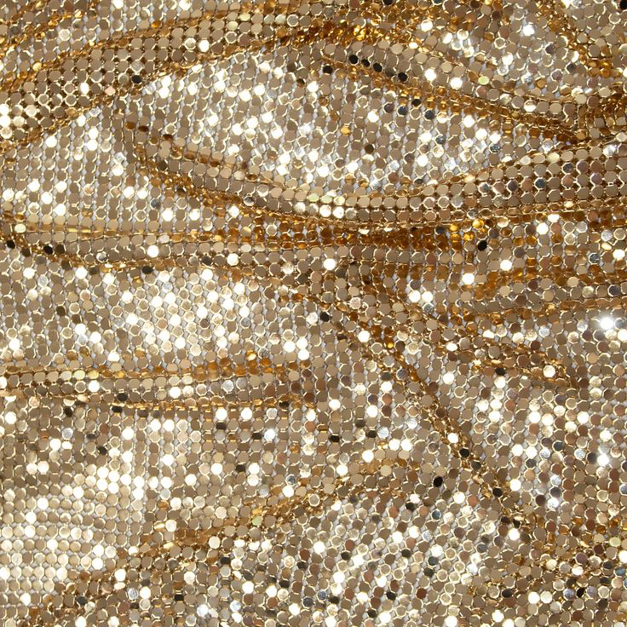
Makayla Thomas International Sales Trainer (727) 297-8730 makayla@devotedcreations.com

