Slide 1
Selfie Glow Sunless Overview

Slide 3
At Selfie Glow we believe that achieving a flawless, bronzed glow should be simple and fun! That’s why our range of at home and salon approved formulas are easy to use to develop color ranging from a sun kissed golden glow to a deep, rich dark tanning result with ease. We care just as much about the high end skin care that goes into our products, as we do the tanning results that come out of them.

Slide 4
Products are formulated with anti-aging, firming and skin toning agents, extreme hydration and skin crucial electrolytes
Kiss any orange tones goodbye as our formulas are long lasting, and provide a dark tan color
All products are high in natural moisturizing antioxidants and oils like Aloe Vera gel, Watermelon Extract, Coconut Water, Plum Oil and more

Slide 6
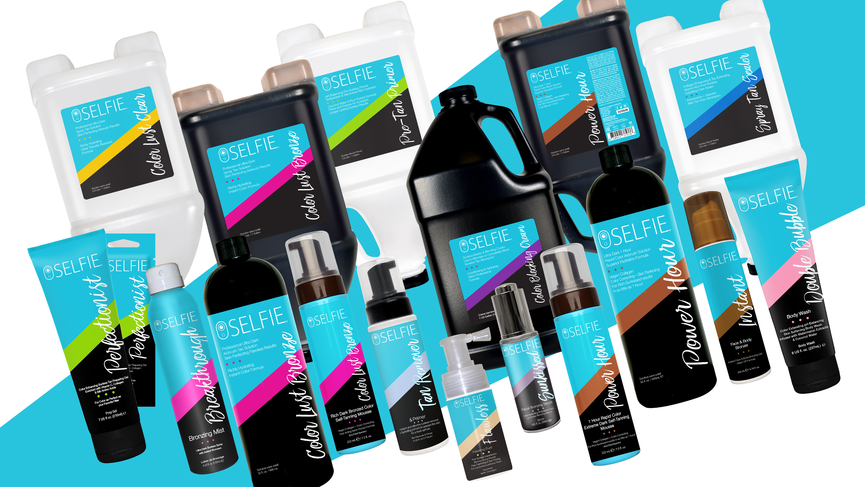

Slide 7
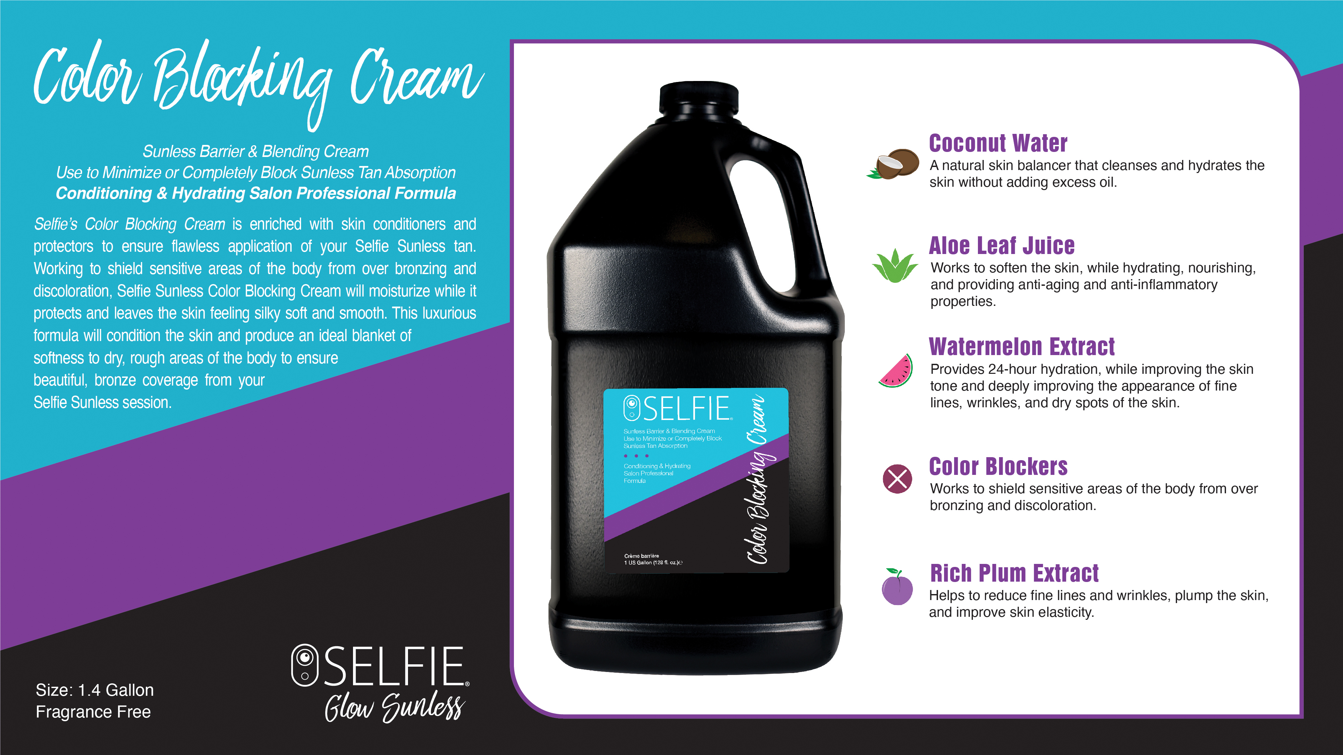

Slide 8
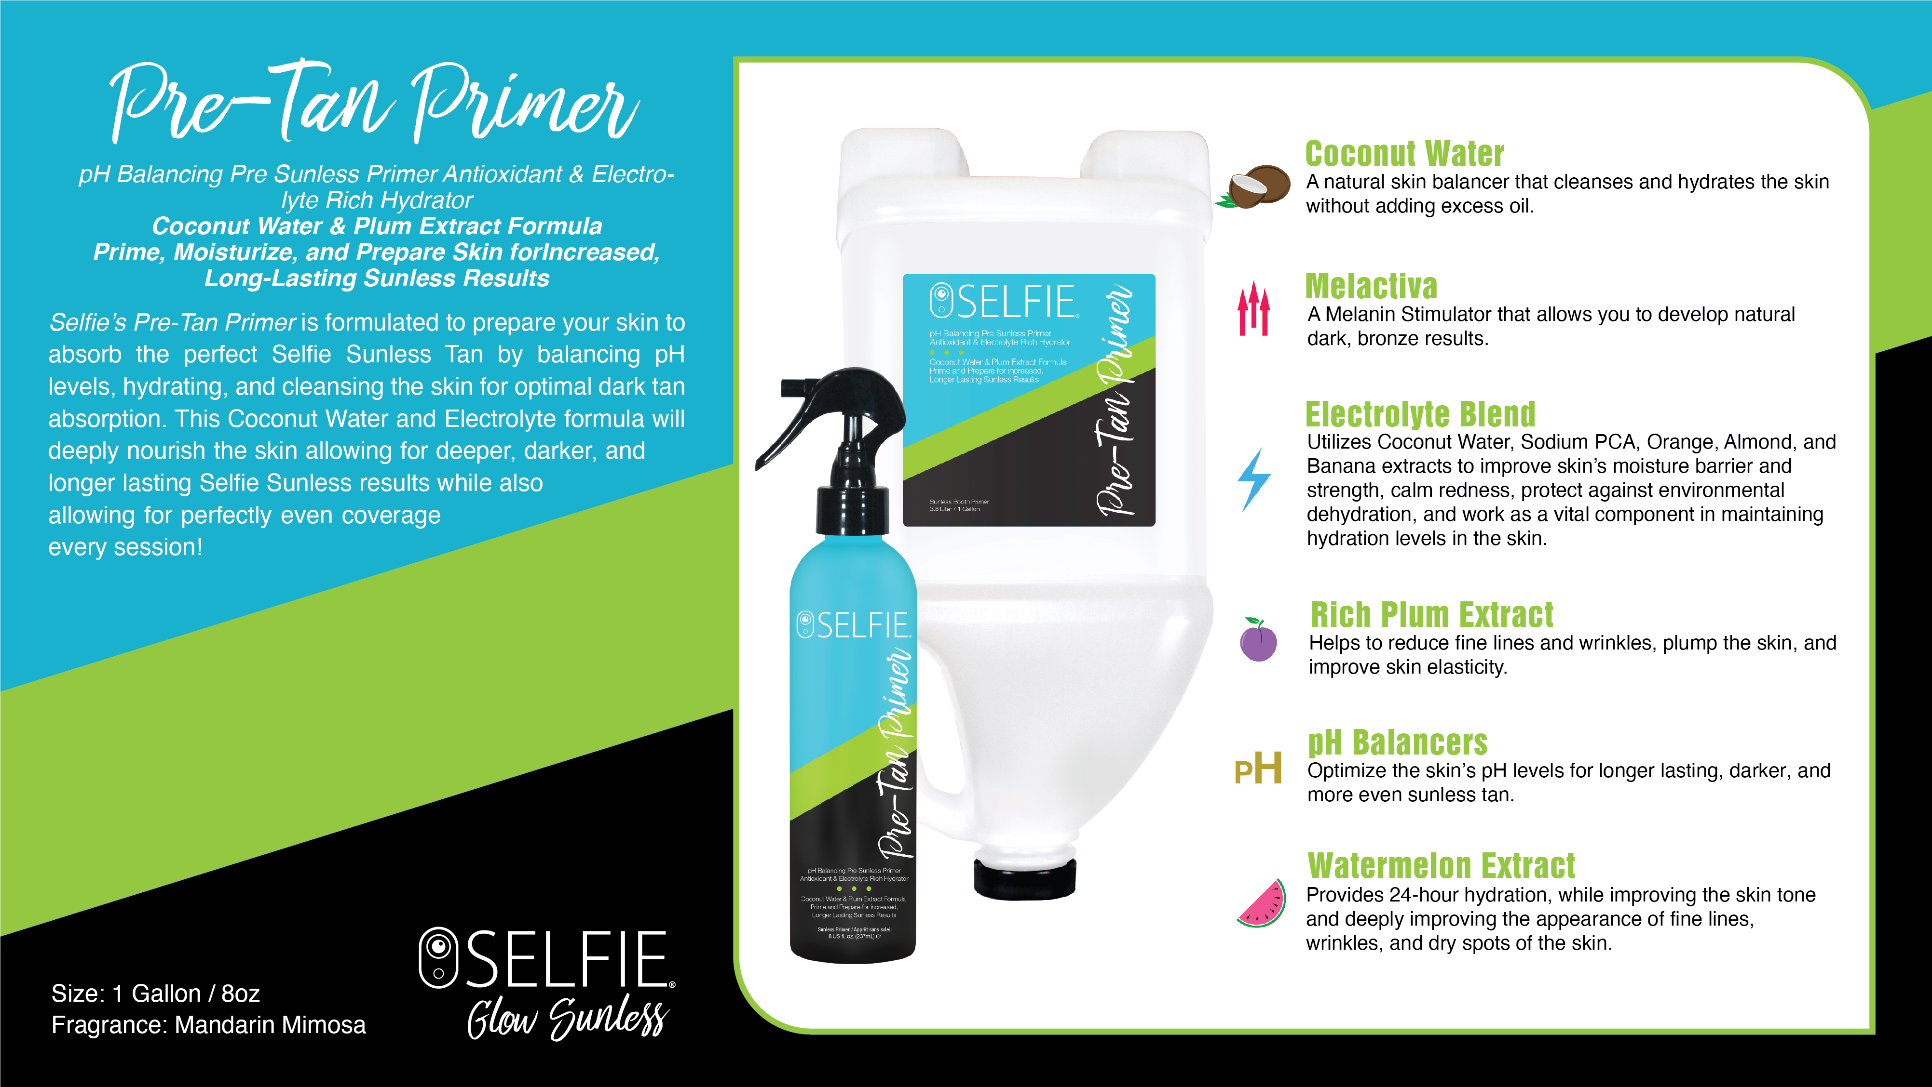

Slide 9
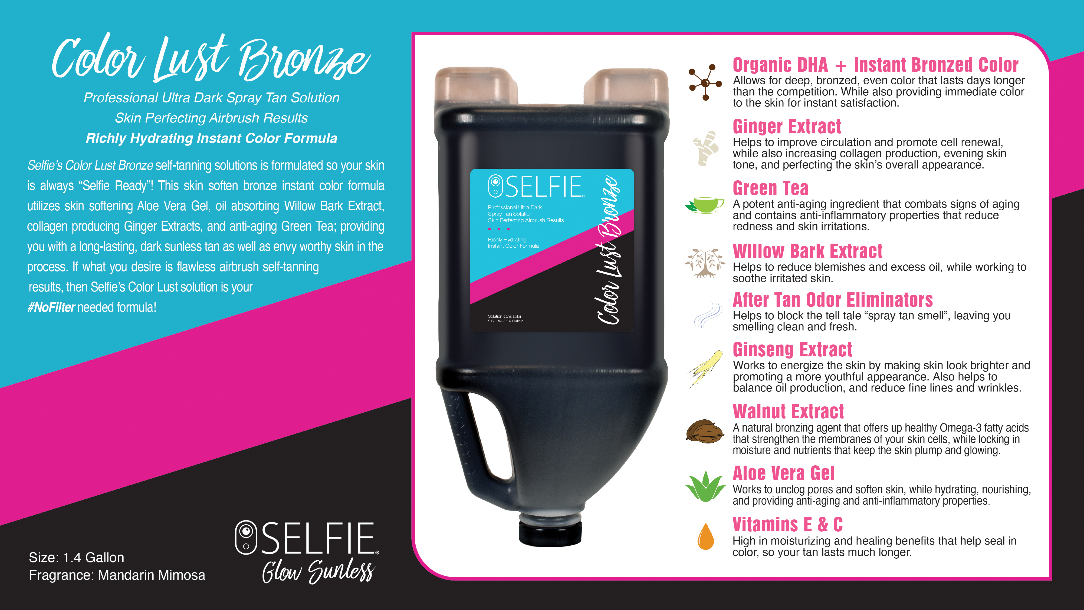
More Reddish Brown Tones rinsing off
Recommend waiting 6-8 hours before rinsing

Slide 10
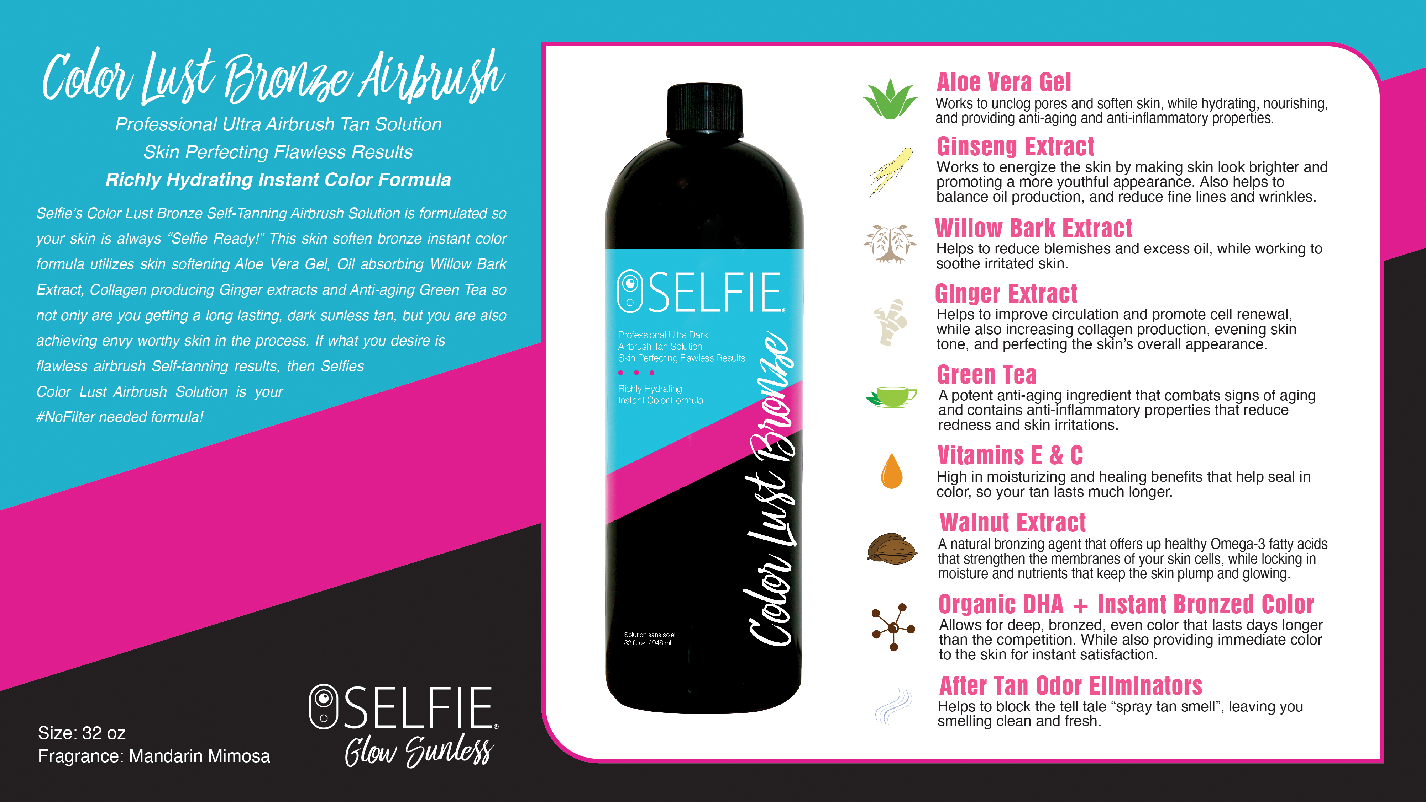

Slide 11
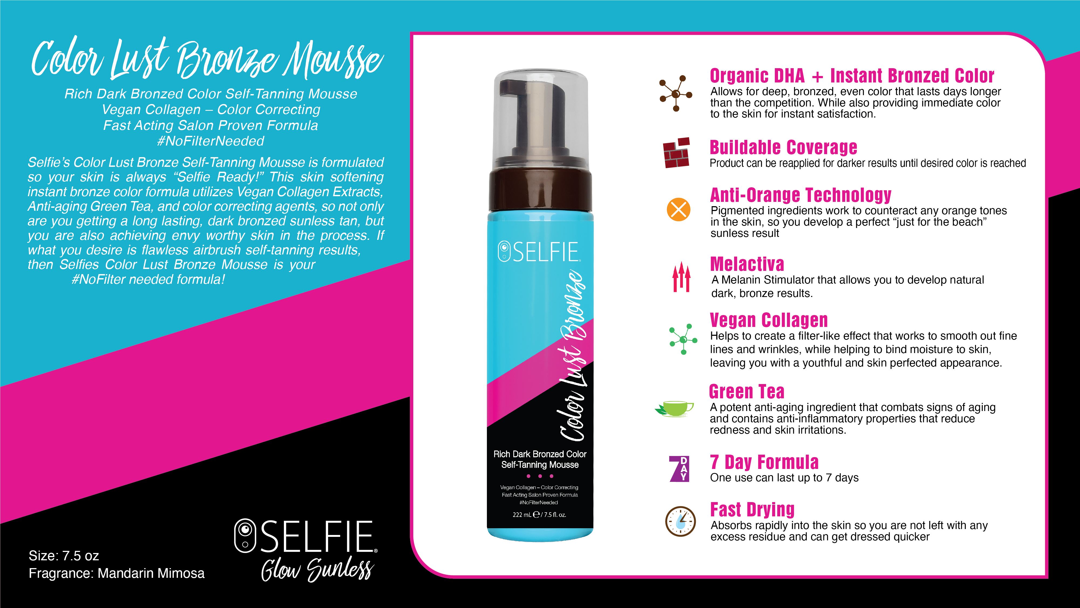

Slide 12
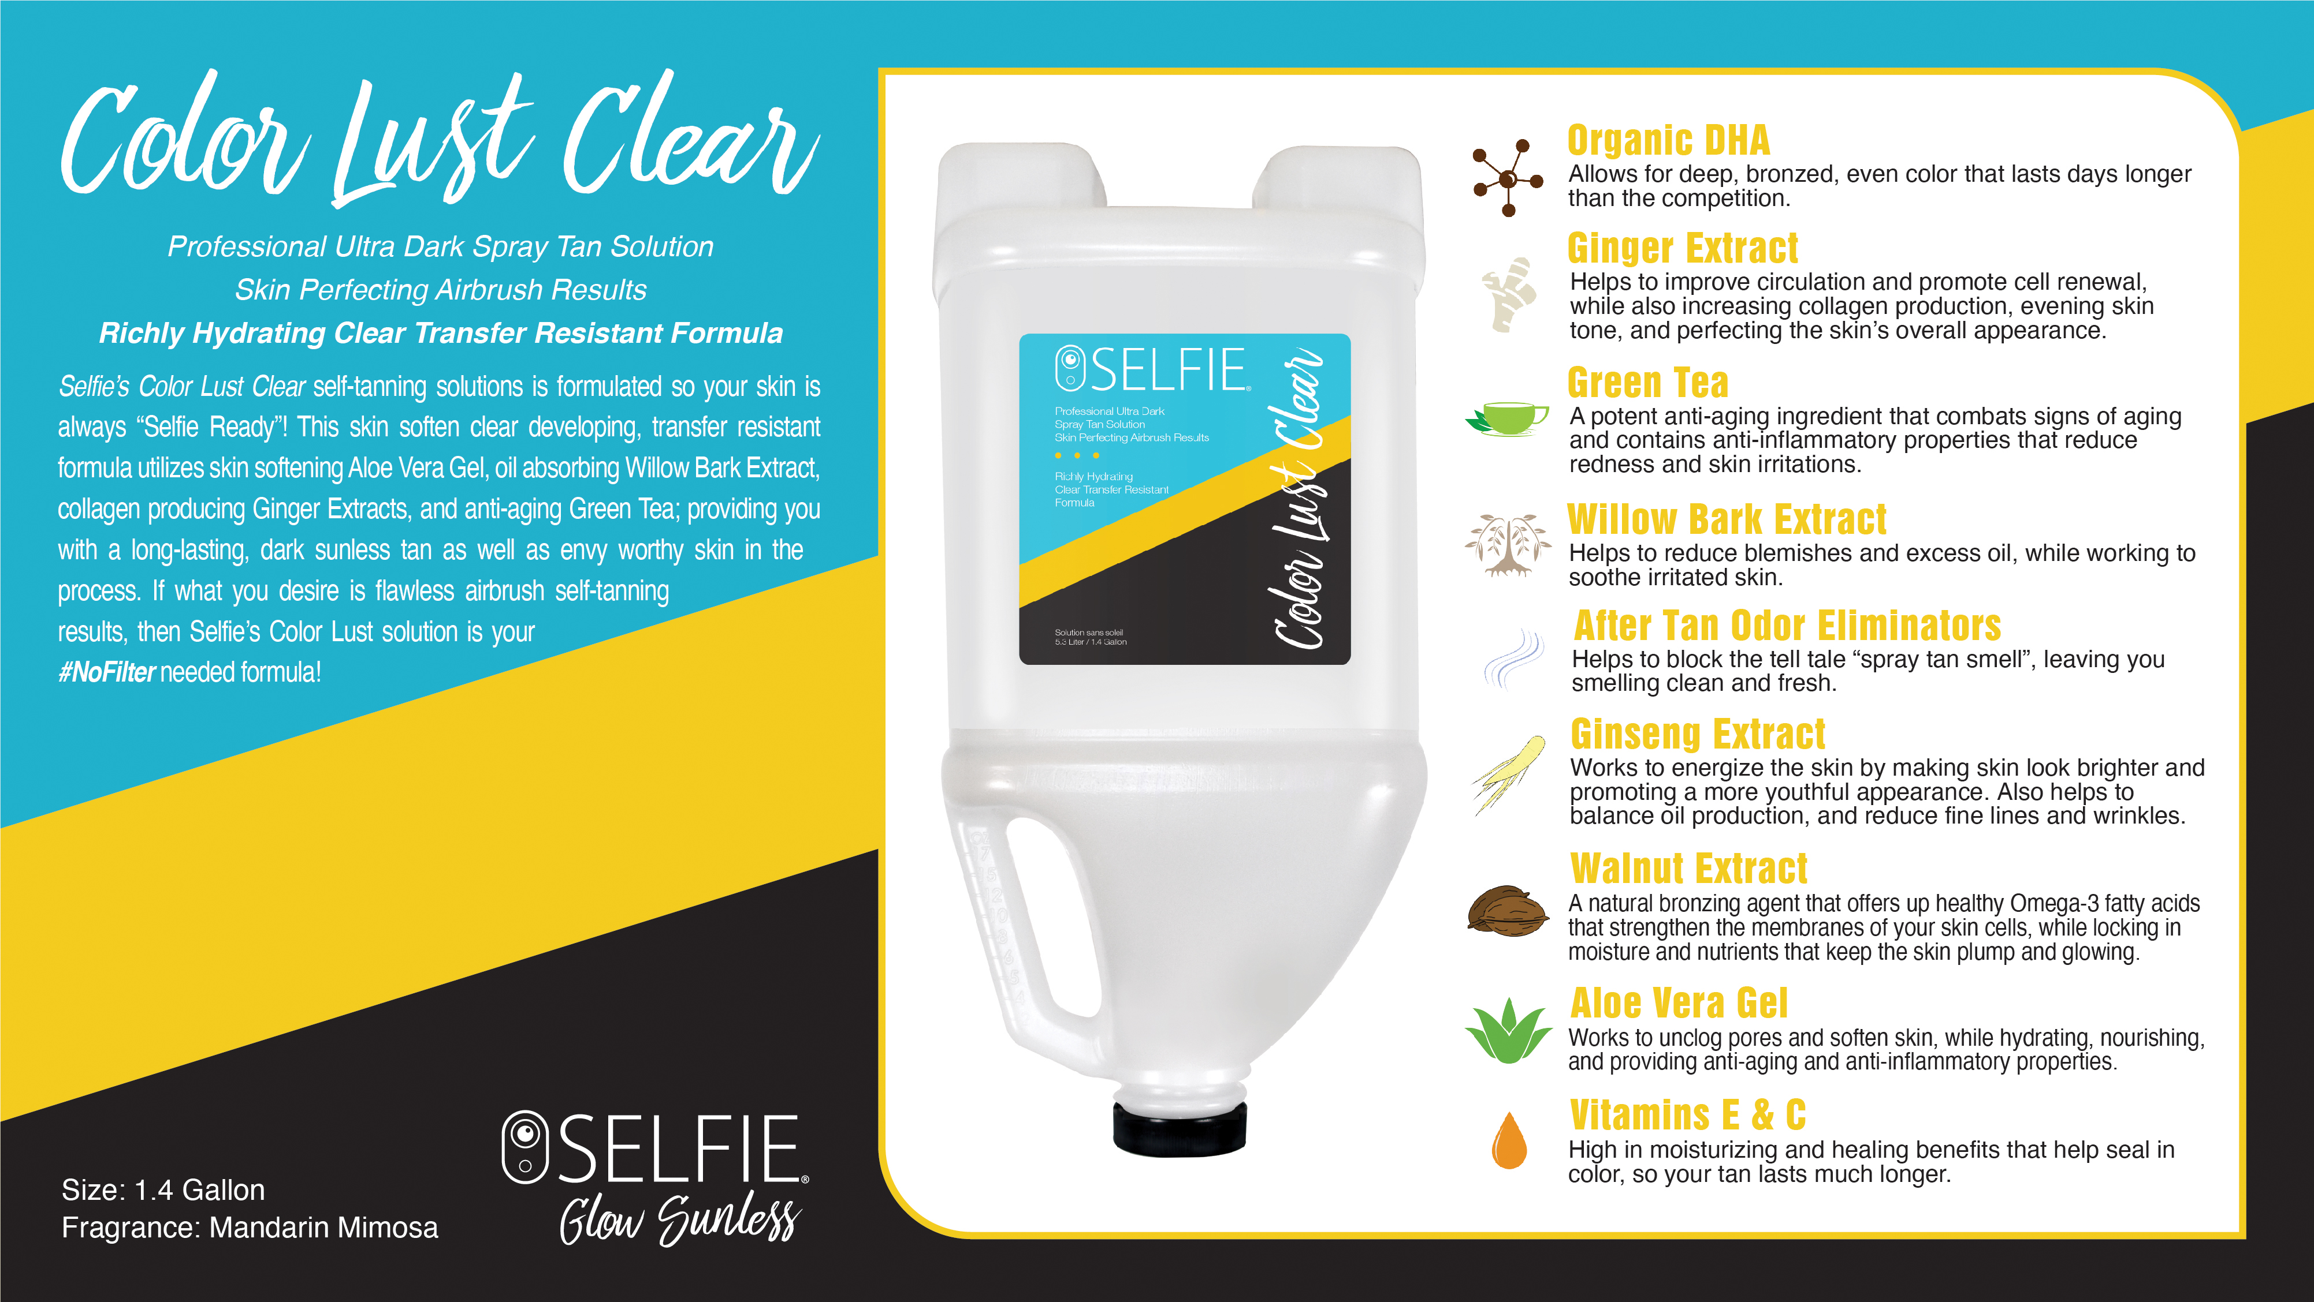
Same formula as Color Lust just transfer resistant
Recommend 6-8 hours before rinsing

Slide 13
More of a purple/gray undertone rinsing off
Higher concentration- would not leave on more than 3-4 hours

Slide 14
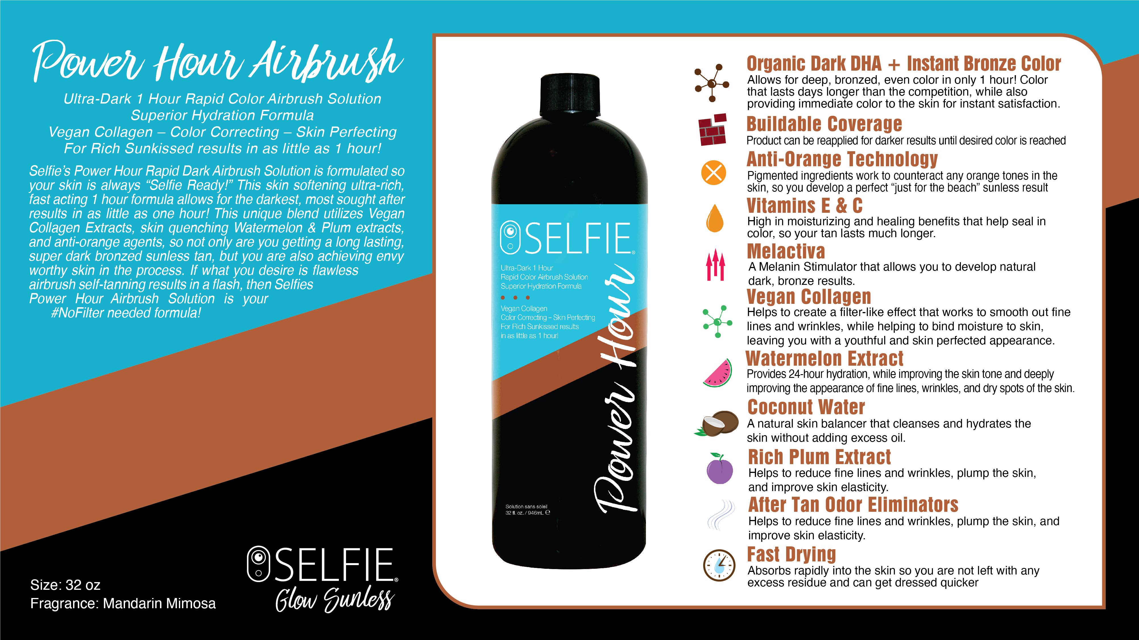

Slide 15
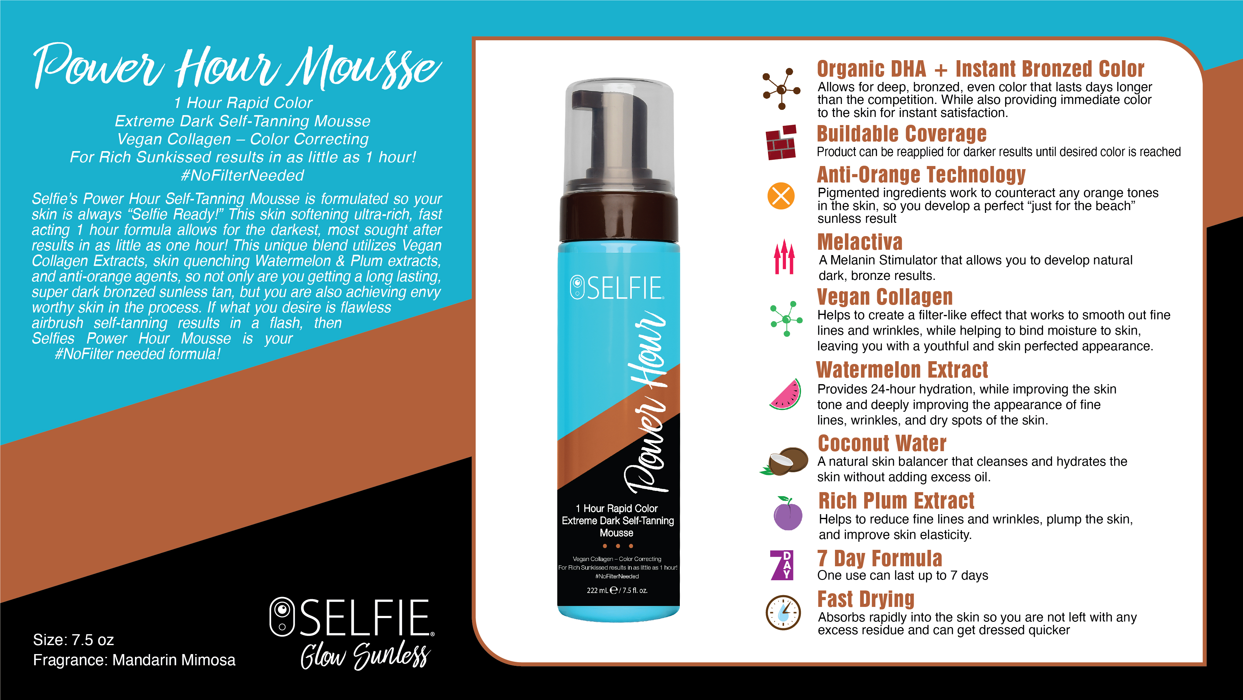

Slide 16
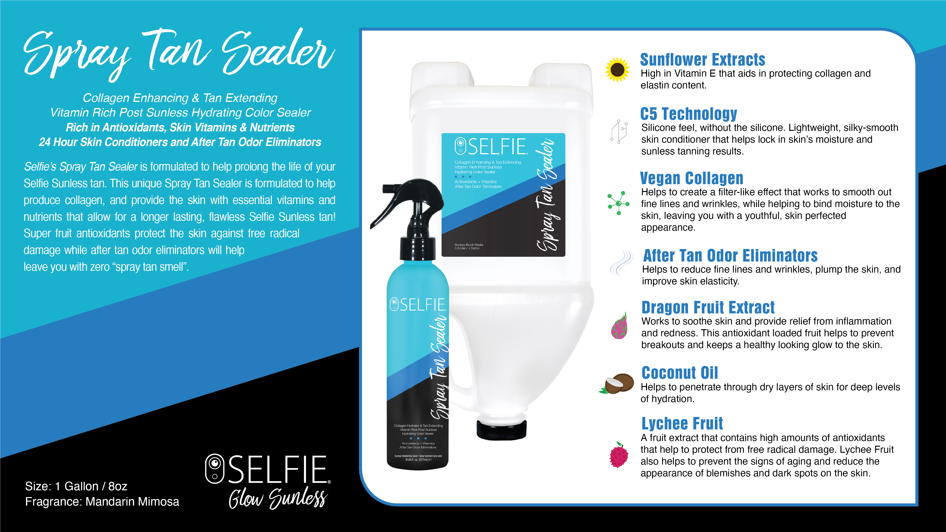

Slide 17
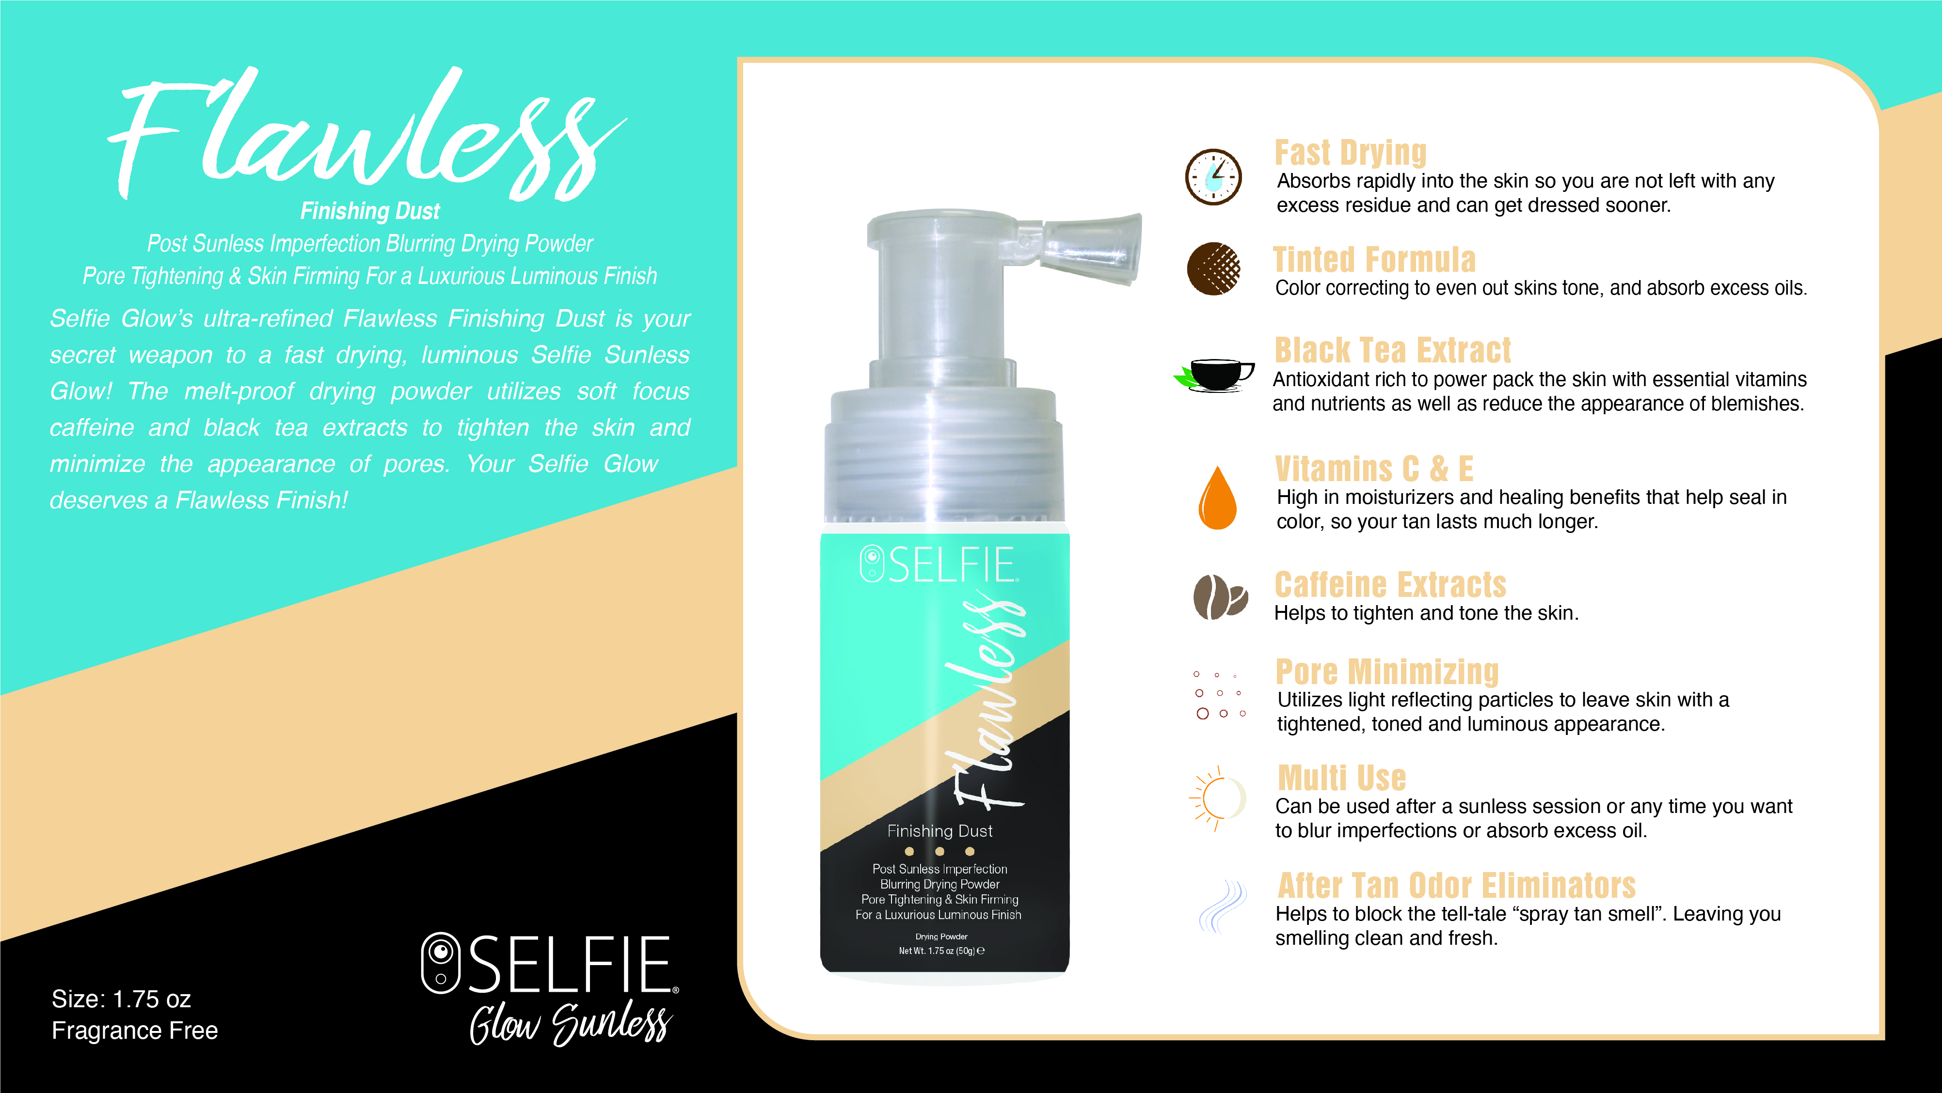
Ideal for someone using a spray booth or receiving an airbrush tan, as it will help dry down any extra residue

Slide 19
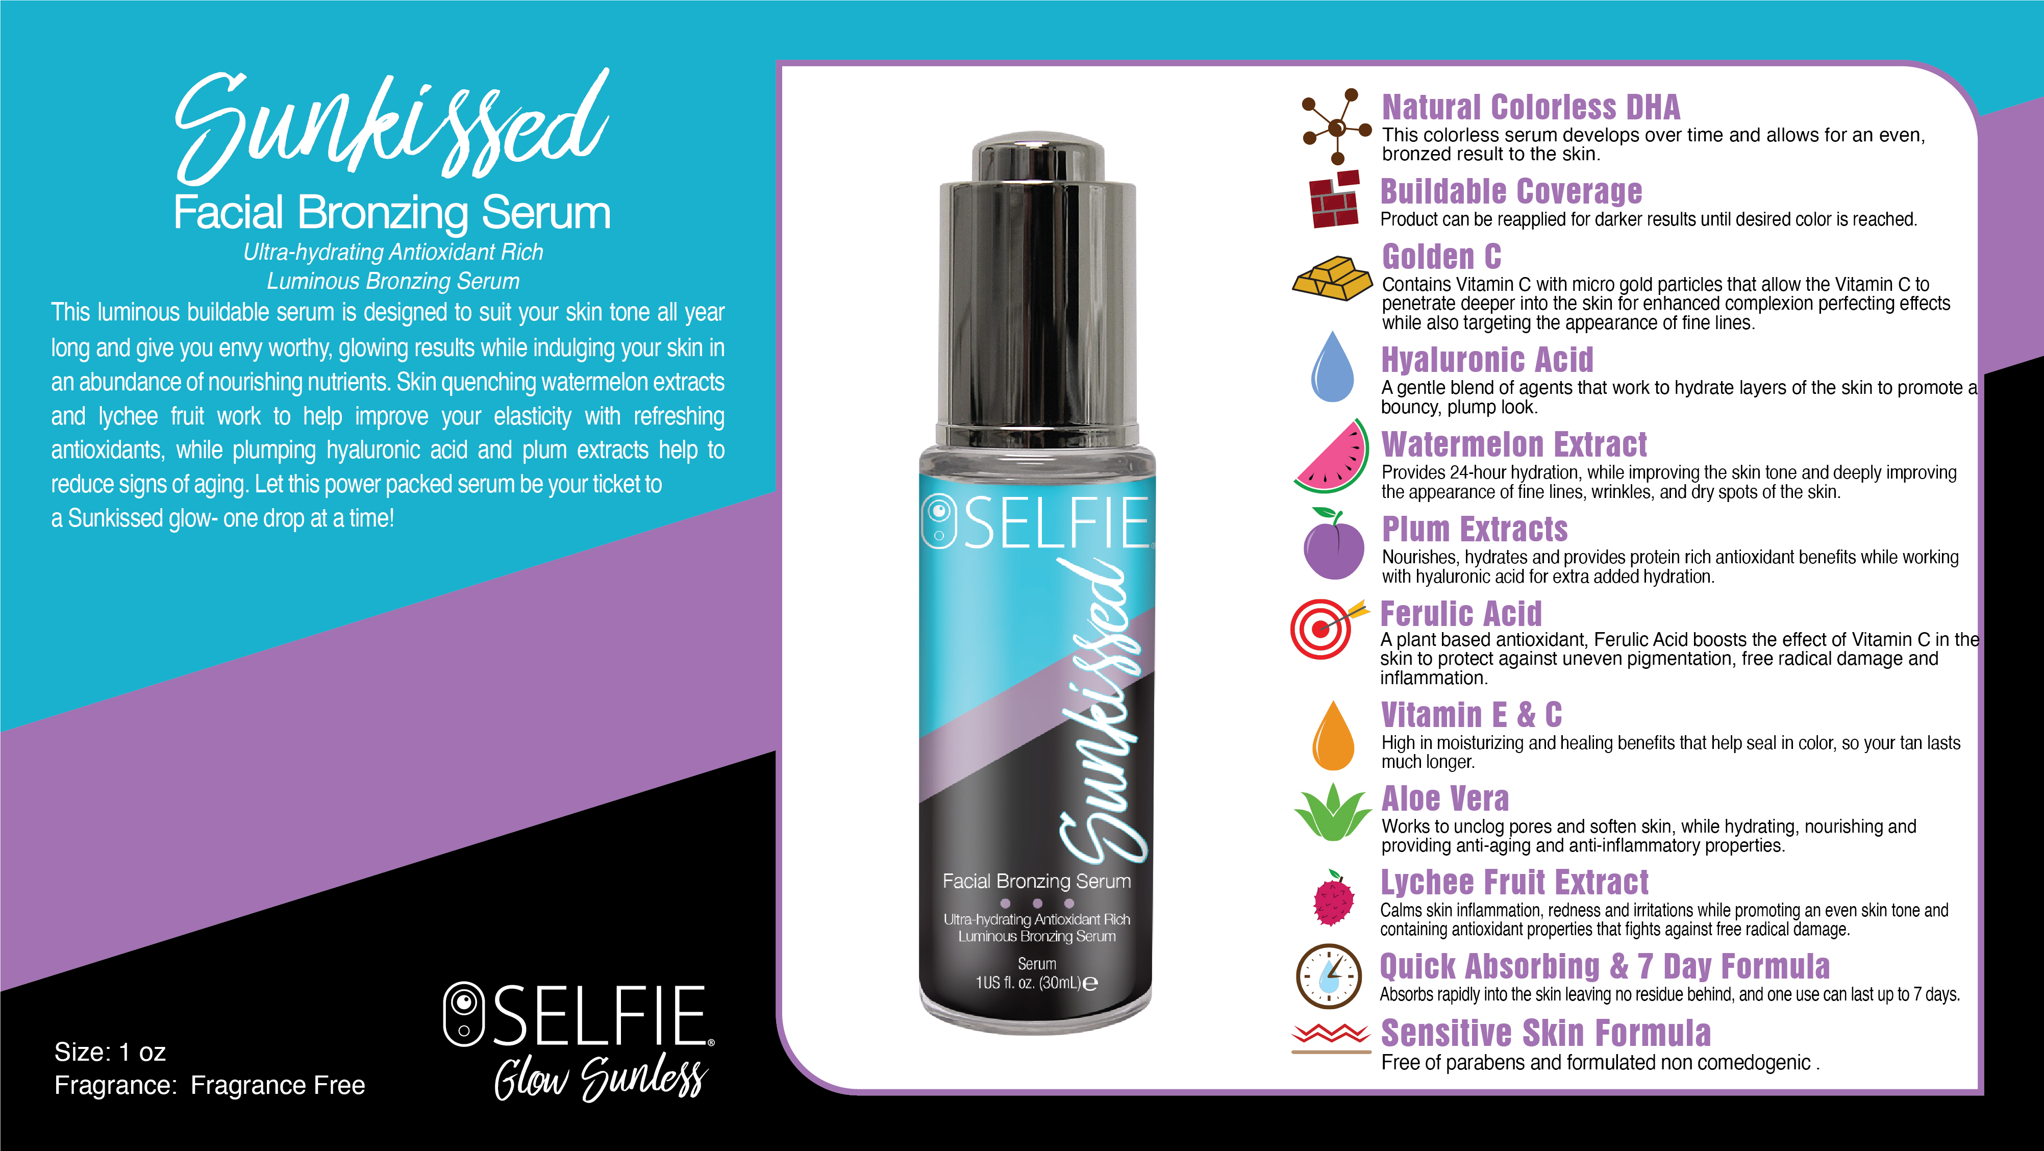

Slide 21
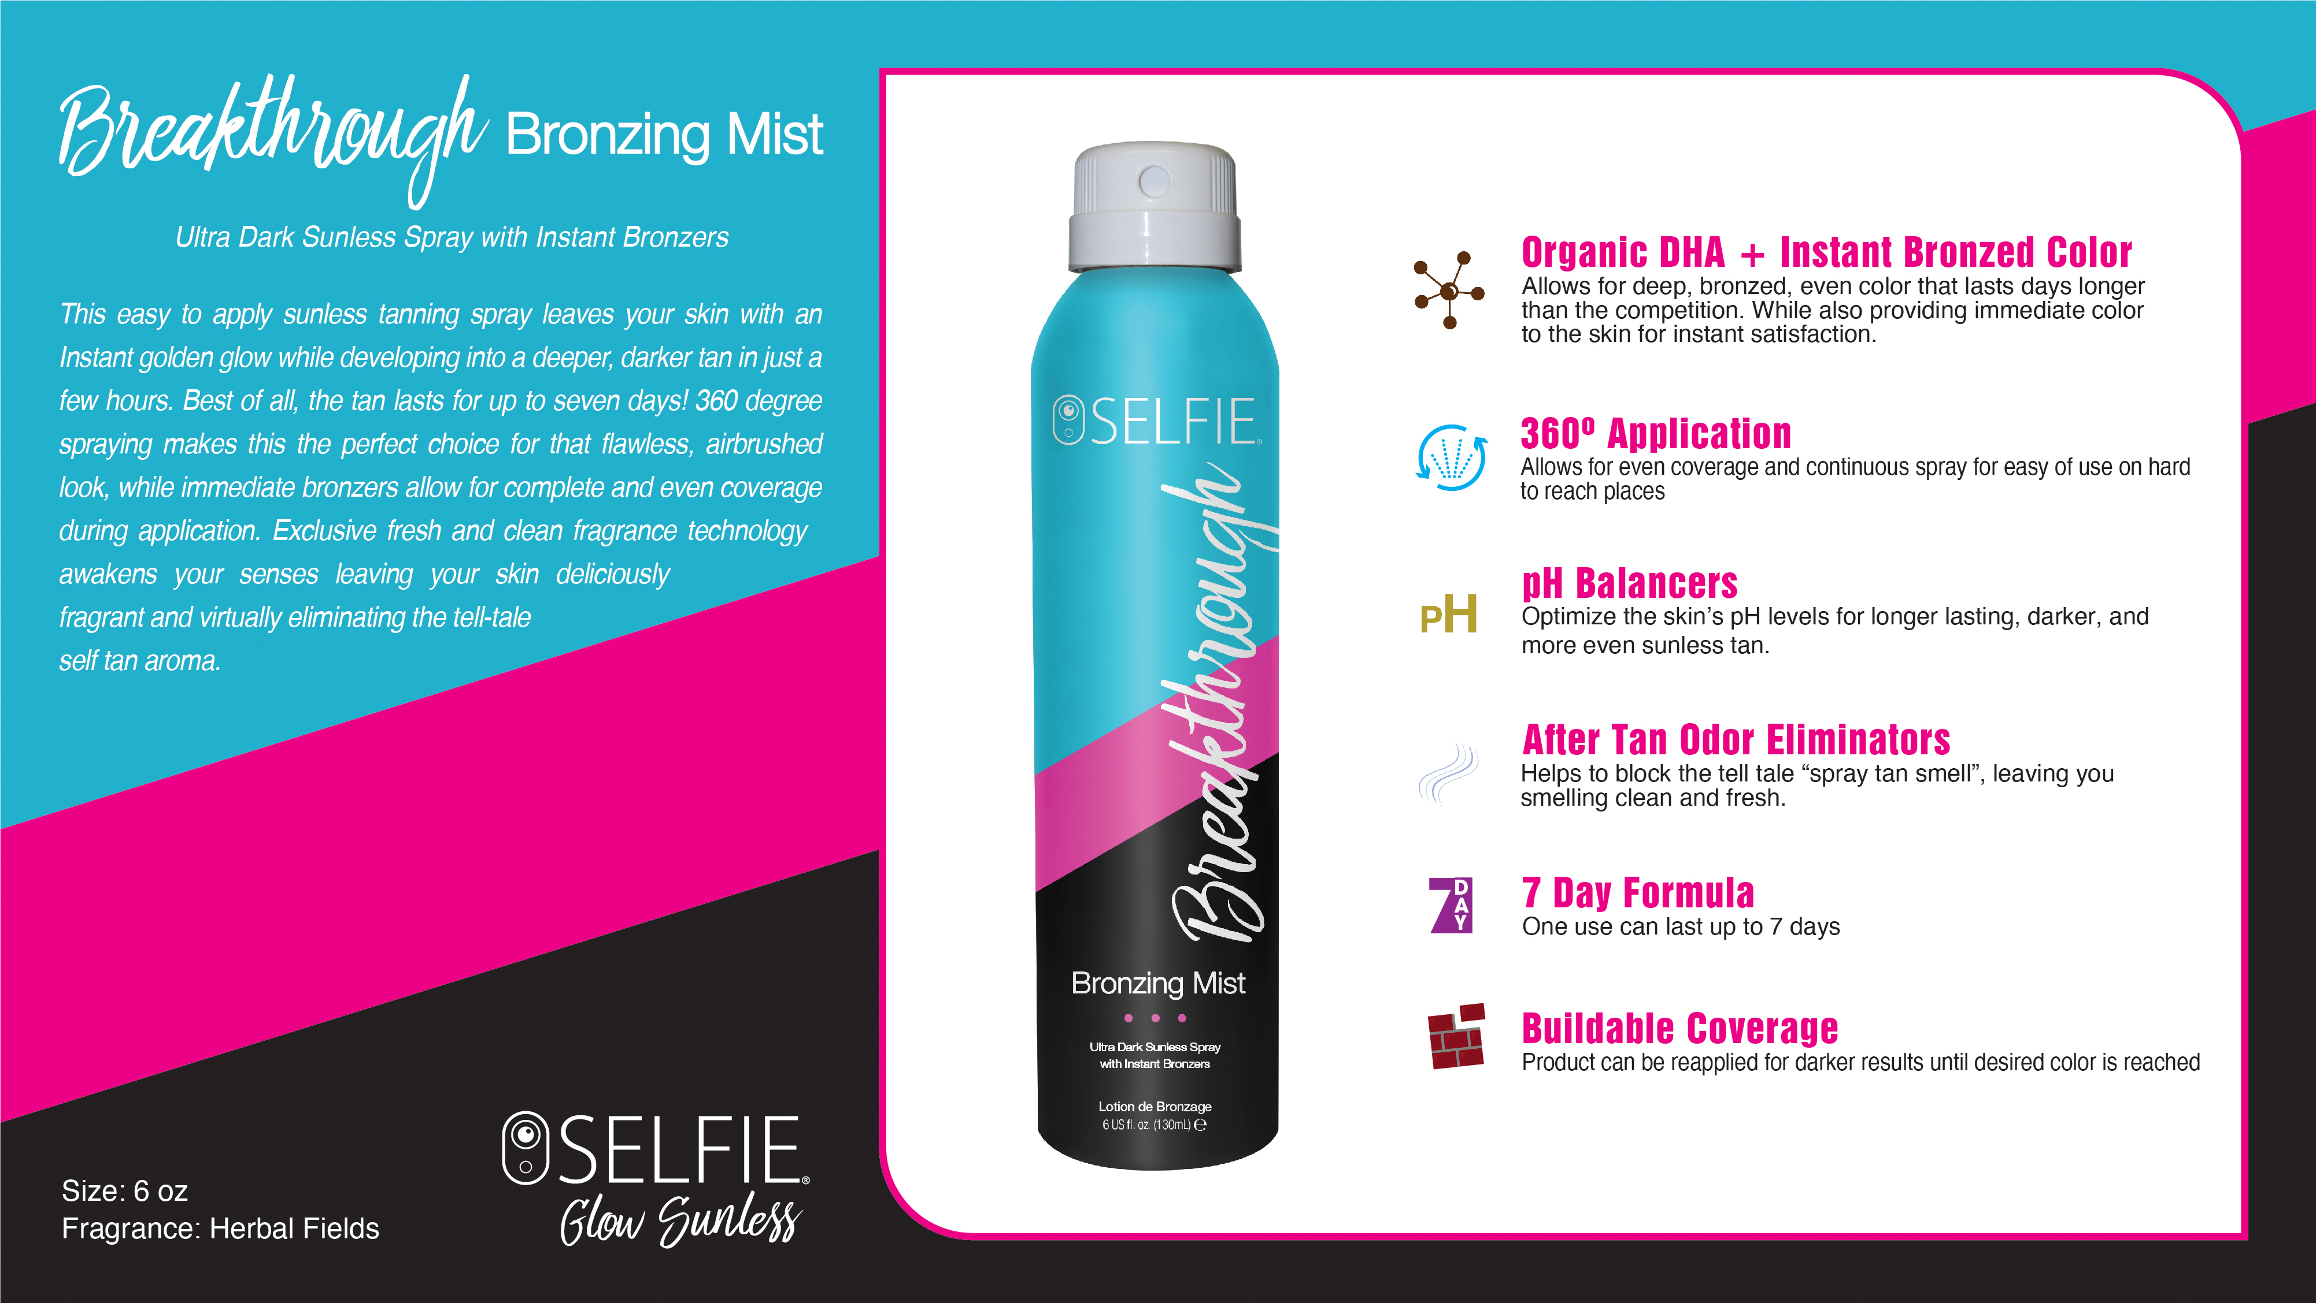
Tan in a can!! Shower off after about 6-8 hours

Slide 22
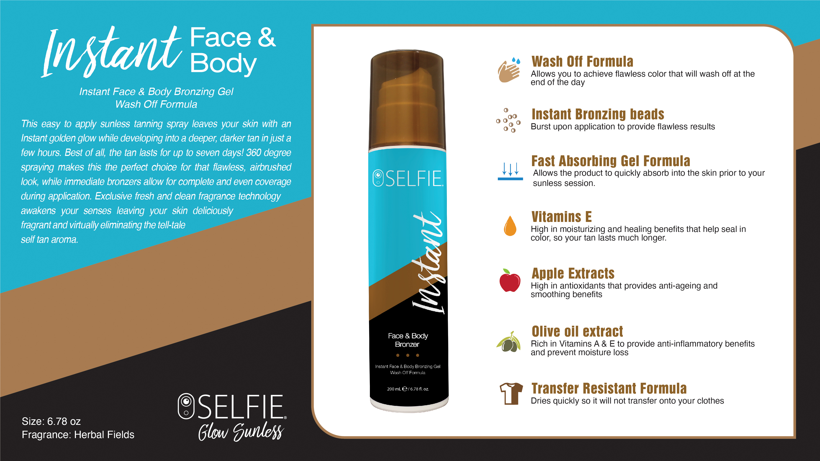
Perfect for a girls night out! Instant color and wash off formula!

Slide 23
