Slide 1
NEW Product Spotlight

Slide 2
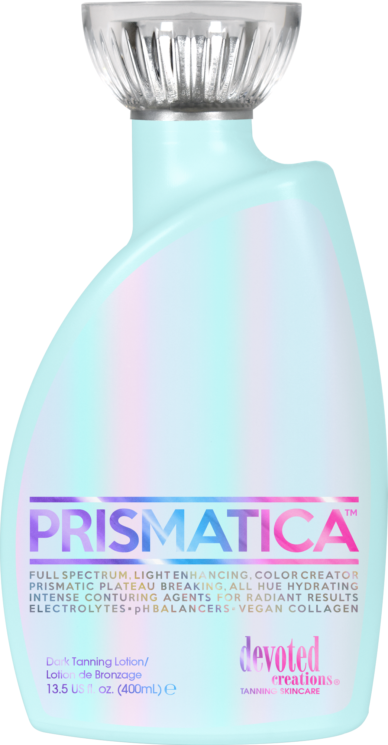
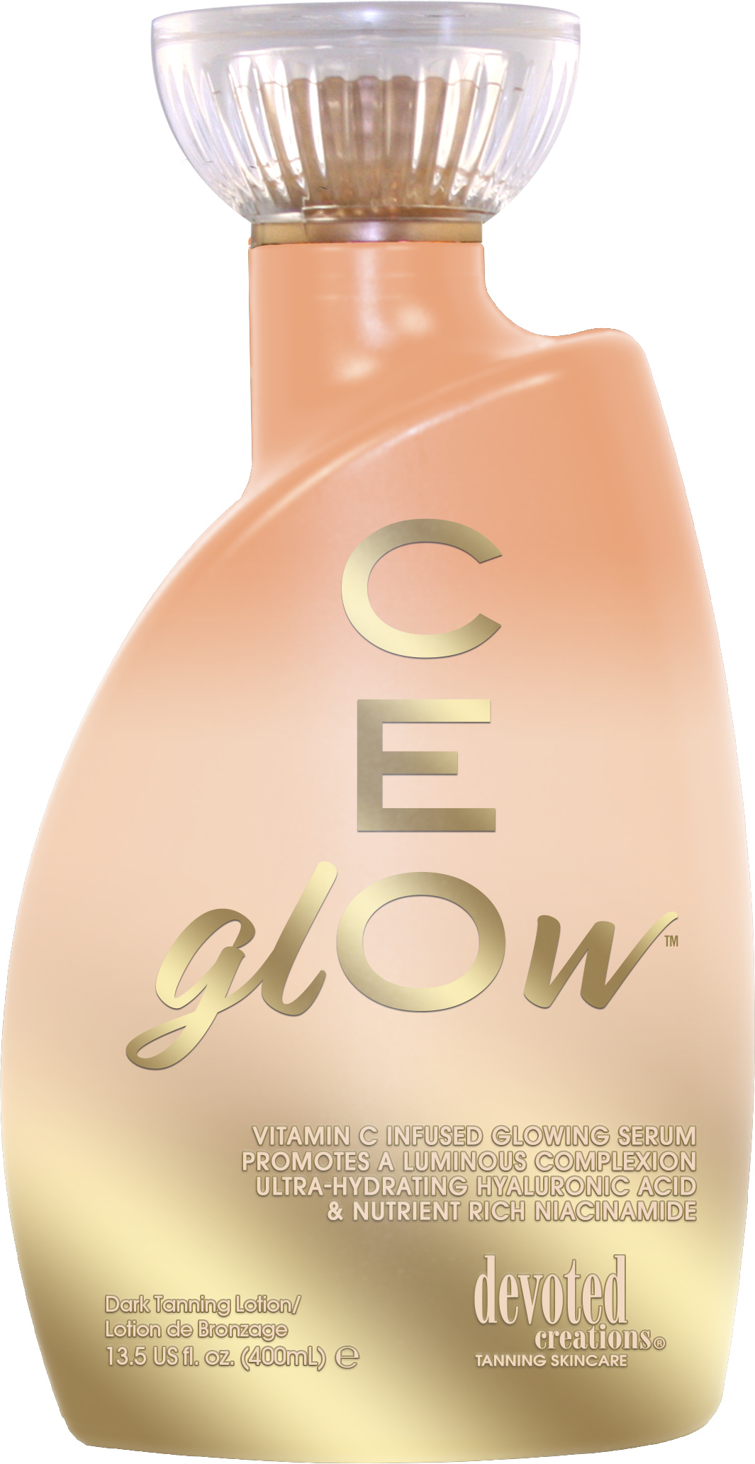
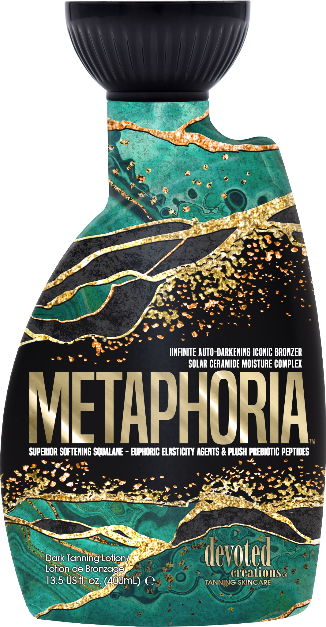

Slide 3
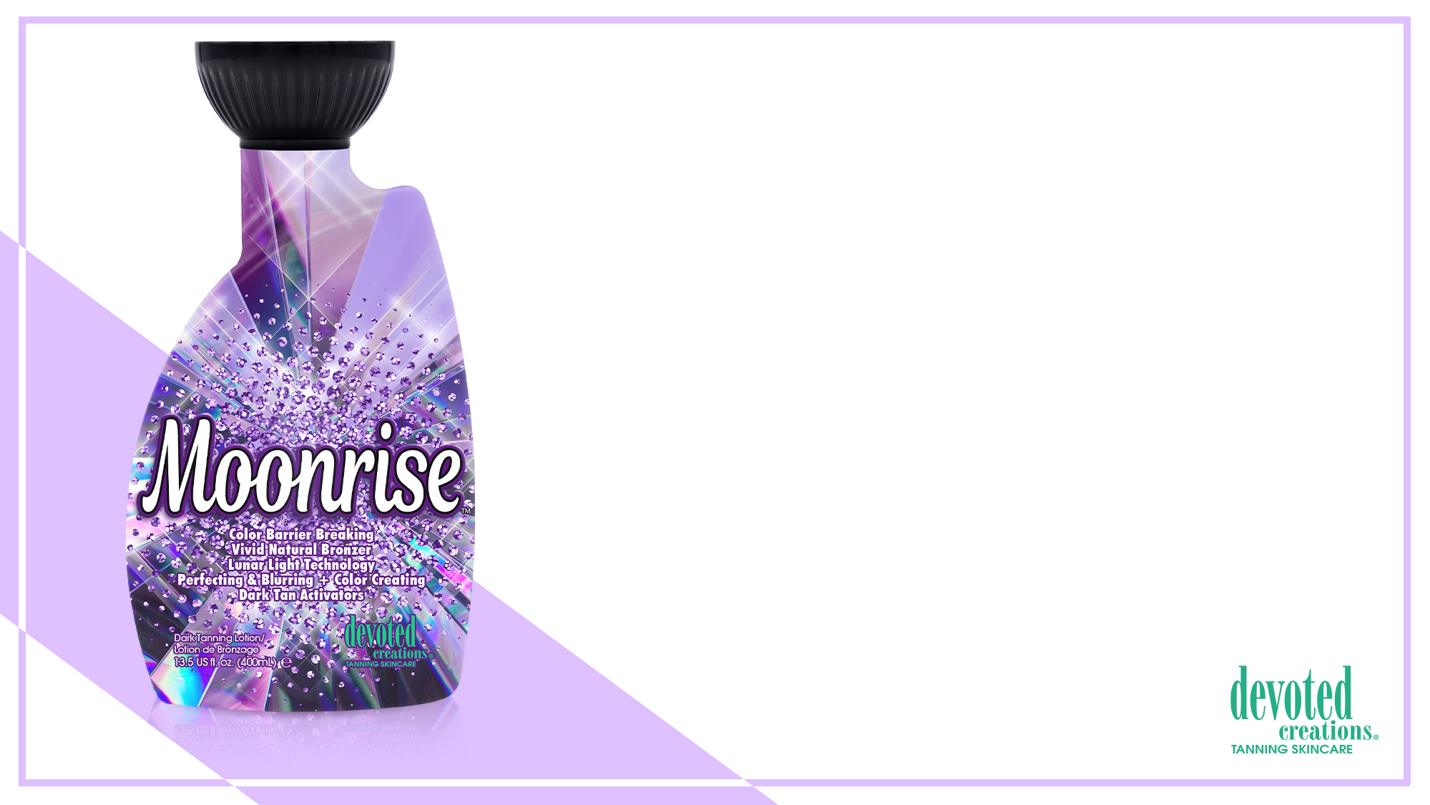
Moonrise™ Color Barrier Breaking | Vivid Natural Bronzer
Lunar Light Technology | Perfecting & Blurring + Color Creating
Dark Tan Activators
Indoor/Outdoor Natural Bronzer
Cashmere Blend
SunXtend
FreshTek
BodyFit Technology
Tattoo & Color Protecting Formula
Renovage
Advanced Matrixyl Synthe 6
Triple Hybrid Formula

Slide 4
Moonrise™ Color Barrier Breaking | Vivid Natural Bronzer
Lunar Light Technology | Perfecting & Blurring + Color Creating
Dark Tan Activators
• Plateau Breaking Natural & Cosmetic bronzers for immediate deep, long lasting bronzed results without the use of self-tanning agents.
• pH Balancing & Formulated for use in all light units - Maximize your session in red light, blue light or UV light with pH balancing agents that allow for optimal light absorption.
• Light Activated Photosomes – Used with any light therapy and helps protect the skins immune system.
• X50 PhotoGlow™ - Glowing skin enhancer that turns light into cellular energy for increased luminosity and elasticity.
• GlowPlex™ - A multi-functional skincare active containing Niacinamide and anti aging peptides to promote glowing skin, blur imperfections and helping to minimize the appearance of dark spots.
• Golden C – Contains Vitamin C with micro gold particles that allow the Vitamin C to penetrate deeper into the skin for enhanced complexion perfecting effects while also targeting the appearance of fine lines and pigmentation.
• Violet Flower – Contains natural anti-inflammatory agents to calm irritated skin as well as comedolytic and bacteriostatic properties that soothe skin imperfections while helping to prevent acne and excess oil on all skin types.
• Caffeine Extracts – Firms, hydrates and tightens the skin for anti-aging and wrinkle soothing properties.
• Rose Water – Antioxidant rich to help ward off free radical damage while also targeting skin sagging and dullness.
Fragrance: Beaming Starburst

Slide 5
Megan Racine
International Sales Trainer
Megan@devotedcreations.com
Madeleine Harrington
Digital Marketing Coordinator & Product Specialist
mharrington@devotedcreations.com

Slide 6
Giveaway!

Slide 7
Megan Racine
International Sales Trainer
Megan@devotedcreations.com
Madeleine Harrington
Digital Marketing Coordinator & Product Specialist
mharrington@devotedcreations.com

