Slide 1
2023 Midseason Product Training

Slide 2
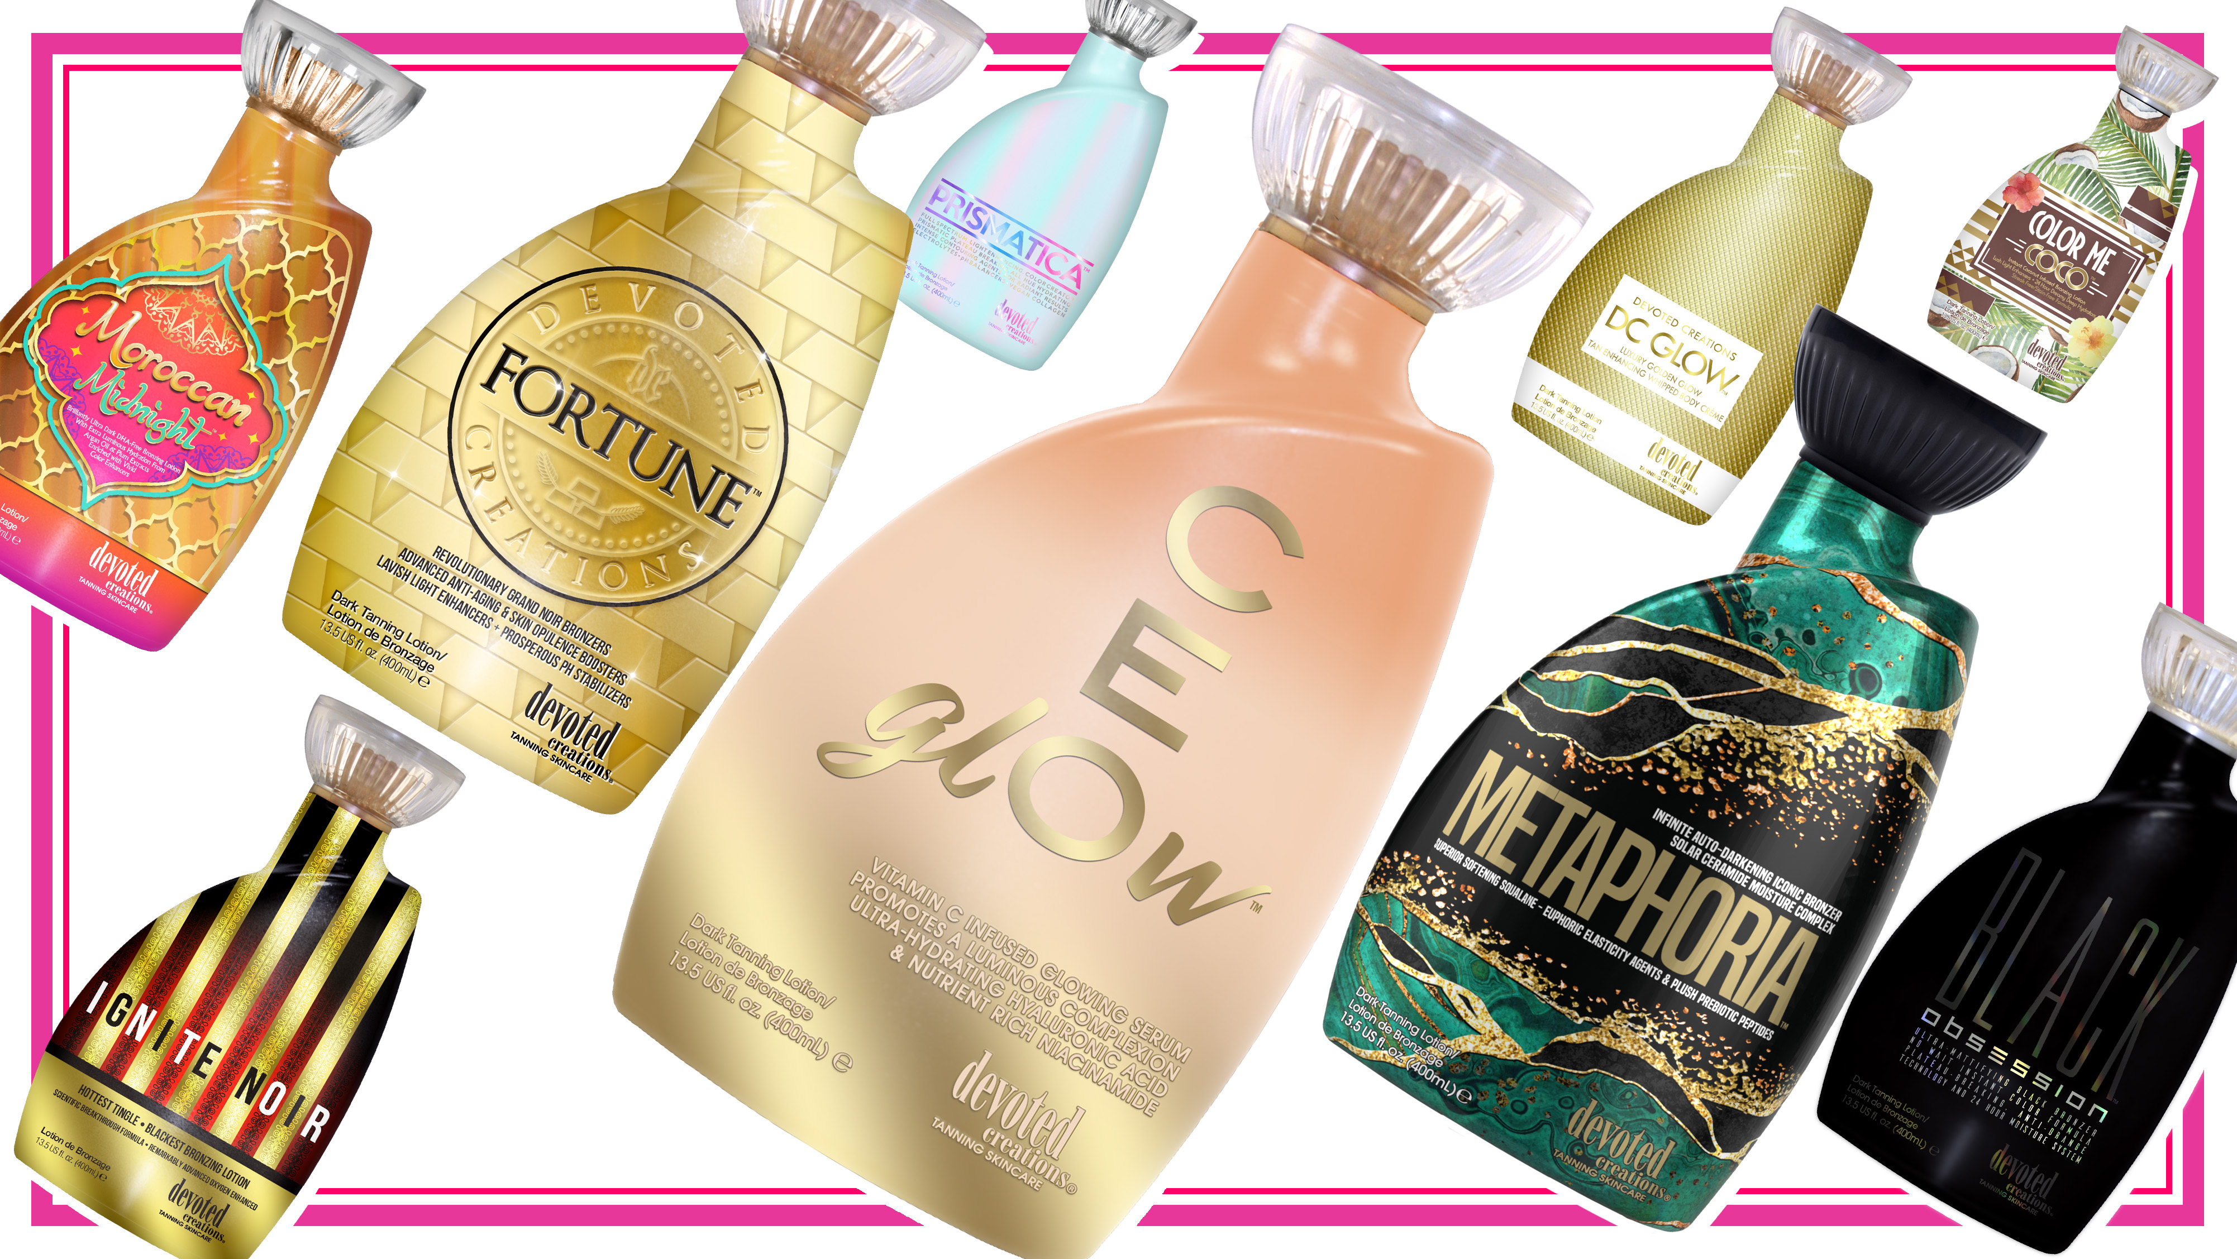
Notes:
2

Slide 3
Commonalities
Cashmere Blend
Renovage
BodyFit
FreshTek
SunXtend
Tattoo & Color Fade Protecting Formula

Slide 4
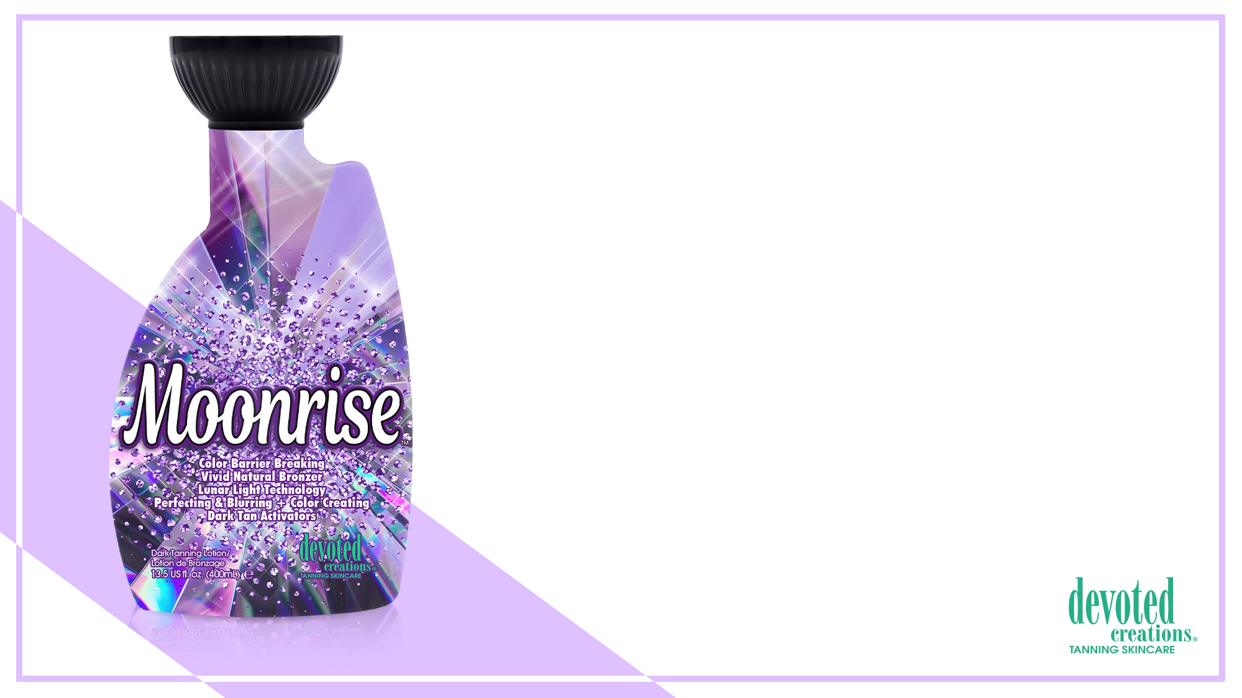
Moonrise™ Color Barrier Breaking | Vivid Natural Bronzer
Lunar Light Technology | Perfecting & Blurring + Color Creating
Dark Tan Activators
• Plateau Breaking Natural & Cosmetic bronzers for immediate deep, long lasting bronzed results without the use of self-tanning agents.
• pH Balancing & Formulated for use in all light units - Maximize your session in red light, blue light or UV light with pH balancing agents that allow for optimal light absorption.
• Light Activated Photosomes – Used with any light therapy and helps protect the skins immune system.
• X50 PhotoGlow™ - Glowing skin enhancer that turns light into cellular energy for increased luminosity and elasticity.
• GlowPlex™ - A multi-functional skincare active containing Niacinamide and anti aging peptides to promote glowing skin, blur imperfections and helping to minimize the appearance of dark spots.
• Golden C – Contains Vitamin C with micro gold particles that allow the Vitamin C to penetrate deeper into the skin for enhanced complexion perfecting effects while also targeting the appearance of fine lines and pigmentation.
• Violet Flower – Contains natural anti-inflammatory agents to calm irritated skin as well as comedolytic and bacteriostatic properties that soothe skin imperfections while helping to prevent acne and excess oil on all skin types.
• Caffeine Extracts – Firms, hydrates and tightens the skin for anti-aging and wrinkle soothing properties.
• Rose Water – Antioxidant rich to help ward off free radical damage while also targeting skin sagging and dullness.
Fragrance: Beaming Starburst

Slide 5
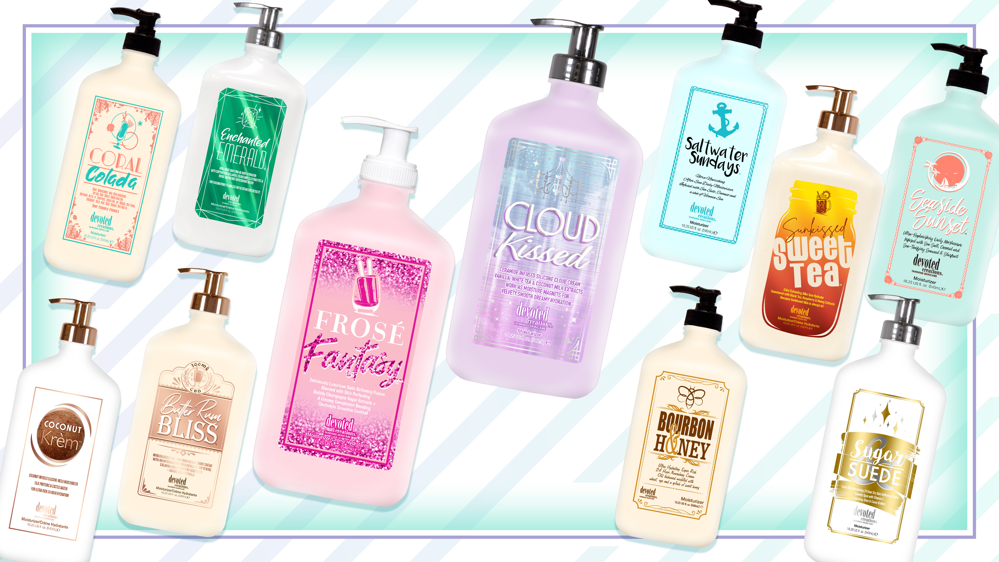

Slide 6
Barefoot Beachwood™ Nautical Nourishing After Sun Daily Hydrator
Island Infusion of Skin Softening Cacay, Coconut & Avocado Oils
to Replenish Skin’s Moisture
• Cacay Oil – Rich is fatty acids, Cacay oil is used to help heal and hydrate the skin while also working to combat fine lines, wrinkles, dryness, dullness, uneven tone and discoloration while helping to restore luminosity.
• Willow Bark Extract – Helps to calm redness soothe irritated skin leaving a more radiant and clear complexion.
• Silicone Blend - Visibly reduce the look of pores and imperfections while offering non-greasy hydration.
• Coffeeberry Extracts – Rich in antioxidants to help ward off free radical damage while also helping to combat the signs of aging.
• White Tea Extracts – Anti-inflammatory that works as a natural antioxidant to help improve the appearance of hyperpigmentation.
• Coconut Milk – Deeply softens and nourishes while calming irritation on even the most sensitive skin.
• Cucumber Extract – A powerful natural soothing agent that also helps to reduce puffiness and decrease skin irritation.
• Avocado Extract – Helps to strengthen the skins natural moisture barrier.
Fragrance: Barefoot Beachwood

Slide 8
Commonalities
Hyaluronic Acid
Vegan Collagen
Multi-use
Formulated for delicate facial skin

Slide 9
Honey Gleam Cream™ Glow Boosting Skin Tint | Contouring Filter Effect
Iconic Airbrush Luminizer
Mega-Moisture Dewy Mineral Mask
• Airbrush Luminizing Skin Tint & Glow Enhancing Mask – This revolutionary facial tan enhancer is formulated to tan, tone and tighten facial skin while also providing a filtered luminous glow.
• Porcelain Flower Extract – Hydrates and nourishes the skin while helping to promote a crystal-clear complexion.
• GlowPlex™ - A multi-functional skincare active containing Niacinamide and anti-aging peptides to promote glowing skin, blur imperfections and helping to minimize the appearance of dark spots.
• Electric Daisy – Allows for a tightening and contouring effect to the skin while also helping to increase skin’s elasticity.
• Glucohyami™ - Helps the skin to restore its natural production of hyaluronic acid to help for a more youthful and tones appearance to the skin.
• Honey Extract – Has natural pore tightening and glow enhancing properties while helping to reduce the appearance of skin’s imperfections.
• Green Tea Extract – Power packed with antioxidants to help reduce environmental stress and damage to the skin while working to decrease puffiness.
• Hyalufix™ - Compliments the skin’s natural hyaluronic acid production by delivering deep down cellular hydration. Significantly appears to correct deep facial wrinkles, improve skin density, firm and plump the skin.
• Vegan Collagen – Helps to strengthen and condition the skin to visibly improve texture and suppleness while also helping to restore skin’s natural bounce and resilience, diminishing the look of fine lines and wrinkles.
• Multi Use – Can be used as a facial tan enhancer, daily glowing moisturizer or dewy makeup primer.
Fragrance: Hypnotic Honey

Slide 11
FB12™ Super Workout Enhancer
Toning & Firming with Cryo-Slimming Hydration
Maximum Moisturization
• Intenslim™ - Works as a natural fat burner while also strengthening the elastin in the skin.
• Cryo-Slimming Frescolat™ - Helps to cool and refresh the skin without the use of menthol.
• Keratoline™ - An AHA alternative, Keratoline gently exfoliates to reveal youthful,
and toned skin.
• Carnitine – An oil absorbing amino acid that assists in decreasing oil production as well as helps to assist in breaking down fat accumulation
• Aquaxyl™ - Helps to quench extreme skin dehydration allowing for a softer and
more hydrated appearance.
• ISO-Slim™ - Works as a slimming and anti-cellulite agent while also assisting in the breakdown of fat cells.
• Green Tea Extracts – Rich in antioxidants to help ward off free radical damage.
• Grape Seed Extracts – Helps to boost collagen production and works to even out
skins tone and texture.
• Vitamins A & C – Power packs the skin with natural vitamins and nutrients for a more perfected appearance of the skin.
Fragrance: Fresh & Clean

Slide 12
Megan Racine
International Sales Trainer
Megan@devotedcreations.com

