Slide 1
2022 Midseason Product Training

Slide 2
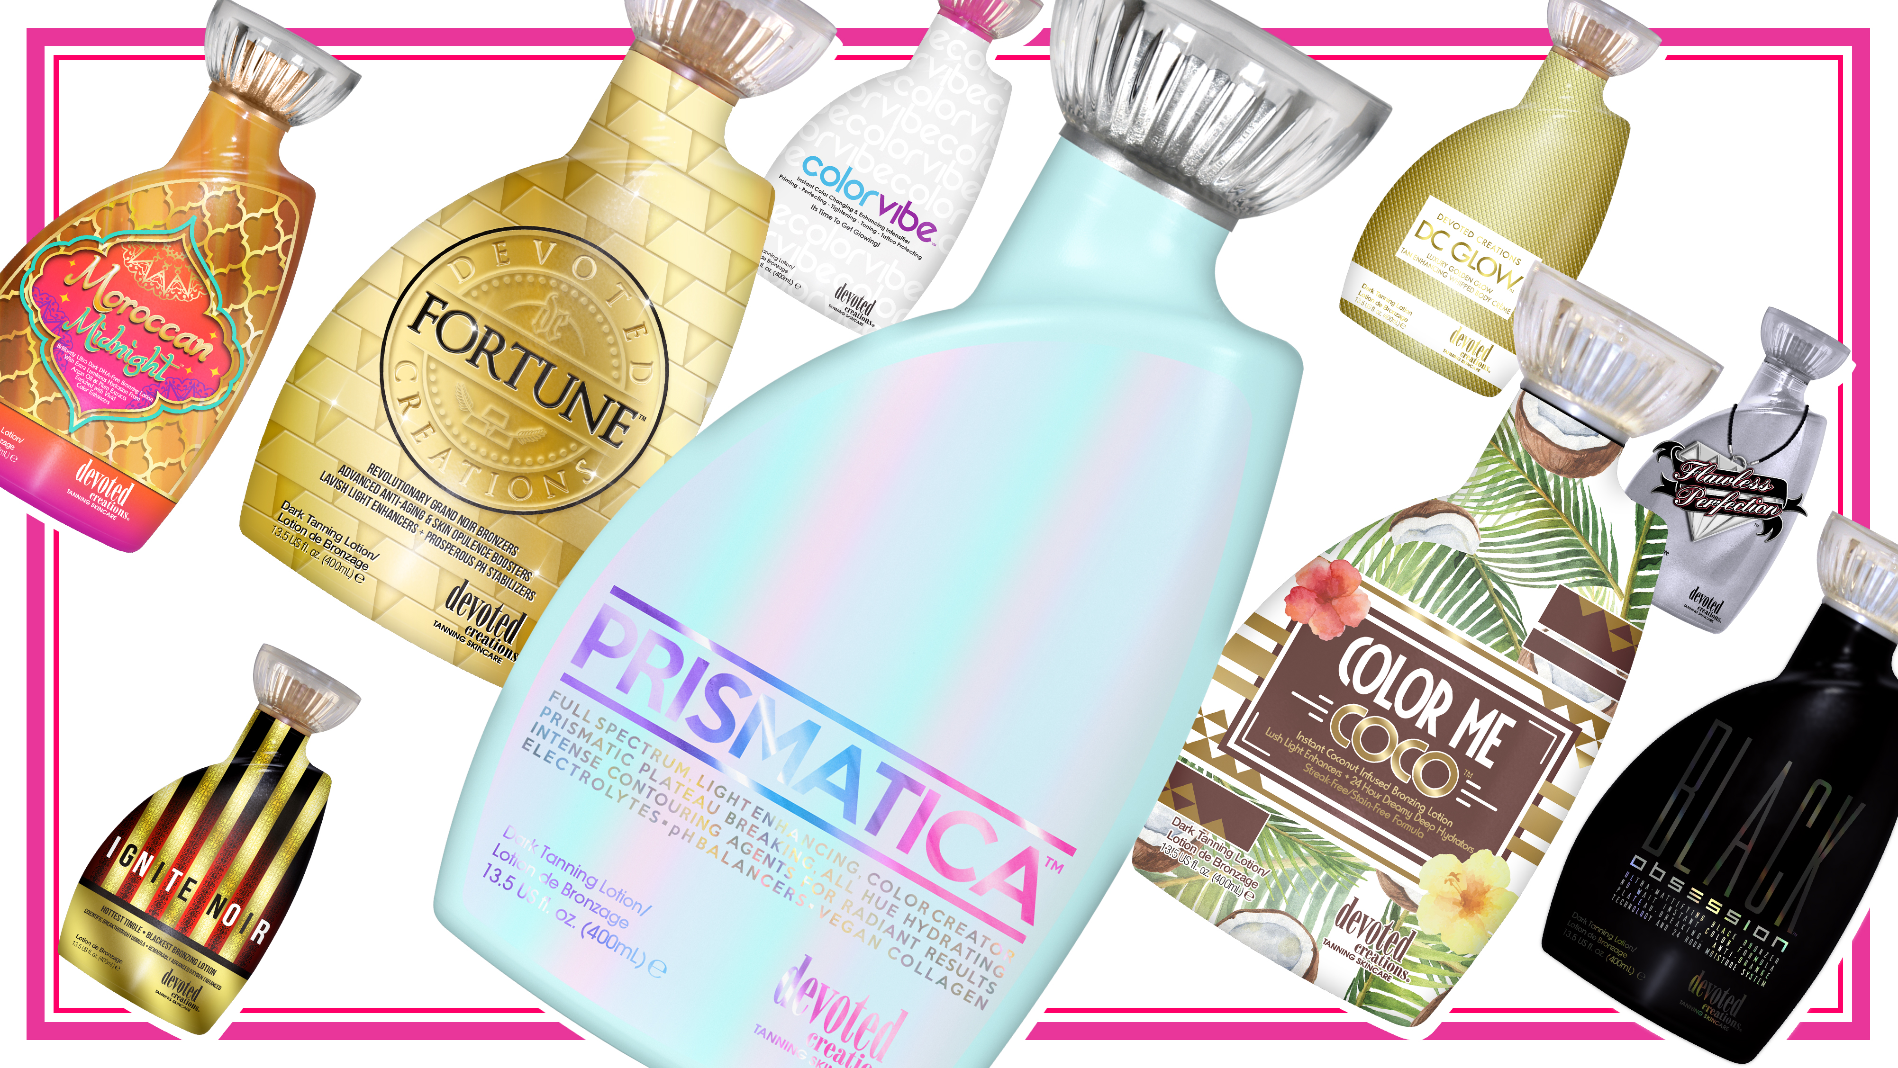

Slide 3
Metaphoria™ Infinite Auto-Darkening Iconic Bronzer
Solar Ceramide Moisture Complex
Superior Softening Squalane – Euphoric Elasticity Agents
Plush Prebiotic Peptides
Color Rush Core Ingredients
Blue Tansy
Renovage
Advanced Matrixyl Synthe 6
BodyFit Technology
SunXtend
FreshTek
Melanin Stimulators
Tattoo & Color Fade Technology

Slide 4
Metaphoria™ Infinite Auto-Darkening Iconic Bronzer | Solar Ceramide Moisture Complex
Superior Softening Squalane – Euphoric Elasticity Agents & Plush Prebiotic Peptides
• Violet Flower – Contains natural anti-inflammatory agents to calm irritated skin, helps to prevent acne by absorbing oil and relieves dry skin conditions.
• Vitamin B5 – Attracts and holds moisture in the skin to prevent skin dryness, may provide soothness to dry, red and irritated skin.
• Superior Ceramide Complex – Works to strengthen skin’s moisture barrier to maintain optimal hydration levels as well as protect by helping to seal out harmful environmental elements.
• Powerful Prebiotic Blend – Works to improve the complexion by balancing the skin’s natural barrier and helps to influence the speed and regrowth of healthy skin while repelling the environmental conditions that cause inflammation.
• Forslean™ – A plant derived compound that helps to break down fat deposits.
• Flavoslim™ – Counteracts the signs of cellulite by improving skin elasticity, while also tightening toning and firming.
• CoQ10 – Helps to support the production of collagen and reduce the appearance of fine lines and wrinkles.
• Resveratrol™ – Potent antioxidant that fights free radical damage caused by environmental stressors while increasing collagen production and smoothing out fine lines.
Fragrance: Lunar Escape

Slide 5
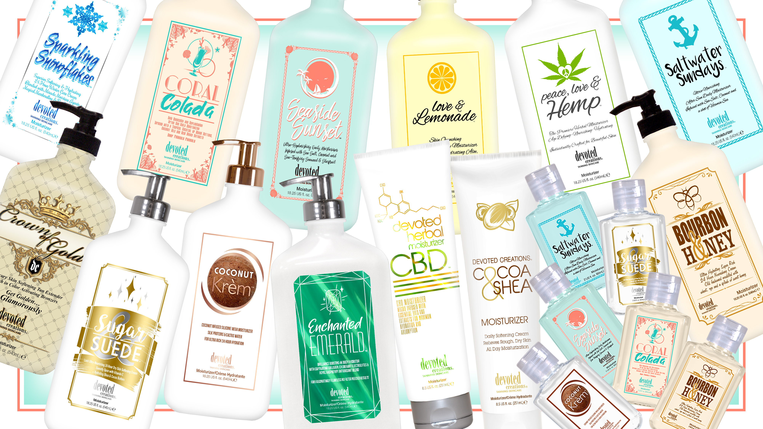

Slide 6
Frosé Fantasy™ Deliciously Luxurious Satin Softening Fusion Blended with Skin Perfecting Bubbly Champagne Extracts + A Creamy Complexion Boosting Electrolyte Smoothie Cocktail
• Satin Softening Daily Moisturizer – Keeps skin hydrated for 24 hours while allowing for touchably smooth results.
• Ultra-Blurring Moisture Lock Technology - Visibly reduce the look of pores and
imperfections for perfected non-greasy hydration.
• Vegan Collagen – Helps to create a filter-like effect that works to smooth out fine lines and wrinkles, while helping to bind moisture to the skin, leaving you with a youthful, skin perfected appearance.
• Sugarcane Derived Squalane™ – Helps to provide weightless hydration,
balance excess oil, soothe, and promote a plump, firm appearance.

Slide 7
Frosé Fantasy™ Deliciously Luxurious Satin Softening Fusion Blended with Skin Perfecting Bubbly Champagne Extracts + A Creamy Complexion Boosting Electrolyte Smoothie Cocktail
• Radiance Boosting Champagne Extracts – Promotes a glowing and youthful appearance to the skin by helping to preserve collagen and rejuvenate the skin.
• Antioxidant Rich Super Fruit Smoothie Blend –
• Strawberry – Good source of vitamin C and antioxidant that help to protect and soothe the skin, targets dark spot formations and brightens the skin’s complexion.
• Pomegranate – Beneficial for acne prone skin as it combats blemishes and can help reduce scarring, hydrates the skin to prevent moisture lock as it absorbs deeply into the dry layers of the skin, boosts collagen and elastin in the skin and protects from free radical damage.
• Blueberry – Combats skin dullness and dryness, aids in moisture retention to work against dead skin loss, high in Vitamin C which helps with brightening up the skin and working against hyperpigmentation or discoloration.
• Elderberry – Helps to protect against UV damage and has astringent properties to shrink the appearance of large pores and balances out excess oil on the skin.
Fragrance: Frosé Fantasy

Slide 9
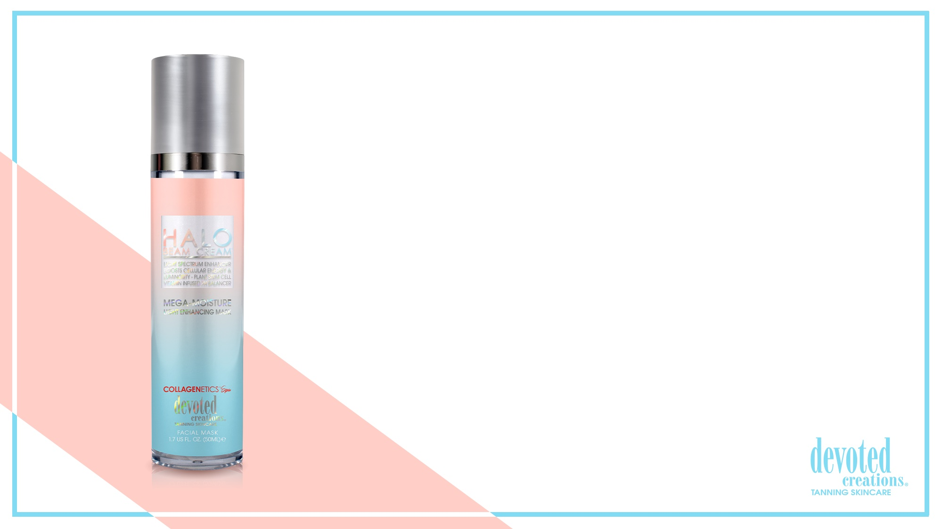
Halo Beam Cream™ Light Spectrum Enhancer • Boosts Cellular Energy & Luminosity Plant Based Stem Cells • Vitamin Infused pH Balancer
• Blue Hued Color Correcting Super Soft Mega Moisture Light Enhancing Mask – This revolutionary facial tan enhancer is formulated to tan, tone, color correct and tighten facial skin while also preparing the skin for absorption of all light hues.
• Vegan Collagen – Helps to strengthen and condition the skin to visibly improve texture and suppleness while also helping to restore skin’s natural bounce and resilience, diminishing the look of fine lines and wrinkles.
• Plant Based Stem Cells – Helps to promote cell turnover and increase collagen production for a more youthful appearance.
• Hyaluronic Acid – Hydrates through the layers of the skin to promote a bouncy, plump look.
• Hyalufix™ - Sustainably sourced from Thai ginger leaves, Hyalufix™ compliments the skin’s natural production of hyaluronic acid. Delivering intensive and deep down cellular hydration, Hyalufix™ significantly appears to correct deep facial wrinkles, improve skin density, firm and plump the skin.
• Golden C – Contains Vitamin C with micro gold particles that allow the Vitamin C to penetrate deeper into the skin for enhanced complexion perfecting effects while also targeting the appearance of fine lines and pigmentation.
• Superox C™ – A specialty derived blend of Kakadu Plum known as one of the world’s richest sources of Vitamin C, Superox C is a potent antioxidant and contains micronutrient benefits that help to protect against environmental damage.
• X50 PhotoGlow™ - Glowing skin enhancer that turns light into cellular energy for increased luminosity and elasticity.
• Apple Cider Vinegar + pH Balancers – Helps to absorb excess oils, unclogs blocked pores and sooth irritation. It also has the power to help restore the natural pH balance to the skin.
Fragrance: Celestial Clouds

Slide 10
What is your favorite new ingredient(s) in the midseason products and why?

Slide 11
Megan Racine
National Sales Trainer
megan@devotedcreations.com
813.361.1866

