Slide 1
Face & Body Care

Slide 2
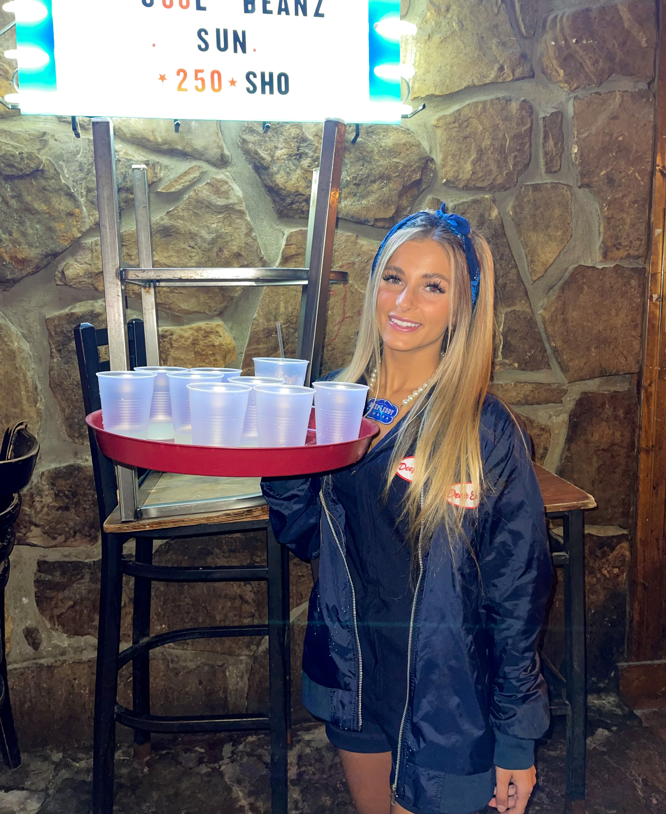
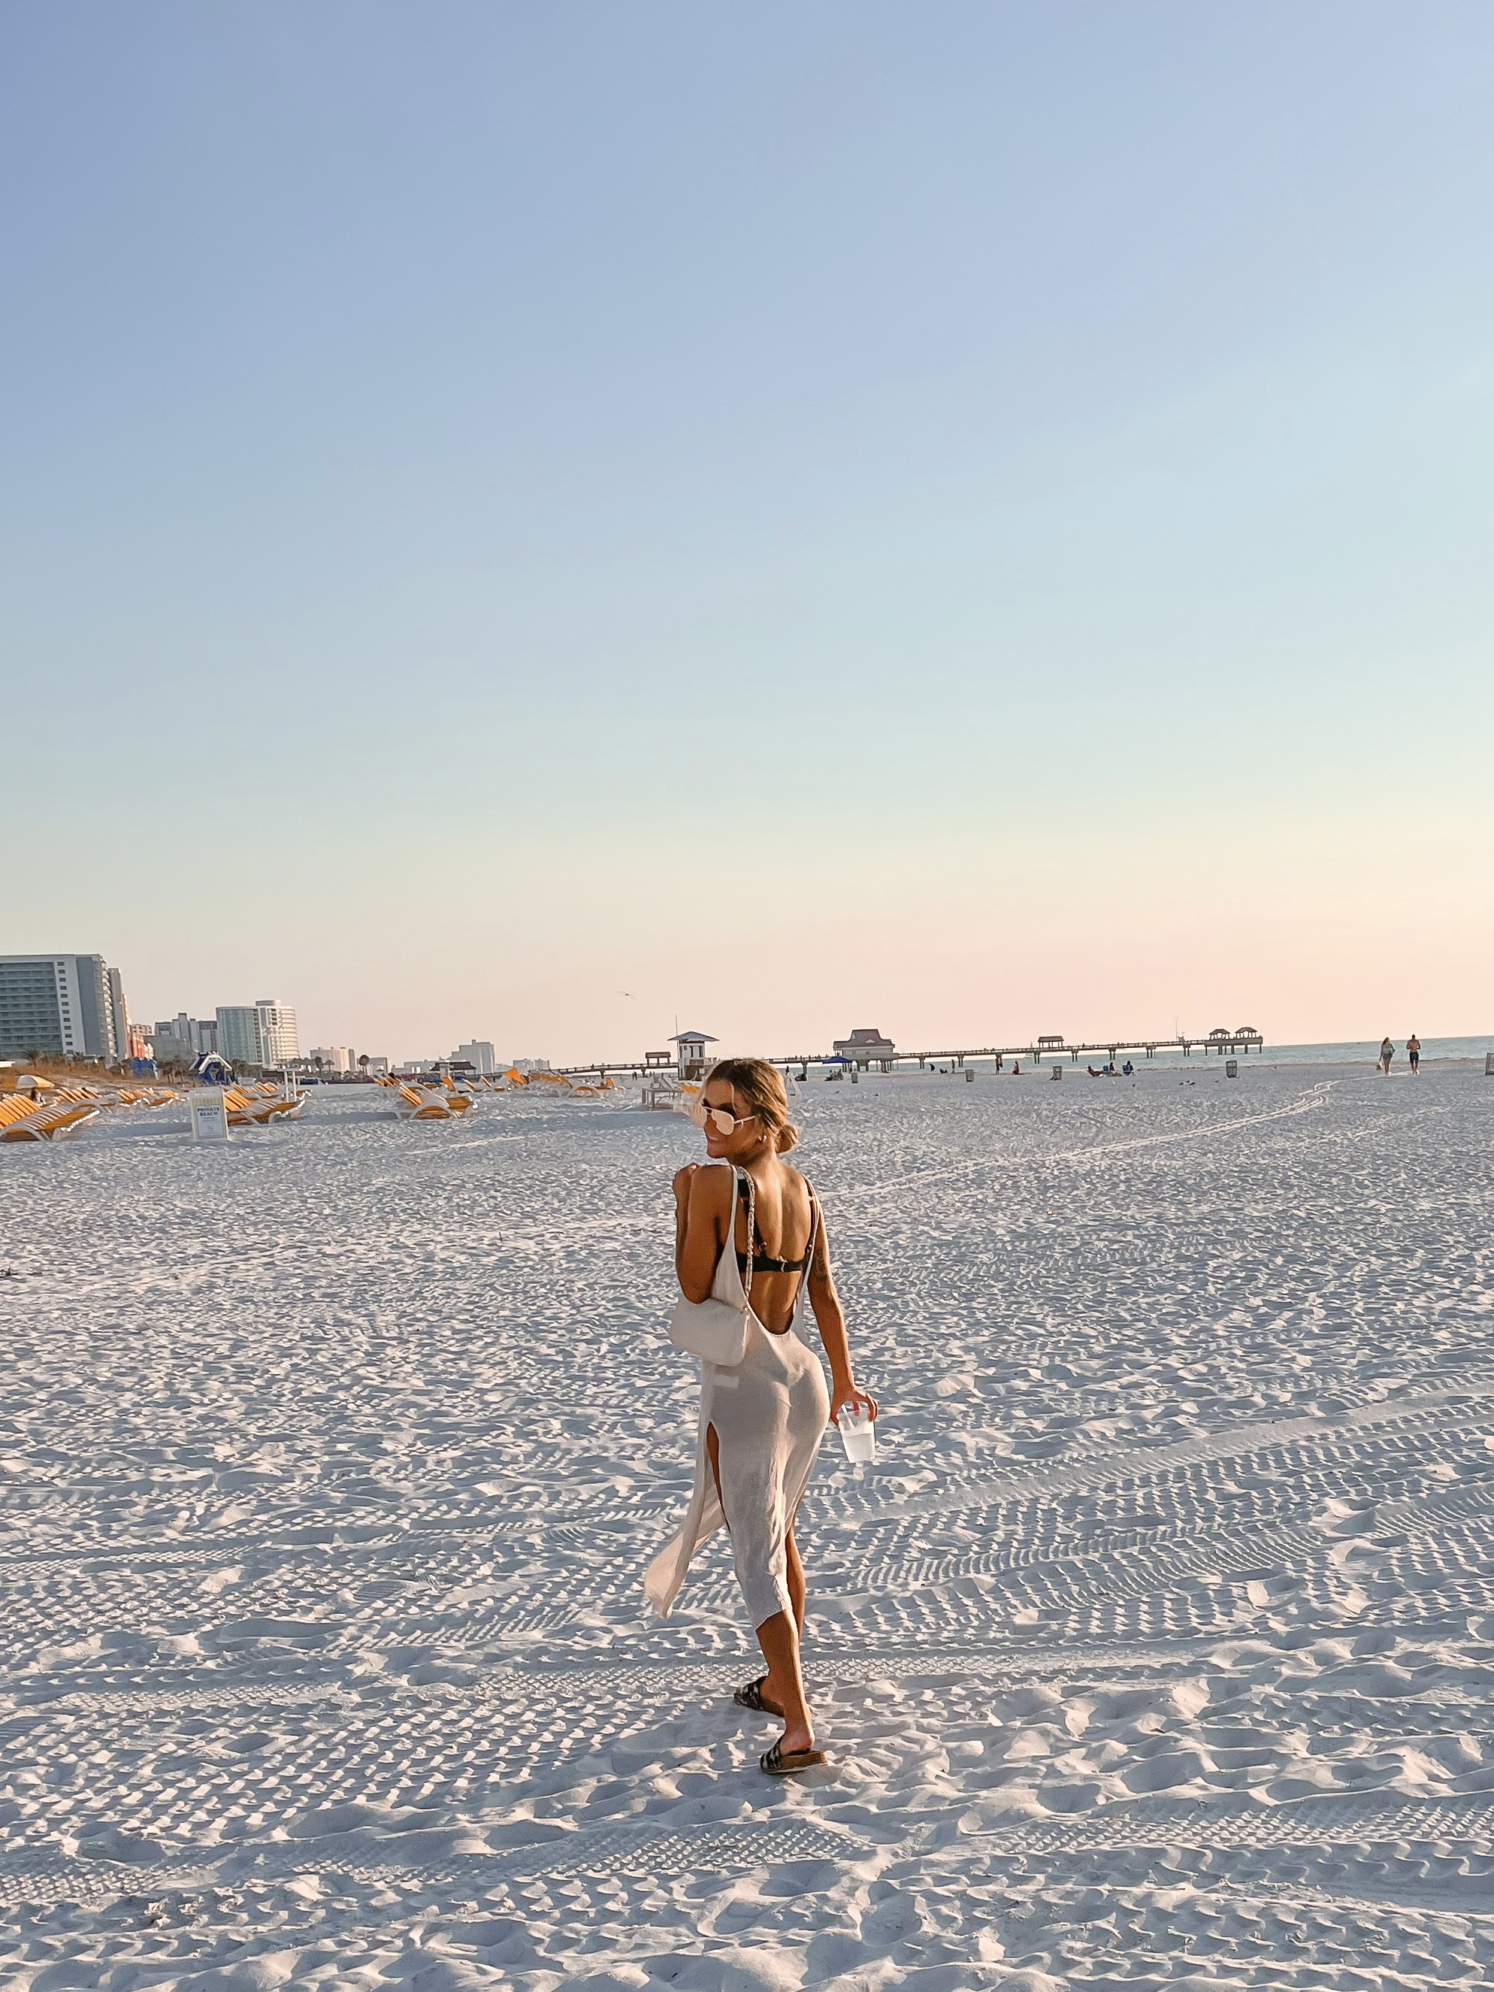
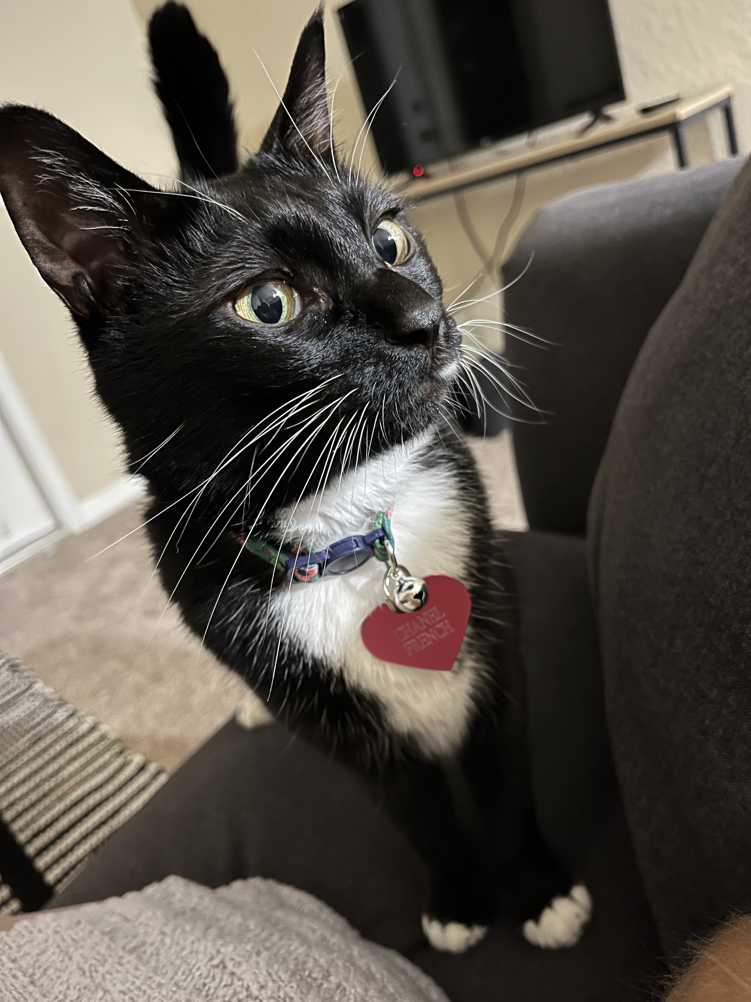

Slide 3
Devoted Difference
True manufacturer for over 25 years
Everything done in house and based in Tampa, FL
Own the company that makes our bottles and packet materials
Distribute to 70+ countries worldwide
Focus on skincare
1st ingredient used in 95% of products is aloe vera
Use highly sought fragrances

Slide 4
Agenda:
Why Face & Body Care?
Face Products
Bath and Shower Products
Tan Extending Hydrators
Bundles/Pairs

Slide 5
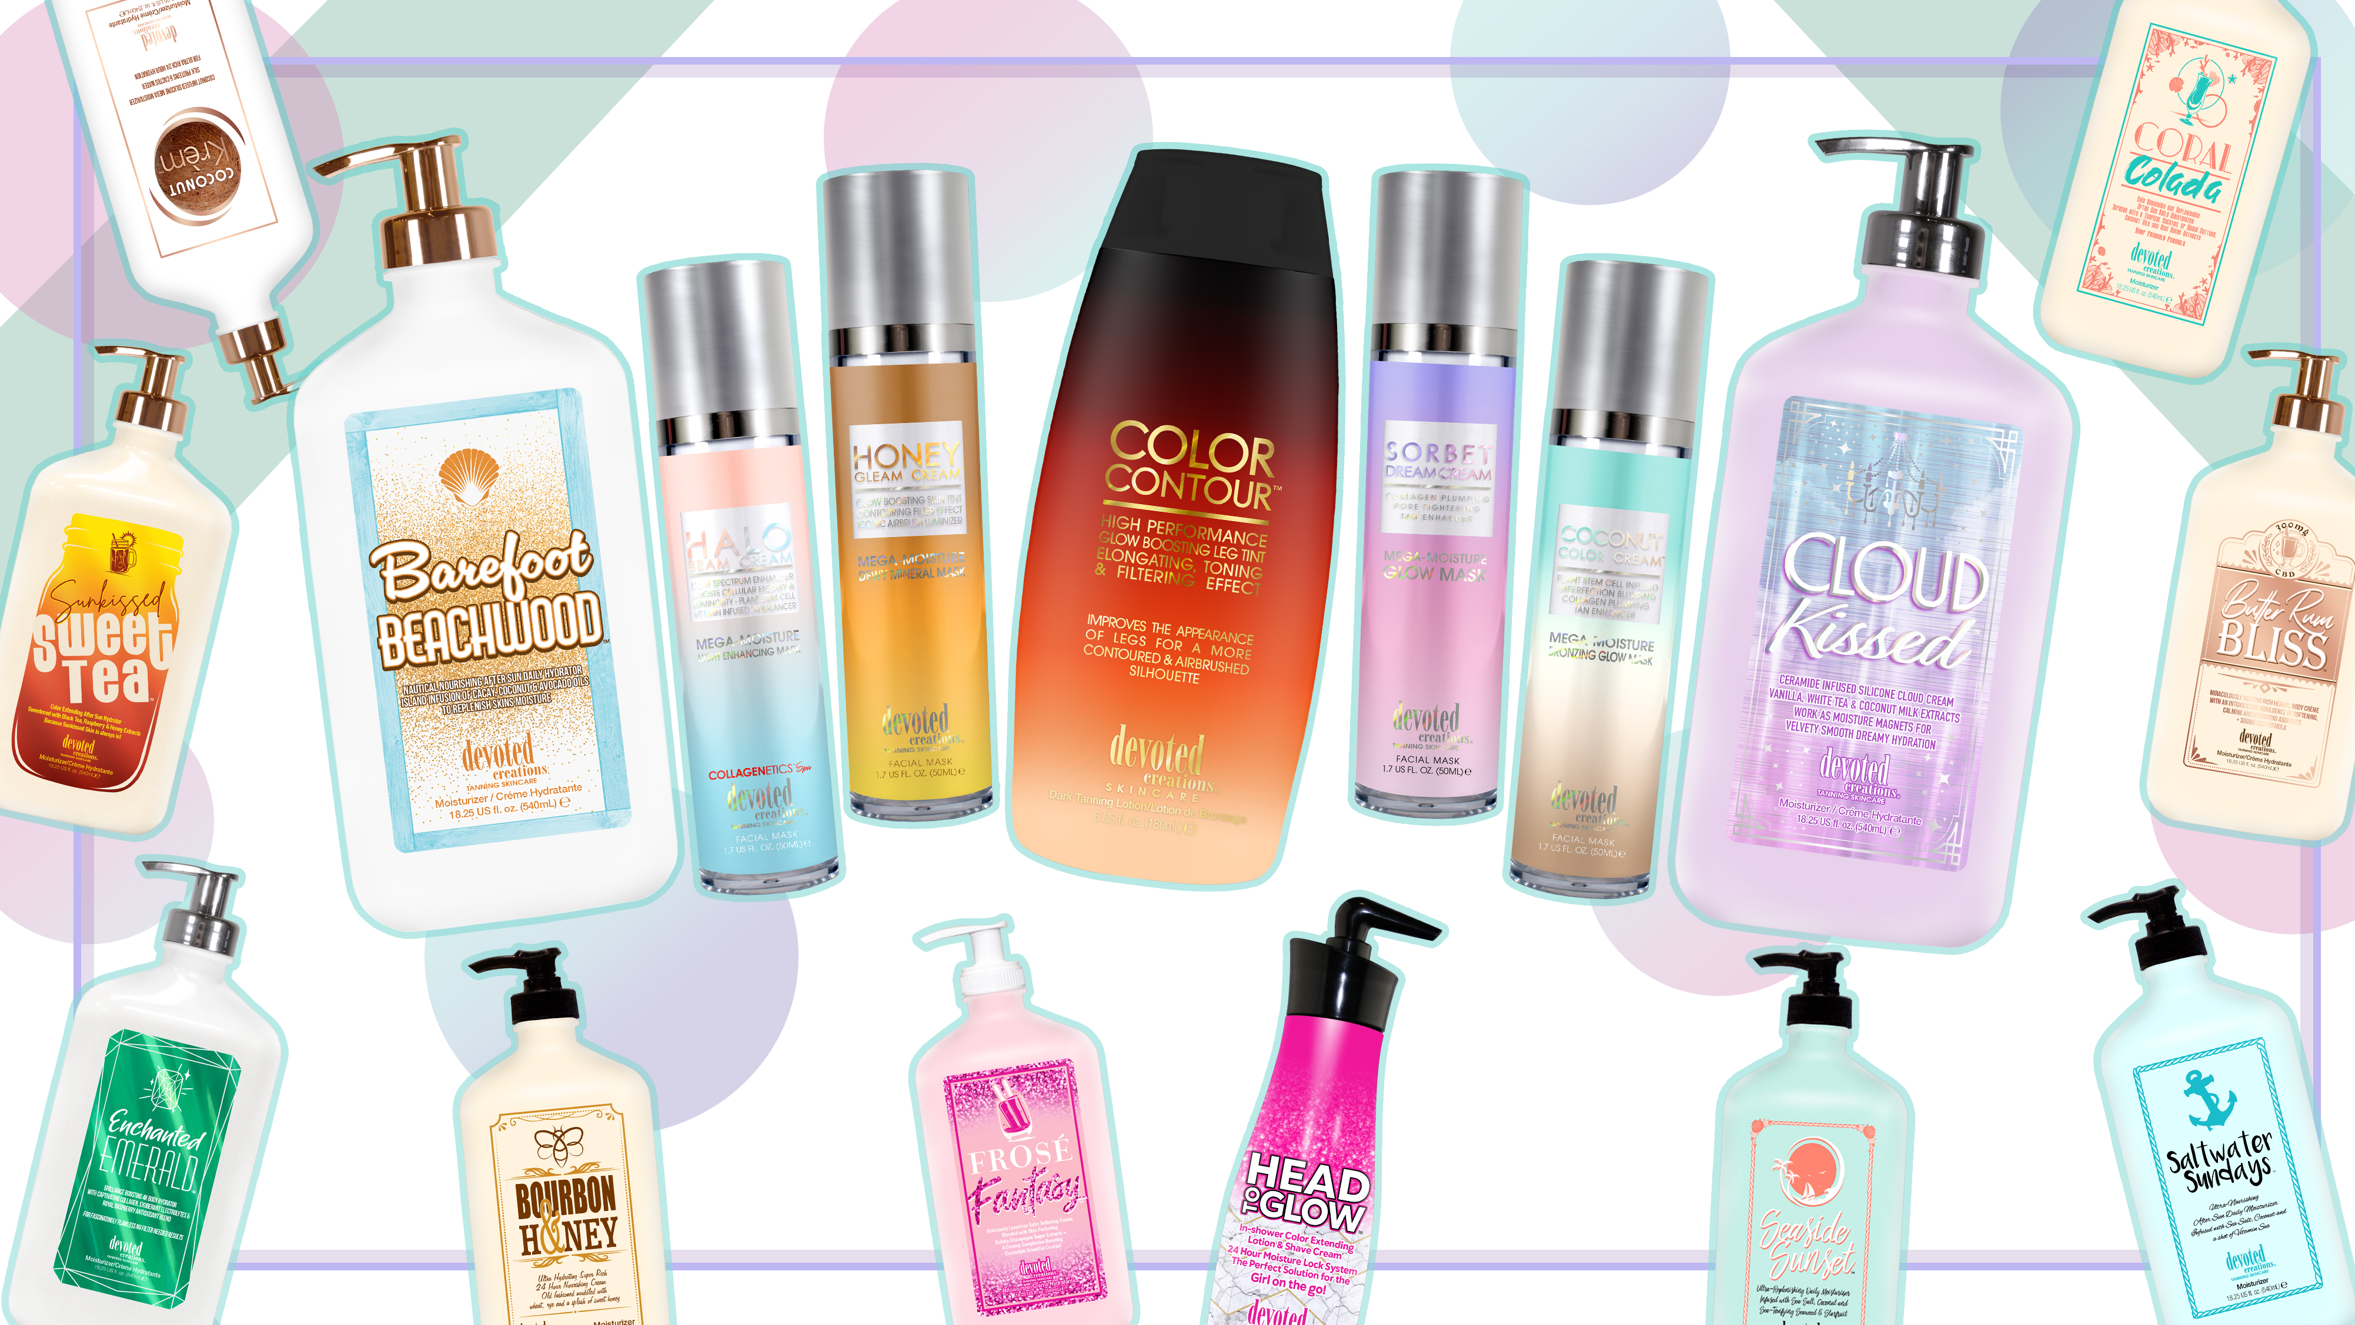

Slide 6
Why Face & Body Care?
We sell face & body care products to enhance and add value to the customer’s overall experience
These are all products that: prolong the customer’s tan, help the customer achieve better results, nourish the customer’s skin, have high end skincare ingridients, have complimenting fragrances to lotions, have complimenting skincare ingridients to lotions
Shampoo & Conditioner analogy!
Skincare Regimen analogy!

Slide 7
Mega Moisture
Mask Collection

Slide 8
Multi Use facial mega moisture mask
Original MMM, the rest stemmed from this
Can be used as a facial accelerator, daily moisturizer, or dewy makeup primer
Vegan Collagen helps with fine lines and wrinkles
Hyaluronic Acid and Plum keep the skin extremely hydrated
Sugarcane Squalene provides hydration, balances excess oil production, soothes, firms and plumps the skin
Blue Hue Color Correcting MM Light Enhancing Mask: formulated to tan, tone, color correct , tighten facial skin while also preparing the skin for absorption of all light hues
Golden C- provides complexion perfecting effects while targeting fine lines and pigmentation
Superox C- protects against environmental damage
Hyalufix- provides deep cellular hydration, helps correct deep facial wrinkles, firm and plump the skin
Mega Moisture
Mask Collection
Airbrush Luminizing Skin Tint and Glow Enhancing MMM
CT Flawless Filter Dupe!!
Porcelain Flower Extract hydrates and nourishes the skin while providing a crystal clear complexion
GlowPlex helps blur imperfections and minimizes appearance of dark spots
Electric Daisy tightens and contours the skin
Honey Extracts tighten pores and helps reduce appearance of skin imperfections
MMM using Sunkissed Facial bronzers
DHA and Natural bronzers are formulated to provide transfer resistant, sunkissed facial results after each use
Added plant based stem cells for increased collagen production to provide a youthful appearance

Slide 9
Why Devoted Creations Bath and Shower Products?
Non Alkaline Paraben and Sulfate Free Sensitive Skin Formulas!!
Unlike most drug store bath and shower products that contain these harsh ingridients that will strip your tan
Bath and shower products formulated specifically with tanners in mind!
We use ingridients focused on extending the life of your tan, keeping skin hydrated, keeping the skin soothed and nourished

Slide 10
Coconut Infused Mega Moisturizing Body Wash
Skin Softening Formula cleanses the skin while deeply hydrating and nourishing
Silk Proteins act as a protective shield of hydration, holding in essential moisture and strengthening the skin’s barrier without clogging pores
Coconut Oil deeply softens and nourishes
Cactus Water is high in antioxidants, vitamins, and electrolytes that keep the skin hydrated
Raspberry and Cactus Water Infused Mega Moisturizing Body Wash
Skin Softening Formula cleanses the skin while deeply hydrating and nourishing
Vegan Collagen helps create a filter like effect that helps smooth fine lines and wrinkles, while binding moisture to the skin
Cactus Water hydrates the skin while providing essential antioxidants, nutrients and vitamins
Royal raspberry extracts are high in vitamin c and can help reduce signs of aging as well as target dark spots and wrinkle formations in the skin
Bath and Shower Products
In Shower Color Extending Moisturizing Shave Cream
Cashmere blend works with the skin’s natural moisture to increase hydration levels, while creating a breathable moisture barrier
Cocoa Butter deeply hydrates the skin
Almond Oil repairs and soothes skin while shaving
Vitamin E keeps the skin smooth, prevents dryness and cracking, and blocks free radicals

Slide 11
Why Devoted Creations Tan Extenders?
Non Alkaline Paraben and Sulfate Free Sensitive Skin Formulas!!
Unlike most drug store bath and shower products that contain these harsh ingridients that will strip your tan
Hydrators formulated specifically with tanners in mind!
We use ingridients focused on extending the life of your tan, keeping skin hydrated, keeping the skin soothed and nourished

Slide 12
Salty Lime Slushie ™
24 Hour After Sun Daily Moisturizer
Many ingredient commonalities with Cactus Cabana and HIM Surf!!
Cactus Water is high in vitamins, nutrients and electrolytes and helps keep the skin moisturized and protected from environmental aggressors
Agave Extracts help tighten sagging skin, soothe inflammation, and hydrate the skin
Mango Butter helps with fine lines and wrinkles while providing a glowing complexion
Sea Salt is a powerful pore tightening agent
Fragrance: Salty Lime Slushie

Slide 13
Barefoot Beachwood™
24 hour Moisturizing Tan Extender
Cacay Oil- Used to help heal and hydrate the skin
Willow Bark Extract- Help calm redness and soothe irritated skin leaving a radiant, clear complexion
Silicone Blend- Visibly reduces the look of pores and imperfections while giving non-greasy hydration
Coffeeberry Extracts- Rich in antioxidants to help ward off free radical damage and combat the signs of aging
Coconut Milk- Deeply softens and nourishes while calming irritation
Cucumber Extract- Natural soothing agent that helps reduce puffiness and irritation
Avocado Extract- Help strengthen the skin’s natural moisture barrier
Fragrance: Barefoot Beachwood

Slide 14
Cloud Kissed™
Ceramide Infused Silicone Cloud Cream
Ceramide Complex – Essential fatty acids that help to moisturize and strengthen the skin’s natural barrier
Silicone Blend - Visibly reduce the look of pores and imperfections while offering non greasy hydration
Vanilla Extracts – Rich in antioxidants to help ward off free radical damage while also helping to combat the signs of aging
White Tea Extracts – Anti-inflammatory that works as a natural antioxidant to help improve the appearance of hyperpigmentation
Coconut Milk – Deeply softens and nourishes while calming irritation on even the most sensitive skin
Marshmallow Extracts – Works to counteract redness and inflammation in the skin while also helping to retain moisture
Vitamin C - Helps to slow the signs of aging while also working to improve the appearance of dark spots and skin imperfections
Fragrance: Cloud Kissed

Slide 15
Coconut Krèm™
1. Coconut Infused Silicone Mega Moisturizer
2. Silicone Blend – Visibly reduce the look of pores and imperfections while offering non-greasy hydration
3. Silk Proteins – Acts as a protective shield of hydration, holding in essential moisture and strengthening the skin’s barrier function without weighing it down or clogging pores
4. Coconut Oil – Deeply softens and nourishes, continual use can improve skin’s texture, has soothing and calming properties that can calm any temporary redness in the skin
5. Matrixyl Synthe 6™ – Targets and fills in fine lines and wrinkle, restores moisture in the skin and minimizes discolorations
6. Cactus Water – High in antioxidants, vitamins and electrolytes to keep skin hydrated, prevents moisture loss, and has antibacterial and calming properties to protect the skin from sun damage, aging and collagen loss
7. Fragrance: Coconut Krem

Slide 16
Enchanted Emerald™
Brilliance boosting 4K Body Hydrator
Revolutionary 4K Blend - allows for deeper hydration, deeper penetration of skincare ingridients, and longer lasting tanning results while blurring imperfections
Vegan Collagen - helps with fine lines and wrinkles, while binding moisture to the skin
Cactus Water - provides extreme hydration
Prestigious Probiotics - help restore and renew the skins moisture balance and barrier
Cocoa and She Butters - provide deep, long lasting hydration
Fragrance: Enchanted Emerald

Slide 17
Sunkissed Sweet Tea™
Color Extending and Color Building Moisturizer specifically designed to gradually add a hint of color and even out and enhance your skin’s natural complexion.
Golden Glow Bronzers – Low levels of DHA to prolong the life of your tan
Raspberry & Black Tea Extracts – Loaded with Vitamin C, antioxidants and skin clearing properties to help reduce the signs of aging
Mint Extract & White Birch – Helps to soothe and calm irritated and sensitive skin, especially after sun exposure
Lemon Extracts – Help promote collagen production for a more youthful appearance
Honey Extracts – Provides radiance boosting properties for a more even and hydrated complexion
Color Fade Protection – Protects the color and luster of tanning results
Lightweight Formula – Perfect as an all year daily moisturizer after showering, sun exposure or anytime your skin needs extra hydration
Fragrance: Sunkissed Sweet Tea

Slide 18
Glocation™
Low DHA moisturizer
Cocoa and Shea Butter- Nourish and hydrate the skin while protecting the skin from environmental stressors
Nicomenthyl™ and Solarepare MB™- Help to nourish, repair and prolong your color by aiding in the healing process of the skin
Pore Refining Blend- Combats oily skin while minimizing the appearance of enlarged pores for a smoother appearance
Maracuja Oil- Rich in essential nutrients and antioxidants~ helps keep your tan even and glowing
Fragrance: Coconut Sands

Slide 19
Face and Body Care Bundles/Pairs
Bundles based on ingridients
Bundles based on fragrance
Bundles based on aesthetic

Slide 20
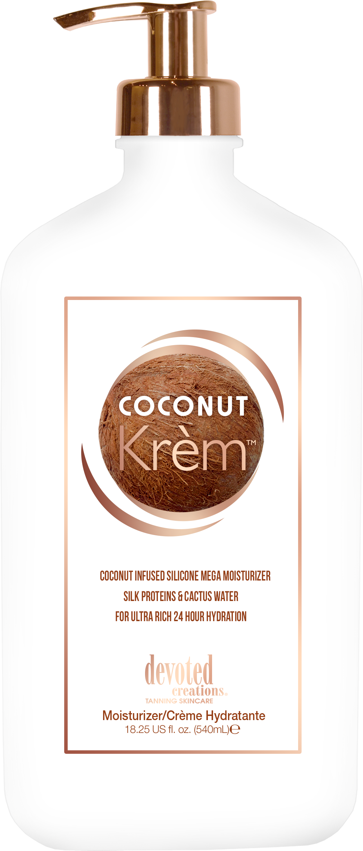
Face and Body Care Bundles/Pairs
Bundle based on fragrance, ingridients and aesthetic

Slide 21
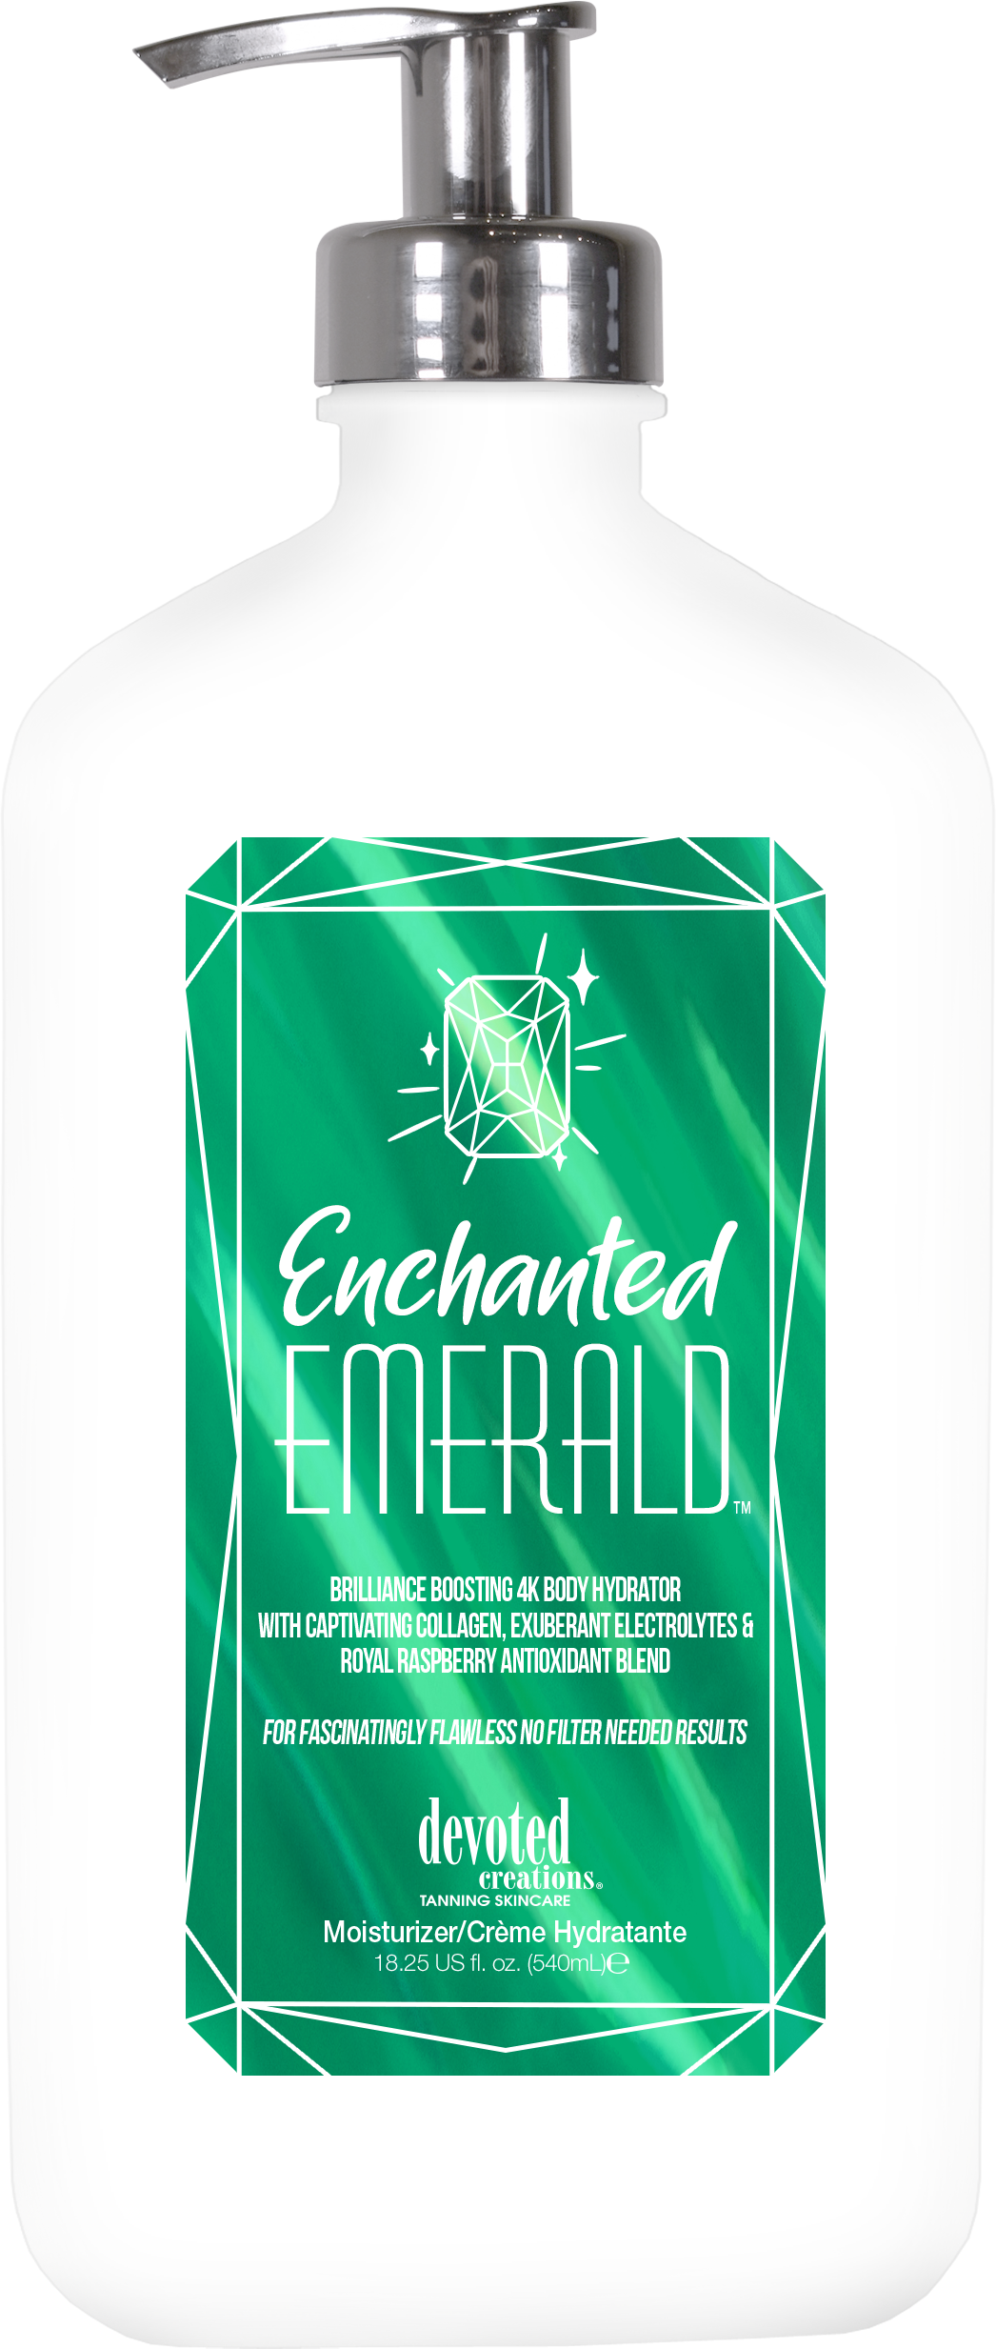
Face and Body Care Bundles/Pairs
Bundle based on fragrance, ingridients and aesthetic

Slide 22
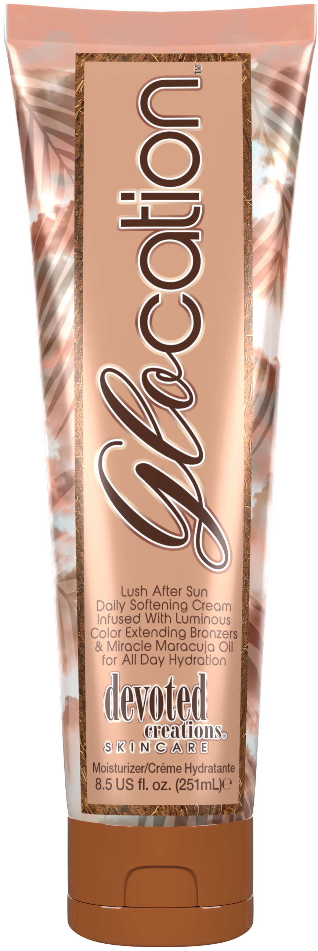
Face and Body Care Bundles/Pairs
Bundle based on fragrance, ingridients and aesthetic

Slide 23
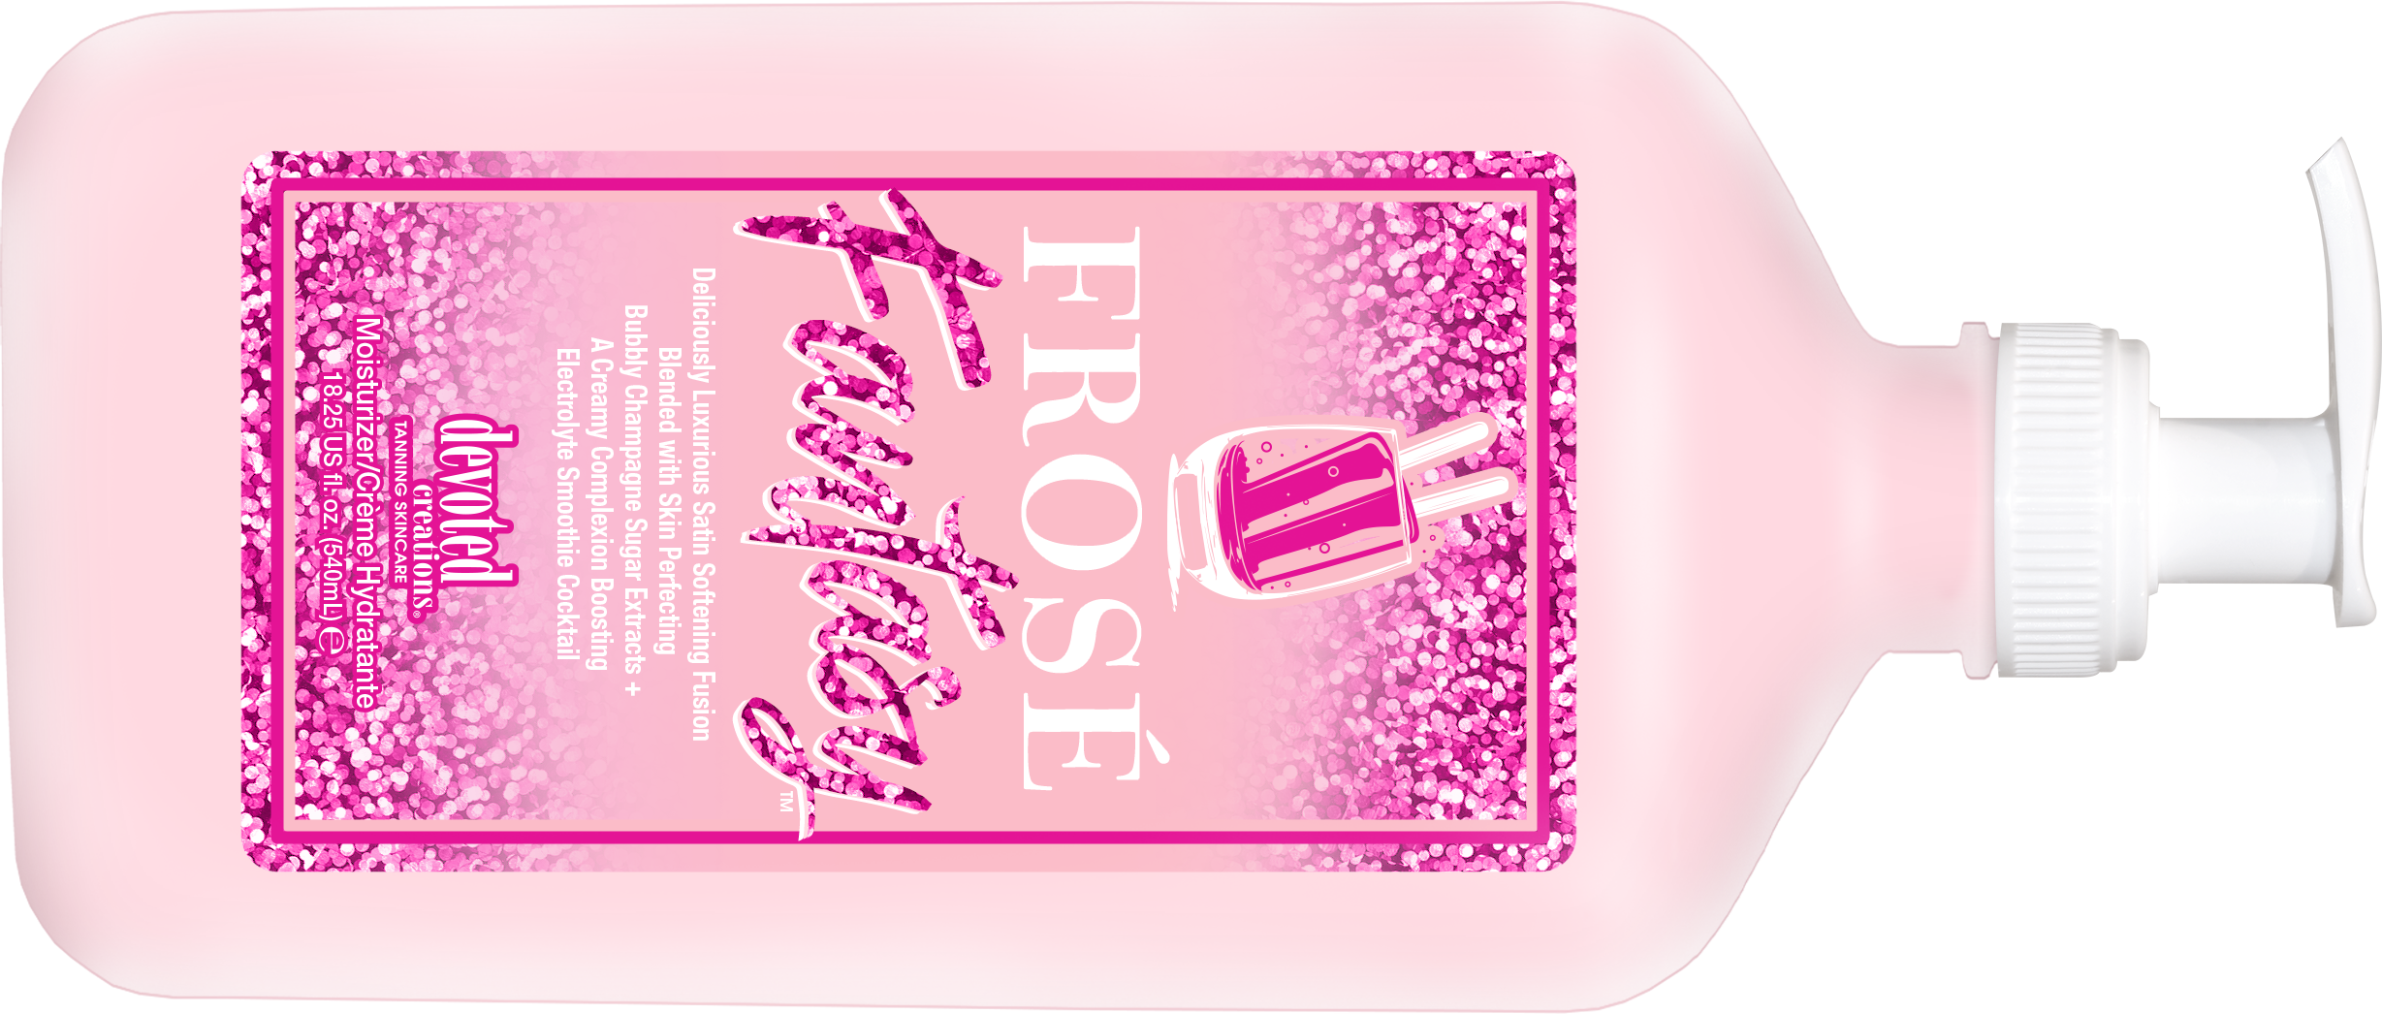
Face and Body Care Bundles/Pairs
Bundle based on aesthetic and ingridients

Slide 24
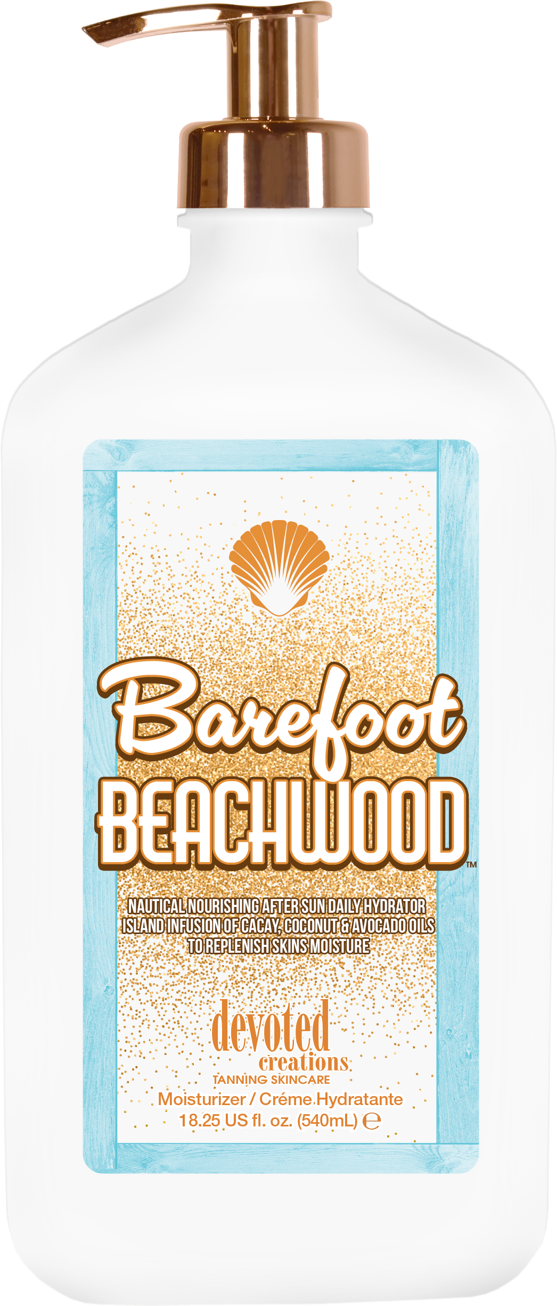
Face and Body Care Bundles/Pairs
Bundle based on aesthetic

Slide 25
Gracie French
International Sales Trainer
gracie@devotedcreations.com

