Slide 1
Your Guide to the Basics

Slide 2
Agenda
Tanning Basics – How the Skin Tans
DC Lotion Basics – The Why
Aftercare

Slide 3
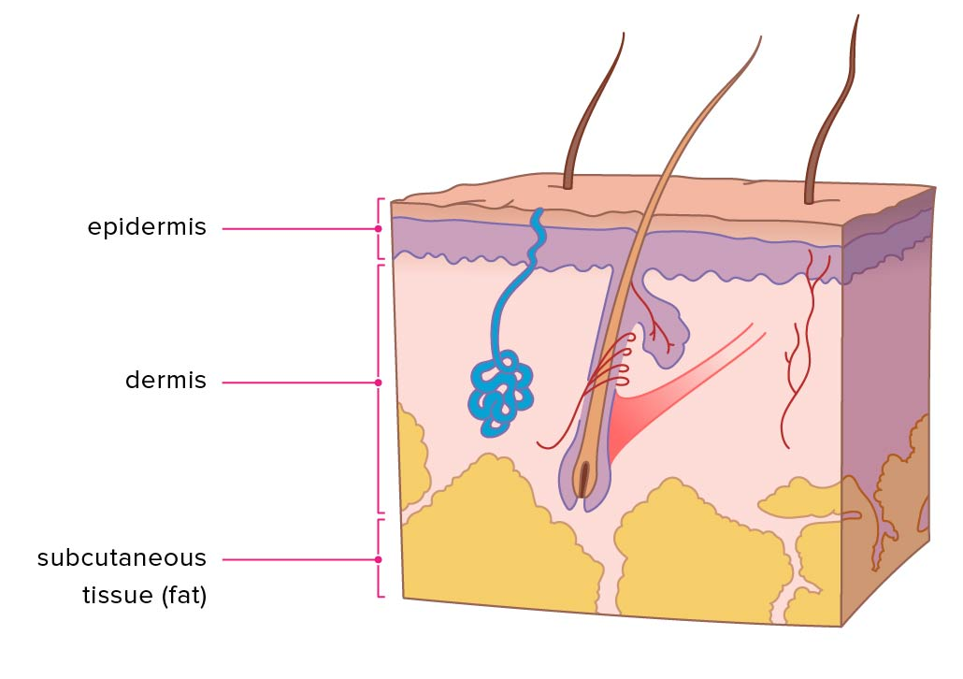
The Tanning Process
Tanning takes place in the skins most outer layer, called the epidermis
UVB light triggers melanin production by stimulating melanocytes
5% of cells are melanocytes - melanocytes produce melanin
Everyone has about 5 million melanocytes in their body
UVA light oxidizes melanin
Think of an apple

Slide 4
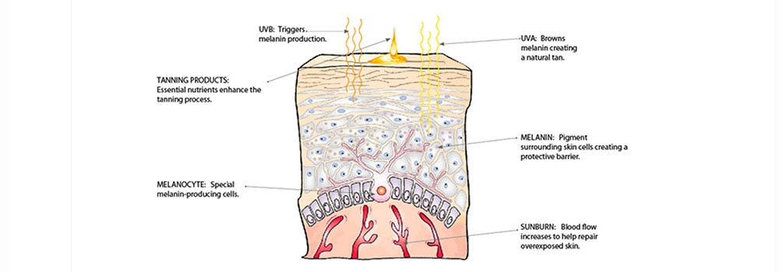
The Tanning Process
Amount of melanin in the skin comes from heredity and genes.
In order to avoid overexposure, acquire a tan gradually, it is better to play it safe with time than take the word of clients.
First time tanners should NEVER go into a bed for the full time on their first visit to the salon.
Sunburns occur when too much UV light is exposed to the skin and disrupts the blood vessels on the surface of the skin, and they work to repair the damaged skin.

Slide 5
How does your tan fade?
Your skin is constantly reproducing new cells.
As new cells get created, they push the old cells out and get shed off.
Skin’s natural exfoliation rate is anywhere from 28-35 days (4-5 weeks).
This varies per person
On average, this process of sloughing and renewal takes 5-6 weeks.
The new cells that are being created inside your body do not contain any oxidation, so the tanning process begins all over.

Slide 6
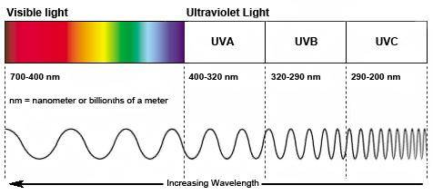
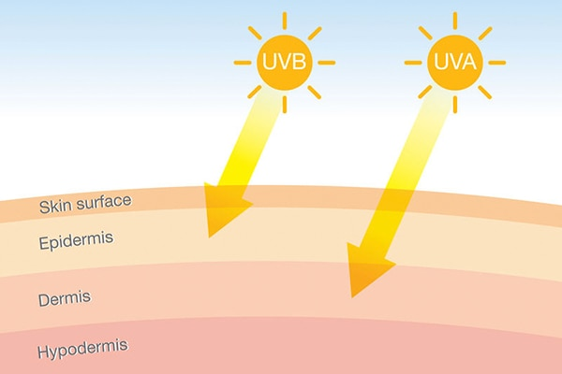
Understanding Light
UVA & UVB light can both be produced by the sun and indoor tanning units.
Indoor tanning units are known to be controlled units because they are built and formulated to tan you with minimized risk of burning.
Burning is not impossible with indoor tanning units**
When exposed to the sun outdoors, you get the entire spectrum of the sun all at once so there is no control over your exposure to UV light.

Slide 7
Benefits of UV exposure on the body
UV light helps with those with skin conditions such as psoriasis and eczema. The costs are a lot less than being performed at their doctor's office.
Exposure to sunlight is thought to increase the brain’s release of a hormone called serotonin. This is associated with boosting mood and helping you feel calm and focused.
A study found that UV exposure clients felt significantly more balanced, less nervous, more strengthened, and more satisfied with their appearance after sunbed use.

Slide 9
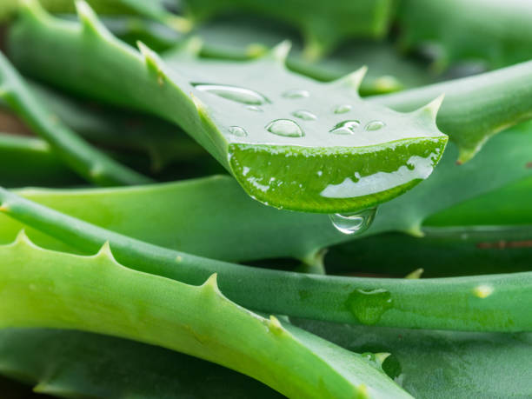
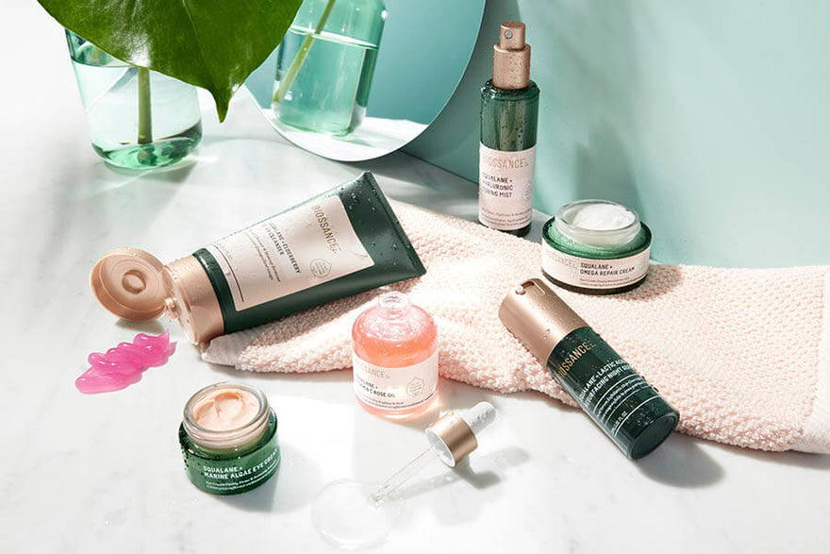
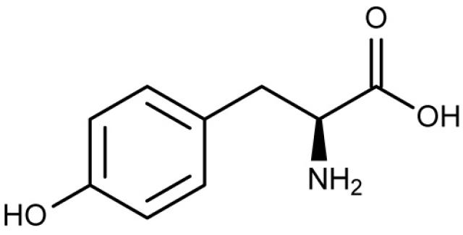
Every Tanner Needs Lotion
Hydration
Tyrosine
Skin health

Slide 10
Hydration
Keeping your skin hydrated is the #1 way to keeping a longer lasting tan
Aloe Vera is the #1 ingredient DC uses in all products
Lotion gives the skin a hydrating barrier to maintain moisture in the skin while absorbing more UV light into the skin for a deeper tan
Protects the natural skin cell life cycle from prematurely being exfoliated off

Slide 11
Tyrosine
An amino acid that reacts on the skin with UV by stimulating melanin production for a faster tan
Every DC tanning lotion contains this ingredient, which means each product will help to accelerate the process of becoming tan
Tanners can achieve 50-60% more color each session by using a tanning lotion that contains Tyrosine

Slide 12
Skin Health
DC uses popular skincare ingredients that most consumers know of, have heard of or use themselves
Aging doesn’t happen in one area, we have skin everywhere which means we age everywhere.
Need to take care of all of our skin, not just a small section
Skincare ingredients are found in every product DC makes

Slide 13
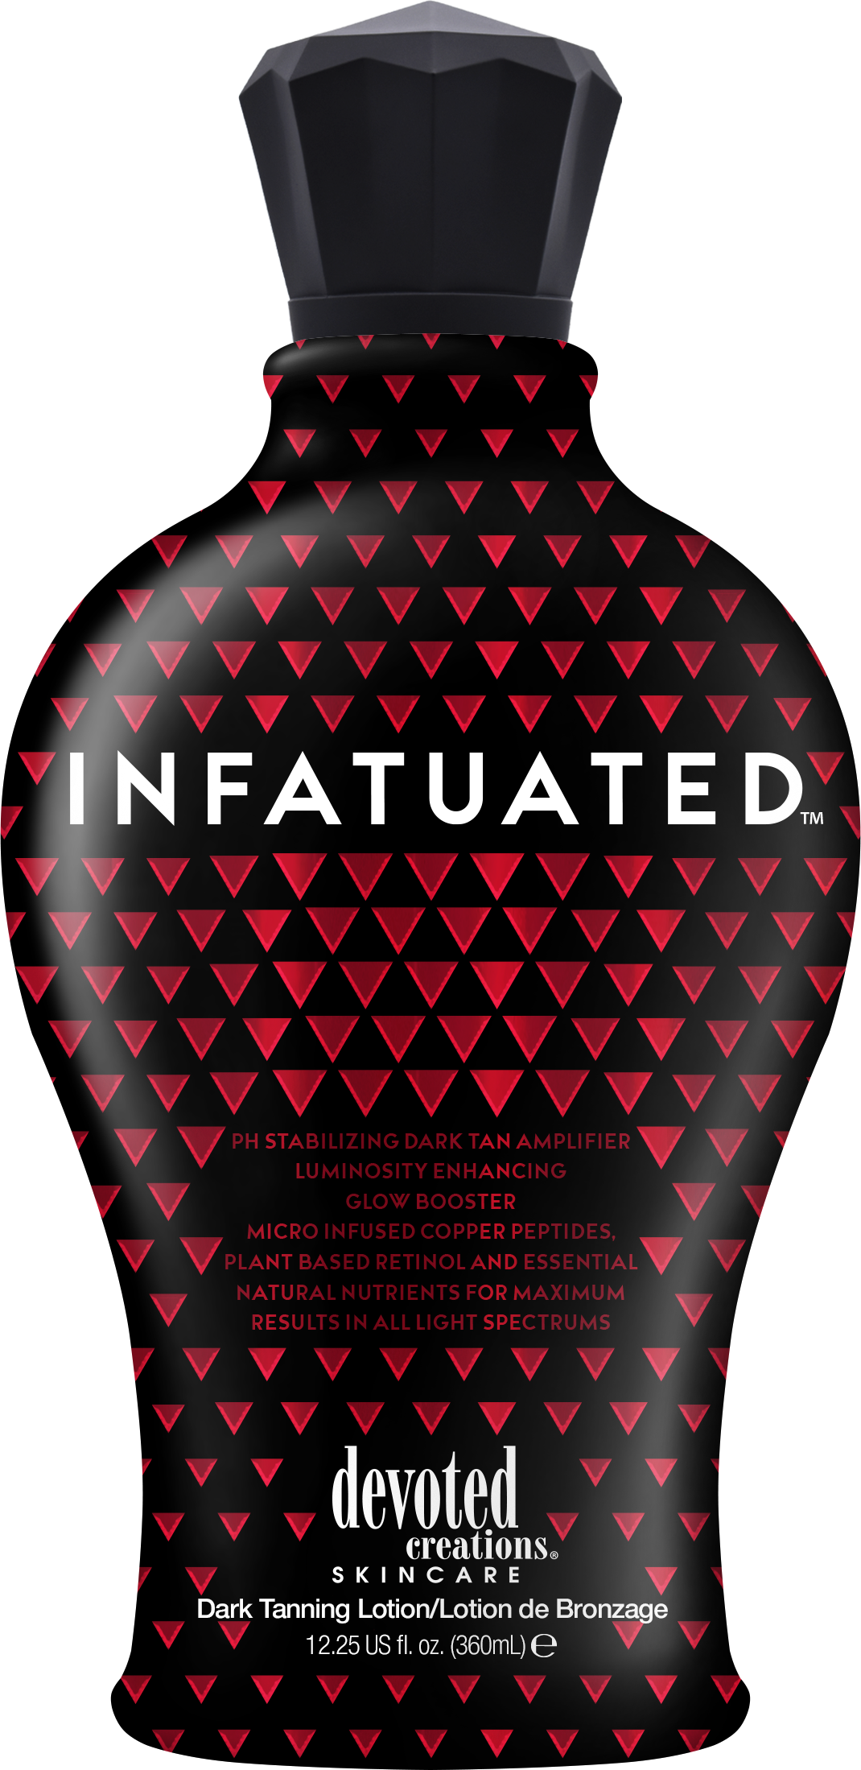
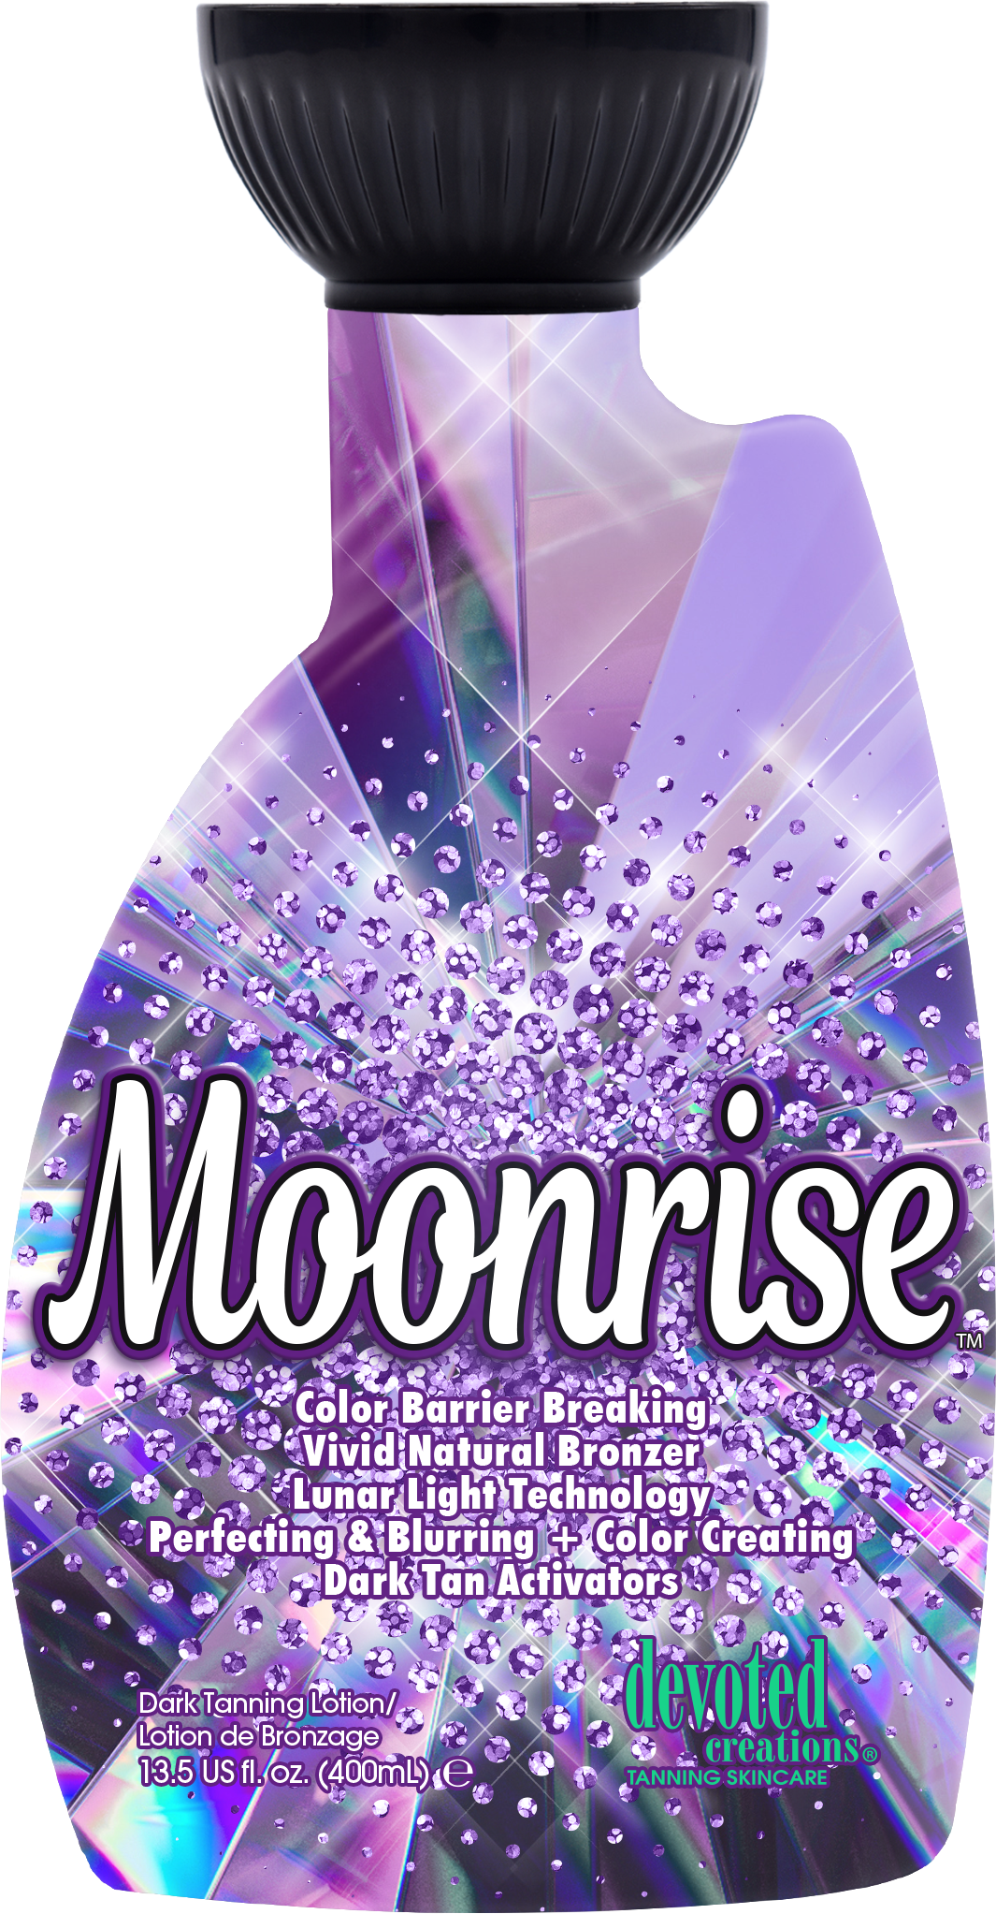
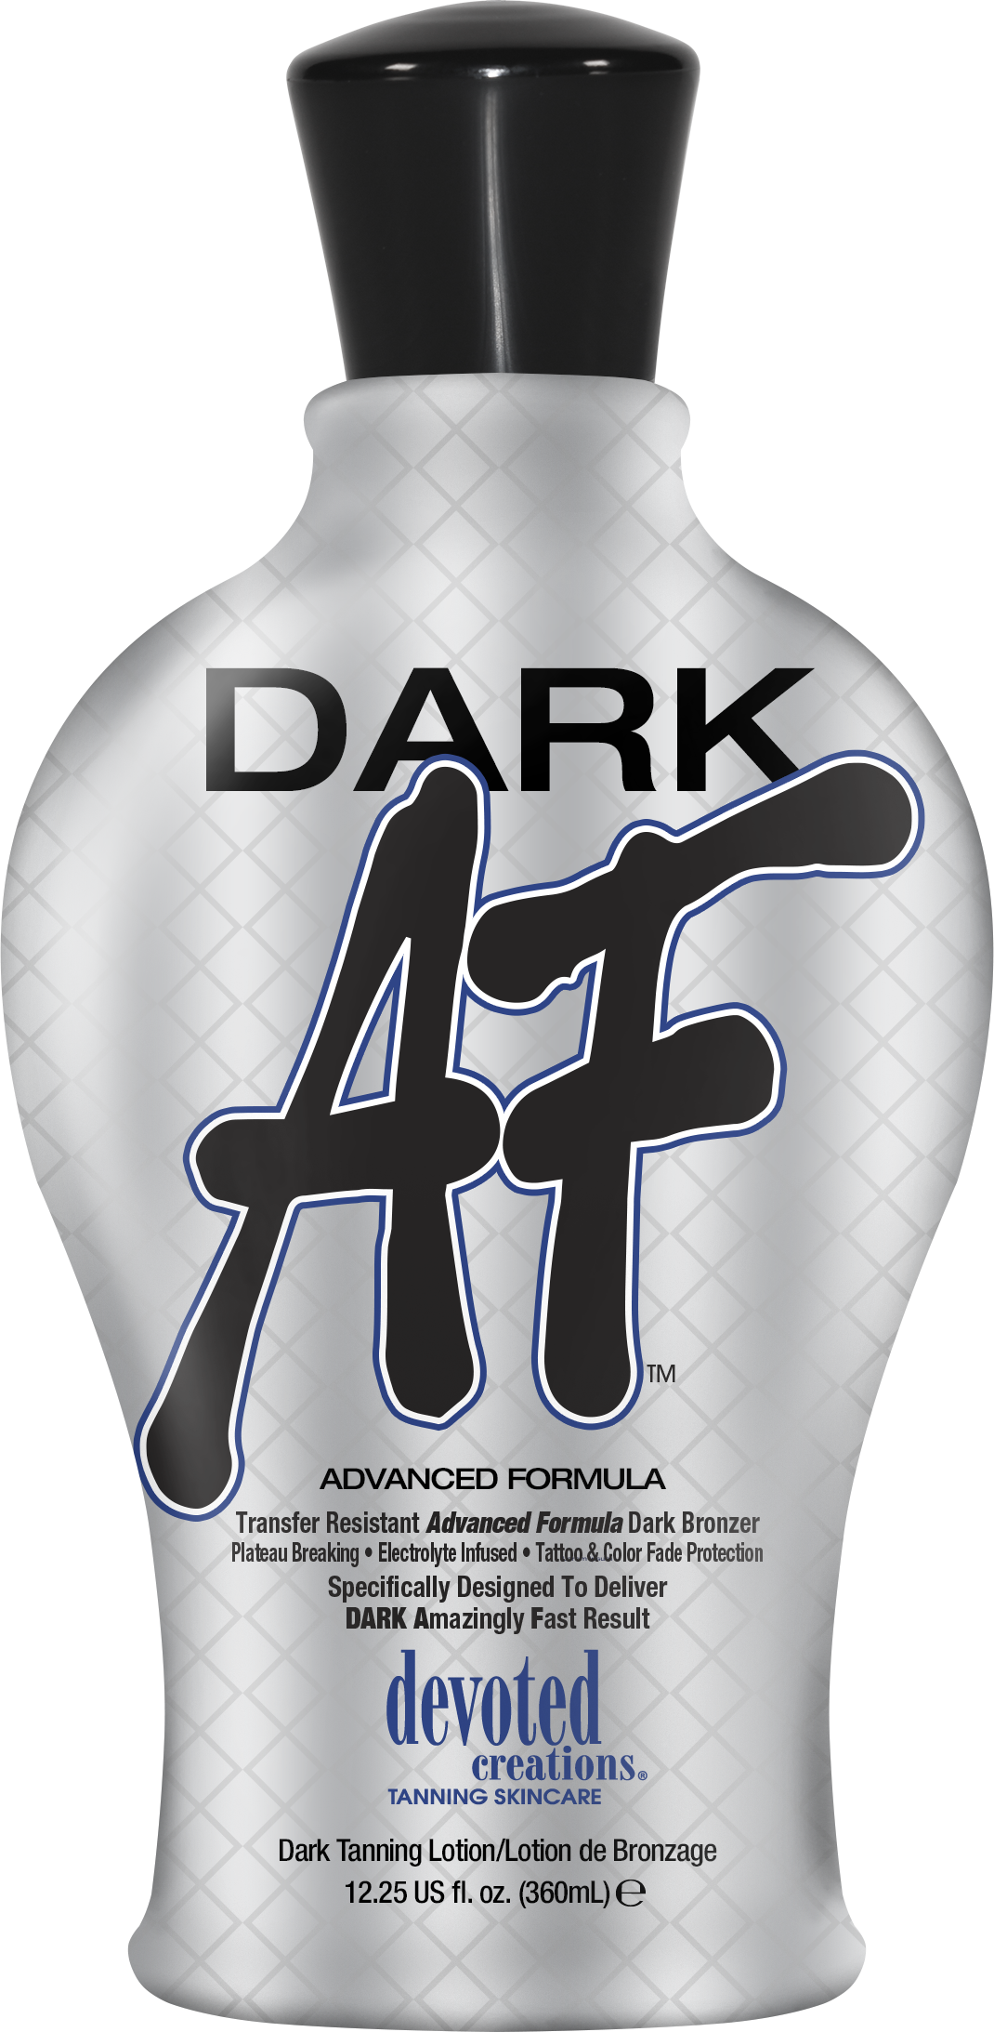
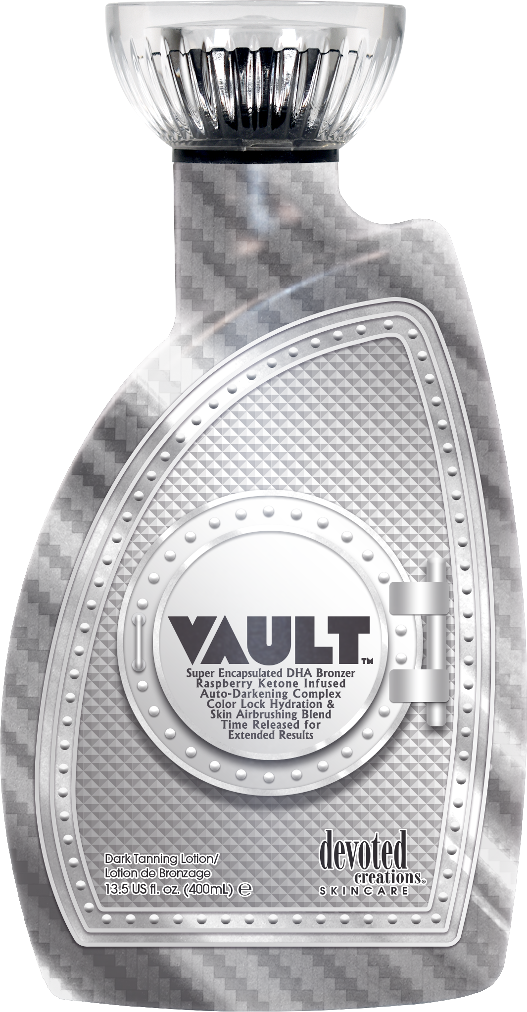
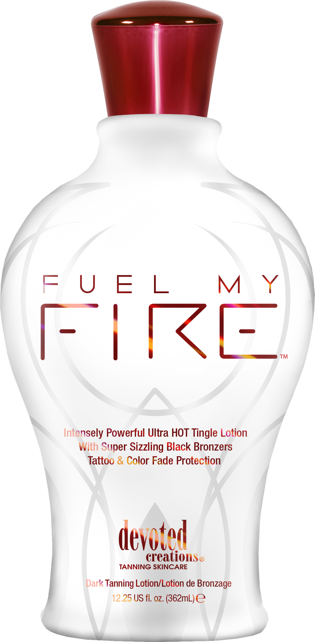
Types of Lotion
Accelerators
Bronzers
Tingles

Slide 14
What is Aftercare?
Aftercare is taking care of your skin after your tanning session
Maintenance of your tan
The next step after your session
Products that don’t have to be used just for tanning, can be used daily to achieve and maintain your best color
Adds hydrating and quality ingredients onto all parts of your skin regularly
Not just an average product that can be bought at a drugstore

Slide 15
Why is this important for our clients?
Saves our clients time and money
A quick fading tan = more frequent visits to the salon
Skincare ingredients in all types of products
Ingredients clients may be using daily already
The perfect regimen for flawlessly tanned & hydrated skin
Aftercare products are made by tanners for tanners
So we know exactly what is needed to maintain our skin’s tan

Slide 16
Review
UVB is for building
UVA is for bronzing
Dry skin and tanning brings no benefit
The business understanding
Why do you have lotion on your shelves?
What is its’ purpose to a tanning client?

Slide 17
Megan Edwards | Key Accounts Manager
megan@devotedcreations.com

