Slide 1
Product Spotlight: Vault

Slide 2
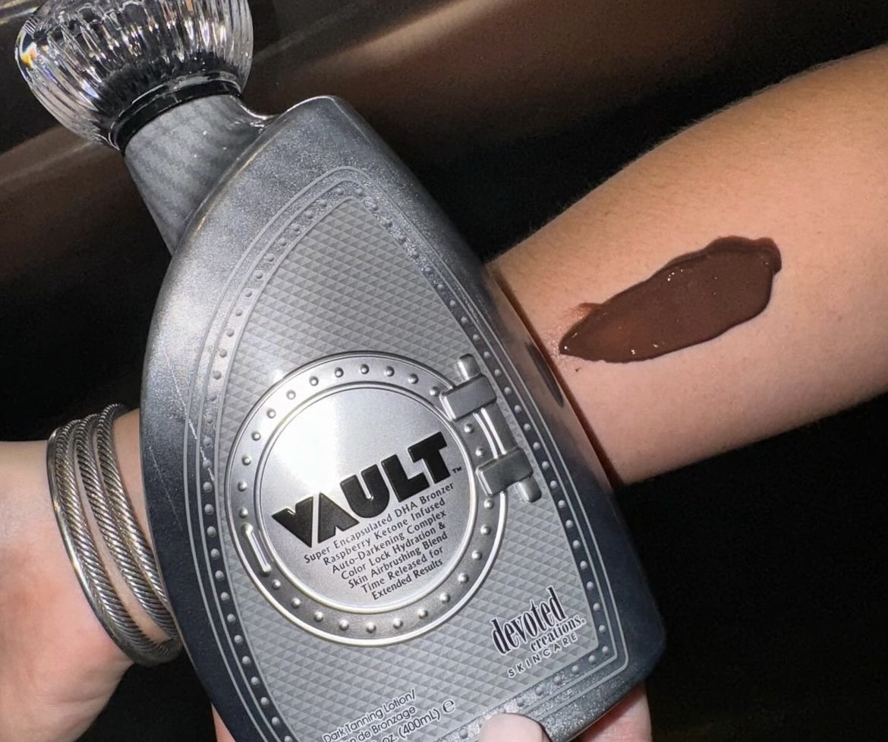
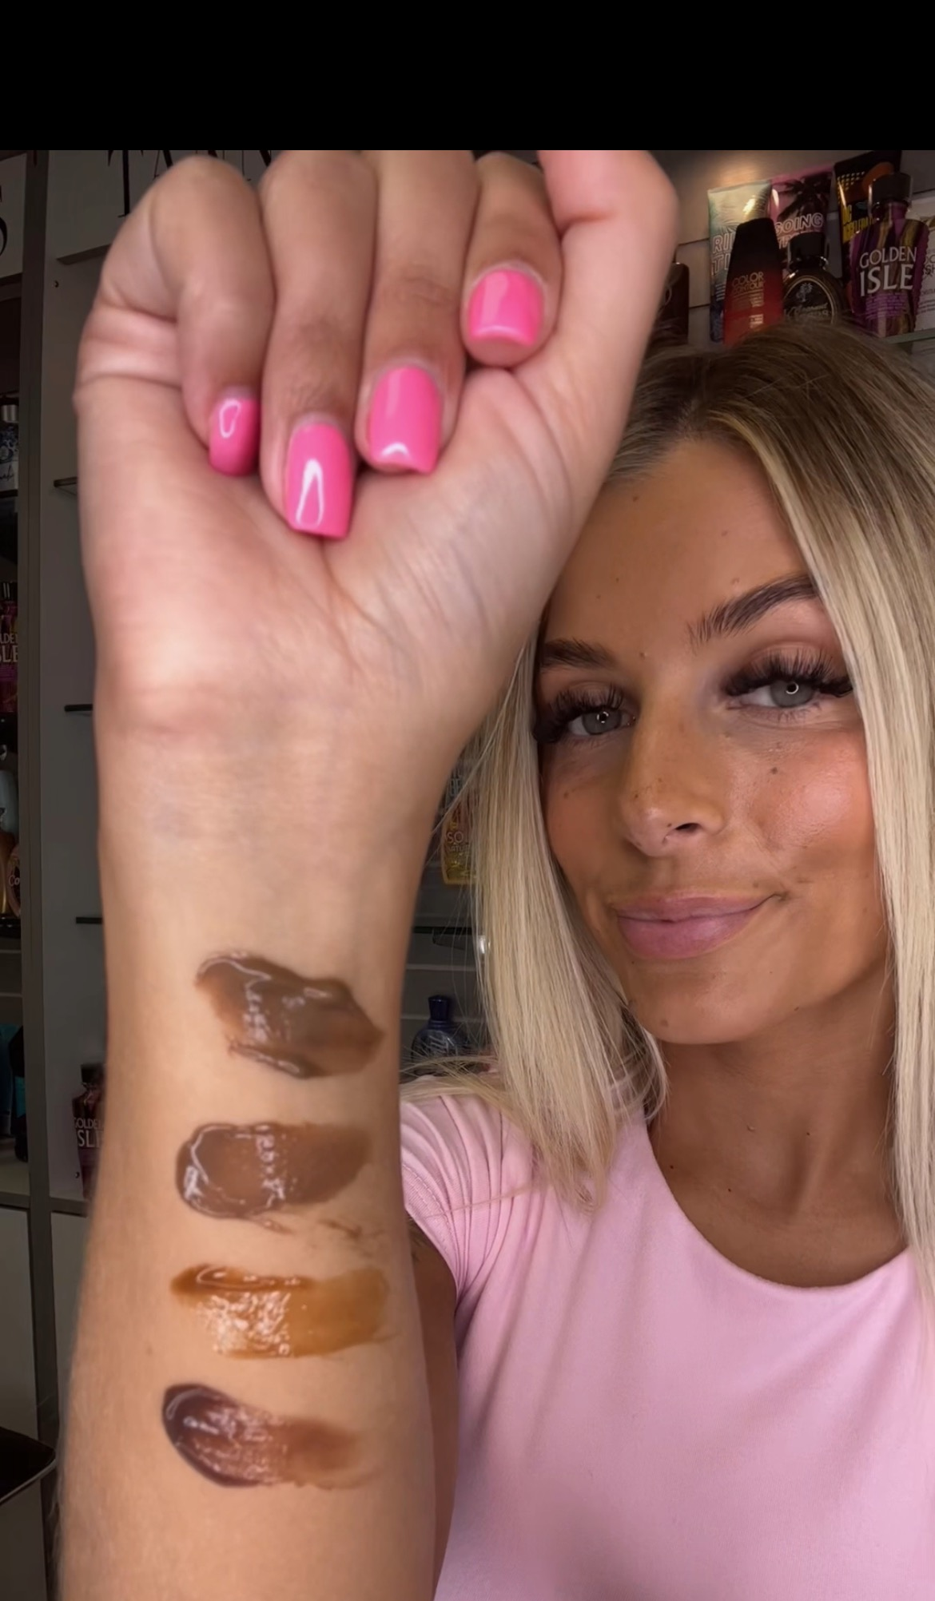

Slide 3
Quick Facts
Darkest bronzer DC makes
Big trend of color – needing more and needing darker
Color Rush Collection
Focused completely on tanning
Unlocking your DARKEST color possible
Ingredients are focused on skincare, but also on getting you dark & staying dark
Highest amounts of cosmetic color, natural bronzing agents & DHA
Cellulite fighting blend
FreshTek
Tattoo & color fade protecting
Color-correcting technology
Anti-orange & anti-reddening
Chromatic Cream fragrance
BBW Iced Vanilla Woods
Vanilla, Lavender, Woodsy, Smoky
Gluten, paraben, soy, sulfate free
Vegan formula

Slide 5
Vault™
Bottle: $163.00
Packet: $17.50
Super encapsulated triple black DHA bronzer with auto darkening complex
Cellulite fighting & slimming technology - Forslean™ & Flavoslim™
Break down fat deposits and counteract signs of cellulite by improving the skin’s elasticity
Copper Peptide & Niacinamide anti-aging blend provides a more youthful, smooth & clear complexion
Proven to help fade scars, stretch marks, wrinkles, sagging skin, acne, redness, uneven tone & texture, excess oil production, clogged pores
Texture smoothing Vegan Collagen
Color-correcting blend – anti-orange & anti-reddening
Skin strengthening probiotic enzymes to protect against free radicals

Slide 6
Vault™
Encapsulated DHA – DHA that is time released on the skin
Slower release of DHA which results in longer lasting color
Anywhere from 10-17 days
Less after tan “DHA smell” due to the encapsulation process
Combined with regular DHA for the darkest delayed color possible
Collagen producing Amino Acid Complex – Multiple amino acids that help with skin pH balancing, collagen production, increased skin hydration, anti-aging benefits and the overall health of the skin
Building blocks of peptides and the skin (can form long chains that turn into peptides)
Amino acids help move and transport water throughout the skin to maintain hydration
SymBronze™ Green (blue in color) enhances new melanin stimulation that is 100% naturally derived from microalgae and absorbs quickly into the skin to start working quicker
Naturally derived erythrulose from Raspberry Ketone for natural bronzing effect
A natural DHA substitute in DHA free self tanners
High in Vitamin C, protects from UV induced damage, helps tighten the skin & increase elasticity
Ingredient Locking Technology – Setting spray for your tan

Slide 7
GIVEAWAY TIME!!!
What is the name of our new melanin stimulating ingredient?
What fruit is in the specialty natural bronzing ingredient?
What is the DC fragrance name of Vault?
What is the fragrance copy?
Name an ingredient in the anti-aging blend.

Slide 8
Megan Edwards| International Sales Trainer
megan@devotedcreations.com

