Slide 1
Devoted Creations: Then vs Now

Slide 2
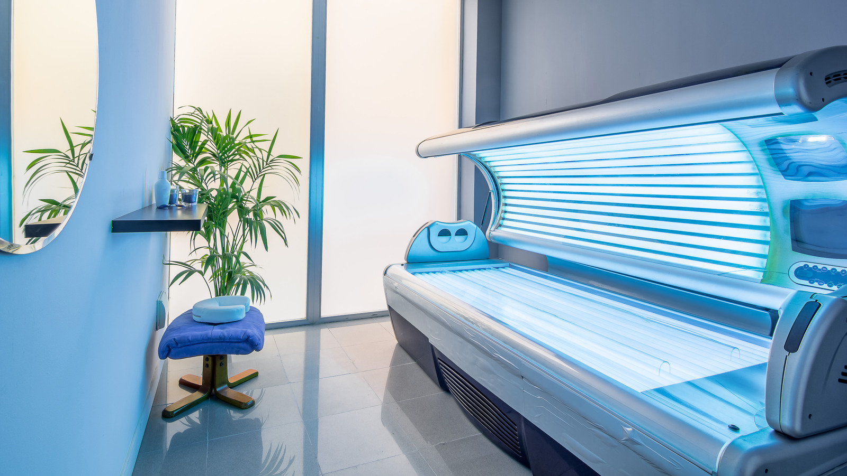
Going Back to 2004 – The Industry
30+ large distribution channels in the US alone
20+ different lotion companies
Everything was separated
30-minute beds all UVB
No spa services, it was strictly all about tanning
Wooden beds

Slide 3
2003: The Idea of Devoted
VP Marketing had an idea to bring together tanning & skincare
Had been working for Kava Kava International for 4 years
We wanted to be different (almost had to be)
All lotions were pretty much the same
Had a mindset of adding a skincare focus to products to be different
One of the only tanning companies at skincare/ingredient shows around the world

Slide 4
The Goal behind Devoted Creations
To be different than what was out there
Incorporated an aloe vera base to formulas for superior and premier moisturization and skin hydration
Create unique formulas using high-end, cosmetic grade skincare ingredients with eye catching bottles shapes and designs
Wanted to bridge the gap between the tanning & beauty industry
As consumers started to take care of their appearance, we began to create 2 in 1 products that help with the appearance on the skincare side WHILE still getting you tan in the process

Slide 5
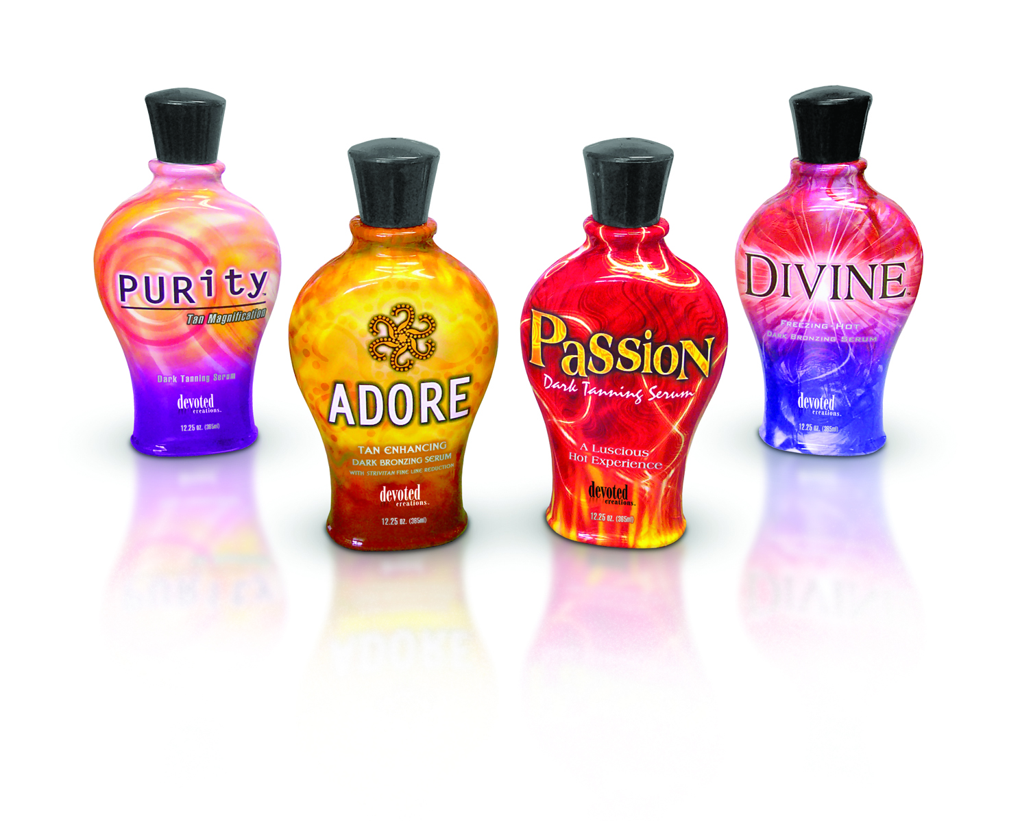
2004: The Debut

Slide 6
DEVOTED CREATIONS
"PURITY"
DARK TANNING LOTION
TAN MAGNIFICATION with FRANKINCENSE & MYRRH
also with SKIN SMOOTHING & FIRMING 'STRIVITAN'
ALOE VERA BASED & with UNIPERTAN V-2002
12.25z BOTTLE
BRAND NEW
Devoted Creations' "PURITY" is a perfect-balance, Skin Smoothing / Firming, & Dark Tanning, Level 1 lotion formula, that is rich in Vitamin E.
"PURITY" is an Aloe based formula that utilizes Unipertan V-2002 along with a wide spectrum of other natural, exotic ingredients, including: Sunflower Oil, Borage Seed Oil, Evening Primrose Oil, Gold of Pleasure Oil, Frankincense, Myrrh Extract, & Silk Extract for a rich, silky, dark tan.
"PURITY" offers a sweet, floral bouquet.

Slide 7
The Growth
Built a large manufacturing facility due to high growth and moved in 2008
With growth and industry changes, as a company we learned how to navigate changing with it
Formulas began becoming more intricate
More research and development
Beauty shows around the world
More than 10 North American distributors had picked up Devoted products
Quickly being sold outside of the US, thus the international growth began

Slide 8
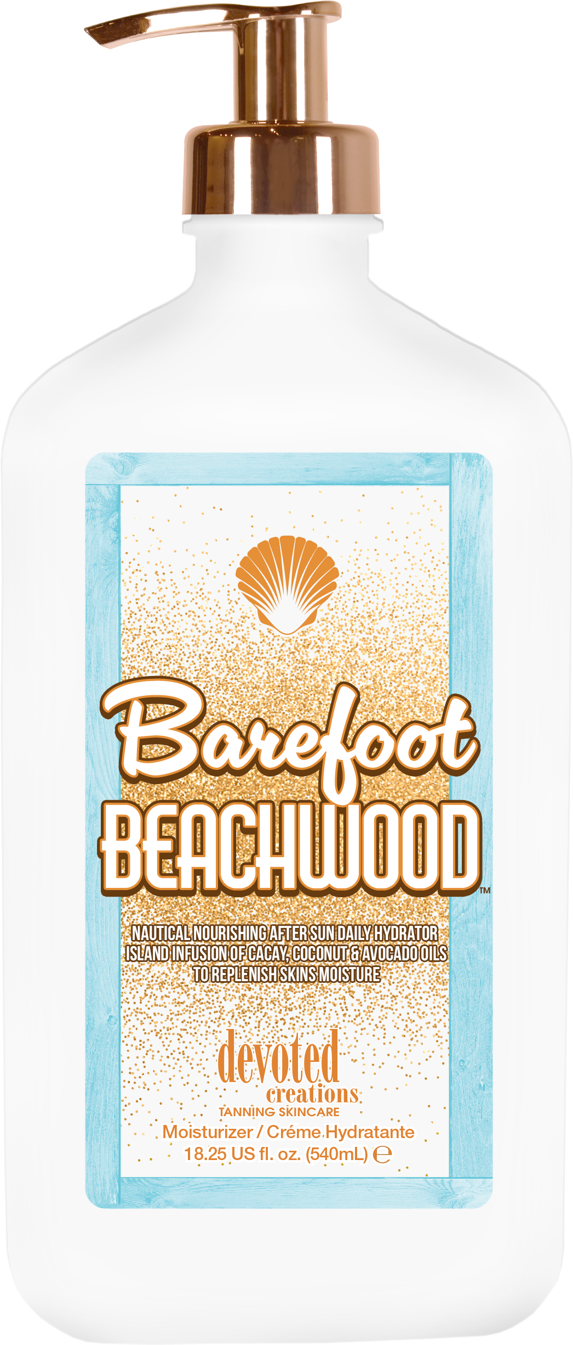
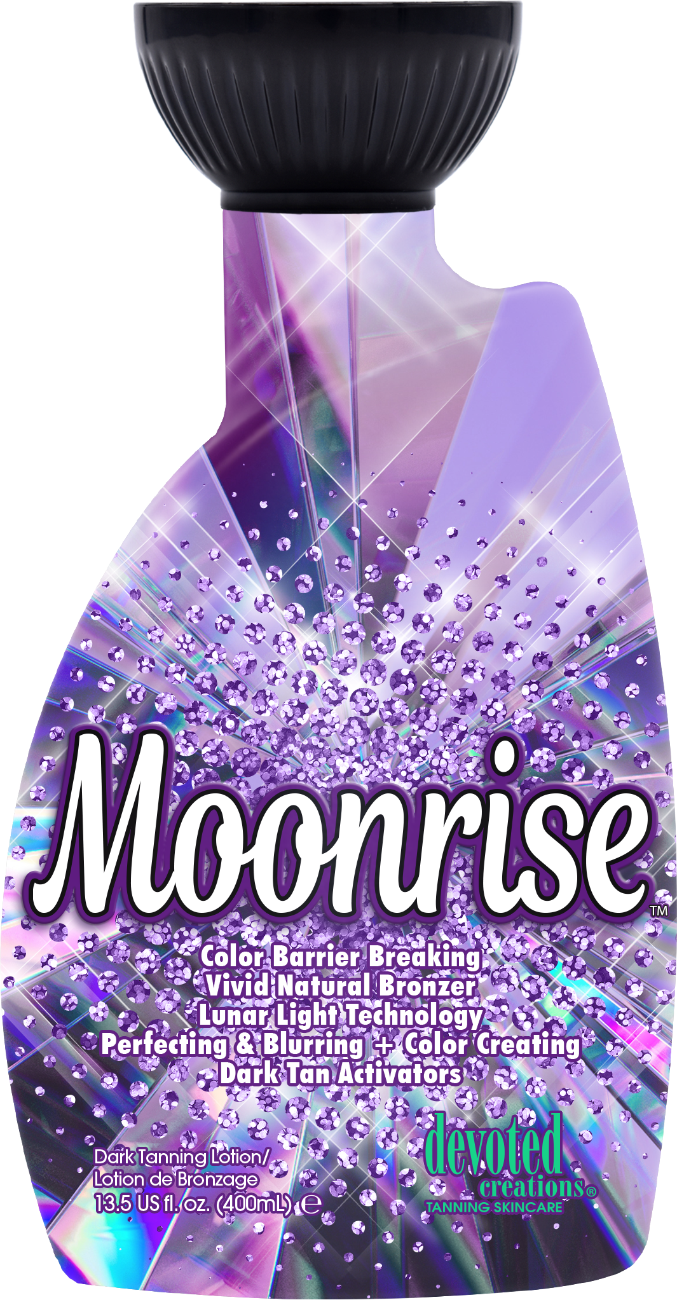
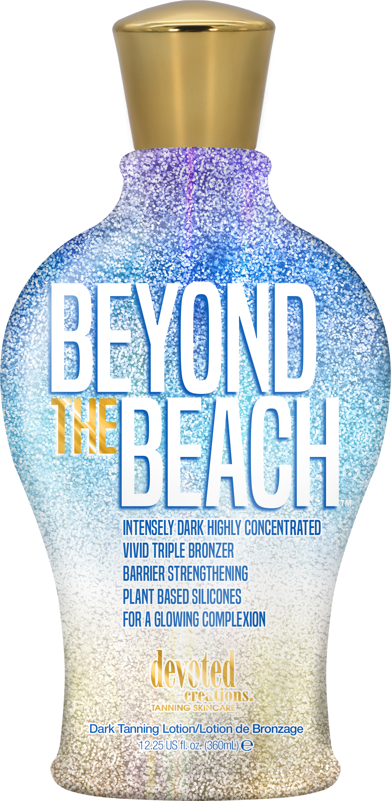
Fun Facts
Color rush began in 2013
Originally called the Beyond line, then went to Innovation line
First red light hybrid collection was Collagenetics
First tingle we created was Trinity
Original formulas based off Strivitan™
Acquired the Ed Hardy Tanning brand in 2009
Soho collection changed bottle shapes
25+ products win IST awards since 2014
40+ officially nominated
Some products have won more than once!

Slide 9
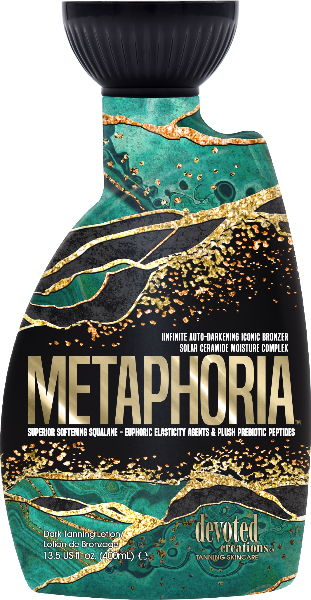
Design Evolution
Now designing with more effects throughout collections
More uses of foil and texture
The feeling of the bottle is where it starts
Different bottle styles and shapes, always looking for something different
Started with tanning lotion, then moisturizers, facial lotions, accessories, etc

Slide 10
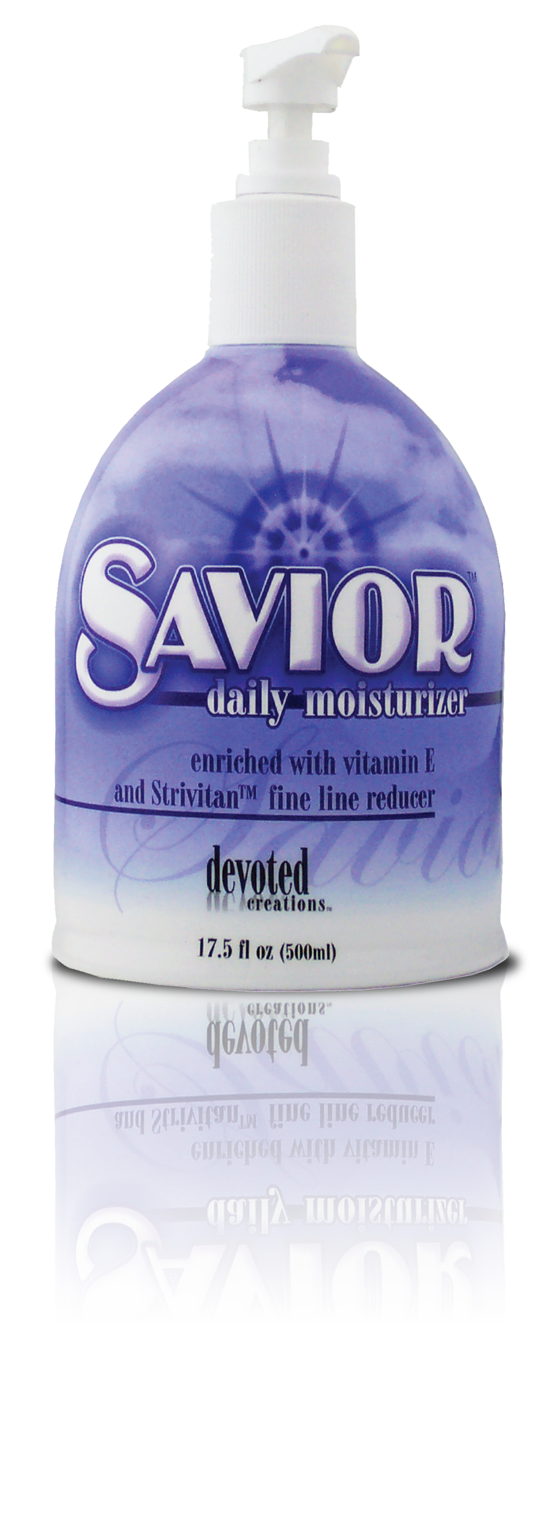
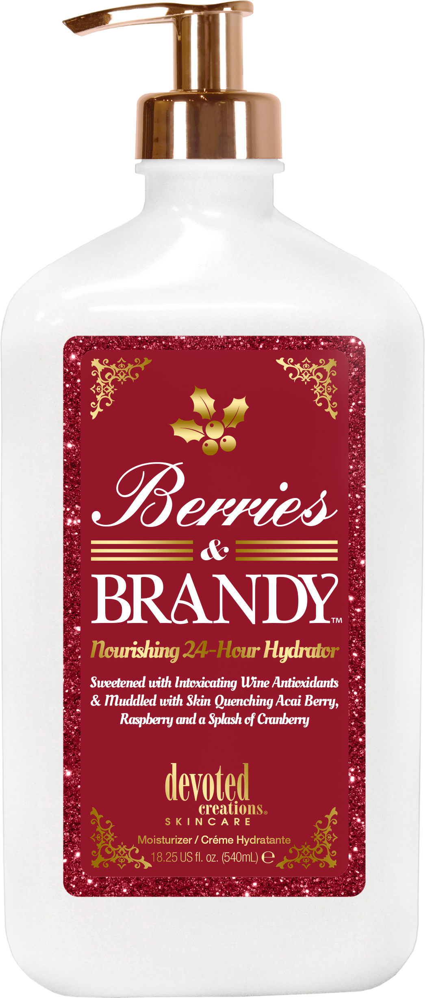
First ever tan extender
Newest tan extender

Slide 11
Throughout the Years
Equipment has evolved which brought the lifestyle of not needing to tan everyday but consumers searching for the long-lasting results in newer beds
Health of skin has become more trending over the last 20 years
Industry moving towards more spa & wellness
Not everyone just wants the darkest lotion
Clients want the best color and the healthiest skin
Led to creation of multi-use products
Better educational materials
Introduction into specialty products

Slide 12
Turning to Chapter 20
Research and development so much more intricate
Rules and regulations worldwide have changed which forces us to take a closer look at product development
Now selling on 6 continents
Skincare technologies have changed and gotten better
Social media and marketing enhancements
Salon education more important than ever

Slide 13
Megan Racine| International Sales Trainer
megan@devotedcreations.com

