Slide 1
Product Spotlight:
Salty Lime Slushie!

Slide 2
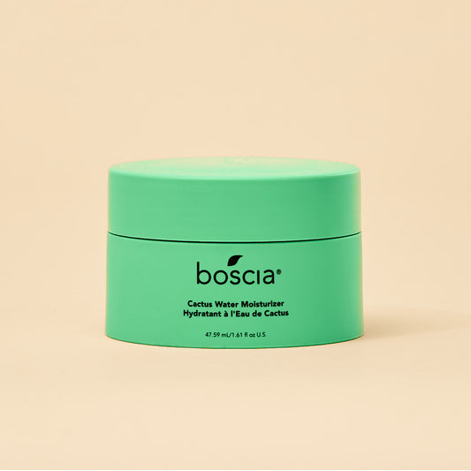
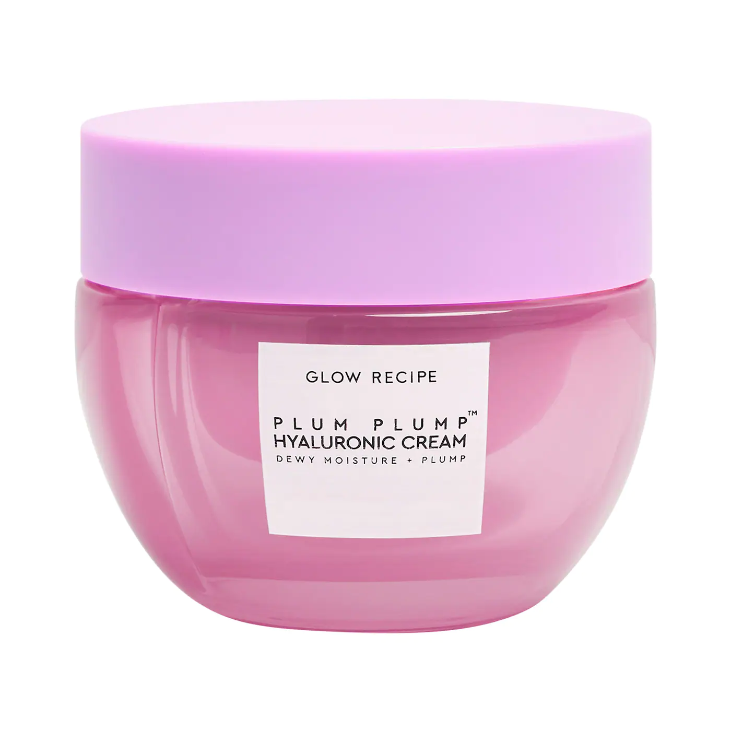
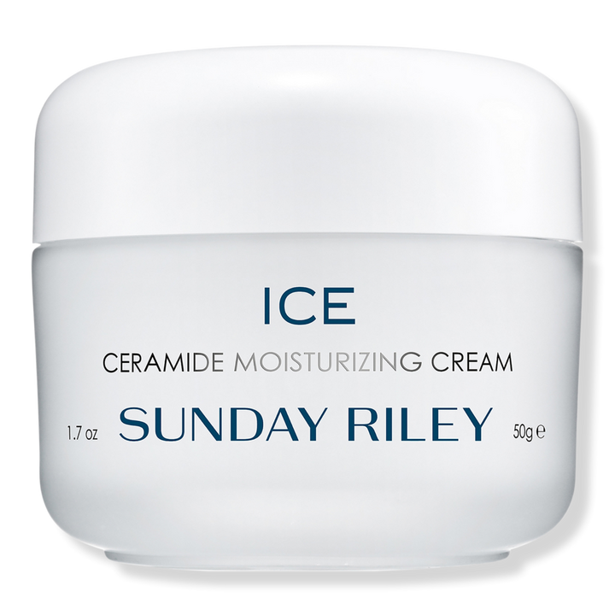
Pairs with:
HIM Surf
Metaphoria
Coconut Color Cream
Coconut Krem
Salty Lime Slushie
1. Plant Based Retinol alternative that helps with all signs of aging and is GREAT for sensitive skin
2. Hydrating Cactus Water helps to regulate moisture levels while assisting in the strengthening of the skin’s barrier by replenishing lost nutrients and vitamins
3. Skin repairing Ceramide Complex that works to rebuild the moisture barrier
4. Kakadu Plum extract for anti-inflammatory & Vitamin C properties; helps to calm the skin of irritations
5. Anti-reddening Tiger Grass to help with healing & soothing properties while combating redness
6. Mel[o]stem™ is the first plant derived ingredient clinically proven to help with sun spots for a more even toned complexion
7. Agave Extract helps to tighten sagging skin and soothing irritations and redness by keeping the skin hydrated
Fragrance: Kiwi & Cactus Water

Slide 3
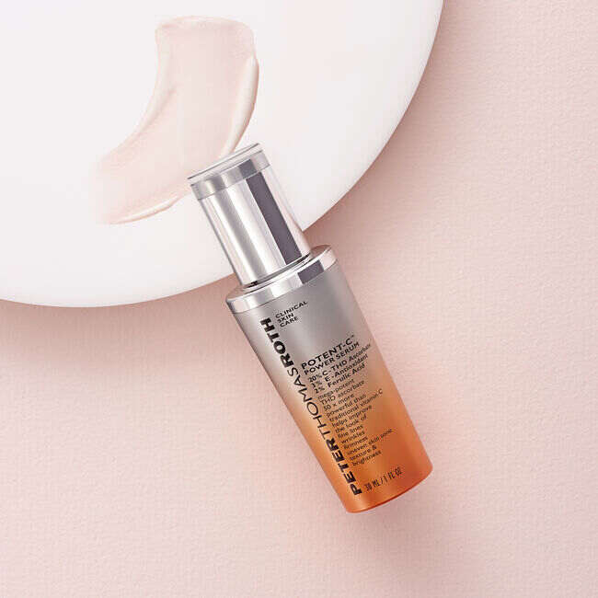
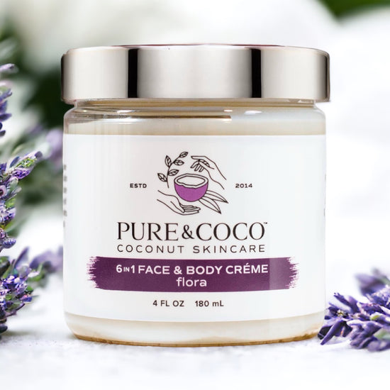
Pairs with:
Salty Lime Slushie
Somewhere on a Beach
HIM Atlantic
Ride or Tide
HIM Hydrate
Aquaholic
1. Electrolyte rich Coconut Water hydrates dehydrated skin for a boost in complexion
2. Anti-reddening Tiger Grass to help with healing & soothing properties while combating redness
3. Mel[o]stem™ is the first plant derived ingredient clinically proven to help with sun spots for a more even toned complexion
4. Ginger Root Extract helps target and calm inflammation and irritations in the skin
5. Sea Buckthorn Berry helps to improve uneven tone & texture, protects against moisture loss and strengthens the skin’s barrier to protect against irritating environmental aggressors
6. Antioxidant rich Mango Butter that provides anti-aging benefits with a glowing complexion
7. Pore Refining Blend – A blend with Baobab, Witch Hazel & Apple Cider Vinegar helps to target large pores on the skin by absorbing excess oil, calming inflammation and regulating oil production
Fragrance: Salty Lime

Slide 4
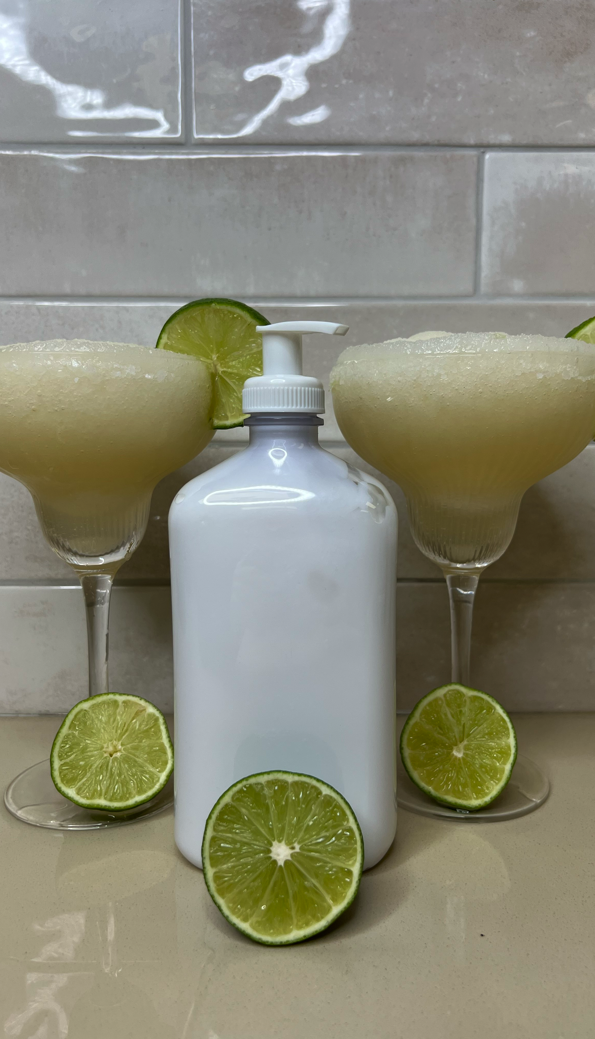

Slide 5
Pairs with:
HIM Surf
Cactus Cabana
#Beachtime
W2B Coastal
Somewhere on a Beach
Salty Lime Slushie™
1. 24-hour after sun daily tan extending moisturizer
2. Agave, Avocado & Caffeine Extracts help to tighten sagging skin and soothing irritations and redness by keeping the skin hydrated
3. Skin repairing Ceramide Complex that works to rebuild the moisture barrier
4. Mango Butter & Calendula Extracts are high in antioxidant properties that protects, strengthens and soothes the skin, targets fine lines & wrinkles and provides a glowing complexion
5. Hydrating Cactus Water helps to regulate moisture levels while assisting in the strengthening of the skin’s barrier by replenishing lost nutrients and vitamins
Fragrance: Salty Lime Slushie

Slide 6
Megan Edwards| International Sales Trainer
megan@devotedcreations.com

