Slide 1
Regimens & Your Tan

Slide 2
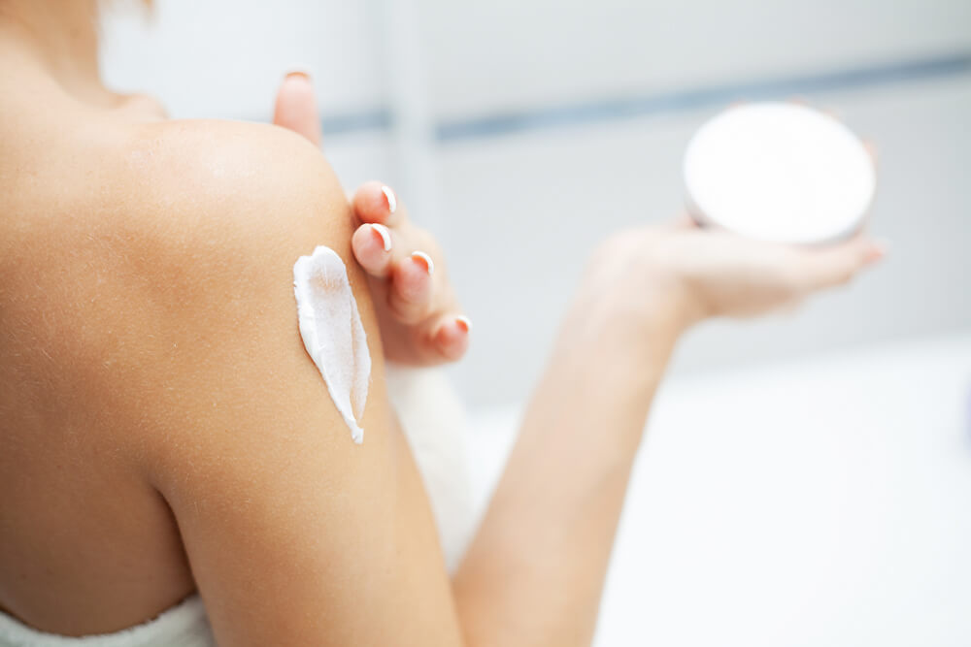
It’s more than your face
The skin on your body deserves to have a skincare routine that is just as effective as the one you have for your face
Just doesn’t need to be as complicated
If it makes things easier, use the same ingredients on your body that you use on your face
Don’t skip the basics

Slide 3
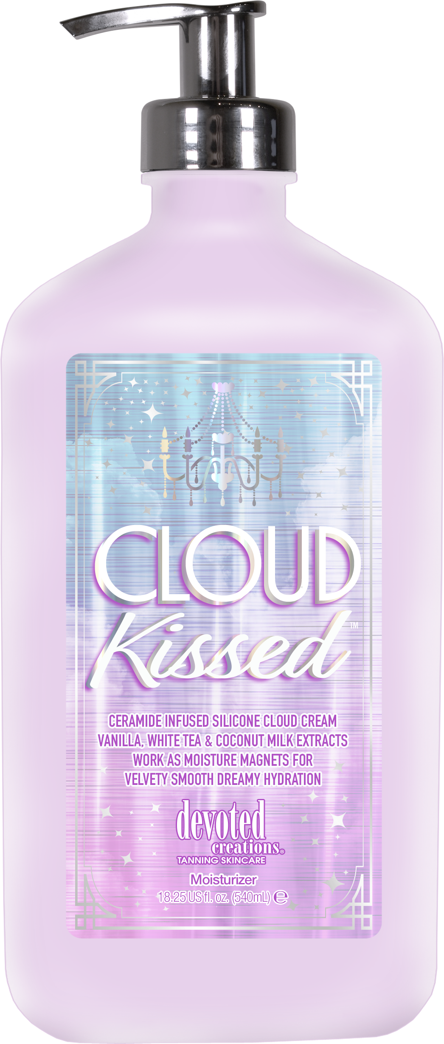
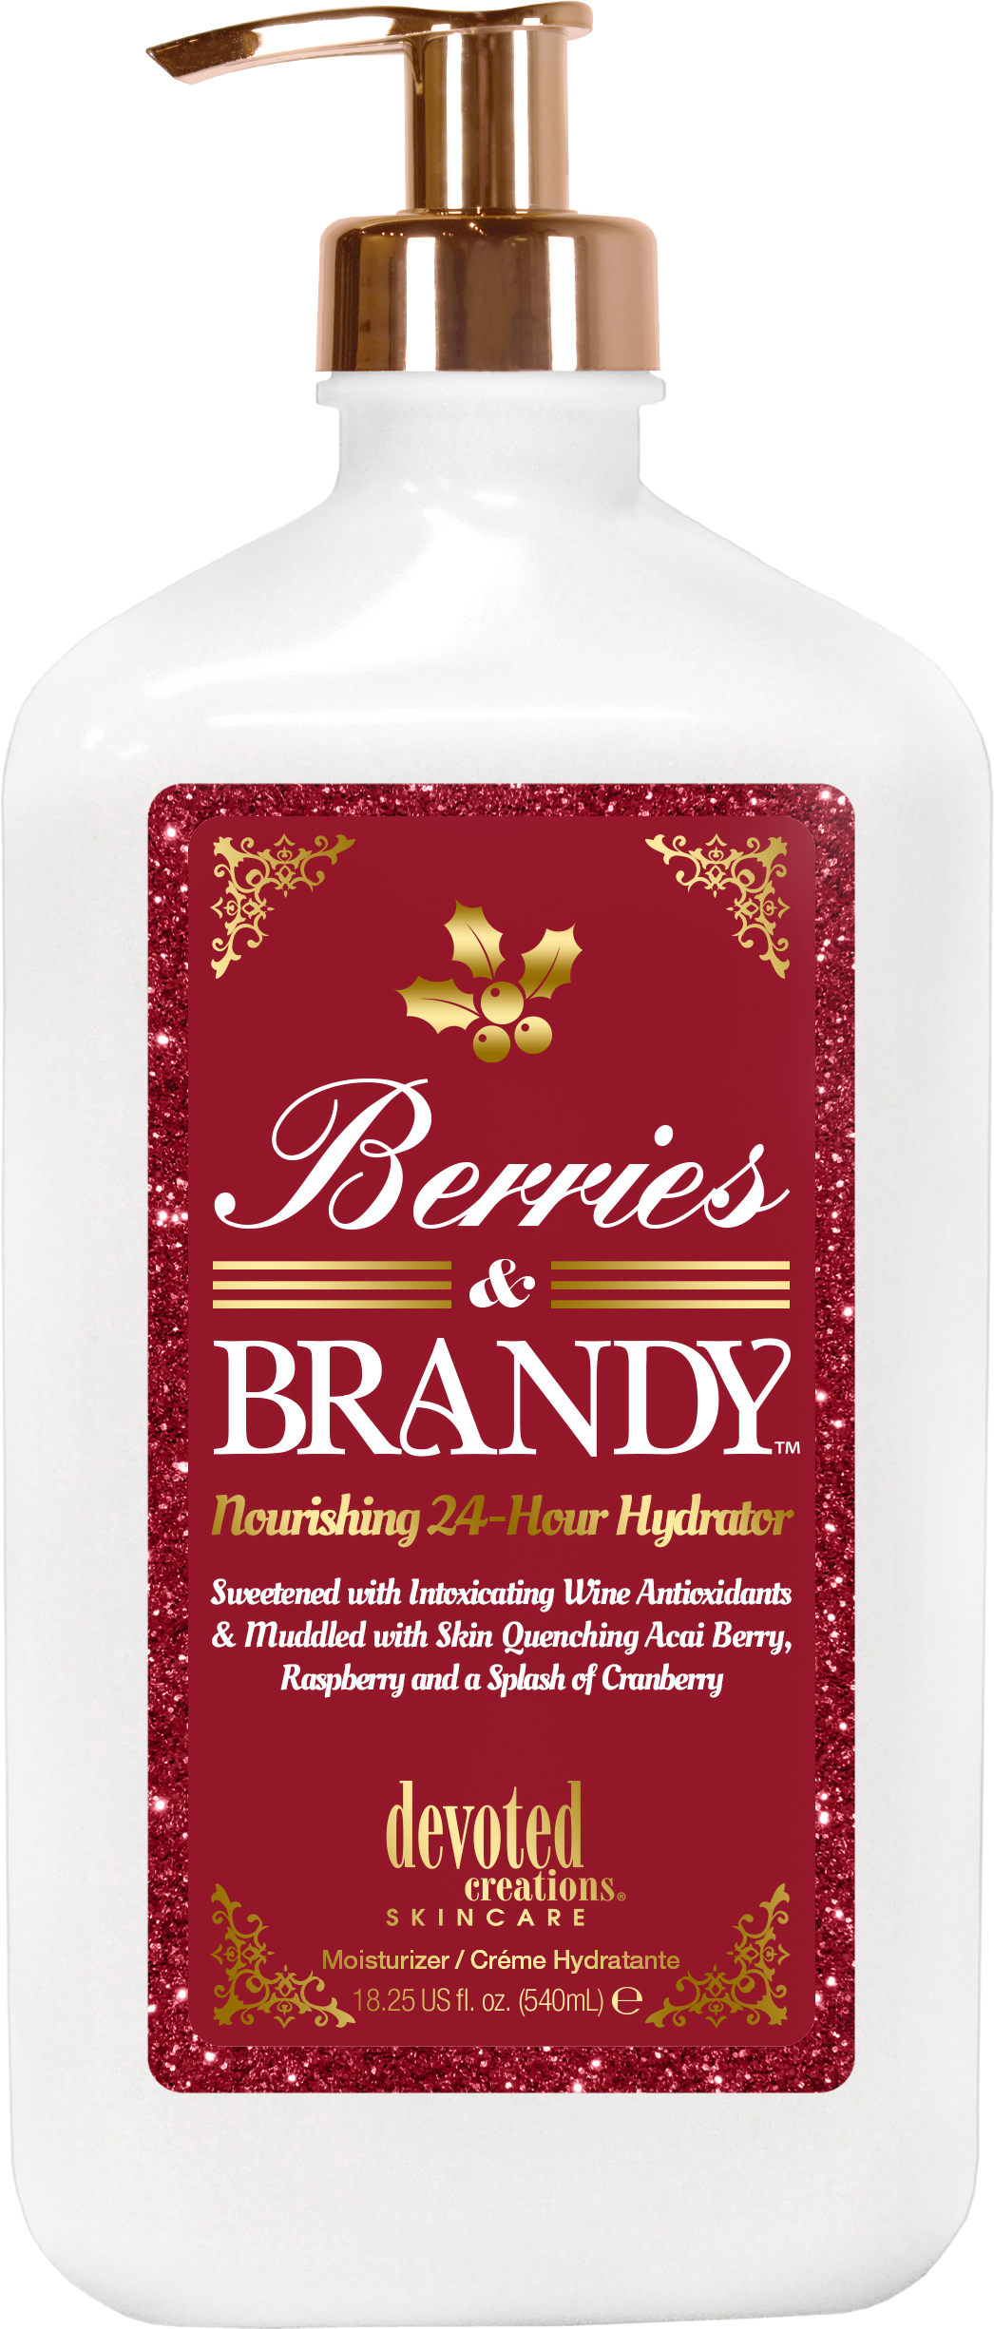
Dry brushing
Cleansing with a sulfate free body wash
Strips away natural oils which can compromise the skin’s barrier
Exfoliation
Body moisturizers
Want to look for moisturizers/tan extenders with glycerin, ceramides or HA
Apply right after getting out of the shower when the skin is still damp
Damp skin allows your skin to better absorb the main ingredients
Antioxidants – protection from environmental elements
Helps reduce signs of aging
Hydration and skin barrier strength

Slide 4
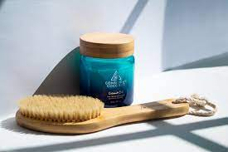
Dry Brushing vs Exfoliation
The only difference is the tool used
Dry brushing uses soft bristles to promote circulation, cell turnover and improves the look of cellulite on the skin
Exfoliation is the process of removing dead skin cells and impurities

Slide 5
Sample Regimen
Double Bubble Body Wash
Sol de Janiero Body Scrub
CeraVe Face Wash
Head to Glow
Glocation
Restorative Moisturizer
Niacinamide Brightening Serum
AHA/BHA Serum
Selfie Sunkissed Serum
Collagenetics Focus Serum
Spot Treatment
Eye Serum/Cream
Sorbet Dream Cream
Rejuvenating Cream with SPF

Slide 6
Sample Regimen
Double Bubble Body Wash
Sol de Janiero Body Scrub
CeraVe Face Wash
Head to Glow
Glocation
Restorative Moisturizer
Niacinamide Brightening Serum
AHA/BHA Serum
Selfie Sunkissed Serum
Collagenetics Focus Serum
Spot Treatment
Eye Serum/Cream
Sorbet Dream Cream
Rejuvenating Cream with SPF

Slide 7
Products & Services – The Cake Theory
Products can be used for multiple services
Build a regimen with your clients on the services they should use to achieve their maximum results, find the package that fits them the best and then top it off with a lotion
Finding out lotion goals = cake mix and ingredients
Creating a routine with equipment = baking
Finding the right package to maximize their sessions/time = cooling time
Finding the right lotion(s) for their goals = frosting
You’re not going to eat a cake without frosting (weird) so you shouldn’t put all this effort into your client and their tanning goals for them to not use a product of any kind

Slide 8
Megan Edwards| International Sales Trainer
megan@devotedcreations.com

