Slide 1
National Mimosa Day

Slide 2
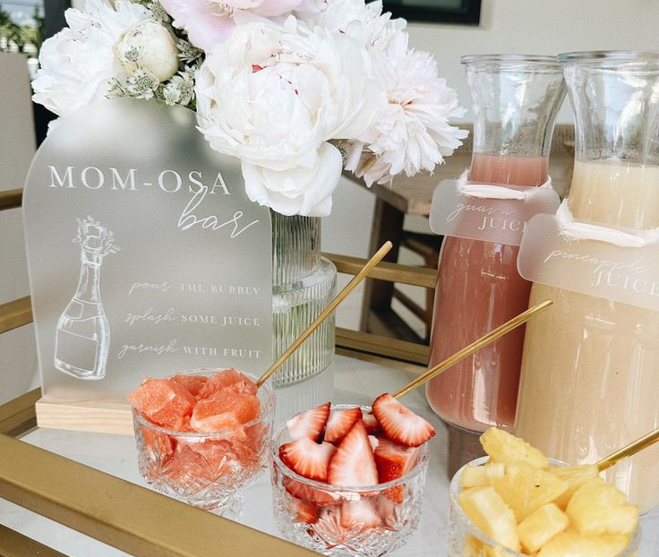
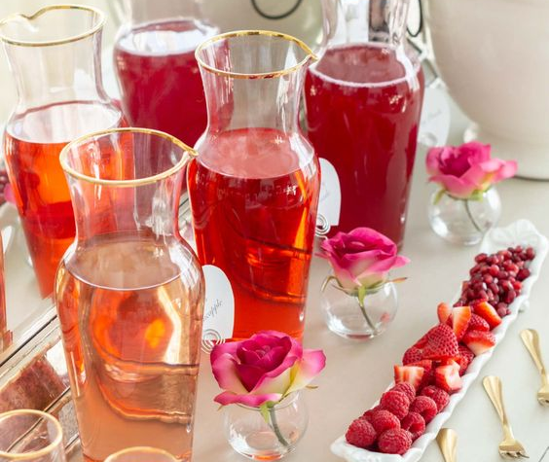
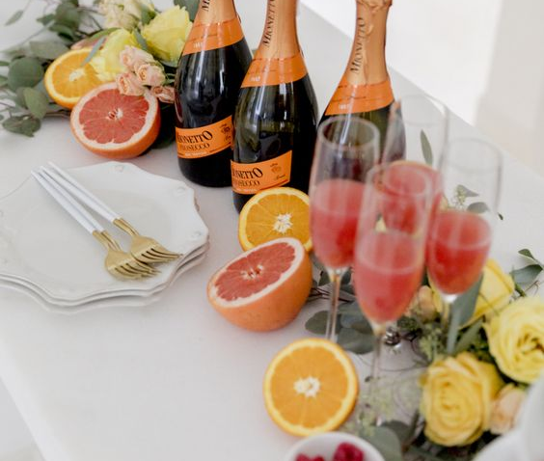
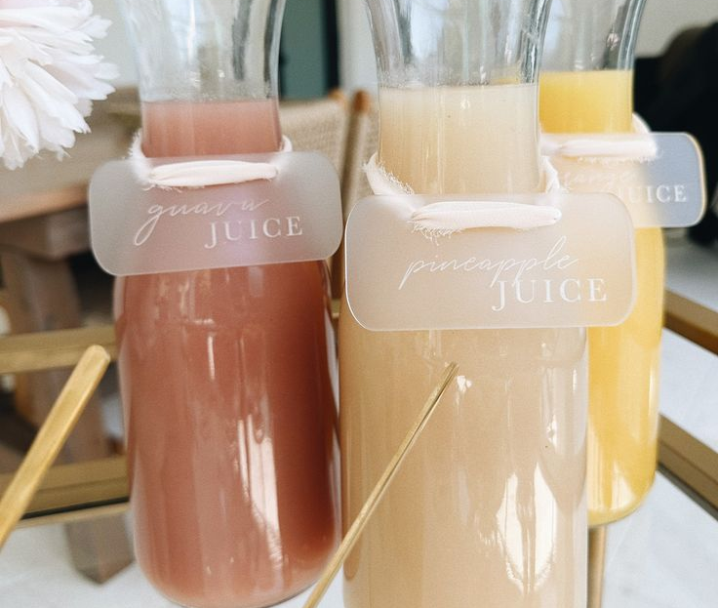
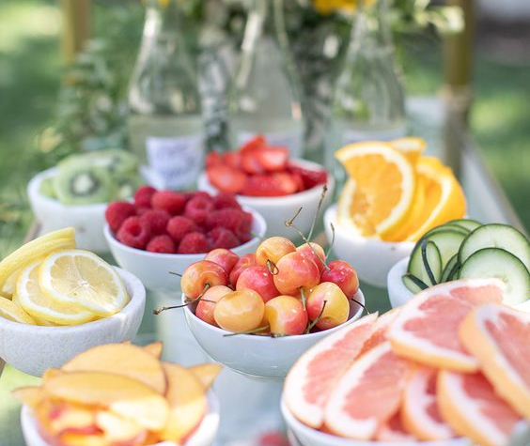
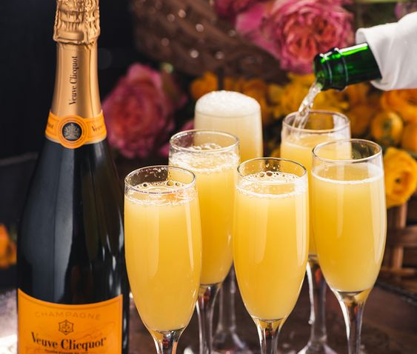

Slide 3
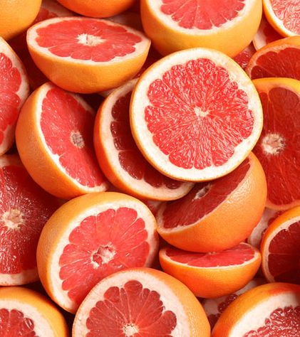
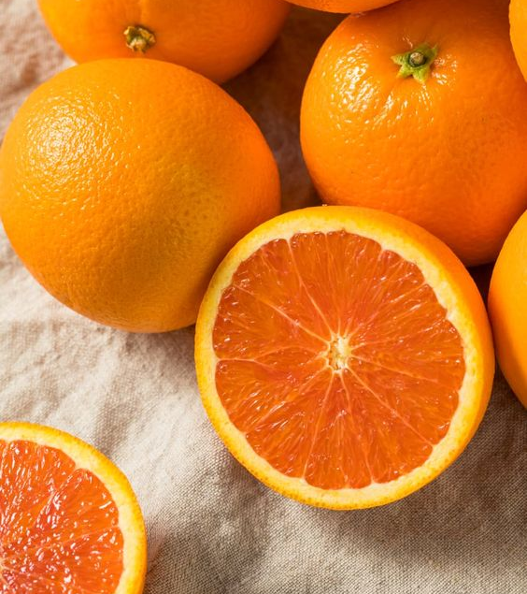
Grapefruit
Orange
Adds more moisture and hydration into the skin for longer lasting benefits
Contains Vitamin C & Beta-Carotene
Improves uneven skin tone and texture
High in antioxidants to protect and strengthen the skin’s barrier
Naturally high in Vitamin C
Brightens the skin’s complexion
Increases collagen production
Targets dark spots & hyperpigmentation
Fights fine lines and wrinkles

Slide 4
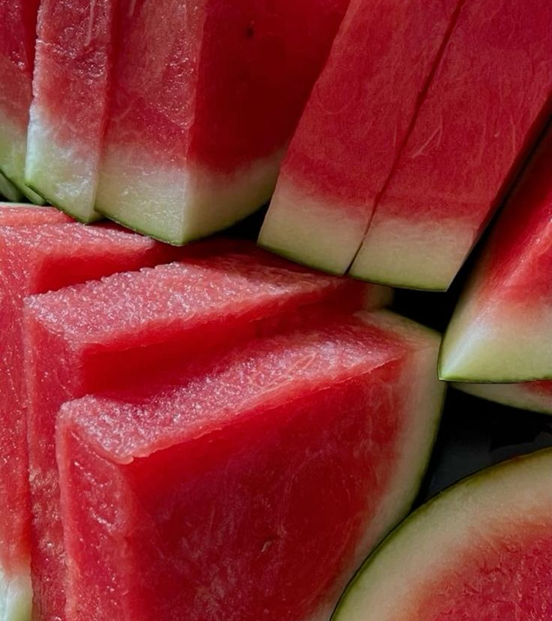
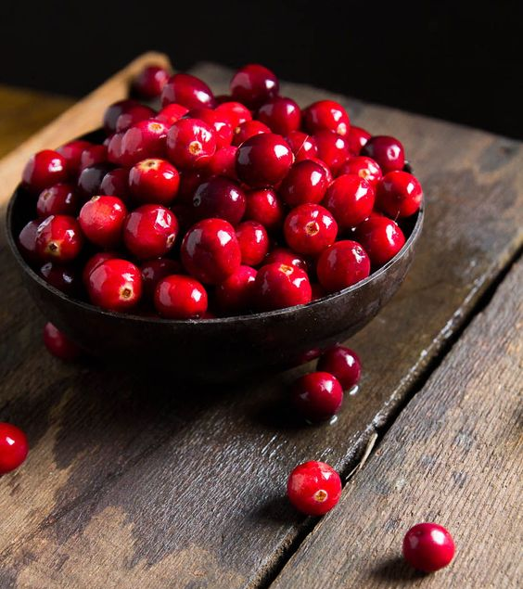
Watermelon
Cranberry
Adds more moisture and hydration into the skin for longer lasting benefits
Contains Vitamin C & Beta-Carotene
Improves uneven skin tone and texture
High in antioxidants to protect and strengthen the skin’s barrier
Naturally high in Vitamin C
Brightens the skin’s complexion
Increases collagen production
Targets dark spots & hyperpigmentation
Fights fine lines and wrinkles

Slide 5
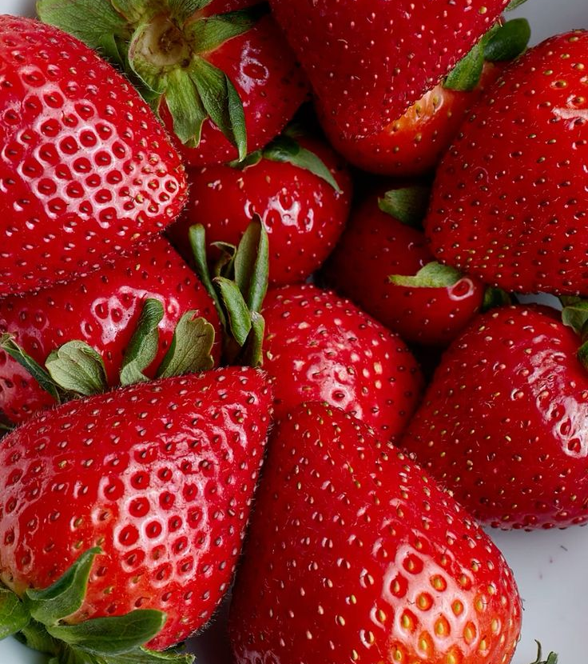
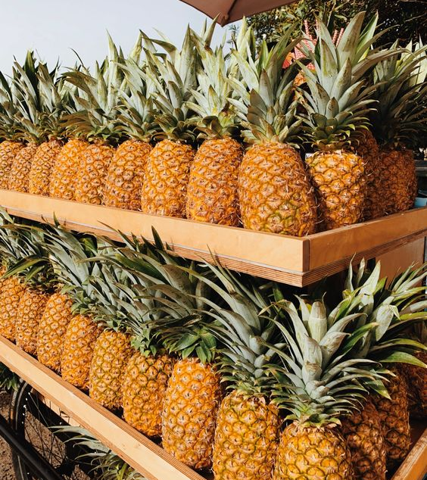
Strawberry
Pineapple
Contains acne fighting properties to help purify clogged pores
High in Vitamin C for skin brightening
Antioxidant properties for skin strengthening
Increase skin hydration and anti-inflammatory benefits
Naturally high in Vitamin C
Helps reduce inflammation and redness on the skin
Promotes collagen production
Targets acne formations and aids in healing dry and damaged skin
Contains natural enzymes to dissolve dead skin cell buildup

Slide 6
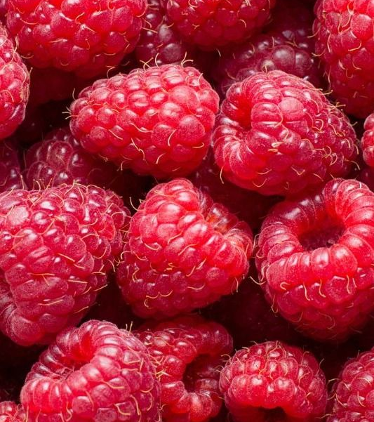
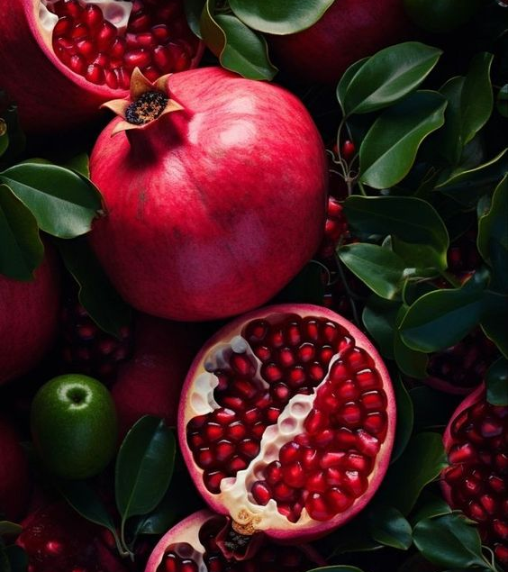
Raspberry
Pomegranate
High in Vitamins & nutrients to help strengthen and heal the skin for a younger looking complexion
Fights signs of acne and helps stimulate collagen production for a more even tone
Hydrating for the skin and great for sensitive skin users with skin conditions
Hydrating and anti-aging properties
Reduces UV induced signs of aging while brightening the complexion
Targets wrinkles, dark spots and hyperpigmentation

Slide 7
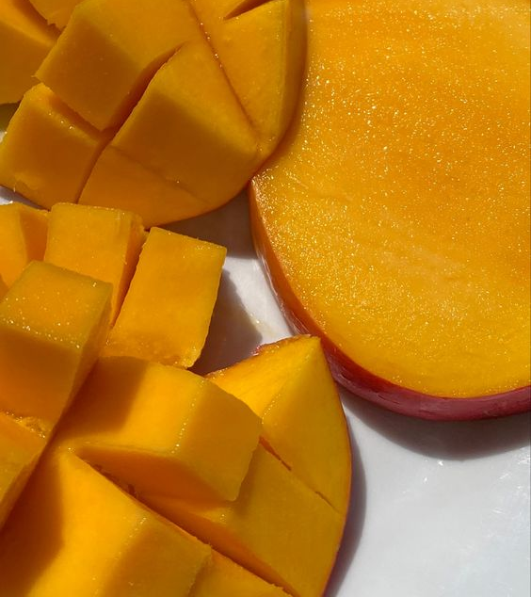
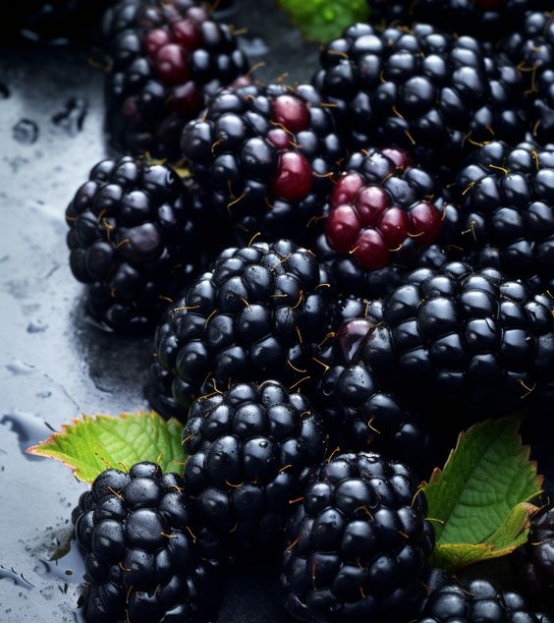
Mango
Blackberry
High in antioxidants for skin strengthening properties
Provides a glowing complexion for skin brightening
Contains anti-aging & hydrating benefits for the skin
Slows early signs of aging
High in Vitamin C to help fight off free radicals
Restores hydration and moisture into the skin
Helps to reduce the appearance of fine lines

Slide 8
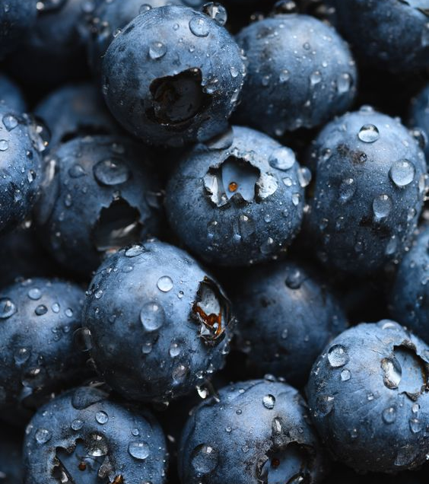
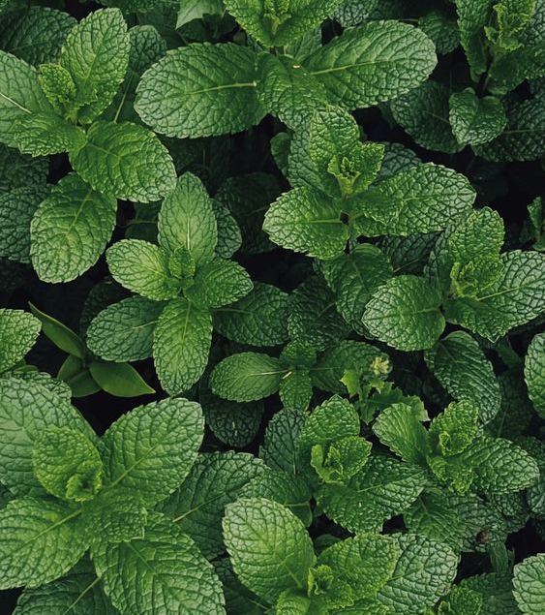
Blueberry
Mint
A natural antioxidant high in Vitamin C
Contains skin brightening properties to help target dry and dull looking skin
Works on the cellular level to help balance the skin and improve uneven texture
Strengthens the skin’s barrier to help prevent wrinkles
Helps to brighten the skin’s complexion
Contains vitamins that help target inflammation and redness
Provides an immediate soothing& cooling effect

Slide 9
Megan Edwards | International Sales Trainer
megan@devotedcreations.com
Makayla Thomas| International Sales Trainer
makayla@devotedcreations.com

