Slide 1
If you liked that, you’ll love this!

Slide 2
More skincare
More DHA
Formulated for sensitive skin
Hyaluronic Acid & Vitamin C

Slide 3
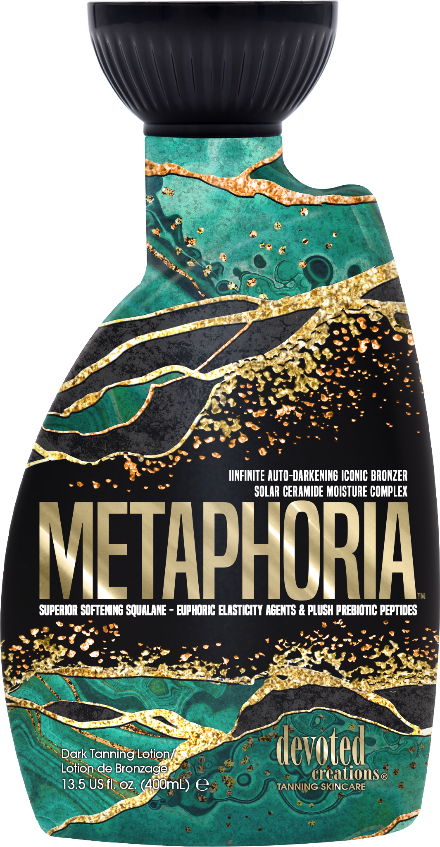
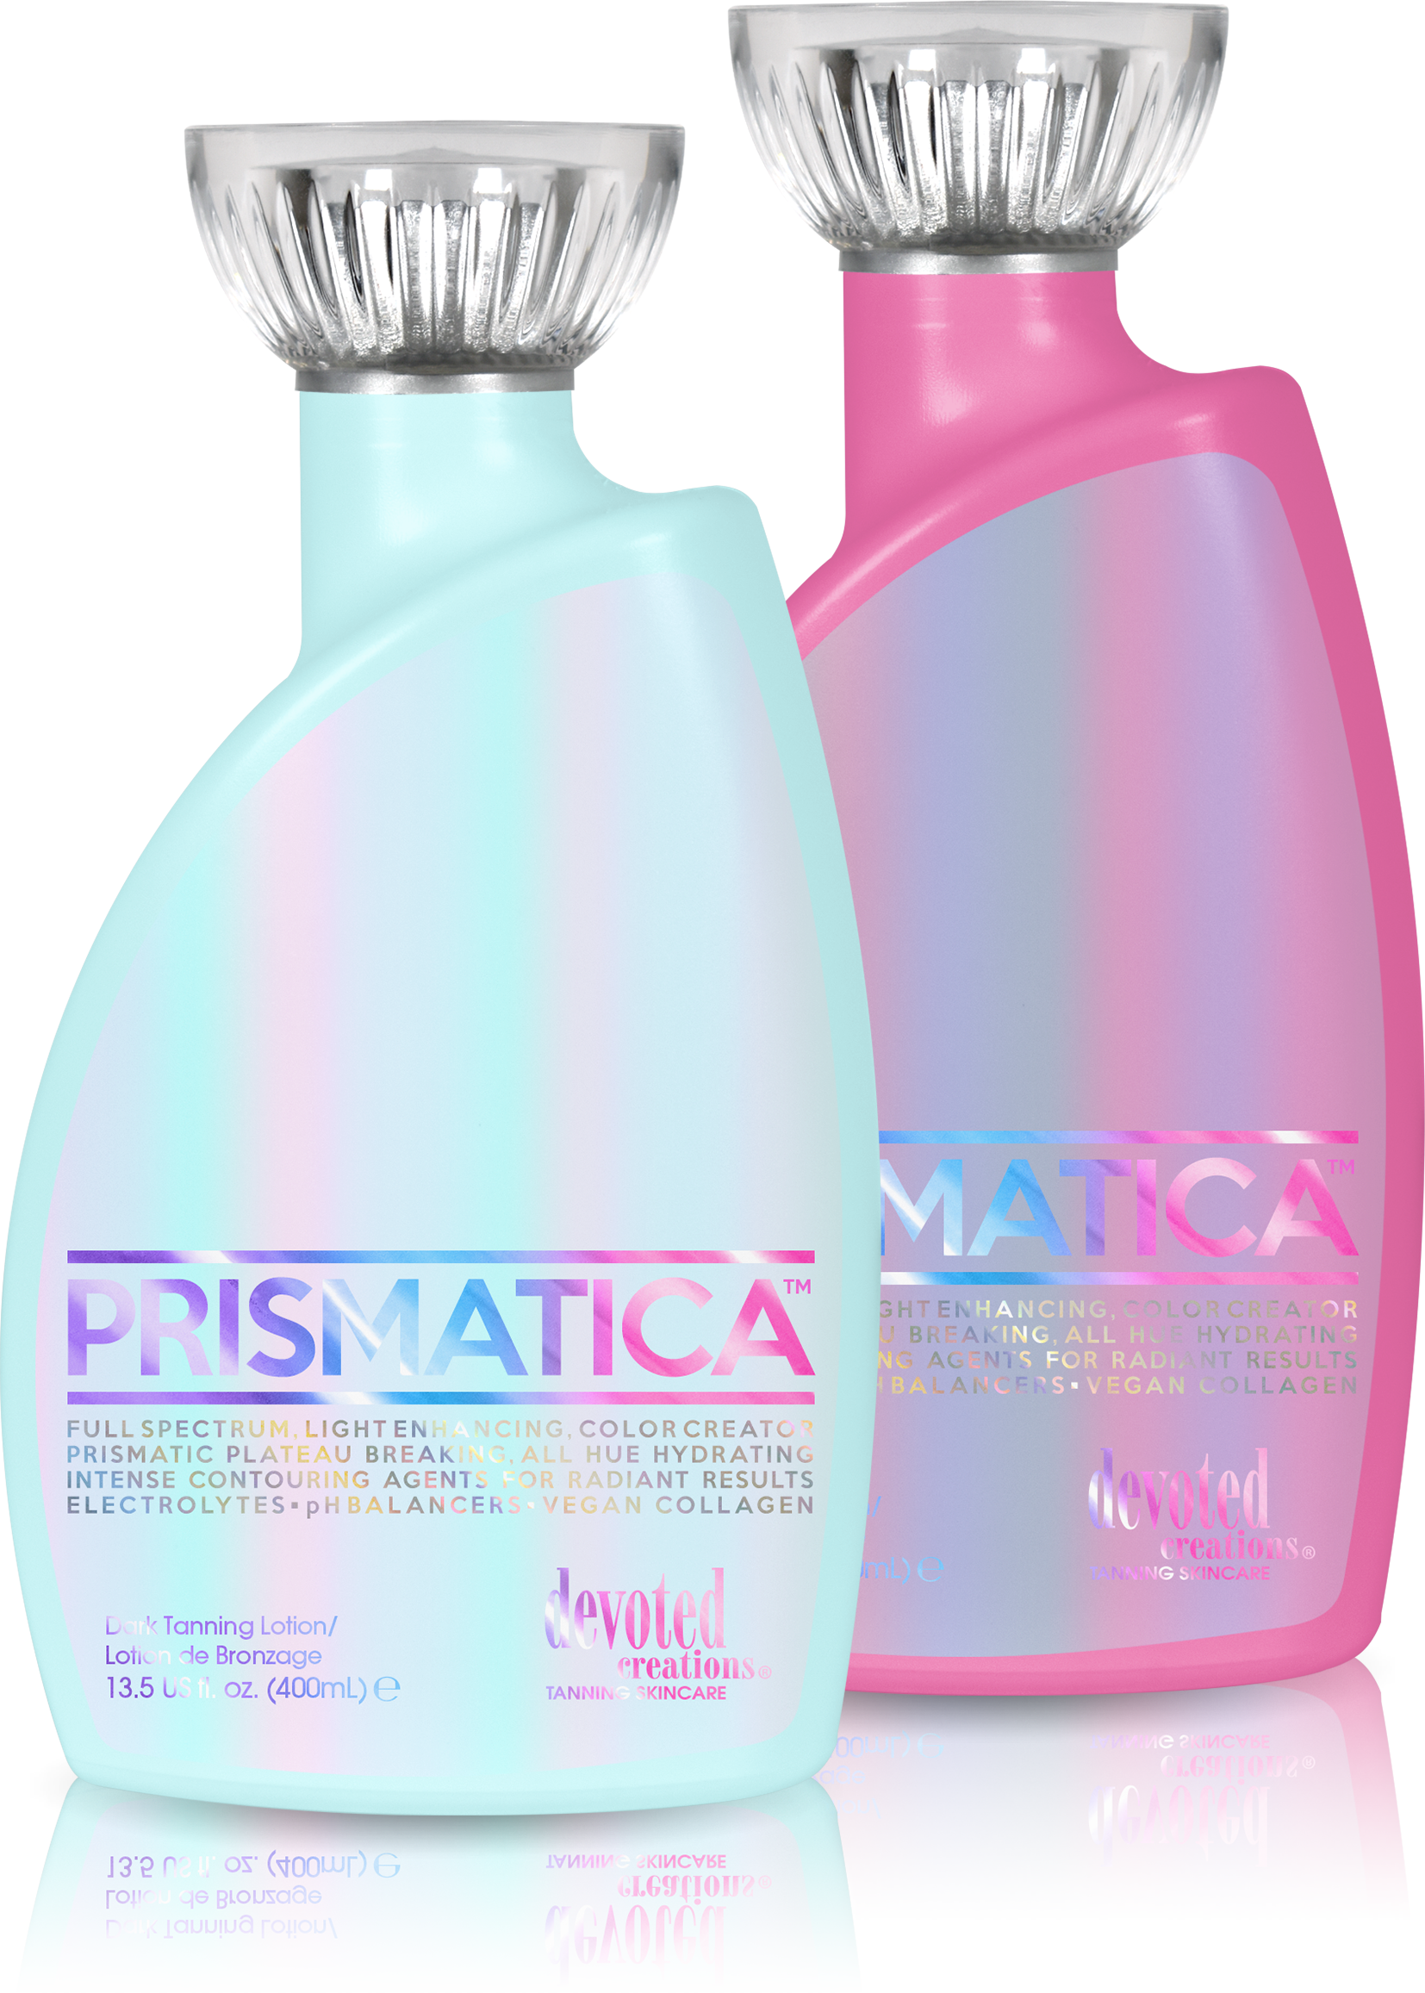
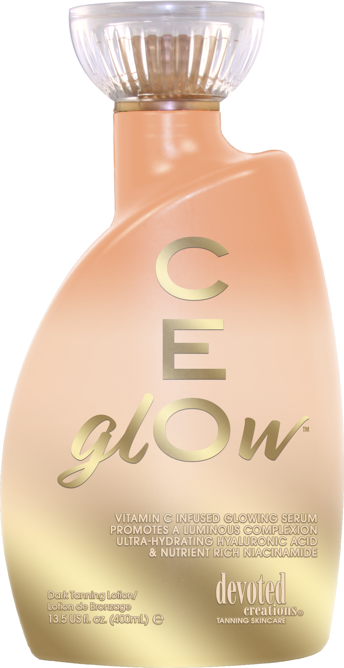
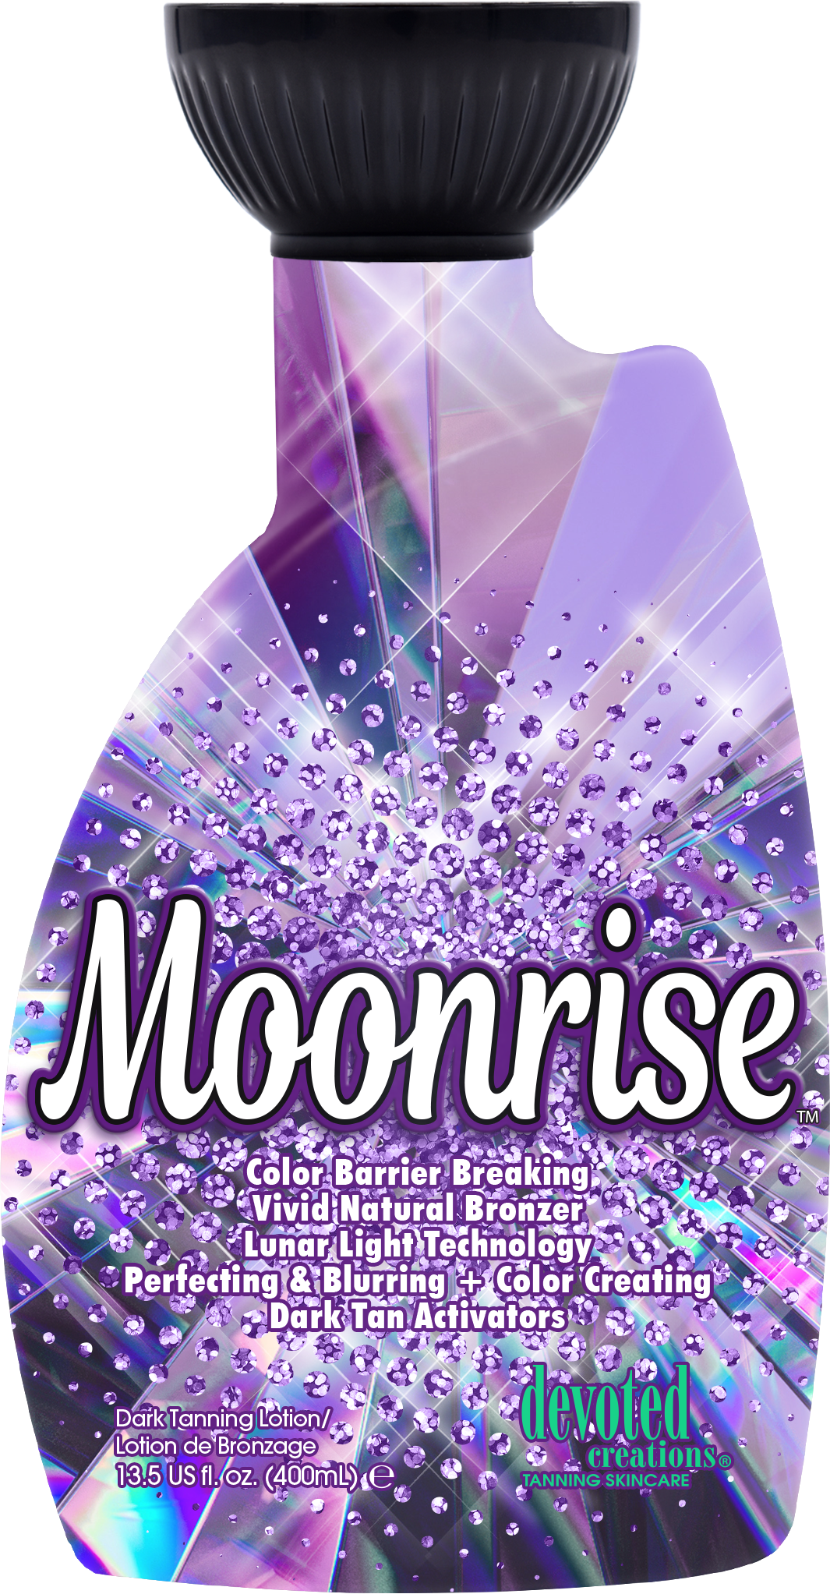
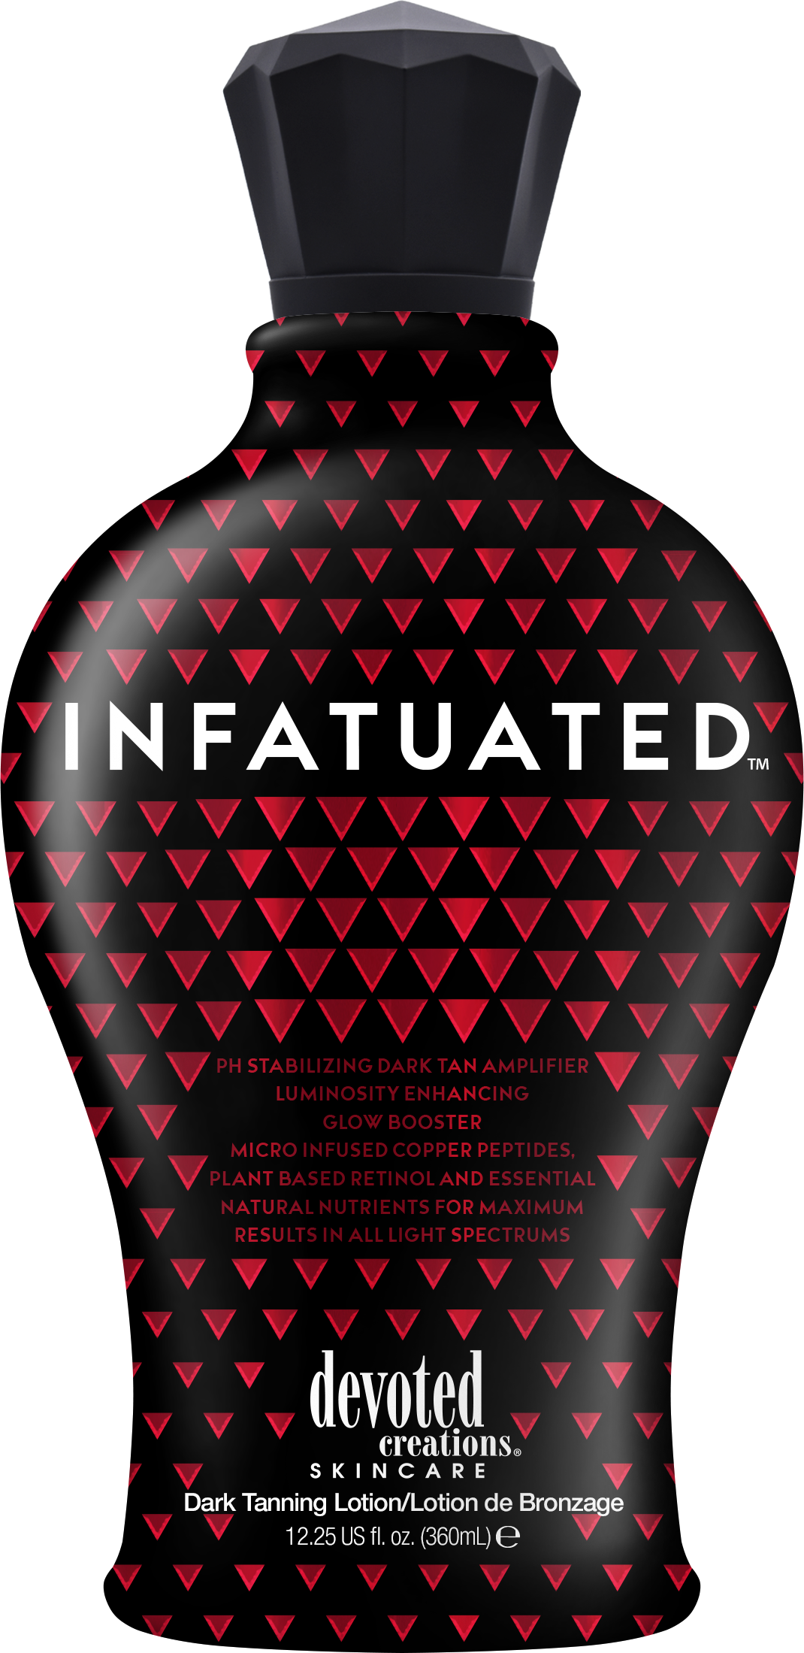
Cellulite Blend
Hybrid technology
Vitamin C Infused
Niacinamide
Vegan Collagen
Clean/fruity fragrance

Slide 4
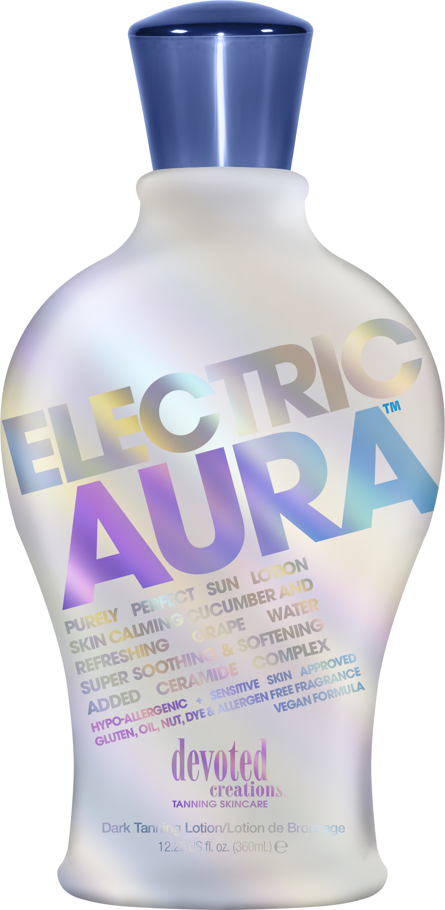
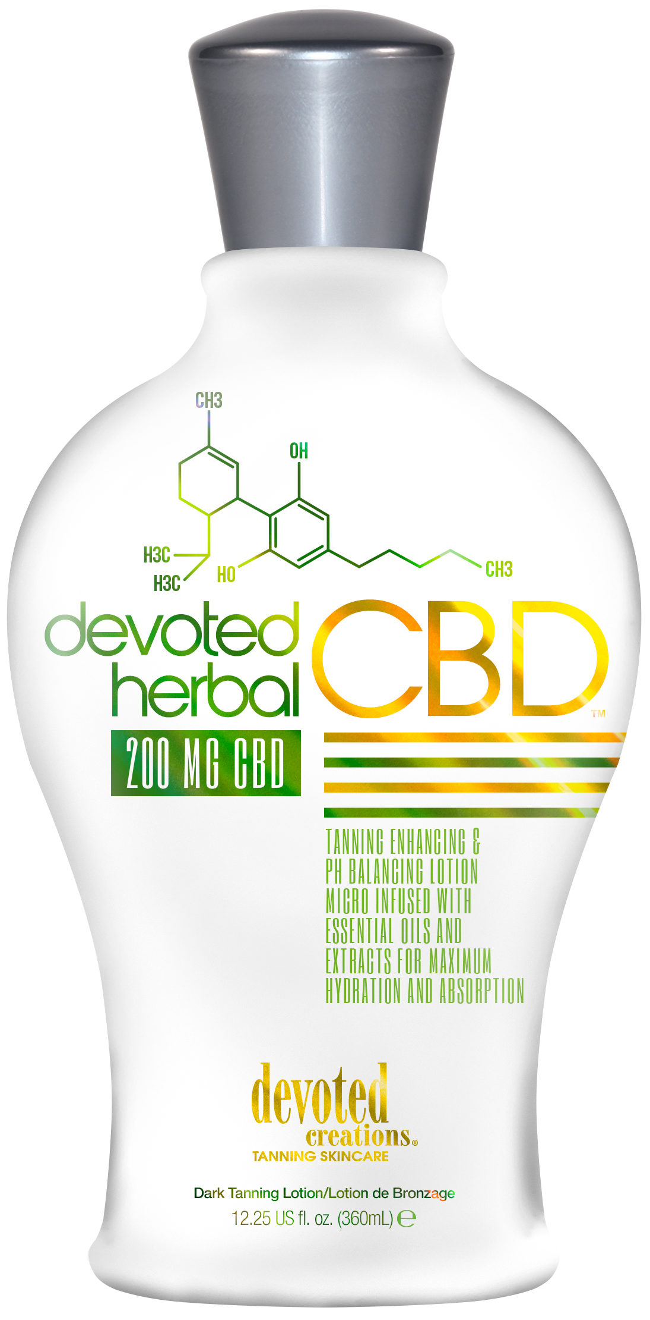
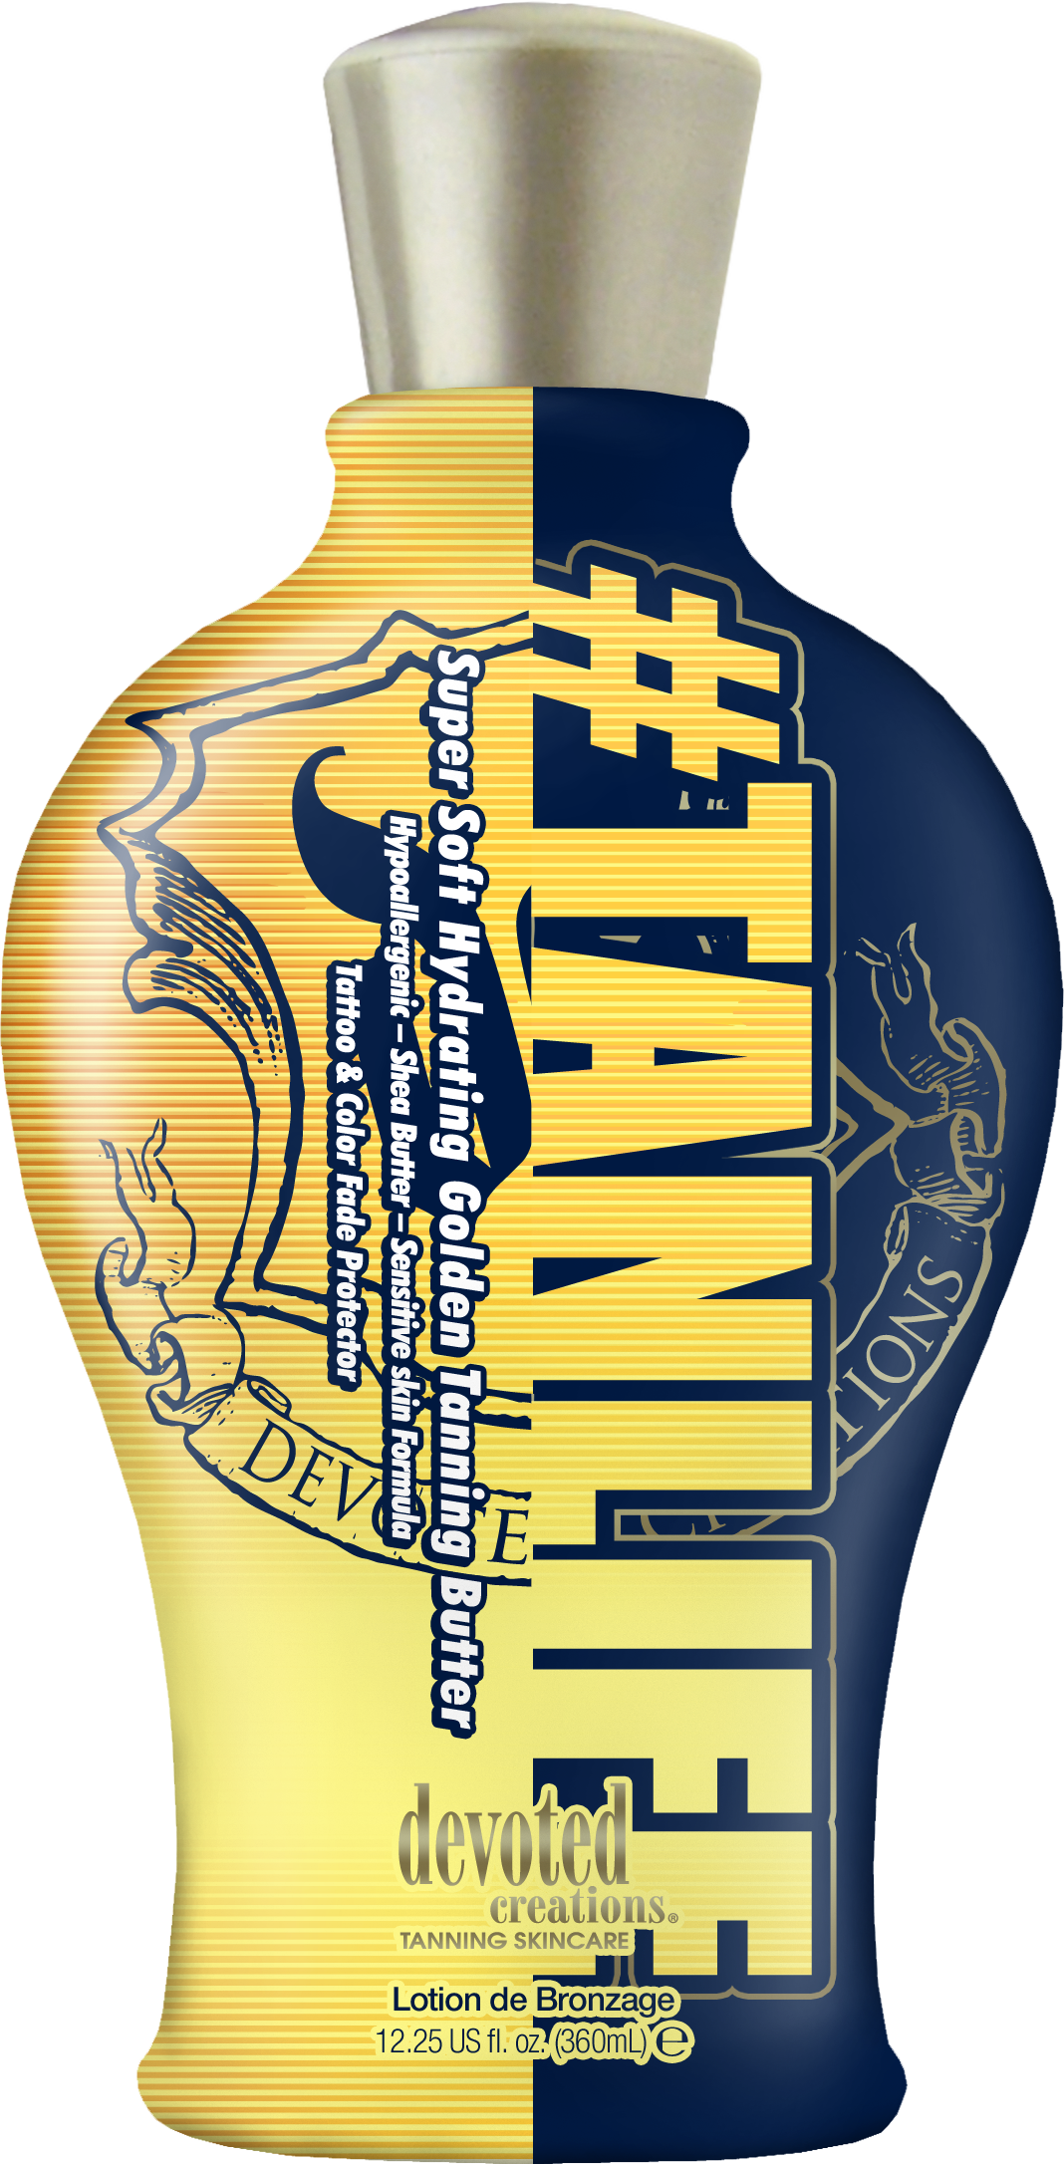
Unisex accelerator
Hybrid technology
Spray tan friendly
Hyaluronic Acid & Ginger Root
Collagen producing peptides
Anti-aging ingredients

Slide 5
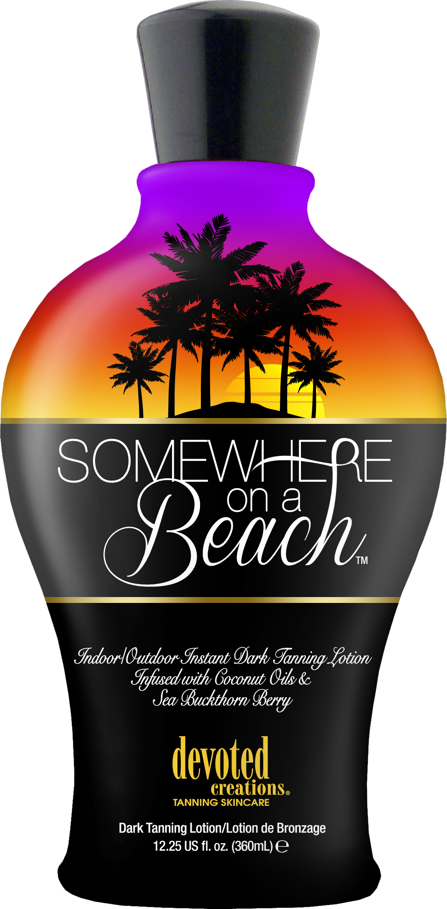
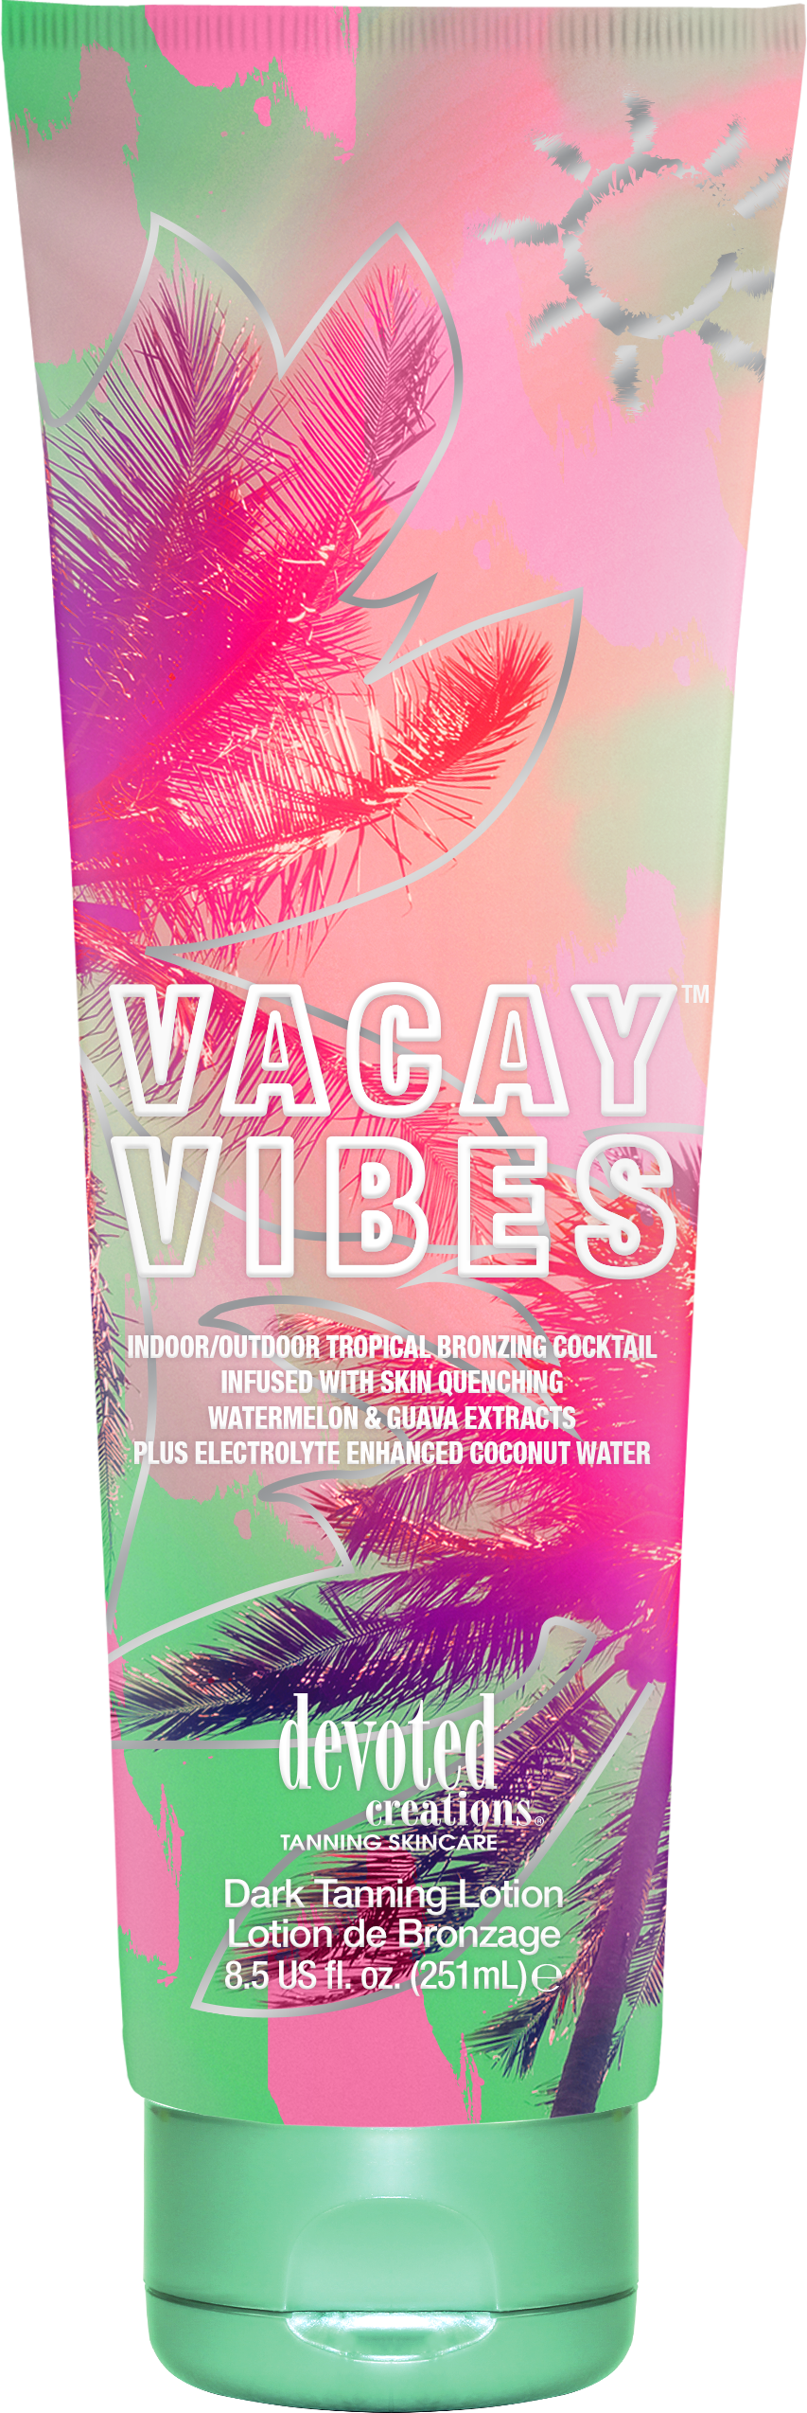
BB Crème formula
Anti-aging ingredients
Antioxidant protection
Unisex fragrance
Hydrating blend

Slide 6
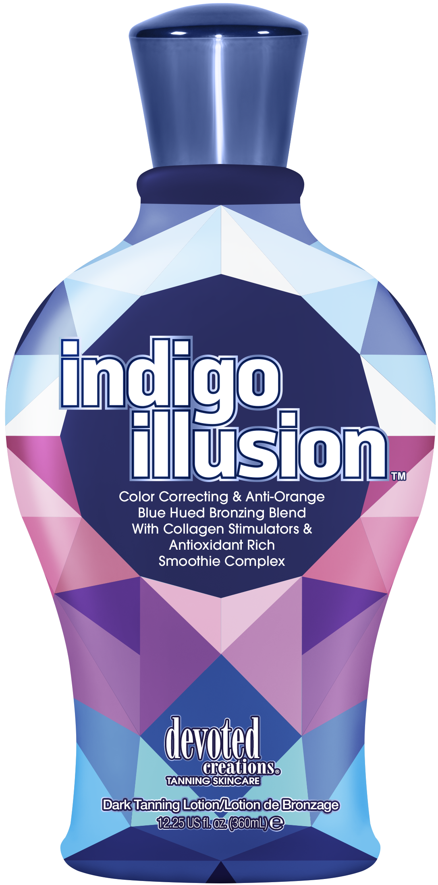
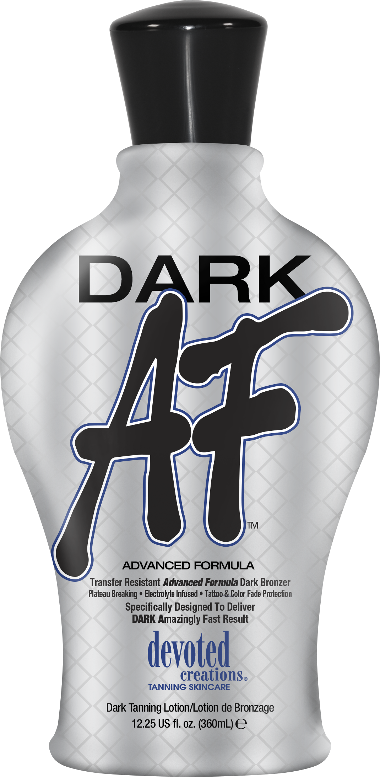
Transfer resistant DHA formula
Anti-aging ingredients
Blue Tansy/Color-correcting
Unisex fragrance
Antioxidant & electrolyte blend

Slide 7
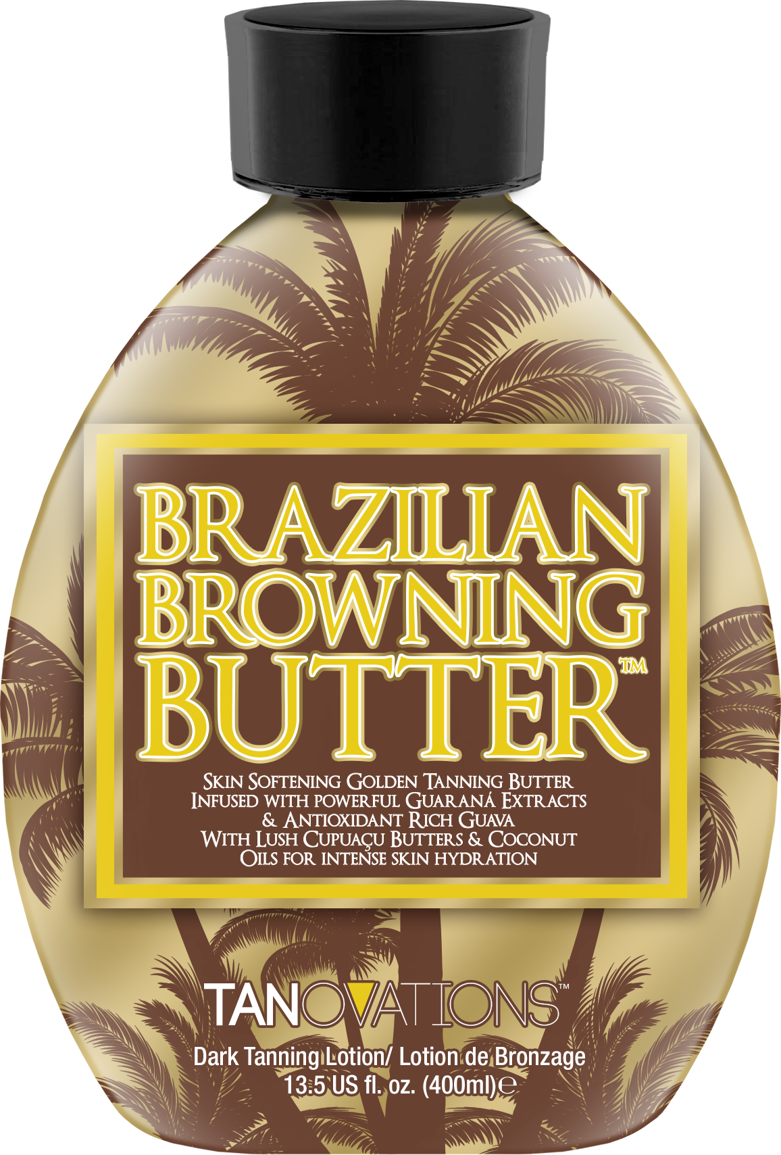
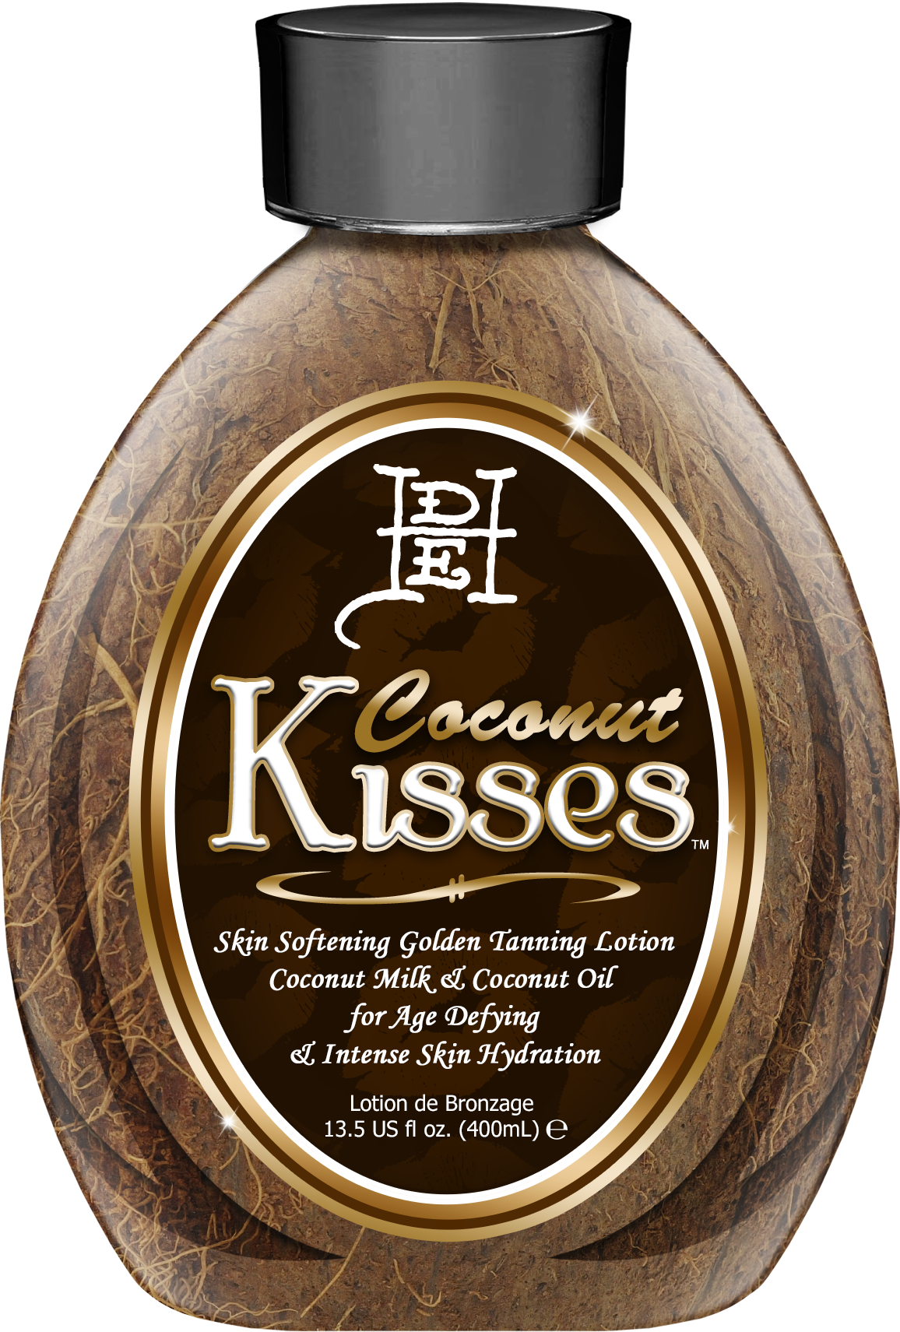
Skin softening pure accelerator
Formulated for dry skin
Anti-aging blend
Skin tightening & toning
Coconut Oil

Slide 8
Pure accelerator
Formulated for dry skin
Upgraded skincare formula
Anti-reddening formula
Anti-aging technology

Slide 9
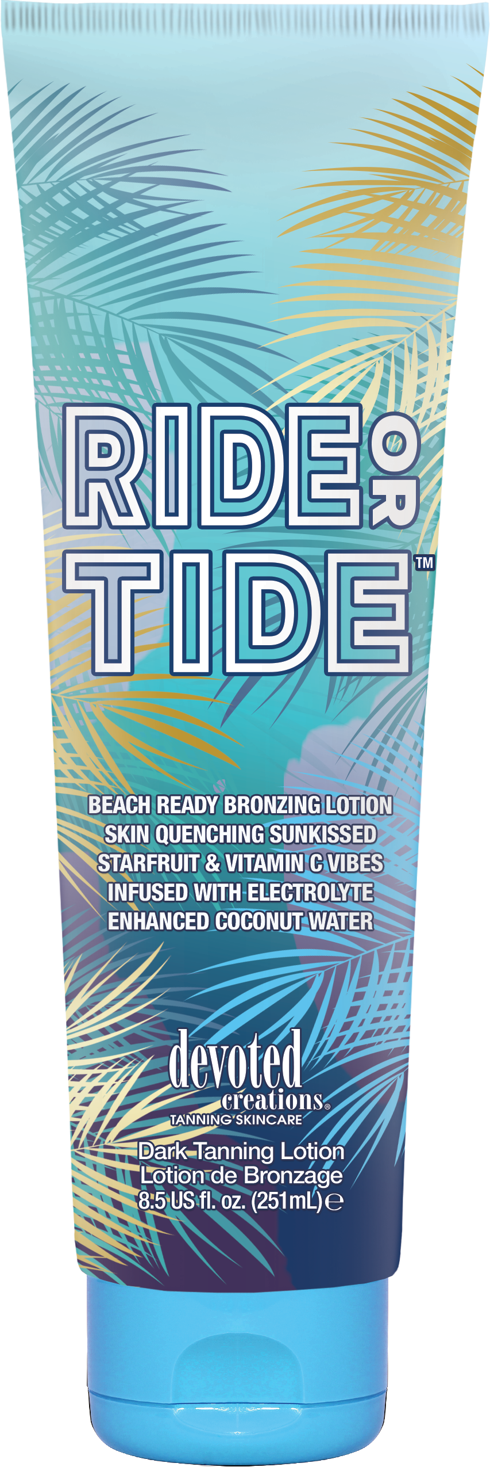
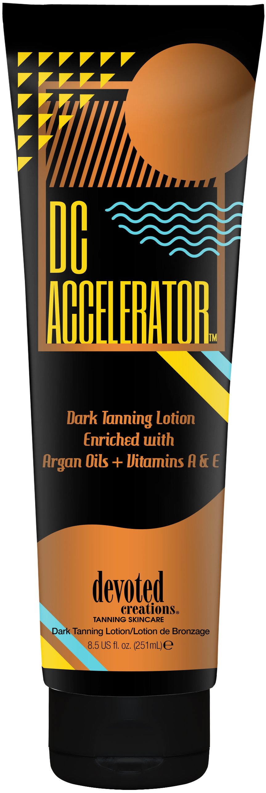
Extreme hydrating blend
Bronze boost complex
Upgraded skincare formula
Anti-aging technology
Electrolytes for skin barrier strengthening

Slide 10
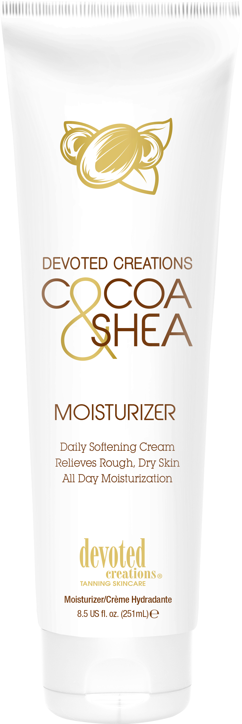
Vacation Glowing & Color Building Daily Moisturizer

Slide 11
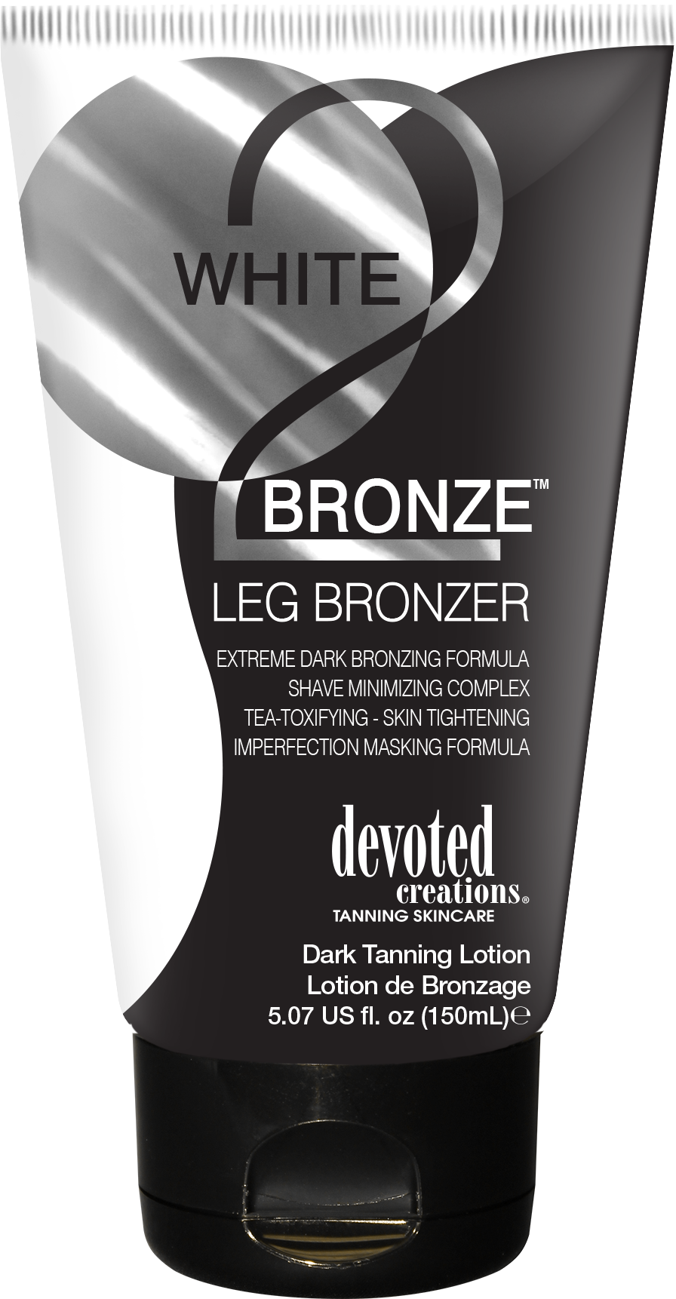
Airbrush Luminizing Tint & Tanner
DHA Free
Multi-Use & BB Crème formula
Cellulite fighting & contouring formula
Hydrating formula
Quick absorbing

Slide 12
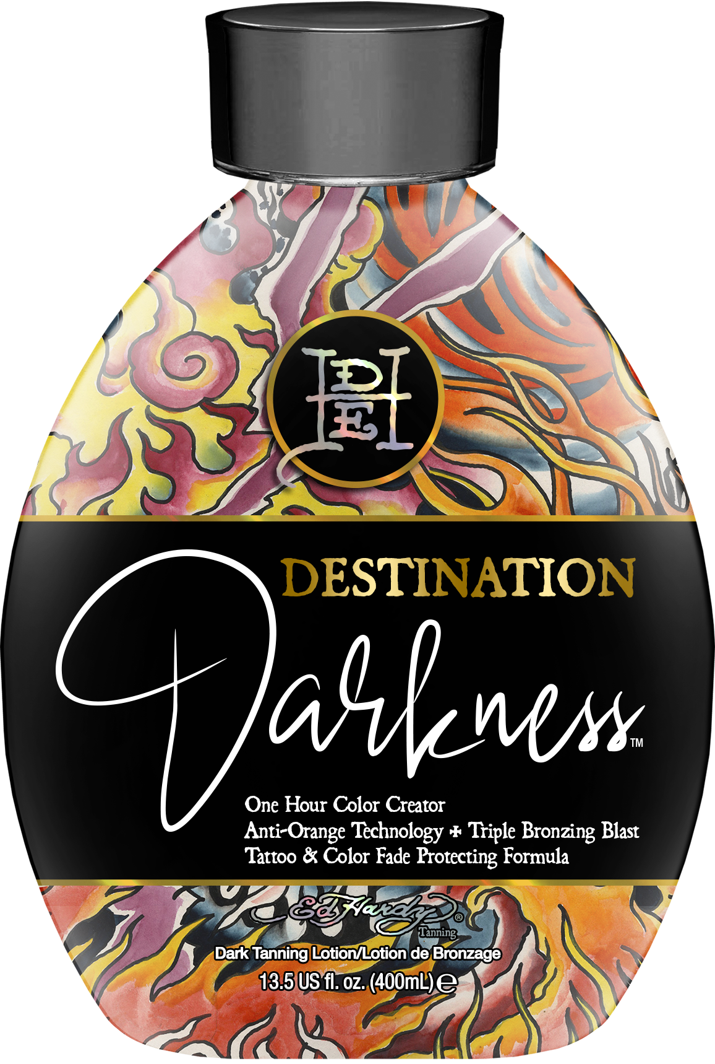
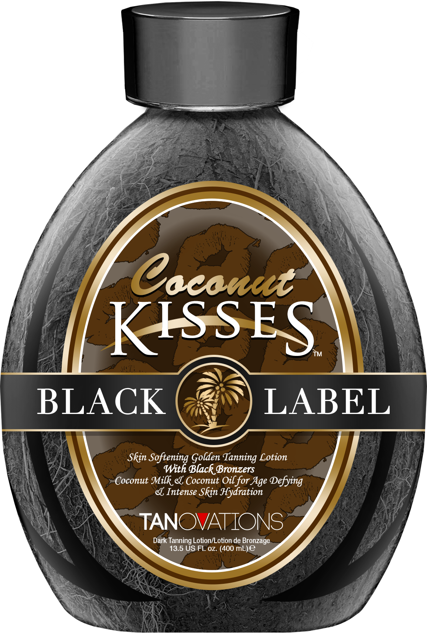
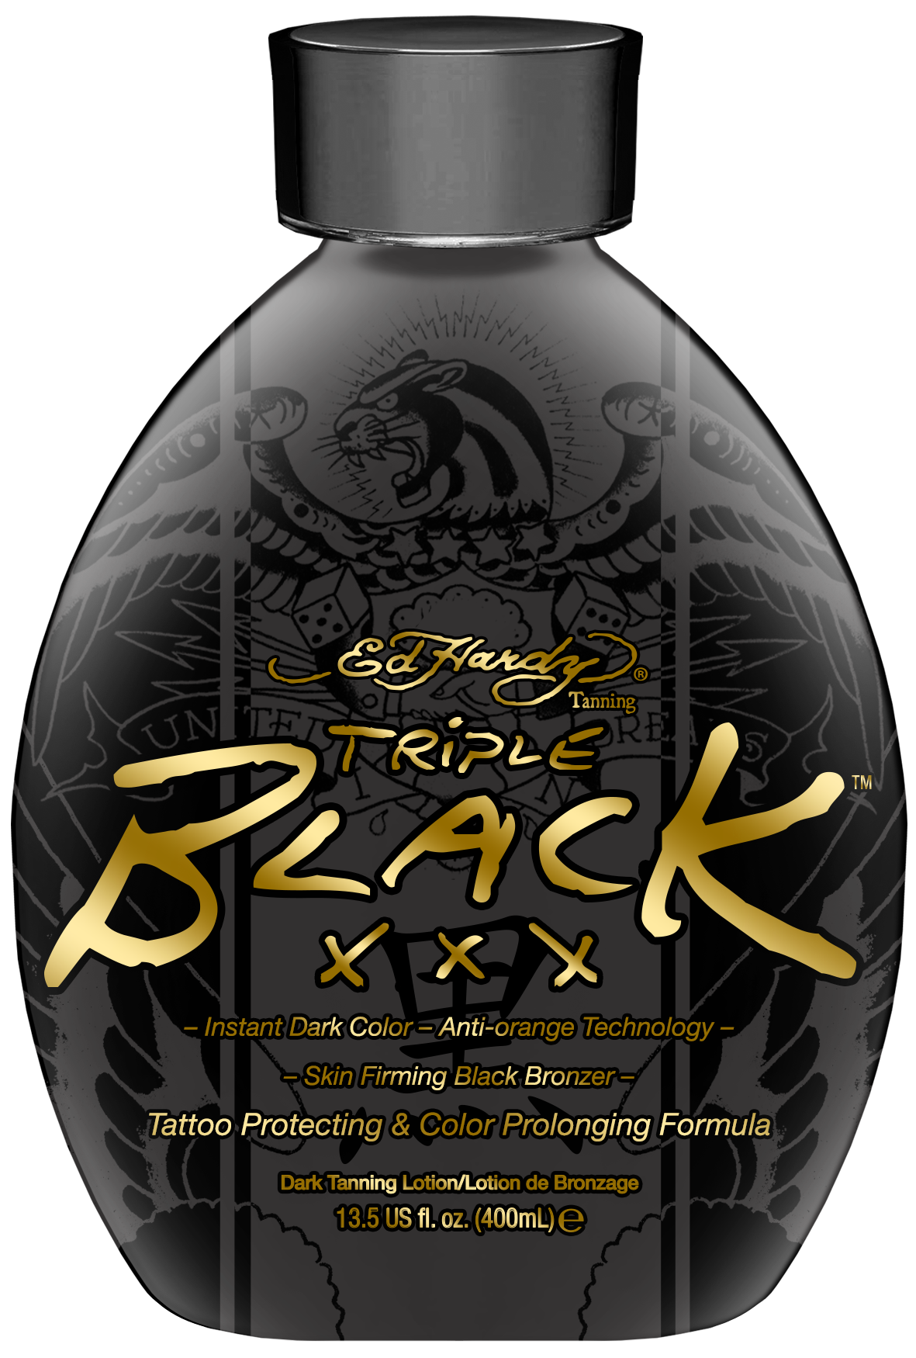
Triple dark bronzer
Color-correcting blend
Upgraded skincare formula
Hydrating natural oils
Anti-aging technology

Slide 13
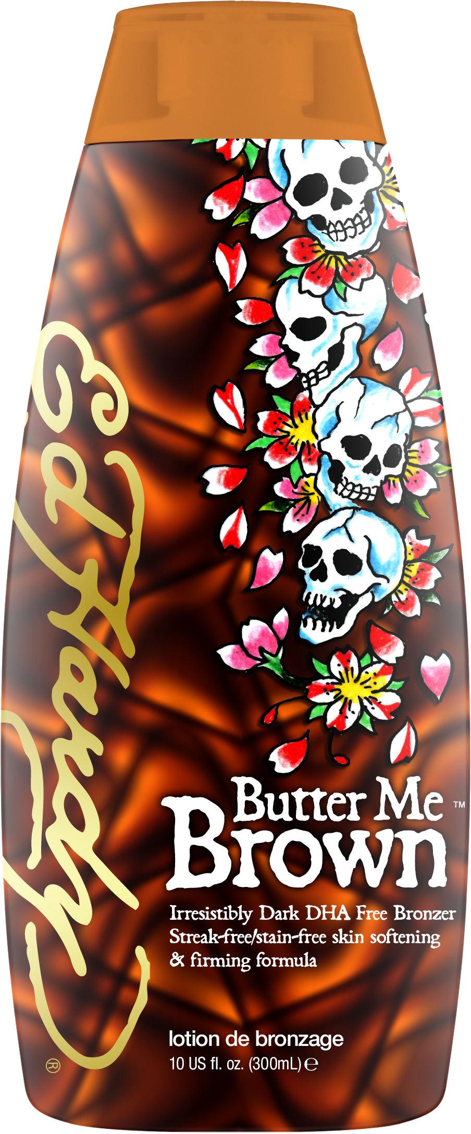
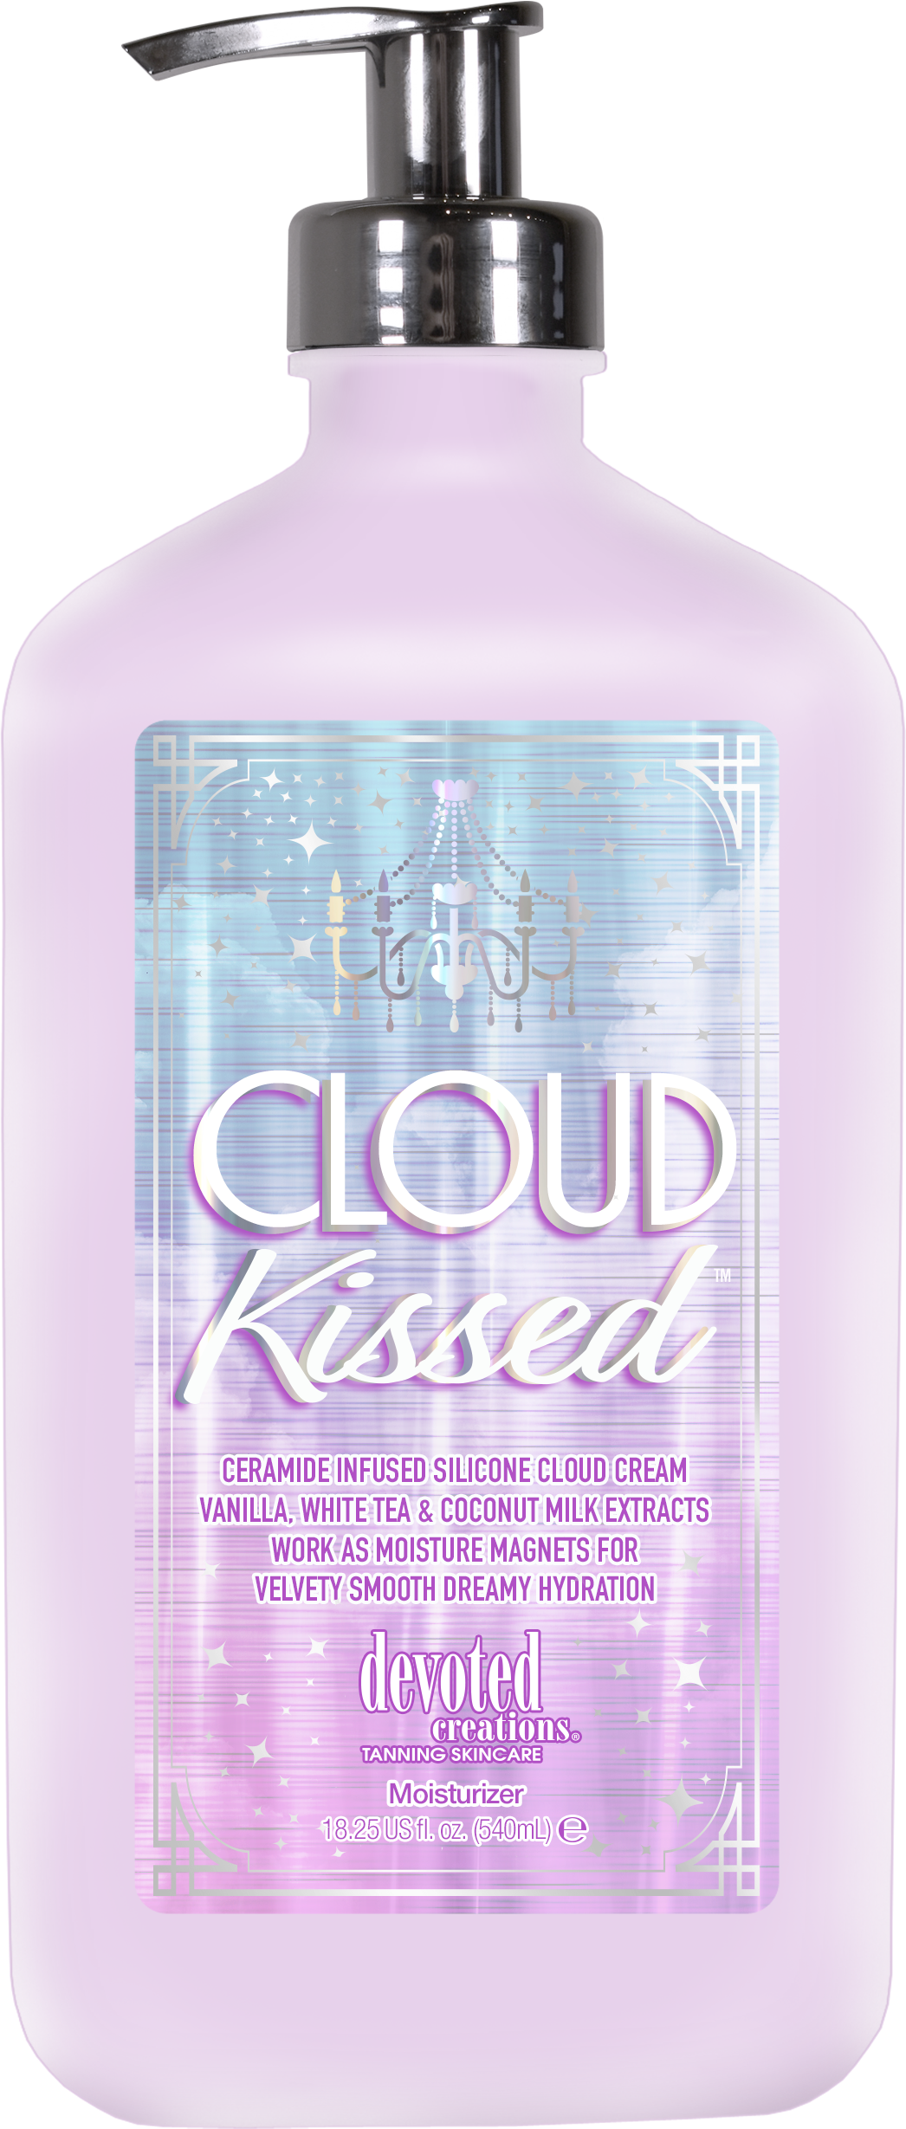
Cocoa & Shea Butter
Upgraded skincare formula
MORE caramel
Skin energizing ingredients
Vanilla fragrance
Extreme hydration

Slide 14
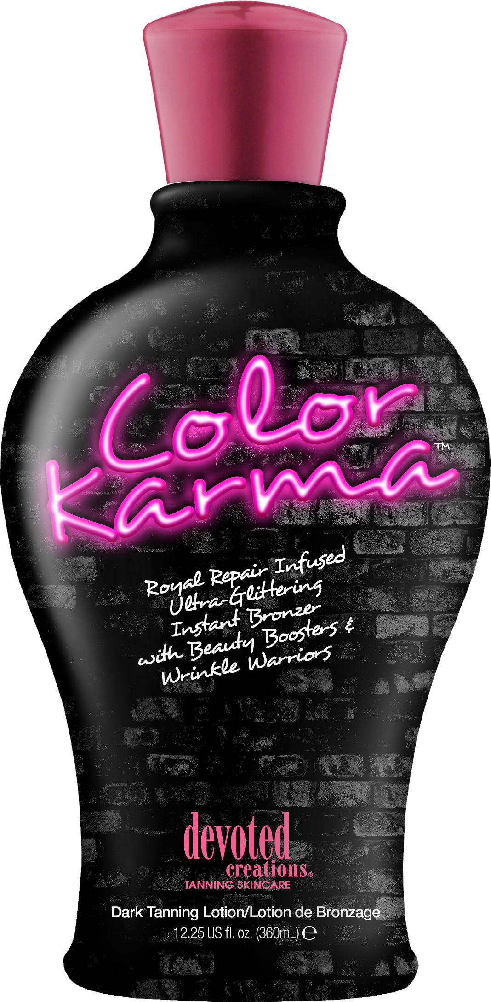
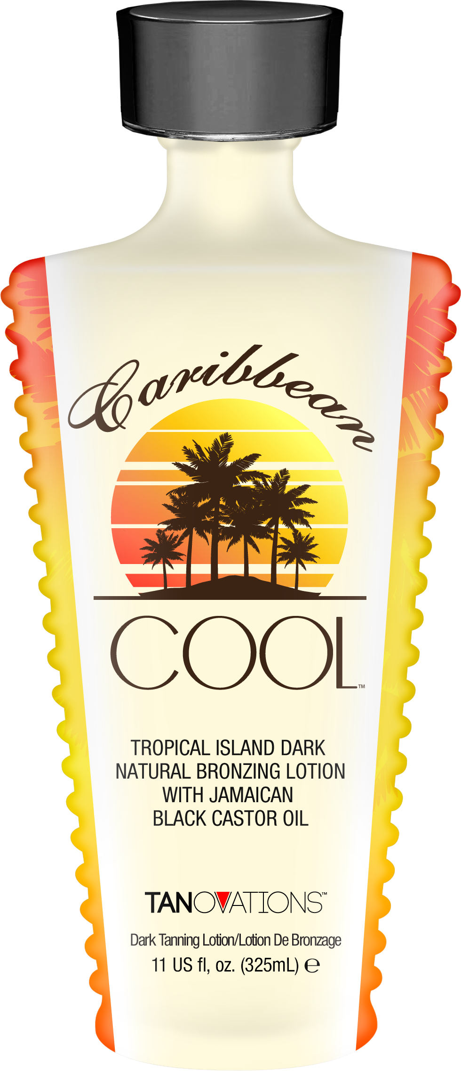
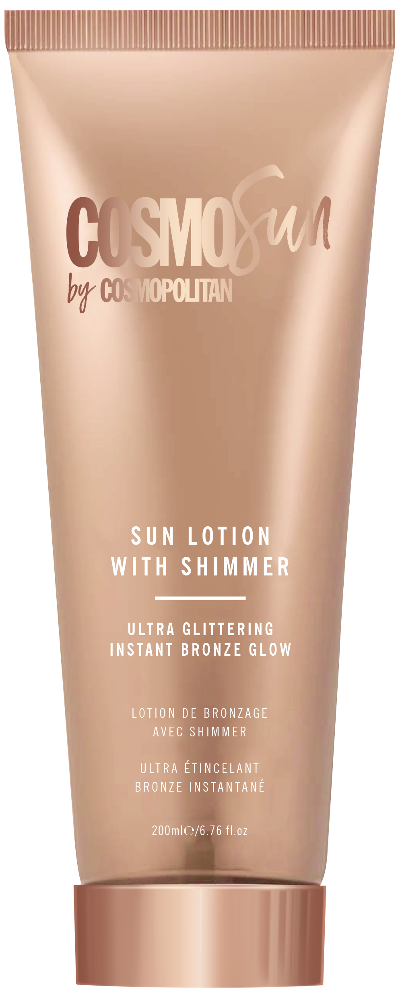
Anti-aging formula
Coconut blend
Castor Oil for inflammation& pore tightening
Natural bronzing shimmer formula
Soft golden fragrance
Upgraded skincare formula

Slide 15
Megan Edwards| International Sales Trainer
megan@devotedcreations.com

