Slide 1
The Countdown to Summer

Slide 2
Summer begins in 55 days!

Slide 3
Ingredients for Summer Skin
Witch Hazel
Aloe Vera
Marshmallow Root
Honey Extract
Coconut Milk
Antioxidants
SPF
Hyaluronic Acid
Tea Tree Oil
Tiger Grass
Cocoa & Shea Butter

Slide 4
Witch Hazel
Marshmallow Extract
Anti-Inflammatory properties helps to alleviate pain and discomfort after sun exposure and speeds up the healing process
Forms a protective & soothing barrier on the skin to treat signs of inflammation and increases moisture levels

Slide 5
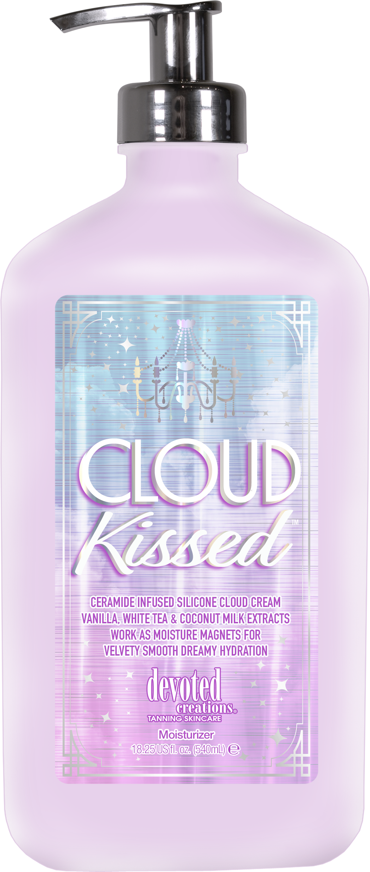
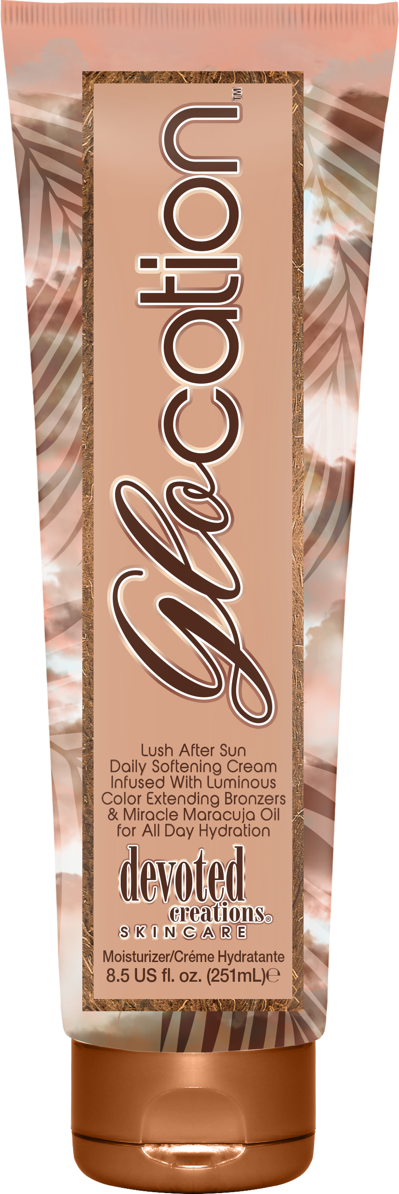
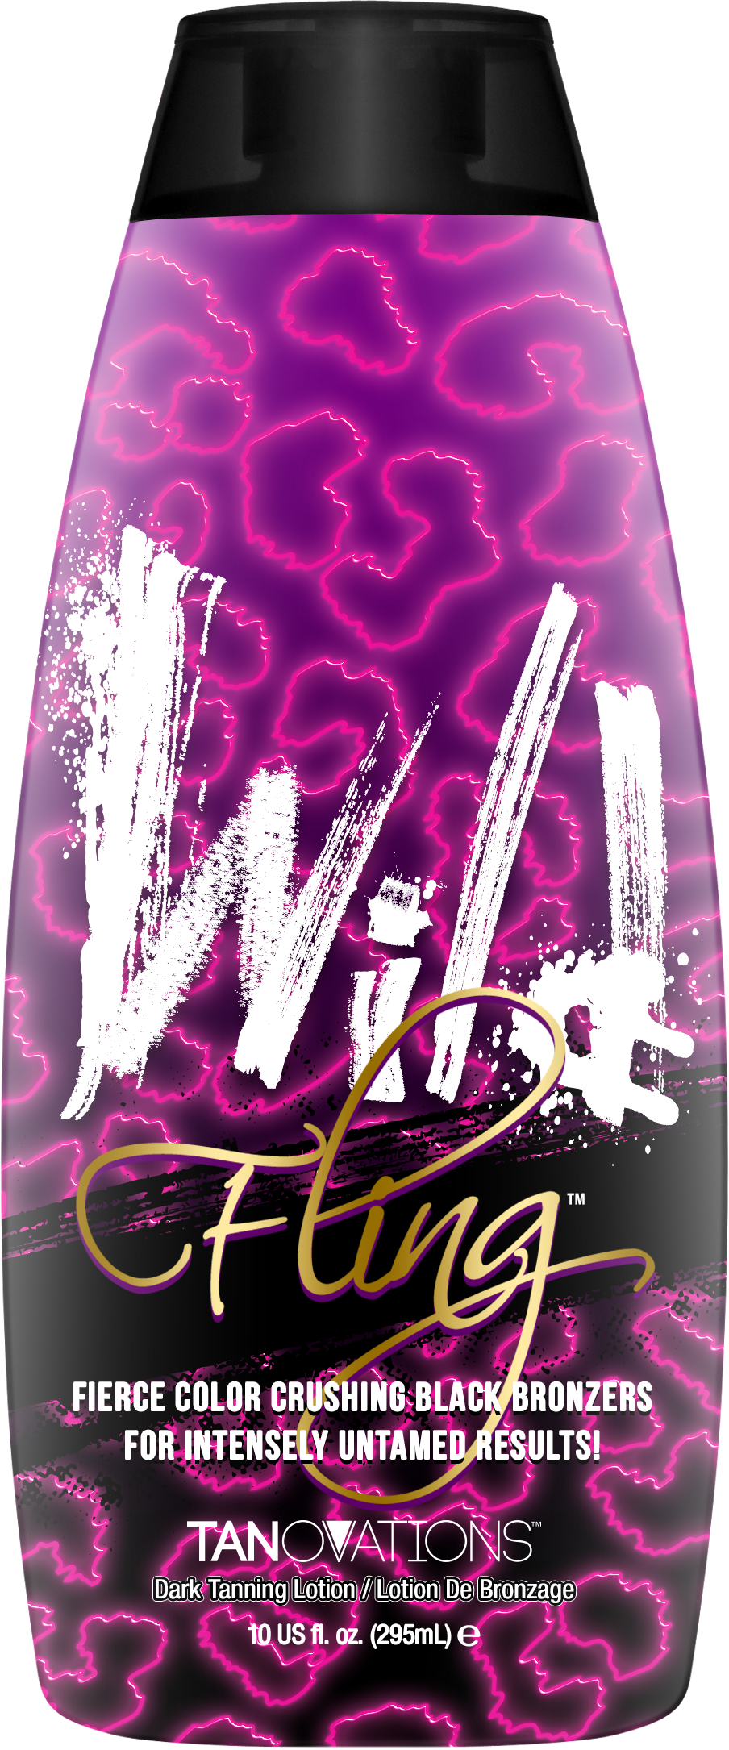
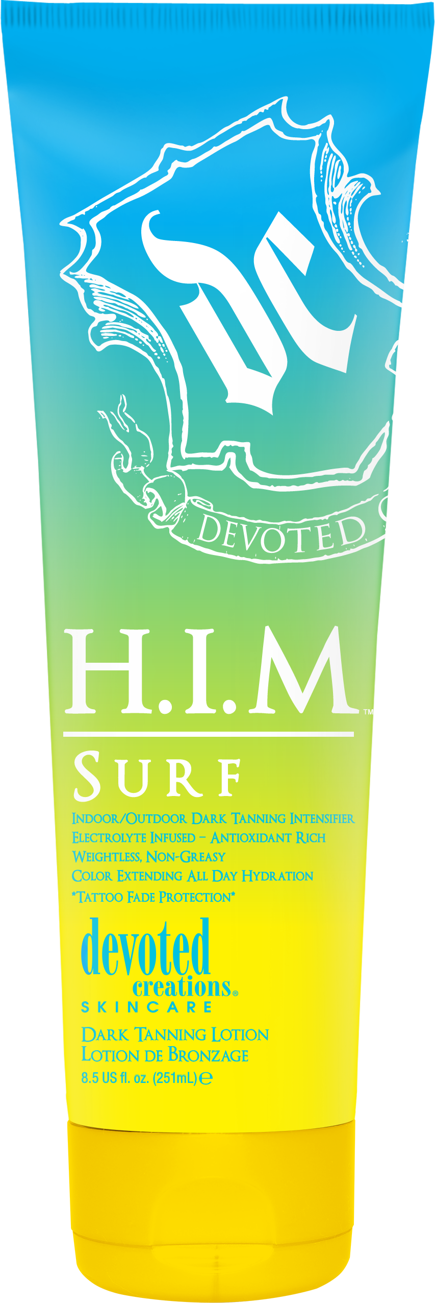
Witch Hazel
Marshmallow Extract

Slide 6
Honey Extract
Coconut Milk
Moisture in honey helps to reduce swelling, redness and provide nutrients and antibacterial properties to the skin
Contains fatty acids that help to reduce itchiness, discomfort & inflammation on the skin

Slide 7
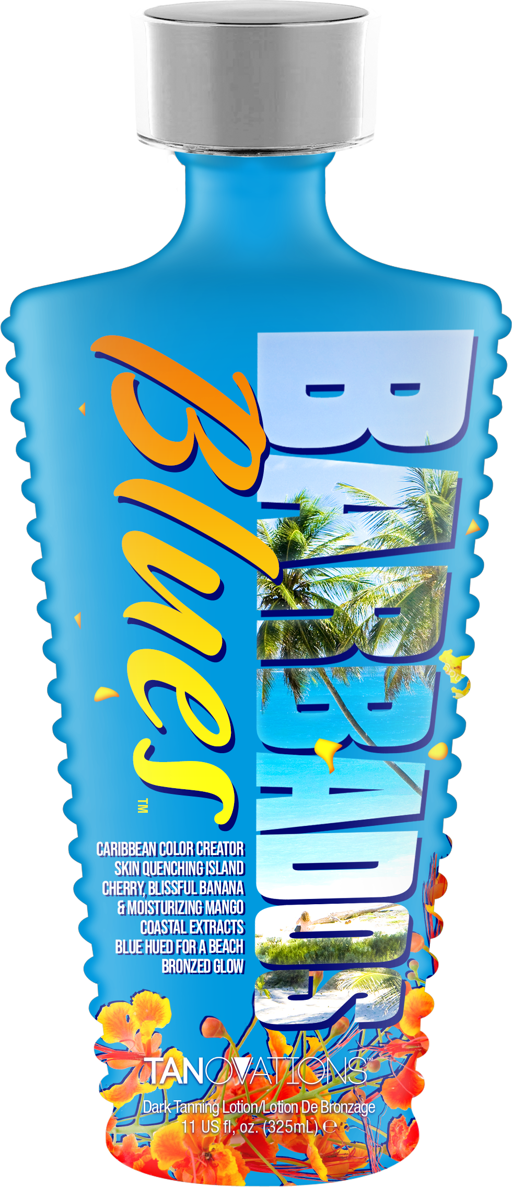
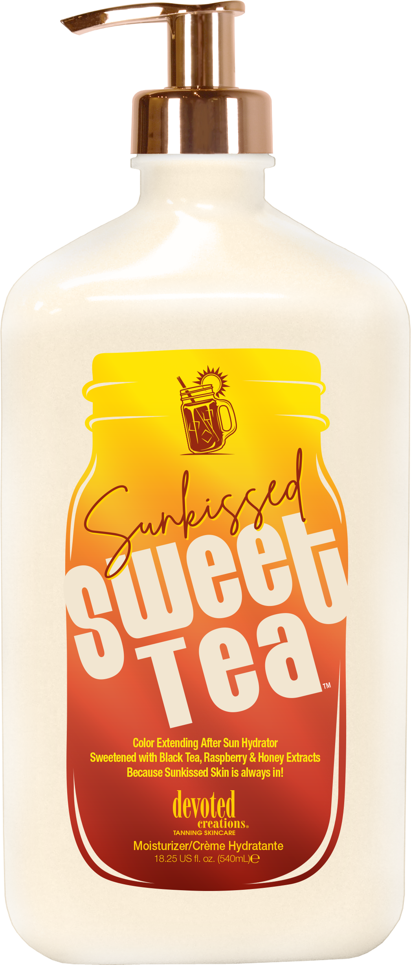
Honey Extract
Coconut Milk

Slide 8
Hyaluronic Acid
Tea Tree Oil
Hydrates the skin, promotes cell renewal and combats signs of aging
Tissue regenerator as it helps to promote new cell growth for anti-aging

Slide 9
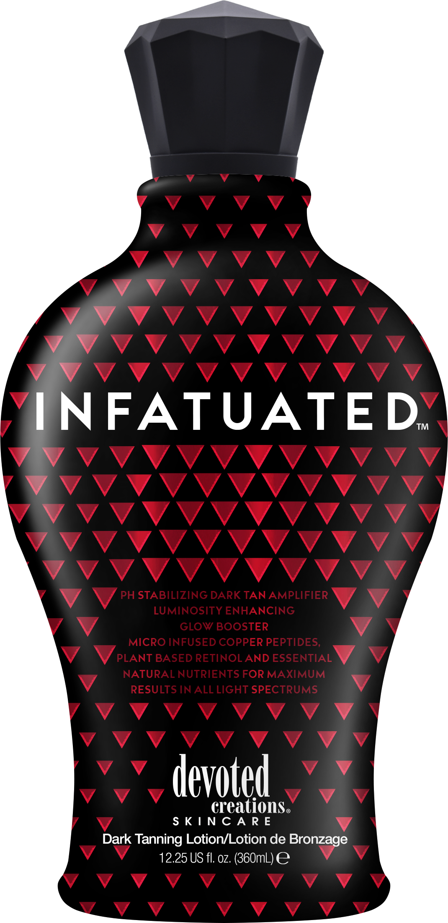
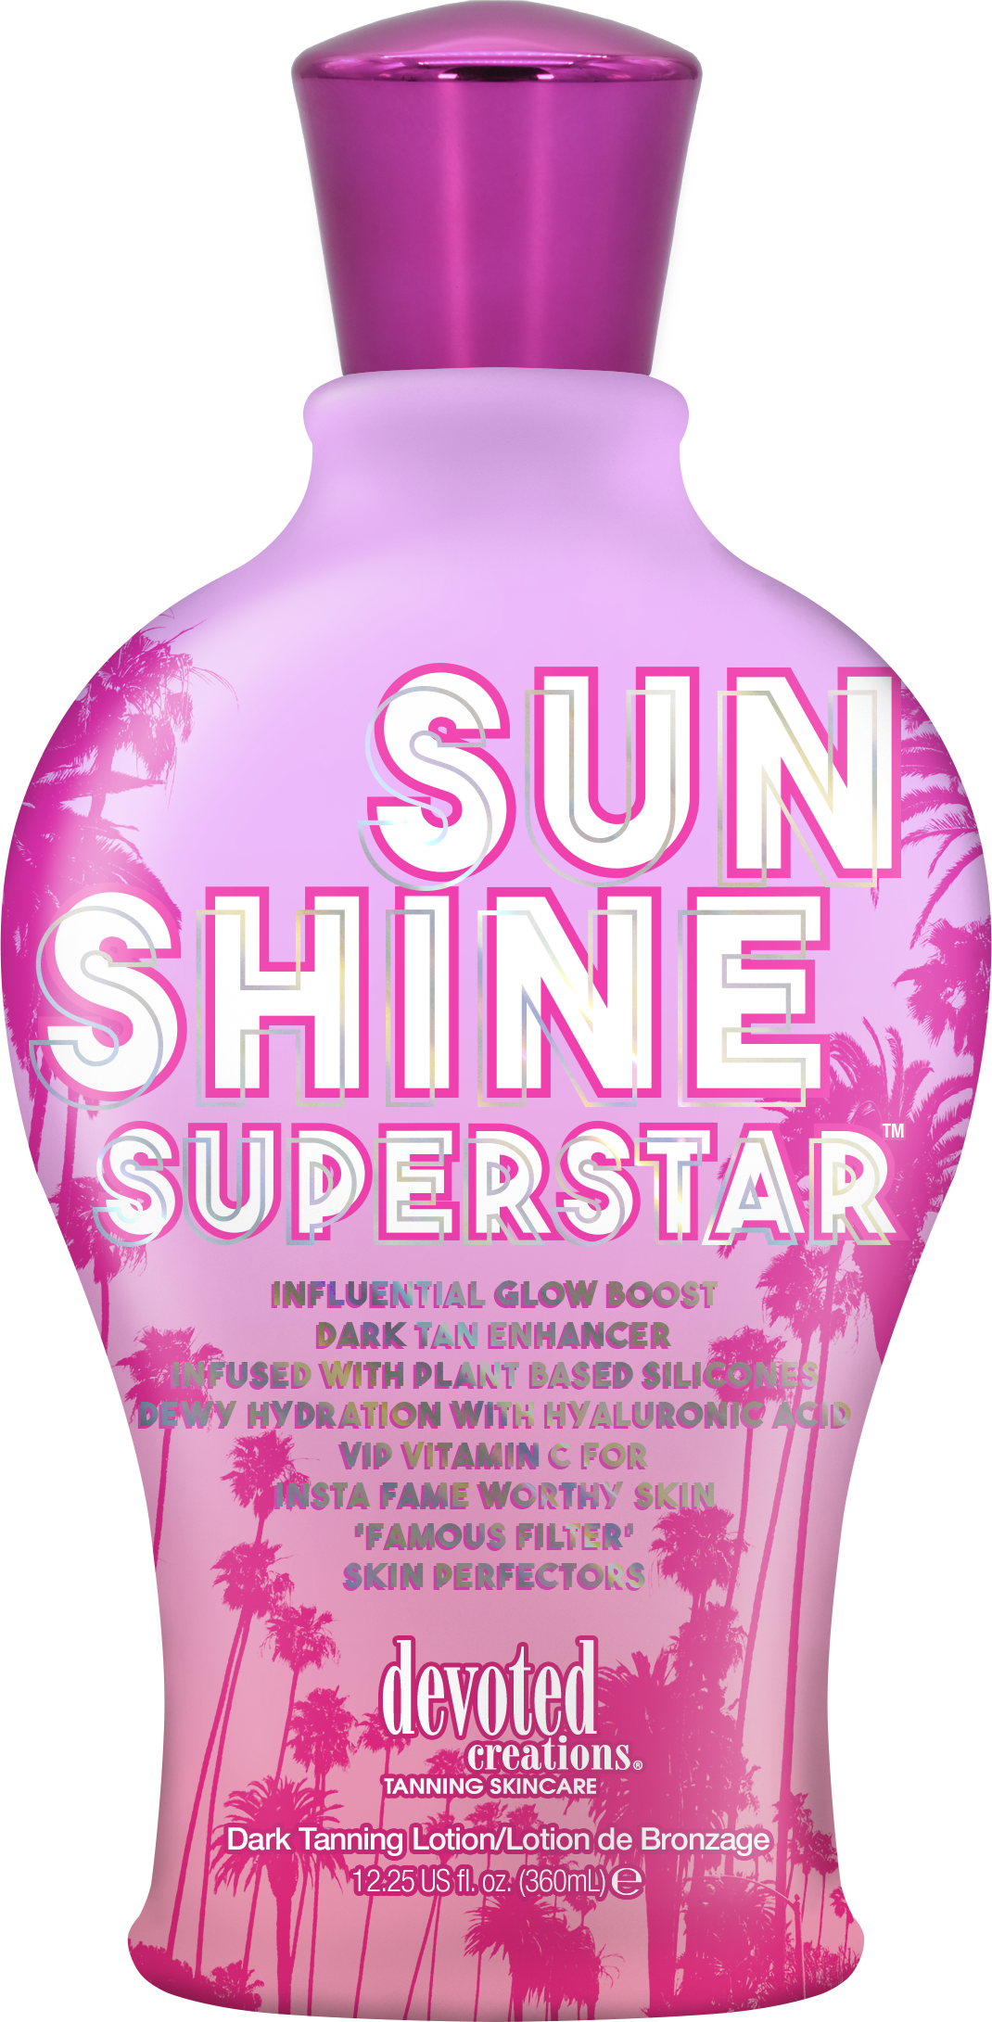
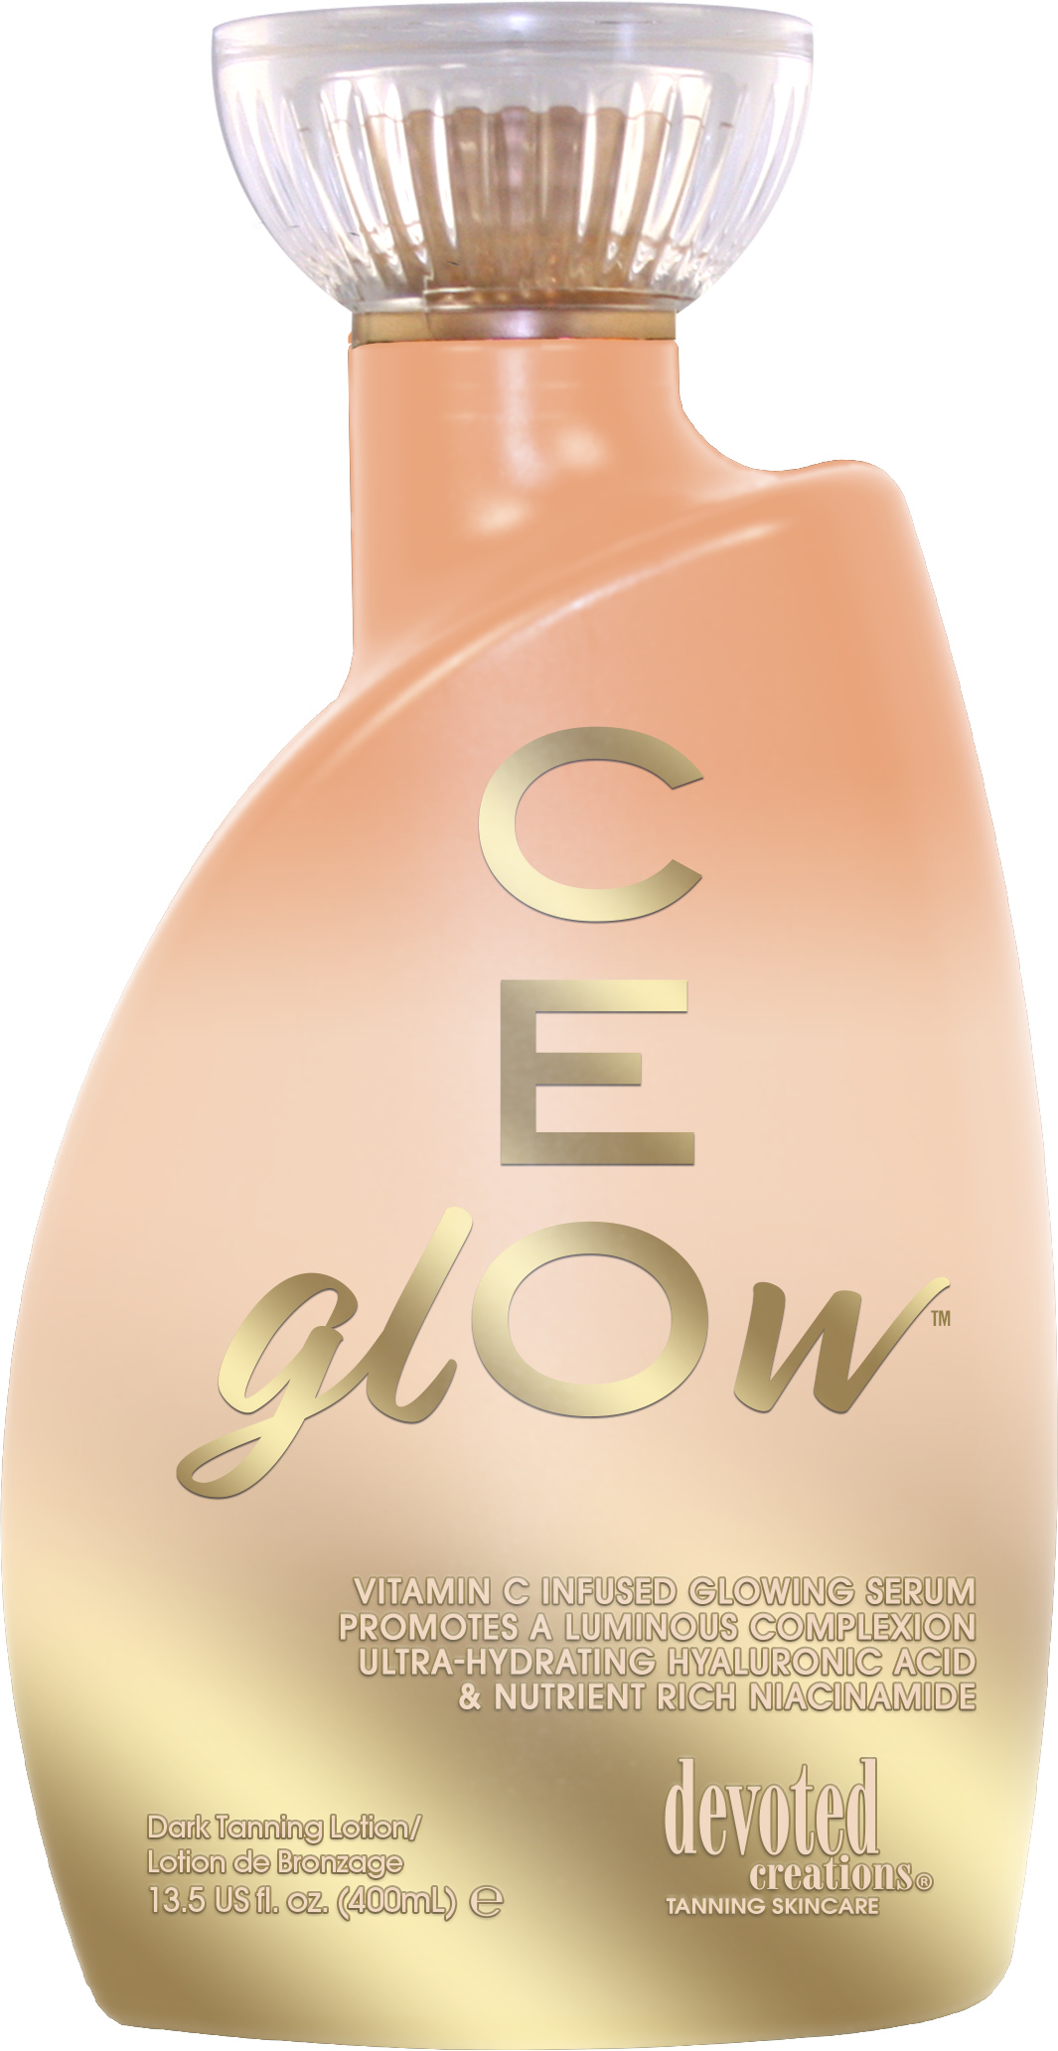
Hyaluronic Acid
Tea Tree Oil

Slide 10
Tiger Grass
Cocoa & Shea Butters
Moisture in honey helps to reduce swelling, redness and provide nutrients and antibacterial properties to the skin
High in fatty acids that help to protect the skin and combat inflammation while maintaining hydration levels

Slide 11
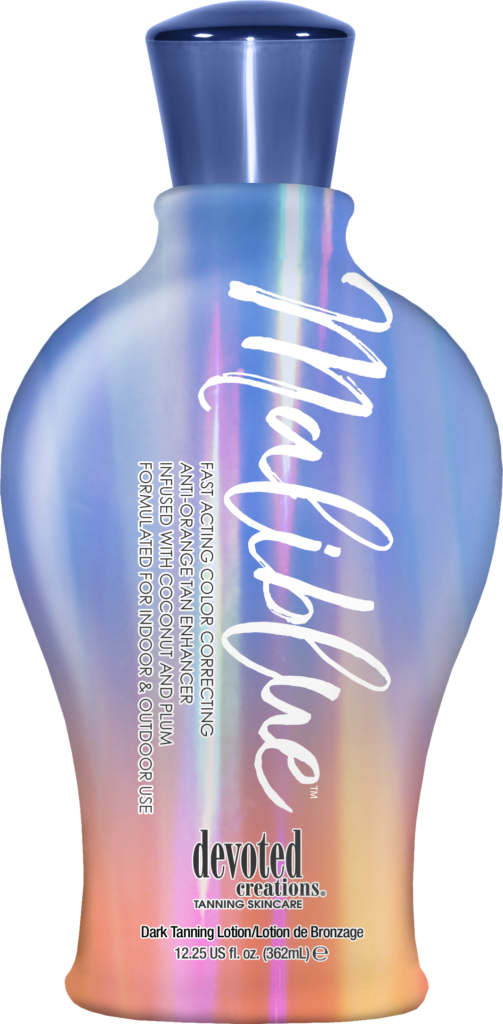
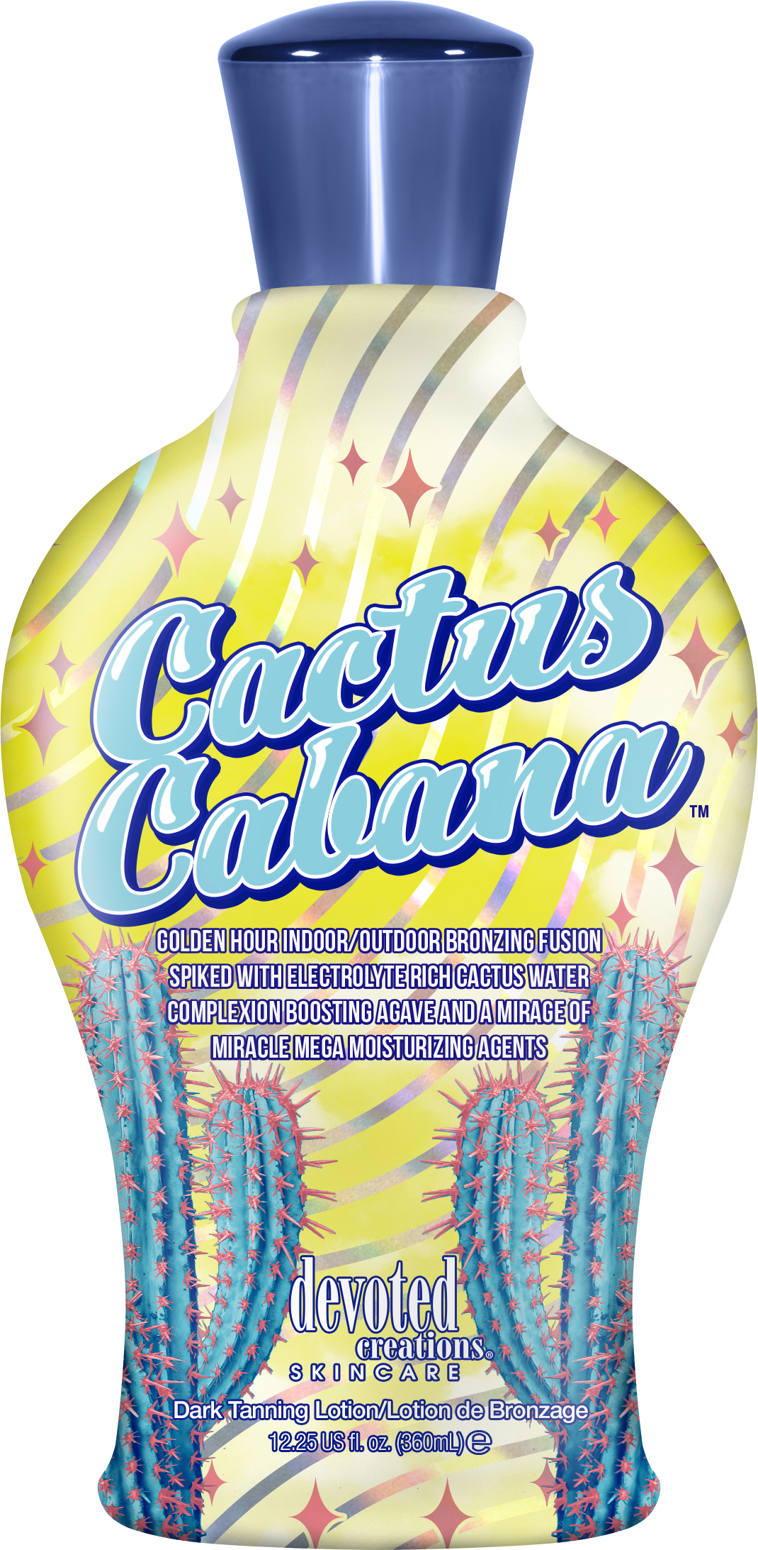
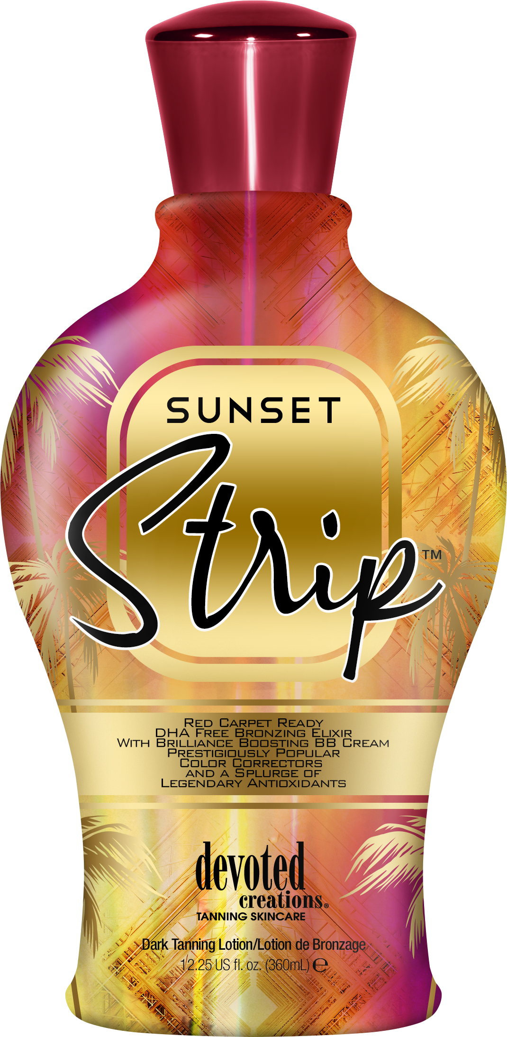
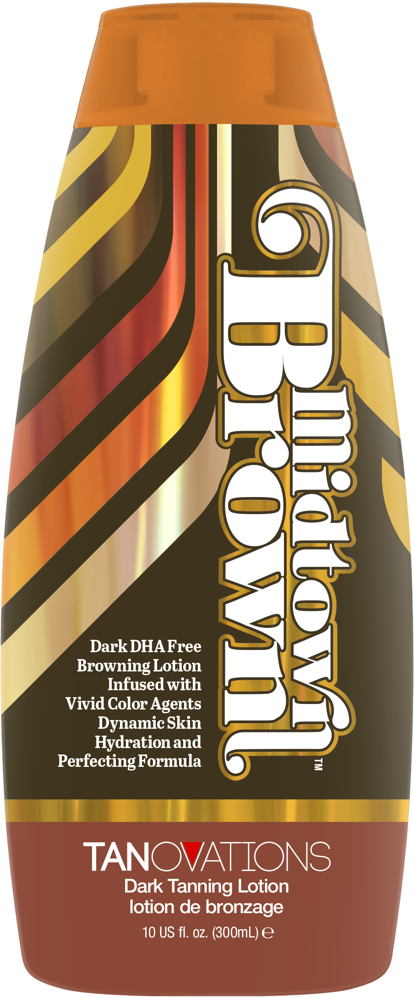
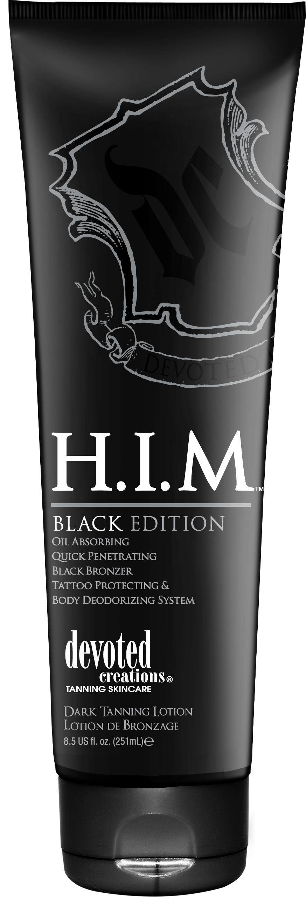
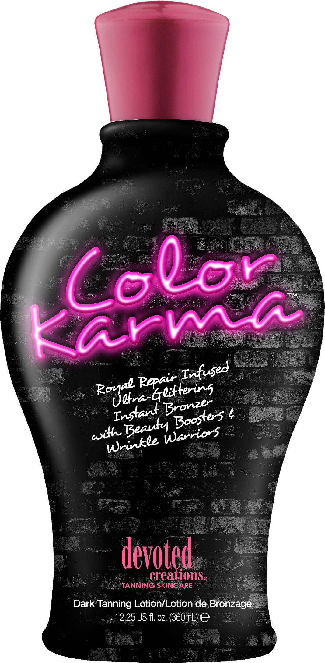
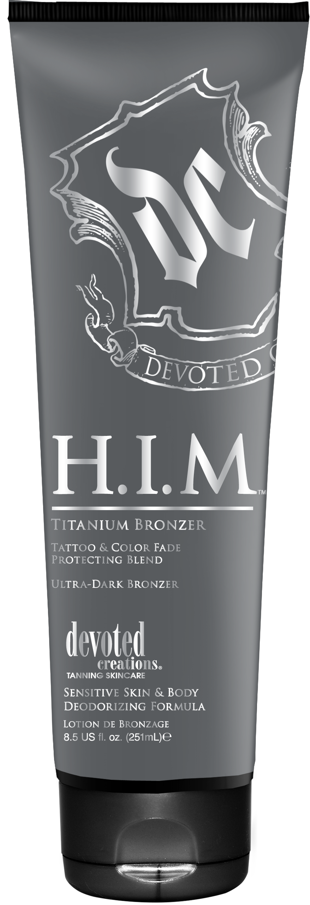
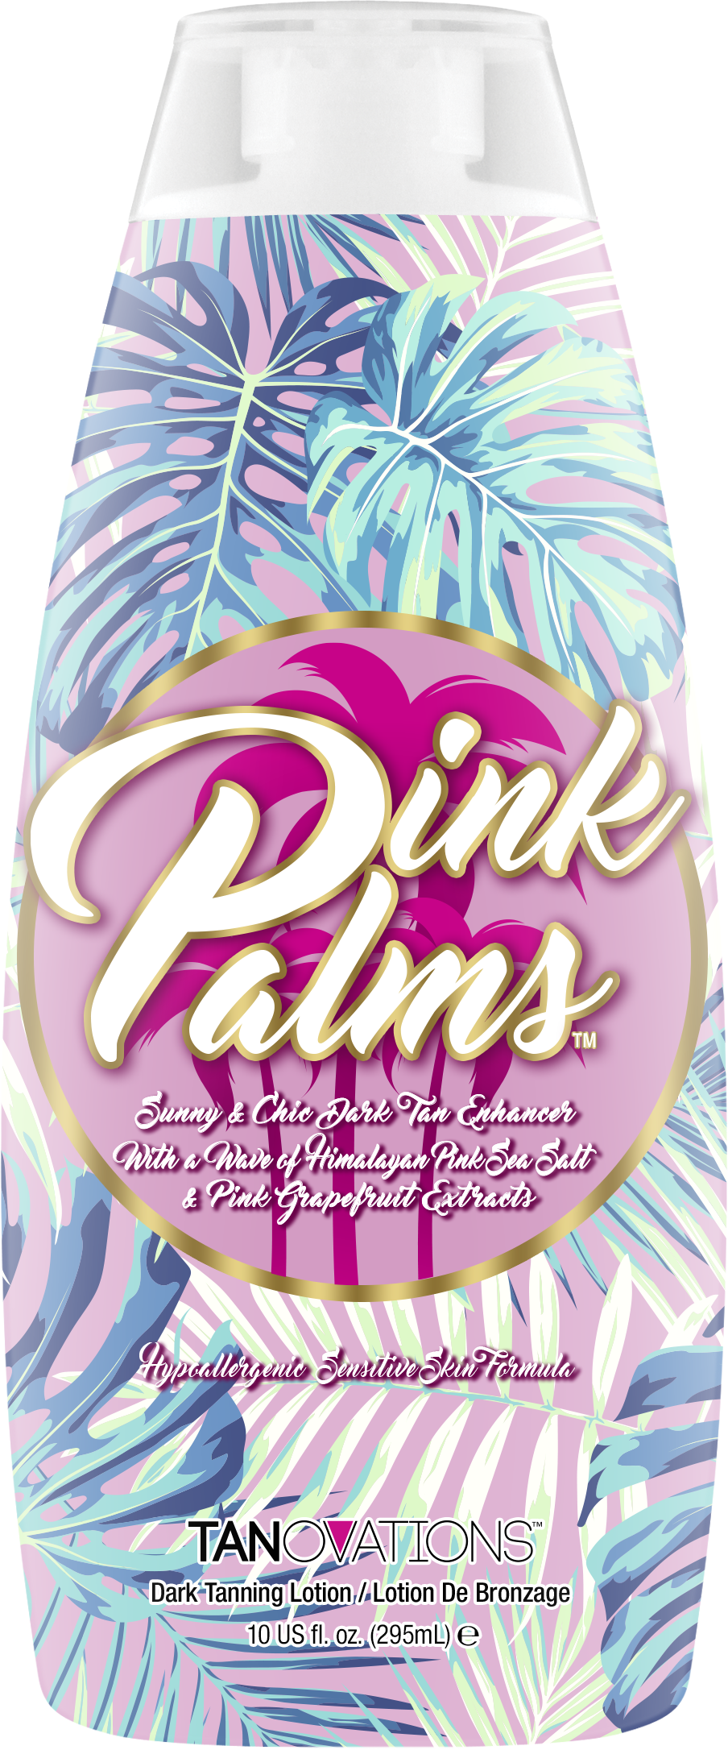
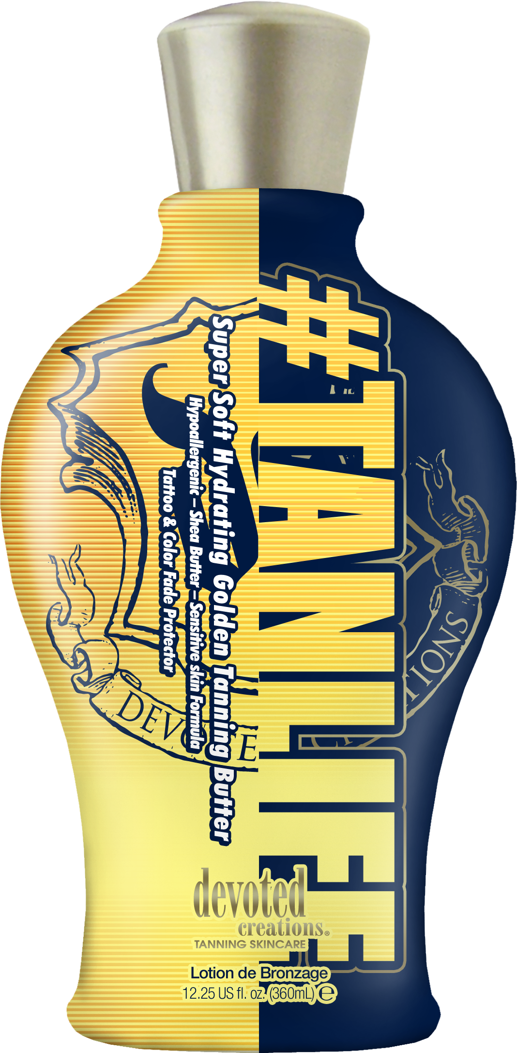
Tiger Grass
Cocoa & Shea Butters

Slide 12
Start Planning Now!
Think of promos to run all summer, not just for the next month
Holiday promos
4th of July, Memorial Day, Labor Day, Father’s Day
Education!
Indoor/outdoor products, spotlight ingredient research
Refresh your space – add in new products to go with the season
Highlight tan extenders and their benefits
Think of ”impulse buy” products to add
Deepen relationships with customers
Build business relationships

Slide 13
Summer Promos!
Product of the month
BOGO
Summer ingredient spotlight
Indoor/Outdoor products
Run sales contests on slow moving products
Tan until the end of the year sale
Upgrade specials
Try a new service for free

Slide 14
Megan Edwards| International Sales Trainer
megan@devotedcreations.com

