Slide 1
National Cucumber & Mango Month

Slide 3
Mango Extract & Mango Butter
Butter comes from the seed
Extract comes from the skin
Contains antioxidant properties that helps to fight against free radicals and prevent cellular damage to the skin
Provides a preventative action on wrinkles, fine lines & other signs of skin sagging as it protects against collagen & elastin degradation
Strengthens the skin’s natural barrier
Contributes to the restoration of a broken barrier to maintain skin hydration
Anti-inflammatory benefits for those with sensitive or dry skin
Helps to heal signs of hyperpigmentation

Slide 4
Mango Extract & Mango Butter
Butter comes from the seed
Extract comes from the skin
Helps to improve skin’s uneven tone & texture
Provides astringent properties to the skin to work against acne formations
Helps to remove dead skin cell buildup for healthier looking skin
Can help reduce dark spots and hyperpigmentation
Helps improve collagen production
Gives the skin a natural glowing effect

Slide 5
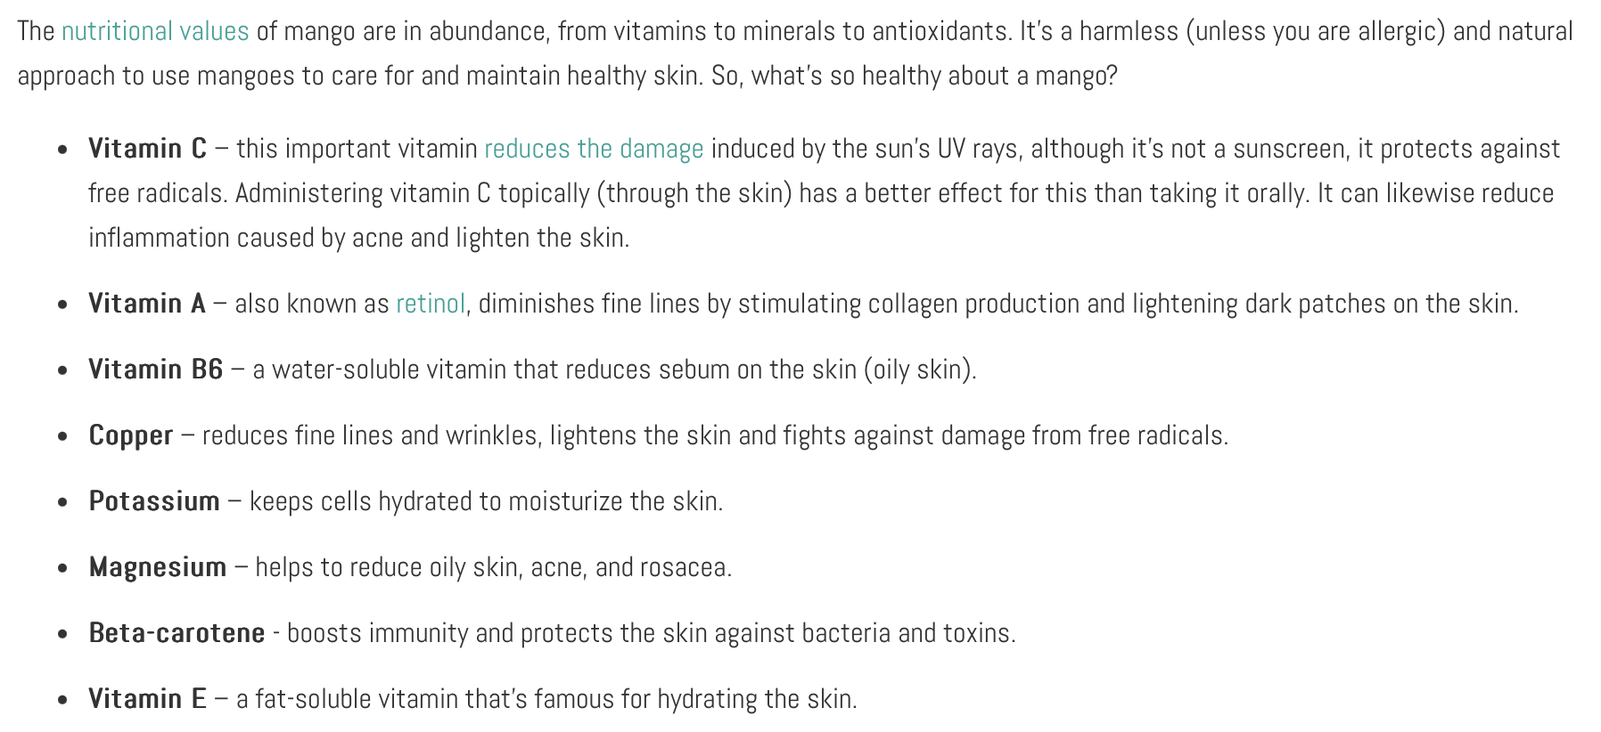
https://www.herbaldynamicsbeauty.com/blogs/herbal-dynamics-beauty/10-amazing-benefits-of-mango-for-skin-health#:~:text=Mango%20extract%20is%20a%20wonderful,regularly%20to%20avoid%20further%20breakouts.

Slide 6
Cucumbers help the body feel refreshed
A water-based skincare ingredient and a natural source of AHA
Helps get rid of dead skin cells and clogged pores for a clear complexion
Naturally cooling & anti-inflammatory for sensitive or irritated skin
Helps to control oil production
Can help even skin tone
High in antioxidants, nutrients and minerals to help strengthen the skin’s barrier
Natural source of water to help keep the skin at ample hydration levels
Creates an instant glowing effect on the skin

Slide 7
Products with Mango
Products with Cucumber
White 2 Bronze Butter
Ride or Tide
HIM Surf
Barbados Blues
Hemp IQ Original
Electric Aura
Turquoise Temptation
Dare to be Dark
Barefoot Beachwood
Saltwater Sundays
Seaside Sunset

Slide 8
Megan Edwards | International Sales Trainer
megan@devotedcreations.com

