Slide 1
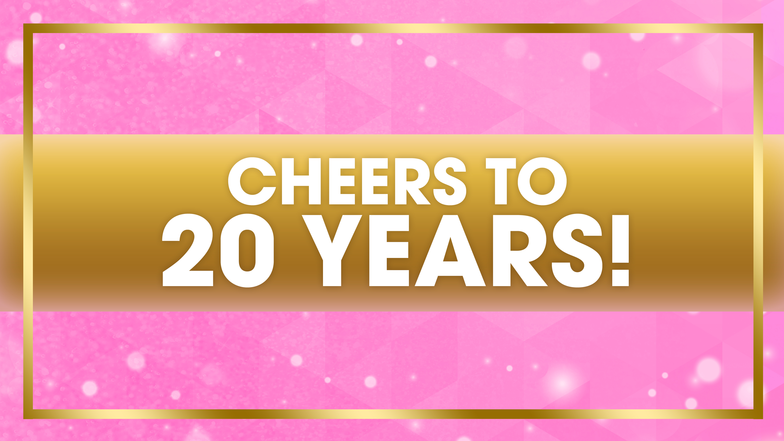
Berrylicious spotlight:
Raspberry & Blueberry

Slide 2
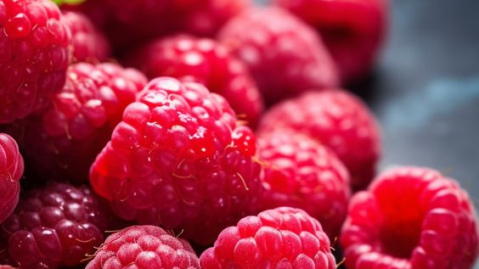
Raspberries and Our Skin
Raspberries contain a ton of antioxidants
  Vitamin c
  Beta-carotene
  Vitamin e
  Glutathione
Protects against dark spot formations and loss of firmness in the skin
Helps to defend the skin from UVB exposure
Protects against free radicals – uhnstable molecules that lead to prematiure aging of the skin
Maintains the skin’s moisture balance
  Perfect for dry & dehydrated skin
Anti-inflammatory and can help stimulate new collagen production
Humectant/emollient
Boosts hydration and moisture to increase the integrity and barrier function of the skin
Contains omega-3 fatty acids which have natural healing properties for those with skin conditions
Gives the skin a glowing complexion

Slide 3
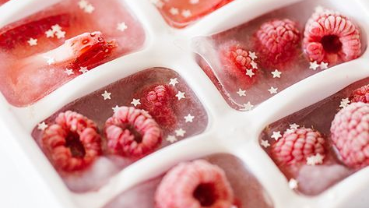
Raspberries & Tanning
Slower working tanning agent and can be less drying
Generally can take 2-3 days to develop with peak color in 4-6
Comes from raspberries, natural sugar, has moisturizing properties
Raspberry Ketones
  A natural DHA substitute in DHA free self tanners
  High in Vitamin C, protects from UV induced damage, helps tighten the skin & increase elasticity

Slide 4
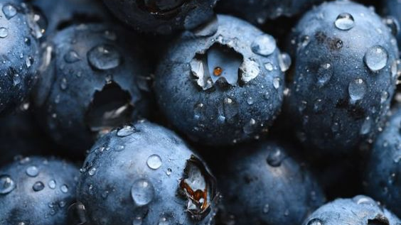
Blueberries & Our Skin
High in vitamins A, C & E, helps with dull looking skin, leads to a healthy complexion
Protects against free radical damage
Shown to reduce age spots and brighten the skin
Has anti-inflammatory compounds to alleviate redness and clogged pores
Stimulates collagen production, enhancing skin elasticity and firmness
Helps remove dead skin cell buildup
Antibacterial properties that helps to combat acne-causing bacteria
Great for acne prone or sensitive skin
High water content = more hydration for the skin
Reduces cellular damage from UV exposure
Regulates oil production
Supports skin regeneration and repair, aids in the healing process of the skin to remain strong and supple

Slide 5
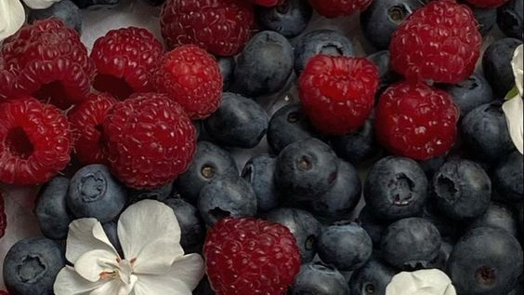
Products with Blueberry
Products with Raspberry
Indigo Illusion
Turquoise Temptation
Frosé Fantsy
Collagenetics Illuminate Light Lotion
Collagenetics Illuminate Beauty Balm
Going off Tropic
Enchanted Emerald
Enchanted Emerald Body Wash
Sunkissed Sweet Tea
Going off Tropic
Berries & Brandy
Vault

Slide 6
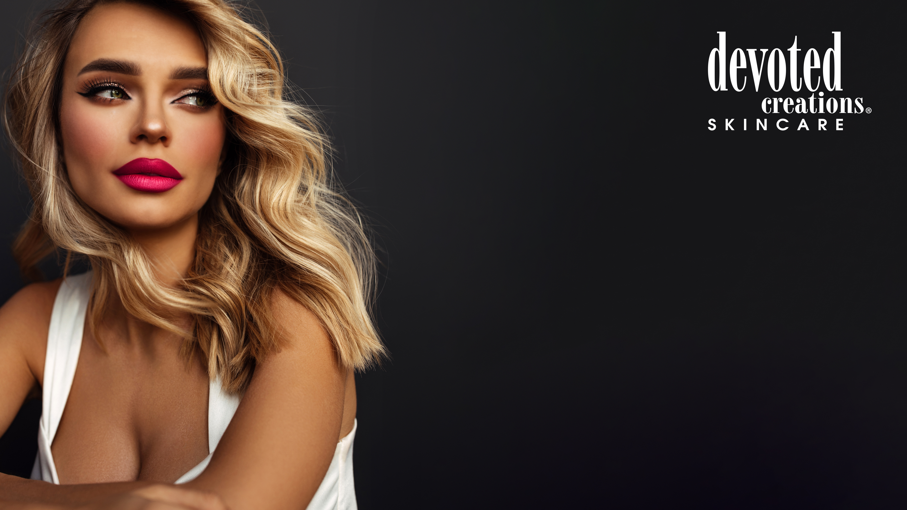
Megan Edwards| Key Accounts Manager
megan@devotedcreations.com

