Slide 1
BUNDLING

Slide 2
Why Bundle?
Delivers a more rounded experience to customers
May have come in for one product, then see it bundled with another product that they didn’t know they needed
SAVING $$$$
Can help boost sales
Cross-selling & upselling can help increase revenue by 30%

Slide 3
What is Bundling?
Grouping products together to sell them as a single unit at a set price
Helps to remove the thinking from a customers purchasing decision
Helps a customer better understand the products you offer
Offering related products to a pending purchase
Helps you move slow-moving stock

Slide 4
AVOID THESE
Avoid bundling lower priced products with a higher priced item.
Bundle products with related prices
i.e Color Rush & Cocoa & Shea/Glocation
This can lower the perceived value of the bundle
You want to give you customers a good value with even better products
Adding unnecessary cognitive load
The amount of energy it takes to make the decision
Decide for the customers and use your knowledge to create the bundle that offers the most value for everyone

Slide 5
Pure Bundling
Offering one price for more
Netflix, your eft memberships
I only want to watch this one show on Netflix, but because I have this membership, I have access to everything
I only want to use this specific bed, but with my membership I can use all the beds if I wanted to

Slide 6
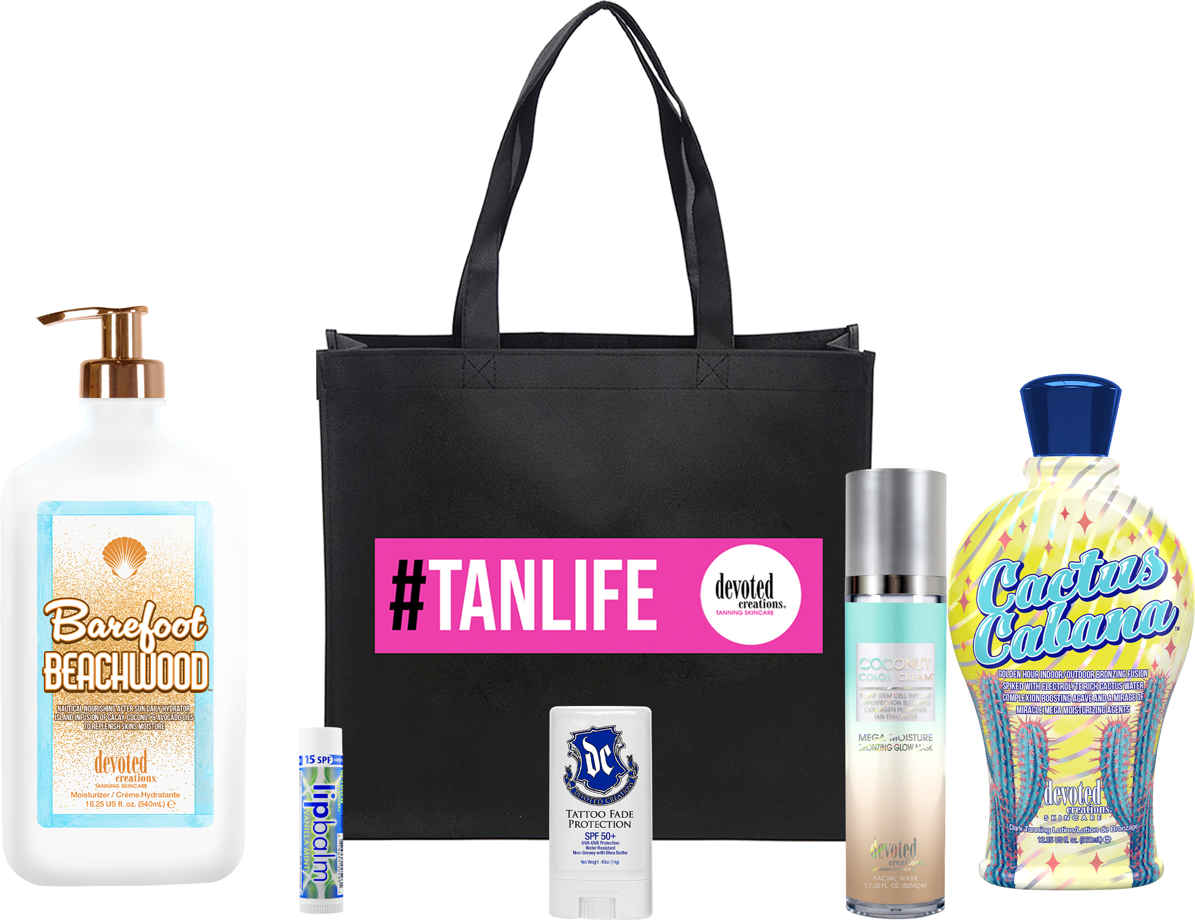
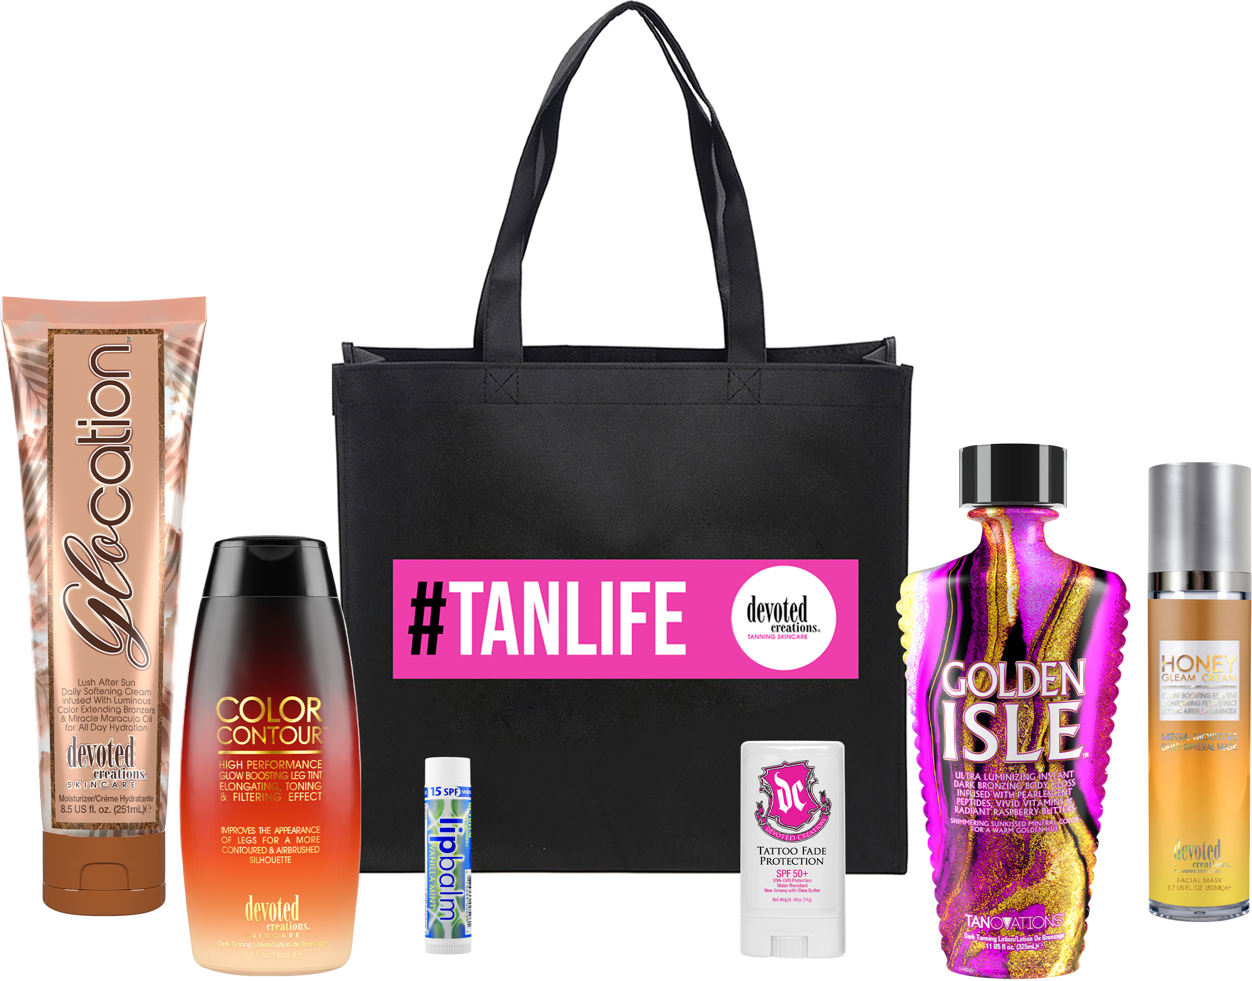
Price Based Bundling
Offering a group of products with a set price that is lower than market retail price
MSRP $177.87
Salon Cost $88.94
50% Discount $44.47
Special Price $35.00
MSRP $173.92
Salon Cost $86.96
50% Discount $43.48
Special Price $35.00

Slide 7
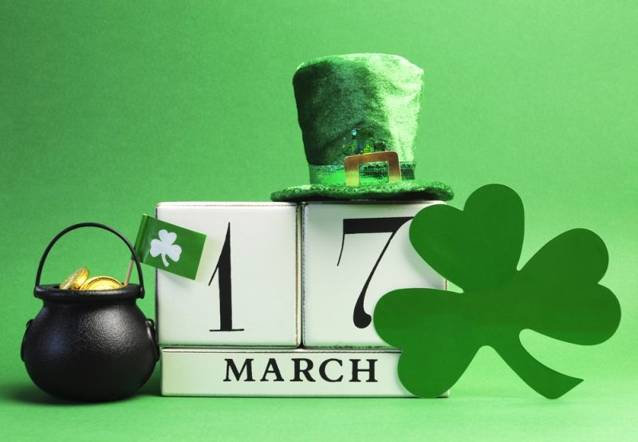
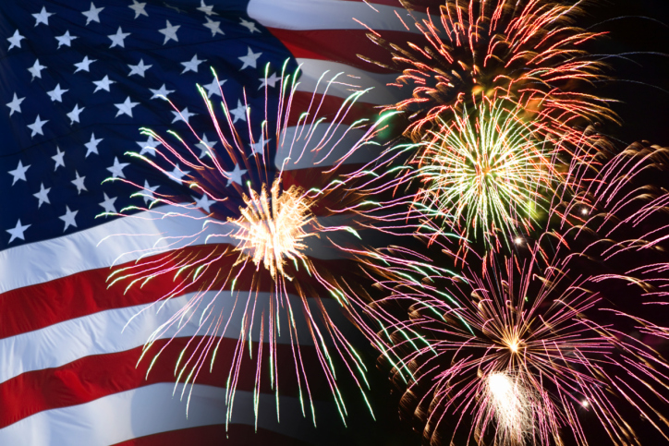
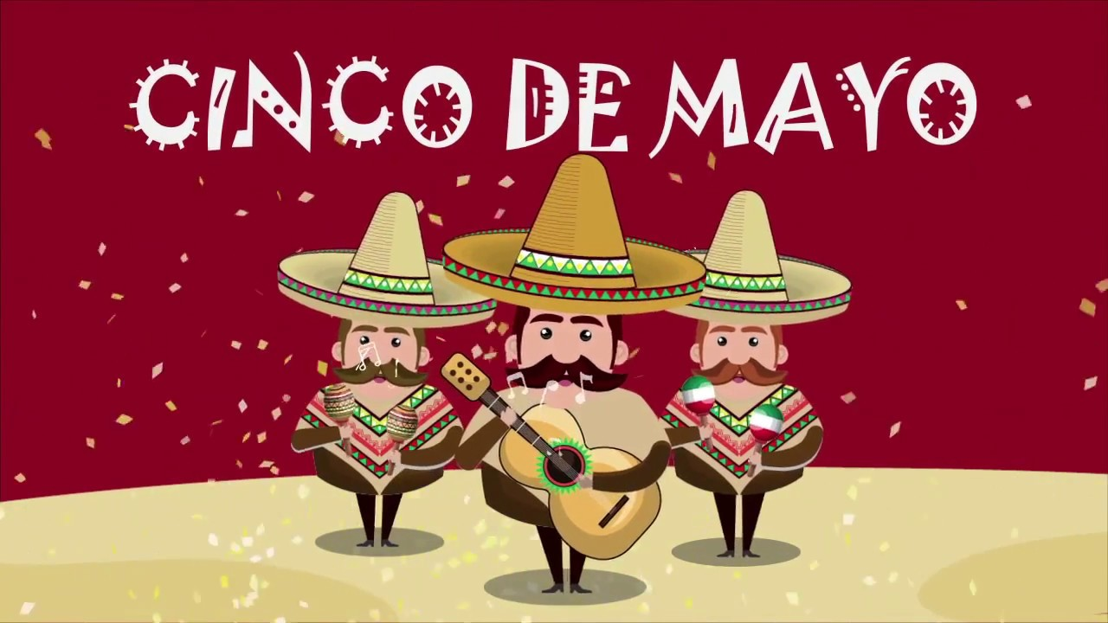
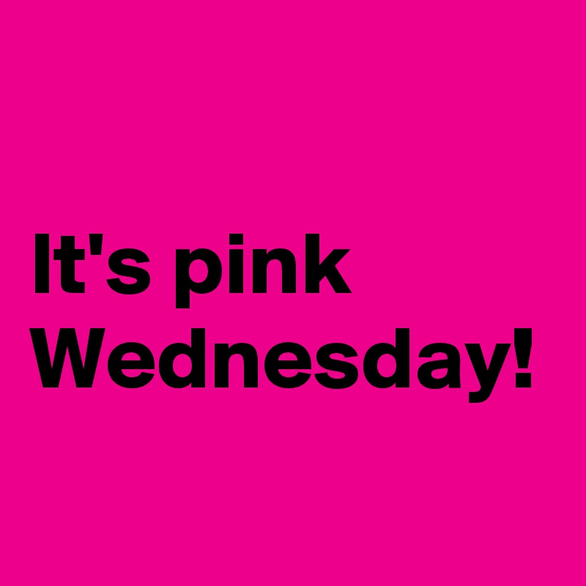
Gifting Bundles
Bundling for holidays, anniversaries, birthdays, etc (Occasion Based Bundles)
Valentines Day
Spring Break
Owner Birthday
Salon Anniversary
Don’t need to always focus on price, just need to highlight the convenience of putting all their favorites together

Slide 8
Bundle Ideas with Services
Buy a lotion upgrade to the next level for x amount of days
Buy a packet upgrade for free
Buy a lotion upgrade to our high pressure bed for x amount of days
Buy a lotion get an add on for x% off
Buy a spray tan friendly lotion and get a free spray tan
Buy any red light therapy product and try a red light session for free
Buy a red light bundle, get 3 free sessions

Slide 9
Bundling Tips
Use your own expertise and knowledge
Allow customers to do the bundling
Promote new products in a bundle
It needs to make sense!
Offer different price points
Should offer an easily defined benefit for the customer
Add in a free item
Help get rid of dead stock
Do it incrementally
Start with bundling lotion with services
Then bundle products together
Then add services to that
Pay attention to who is taking advantage of it
Study buyer purchase patterns, know your customers preferences
Test different combinations, trial & error
Bundle overstock or less popular items with popular items to give them more notice

Slide 10
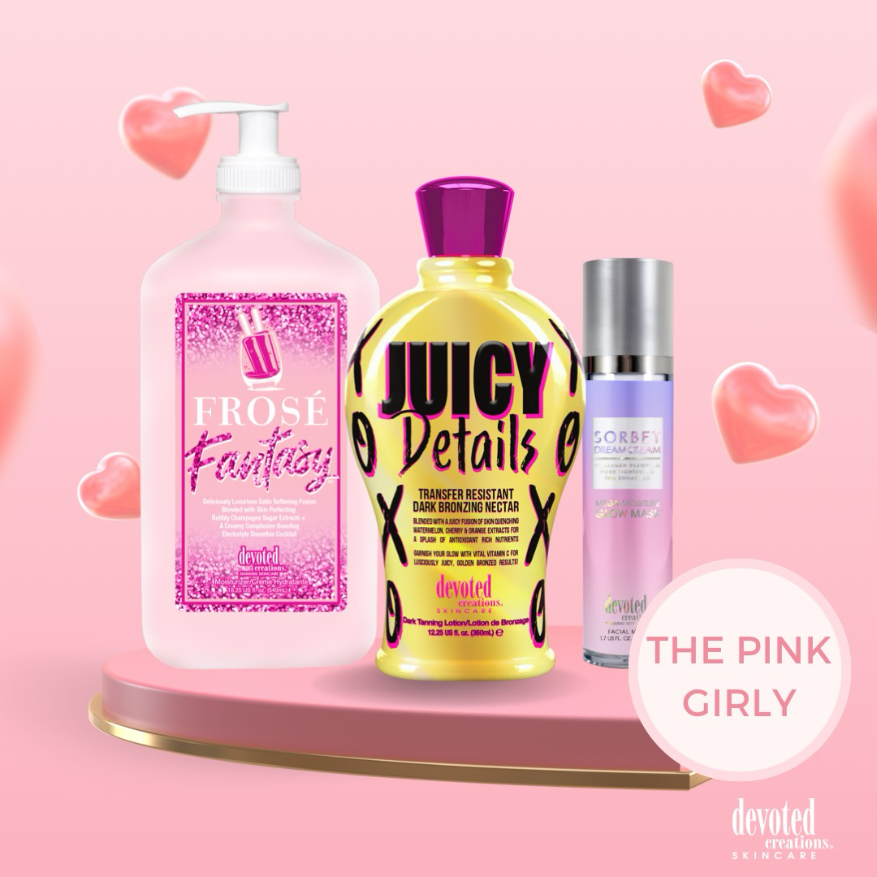
Fragrance
Ingredients
Vegan Collagen
Watermelon Extract
Spray Tan Friendly
Packaging

Slide 11
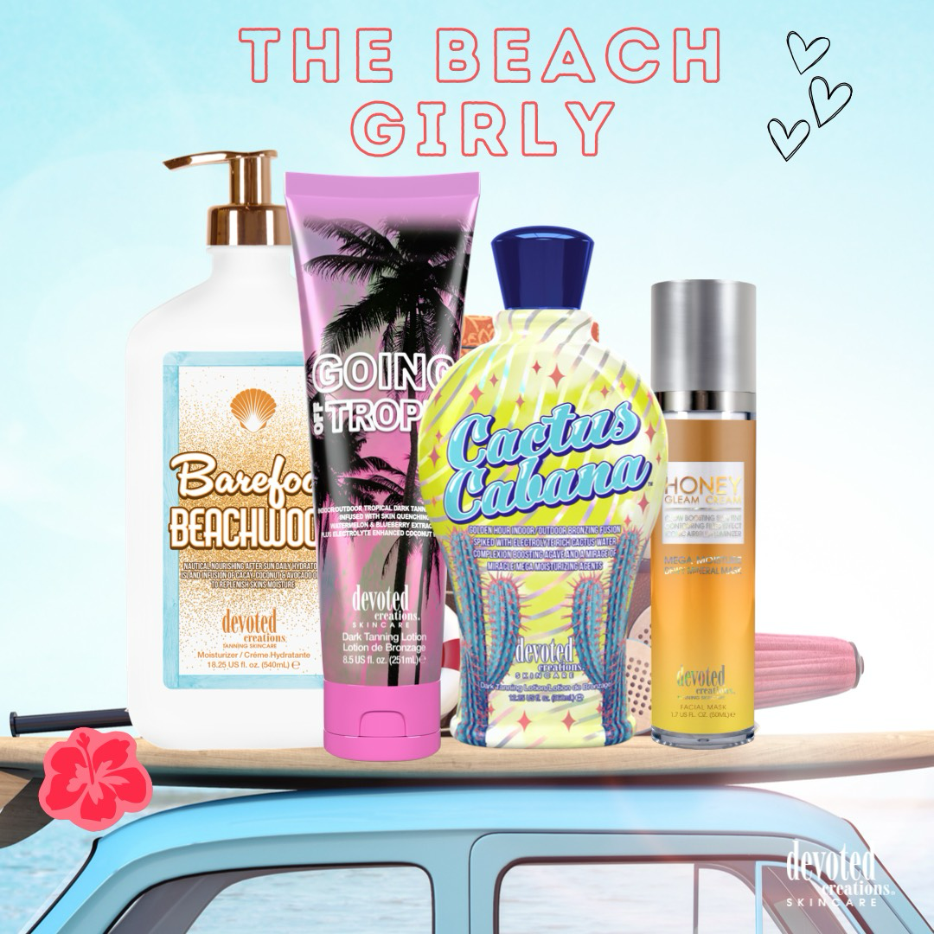
Indoor/Outdoor options
Moisture Retaining Ingredients
Formula
Packaging

Slide 12
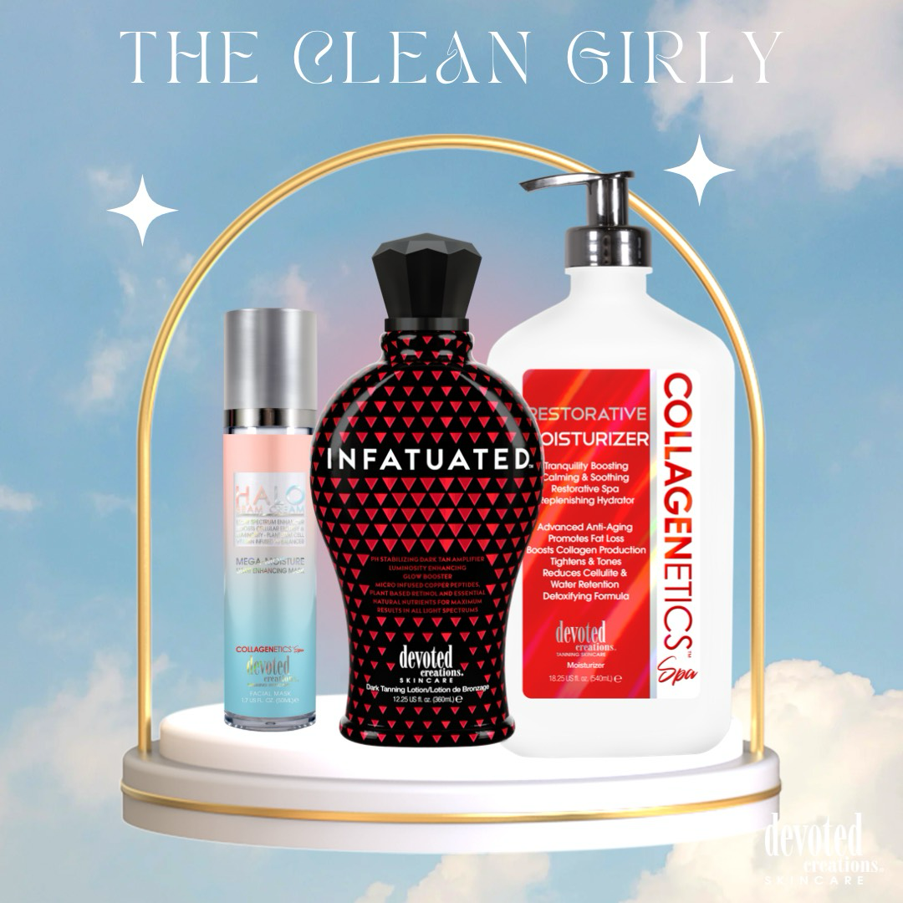
Red Light Compatability
Fragrances
Formulas
Packaging
Ingredients
X50 Photoglow
ACV
Hyaluronic Acid
Anti-Aging & Skincare

Slide 13
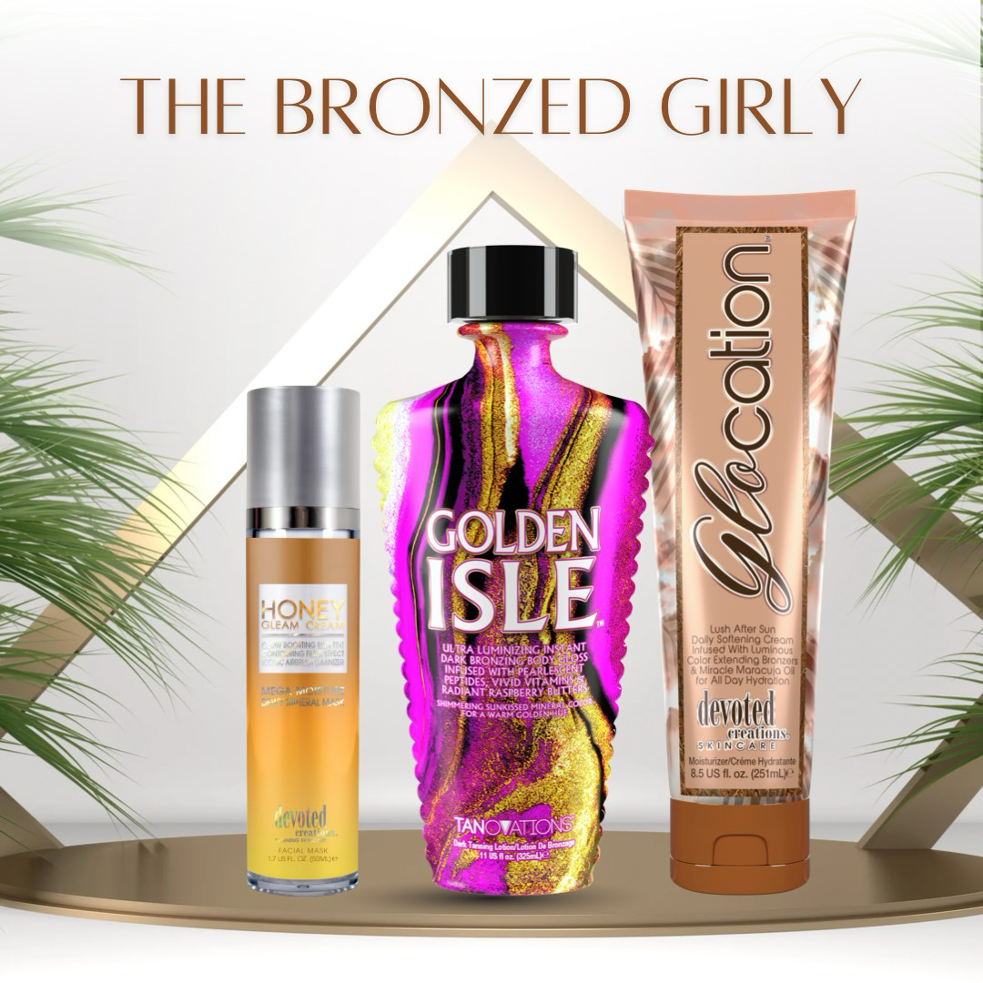
Indoor/Outdoor options
Formula
Packaging

Slide 14
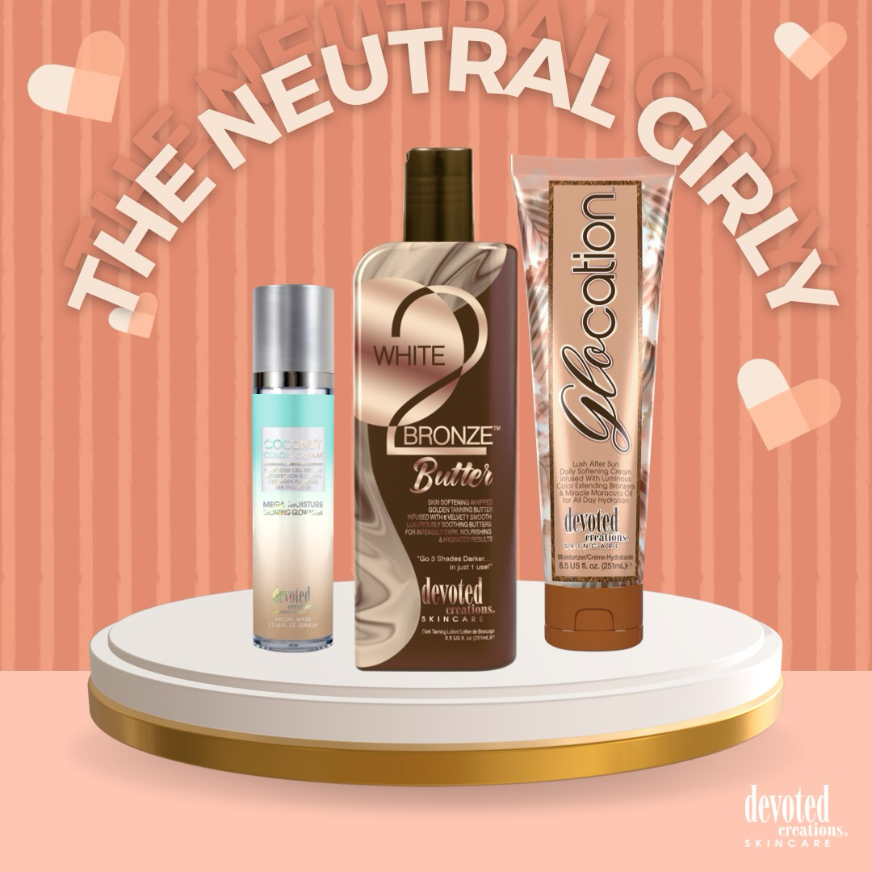
Ingredients
Skin repairing
Skin hydrating
Vegan Collagen
Matrixyl
Moisture Retaining Ingredients
Formula
Packaging

Slide 15
Megan Racine| International Sales Trainer
megan@devotedcreations.com

