Slide 1
All things skin maintenance

Slide 2
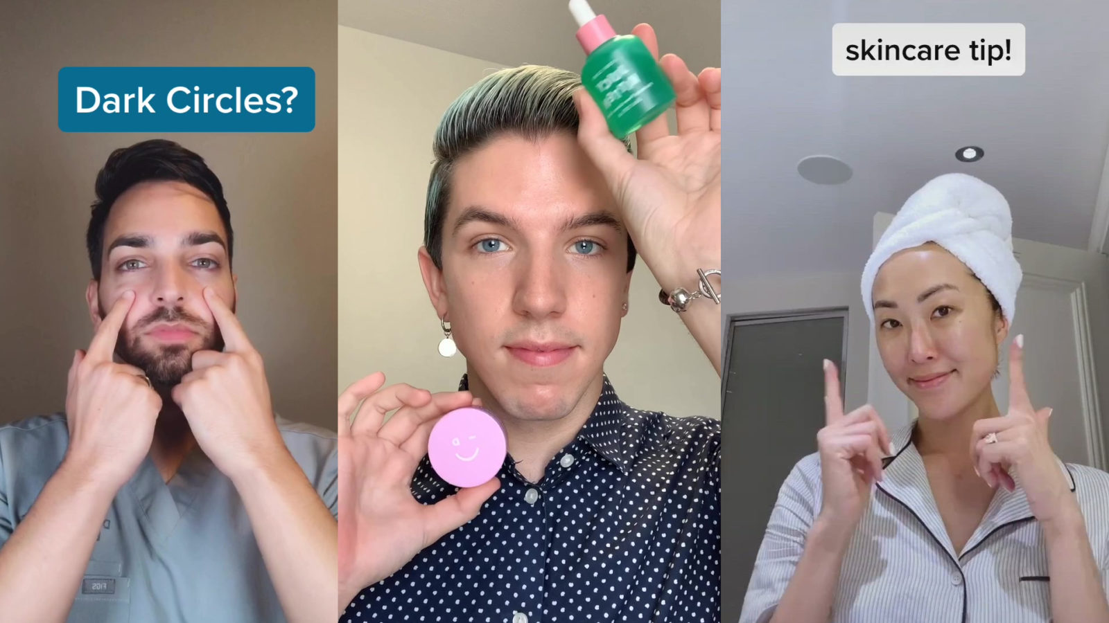
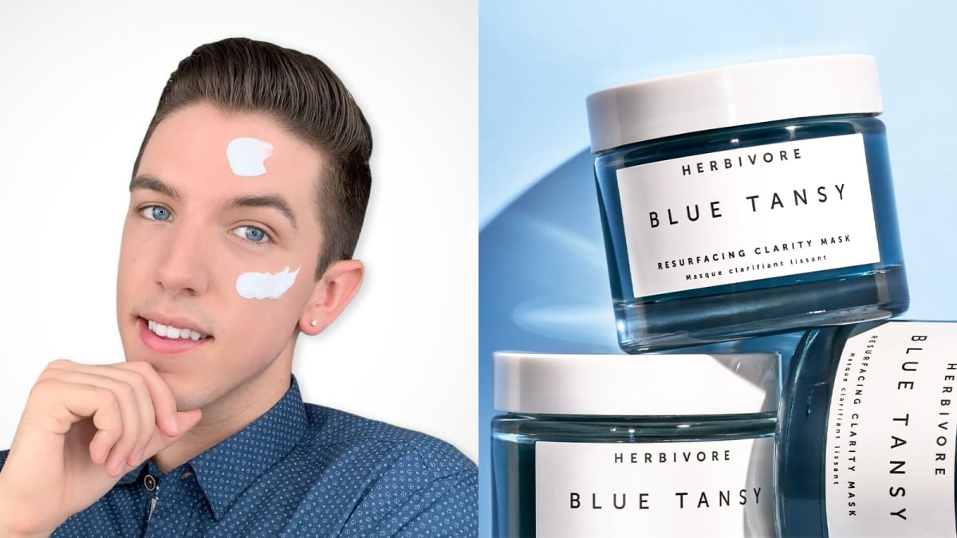
2022 Skincare trends
Health and wellness became huge during the pandemic
Social media presence grew among many people throughout the world who would share their routines, experts would say what’s good for your skin, etc

Slide 3
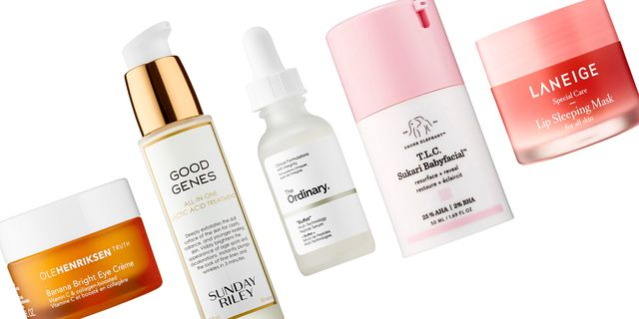
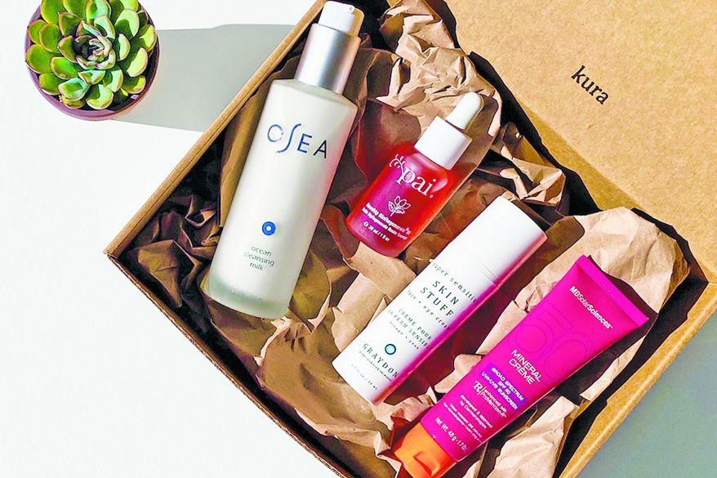
2022 Skincare trends
Anti-inflammatory skincare as it is more gentle on the skin
Aloe vera, white birch, sea buckthorn berry, tiger grass, resveratrol
Sunscreen – always has been essential for our skin and continues to grow in popularity
Cosmosun spf
Keeping routines simple
Putting too many products on our skin can do the opposite of what we really want it to do

Slide 4
2022 Skincare trends
Clients are investing in their skin for products that work, we also want them to invest when it comes to lotion
Barrier repair and supporting our microbiome
The support and balance of our skin’s bacteria is important for the strength of our skin barrier to be protected from the outside world
Treatments that boost atp in our skin
Skin health that starts with everyday lifestyle
Honest skincare
New focus as customers want brands they can trust, have transparency and honesty
Higher focus on ingredients

Slide 5
Ingredient focused
Vitamin c, vitamin a derivatives, niacinamide among some of the top searches for skincare ingredients because they have been proven to work
Customers are more aware of what can be harmful for their skin, looking for antioxidants
Quality over quantity, too many products start blocking out what the others can do. Less products with some of the best skincare is what our clients want
Color rush collection
Probiotic & prebiotic infused ingredients that maintain our optimal balance
Plant based extracts
Squalane, bakuchiol, apple, rose

Slide 6
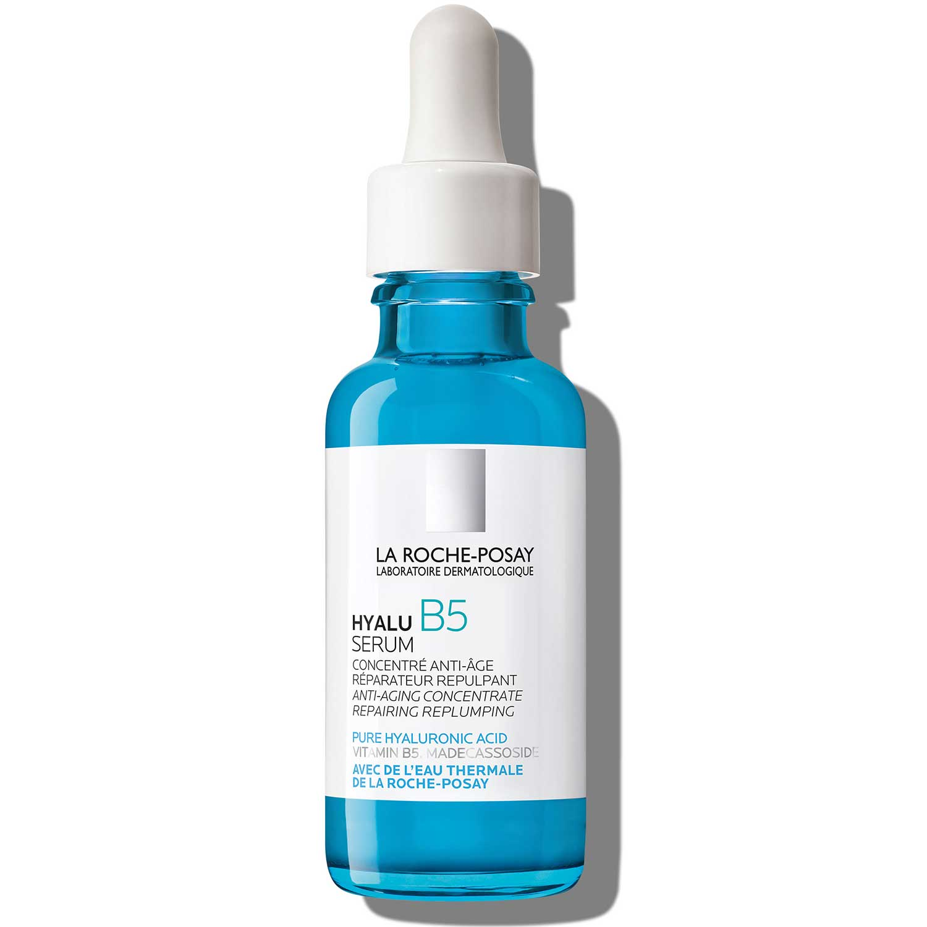
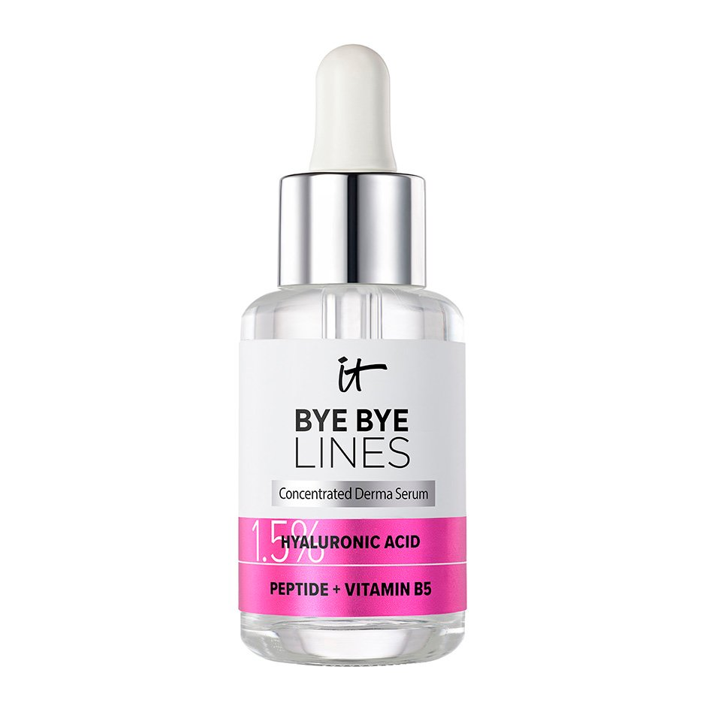
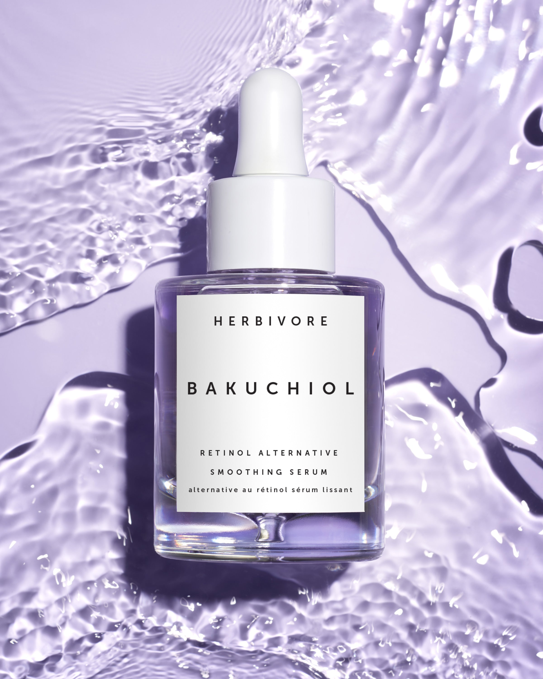
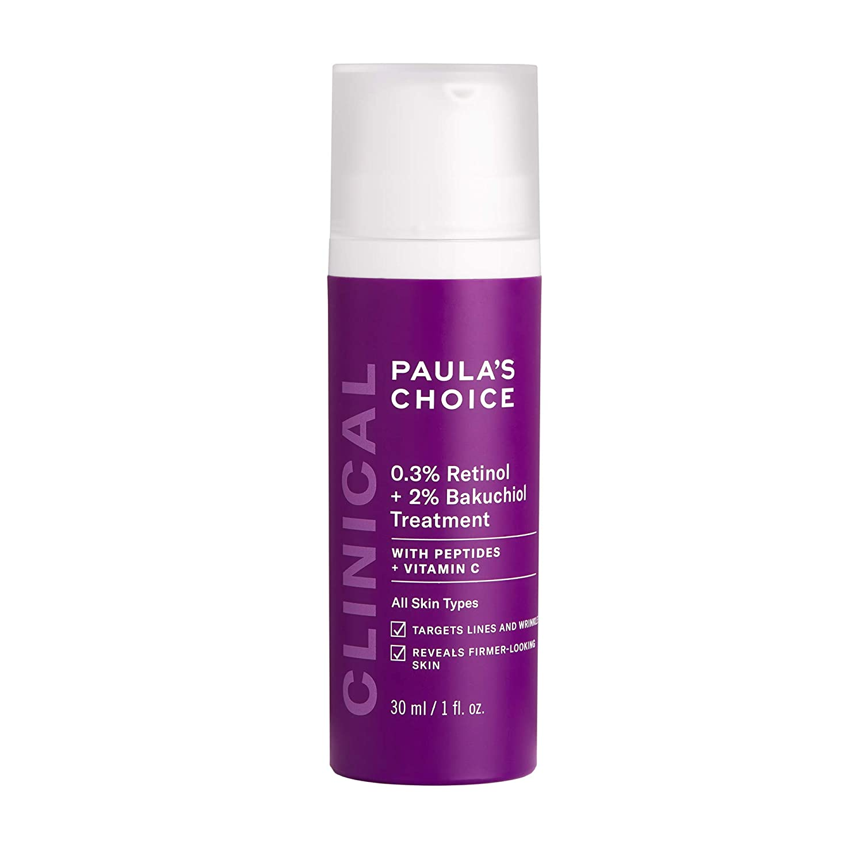
Ingredient focused
Hyaluronic acid – holds 1000x its weight in water, prevents moisture loss, one of the best moisturizing agents for all skin types
Vitamin a derivative – promotes cell renewal, helps to reduce acne, protect against free radical damage and promotes collagen production in the skin

Slide 7
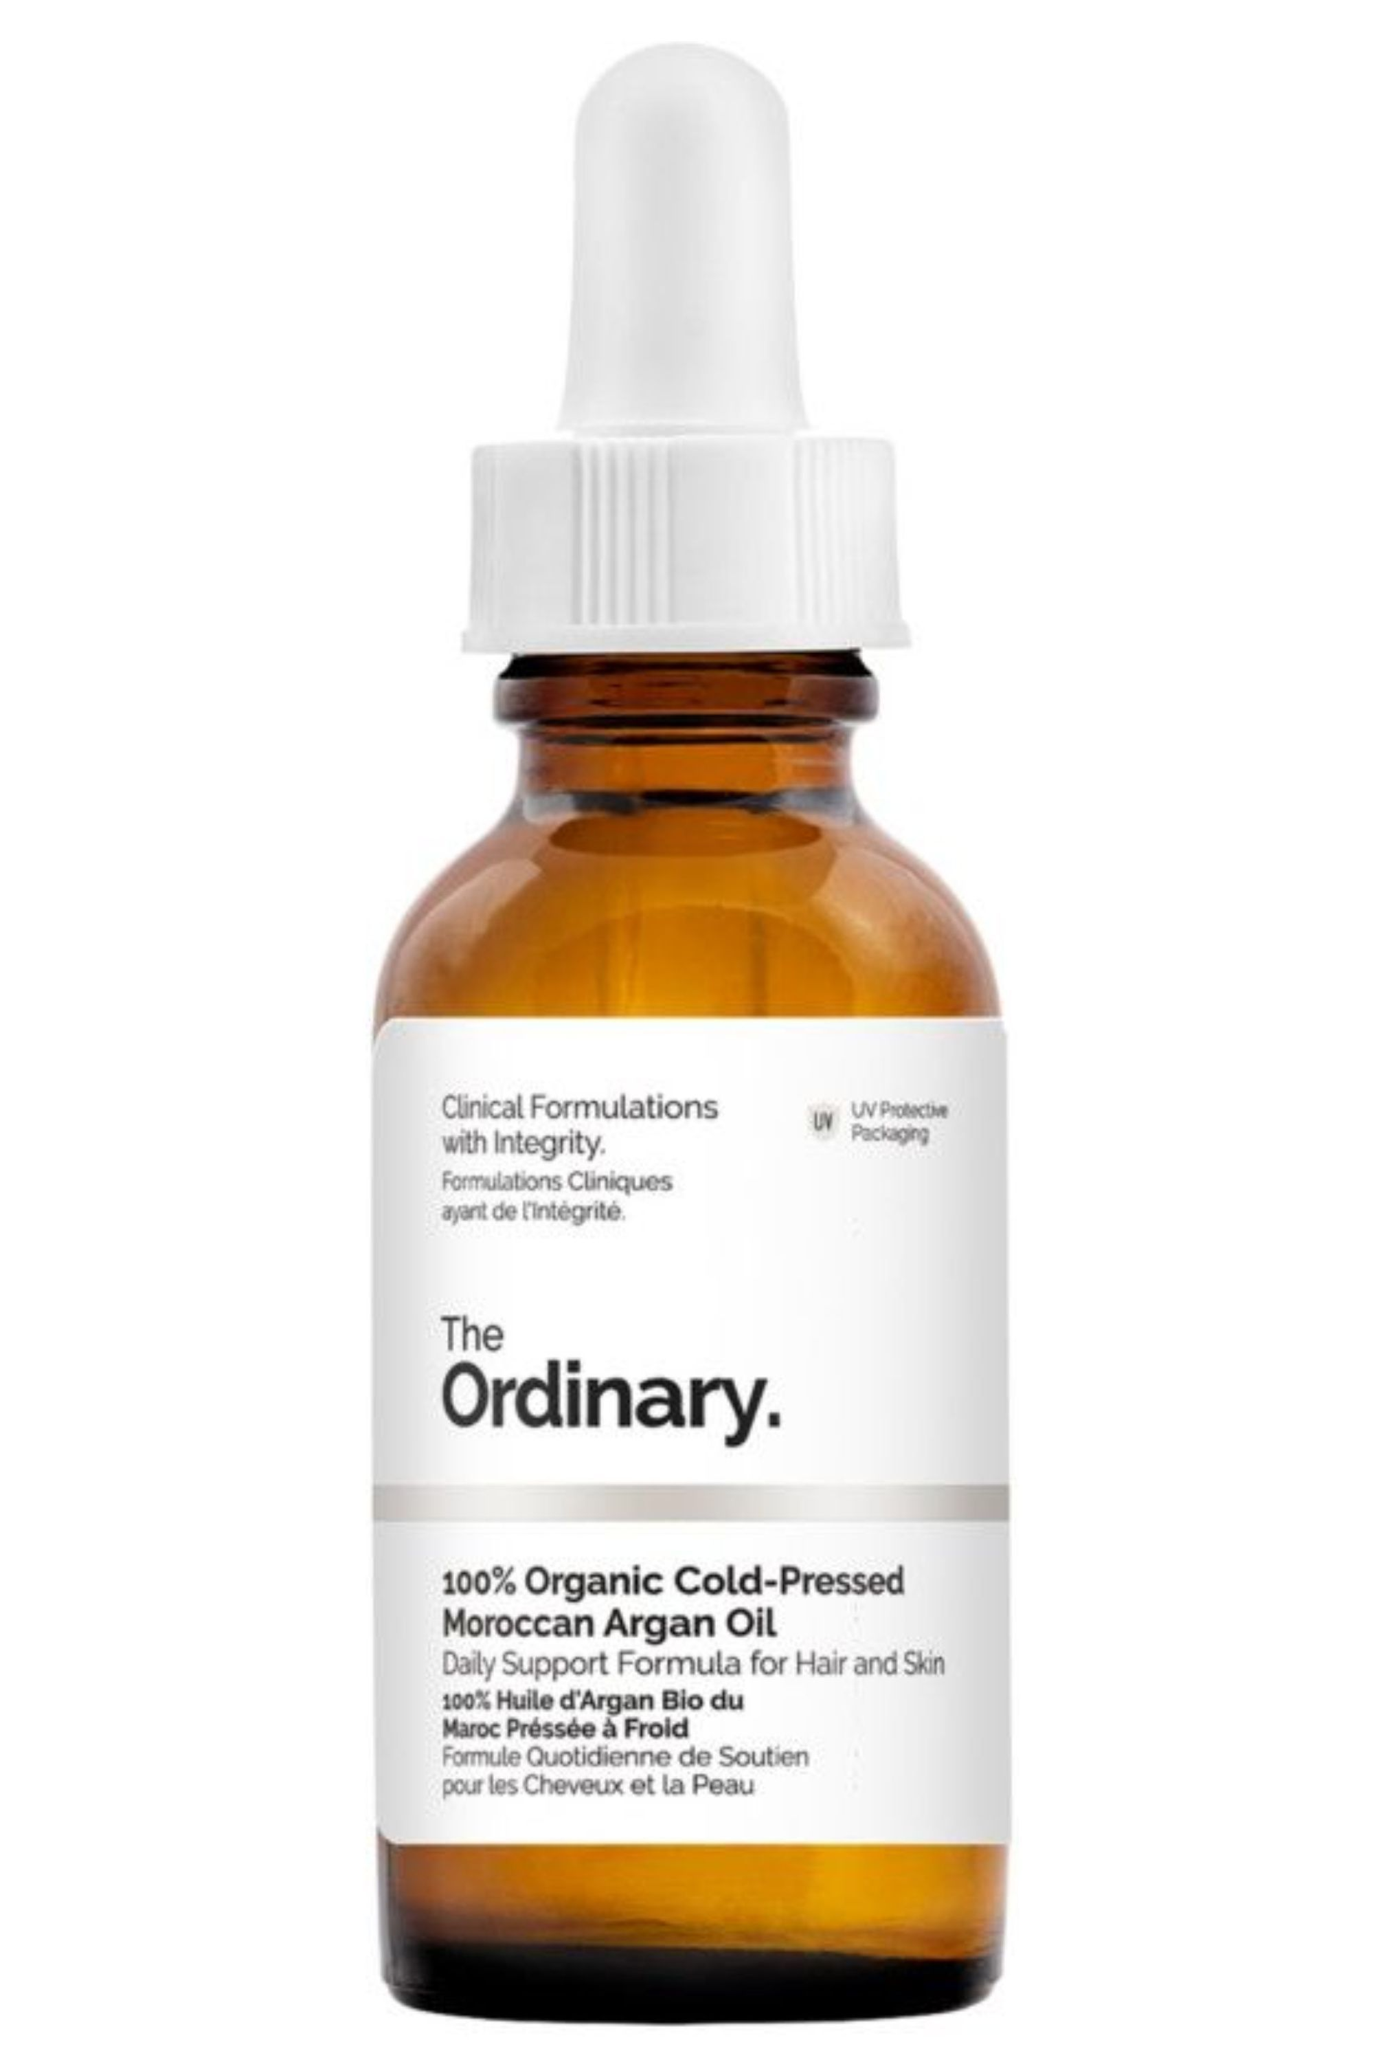
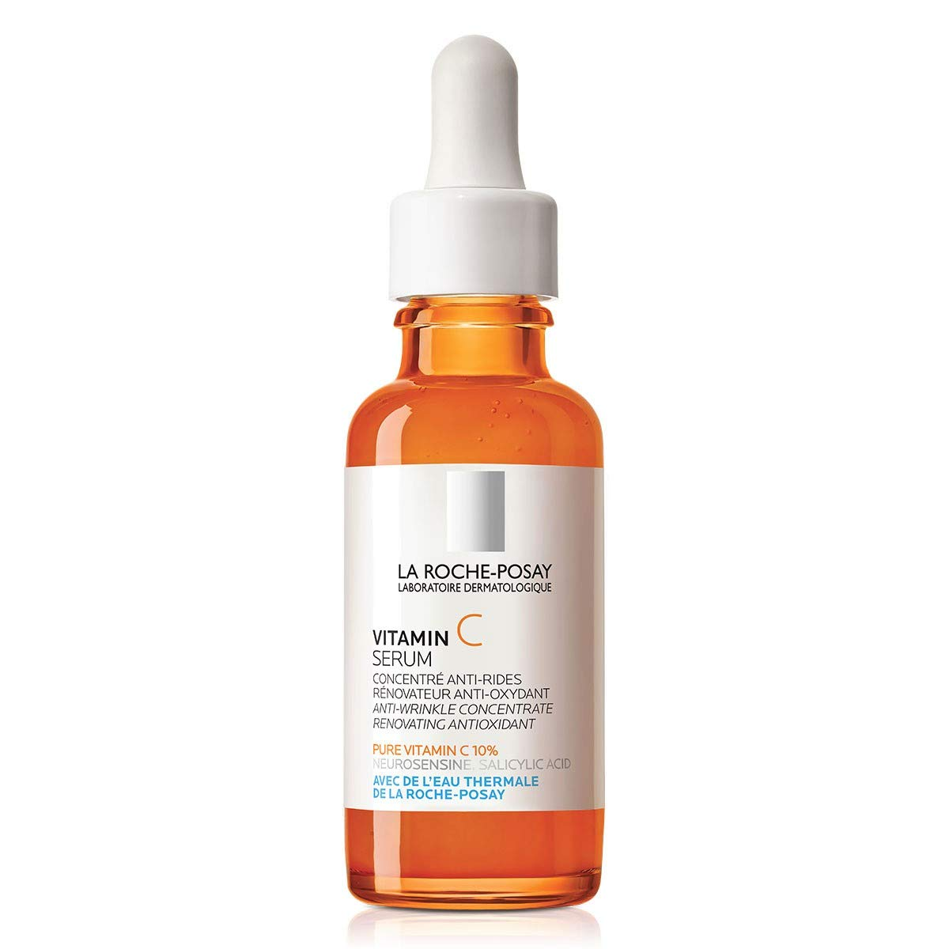
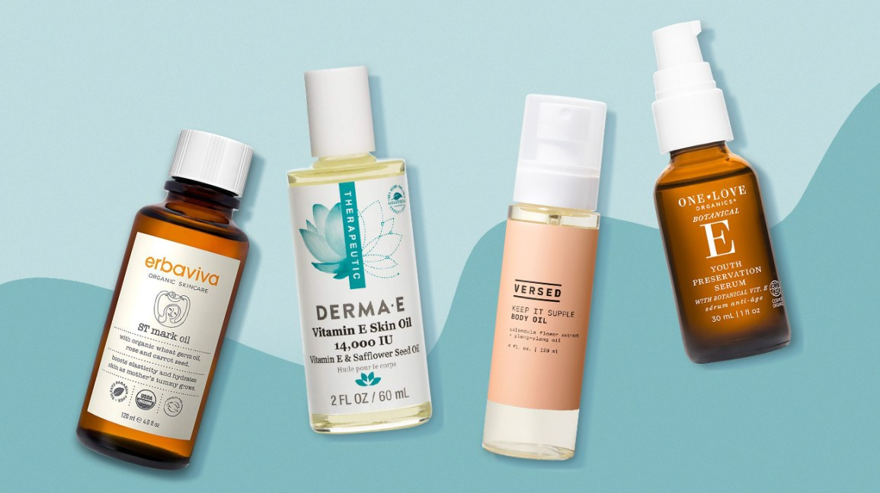
Ingredient focused
Argan oil – antioxidant and anti-inflammatory agents that promotes skin healing, effective in reducing the appearance of fine lines & wrinkles, best for acne prone/normal skin tones
Vitamin c & E – work very well together to provide moisturizing agents, brighten and even out skin tone, antioxidants that help to repair the skin

Slide 8
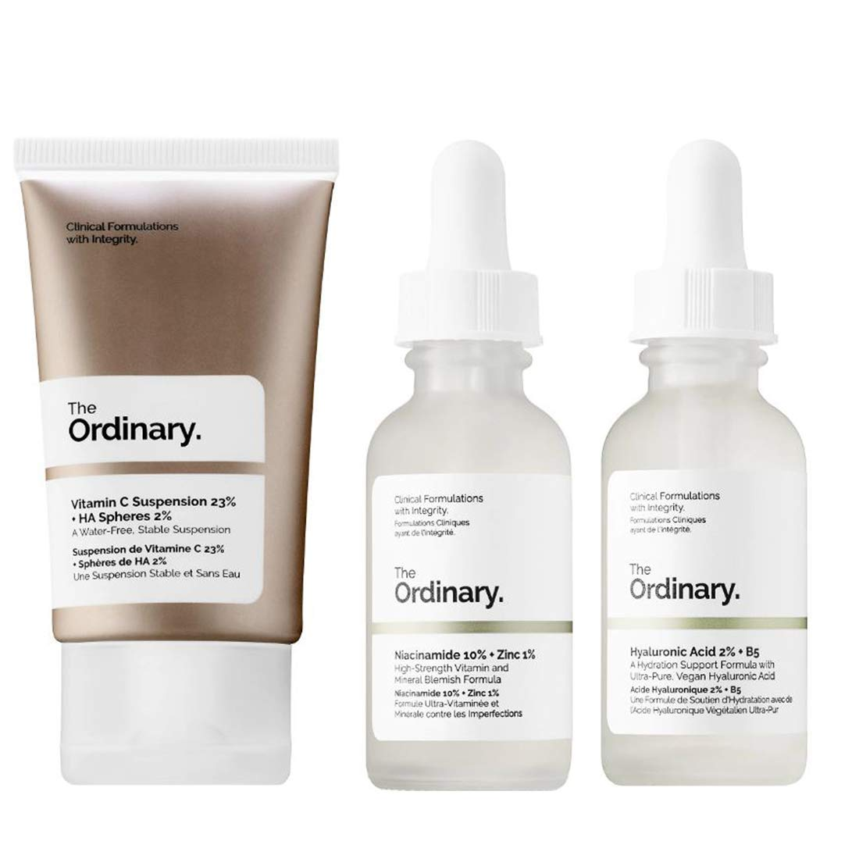
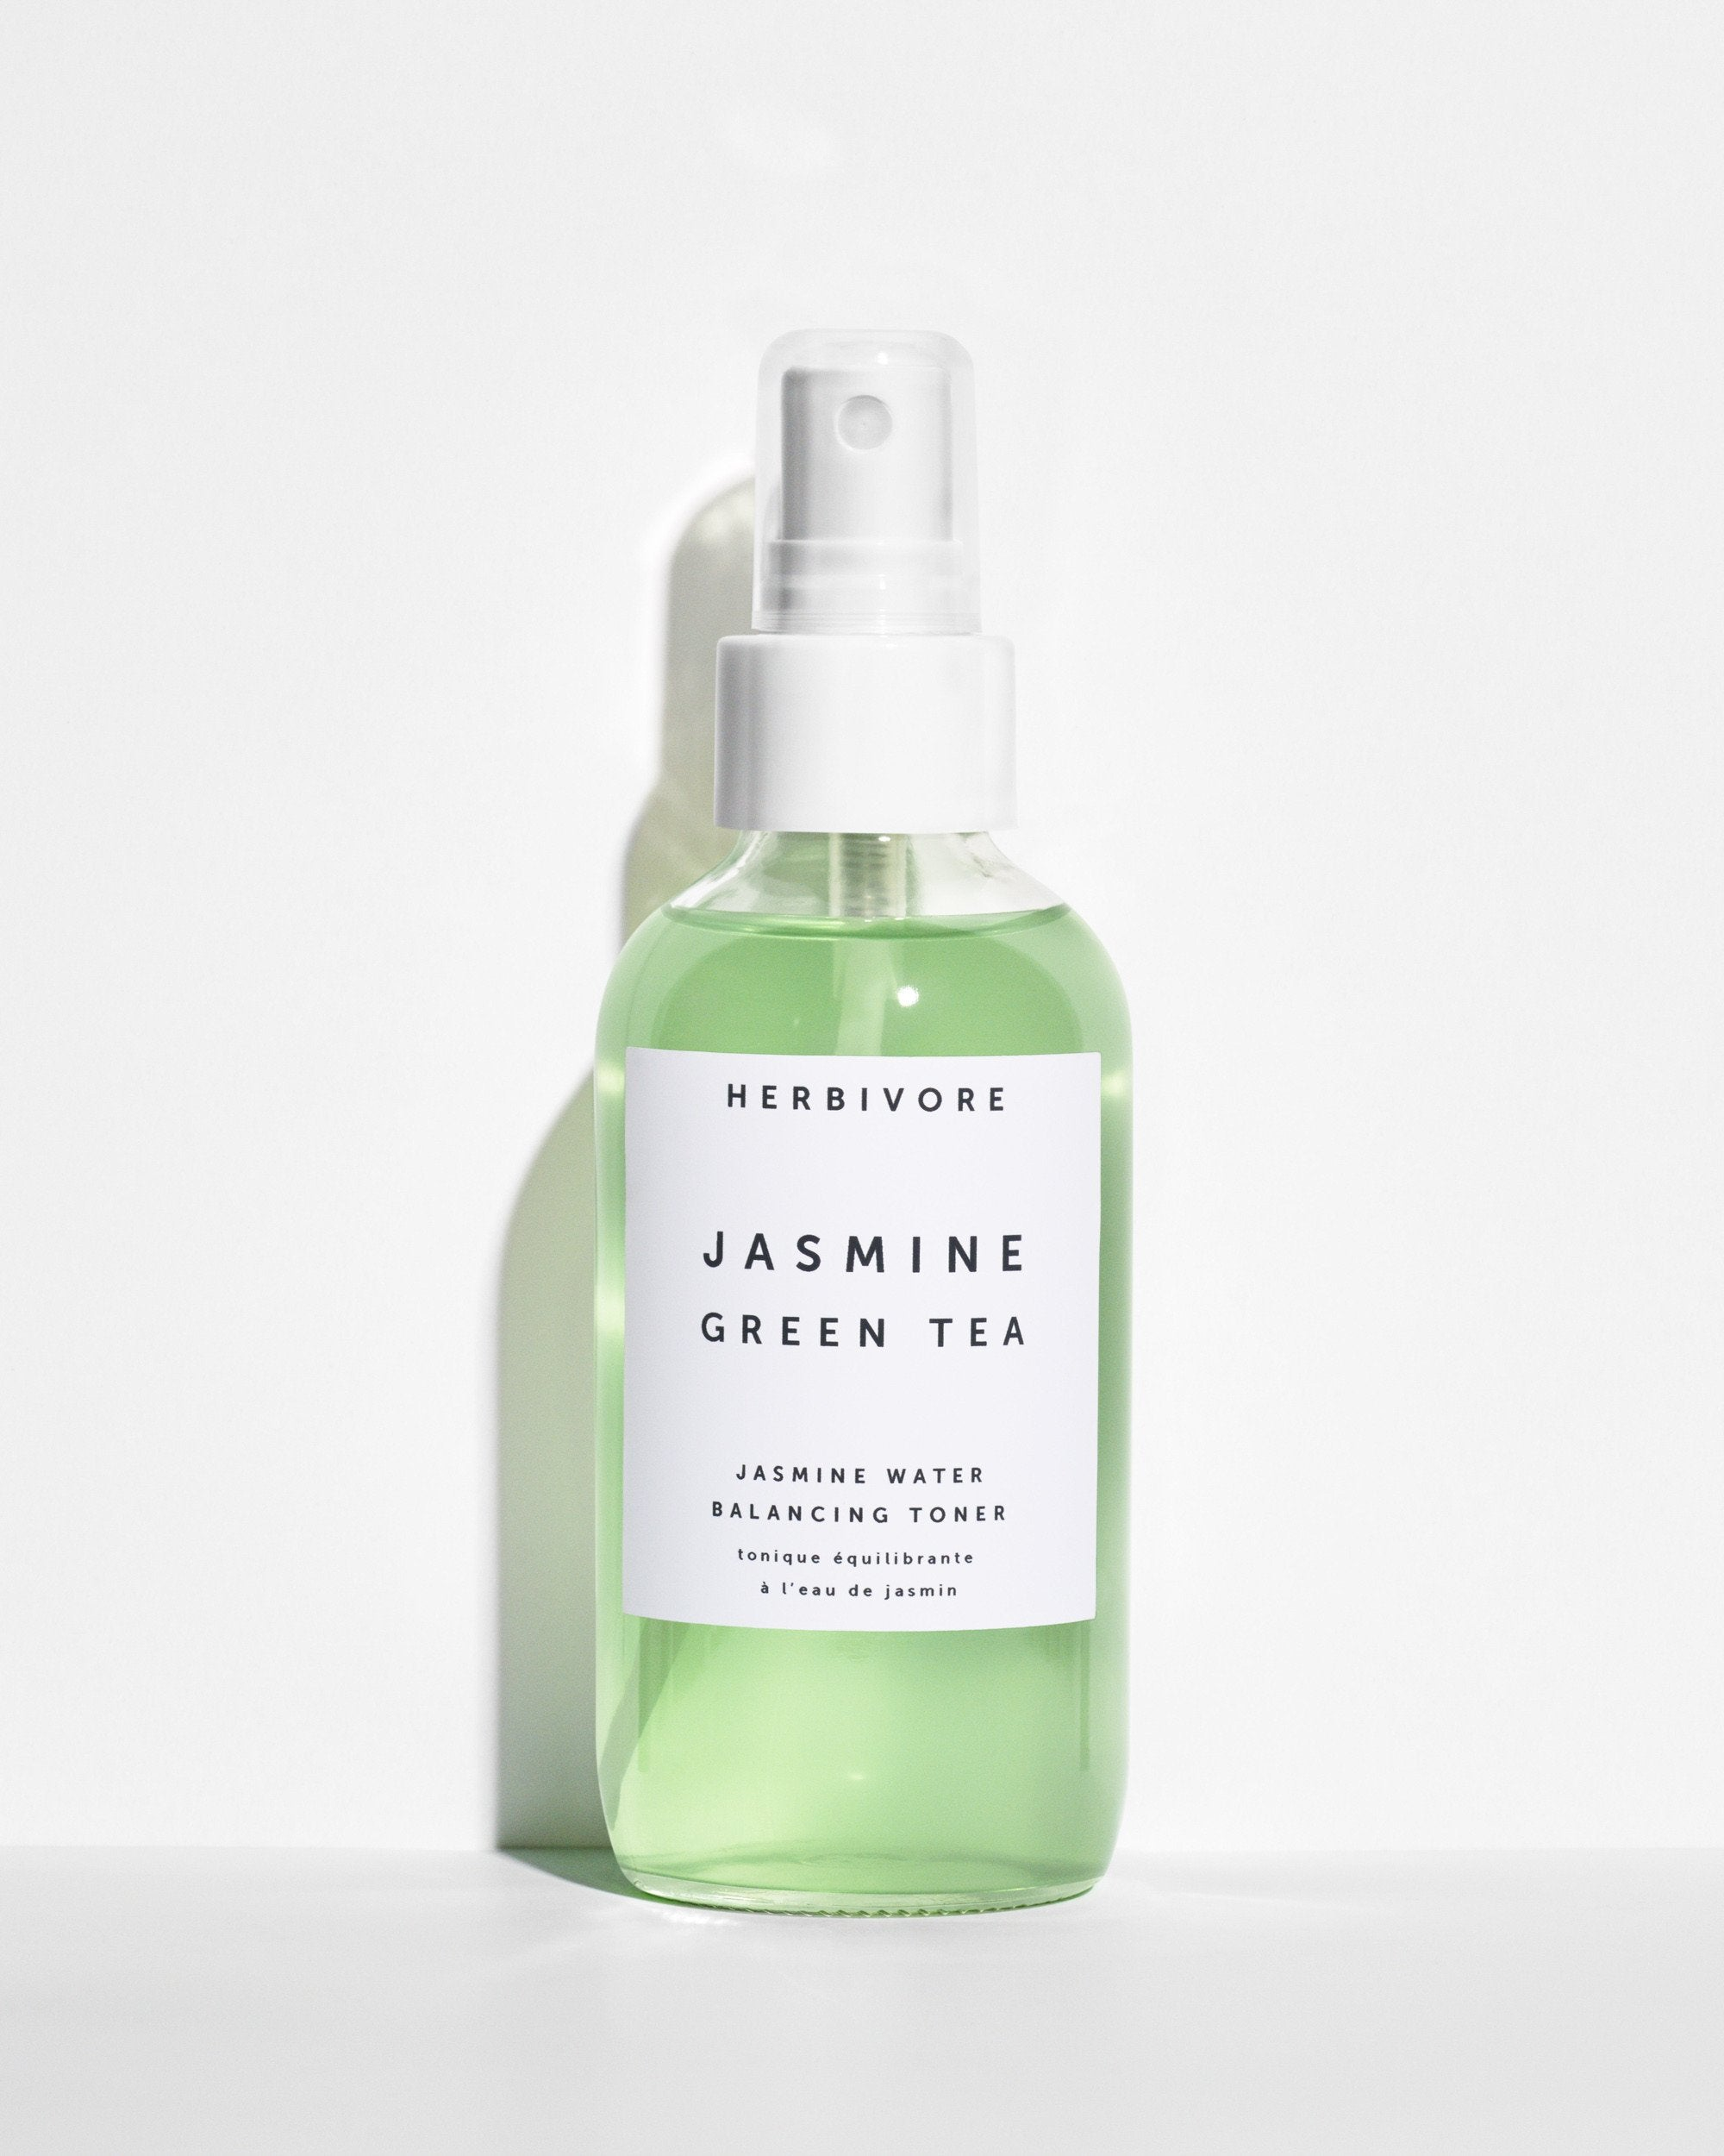
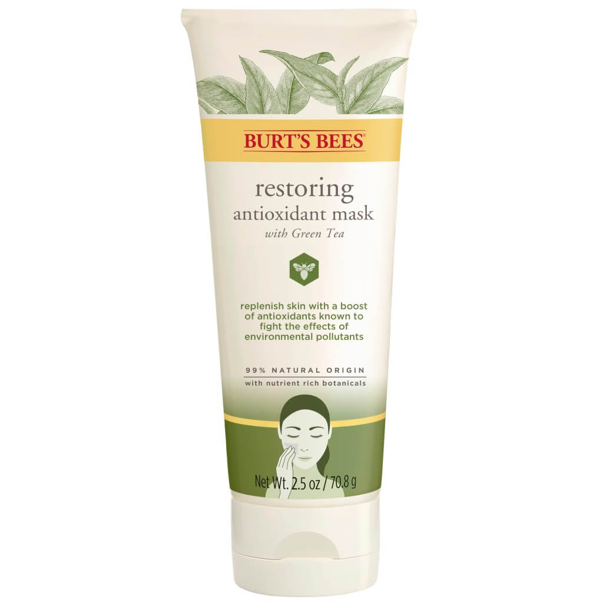
Ingredient focused
Niacinamide (vitamin b3) – increases elasticity, strengthens or skins barrier, reduces inflammation
Green tea – contains vitamin c and has antioxidant, anti-aging and anti-inflammatory benefits, decreases collagen breakdown

Slide 9
Skin maintenance
Continued focus of what we put in our bodies just as much as onto our skin
Gut health, hormone balance, mental health
Hydration of the body
Non-invasive treatments for the skin that focus on quality, texture, tone
Body care growing to take care of our skin
Moisturization, non-comedogenic, sensitive skin formulas, mineral oil free
Beauty history is repeating itself (among other trends)

Slide 10
Skin maintenance
Eating a well balanced diet
Less stress
More water
Maintaining moisture in our skin
Humidifier in the winter to replenish moisture into our top layer
Getting enough sleep
mineral based sunscreen
Exfoliating helps keep the skin smooth and increase absorption rate of skincare products

Slide 11
Megan Racine
National Sales Trainer
megan@devotedcreations.com
813.361.1866

