Slide 1
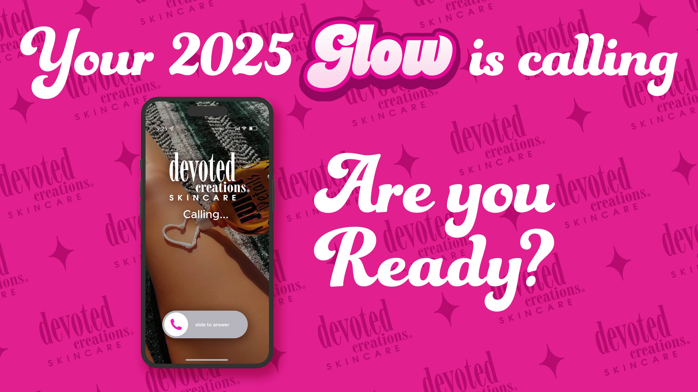

Slide 2
Become the Expert
Have a full understanding of what you’re talking about
Create the product story
Use the product
What do you like best about the product?
Influence clientele into the purchase based on your KNOWLEDGE
You are a tanning salesfluencer!

Slide 3
Ask Questions!
A tanning salesfluencer creates conversation
A building block to becoming the expert
Not asking questions = not influencing
“What product are you going to be using today?”
“How do you like that?”
“I have something similar to that that I think you’re going to love!”
Build a relationship with your clientele

Slide 4
Selling a Story
Start with the introduction (standard features)
Each product is practically the same
Constants = How, Why, What
Variables = Who, Where, When
Tanning Salesfluencer
~Sales~ but you're selling what they are influenced to buy
Influencing them by providing knowledge
Online influencers don’t normally go in depth into what they are talking about
1 fact for every $15
Fragrance doesn’t count
1 fact for every $10 for all aftercare
New car analogy – all cars with take you from point a to point b
What features does the new car have that would entice you to buy it over something else?

Slide 6
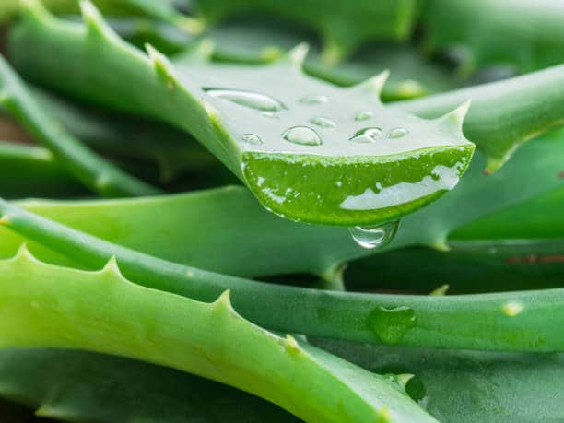
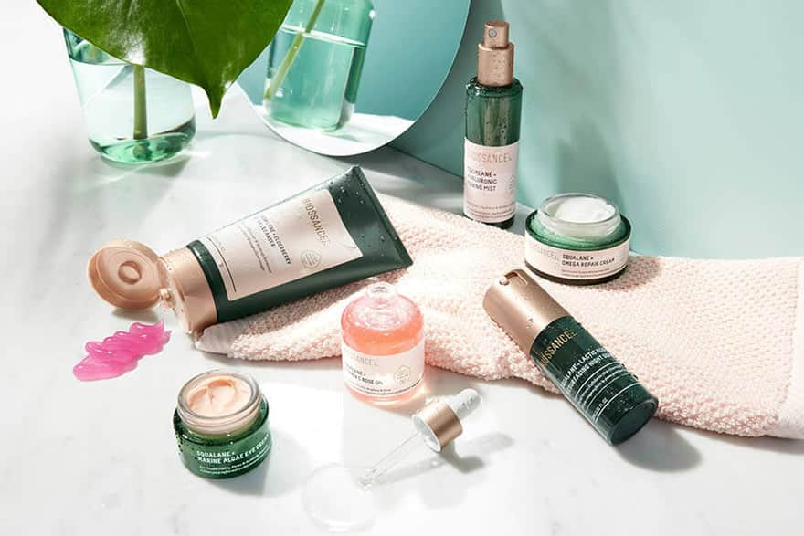
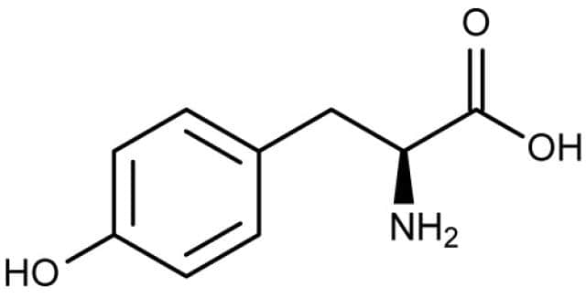
Every Tanner Needs Lotion
Hydration
Tyrosine
Skin health

Slide 7
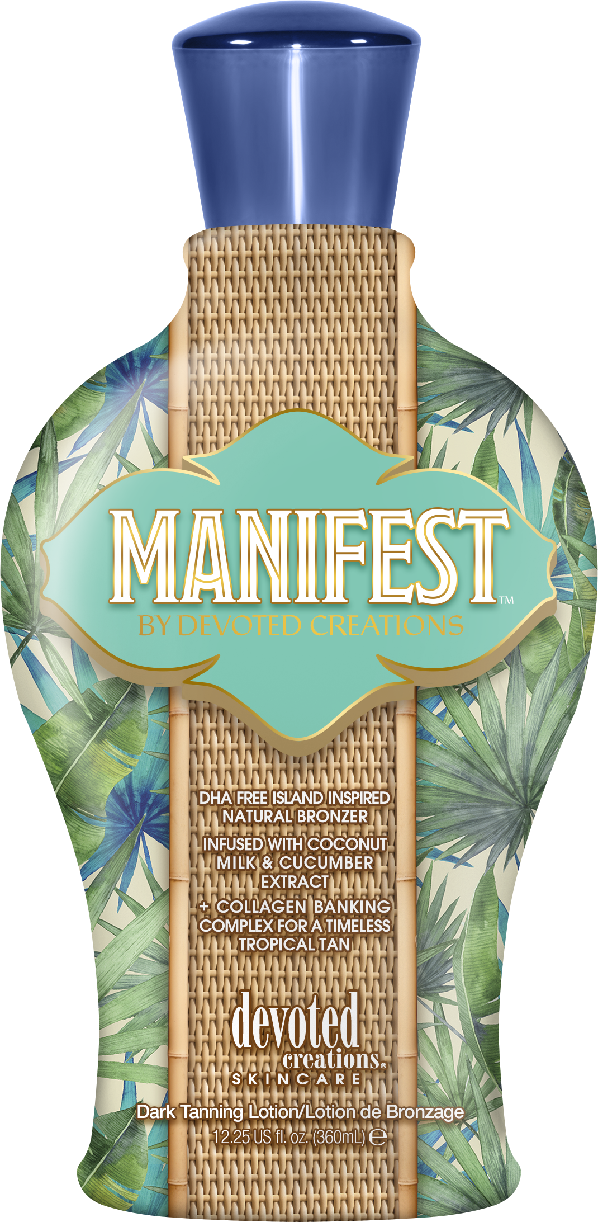
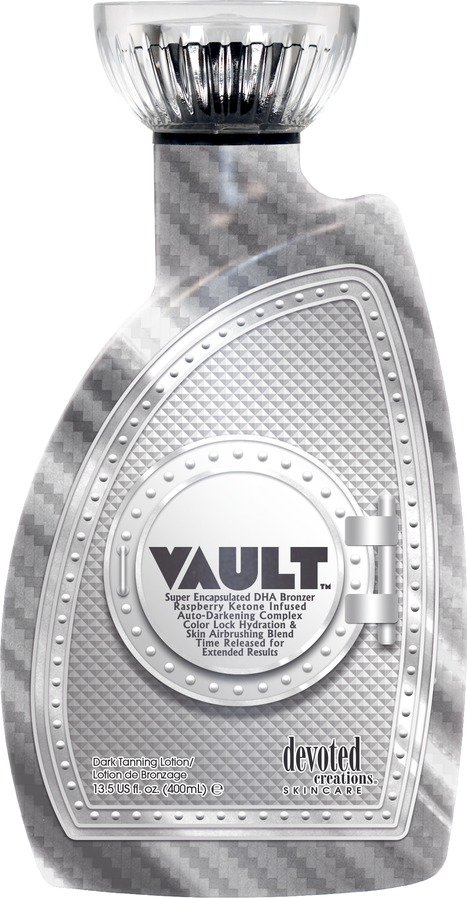
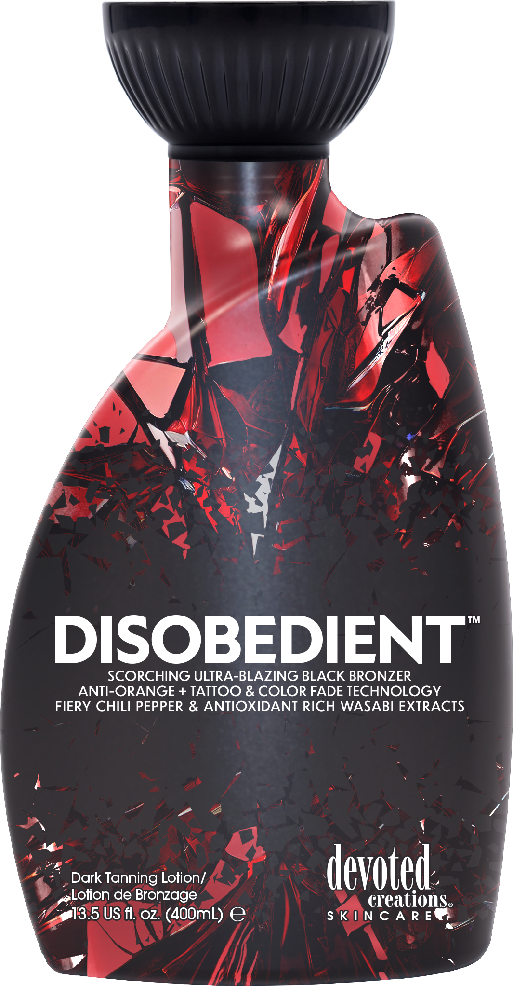
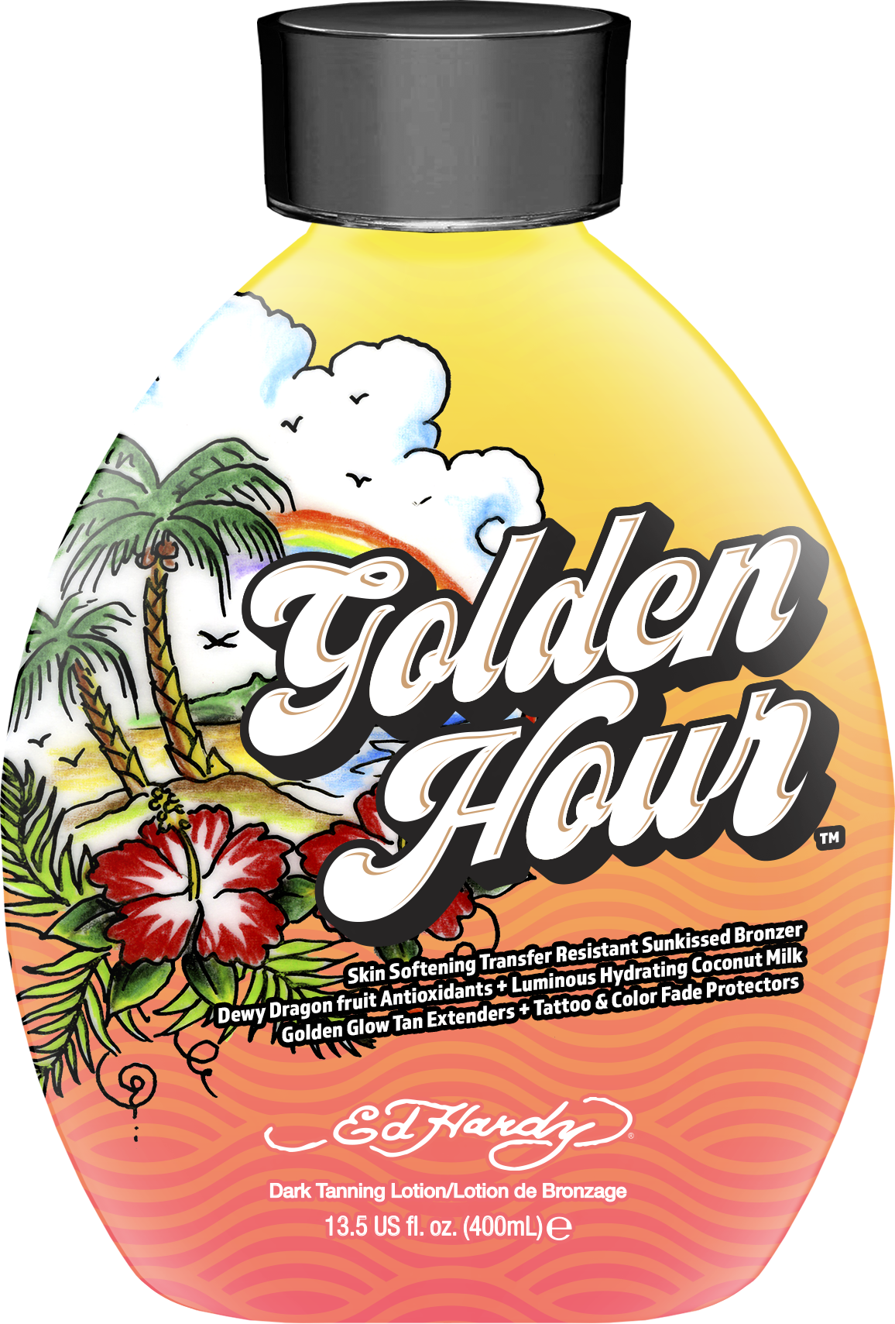
Types of Lotion
Accelerators
Bronzers
Tingles

Slide 8
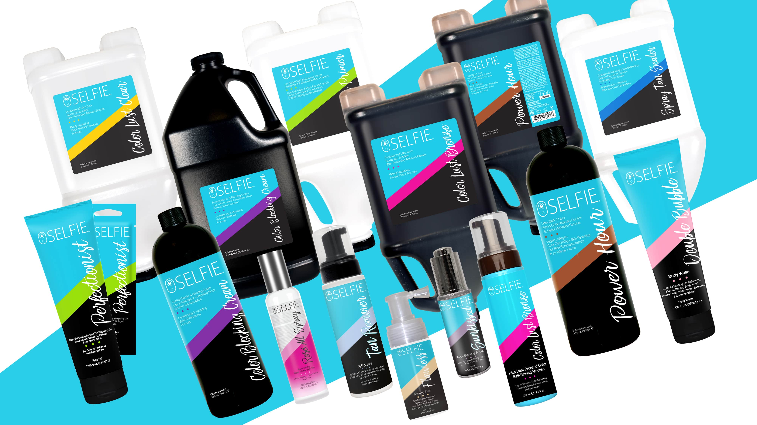

Slide 9
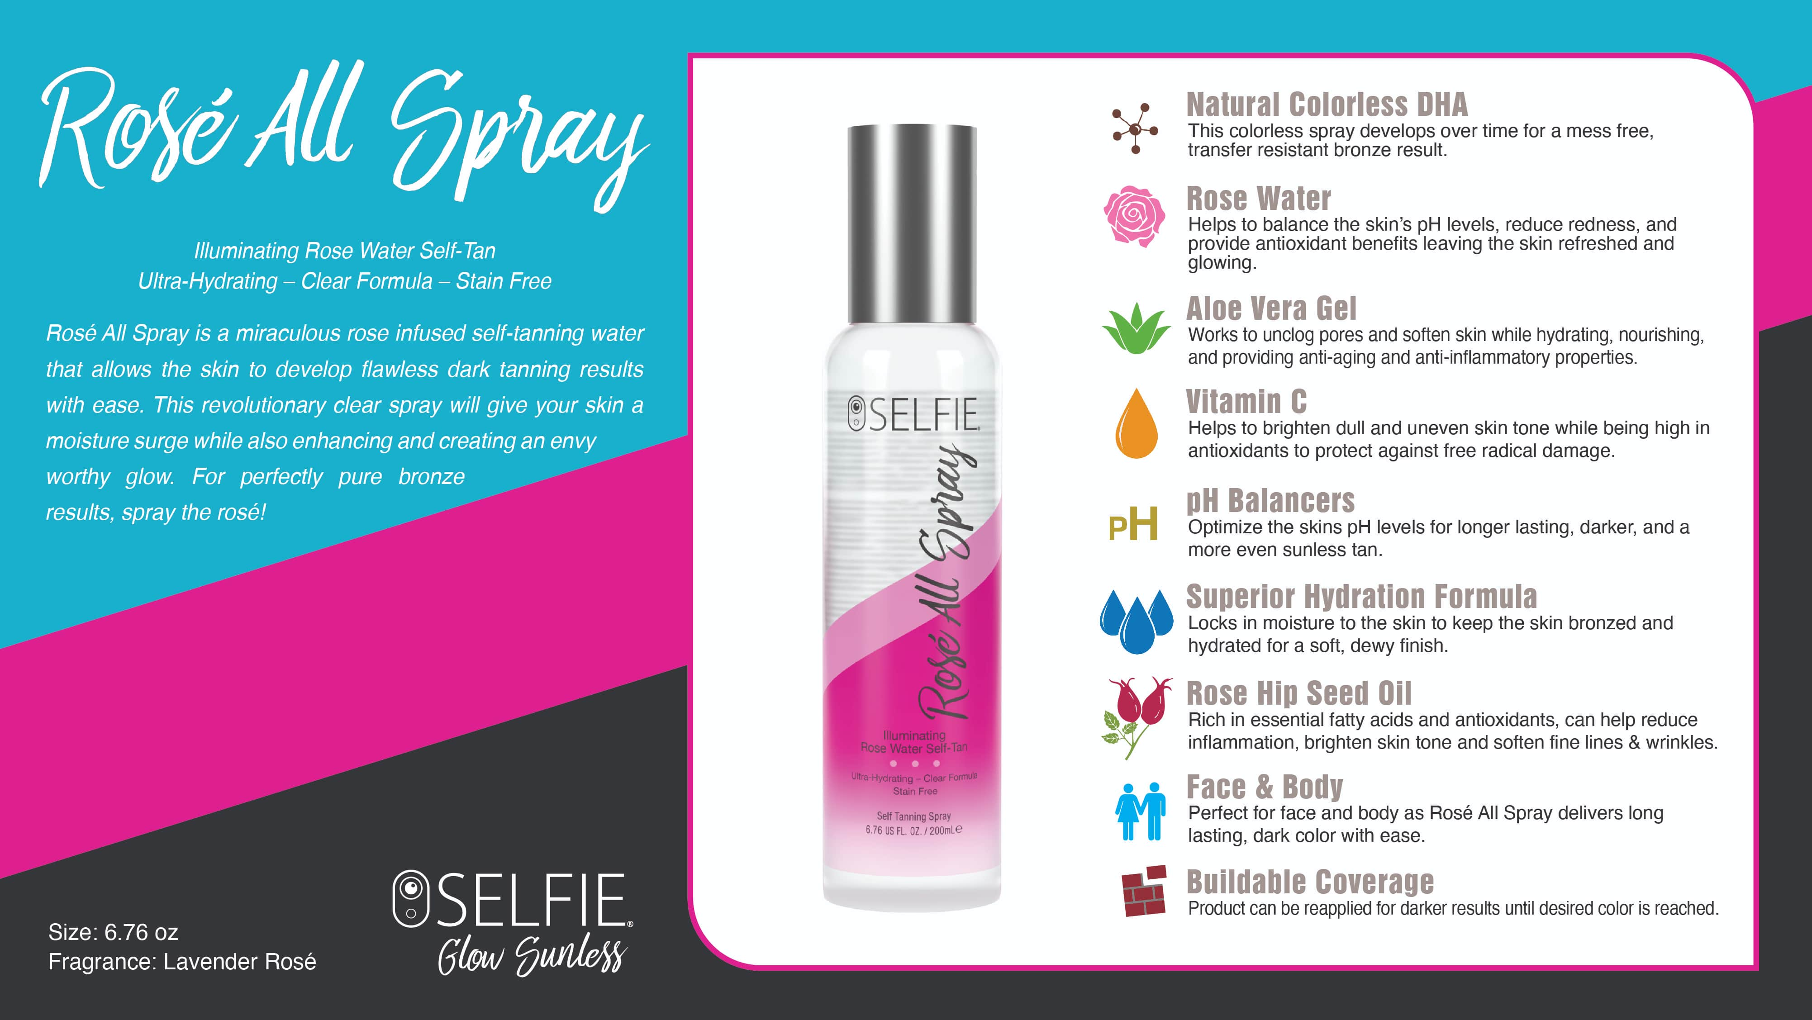

Slide 10
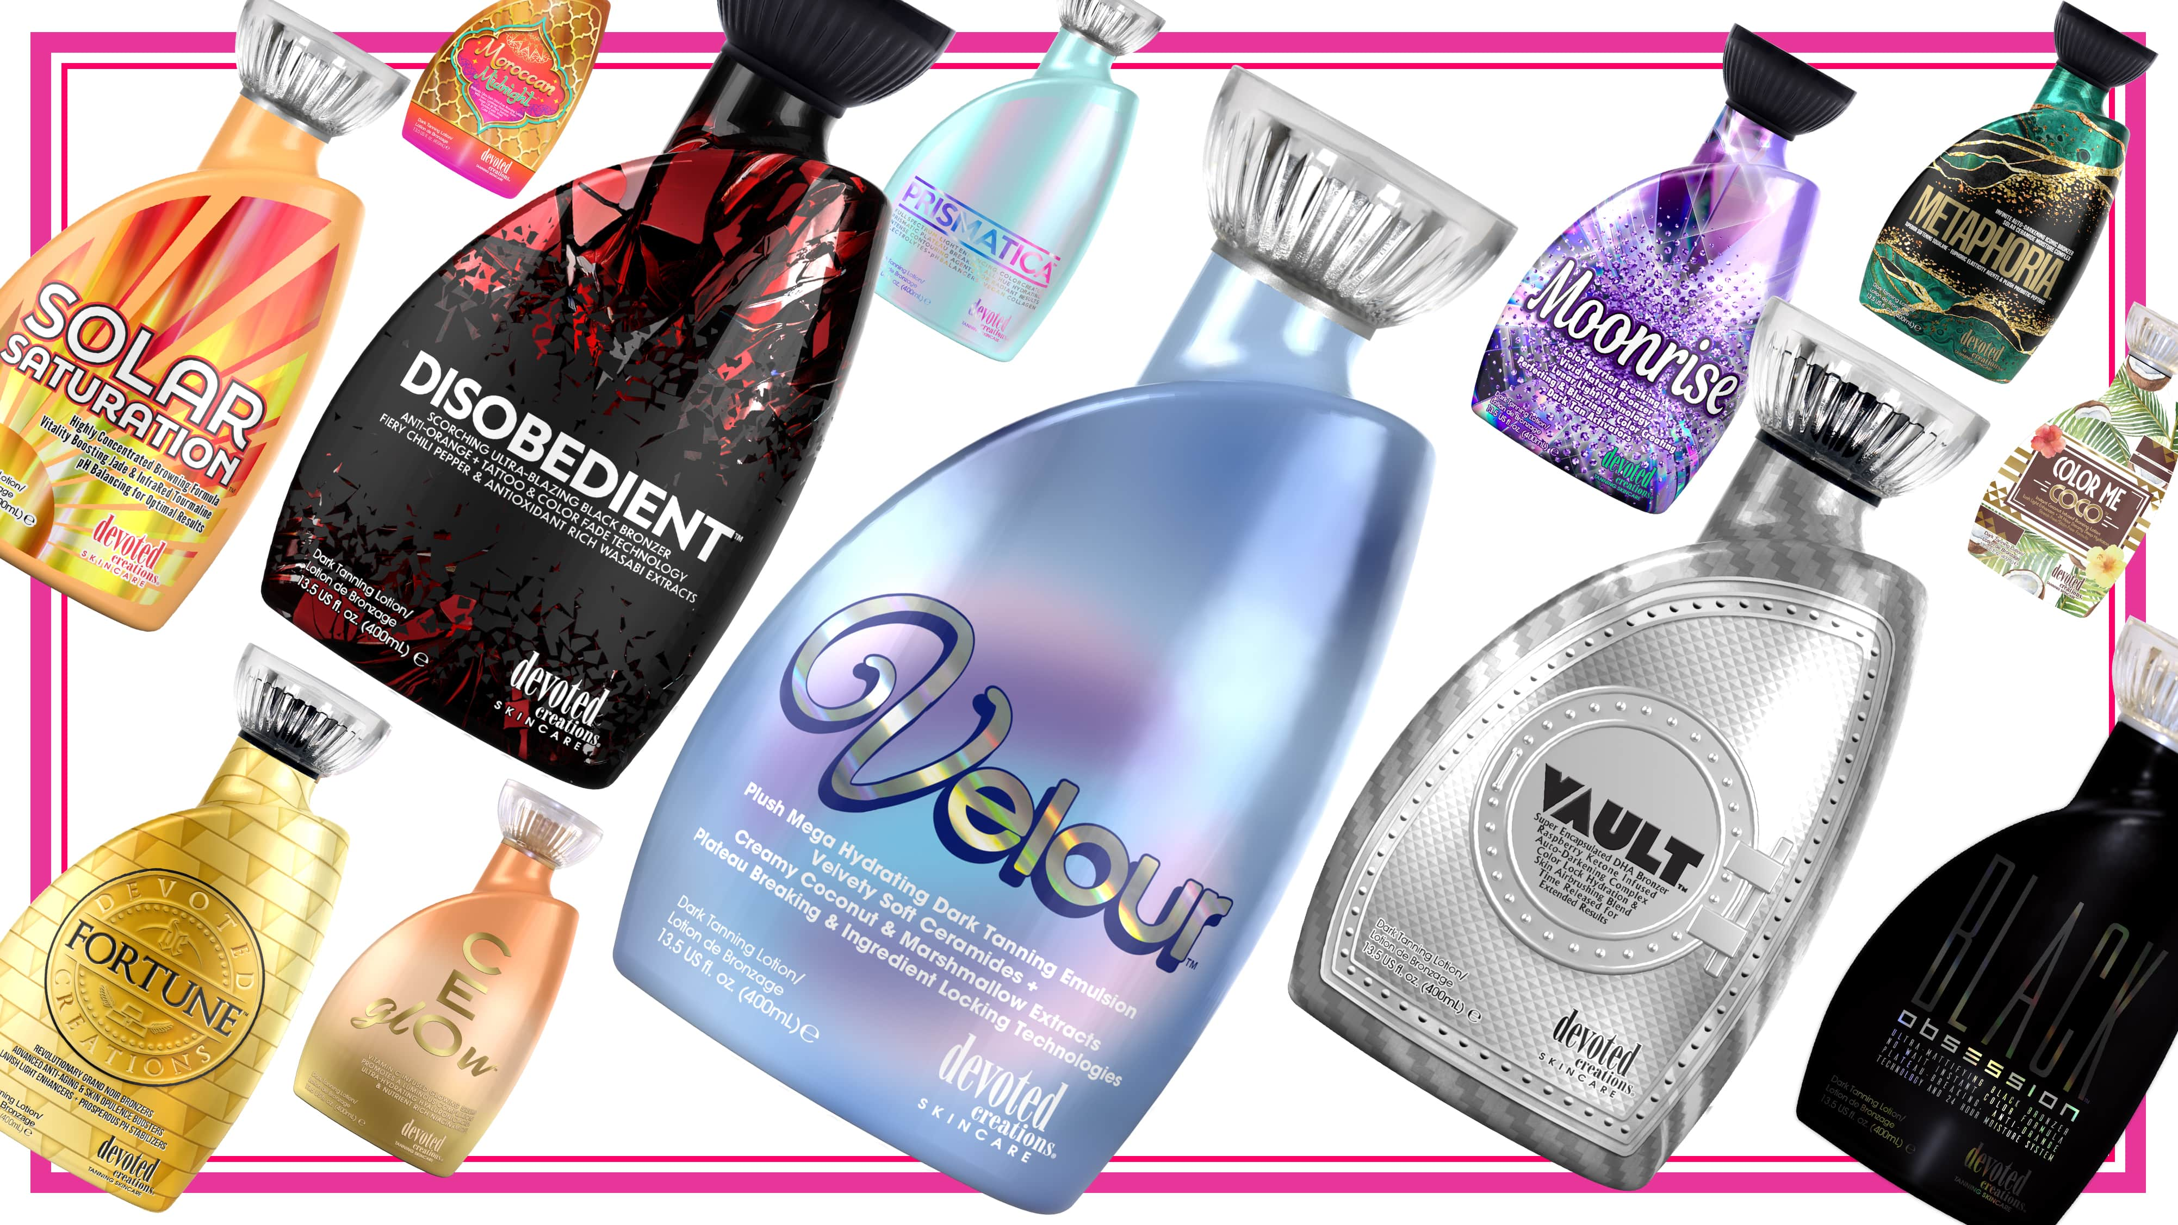

Slide 11
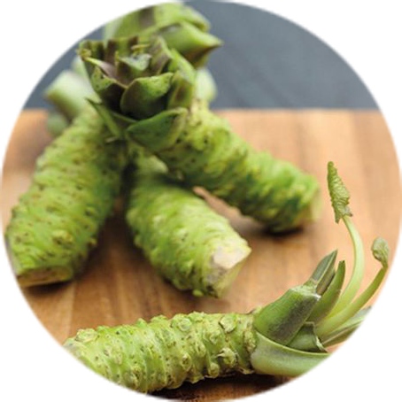
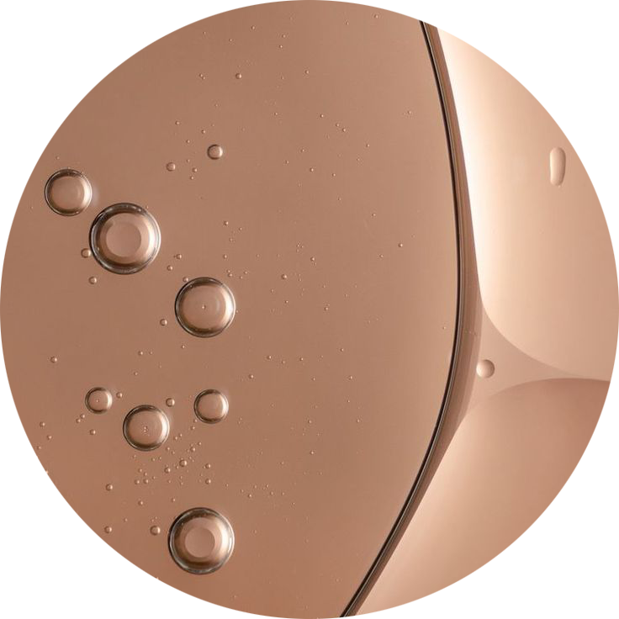
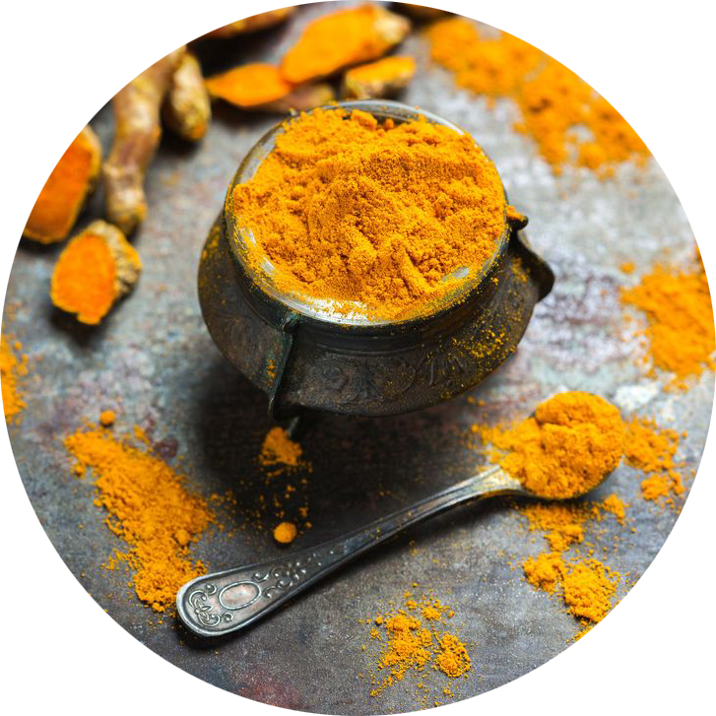
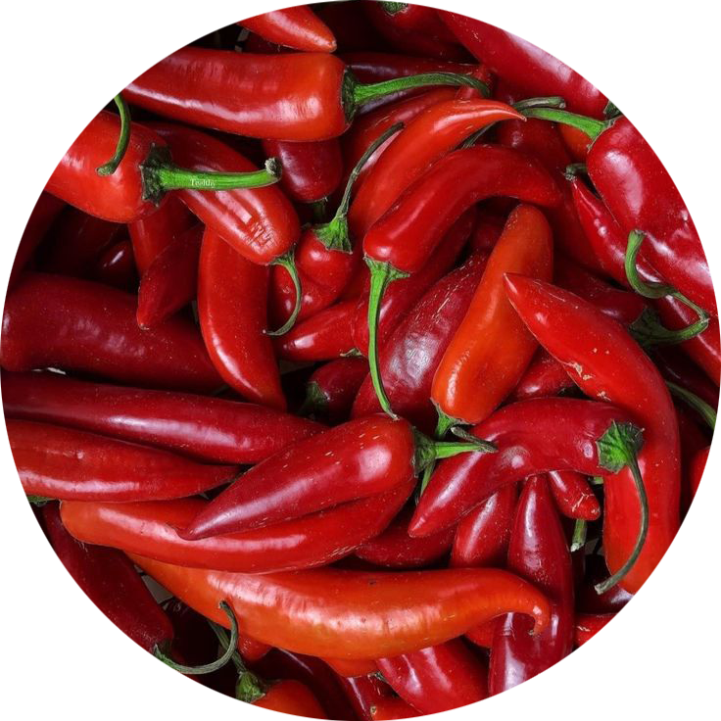
HOT DHA Tingle Triple Bronzer
Chili Pepper & Wasabi helps increase microcirculation
Extra melanin stimulating blend for deeper, longer-lasting color
Color Correcting
Ginger & Turmeric Root Extract helps with redness & inflammation in the skin
Anti-orange formula
Anti-Aging
Exosomes and Striover™ rejuvenate and regenerate the skin, help with inflammation and increase elasticity strength

Slide 12
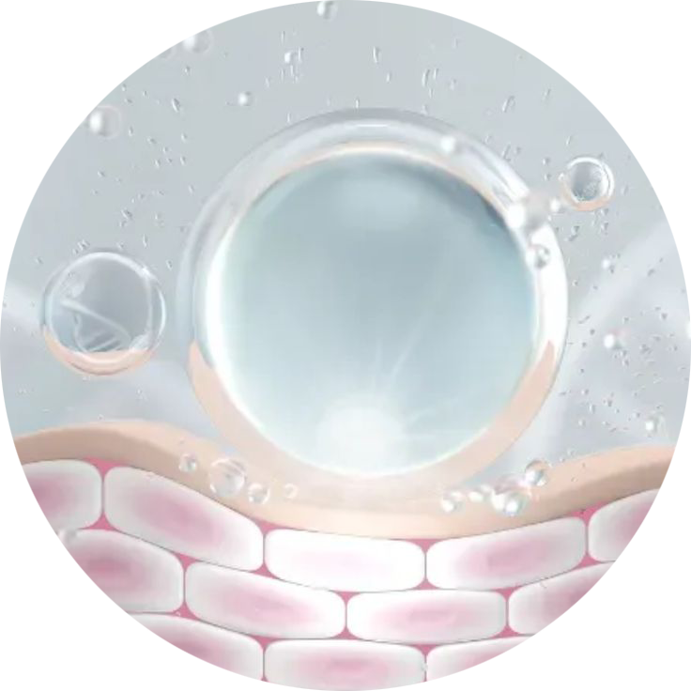
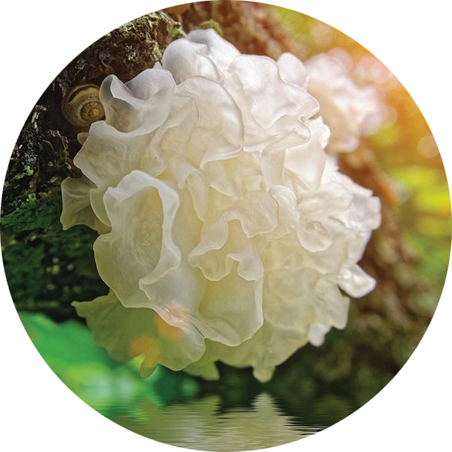
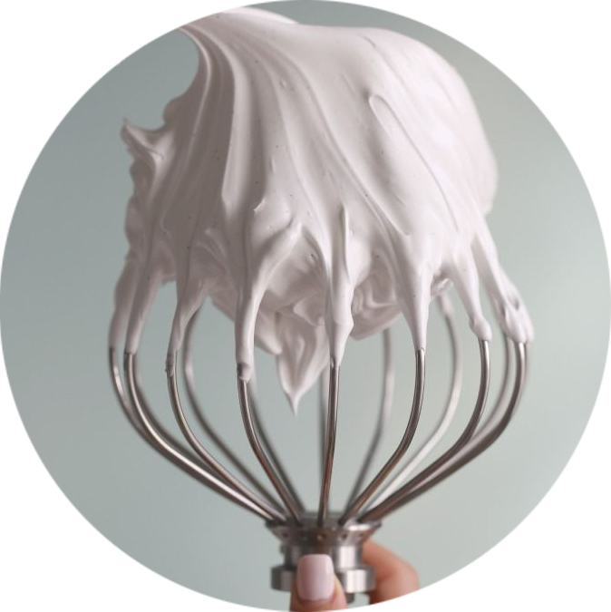
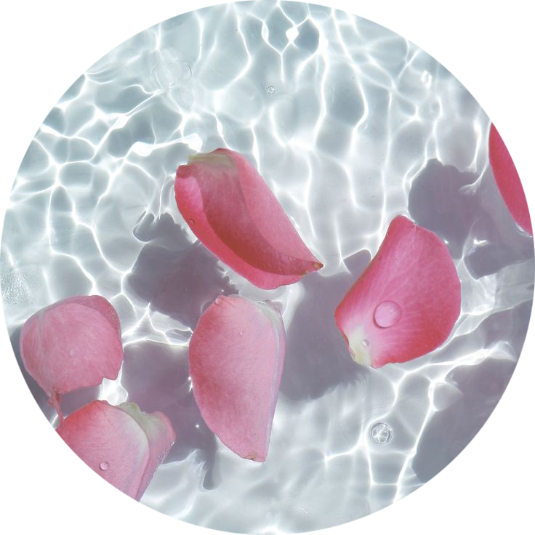
Plateau Breaking Intensifier
Extra melanin stimulators create a deeper, longer-lasting tan without bronzer
Neuroglow™ mimics positive effects from the sun
Immense Hydration
Snow Mushroom and Marshmallow retain moisture in the skin and provide deeper hydration
Anti-Aging
Exosomes, Peptides & a Collagen Complex helps increase collagen production, soften fine lines & wrinkles and provide a more even complexion
pH Balancing
Rose Water extract naturally balances the skin’s pH while calming inflammation

Slide 13
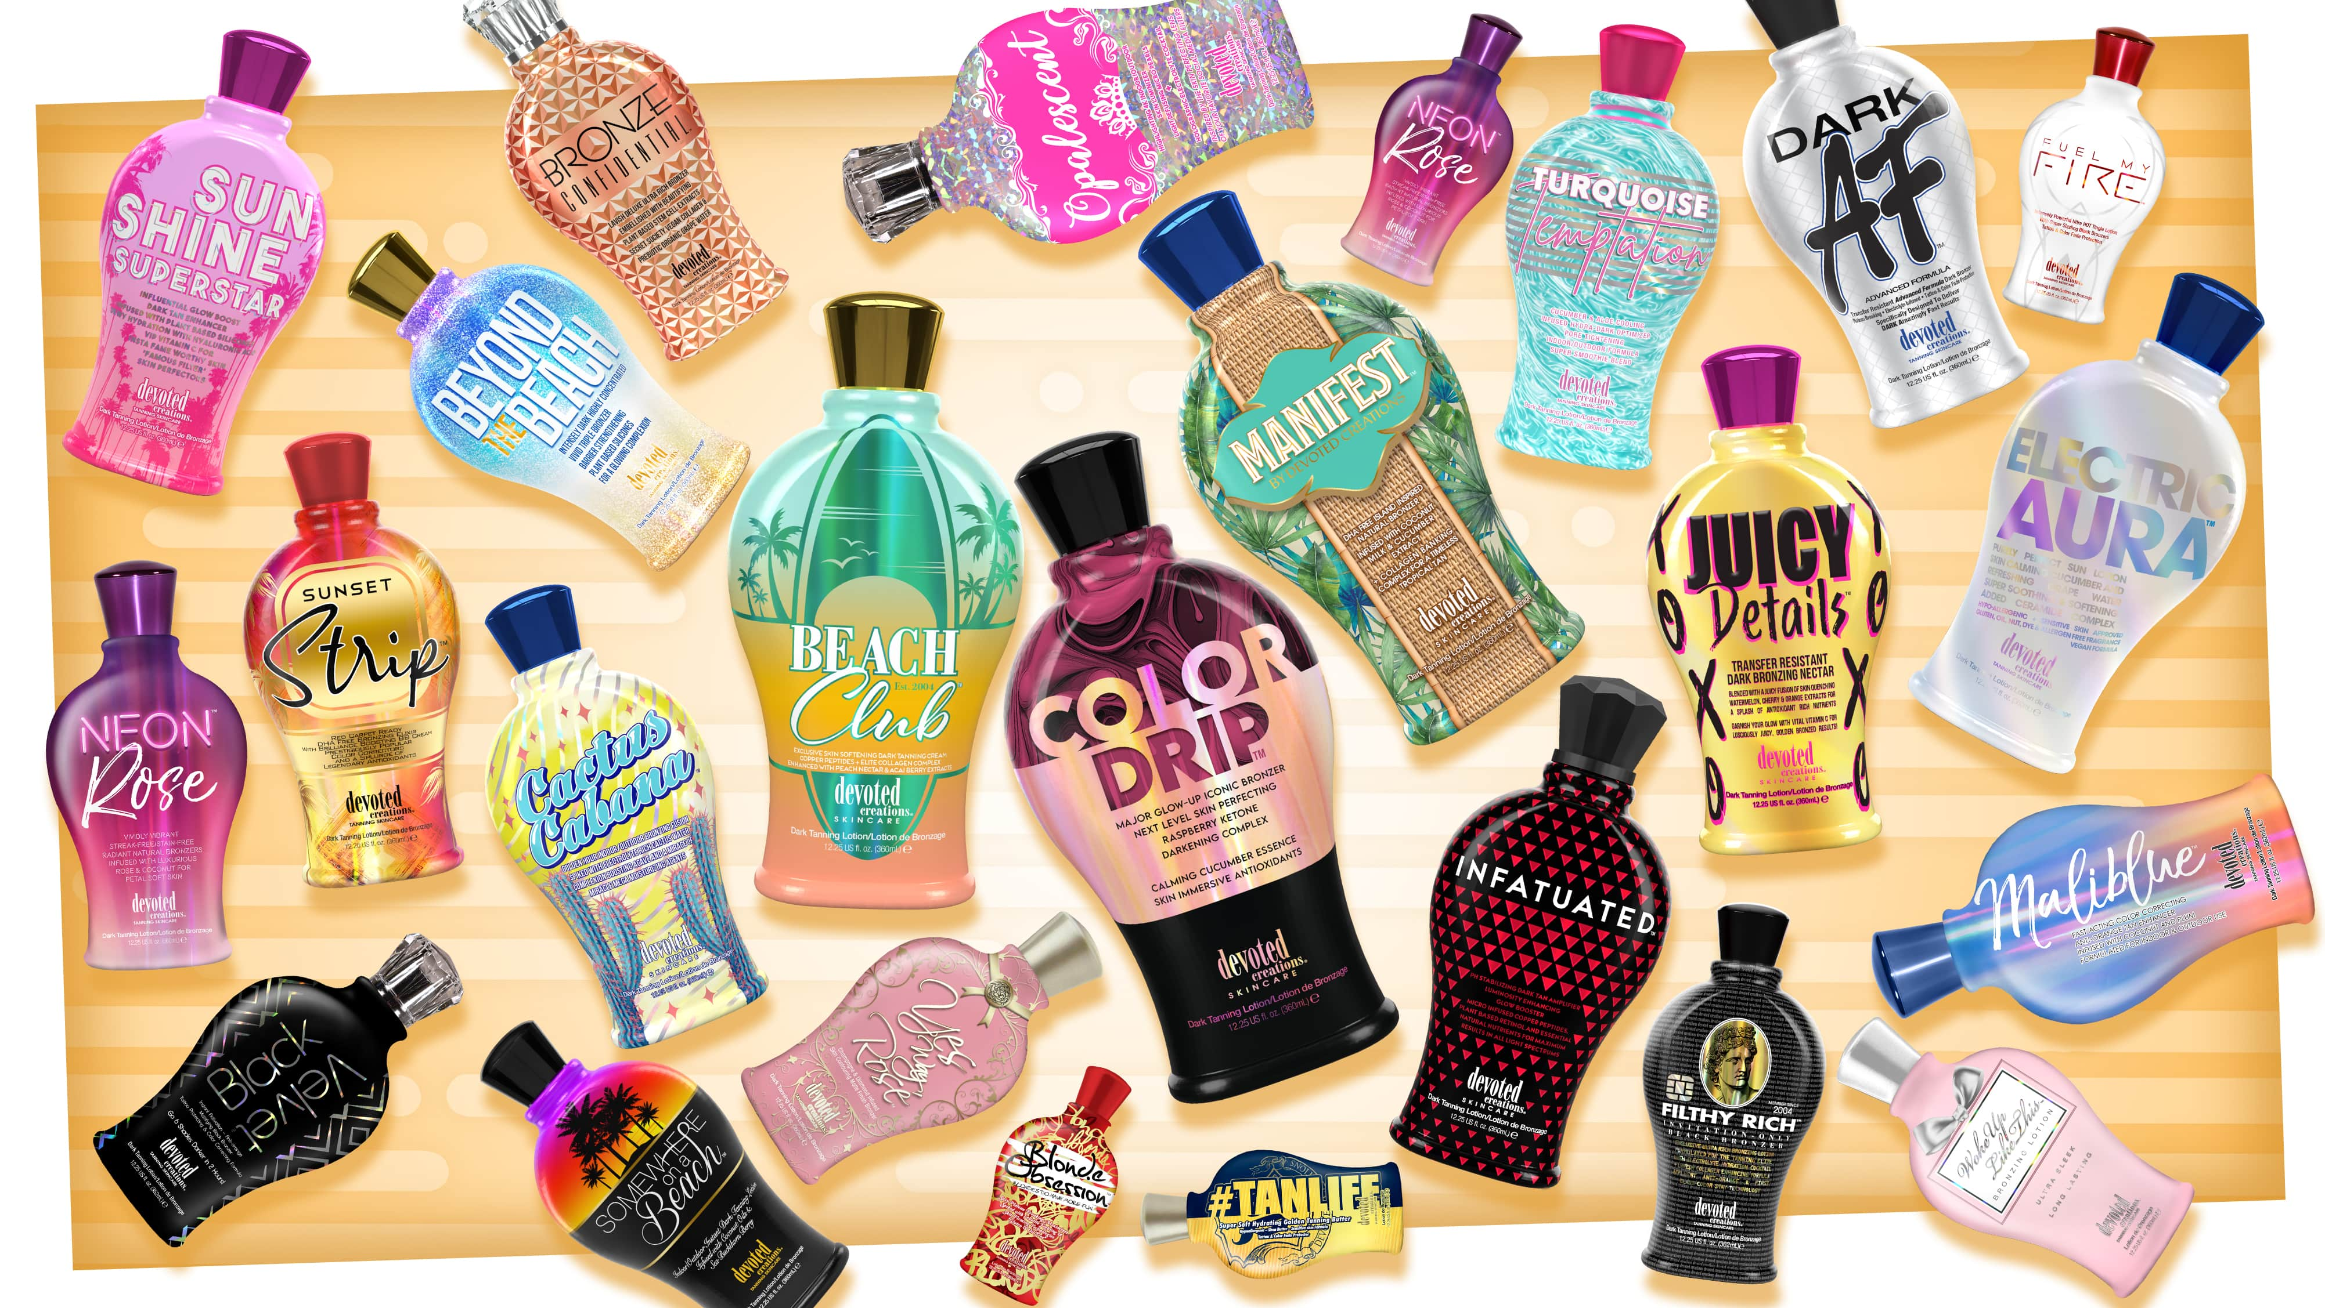

Slide 14
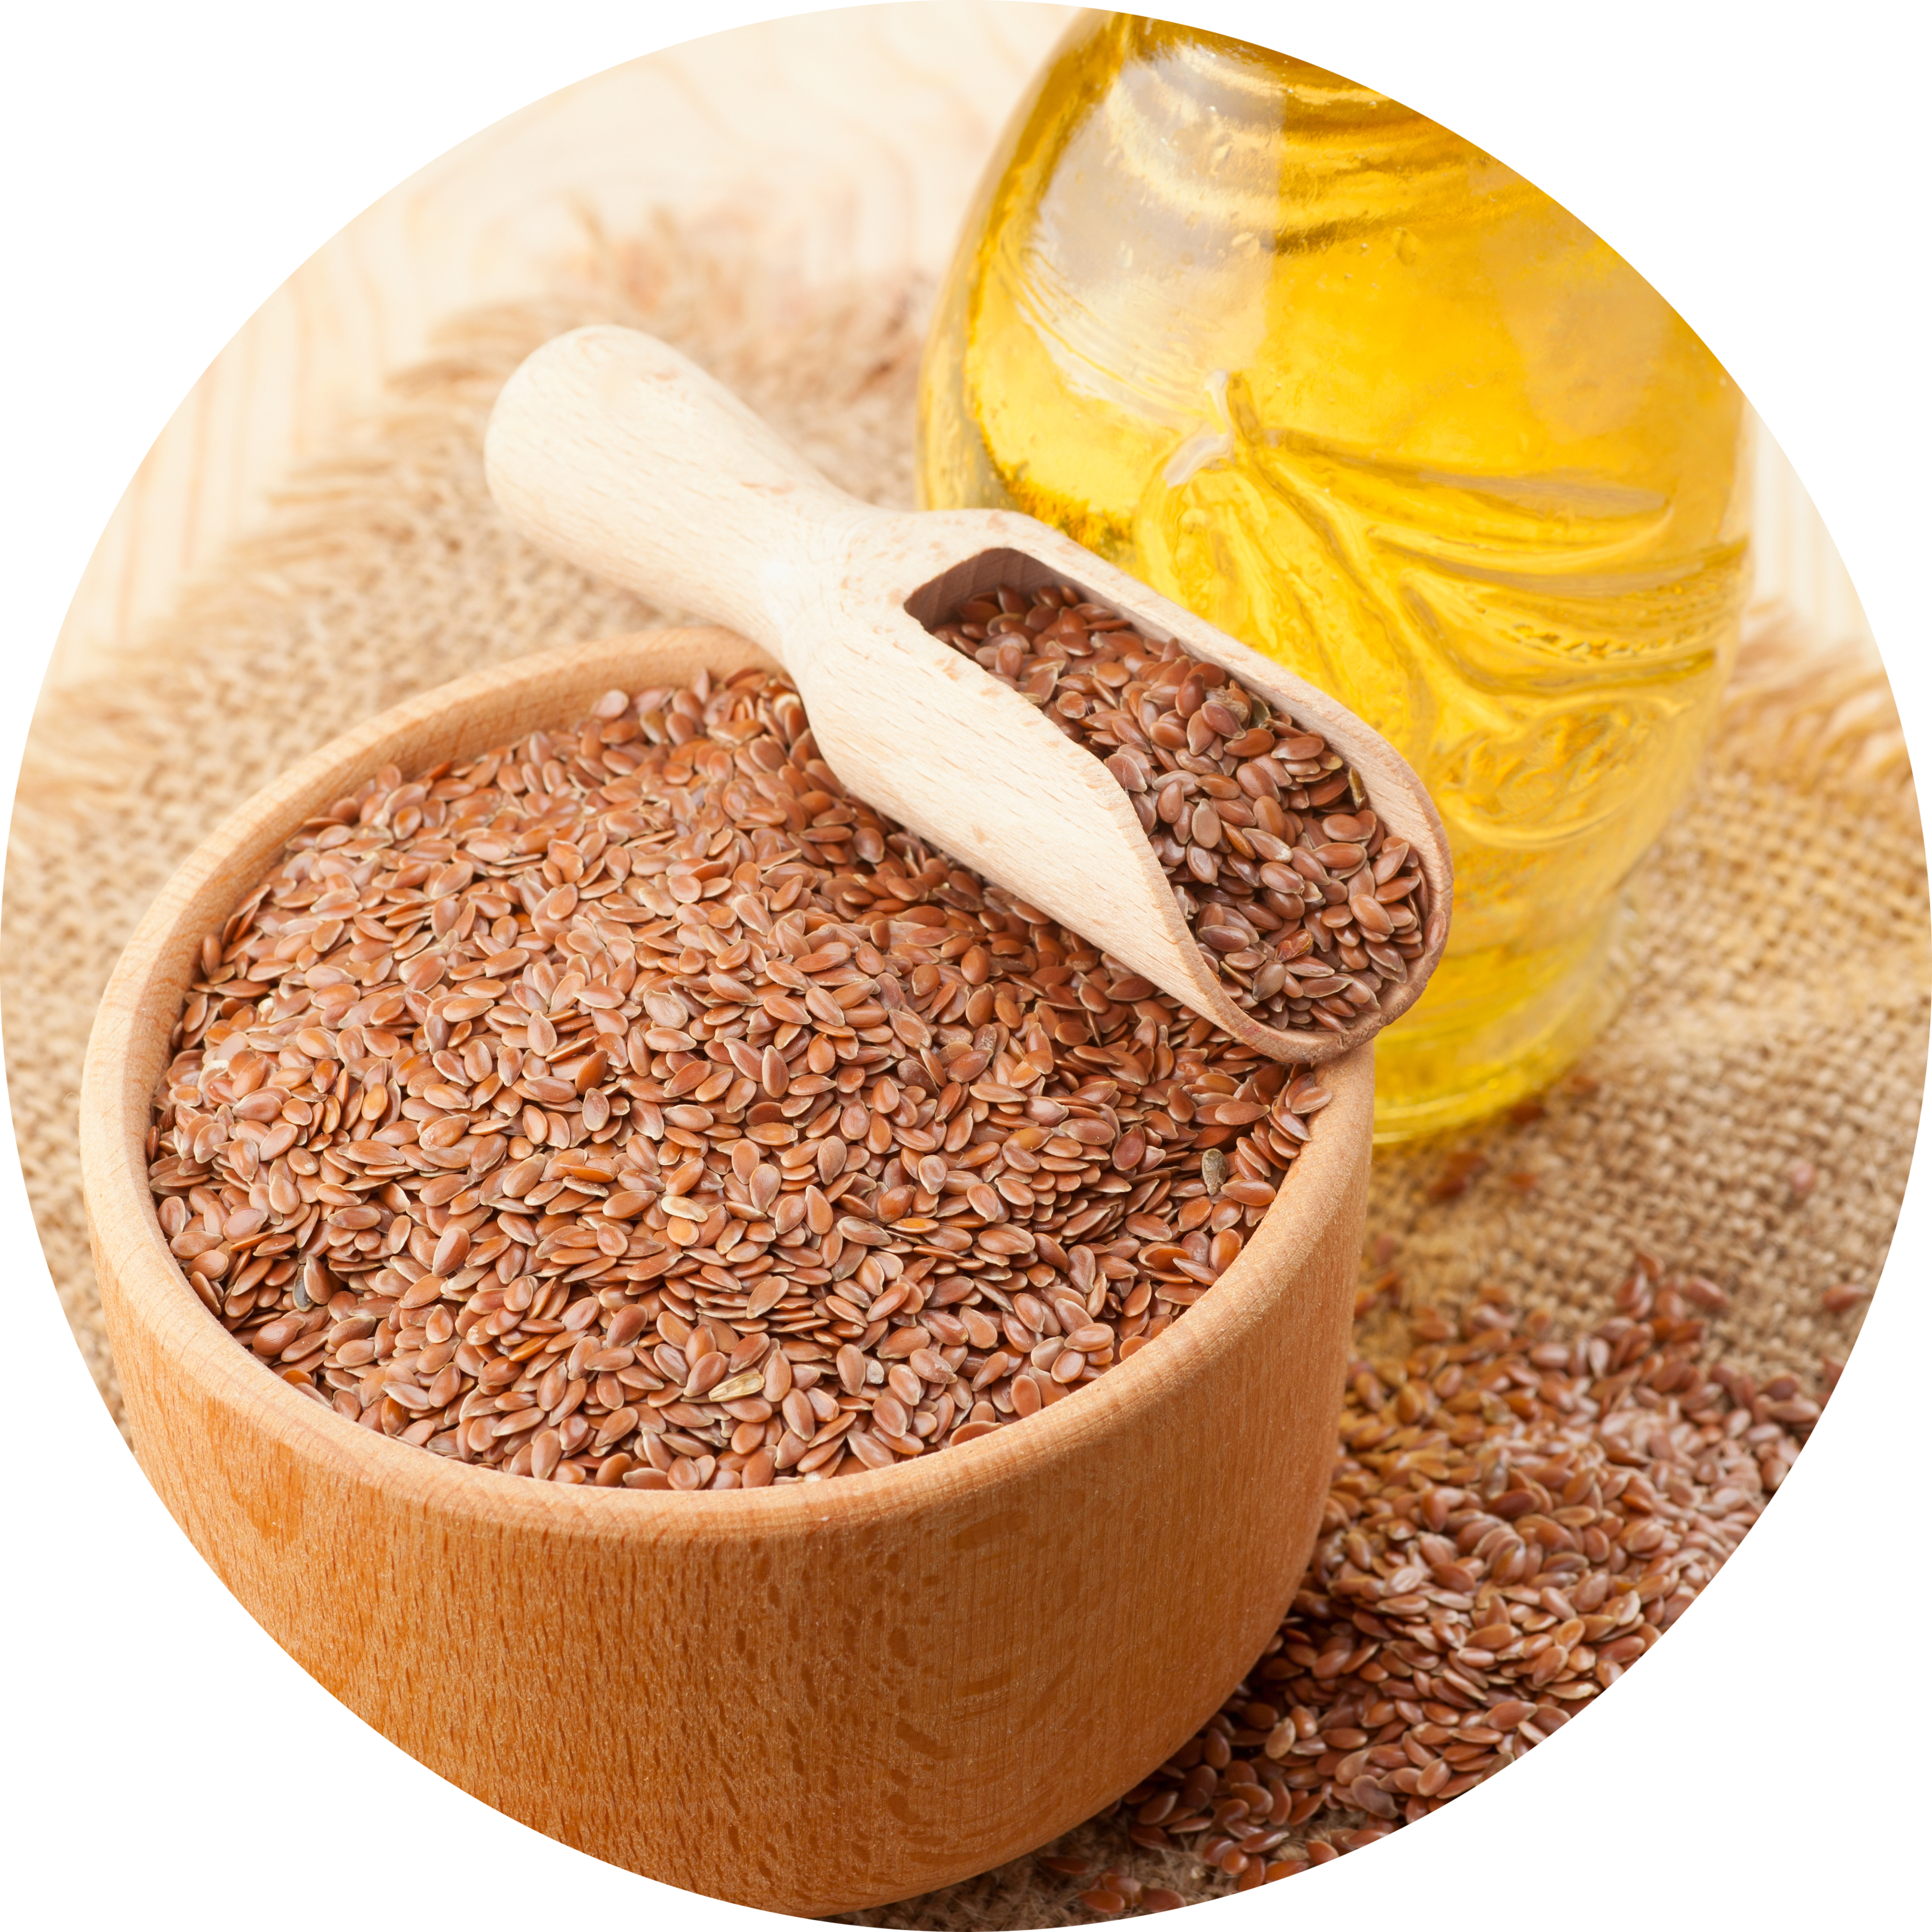
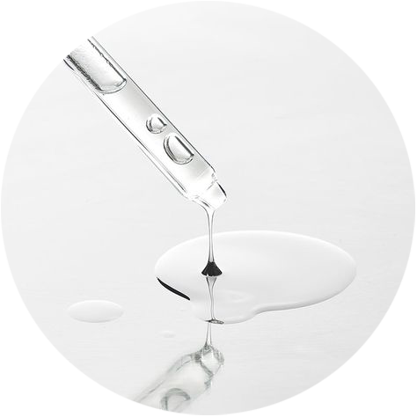
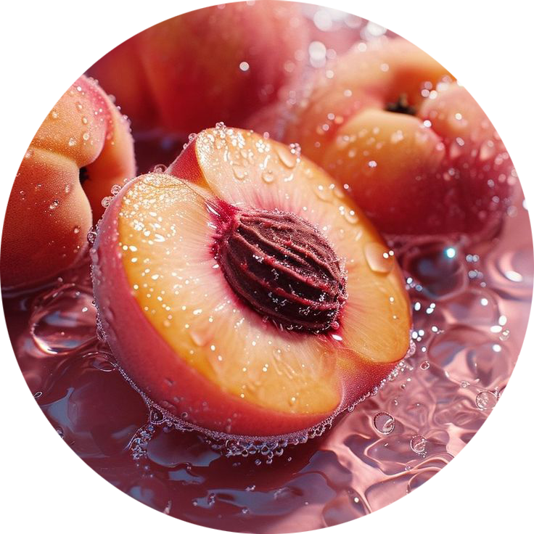
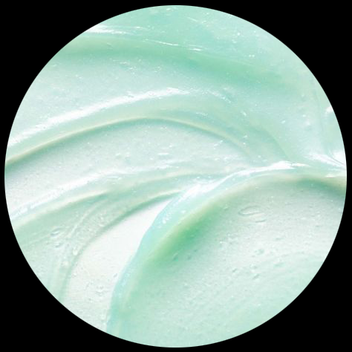
Plateau Breaking Intensifier
Extra melanin stimulators create a deeper, longer-lasting tan without bronzer
Anti-Aging
Copper Peptide & a Collagen Complex helps increase collagen production to be stored in the body for a more youthful complexion along with targeting scars & stretch marks
Color Correcting
Anti-reddening Tiger Grass calms inflammation
Skin Perfecting
Peach Extract, Neuroglow™ & French Flax Seed Oil repair a damaged barrier, improve skin’s radiance and provide a natural glow to the skin

Slide 15
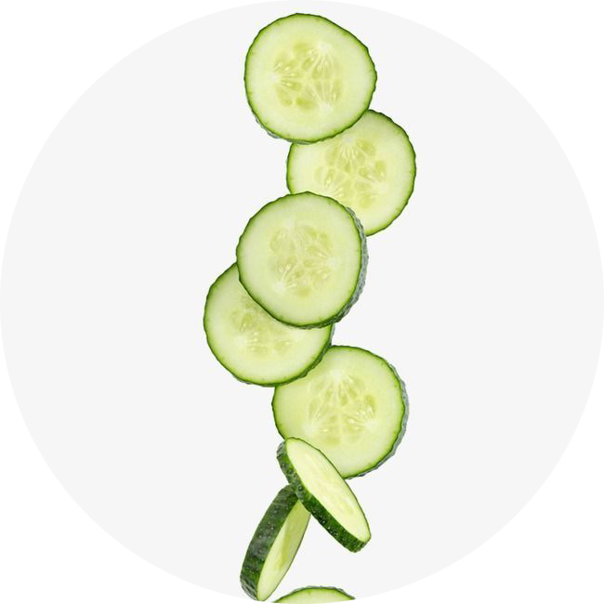
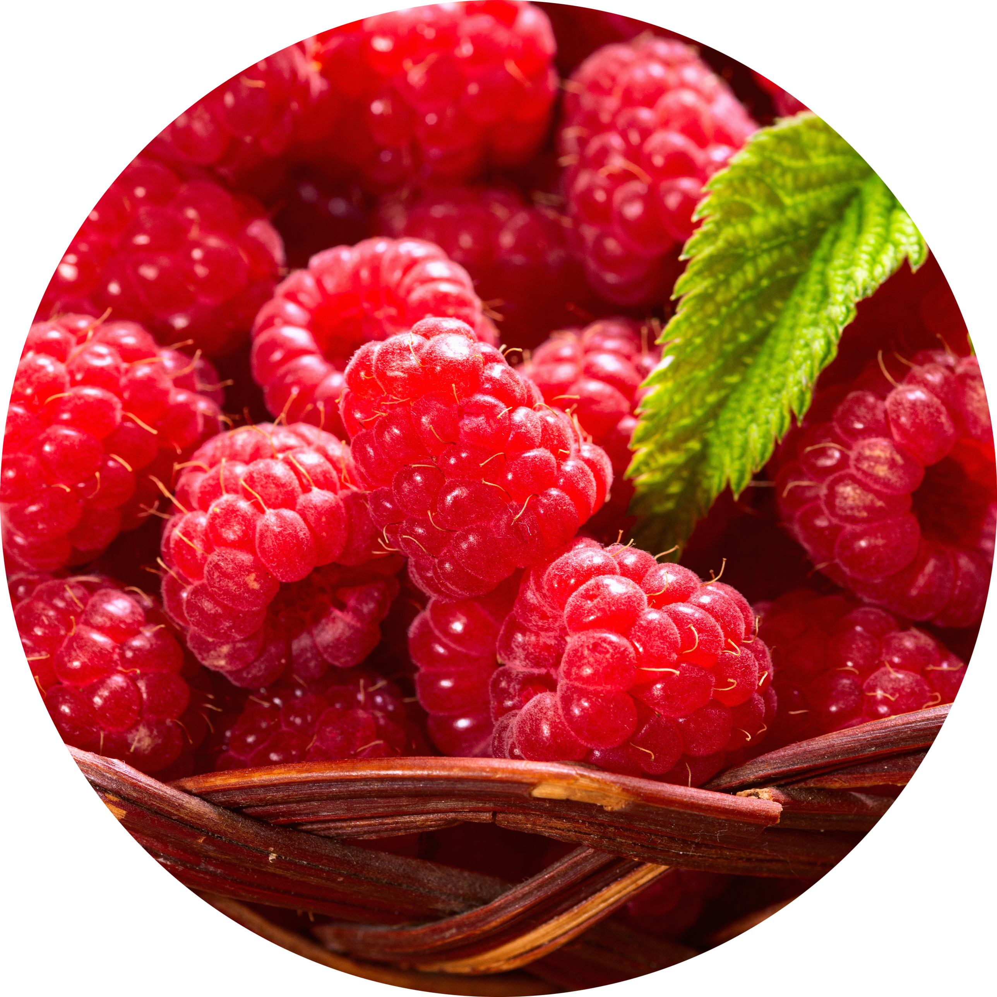
Glow Up Iconic Triple Bronzer
A blend of DHA, natural & cosmetic bronzers give immediate and delayed results
Extra melanin stimulators create a deeper, longer-lasting tan without bronzer
Raspberry Ketones deliver longer lasting color after each session
Anti-Aging
A Peptide & Collagen Complex helps increase collagen production, soften fine lines & wrinkles and provide a more even complexion
Deeper Hydration
Snow Mushroom and Cucumber deliver deeper & longer-lasting hydration to the skin
Skin Firming
Reneseed™ & Striover™ strengthen skins elasticity for a more tightened and toned appearance while softening fine lines, wrinkles and large pores

Slide 16
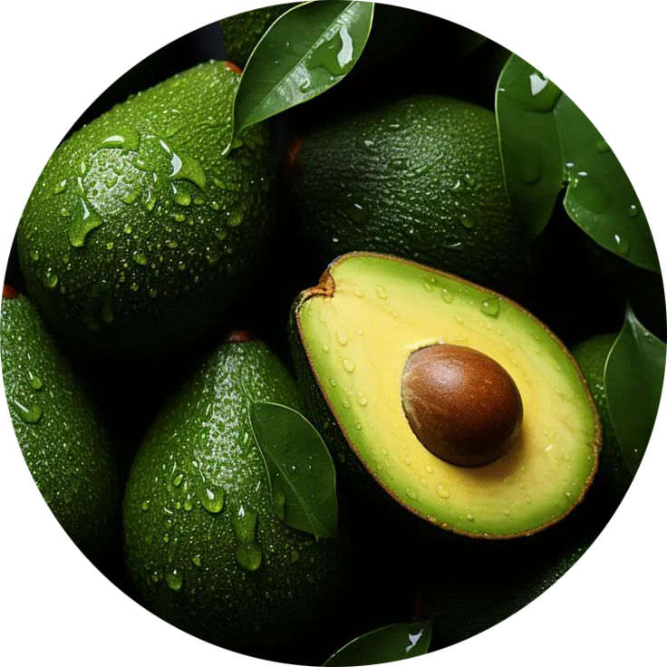
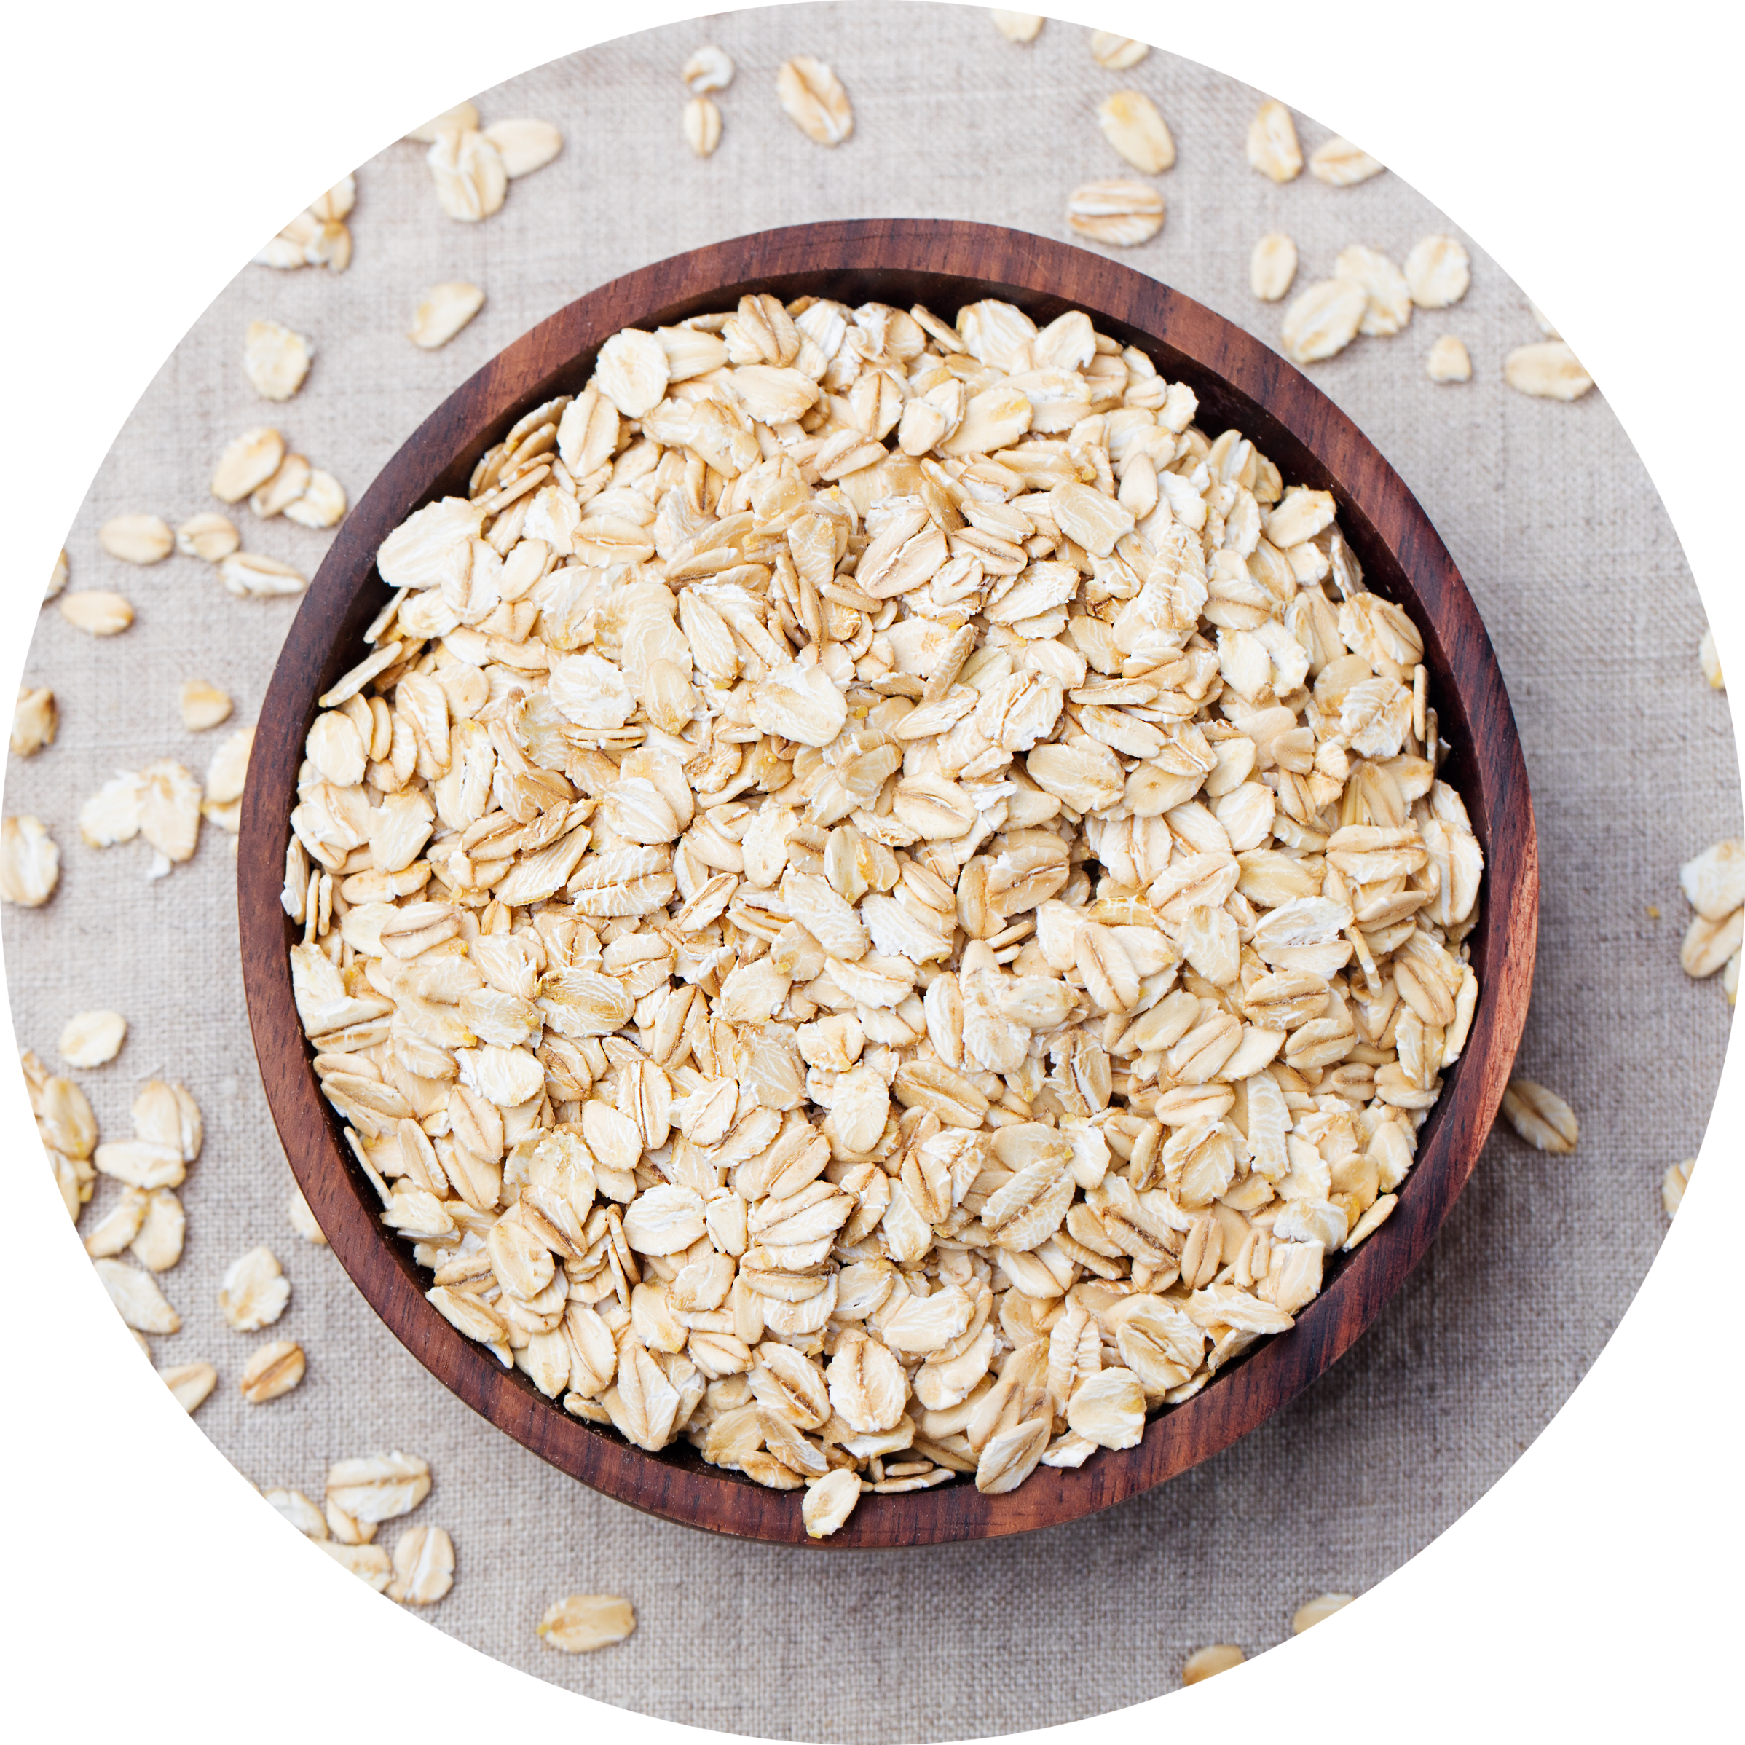
Island Inspired Natural Bronzer
Extra melanin stimulators create a deeper, longer-lasting tan without self tanning agents
Raspberry Ketones deliver longer lasting color after each session
Airbrush-like results with a BB cream finish
Anti-Aging
A Collagen Complex works to build new collagen and store in the body for a longer-lasting, more youthful looking complexion
Hydrating for Sensitive Skin
Cucumber Extract delivers weightless and long-lasting hydration to the skin while combating inflammation
Oat Extract provides gentle healing to dry & irritated skin
Skin Perfecting
Striover™ strengthen skins elasticity for a more tightened and toned appearance while Avocado combats inflammation and uneven texture

Slide 17
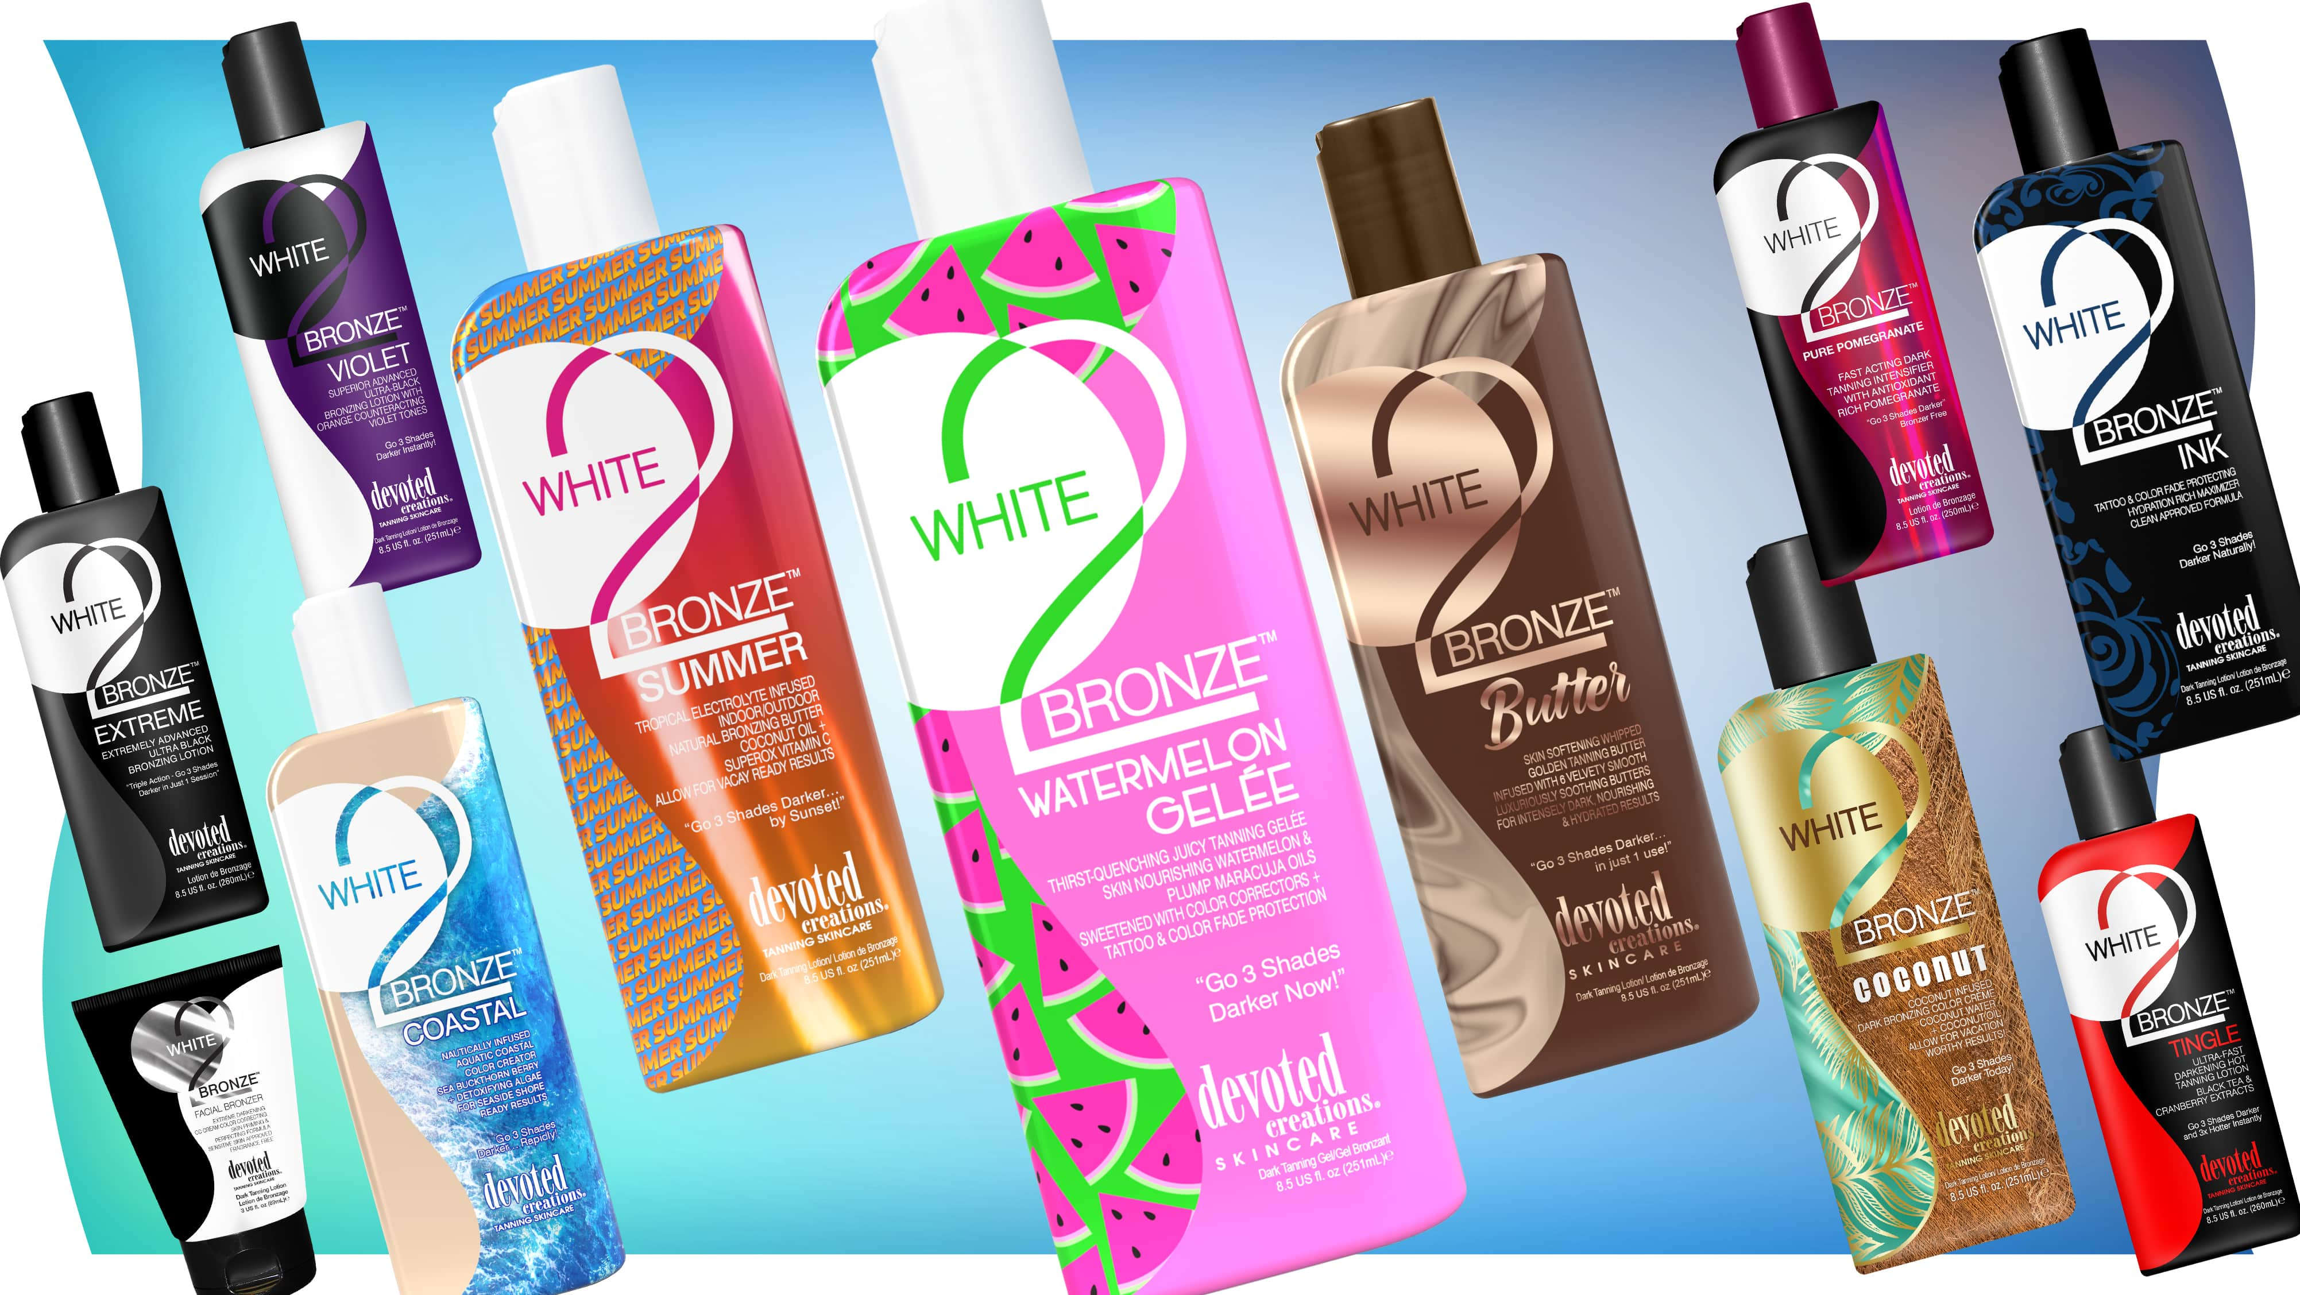

Slide 18
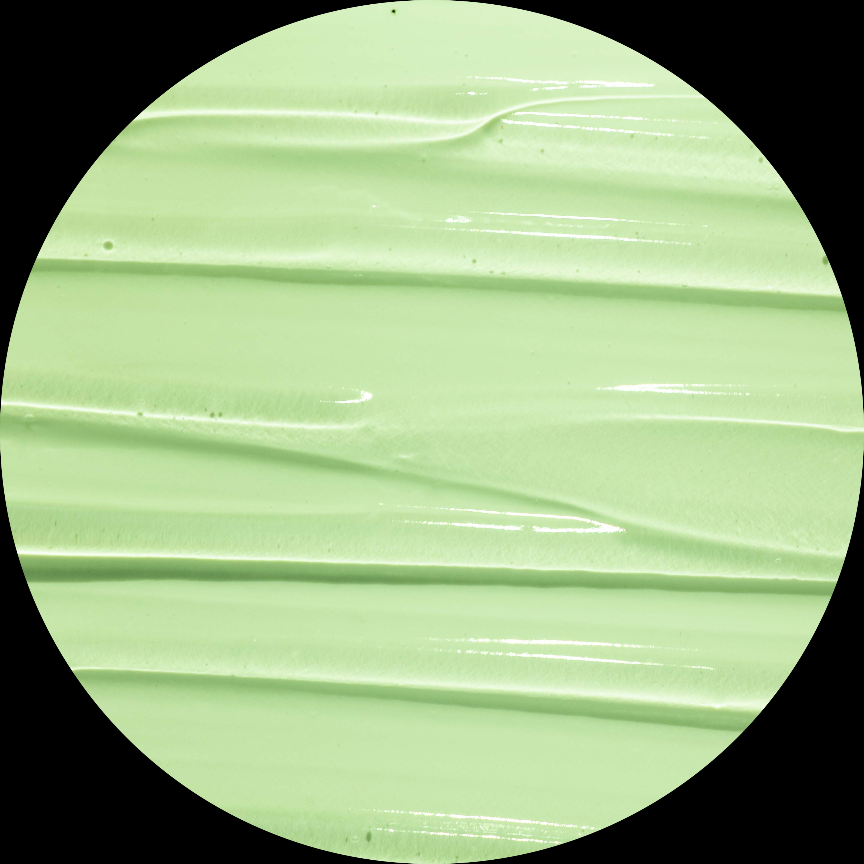
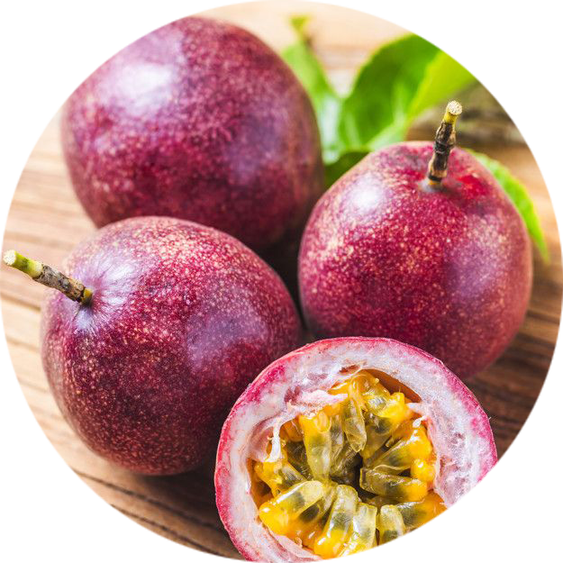
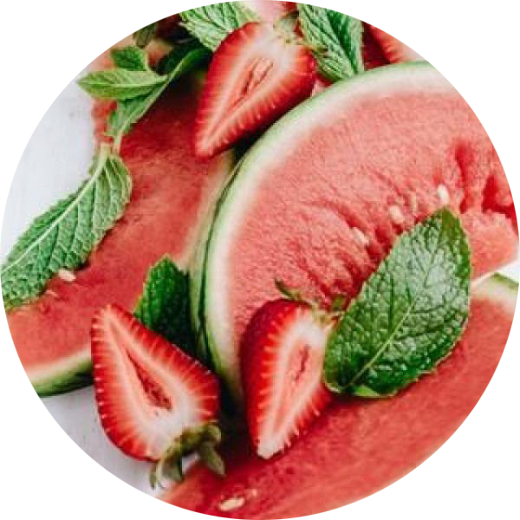
Juicy Tanning Gelee Formula
Extra melanin stimulators create a deeper, longer-lasting tan without bronzer
Gel-like formula for quick absorption into the skin with immediate hydration
Neuroglow™ mimics positive effects from the sun
Thirst-Quenching Hydration
Hyaluronic Acid & Maracuja Oil hydrate deep dry layers of the skin for long-lasting hydration
Antioxidant Fruit Blend
Watermelon, Strawberry, Cherry & Plum Extracts repair skin’s barrier, increase moisture levels and strengthen & protect the skin
Skin Perfecting
Striover™ strengthen skins elasticity for a more tightened and toned appearance

Slide 19
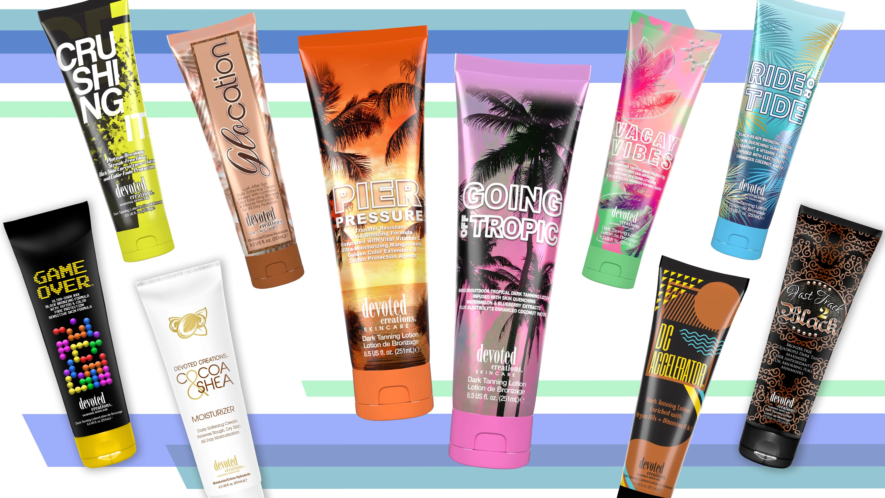

Slide 20
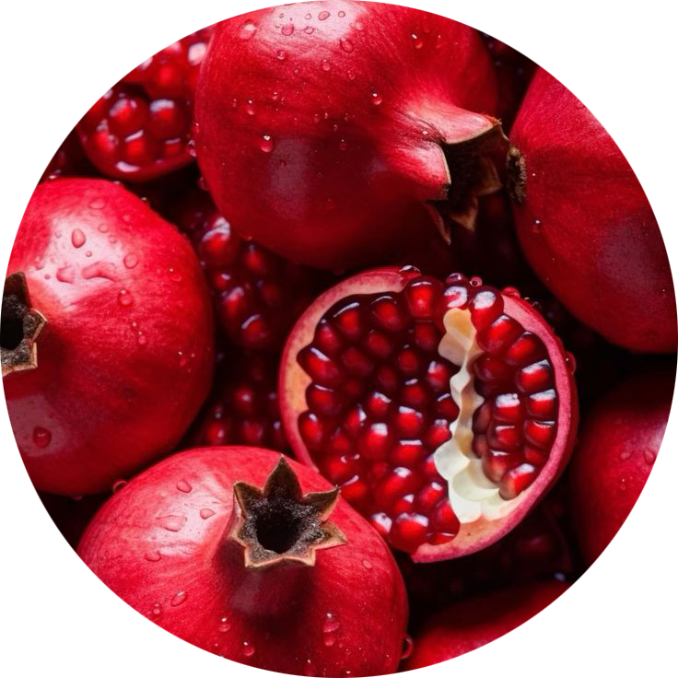
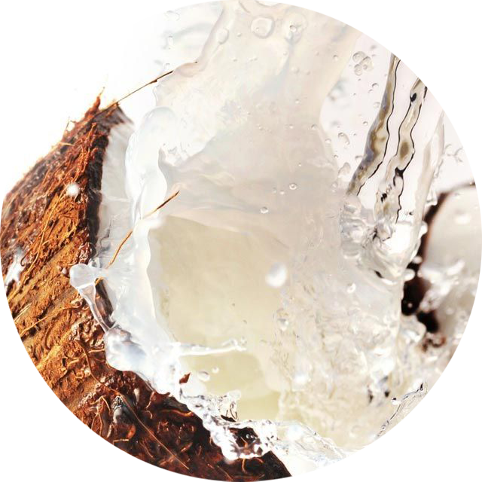
Transfer Resistant White Bronzer
Bronze Boost Complex for enhanced melanin activity without transferring onto clothes
Vital Hydration
Snow Mushroom and Coconut Water rehydrate dry skin
Skin Perfecting & Anti-Aging
Kakadu Plum & Pomegranate Extract fight inflammation, redness, dull skin and signs of aging
Skin Firming
Striover™ strengthen skins elasticity for a more tightened and toned appearance

Slide 21
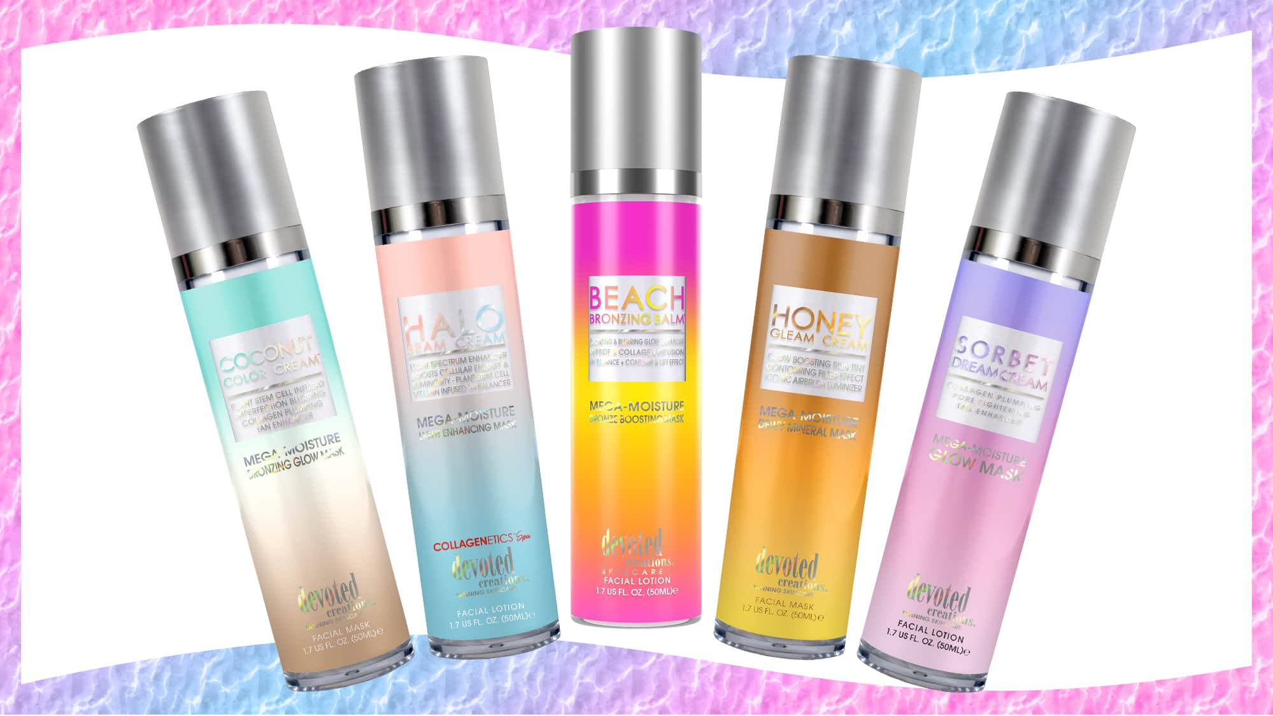

Slide 22
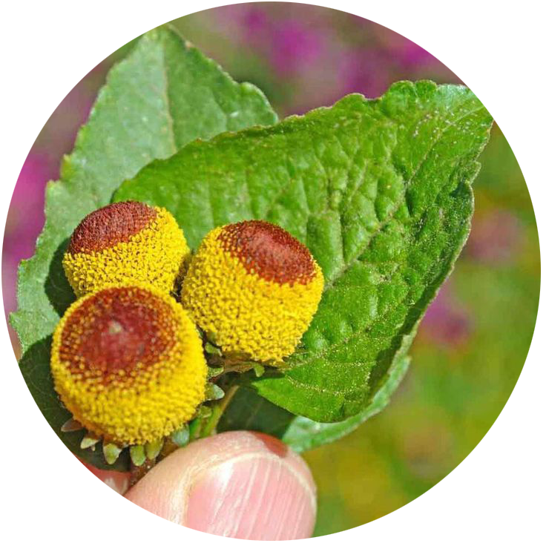
Multi-Use Bronze Boosting Facial Lotion
A mixture of DHA, natural & cosmetic coloring will deliver immediate and delayed results to the skin
Skin Perfecting
Niacinamide, Eterwell™ Youth and Turmeric Root combat inflammation, large pores, uneven texture and acne formations
Anti-Aging
Peptides, Exosomes & natures Botox soften fine lines and wrinkles, rejuvenate and regenerate healthy skin cells while keeping the skin youthful and tan
Barrier Repairing
Flax Seed Oil & Pomegranate Extract repairs the skins barrier against environmental aggressions while maintaining ample moisture levels in the skin

Slide 23
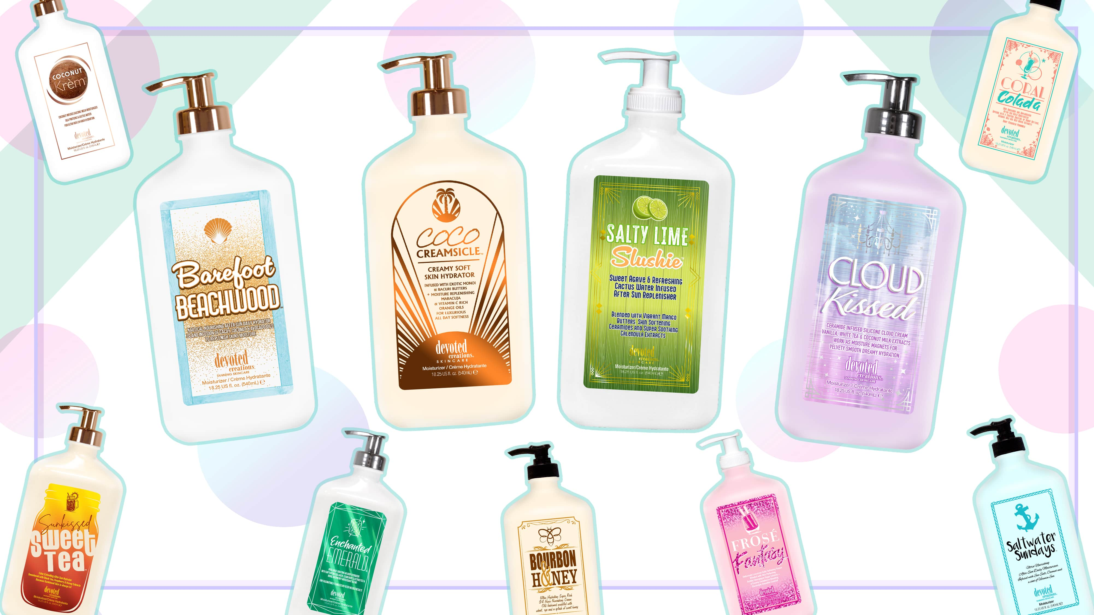

Slide 24
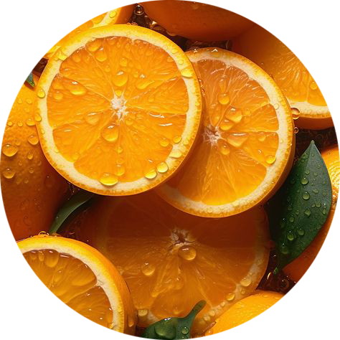
Orange Oil
High in Vitamin C, Orange Oil helps to deliver a glowing complexion, even skin texture and a clear complexion
Copper Peptide
An anti-aging peptide that works against scars and stretch marks in the skin
Hibiscus Extract
A prebiotic that provides skin barrier strengthening properties to fight against free radical damage

Slide 25
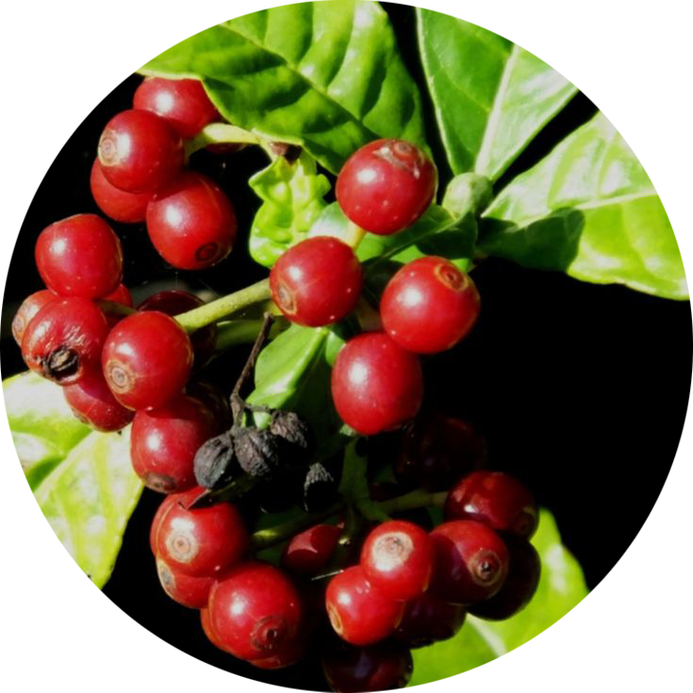
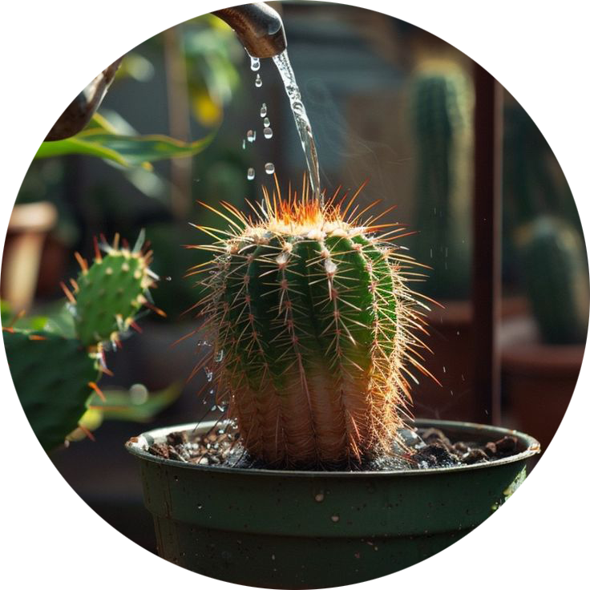
Cactus Water
High in nutrients, vitamins and electrolytes to keep the skin hydrated
Coconut Water
An electrolyte that helps to rehydrate dehydrated skin
Coffeeberry Extract
An antioxidant that works to protect against cellular damage in the skin

Slide 26
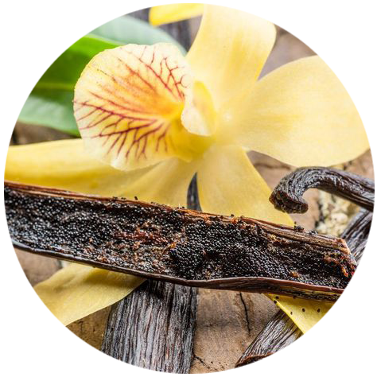
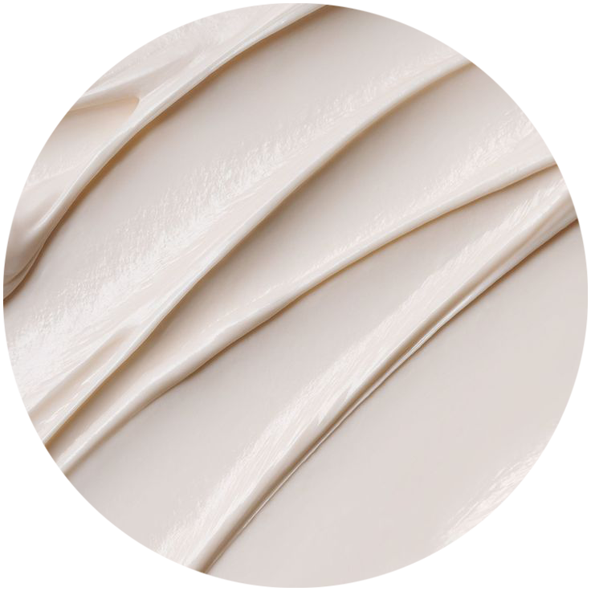
Ceramide Complex
Repairs the skin’s natural moisture barrier and helps lock in moisture
Marshmallow Extract
Combats inflammation and keeps the skin at ample moisture levels for a glowing, hydrated complexion
Vanilla Extract
An antioxidant that provides skin protecting and strengthening properties against free radicals

Slide 27
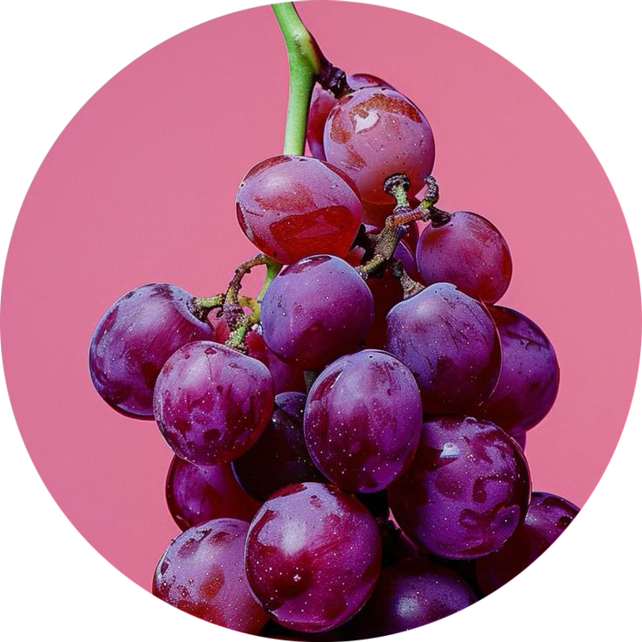
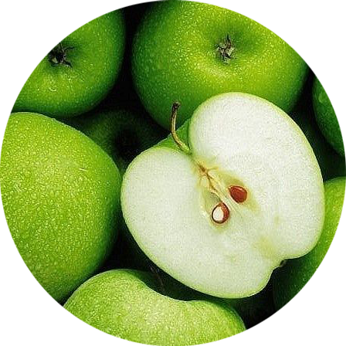
Skin Perfecting
Wound healing and cellulite fighting technologies repair skin’s barrier, increase collagen production, provide an even complexion and provide firmness to the skin
Anti-Aging Berry Infusion
Resveratrol and Apple Stem Cell Extracts help to increase collagen production while Cranberry & Raspberry Extracts provide hydration, skin strengthening and antioxidant protection

Slide 28
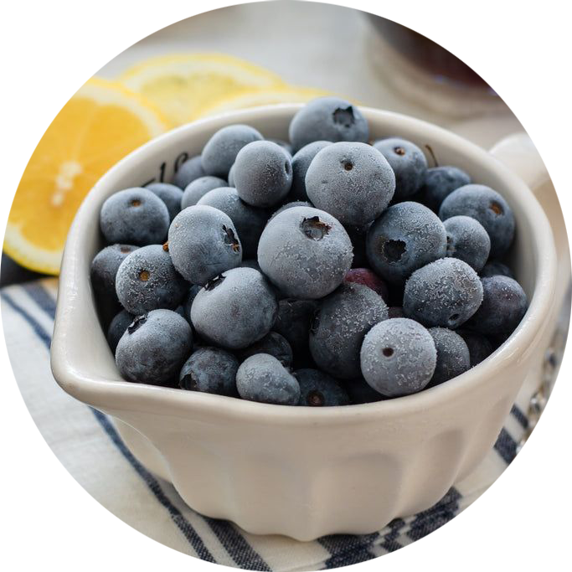
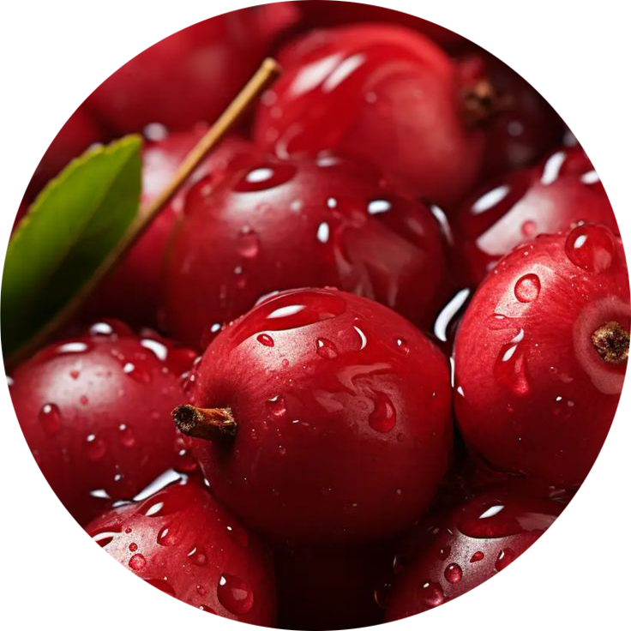
Resveratrol Wine Infusion
Potent antioxidant that helps to build collagen production and strengthen the skin
Berry Blend
Cranberry, Acai Berry & Raspberry Extracts provide electrolytes, hydration and essential nutrients to strengthen the skin’s barrier
Cellulite Fighting
Cellulite fighting blend to help restore firmness and structure to the skin

Slide 29
Notes:
29

Slide 30
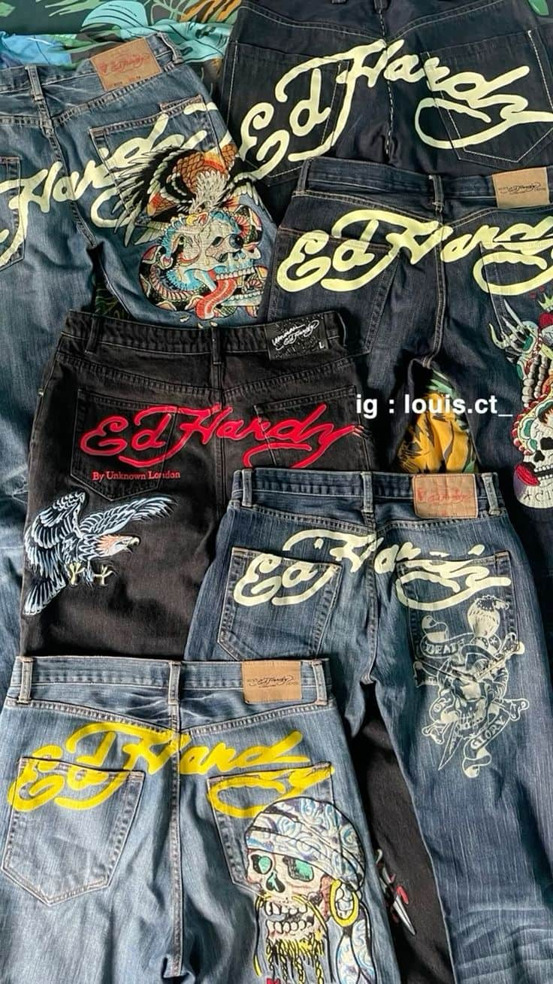

Slide 31
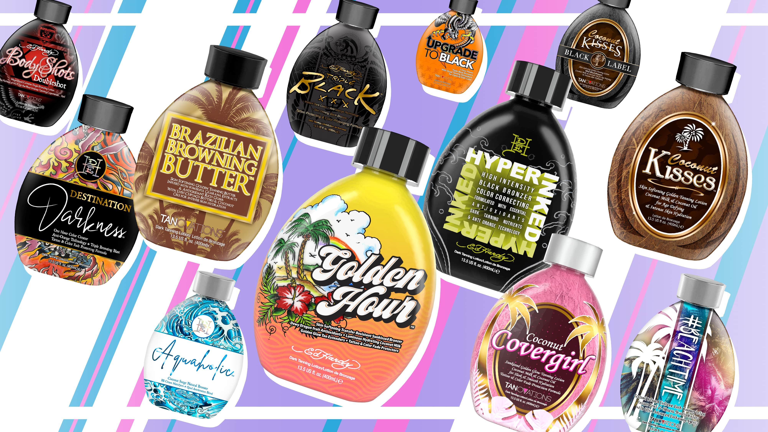

Slide 32
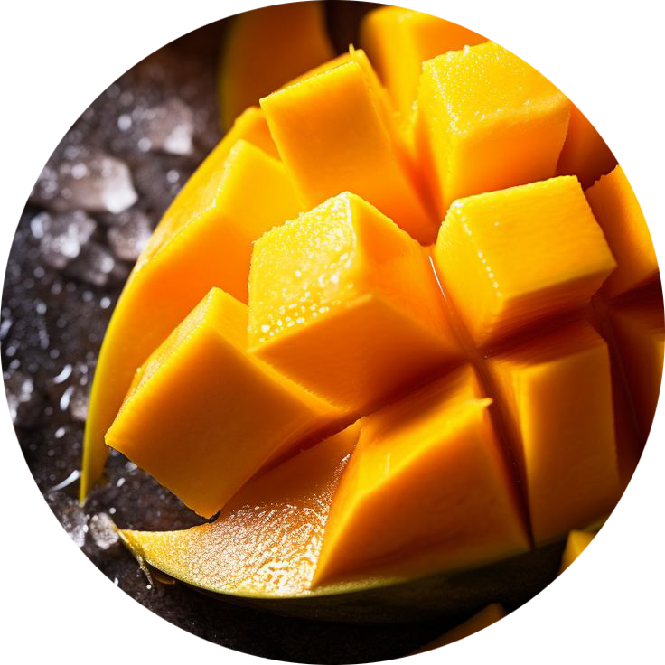
Sunset Glow Transfer Resistant Bronzer
Quad tyrosine blend & extra melanin stimulators provide natural color with delayed bronzers without transferring onto clothes
Neuroglow™ mimics positive effects from the sun
Hydration Blend
Coconut Milk, Mango Butter & Maracuja Oil retain moisture in the skin for a better hydrated appearance
Skin Perfecting
Hibiscus Extract and Vitamin C perfect the skin’s appearance, combats dull looking skin, and strengthens & protects against environmental aggressors

Slide 34
Plateau Breaking Triple Bronzer
Provides the skin with natural, immediate & delayed bronzing effect
Tan enhancing Beta-Carotene & Carrot Extract
Skin Protecting
Antioxidant blend of Pomegranate & Hibiscus Extracts strengthen the skin’s outer barrier to protect against free radicals and signs of aging
Skin Perfecting
Green Tea & Caffeine Extracts tighten and tone while sloughing off dead skin cell buildup for a smoother appearance

Slide 35
Skin Repairing
Banana Extract and a Ceramide Complex repairs the skin’s natural barrier to protect against moisture loss and environmental aggressors
Hydrating Infusion
Coconut blend to deeply hydrate dry layers of skin

Slide 36
Selling a Story
Start with the introduction (standard features)
Each product is practically the same
Constants = How, Why, What
Variables = Who, Where, When
Tanning Salesfluencer
~Sales~ but you're selling what they are influenced to buy
Influencing them by providing knowledge
Online influencers don’t normally go in depth into what they are talking about
1 fact for every $15
Fragrance doesn’t count
1 fact for every $10 for all aftercare
New car analogy – all cars with take you from point a to point b
What features does the new car have that would entice you to buy it over something else?

Slide 37
Megan Edwards | Key Accounts Manager
megan@devotedcreations.com

