Slide 1

Notes:
1

Slide 2
















Slide 3
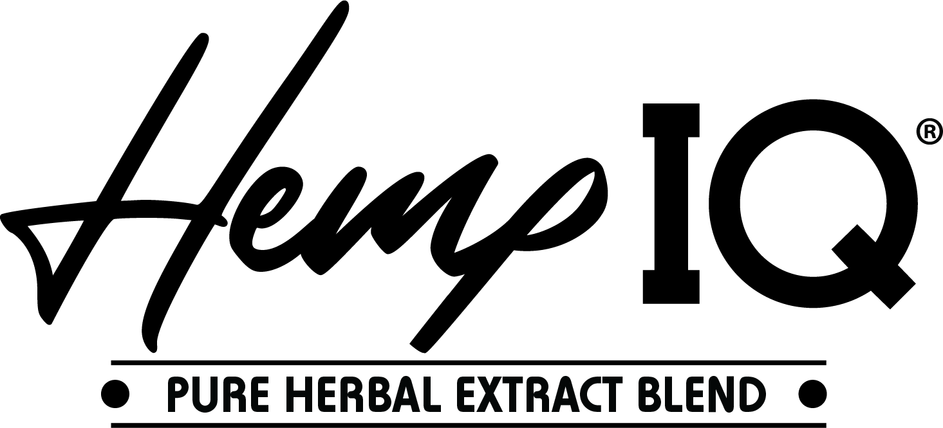


Slide 4
The Basics
Why we use Lotion
Category of Lotion
Base of Lotion

Slide 5
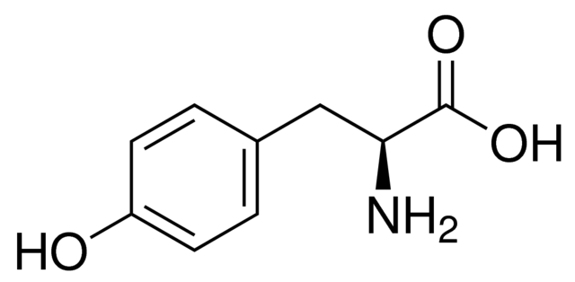
Why do we use tanning lotion?
HYDRATION
UV light needs somewhere to pull moisture from
Natural exfoliation process is 30-45 days
What is “tanning dry”?
Dehydrated skin speeds up exfoliation process to 5-7 days
Color won’t last as long
Wasting time and money
TYROSINE
30-60 seconds instead of 7-10 minutes
Tyrosine stimulates your melanin activity allowing you to start tanning faster
Every product contains tyrosine
Increase results by 60%
Notes:
5

Slide 6
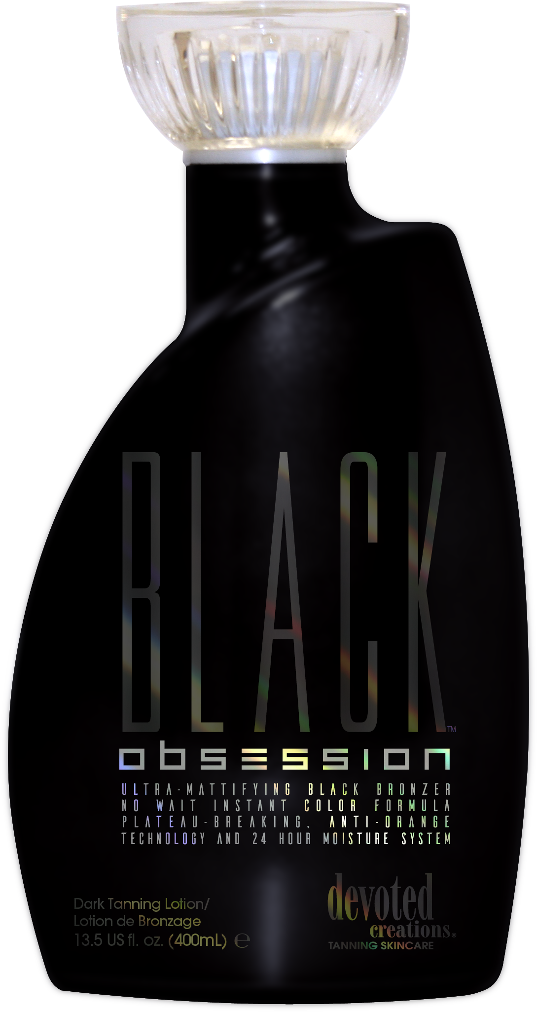
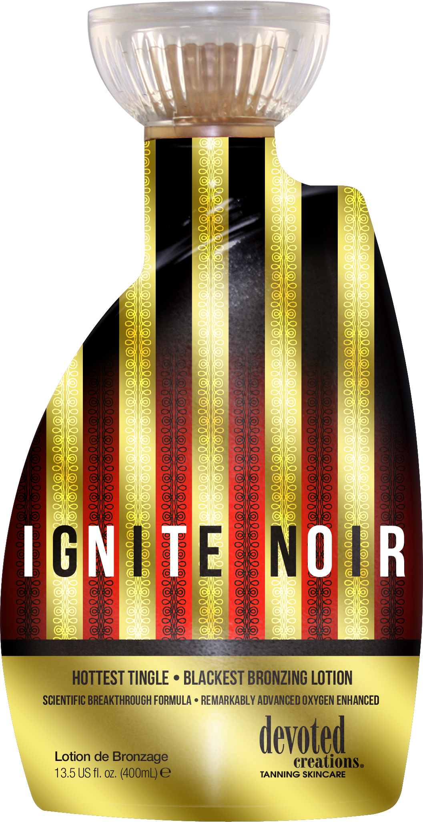
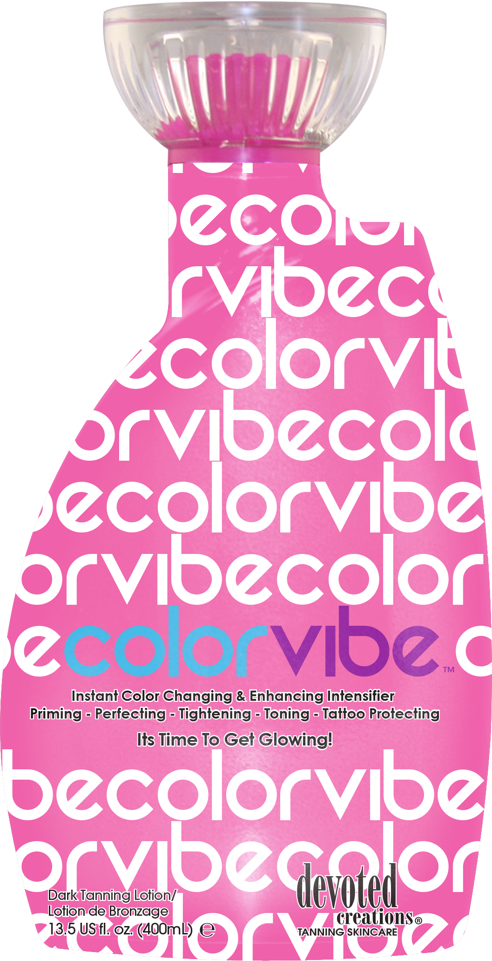
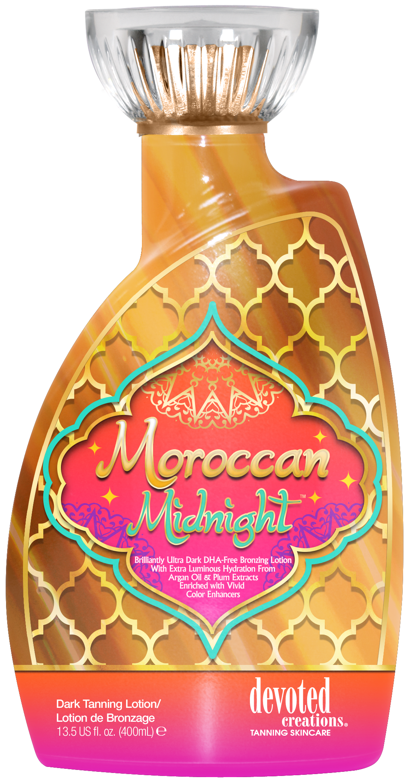
Categories of Lotion
Accelerators
Tingles
Bronzers
Notes:
6
Cooling lotions

Slide 7
Accelerators
Optimizer, Intensifier, Pure Accelerator – they all mean the same thing!
Blends tyrosine and moisturizers to accelerate the tan without the use of bronzers, tingle or anything extra
Who are they for?
First time tanners
Fair skin tanners
Lazy lotion users
Indoor/Outdoor
ANYONE!
No streaking
No staining
No after tan smell
For all skin types
Indoor/Outdoor use
Notes:
7

Slide 8
Bronzers
DHA
Natural
Cosmetic
Colorless and odorless ingredient that reacts with the amino acids in the keratin of our skin to create a browning effect
Most commonly used self tanning agent on the market - sunless solution, self tanning mousse, etc
Monosaccharide sugar – plant derived
Will NOT turn you orange
If it grows in the ground it turns you brown
Plant derived ingredients - flower extracts, caramel extract, carrot oil, plant extracts
Streak-Free/Stain-Free formula
No after tan odor, good for all skin types
Color of the lotion = makeup
For the customer who wants instant results
Easier to see where the lotion is being applied
***If the bottle has any type of bronzer in it, it will be indicated on the front of the bottle***
Notes:
8

Slide 9
Tingle
Only about 8% of tanners use tingle lotion – DO NOT try to sell them a tingle if they have never tried it before
Tingle users tend to spend 2x the amount as the average customer on products. It is okay to show them the higher priced products because they are used to spending the money for quality tingle products
What is a tingle and what does it do?
Increase Microcirculation
Makes you hot
Turns you red
Feels like you’re burning/tingling
Increases Bloodflow
Benzyl Nicotinate
Increases Oxygen Production
Notes:
9

Slide 10
Bases of Lotion
Notes:
10

Slide 11
Cashmere Blend
Smart Base, controlled moisture system
Knows what areas of the skin are dry and oily – Sends moisture where needed for dryer skin, and less for oily areas
Draws moisture from the air and traps it in your skin
Skin stays hydrated for up to 24 hours
Notes:
11

Slide 12
Silicone
Hairspray for your tan!
Lock in vitamins and nutrients
Not recommended for double dip clients
C5 Technology
Breathable form of silicone
Spray tan friendly
Helps lock in DHA if you are double dipping
Notes:
12

Slide 13
BB Cream
Mixes foundation and moisturizer
Created for tanners on the go
Good for all skin types
Helps shrink pore size and uneven skin tone
Matte and airbrush looking finish
CC Cream
Mixes foundation and moisturizer
Created for tanners on the go
Good for all skin types
Helps shrink pore size and uneven skin tone
Matte and airbrush looking finish
Notes:
13

Slide 14
Tapioca Starch
Thicker, body butter feeling and more hydrating for dry skin clients
For normal to extreme dry skin
Not labeled a certain base = Tapioca Starch
Notes:
14

Slide 15
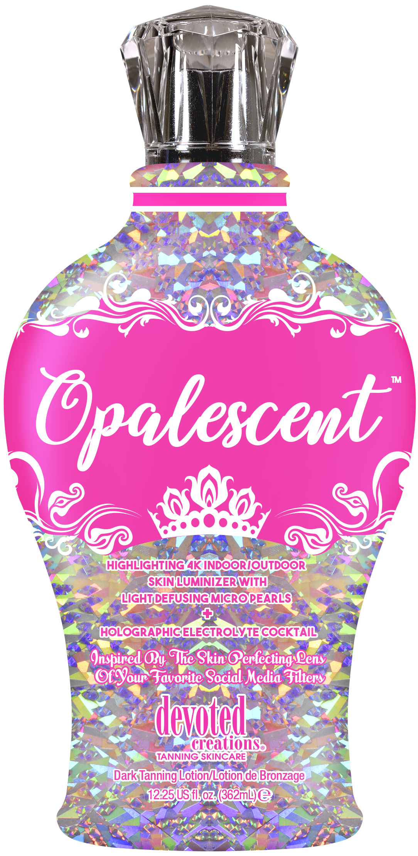
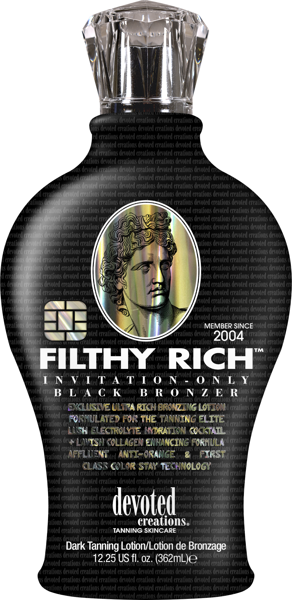
*4K Blend*
Provides a clear complexion
Primer for your skin
Allows for deeper hydration, longer lasting tanning results, better penetration of skin care ingredients
Notes:
15

Slide 16
Core Ingredients
Blue Tansy™
Flower extract that contains calming and healing properties and uses a blue hue to counteract natural orange tones in the skin
SunXtend™
Works to prevent color fading and extends the life of your tan
Fresktek™
A proprietary blend of deodorizing and skin freshening ingredients
Melatime™
Melanin booster for faster, darker results
Notes:
16

Slide 17
Core Ingredients
Advanced Matrixyl Synthe 6™
Powerful anti-aging peptide that reduces the appearance of fine lines and wrinkles for long lasting results
Renovage™
Targets the appearance of wrinkles and aging; firm, hydrates and plumps the skin
Bodyfit™
Reduces the appearance of cellulite and restore firmness
Notes:
17

Slide 18


Slide 19
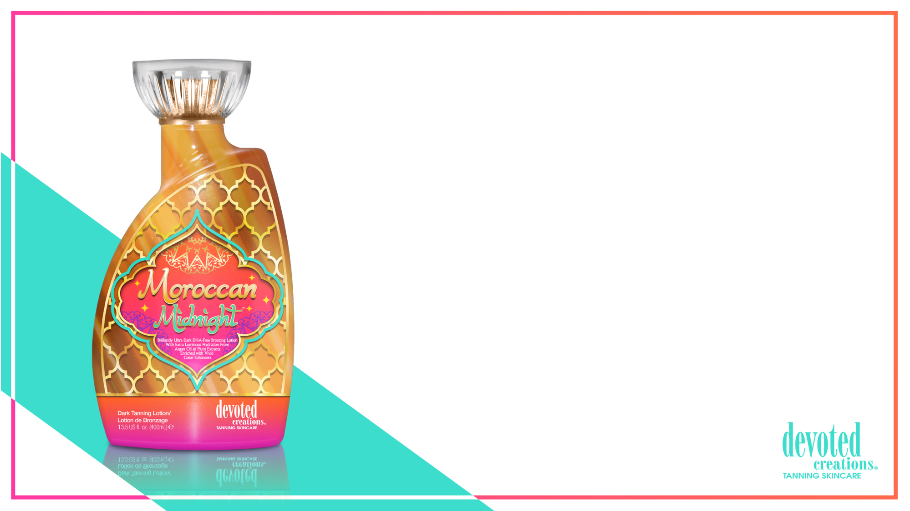
Moroccan Midnight™
Brilliantly Ultra Dark DHA-Free Bronzing Lotion
With Extra Luminous hydration from Argon Oil & Plum Extracts
Enriched with vivid color enhancers
Formulated with multiple accelerators that work to target melanin production to deliver fast, dark tanning results
Super High levels of Natural and Cosmetic bronzers deliver a streak-free/stain-free bronzed result
Rich Caramel Extracts – Impart dark long-lasting color with self tanners
Added Argon Oil delivers a velvety smooth feeling to the skin while locking in moisture for the entire day
Plum Oil - A rich oil that offers a non-greasy and silky skin feel that moisturizes skin
PhytoCellTec - Binds to healthy skin cells, allowing healthy skin cells to live longer
Liquid Glass works as a primer to mask tiny imperfections in the skin
Tan extending and tattoo protecting blend
Kakadu Plum and Almond Oils are rich in antioxidants to help block free radical damage
Renovage ™ - Anti-aging complex that reduces the appearance of fine lines and wrinkles
Fragrance: Midnight Moroccan Orchid

Slide 20
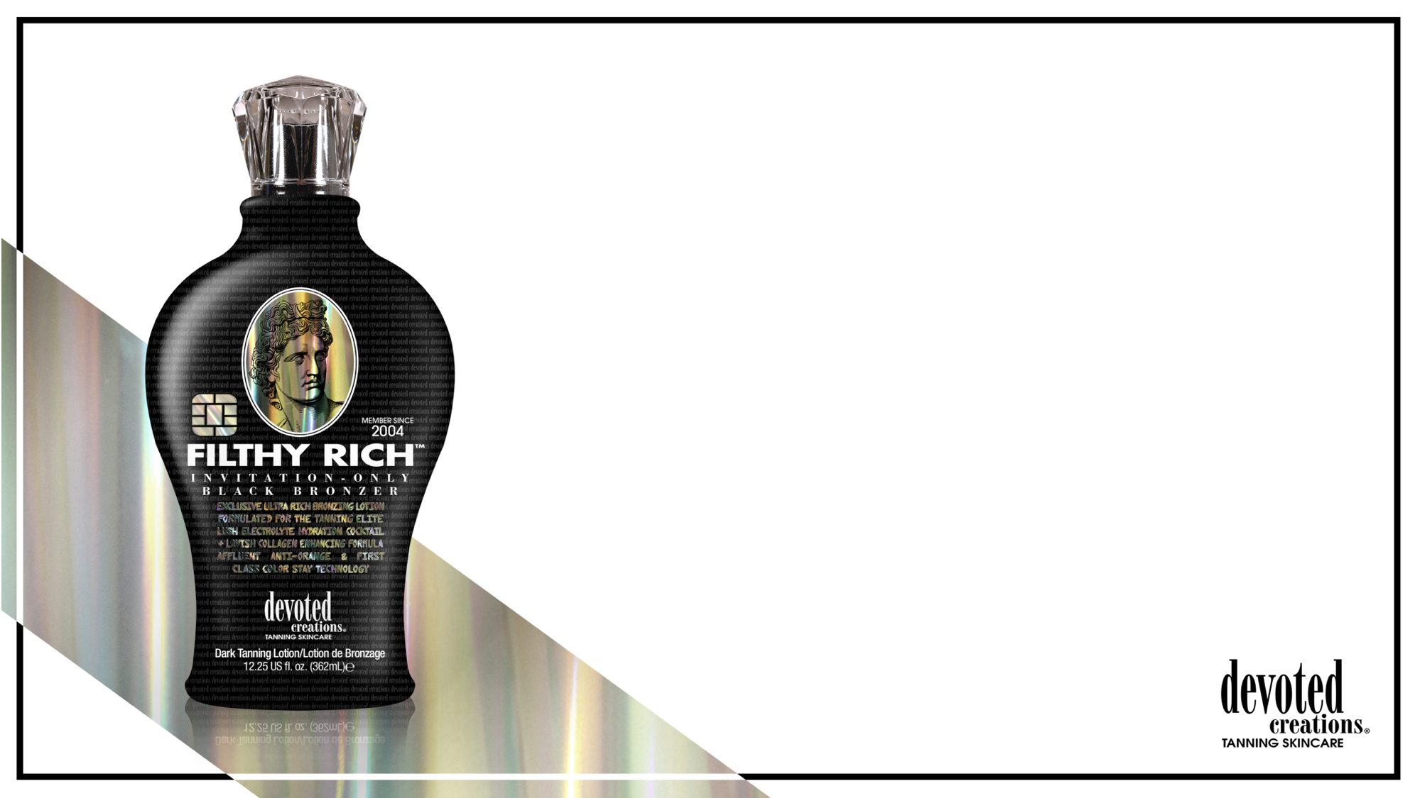
Filthy Rich™
Exclusive Ultra Rich Bronzing Lotion Formulated for the tanning Elite
Lush Electrolyte Hydration Cocktail + Lavish Collagen Enhancing Formula
Affluent Anti-Orange & First Class Color Stay Technology
Invitation Only Black Bronzer
Revolutionary 4K Blend – Allows for deeper hydration and longer lasting tanning results as well as better penetration of the high end skincare ingredients, while also working to blur imperfections and allow for a crystal clear complexion
Supercharged Electrolyte Cocktail – Utilizes Magnesium, Coconut Water, Sodium PCA, Orange, Almond and Banana extracts to improve skins moisture barrier and strength, calm redness, protect against environmental dehydration, and work as a vital component in maintaining hydration levels in the skin
Sugarcane Derived Squalane™ – Works to reduce the appearance of fines lines and wrinkles, balances oil production on the skin to promote a fimer appearance, non-comedogenic and suitable for all skin types
Vegan Collagen – Helps to strengthen and condition the skin to visibly improve texture and suppleness while also helping to restore skin’s natural bounce and resilience, diminishing the look of fine lines and wrinkles
Blue Tansy™ – Provides anti-orange agents so the skin develops the most natural, dark bronzed result
Charcoal Extracts – Helps to detoxify and pull impurities from the skin
Bakuchiol – Works by increasing cell turnover, thereby stimulating collagen production and diminishing wrinkles, skin laxity, and overall photo damage
Body Fit™ Technology – Reduces the appearance of cellulite and restores firmness
FreshTek™– A proprietary blend of deodorizing and skin freshening ingredients
Advanced Matrixyl Synthe 6™ – Powerful anti-aging peptide that reduces the appearance of fine lines and wrinkles for long-lasting results
Fragrance: Rich Mandarin Woods

Slide 21
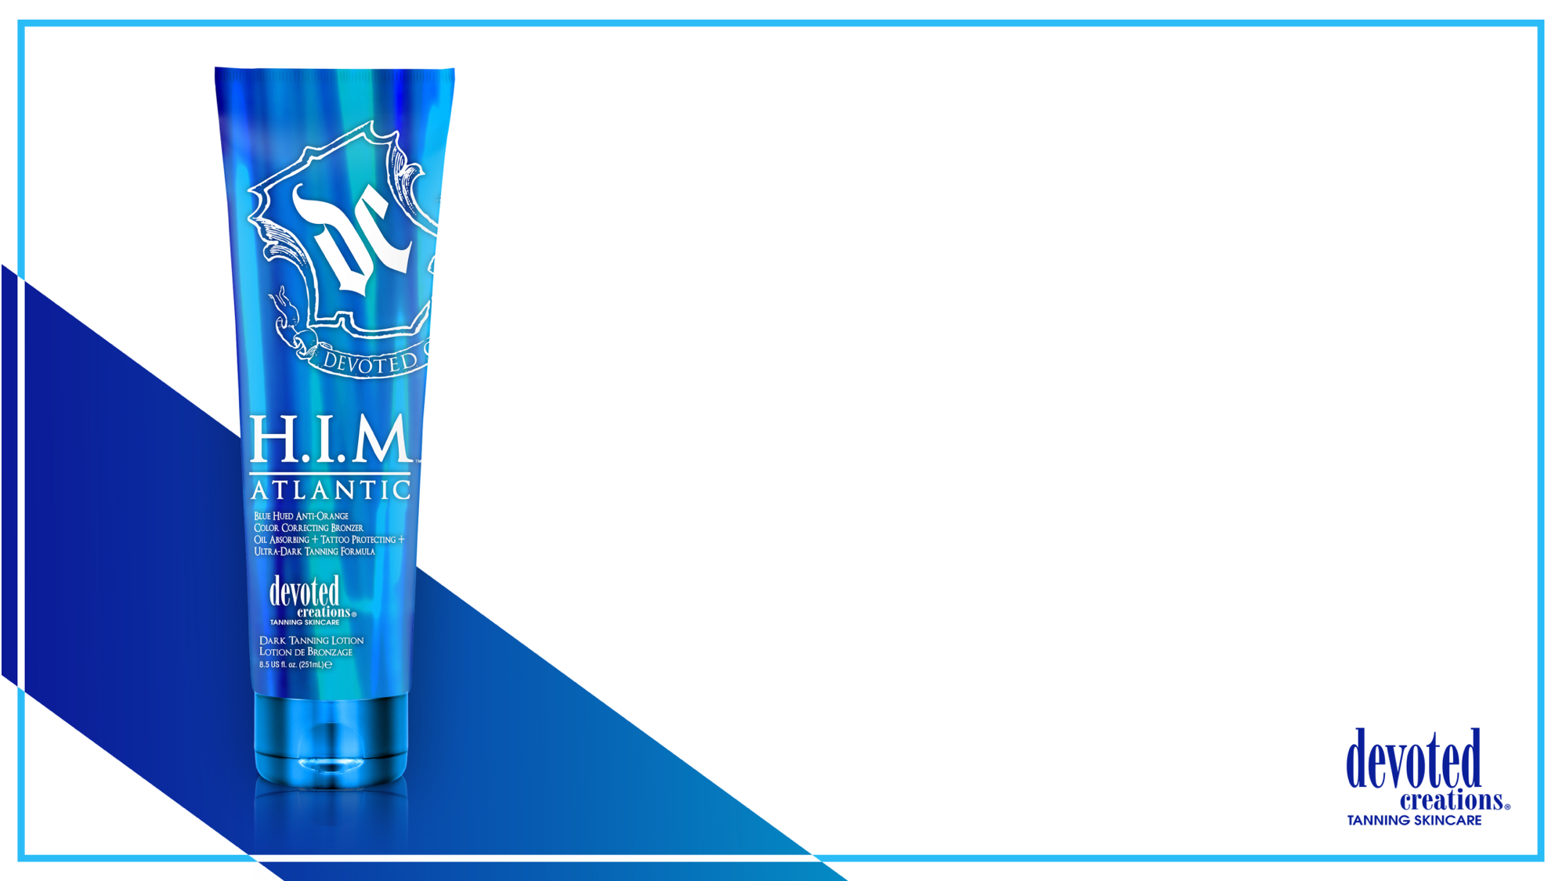
HIM Atlantic™
Blue Hued Anti-Orange Color Correcting Bronzer
Oil Absorbing + Tattoo Protecting + Ultra Dark Tanning Formula
Blue Hued Bronzing Blend – Allows your skin to develop natural, dark brown just from the beach color
Tiger Grass – Color-Correcting ingredient that reduces redness and helps protect skin from environmental stress and blemishes
Turmeric Root Extract – Known for its antioxidant and anti-reddening properties. Turmeric helps to improve the look for the surface of your skin and create a more. Blemish free, even appearance
Blue Tansy™ – Provides anti-orange agents so the skin develops the most natural, dark bronzed result
Matrixyl Synthe 6™ – Targets and fills in fine lines and wrinkles
Tamanu Oil- A powerful skin regenerator; aiding in wrinkle reducing, blemish-fighting, and moisturize dry skin. Also, helps to hide the appearance of scars and stretch marks
Shea Butter- Helps to soothe dry skin and improves the skin’s elasticity
Avocado Extract – Helps counter act reddening in the skin caused by irritation, good for tanners with skin conditions, protects against environmental damages
Vitamins C & E - Protect the skin from environmental damage, promote a more youthful looking appearance
FreshTek™ – Body deodorizing blend to leave the skin with no after tan odor
SunXTend™ – Extends the life of your tanning results and helps to prevent color fading
Fragrance: Blue Waters

Slide 22
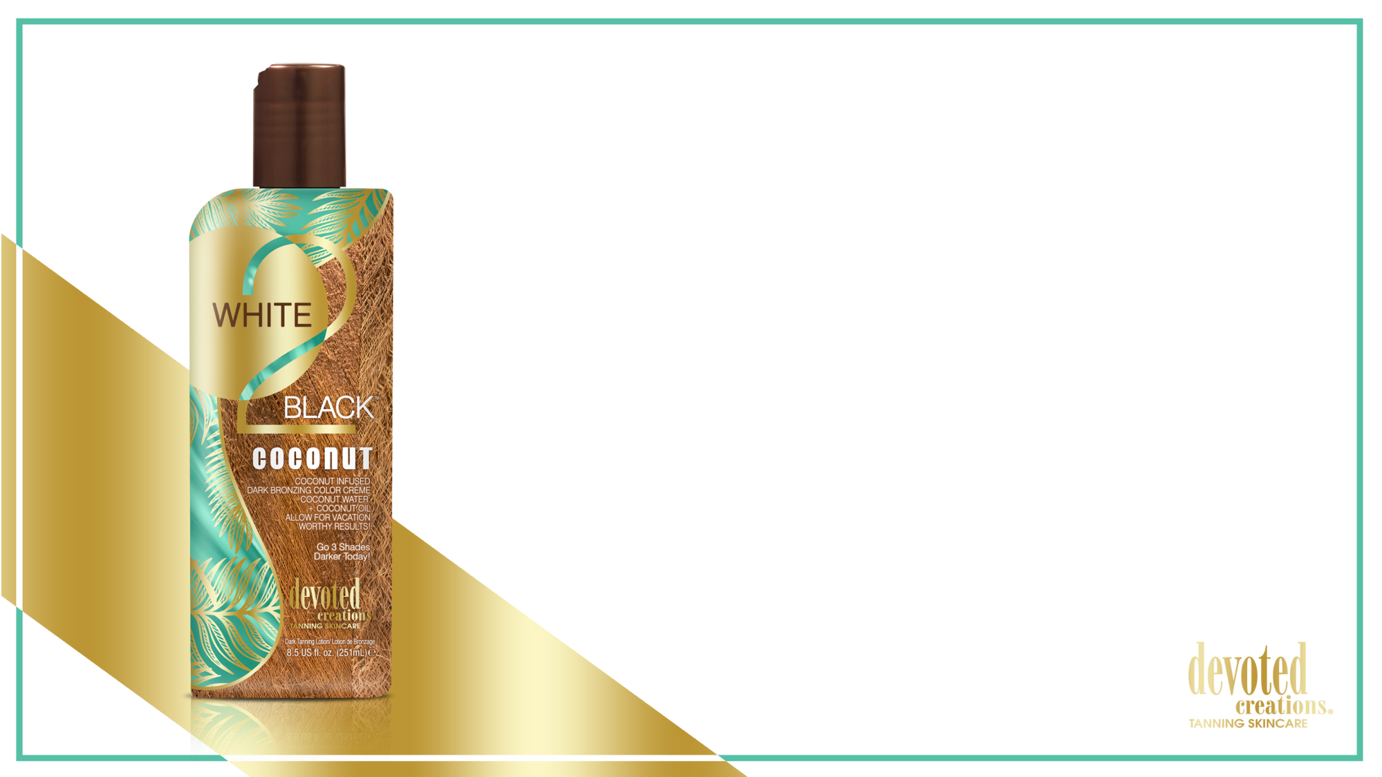
White 2 Black Coconut™
Coconut Infused Dark Bronzing Color Crème
Coconut Water + Coconut Oil Allow for Vacation Worthy Results!
Go 3 Shades Darker…Today!
Dark Bronzers – A blend of DHA, Natural and Cosmetic Bronzers allow for dark immediate and delayed bronzing results
Cactus Water – High in antioxidants, vitamins and electrolytes to keep skin hydrated while protecting against sun damage, aging and collagen loss
Coconut Oils & Extracts - Deeply softens and nourish the skin for long lasting hydration, anti-inflammatory properties and improves texture
Blue Tansy™ – Provides anti-orange agents so the skin develops the most natural, dark bronzed result
ALA Technology™ - Prolongs the life of healthy skin cells for a more youthful appearance to the skin
Fragrance: Waikiki Coconut

Slide 23
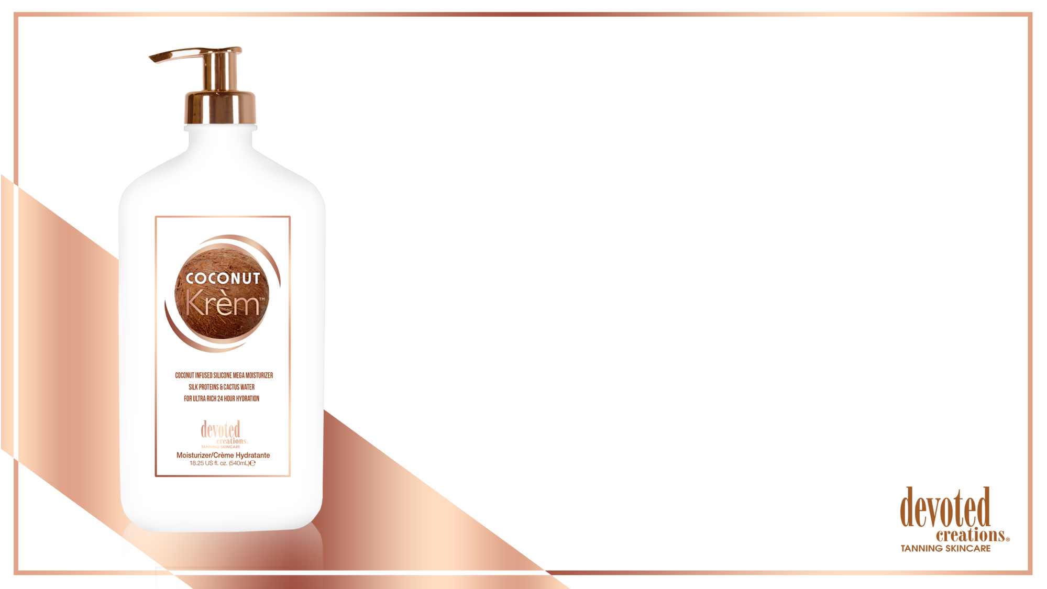
Coconut Krèm™
Coconut Infused Silicone Mega Moisturizer
Silk Proteins & Cactus Water for Ultra Rich 24 Hour Hydration
Silicone Blend – Visibly reduce the look of pores and imperfections while offering non-greasy hydration
Silk Proteins – Acts as a protective shield of hydration, holding in essential moisture and strengthening the skin’s barrier function without weighing it down or clogging pores
Coconut Oil – Deeply softens and nourishes, continual use can improve skin’s texture, has soothing and calming properties that can calm any temporary redness in the skin
Matrixyl Synthe 6™ – Targets and fills in fine lines and wrinkle, restores moisture in the skin and minimizes discolorations
Cactus Water – High in antioxidants, vitamins and electrolytes to keep skin hydrated, prevents moisture loss, and has antibacterial and calming properties to protect the skin from sun damage, aging and collagen loss
Fragrance: Creamy Coconut

Slide 24
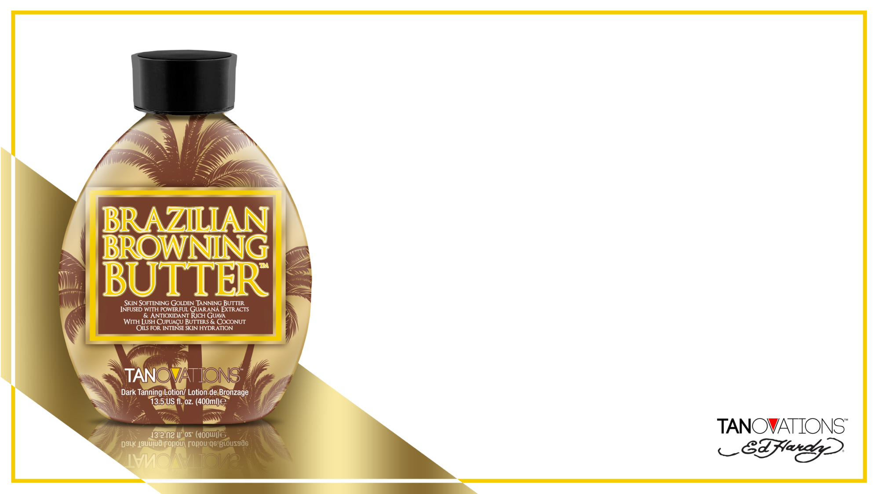
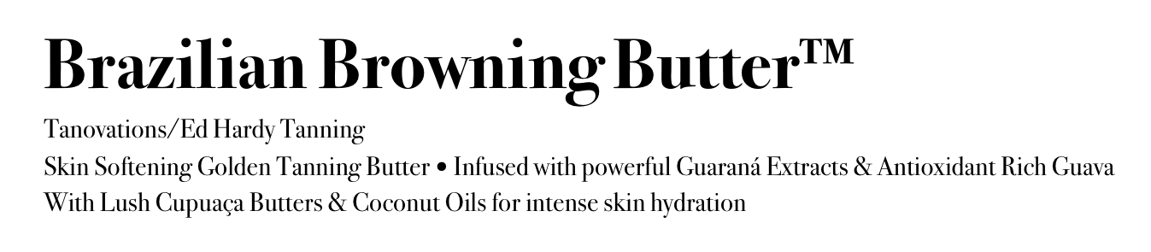
Brazilian Browning Butter™
Tanovations/Ed Hardy Tanning
Skin Softening Golden Tanning Butter $•$ Infused with powerful Guaraná Extracts & Antioxidant Rich Guava
With Lush Cupuaça Butters & Coconut Oils for intense skin hydration
Super soft and hydrating dark tanning butter that allows you to develop golden bronze results without self-tanning agents
Cupuaçu Butters – Help to lock in moisture and restore skins elasticity
Quad Tyrosine allows skin to develop the darkest results possible
Guava Extracts – Super fruit antioxidant that helps fight the appearance of wrinkles
Guarana Extracts – Super high in caffeine that helps to tighten and tone the appearance of skin
Coconut Oil – Ultra hydrating for longer lasting, softer results, anti-inflammatory properties for temporary calmness
After Tan Odor Eliminator – Proprietary blend of deodorizing and skin freshening ingredients
Fragrance: Vacation Vibes

Slide 25
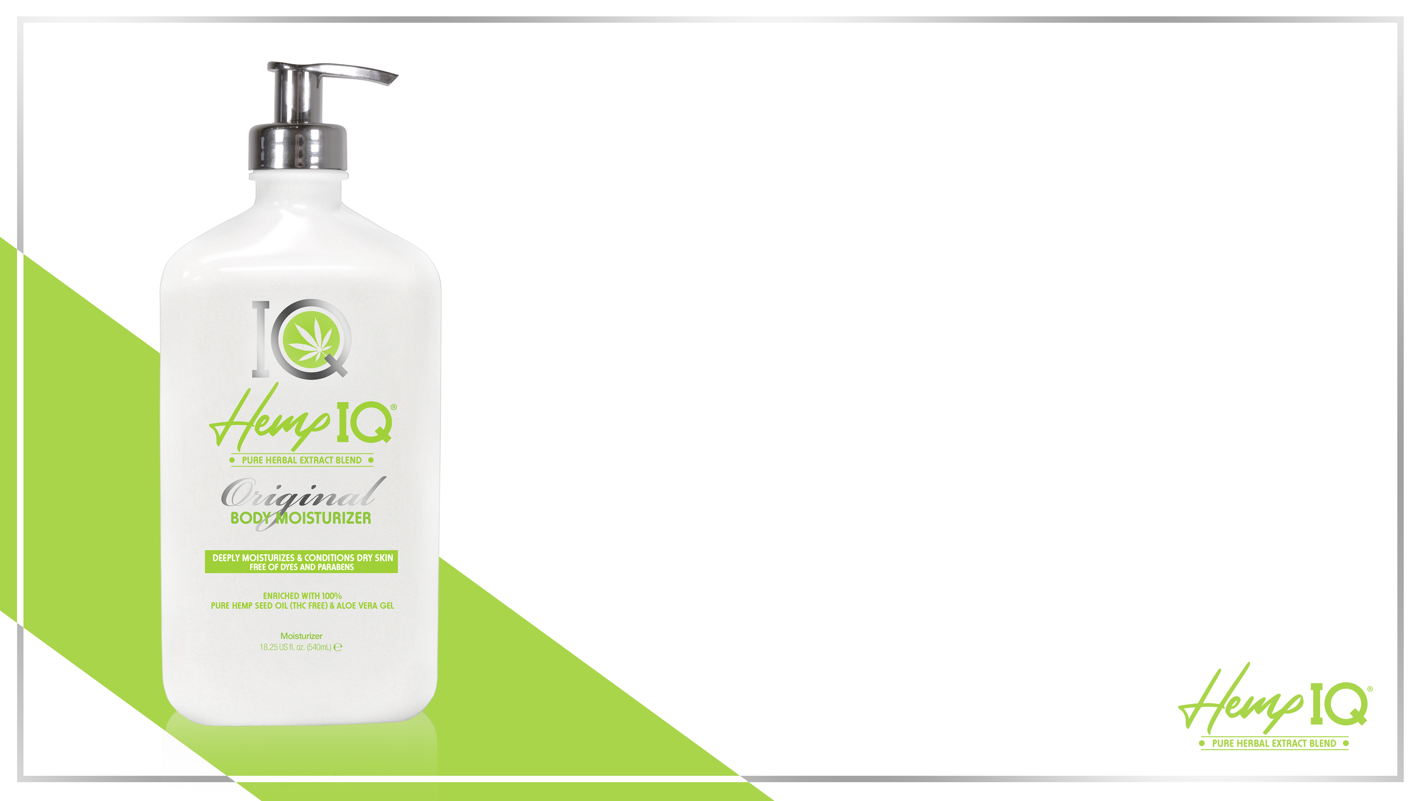
Hemp IQ Original™
Deeply Moisturizes & Conditions Dry Skin
Free of Dyes and Parabens
Daily rich body crème that will keep skin hydrated for up to 24 hours
100% Pure Hemp Seed Oil – Gives skin essential hydration and contains Amino Acids, which are naturally high in vitamins, proteins and antioxidants
Vitamin E – Helps to fight off free radicals, while also containing antioxidants, anti-inflammatory properties and anti-aging benefits
Mango Butter – Cleanses the skin’s surface of impurities and helps to unblock clogged pores
Rice Extract – Soothe and soften the skin without irritation
Cocoa & Shea Butter – Helps to hydrate and add moisture to dry and damaged skin
Oat Extract – Absorbs excess oil on the skin, helps reduce acne, and has anti-inflammatory properties to help treat dry skin and slough off dead skin cells
Cucumber Extract – Helps to naturally nourish, hydrate, comfort, soothe, calm and de-puff the appearance of skin
Fragrance: Clean & Fresh

Slide 26
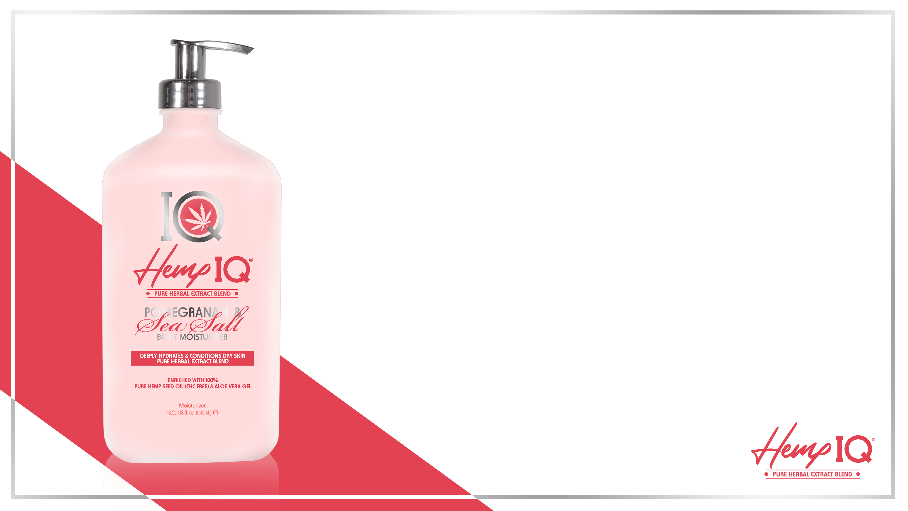
Hemp IQ Pomegranate™
Deeply Moisturizes & Conditions Dry Skin
Free of Dyes and Parabens
Daily rich body crème that will keep skin hydrated for up to 24 hours
100% Pure Hemp Seed Oil – Gives skin essential hydration and contains Amino Acids, which are naturally high in vitamins, proteins and antioxidants
Vitamin E – Helps to fight off free radicals, while also containing antioxidants, anti-inflammatory properties and anti-aging benefits
Vitamin C – Helps to repair skin cells, fight free radical damage and helps to boost collagen production
Rice Extract – Soothe and soften the skin without irritation
Cocoa & Shea Butter – Helps to hydrate and add moisture to dry and damaged skin
Pink Pomelo Extract – High in antioxidants that prevent skin damage
Pomegranate Extract – Helps to fight bacteria and soothe dry and tired skin
Dead Sea Salt – Helps to cleanse pores and balance oil production, while retaining moisture from within
Fragrance: Pink Pomelo & Sea Salt

Slide 27
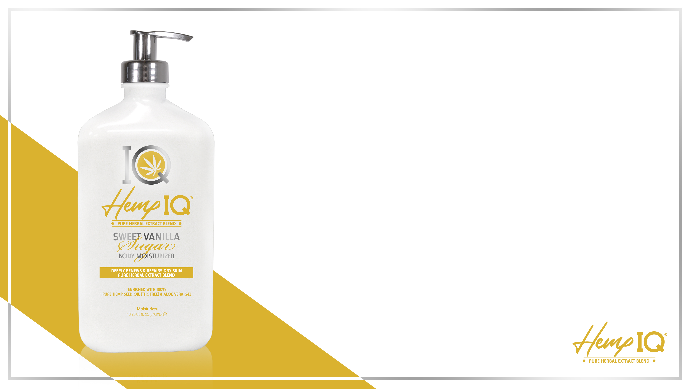
Hemp IQ Sweet Vanilla Sugar™
Deeply Moisturizes & Conditions Dry Skin
Free of Dyes and Parabens
Daily rich body crème that will keep skin hydrated for up to 24 hours
100% Pure Hemp Seed Oil – Gives skin essential hydration and contains Amino Acids, which are naturally high in vitamins, proteins and antioxidants
Sugar Cane Extract – Works as a natural antibacterial, packed with high levels of skin soothing antioxidants that fight breakouts and reduce the signs of aging
Rice Extract – Soothe and soften the skin without irritation
Cocoa & Shea Butter – Helps to hydrate and add moisture to dry and damaged skin
Ginger Root Extract – Improves skin elasticity and contains anti-aging properties
Papaya Extract – Helps to decrease inflammation, remove dead skin cells, and unclog blocked pores
Fragrance: Vanilla & Musk

Slide 28
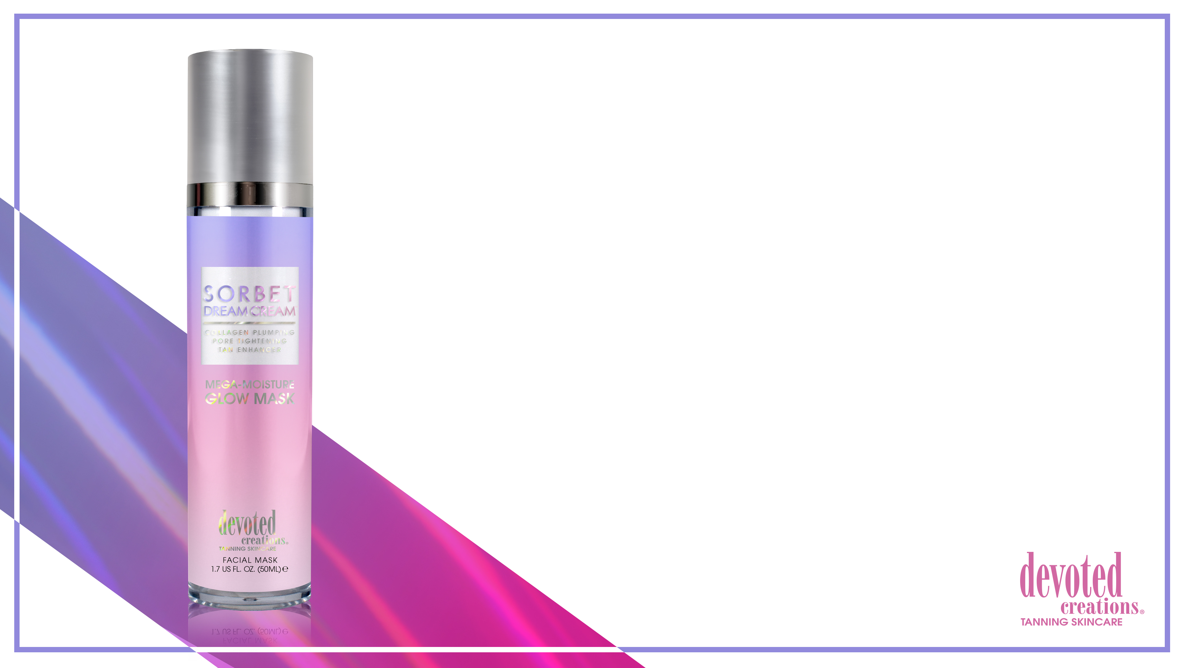
Sorbet Dream Cream™
Collagen Plumping – Imperfection Blurring
Pore Tightening – Skin Perfecting Tan Enhancer
Sugarcane Squalane – Helps to provide weightless hydration, balance excess oil, soothe and promote a plump, firm appearance to the facial skin, non-comedogenic and good for all skin types
Tiger Grass – Color-Correcting ingredient that reduces redness and helps protect skin from environmental stress and blemishes
Vegan Collagen – Helps to strengthen and condition the skin to visibly improve texture and suppleness while also helping to restore skin’s natural bounce and resilience, diminishing the look of fine lines and wrinkles
Electrolyte Cocktail – Utilizing Magnesium, Coconut Water, Sodium PCA, Orange, Almond and Banana extracts to improve skin’s moisture barrier and strength, calm redness, protect against environmental dehydration and work as a vital component in maintaining hydration levels in the skin
Hyaluronic Acid ™ - A gentle blend of agents that work to hydrate layers of the skin to promote a bouncy, plump look
Antioxidant Rich Plum – Nourishes, hydrates and provides protein rich antioxidant benefits while working with hyaluronic acid for extra added hydration
Watermelon Extracts- Helps to soothe irritation, deliver essential vitamins and work as a natural anti-inflammatory
Multi Use – Can be used as a facial tan enhancer, daily facial moisturizer, overnight facial night mask or makeup primer
Fragrance: Sugared Sorbet

Slide 29
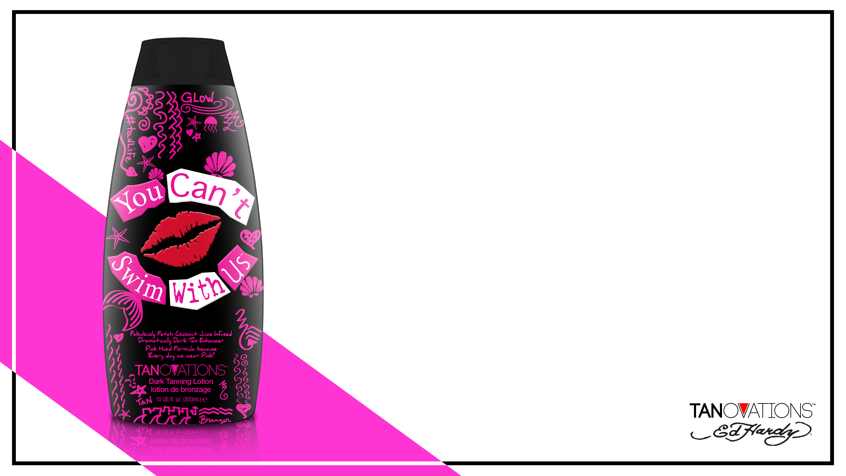
You Can’t Swim With Us™
Fabulously Fetch Coconut Juice Infused
Dramatically Dark Tan Enhancer
Pink Hued Formula because ‘Everyday we wear Pink’
Dark tan enhancer for use indoor and outdoor without the use of bronzing agents
Coconut Water blend for skin balancing and electrolyte benefits to give the skin reparative hydration
Melanin stimulators allow a jump start in the tanning process for faster, darker results
Antioxidant formula helps to ward off free radical damage
Matrixyl Synthe 6™ – Targets and fills in fine lines and wrinkles
Diamond Dust extracts allow for an illuminating effect to the skin
Naturally energizing and cellulite fighting Champagne, Coffee and Guarana extracts work together to tighten and reduce the appearance of imperfections in the skin
Vitamin E – Helps reduce the appearance of scars and stretch marks
Hypoallergenic, Vegan and Gluten & Carb Free formula for sensitive skin tanners
Fragrance: Cool Pink Coco

Slide 30
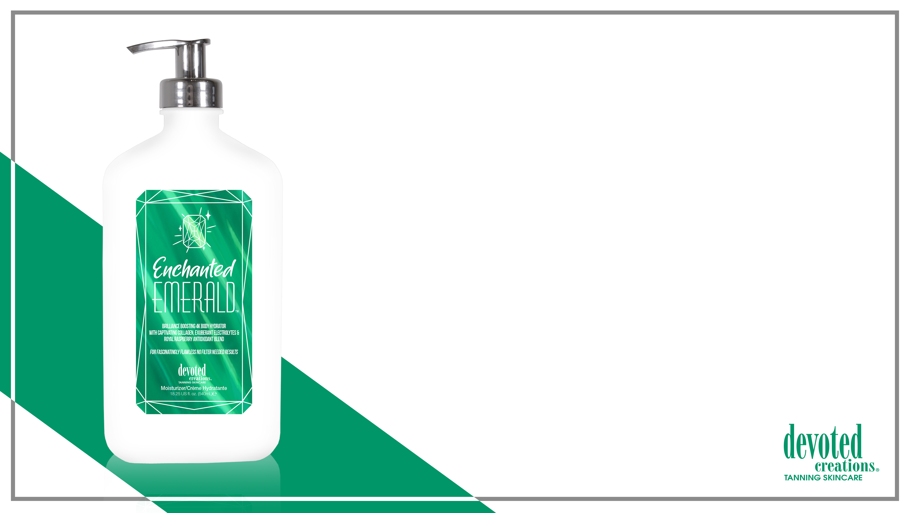
Enchanted Emerald™
Brilliance Boosting 4K Body Hydrator
With Captivating Collagen, Exuberant Electrolytes & Royal Raspberry Blend
For Fascinatingly Flawless No Filter Needed Results
Sugarcane Squalane – Helps to provide weightless hydration, balance excess oil, soothe and promote a plump, firm appearance to the facial skin, non-comedogenic and good for all skin types
Revolutionary 4K Blend – Allows for deeper hydration and longer lasting tanning results as well as better penetration of the high end skincare ingredients, while also working to blur imperfections and allow for a crystal clear complexion
Vegan Collagen – Helps to strengthen and condition the skin to visibly improve texture and suppleness while also helping to restore skin’s natural bounce and resilience, diminishing the look of fine lines and wrinkles
White Birch – Anti-aging and skin firming benefits
Cotton & Rice Extract – Soothe and soften the skin without irritation
Cocoa & Shea Butter – Provides deep, long lasting hydration
Royal Raspberry Extracts – High in Vitamin C, raspberry extract can help to reduce the signs of aging as well as target dark spots and wrinkle formations in the skin
Prestigious Probiotics – Helps to restore and renew the skin’s moisture balance and barrier
Cactus Water – High in antioxidants, vitamins and electrolytes to keep skin hydrated while protecting against sun damage, aging and collagen loss
Paraben, Gluten & Sulfate Free Sensitive Skin Formula
Fragrance: Enchanted Emerald

Slide 31
If you are named WINNER, send me an email with:
Name
Salon Name
Shipping Address
Megan Racine
National Sales Trainer
Megan@devotedcreations.com
813-361-1866
Notes:
31

